Slide 1
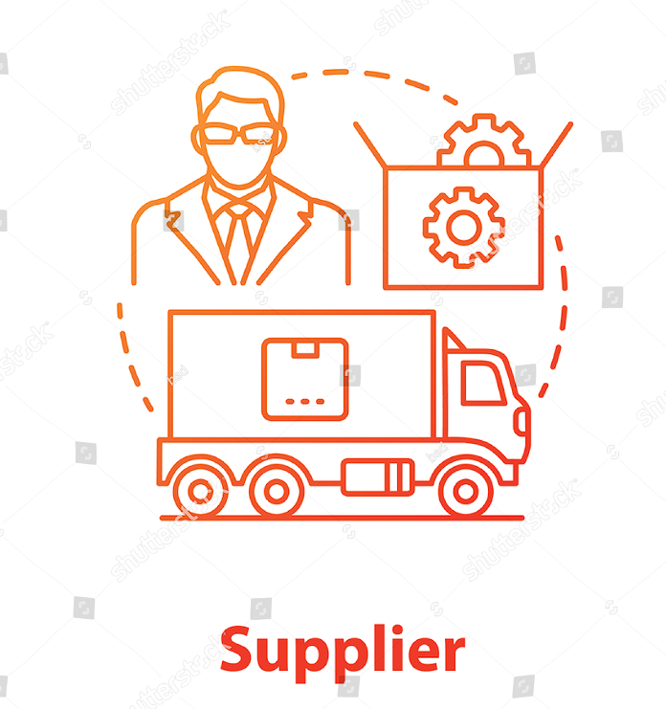
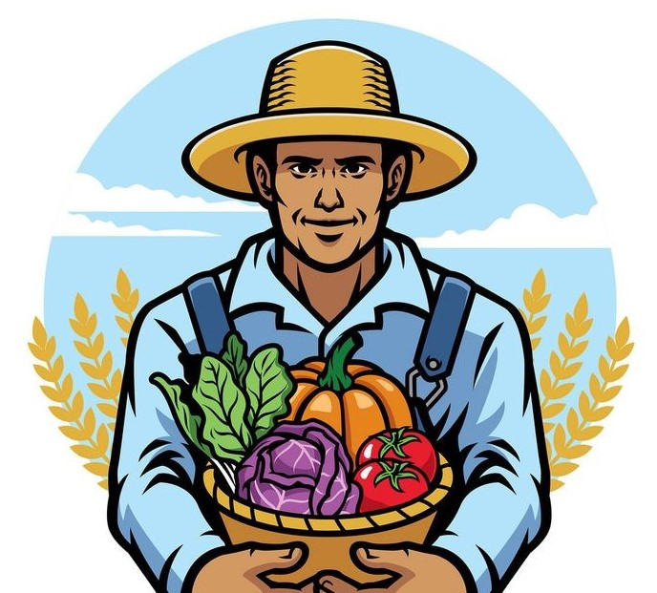
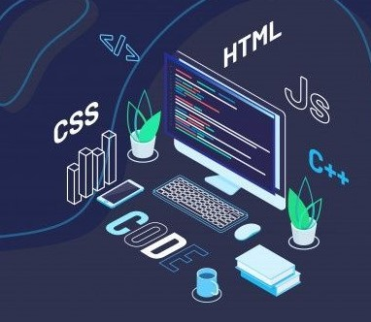
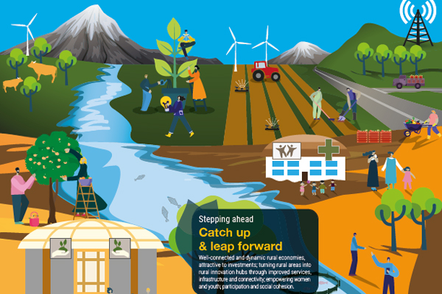
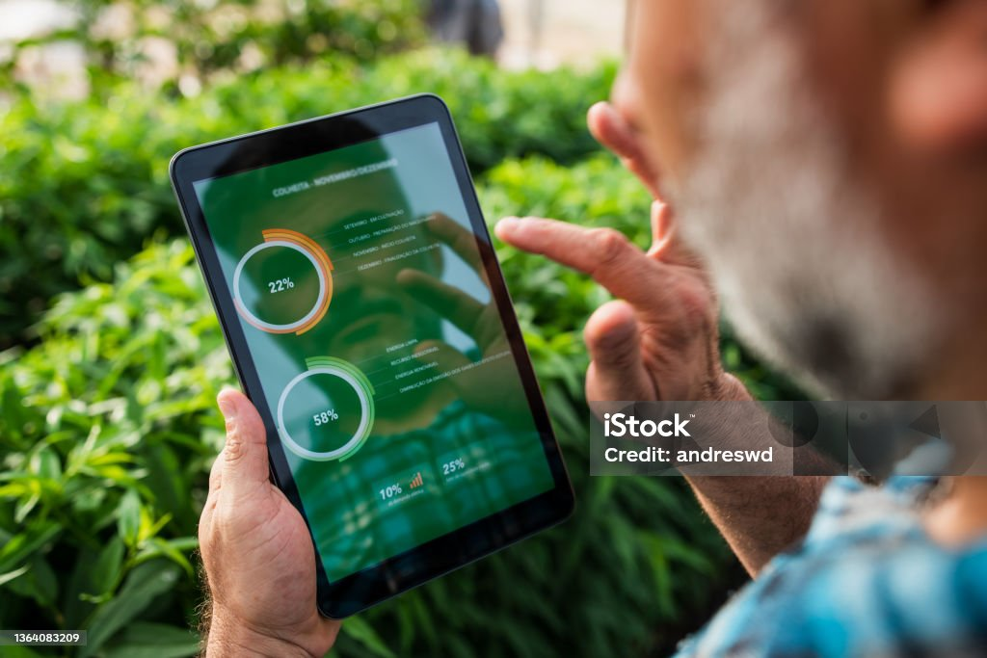
Farmer
Registration: Input personal and farm details.
Real-time Data Entry: Update crop status, yield, and issues.
Market Trends: Access pricing and demand data.
Inventory Management: Track and manage harvested produce.
Rural Development: Engage in local projects and programs.
Web Application (Central Hub):
Market Pricing: Display current prices and trends.
Weather Updates: Provide forecasts and alerts.
Farming Advice: Offer guidance based on data.
Inventory Tracking: Manage stock and distribution.
Communication Channels: Facilitate interactions among stakeholders.
Rural Development Resources: Access job opportunities, training, and infrastructure updates.
Provide Inputs: Offer seeds, fertilizers, and equipment.
Track Demand: Monitor and forecast demand for their products.
Bulk Messaging: Communicate offers and updates to farmers.
Rural Development:
1)Agri-Contributions:Showcase agricultural practices contributing to rural development.
2)Farmer Empowerment:Resource and Training for Farmers.
-Mentorships Programs.
3)Govt Scheme and intiatives:Informal Portal for govt scheme and intiatives.
4)Communit Engagement:
-Forum for Rural Communities.
-Crowdfund platform for rural infastructure development .
Food Technology:
1)Precise Agriculture:Optimise your Crop yields-input data and get persanalized Recomondation.
Drone Scouting:upload images of your drone and get insights.
Hydroponics Calculator:Calculate your perfect nutrient mix for your crop.
2)Farm-to-table logistics:Route Optimization:Enter your delivery routes and get optimized Schedule
Supply Chain Management:Track your produce from farm to table.
3)Farmers Data Platform:Track farm performance and get insights.

