Slide 1
Implementation of Blockchain in E-commerce
1.Shafiul Bashar
ID:191-15-12937
2.Jahidul Islam
ID:182-15-11497
Dr. Fizar Ahmed
Saturday 30 July 2014

Slide 2
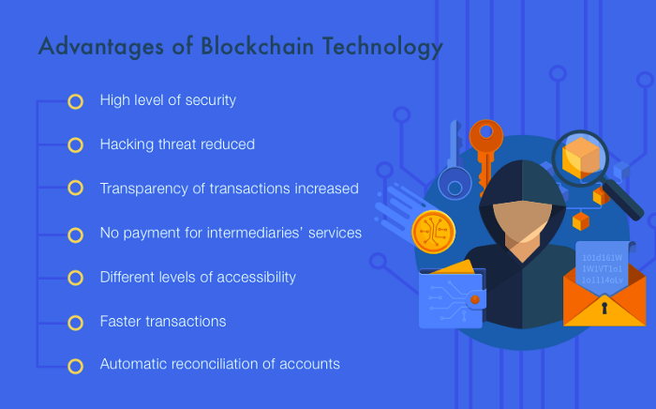
Blockchain

Slide 3

Blockchain in E-commerce

Slide 4


