Slide 1
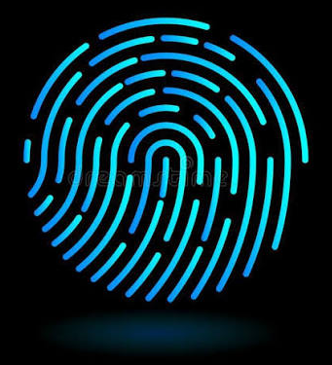


Detecting LLM Hallucinations with Uncertainty Fingerprinting
A Python implementation tutorial
Shafiya Kausar, Anuradha Kar
Workshop date: November 6, 2026

Slide 2
PyCon ES 2026 programme
https://2026.es.pycon.org/en/programa/
Full schedule, rooms and other workshops

Slide 3
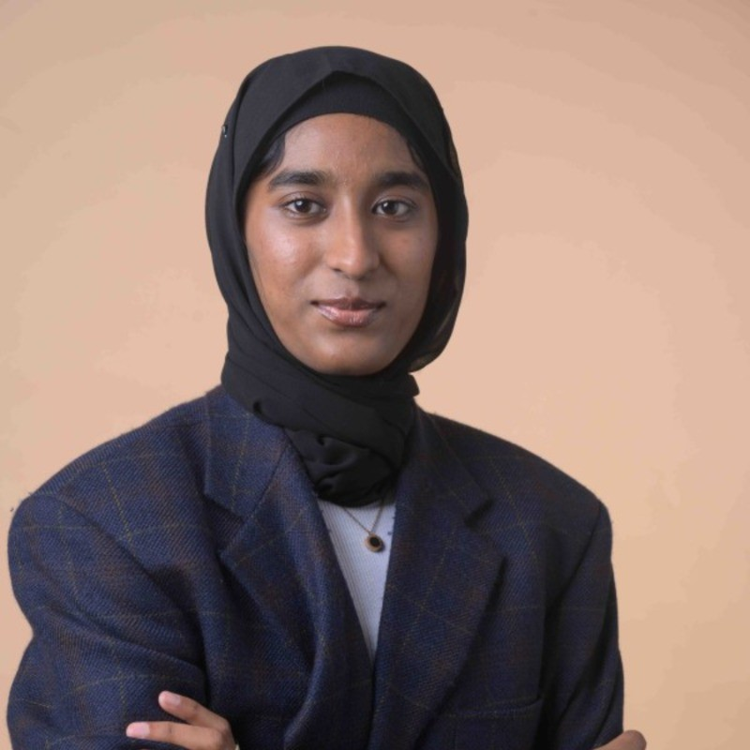

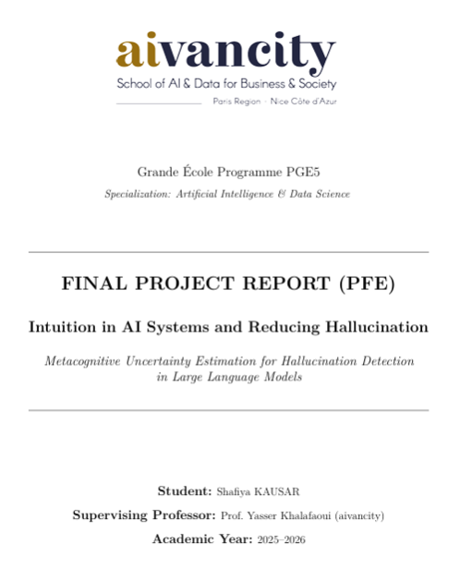
Presenter profiles
Shafiya Kausar
Master of AI and Data Science, aivancity Paris
shafiya.kausar@aivancity.education
Anuradha Kar
Associate Professor, aivancity, Coordinator, Master of AI and Data Science Paris
kar@aivancity.ai
Sincere thanks: Dr. Yasser Khalafaoui, Master thesis supervisor

Slide 4
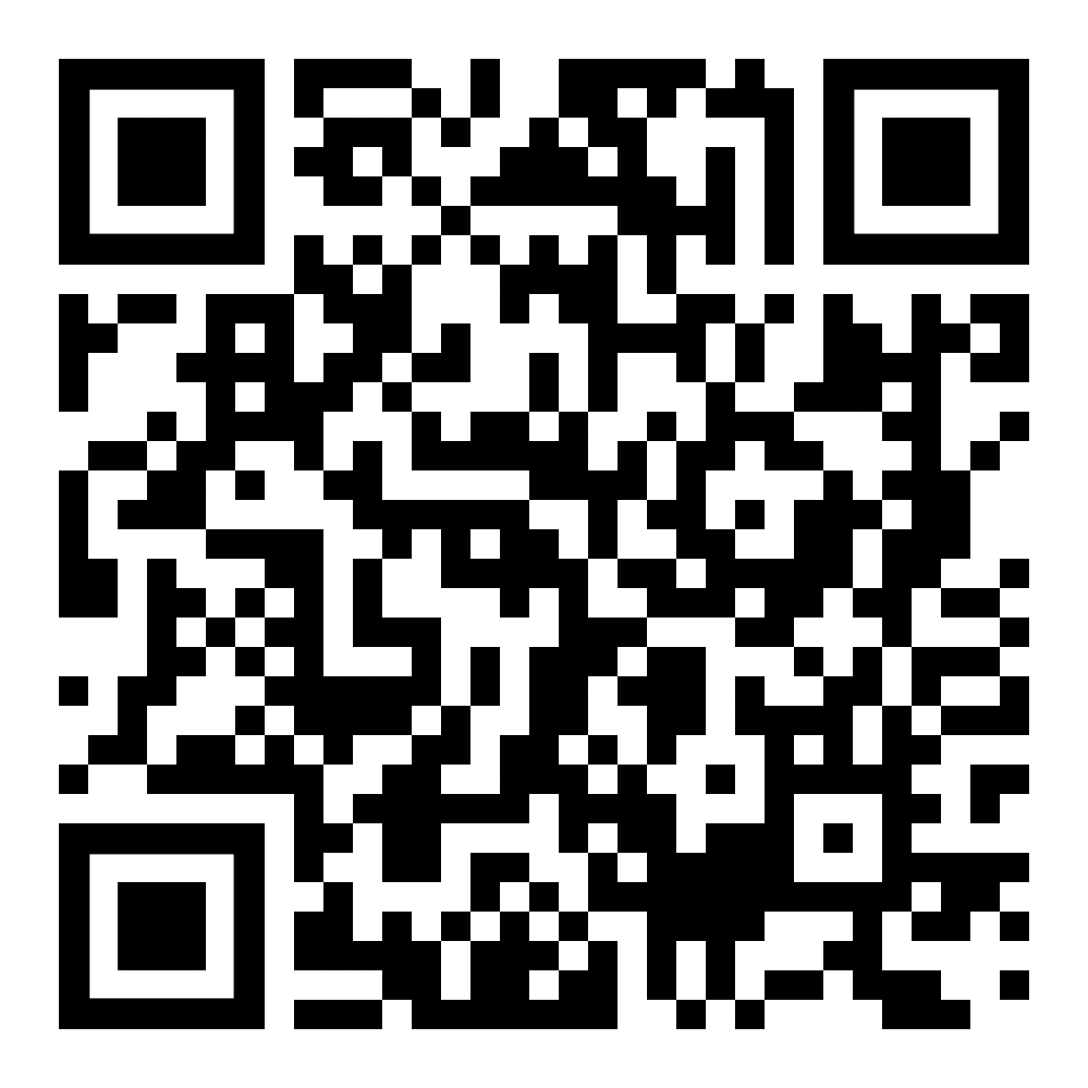
Learning objectives
IMPORTANT: go to the GitHub repo and run the setup check notebook!
By the end of this hands-on workshop, you will be able to:
Explain what an AI hallucination is, the main kinds, and why an AI can sound sure when it is wrong
Write code for four simple checks that show when an AI is unsure, and see which one works best
Spot patterns that show which answers are likely hallucinated
Decide when an AI should answer, double-check, or say “I don’t know”
Try a live app to play with hallucination detection!
Scan to open the repo

Slide 5

Setup: do this before we start (5 min)
git clone \
https://github.com/Shafiya0101/pycones2026-uncertainty-workshop.git
cd pycones2026-uncertainty-workshop
python -m venv .venv
source .venv/bin/activate # Windows: .venv\Scripts\activate
pip install -r requirements.txt
jupyter lab
THEN
Open 00_setup_check and run all cells
GOOD TO KNOW
CPU only · no API key · Colab works too

Slide 6
Workshop roadmap · 90 min
End goal: a working detector that tells you when to trust an LLM answer, and what kind of failure it is.
a · 10 min
All about hallucinations
What are hallucinations and its types
Live demo
b · 20 min
Uncertainty signals
What clues can be used to detect hallucinations
Notebook 01
c · 15 min
Uncertainty fingerprinting
Detecting patterns in hallucinations
Notebook 02
d · 15 min
Adaptive policy
When should the AI answer, check, or refuse to answer if there is hallucination?
Notebook 03
e · 25 min
Experiments & live demo
Try our hallucination analysis app!
App
f · 5 min
Remarks and conclusion
Limitations and future work

Slide 7
Workshop steps
Detect → Combine → Decide → Stress-test
SETUP
2 min
CHALLENGE 1
3 min
CHALLENGE 2
12 min
Setup check
Check that your laptop is ready
Spot the hallucination
Can you spot the AI’s made-up answer?
Uncertainty signals
Four clues that show when an AI is guessing
00_setup_check
Raise your hand
01_uncertainty_signals
CHALLENGE 3
12 min
CHALLENGE 4
12 min
CHALLENGE 5
15 min
Fingerprinting
Sort answers into safe and risky groups
Adaptive policy
When should the AI answer, check, or refuse?
App based experimentation
Find answers that fool the checks
02_fingerprinting
03_adaptive_policy

Slide 8
Basics: five words to know
Word | Plain meaning | Example | Used in
LLM | Predicts the next word, again and again | “The capital of France is …” → “Paris” | Everywhere
Uncertainty signal | A clue that shows how sure the AI is | 10 different answers = the AI is guessing | Notebook 01
Fingerprinting | Putting an answer in a safe or risky box, using two clues | Same answers = safe box. Different answers = risky box | Notebook 02
Greedy answer | Most likely answer: what users see | Temperature 0 = same answer every time | All notebooks
Samples | Random extra answers from the same model | 10 samples per question | Notebook 01
Ground truth | Correct answer from the dataset | “Stilwell” for “Vinegar Joe” | Evaluation

Slide 9
What is a hallucination?
Fluent, confident output of an LLM that is not supported by the world, the input, or the model’s own reasoning.
FACTUALITY
Wrong about the world
Invents facts, or gets a real fact wrong.
“The Eiffel Tower opened in 1901.”
FAITHFULNESS
Wrong about the input or itself
Ignores the instruction, contradicts the source, or contradicts itself.
“Step 2 says 12; the answer says 15.”

Slide 10
Types of hallucinations
Family | Type | What happens | Example
Factuality | Fabrication | Invents facts or entities | Cites a paper that was never written
Factuality | Factual inconsistency | Gets a real fact wrong | “The Eiffel Tower opened in 1901.”
Faithfulness | Instruction inconsistency | Ignores what was asked | Asked to translate, it answers instead
Faithfulness | Context inconsistency | Contradicts its source | Summary says sales rose; the report says they fell
Faithfulness | Logical inconsistency | Reasoning conflicts with itself | Step 2 says 12; the answer says 15
Taxonomy after Huang et al., “A Survey on Hallucination in Large Language Models” (2023)

Slide 11
A confident fabrication
Illustrative example
PROMPT
“Summarize the 2019 paper ‘Neural Entropy Gates for Language Models’ by Hartmann et al.”
MODEL OUTPUT
“Hartmann et al. (2019) introduced entropy gates in NeurIPS 2019, reducing perplexity by 12% on Penn Treebank by dynamically gating hidden-state updates…”
REALITY
The paper doesn’t exist. Authors, venue and numbers are all invented, yet it reads like a real citation.
REAL-WORLD CASE
Mata v. Avianca (2023): a New York lawyer filed ChatGPT-invented case citations, including “Varghese v. China Southern Airlines”. The model even said the cases were real.

Slide 12
Confident fabrications are not rare
6.5–57%
Among answers where the AI seemed confident, between 6.5% and 57% were wrong, depending on the model and dataset.
5–29%
When the AI gave the exact same answer all 10 times, it was still wrong in 5–29% of cases (Mistral-7B)
Source: study paper (Section V-D, Table VI) and workshop README

Slide 13
Can you detect the hallucination?
⏱ 2 min
Four answers from an LLM. Raise your hand for each one you think is wrong.
A
Who wrote Frankenstein?
“Mary Shelley. It was first published anonymously in 1818.”
B
First woman to win the Nobel Prize in Literature?
“Pearl S. Buck, who received the prize in 1938 for her novels about rural China.”
C
Which element has the symbol W?
“Tungsten. The symbol comes from its German name, Wolfram.”
D
Which paper introduced the Transformer?
“‘Attention Is All You Need’ by Vaswani et al., presented at ICML 2017.”

Slide 14
The reveal: 2 of 4 were hallucinations
Same fluency, same confidence. The errors hide right next to true facts.
A ✓ Correct
“Mary Shelley. It was first published anonymously in 1818.”
B ✗ Hallucination
“Pearl S. Buck, who received the prize in 1938…”
Actually: Selma Lagerlöf, in 1909. Buck won in 1938, but wasn’t first.
C ✓ Correct
“Tungsten. The symbol comes from its German name, Wolfram.”
D ✗ Hallucination
“…by Vaswani et al., presented at ICML 2017.”
Actually: NeurIPS 2017 (then called NIPS), not ICML.

Slide 15
Why are hallucinations hard to detect?
03
Nobody checks the answer
When people use the AI for real, there is no answer sheet to check against. We have to judge from the AI’s own behaviour.
01
Good writing is not proof
A wrong answer reads just as smoothly as a right one. You can’t tell by the style.
02
It sounds sure even when it’s wrong
The AI doesn’t hesitate or hedge when it makes a mistake. It sounds just as certain.
A hallucination looks exactly like a correct answer!

Slide 16
Why are hallucinations hard to detect?
04
Repeating is not the same as right
Ask the AI ten times and it may give the same wrong answer ten times.
05
Every check has blind spots
Entropy, logits, consistency and NLI each miss different some kinds of mistakes.
06
Checking costs time and money
Asking ten times and checking every answer takes much more time and computing than asking once.
Takeaway
No single check is enough. We combine several, and we study the cases where every check says “fine” but the answer is still wrong.

Slide 17
What the research says (1/2)
SINGLE SIGNALS HAVE BLIND SPOTS
NATURE 2024
Farquhar et al.
Semantic entropy targets confabulations only. The authors exclude systematic, learned errors.
FINDINGS OF EMNLP 2025
Simhi et al., “Trust Me, I’m Wrong”
Models hallucinate with high certainty, even when they know the answer. Existing mitigations struggle with these cases.

Slide 18
What the research says (2/2)
COMBINING SIGNALS HELPS
UQLM · NeurIPS 2025
Ensemble beats the best single scorer in 18 of 24 AUROC cases. Python library.
HaluNet · 2025
Fuses token likelihood, entropy and hidden states in one network.
BEACON · arXiv 2026
Combines NLI entropy, embeddings, CoT consistency and paraphrase stability.
Chauhan et al. · 2026
Supervised ensembles beat the best single scorer in 30 of 32 settings.
Our step
Others merge signals into one score. We read the pattern to classify the type of hallucination, and act on it.

Slide 19
What are uncertainty signals?
An uncertainty signal is a clue in how the AI behaves that shows how sure it is. We don’t need to know the right answer.
❓
One question
🔁
Ask the model N times
📊
Read answers + probabilities
🎯
How sure is it?
→
→
→

Slide 20
Think of a person who is unsure
Spotting an unsure person…
…spotting an unsure AI
Gives a different answer every time you ask
→
Self-consistency · do the answers match?
Keeps changing what they actually mean
→
Semantic entropy · how many different meanings?
Hesitates and stumbles over words
→
Logit confidence · how unsure was it of each word?
Contradicts what they said earlier
→
Contradiction · do the other answers disagree with the one shown?

Slide 21
The four uncertainty signals (1/2)
01 · AGREEMENT
Self-consistency
Does it give the same answer every time?
How: Sample 10 answers, measure agreement with the biggest group.
02 · MEANING
Semantic entropy
Do the answers mean different things?
How: Cluster samples by meaning, then compute entropy over clusters.

Slide 22
The four uncertainty signals (2/2)
03 · PROBABILITY
Logit confidence (LP)
How Sure is the model sure of each token (word) it generates?
How: Aggregate the token log-probabilities of the shown answer.
04 · LOGIC
Contradiction
If the generated answers are contradicting with each other?
How: An NLI model checks each sample against the greedy answer.

Slide 23
Datasets used
3 datasets · 5 settings × 200 questions
Dataset | Description | Project page
TriviaQA (Joshi et al., 2017) | General-knowledge quiz questions · ~95k | nlp.cs.washington.edu/triviaqa
Natural Questions (Kwiatkowski et al., 2019) | Real Google search questions · ~307k | ai.google.com/research/NaturalQuestions
HotpotQA (Yang et al., 2018) | Questions needing two facts combined · ~113k | hotpotqa.github.io

Slide 24
How we ran the study (1/2)
5 settings × 200 questions
MODELS
Three AI models: Mistral-7B (main), Qwen2-7B and Qwen2-1.5B. Small, compressed versions that run on a laptop.
DATA
Three question sets: TriviaQA, Natural Questions and HotpotQA. 200 randomly chosen questions from each.
GENERATION
Ten answers per question: each question we generated 10 answers

Slide 25
How we ran the study (2/2)
5 settings × 200 questions
SIGNALS
THE CHECKS: All four: matching answers, matching meanings, the AI’s word confidence, and contradictions
LABELS
MARKING ANSWERS RIGHT OR WRONG: We use label containment, word - matching rule, secondly, LLM as a judge, which in this case is Claude Haiku.
METRICS
THE SCORE: AUROC: how well a check spots wrong answers. 50% = guessing, 100% = perfect. .

Slide 26
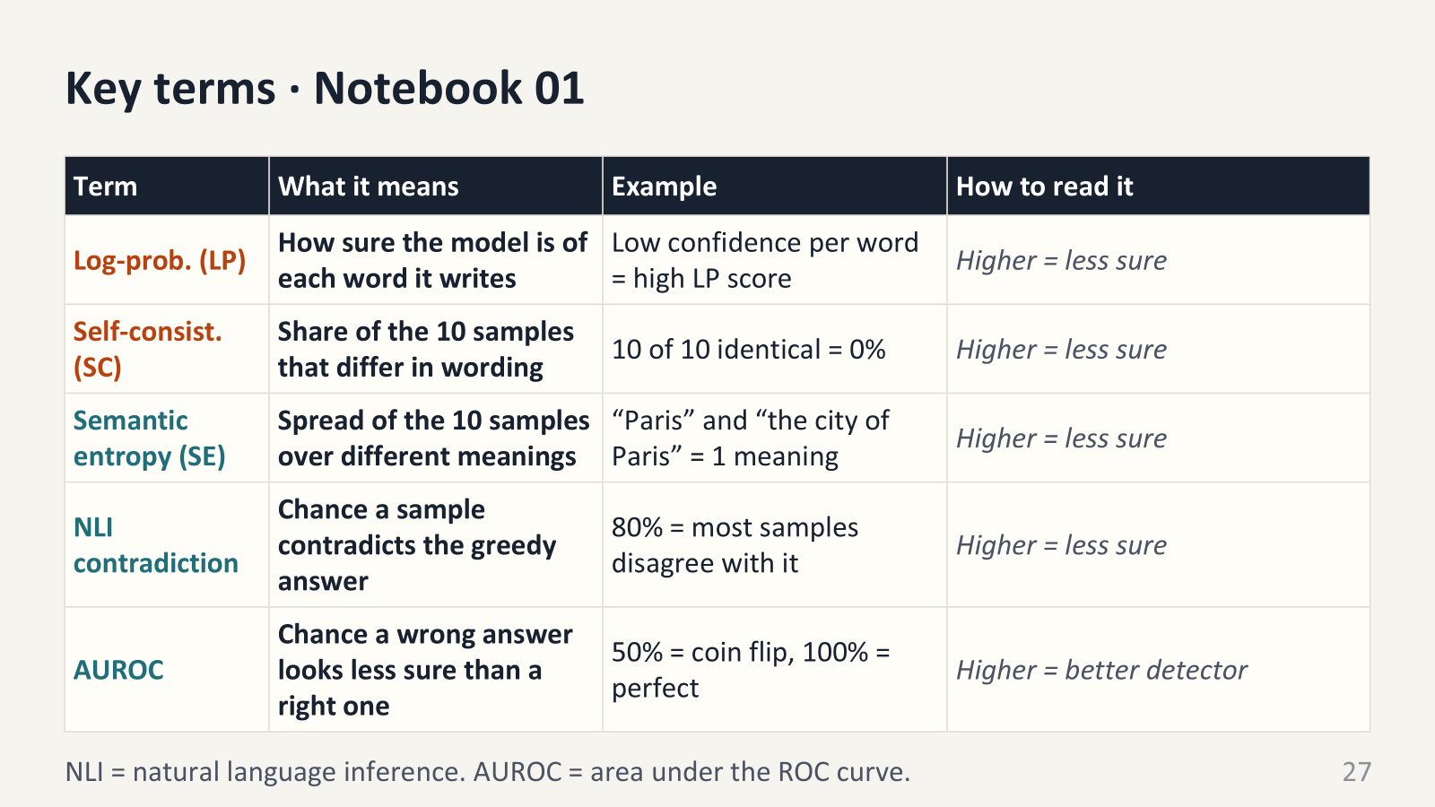

Slide 27
Hands-on · Notebook 01
⏱ ≈ 12 min
Greedy answer + 10 samples per question, precomputed. Higher score = more uncertain.
Implementations
STEP 1 Self-consistency
STEP 2 Semantic entropy
STEP 3 Logit confidence
STEP 4 Contradiction
Step 5 Combine all four signals
Which signal is best to detect hallucination?
AUROC: 50% = guessing, 100% = perfect. Predict first, then run.
Bonus: Done early? Change line to load_setting("mistral_hotpotqa", “qwen2_1_5b_triviaqa”, “qwen2_7b_triviaqa”) and re-run. Is any signal still the best?
Run the code, check the signal values, check corresponding AUROCs and determine which signal works best.

Slide 28
Use it in your own work (1/2)
The core idea: ask the AI the same question several times and see whether the answers agree.
“When did the Eiffel Tower open?” × 5
1889 · 1889 · 1889 · 1889 · 1889
✓ They agree: more likely right
“When did the Eiffel Tower open?” × 5
1889 · 1901 · 1889 · 1912 · 1895
⚠ They disagree: don’t trust it yet
Agreement means “more likely right”, not “guaranteed right”.

Slide 29
Use it in your own work (2/2)
STEP 1
Ask more than once
Send each question 5–10 times; keep every answer.
STEP 2
Compare answers
The notebook’s code checks if they match in words and meaning.
STEP 3
Test on your topic
Check 100–200 answers by hand: which check works best?
STEP 4
Decide what to do
If unsure: say “I don’t know”, look it up, or ask a person.
📓 Take the notebook home: it gives you
Working, tested code
Swap in your own questions and answers.
A ready-made scoreboard
One line shows which check works best.
Runs on any laptop
No GPU or paid service needed.
Fits: customer chatbots · ask-your-documents tools · sorting data with AI · testing a new model

Slide 30
Uncertainty fingerprinting
A fingerprint shows where an answer lands on two checks: do the 10 answers use the same words, and do they mean the same thing? That sorts every answer into one of four boxes.
words agree · meanings differ
Shallow mimicry
Same words, different meaning. Rare.
words differ · meanings differ
Knowledge gap
The 10 answers disagree. The AI is guessing. Most wrong answers are here.
Meanings disagree (Semantic Entropy) ↑
words agree · meanings agree
Confident
The 10 answers agree. Looks safe, but ⚠ confident wrong answers hide here.
words differ · meanings agree
Paraphrase
Different wording, same meaning. Not a real doubt. Rare.
Words disagree (Self- Consistency uncertainty) →

Slide 31
The hidden danger: confident fabrication
DEFINITION
Unanimous and wrong
All 10 samples are identical and the answer is wrong.
It lands in Confident, so the fingerprint can’t flag it.
EXAMPLE
“Capital of Australia?”
10 / 10 samples: Sydney
Correct answer: Canberra
Every signal looks calm. Only outside evidence can catch it.

Slide 32
What the four boxes show
REAL RESULTS · MISTRAL-7B ON TRIVIAQA · 200 QUESTIONS
Confident
(answers agree) / 92 questions· 6.5% wrong
Shallow
/ 10 questions · too few to judge
HOW TO READ IT
The red flag: when the AI’s answers disagree, it is wrong far more often (42.5% versus 6.5%). Knowledge gap had the most errors in every setting we tested.
A simple rule: if the answers disagree, don’t answer. We don’t need an answer key for this.
The catch: a plain score cut-off does about as well, so the boxes are not magic. More on this later.
Paraphrasing
/ 11 questions · too few to judge
Knowledge gap
(answers disagree) / 87 questions · 42.5% wrong
df = add_signals(load_setting("mistral_triviaqa"))
Now lets change the model to Qwen and see the effect on the fingerprints!

Slide 33
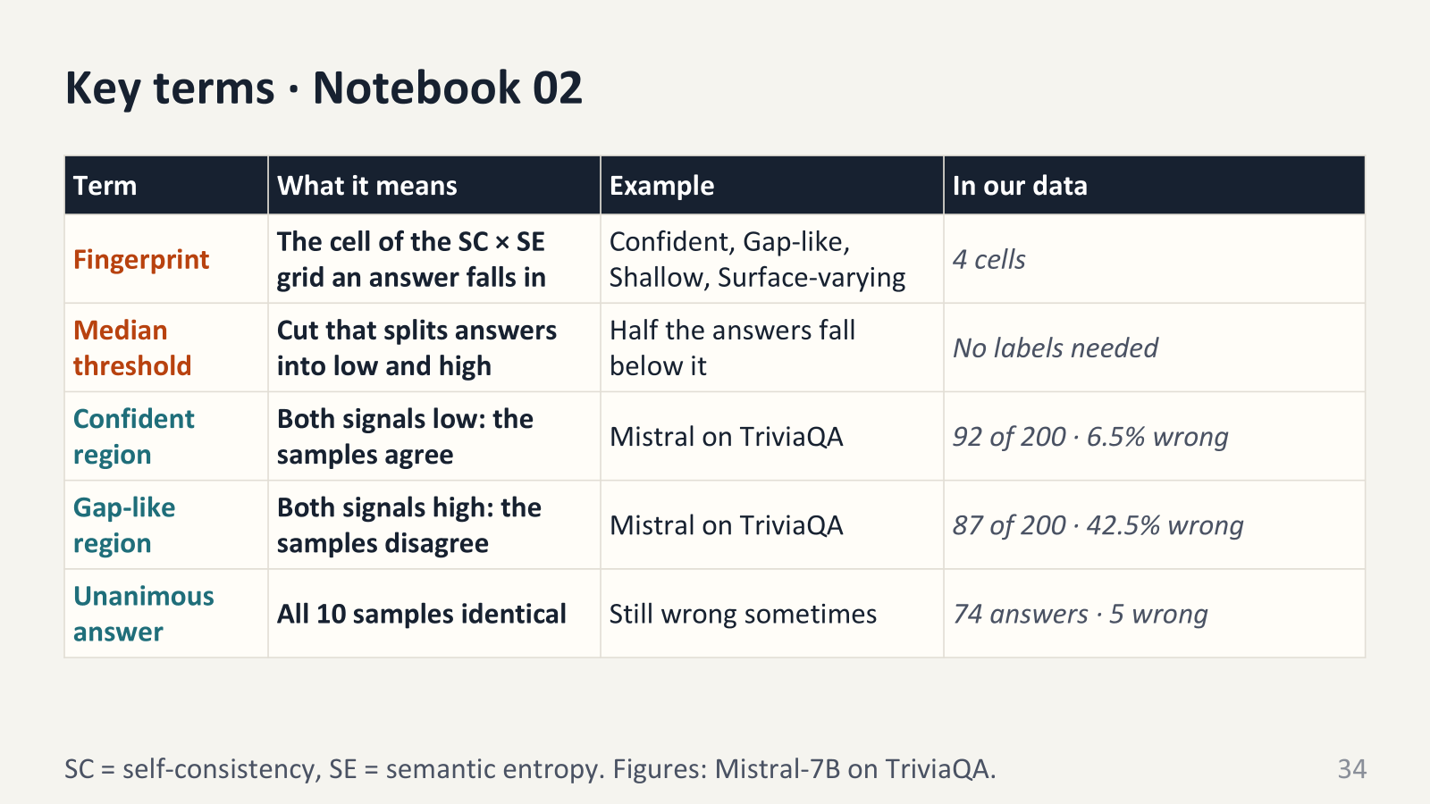

Slide 34
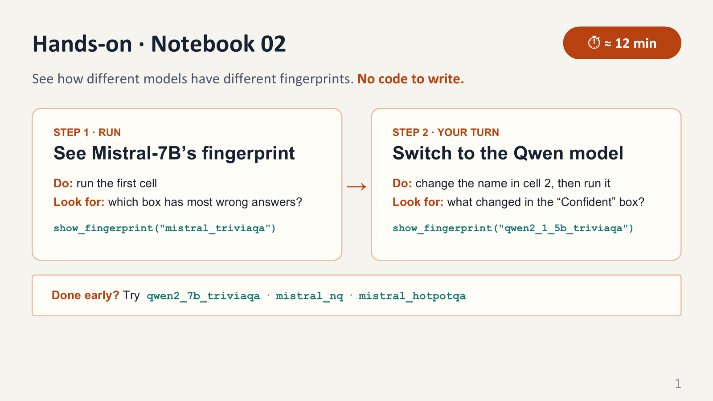

Slide 35
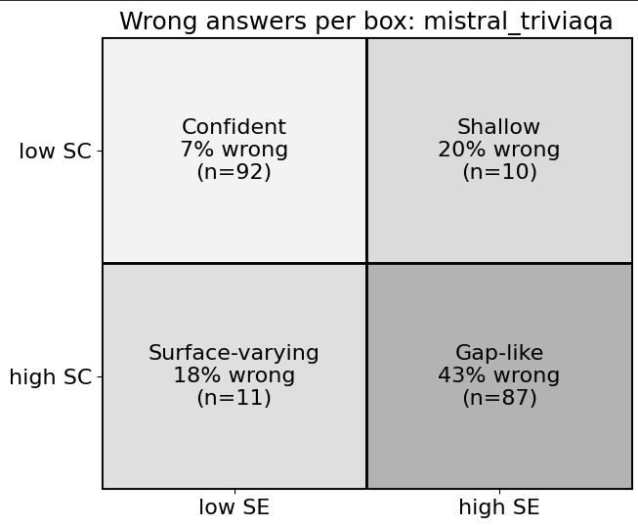

Slide 36
Discuss
⏱ 3 min
Look at the table of unanimous-but-wrong answers from Step 4.
1
Which model’s “Confident” box can you trust more? How can you tell?
2
Why might a smaller model be wrong even when its answers agree?
3
Would you use the same cut-offs for every model? Why not?
Bonus: Try mistral_nq or mistral_hotpotqa. Does the “Confident” box get more or less reliable?

Slide 37
What notebook 02 shows
Most answers land in two boxes
Same words usually means same meaning, so answers are mostly Confident or Knowledge gap.
Disagreement is the warning sign
When the AI’s answers disagree, it is wrong far more often. We can spot this without an answer key.
Confident does not mean correct
Some wrong answers sit in the Confident box. Only an outside source, like a document or a person, can catch them.
Every model is different
The smaller Qwen model was wrong about 40% of the time even in its Confident box, versus about 6.5% for Mistral.
Next
Turn the boxes into a rule. When should the AI answer, double-check, or say “I don’t know”?

Slide 38
Use fingerprints in your own work (1/2)
Our message: you can sort AI answers by risk without knowing the right answer. But “Confident” still doesn’t mean “correct”.
EXAMPLE · A SUPPORT CHATBOT
💬 Customer asks
“Can I return a sale item after 30 days?”
🔁 Ask 10 times
The bot quietly writes 10 answers.
🔍 Two checks
Do words match? Do meanings match?
📦 Pick a box
Compare with your medians.
🚦 Act
Confident: reply. Gap-like: hand to a person.
→
→
→
→

Slide 39
Use fingerprints in your own work (2/2)
1 · No answer key needed
The AI’s own answers give us the clues, so this works on real users’ questions as they arrive.
2 · Decide what each box triggers
Before launch, agree what happens in each box: reply, say “I’m not sure”, look it up, or hand over to a person.
3 · Confident does not mean correct
For health, legal or money questions, check even the Confident answers against a trusted source.
📓 Notebook 02
Pick a model and dataset show_fingerprint("…") → see its four boxes → compare models

Slide 40
Adaptive policy: A rule for when the AI answers, double-checks, or says “I don’t know”
NEXT!
Measuring how unsure the AI is isn’t enough. Use it to decide what to do with each question.
← Low uncertainty
High uncertainty →
✅ Answer
the AI is sure, so reply straight away.
🔍 Verify
look it up or ask a bigger model before replying.
✋ Abstain
don’t risk a wrong answer.
Rule = (U_lp + U_sc + U_se + U_cont) / 4

Slide 41
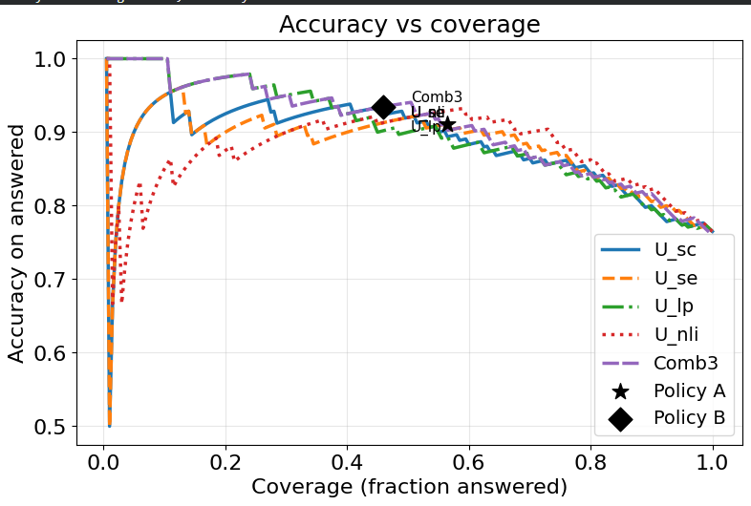
Accuracy and coverage curves
The policy you build lands on one point on this curve. It gives two numbers: how many questions got answered (coverage) and how many of those were right (accuracy).
COVERAGE
how many it answers. Out of 100 questions, how many does the AI actually answer?
ACCURACY
how often it’s right. Of the questions it answered, how many were correct?
Policy A: answer everything except the Gap-like box.
Policy B: answer only the Confident box

Slide 42
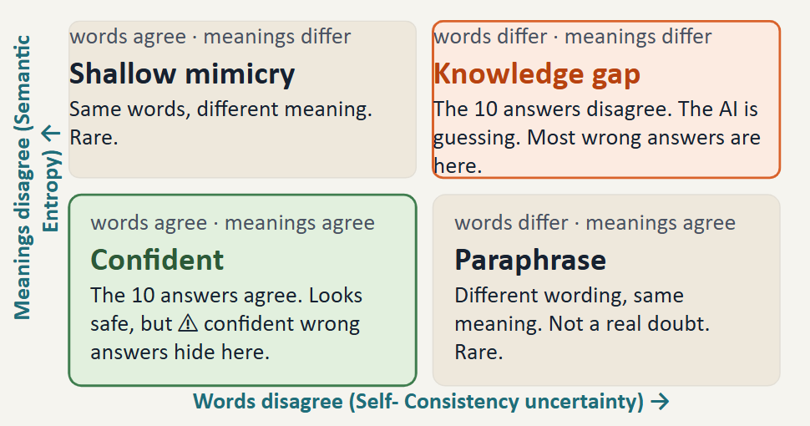
Reminder!

Slide 43
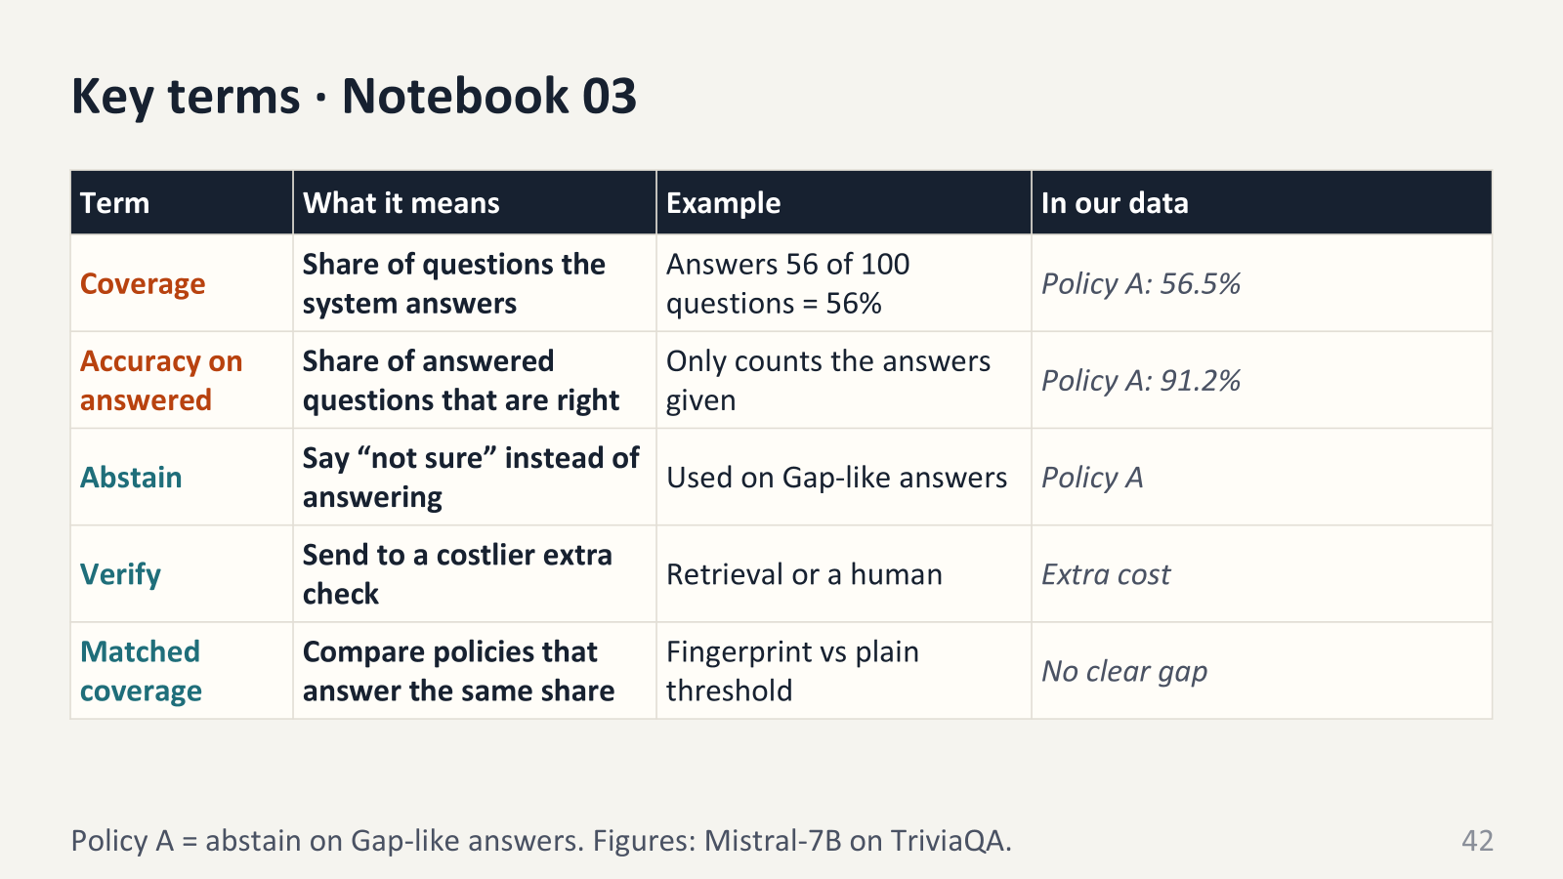

Slide 44
Hands-on · Notebook 03
⏱ ≈ 12 min
Be the AI’s manager: decide when it answers, double-checks, or says “I don’t know”.
STEP 1 · RUN
Observe the Accuracy-Coverage curve
STEP 2 · RUN
Sort questions into three groups: answer, double-check, “I don’t know”.
STEP 3 · Experiment
Change the thresholds
q_answer, q_abstain = 0.45, 0.80
q_answer and q_abstain are two dials that decide how careful the AI should be.
STEP 4 · Analyse
Do you think accuracy is better in fingerprint?

Slide 45
Assistance understanding notebook 3
Imagine a LLM that answers questions, and you want to know when to believe it.
Signals: you ask the LLM the same question 10 times. If it says the same thing every time, it is probably sure. If it keeps changing its answer, it is guessing. These are the clues.
Score: you put all the clues together into one number. A small number means “the LLM is sure.” A big number means “the LLM is guessing.”
Fingerprint: you sort the questions into boxes. One box is “sure,” one is “guessing,” and so on. The boxes tell you why the LLM is unsure.
Dials (q_answer, q_abstain): these decide what the LLM does:
Very sure: it answers right away.
A bit unsure: it checks first.
Very unsure: it says “I don’t know.”

Slide 46
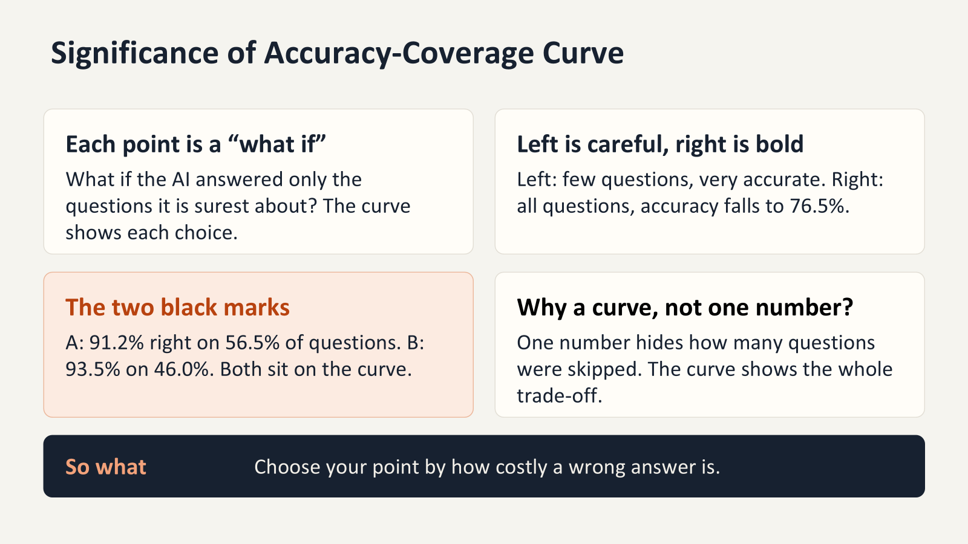
Significance of Accuracy-Coverage Curve

Slide 47
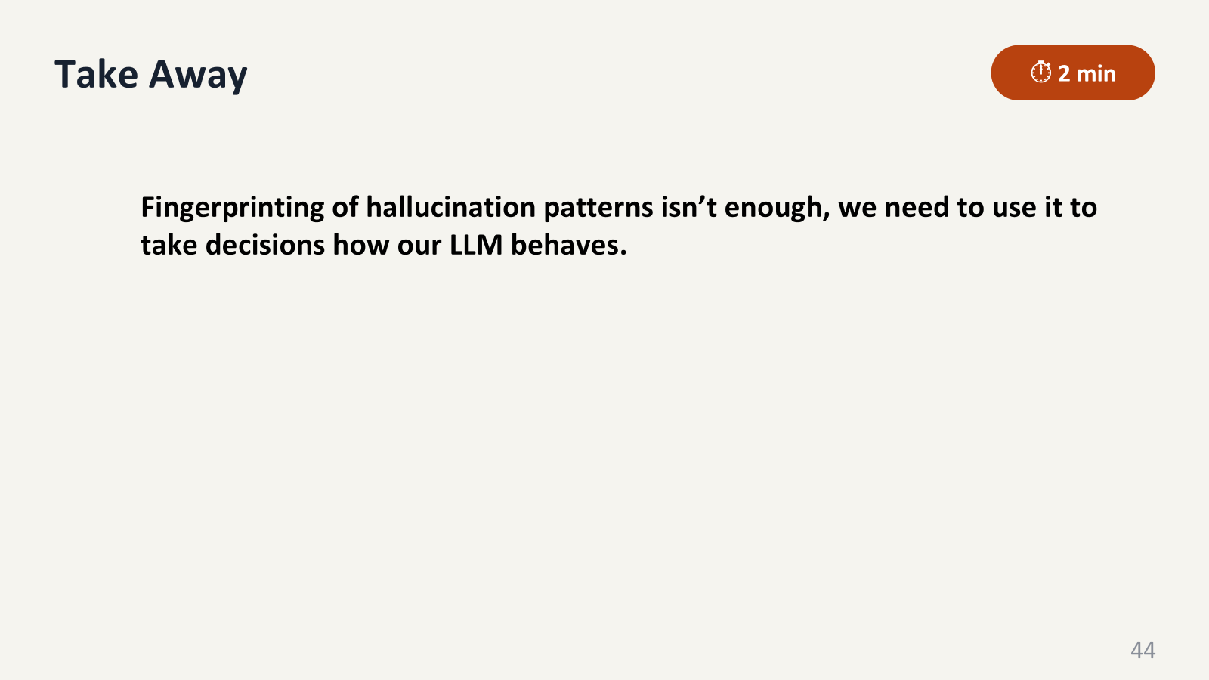

Slide 48
What we learned from notebook 03
Being right costs answers
The more careful the AI is, the fewer questions it answers. Choose the balance on purpose.
Double-checking is the middle path
Spend extra effort only on the questions the AI is unsure about.
The boxes explain
Even if the accuracy is similar, they tell you why the AI held back.
Next
our results across 3 models and 3 datasets, then a live demo.

Slide 49
Use a policy in your own work (1/2)
Our message: decide in advance what your AI does when it is sure, unsure, or very unsure.
EXAMPLE · A COMPANY HR ASSISTANT
✅ Sure: “How many days of leave do I have?” Answer right away.
🔍 Unsure: Look it up in the staff handbook first, then answer and show where it came from.
✋ Very unsure: Say “I’m not sure. Here’s who to ask in HR.”

Slide 50
Use a policy in your own work (2/2)
THREE DECISIONS TO MAKE BEFORE LAUNCH
1 · How much can you skip?
Set a minimum: for example, answer at least 60% of questions.
2 · What does “verify” cost?
Time, money, a bigger model or a person. Put real numbers on it.
3 · Which mistakes hurt?
The higher the stakes, the more you should verify or abstain.
📓 Notebook 03
Route my_actions → score evaluate_actions → check it’s worth it matched_coverage_comparison

Slide 51
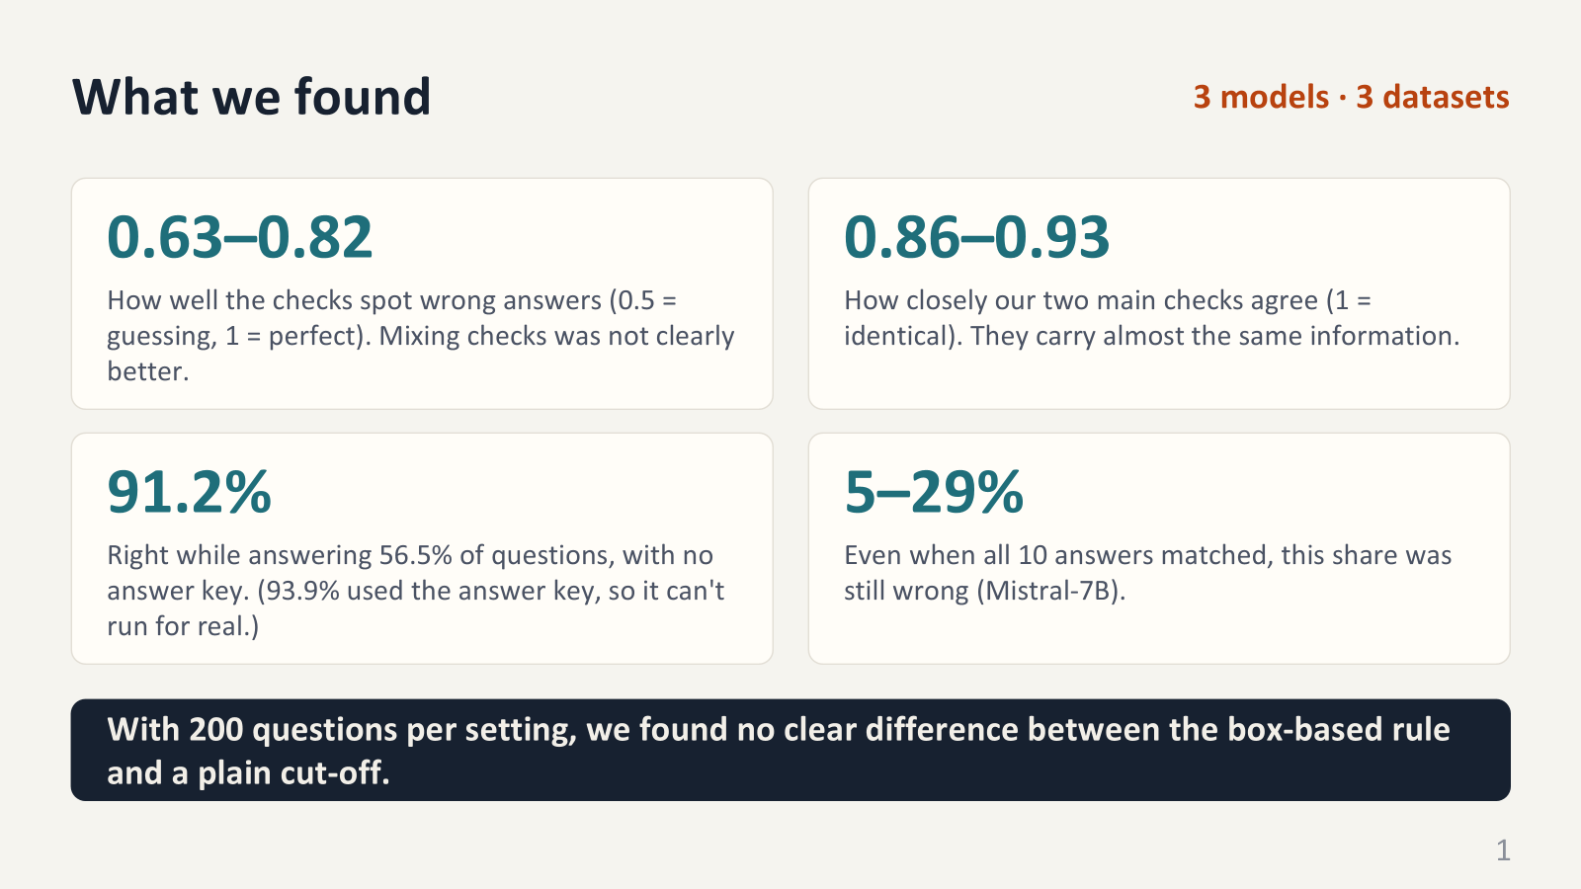
Results across models and datasets
3 models · 3 datasets
0.63–0.82
Detection AUROC. Combining signals did not significantly beat SelfCheckGPT-NLI.
0.86–0.93
Spearman correlation between self-consistency and semantic entropy.
91.2%
Label-free accuracy at 56.5% coverage (93.9% at 81.5% with correctness labels).
5–29%
Of unanimous 10-sample Mistral-7B answers were still wrong.
A fingerprint policy was never significantly better than a plain threshold at the same coverage.

Slide 52
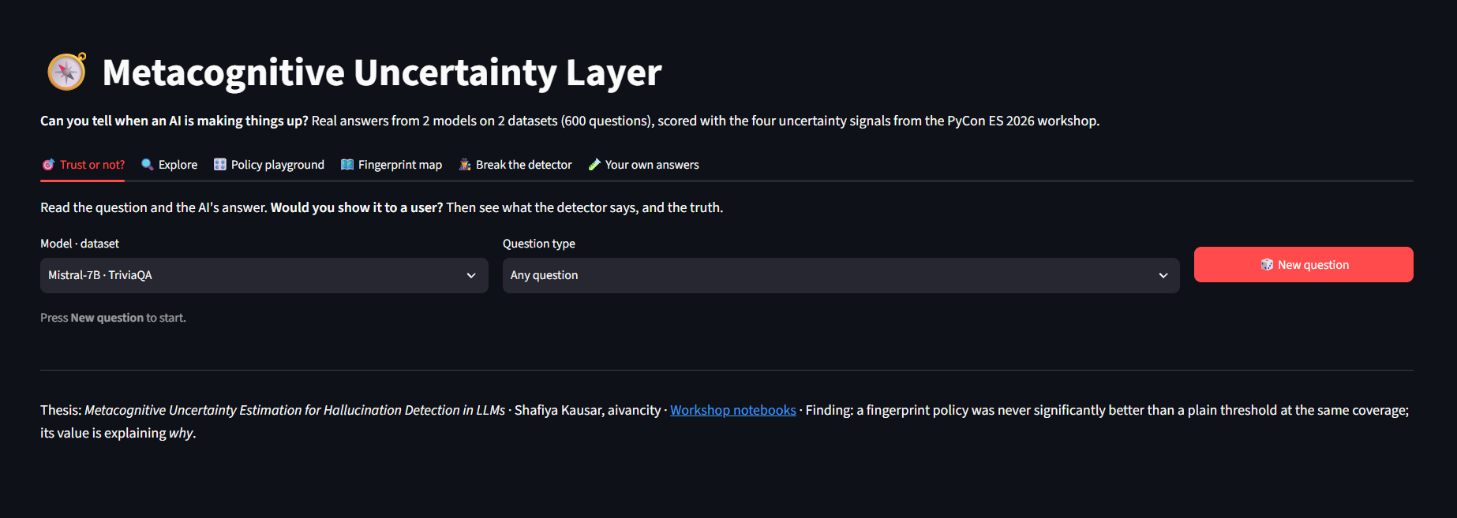
Finally! Playing with Hallucinations with our app
🔗 https://pycon2026-uncertainty-workshop.streamlit.app/

Slide 53
How to use the app?
1
Section 1: Trust or not?
Read a real question and the AI’s answer, click “I’d trust it” or “I wouldn’t”, then see the truth, the signals and the detector’s verdict.
Explore various possible hallucinations!
2
Explore fingerprints
Search or filter all 200 questions (confident fabrications, Gap-like, graders disagree…). For each one you see the answer, both grades, all 4 signals (“more uncertain than X% of questions”) and the 10 samples grouped by meaning.
3
Policy playground
You’re now the LLM’s manager! For each question, the AI can answer straight away, get or say ‘I don’t know.’ You decide what happens!
4
Fingerprint map for models-dataset pair
5
Test your LLM!

Slide 54
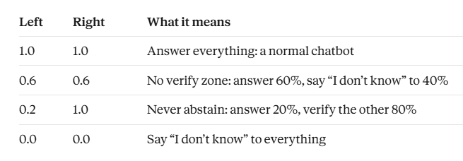
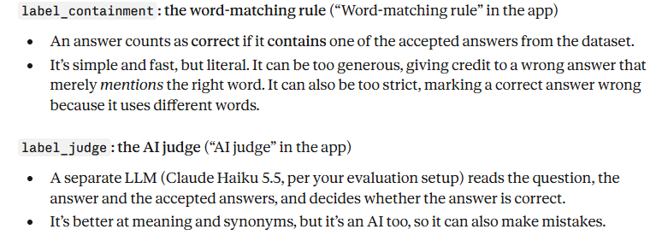
Help with using the Policy playground
The left slider is Answer cut off: answer the safest X% directly. The right slider is Abstain cut-off : above this point, say ‘I don’t know.’ Everything in between gets double-checked.
Drag both sliders to 1.0. This is a normal chatbot: it answers everything. 76.5% right, and 47 wrong answers reach users out of 200.
Return to 0.45 and 0.80. Now only 13 wrong answers get through, and accuracy is about 92%. 40 questions got ‘I don’t know’, and 18 of those were actually right. We threw away good answers.
How to minimize this?
Grader setting chooses how the app decides whether each AI answer is right or wrong.

Slide 55
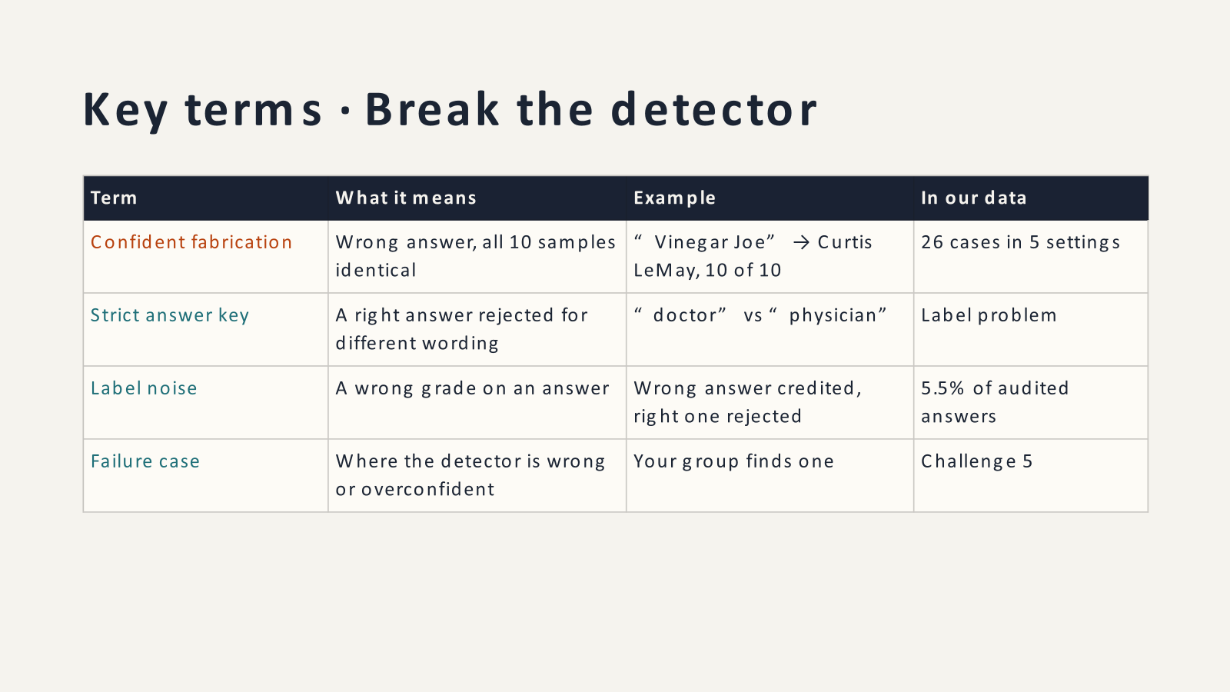

Slide 56
Break the detector
The detector said “fine”, but the answer was marked wrong. Whose fault is it?
🤖 Fabrication
The model really is wrong.
Says “Sydney” for the capital of Australia.
📏 Answer key too strict
Right answer, but the key wants exact words.
Says “physician”; the key says “doctor”.
🏷 Grading mistake
The label itself is wrong.
A wrong answer gets credit for mentioning the right word.
🤷 Ambiguous
Reasonable people would disagree.
“Who invented the telephone?” Bell or Meucci?

Slide 57
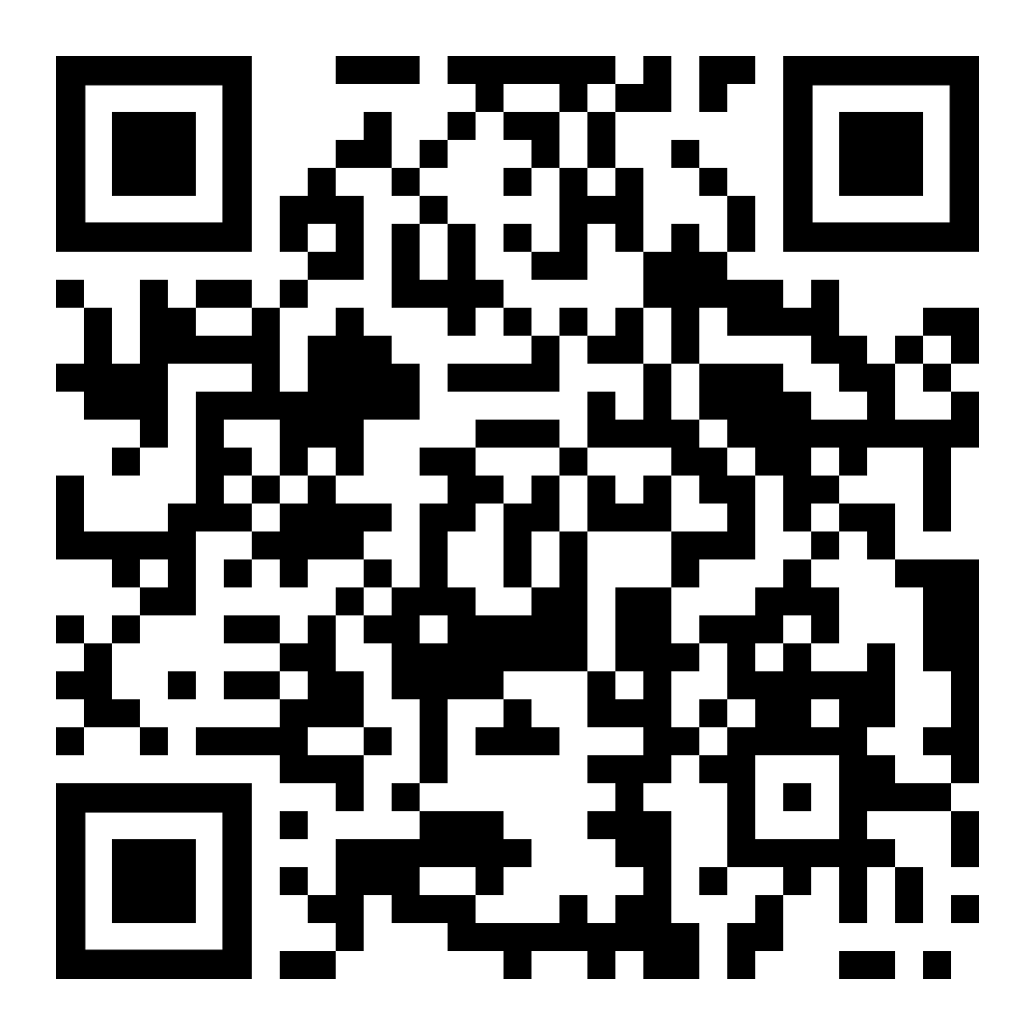
Try it in the app
Scan to open the app
⏱ 15 min
Open the app (Scan the QR code) → tab 🕵️ Break the detector.
Work in groups of 3–4. It takes about 7 minutes, and nobody needs to write code.
Tip: Step 2 lets you pick a cause for each case, and you can download your verdicts.
A fifth check like the other four, or something completely different?

Slide 58
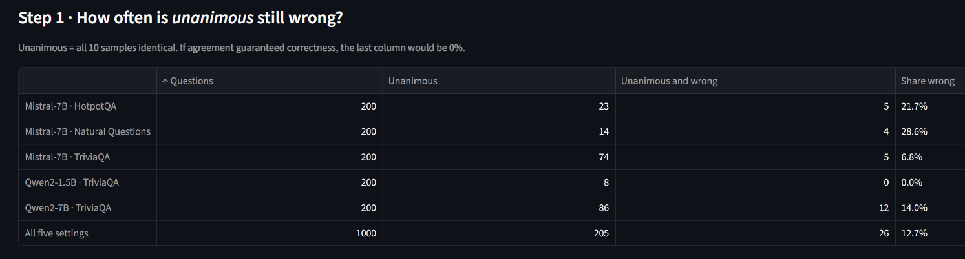
Help for Break the Detector part
These are answers where the model said the same thing all 10 times. If agreement meant correct, the last column would be 0
Mistral · Natural Questions is 28.6% wrong, and overall 26 of 205 unanimous answers were wrong.
Why is Qwen2-1.5B at 0%?” Answer: it was rarely unanimous, only 8 times out of 200, so it doesn’t prove it’s safe.

Slide 59
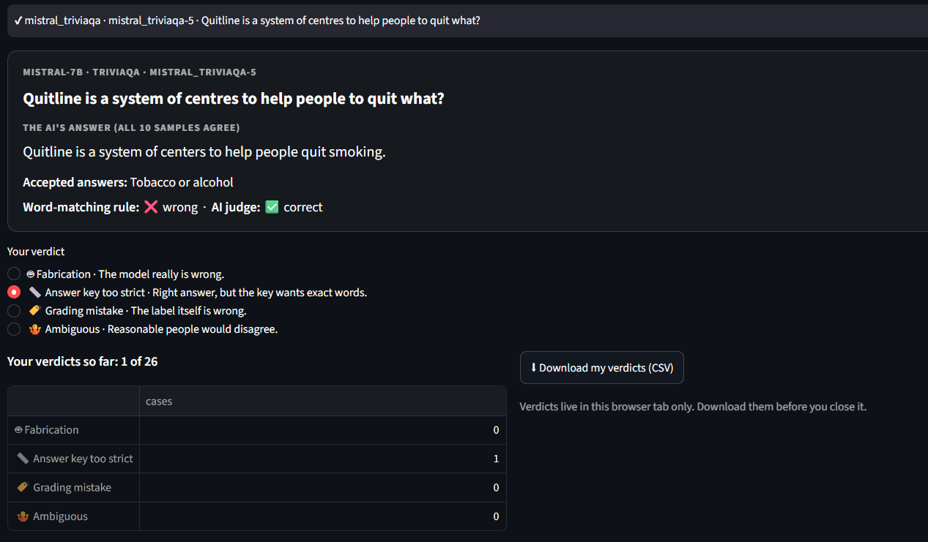
Help for Break the Detector part
Each group clicks a verdict for each of its cases and watches the tally build up.
Read out their tally, and write the totals in four columns: fabrication, strict key, grading mistake, ambiguous.
“How many of these 26 were truly the model’s fault?”

Slide 60
What notebook 04 shows
Agreement isn’t proof
An AI can give the same wrong answer ten times in a row.
Not every mistake is the model’s
Some are strict answer keys or grading errors.
How you grade changes the score
A word-matching rule and an AI judge don’t always agree.
The hardest cases need outside help
Sure and wrong: only a source, database or person catches it.
Try it
Keep testing in the live demo: huggingface.co/spaces/Shafiya1234/metacognitive-uncertainty-layer

Slide 61
Is your LLM hallucinating? Test it with the app!
Who was the first woman to win the Nobel Prize in Literature?
Pearl S. Buck
Pearl S. Buck
Pearl S. Buck.
pearl s. buck
Pearl S. Buck
Expect: Confident, with every signal at zero.
The truth: it was Selma Lagerlöf, in 1909. Pearl Buck won in 1938,
Lesson: agreement isn’t proof. This is exactly the blind spot
In what year did the Eiffel Tower open?
The Eiffel Tower opened in 1889.
The Eiffel Tower opened in 1887.
The Eiffel Tower opened in 1901.
The Eiffel Tower opened in 1889.
The Eiffel Tower opened in 1900.
Expect: Gap-like, with four meaning groups and high semantic entropy. NLI contradiction should also be high,
The truth: 1889.
Lesson: this is the case the detector is good at. The model is guessing, and it shows.
What is the capital of Australia?
The capital of Australia is Canberra.
Australia's capital is Canberra.
Canberra is the capital of Australia.
The capital city of Australia is Canberra.
Australia's capital city is Canberra.
Lesson: this is why semantic entropy is important
Comparing words alone would raise a false alarm.
Summarize the 2019 paper “Neural Entropy Gates for Language Models” by Hartmann et al.
It introduced entropy gates that cut perplexity by 12% on Penn Treebank. It proposed gating attention heads by entropy, presented at NeurIPS 2019. The paper showed that entropy-based dropout improves LSTM training. It introduced a method for compressing transformers using entropy gates. Hartmann et al. used entropy gates to speed up machine translation by 30%.
The truth: the paper doesn’t exist;
Lesson: when a model invents something, it often invents something different each time.

Slide 62
Audit your own AI’s mistakes (1/2)
WHAT TO FIX FOR EACH CAUSE
🤖 Fabrication
Add outside evidence: documents, a database, or a person.
📏 Strict key
Accept synonyms, or grade with an AI judge.
🏷 Grading mistake
Fix the grading rule, then re-score.
🤷 Ambiguous
Reword the question, or allow several answers.

Slide 63
Limitations and failure cases (1/2)
WHAT WENT WRONG · FAILURE CASES
Short answers only
We tested short factual answers, not long texts or step-by-step reasoning models.
Smaller models were harder
On the smallest model (Qwen2-1.5B), our combined checks did clearly worse than an existing method, SelfCheckGPT-NLI.
Small test sets
Only 200 questions per setting, so small differences could be missed.
Few models
Three compressed (4-bit) models. Natural Questions and HotpotQA used Mistral only.

Slide 64
Future work
Make the evidence stronger
More questions per setting. With 200 questions the intervals are wide, so small effects can’t be ruled out. A power analysis would show how many questions are needed to detect, say, a 2-point AUROC gain.
A complete grid. Run all three models on all three datasets; today NQ and HotpotQA use Mistral only.
More and newer models, including full-precision versions, larger open models and instruction-tuned vs base pairs, to test whether the 4-bit quantization shaped the results.
Catch the confident fabrications
This is the biggest open problem: 5–29% of unanimous answers were still wrong, and every sampling signal missed them.
Add signals of a different kind: retrieval or knowledge-base checks, cross-model disagreement (ask a different model), and internal-state probes such as semantic entropy probes.
Test whether any of these flag the unanimous-but-wrong cases specifically, rather than improving average AUROC.

Slide 65
Repository and further reading
Repository
WORKSHOP NOTEBOOKS
github.com/Shafiya0101/
pycon2026-uncertainty-workshop
RESEARCH CODE
github.com/Shafiya0101/
metacognitive-uncertainty-layer
THESIS (PREPRINT)
doi.org/10.13140/RG.2.2.11958.66884
CPU-only · no API key · MIT license
Further reading
Farquhar et al., 2024
Detecting hallucinations in LLMs using semantic entropy. Nature 630.
Manakul et al., 2023
SelfCheckGPT. EMNLP.
Vashurin et al., 2025
Benchmarking uncertainty quantification with LM-Polygraph. TACL.

Slide 66
Collaborations welcome!
Thank you! Questions?
Shafiya Kausar · Anuradha Kar
Notebooks: github.com/Shafiya0101/pycon2026-uncertainty-workshop
Live demo: https://pycon2026-uncertainty-workshop.streamlit.app/

