Slide 1
Education management system
Presented by
Group-11
MD. MINHAZ UDDIN Mohammad Shafkat Hasan Juhayer Abdullah
Id-19101013 Id-19101077 Id-18301251
Sec-06 Sec-06 Sec-06

Slide 2
The Story behind our Project
1
For the welfare and betterment of student.
Easier access and time lessening project for administration.
Digitalization of education in a different dimension.

Slide 3
planning
2
Making a collaboration among students, teachers, school administration bodies, and education boards.
Improving communication among all of the branches of the education system of a country.

Slide 4
Analysis
3
Mainly, the system is build for students.
On the other hand, both students and administration can be benefitted as it simplifies their work.
It can be widely accessible both in browser and mobile app.

Slide 5
Design
4
Updated academic information.
Admission application.
Update result and notice.
Fees collection.(Digital payment method).
Generate CV.

Slide 6
Analysis of Proposed System
5
A unique feature : Verified CV generation.
New dimension for educational purpose.

Slide 7
Requirement Analysis
6
Functional Requirements :
Recorded Management for Student
FR1.1: Make categories like Student results, CV, etc.
FR1.2: Admin and users must go through an authentication process.
FR1.3: Anyone can browse through to find the educational Info of a student.
FR1.4: Users should be able to leave comments.

Slide 8
Requirement Analysis
7
Academic Administration
FR2.1: Fee collection.
FR2.2: Data feed for job recruiters.
FR2.3: Improve Communication.
FR2.4:Different Account types.

Slide 9
Requirement Analysis
8
Non Functional requirements:
Recorded Management for Student
NFR1.1: Student information must be verified.
NFR1.2: Info update latency should be less than 10s. FR1.
NFR1.3: Only Admin can edit Info.
NFR1.4: It should have education board approval.

Slide 10
Requirement Analysis
9
Academic Administration
NFR2.1: All the payments should be made with the verified user information.
NFR2.2: Troubleshoot for mistakes in payments.
NFR2.3: Manual Payment method strategy in case the system can't cope with the situation.
NFR2.4: Data feed should be approved by the verified authority.
NFR2.5: Password recovery method with a verified identity.
NFR2.6: Student profile can be approved only by a verified authority.

Slide 11
Requirement Analysis
10
Operational: 1. Mobile Devices 2. Web Browsers.
Performance: Data load takes less than 3 seconds.
Security: Only Admin can update or add verified Info.
Cultural & Political: Data can only be accessed in Bangladesh. Supported language Bangla and English.

Slide 12
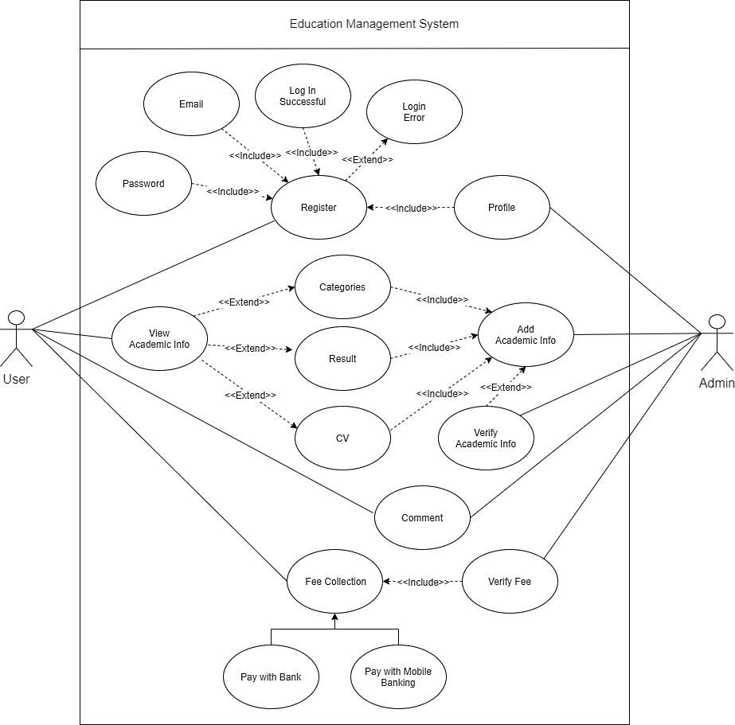
Use Case Diagram.
11

Slide 13
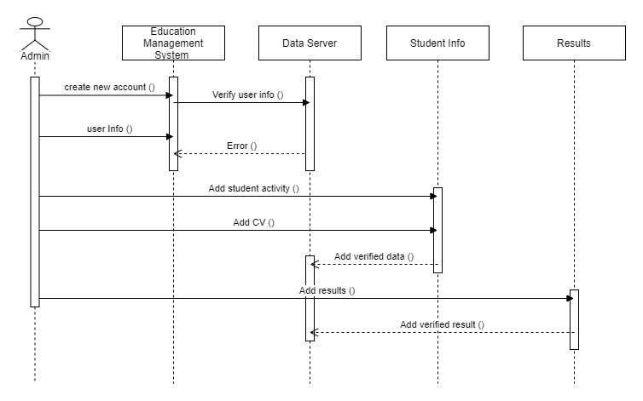
12
Sequence Diagram

Slide 14
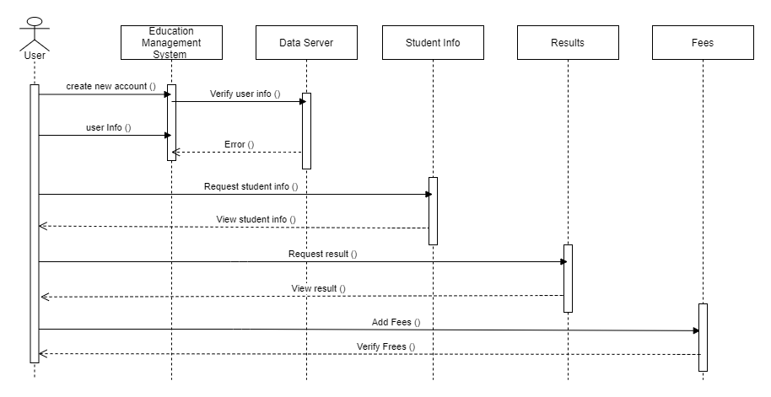
13
Sequence Diagram

Slide 15
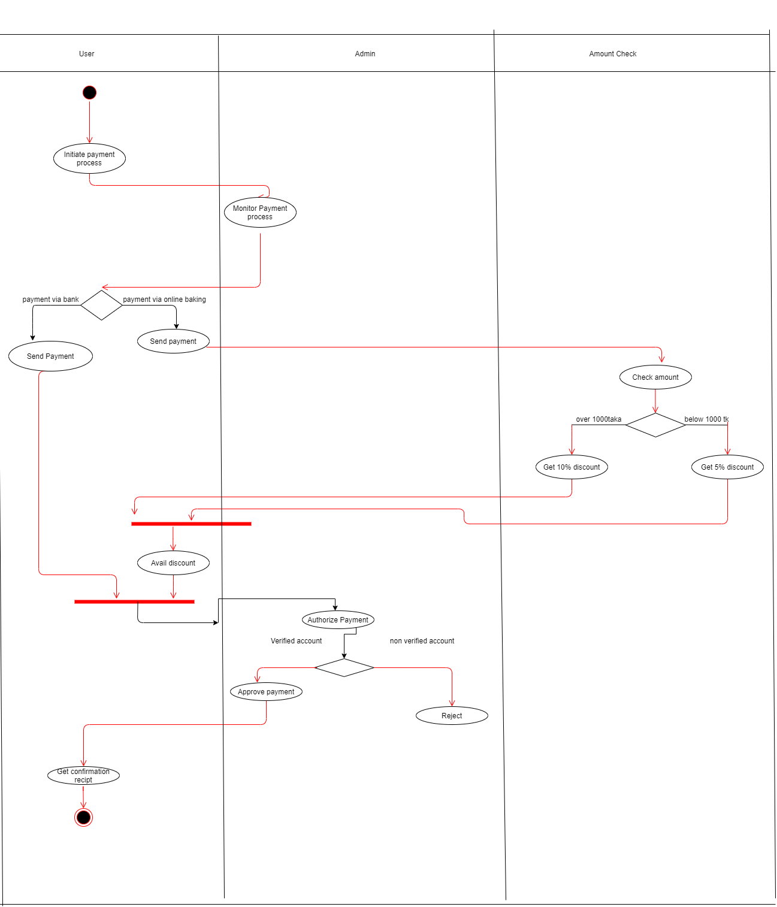
14
Activity Diagram

Slide 16
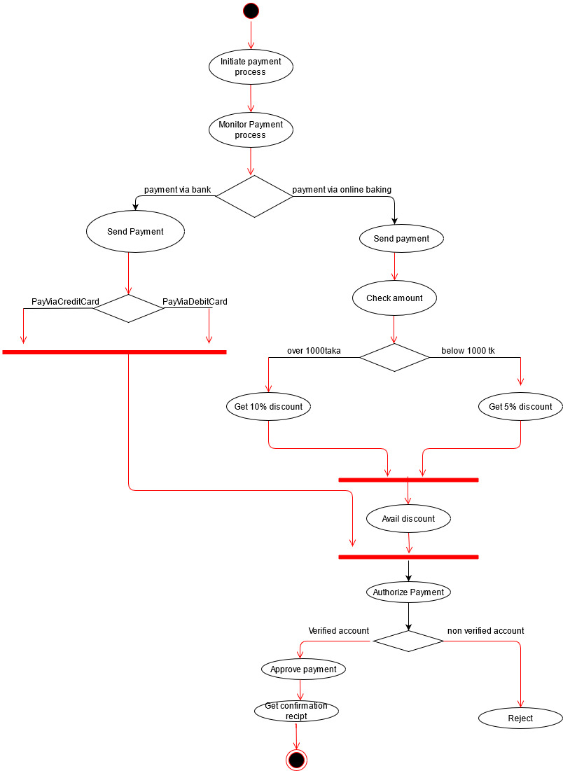
15
Activity Diagram

Slide 17
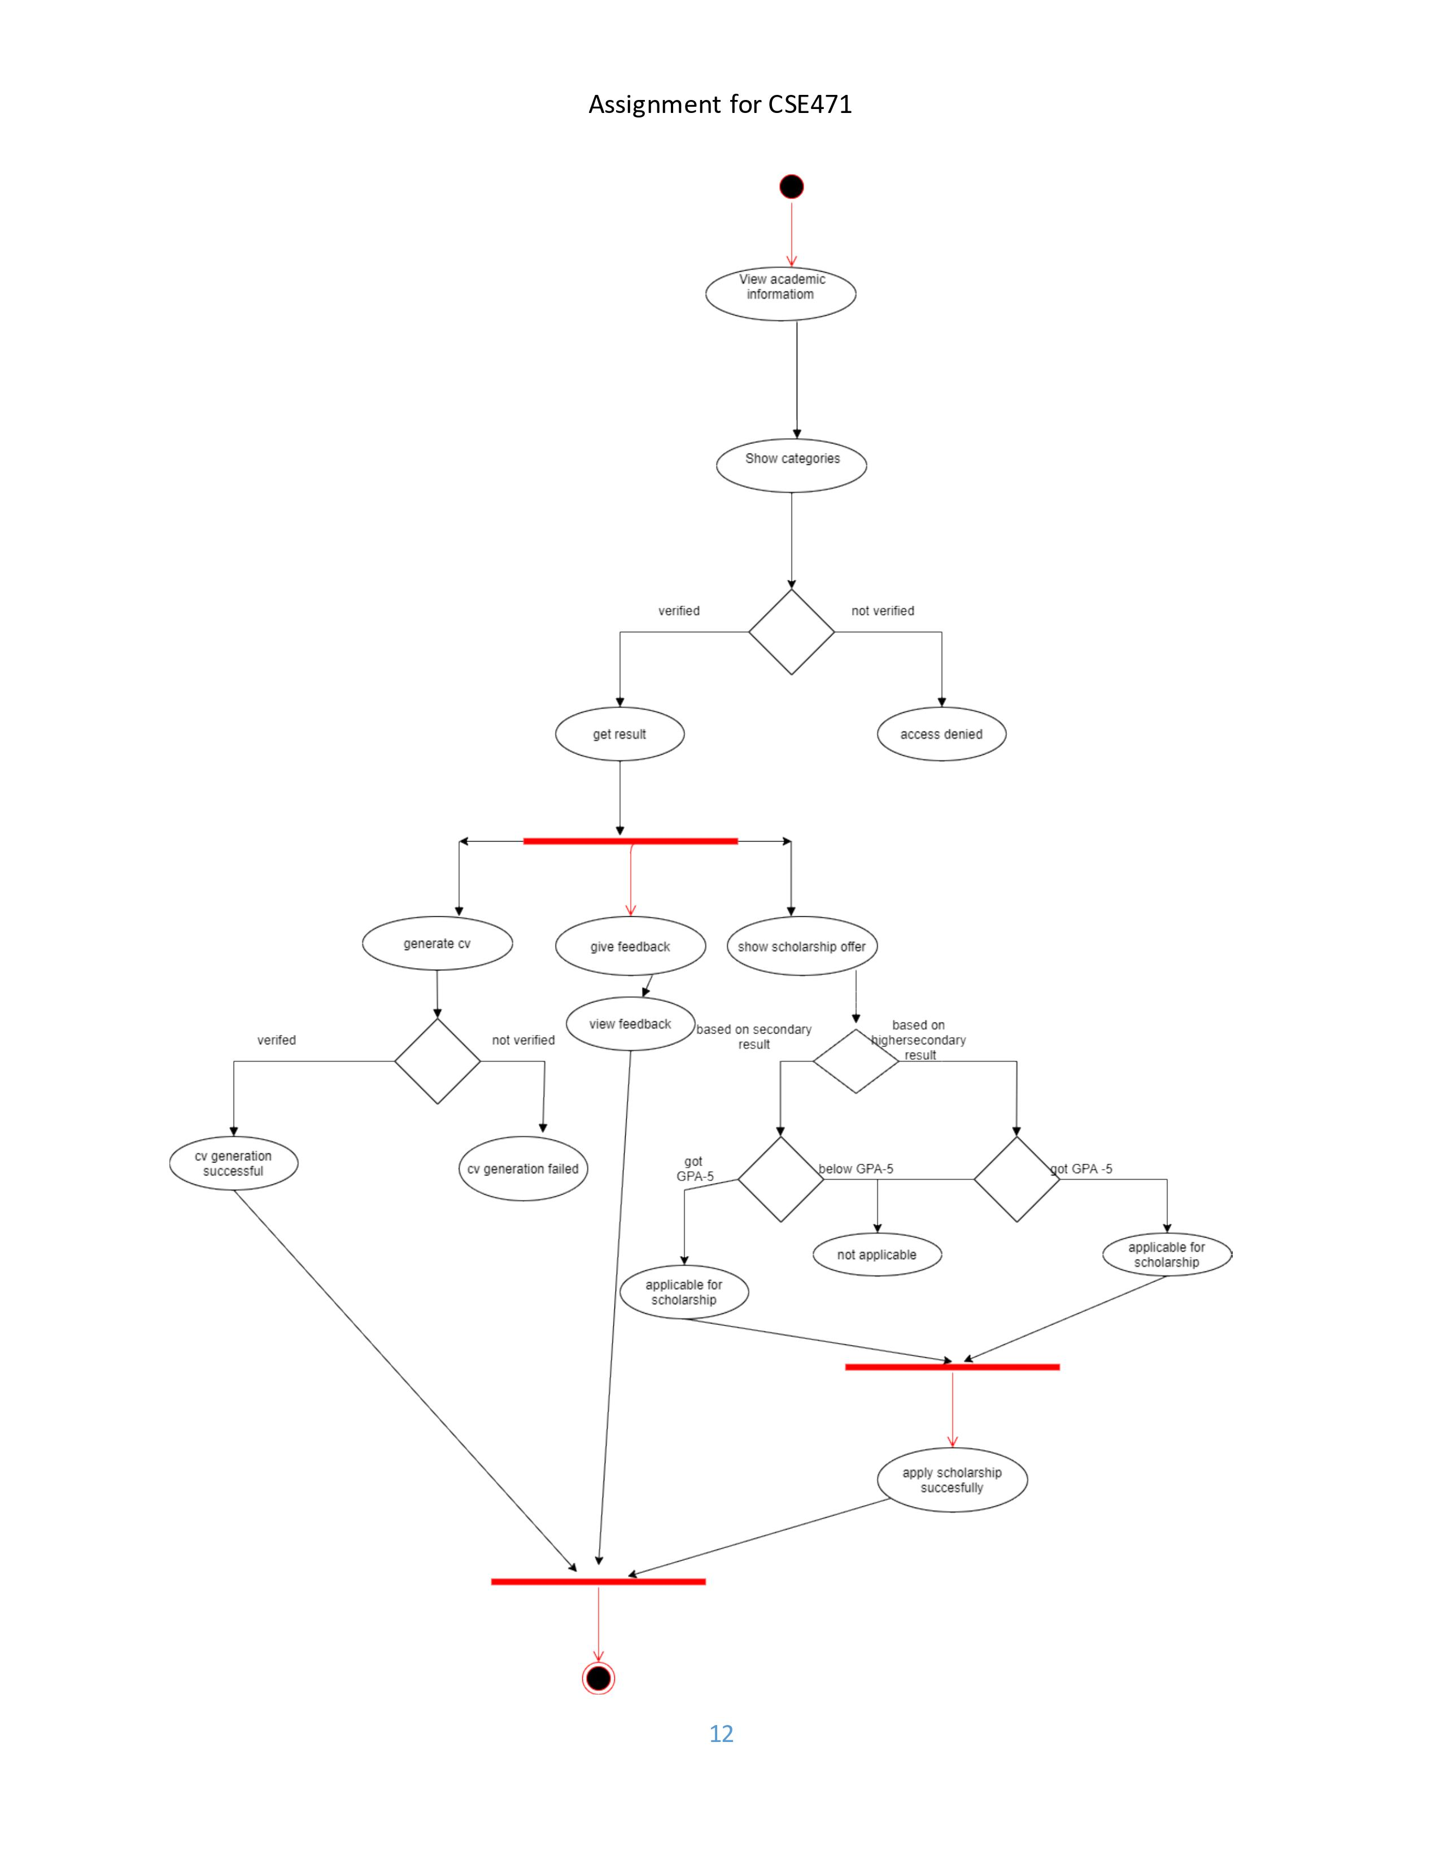
16
Activity Diagram

Slide 18
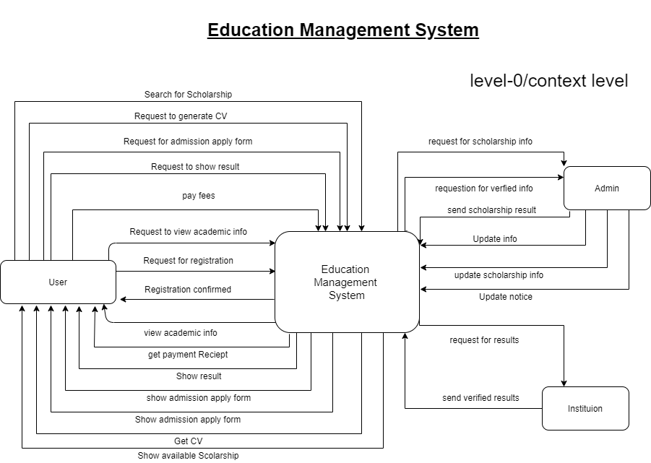
17
Dara flow diagram kevel-0

Slide 19
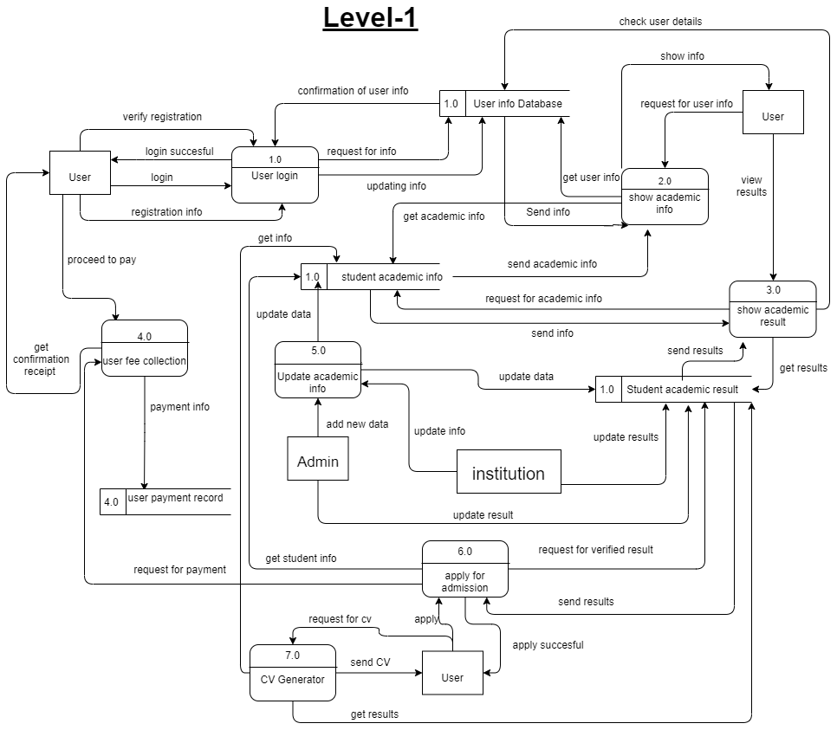
18
Dara flow diagram level-1

Slide 20
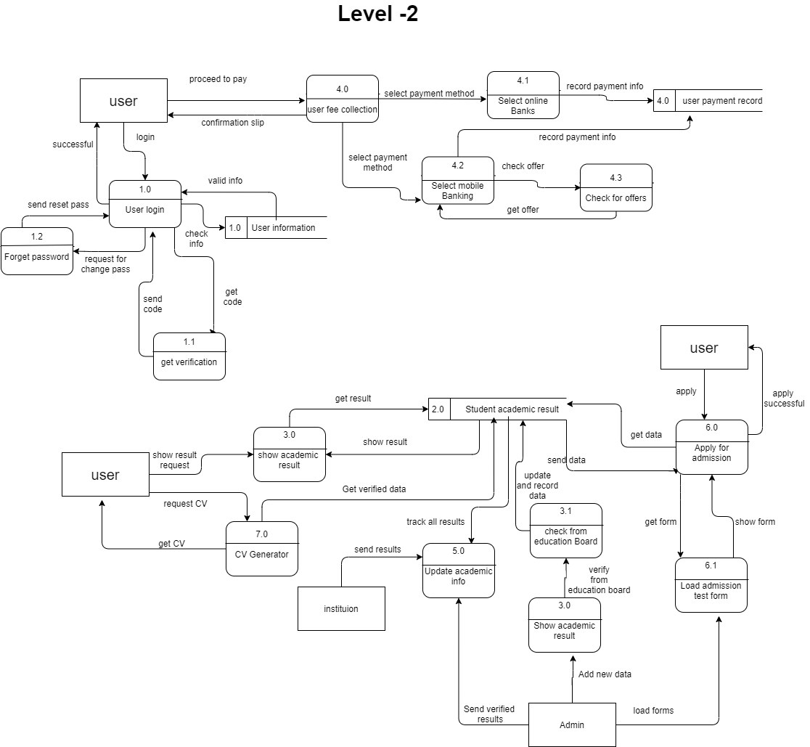
19
Dara flow diagram level-2

Slide 21
conclusion
20

