Slide 1
jQuery

Slide 2
What is jQuery?
jQuery is a fast and concise JavaScript Library that simplifies HTML document traversing, event handling, animating, and Ajax interactions for rapid web development. (jQuery.com)
JQuery is a lightweight, "write less, do more", JavaScript library.
An open source JavaScript library that simplifies the interaction between HTML and JavaScript.
Jquery is easy to learn and master

Slide 3
Why learn jQuery?
Write less, do more:
$("p.neat").addClass("ohmy").show("slow");
Performance
Plugins
It’s standard
… and fun!
Notes:
That little snippet loops through all <p> elements with the class "neat" and then adds the class "ohmy" to it, whilst slowly showing the paragraph in an animated effect. No browser checks, no loop code, no complex animation functions, just one line of code!

Slide 4
Installing Jquery
Steps for adding Jquery to your web pages .
Go to http://docs.jquery.com/Main_Page OR
Go to https://ajax.googleapis.com/ajax/libs/jquery/3.6.0/jquery.min.js
Use following code snippet
< html >
< head >
< script src="Jquery.js">
< body>

Slide 5
jQuery Syntax
With jQuery you select (query) HTML elements and perform "actions" on them.
Basic syntax is: $(selector).action()
A $ sign to define/ access jQuery
A (selector) to "query (or find)" HTML elements
A jQuery action() to be performed on the element(s)
Examples:
$("p").hide() - hides all elements.
$("#test").hide() - hides the element with id="test".
$(".test").hide() - hides all elements with class="test".

Slide 6
Document Ready Event
We cannot use the DOM before the page has been constructed. jQuery gives us a more compatibile way to do this.
The DOM way
The direct jQuery translation
The jQuery way
window.onload = function() { // do stuff with the DOM }
$(document).ready(function() { // do stuff with the DOM });
$(function() { // do stuff with the DOM });
This is to prevent any jQuery code from running before the document is finished loading (is ready).
Trying to hide an element that is not created yet
Trying to get the size of an image that is not loaded yet

Slide 7
Hide divs with pure JavaScript
divs = document.getElementByTagName(‘div’);
for (i = 0; i < divs.length; i++) { divs[i].style.display = ‘none’;
JQuery
$(“div”).hide();

Slide 8
Jquery Selectors
jQuery selectors allow you to select and manipulate HTML.
With jQuery selectors you can find elements based on their id, classes, types, attributes, values of attributes and much more. It's based on the existing CSS Selectors and in addition, it has some own custom selectors.
All type of selectors in jQuery, start with the dollar sign and parentheses: $().
Types of jquery selectors .
Element selector
Id (#) selector
Class (.) selector

Slide 9
Element Selector
The jQuery element selector selects elements based on their tag names.
Example
$(document).ready(function(){ $("#button").click(function(){
$("p").hide();
});
});

Slide 10
ID Selector
The jQuery #id selector uses the id attribute of an HTML tag to find the specific element.
Example
$(document).ready(function(){ $("#button").click(function(){
$(“#test").hide();
});
});

Slide 11
Class Selector
The jQuery class selector finds elements with a specific class.
Example
$(document).ready(function(){ $("#button").click(function(){
$(“.test").hide();
});
});

Slide 12
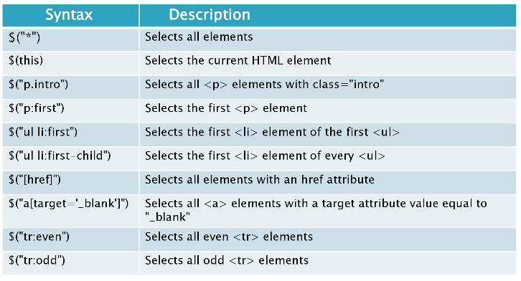
More Jquery Selectors

Slide 13
Aspects of the DOM and jQuery
Identification: how do I obtain a reference to the node that I want.
Traversal: how do I move around the DOM tree.
Node Manipulation: how do I get or set aspects of a DOM node.
Tree Manipulation: how do I change the structure of the page.

Slide 14
jQuery / DOM comparison
DOM method | jQuery equivalent
getElementById("id") | $("#id")
getElementsByTagName("tag") | $("tag")
getElementsByName("somename") | $("[name='somename']")
querySelector("selector") | $("selector")
querySelectorAll("selector") | $("selector")

Slide 15
jQuery terminology
the jQuery function
refers to the global jQuery object or the $ function depending on the context
a jQuery object
the object returned by the jQuery function that often represents a group of elements
selected elements
the DOM elements that you have selected for, most likely by some CSS selector passed to the jQuery function and possibly later filtered further

Slide 16
The jQuery object
The $ function always (even for ID selectors) returns an array-like object called a jQuery object.
The jQuery object wraps the originally selected DOM objects.
You can access the actual DOM object by accessing the elements of the jQuery object.
// false
document.getElementById("id") == $("#myid");
document.querySelectorAll("p") == $("p");
// true
document.getElementById("id") == $("#myid")[0];
document.getElementById("id") == $("#myid").get(0);
document.querySelectorAll("p")[0] == $("p")[0];

Slide 17
Moving Elements Examples
Get element with ID foo and add some HTML.
$(“#foo”).append(“<p>test</p>”);
<html>
<body>
<div>jQuery</div>
<div id=”foo”>example<p>test</p></div>
</body>
</html>

Slide 18
Moving Elements Examples
Move paragraphs to element with id “foo”
$(“p”).appendTo(“#foo”);
<html>
<body>
<div>jQuery
<p>moving</p>
<p>paragraphs</p>
</div>
<div id=”foo”>example</div>
</body>
</html>
$(“p”).appendTo(“#foo”);
<html>
<body>
<div>jQuery</div>
<div id=”foo”>example
<p>moving</p>
<p>paragraphs</p>
</div>
</body>
</html>

Slide 19













Attributes
Get
.attr(‘id’)
.html()
.val()
.css(“top”)
.width()
Set
.attr(‘id’, ‘foo’)
.html(“<p>hi</p>”)
.val(“new val”)
.css(“top”, “80px”)
.width(60)

Slide 20


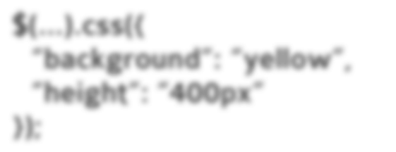
Attributes
Set border to 1px black
$(...).css(“border”, “1px solid black”);
Set various css properties.
$(...).css({
“background”: “yellow”, “height”: “400px”
});
Set all link’s href attribute to google.com
$(“a”).attr(“href”, “http://google.com”);

Slide 21







Attributes
Replace HTML with a new paragraph.
$(...).html(“<p>I’m new</p>”);
<div>whatever</div> turns into
<div><p>I’m new</p></div>
Set checkboxes attribute “checked” to checked.
$(“:checkbox”).attr(“checked”,”checked”);
Set input value to 3.
$(...).val(“3”);
Get input value.
$(...).val();

Slide 22
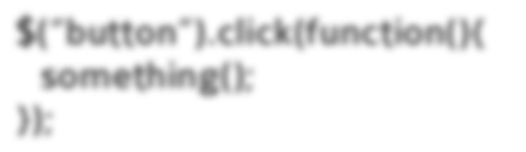
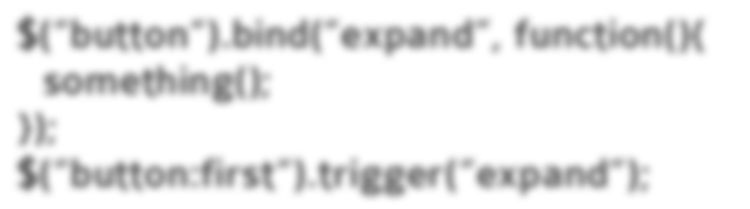


Events
When a button is clicked, do something.
$(“button”).click(function(){ something();
});
Setup a custom event and trigger it.
$(“button“).bind(“expand”, function(){ something();
});
$(“button:first“).trigger(“expand”);
Unbind custom event.
$(“button“).unbind(“expand”);

Slide 23

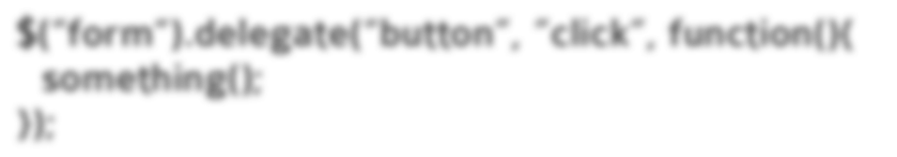
Event Delegation
Attach events to document
$(“button”).live(‘click’, function(){ something();
});
Attach event delegation to elements
$(“form“).delegate(“button”, ”click”, function(){ something();
});

Slide 24
Ajax Examples
Post data, “bar” equals “baz” to tag.php using get.
$(...).get(“tag.php”, { “bar”: “baz” });
Post data, “foo” equals “bar” to send.php, then alert the response.
$.post(“send.php”, { foo: ”bar” }, function(response){
alert(response);
});

Slide 25
Plugin Example
$.fn.myPlugin = function(){ return this.each(function(){
$(this).html(“you used myPlugin!”);
});
});
$(“div”).myPlugin();
<html>
<body>
<div>you used myPlugin!</div>
<div>you used myPlugin!</div>
</body>
</html>

