Slide 1
Metaverse
Immersive 3D

Slide 2


Agenda
A
Introduction
Metaverse concept
Layers of Metaverse
Companies deals
Pro’s & Con’s
Conclusion

Slide 3
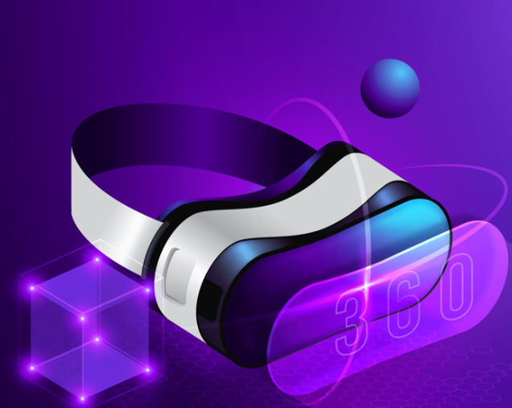
Introduction to Metaverse
Metaverse will include elements from both physical and virtual worlds.
A metaverse is a form of mixed reality i.e., a combination of augmented and virtual reality.
The Metaverse is a network of virtual Places
that are linked into the virtual universe.
It often described as a future version of the
Internet.
The word Metaverse derived from Greek
Which means by META means BEYOND &
VERSE means UNIVERSE.

Slide 4

Metaverse Will Be Future Technology
Meta defines the metaverse as "a set of virtual spaces where you can create and explore with other people who aren't in the same physical space as you.”

Slide 5
Metaverse concept comes from…..???
The concept of the metaverse has roots in science fiction and has been evolving over several decades. The term itself was popularized by author Neal Stephenson in his 1992 science fiction novel "Snow Crash." In the novel, the metaverse is a virtual reality space where users interact with each other and digital environments using avatars. In recent years, the term "metaverse" has been brought into mainstream discussions by technology companies and entrepreneurs who are actively working on developing the technological infrastructure and applications that could bring about a more immersive and interconnected digital universe . While the metaverse as a concept has been around for a while, its practical realization is still in the early stages, with ongoing developments in virtual reality, augmented reality, artificial intelligence, and other technologies contributing to its evolution.

Slide 6
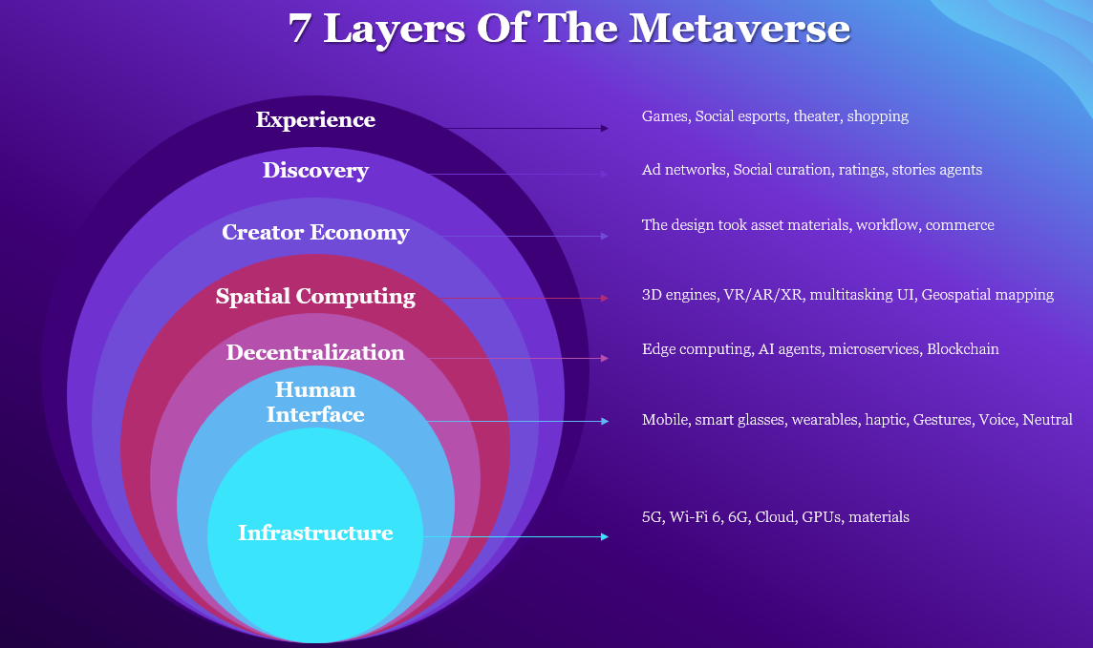
Layers of the Metaverse

Slide 7
COMPANIES DEALS WITH METAVERSE :
Several technology companies and platforms have been actively involved in or exploring opportunities related to the metaverse. Keep in mind that the metaverse landscape is dynamic, and new developments may have occurred since then. Here are some notable companies that have shown interest in or are actively working on metaverse-related projects:
Facebook : Meta, the parent company of Facebook, has been a major player in the development of the metaverse. They are investing heavily in virtual reality (VR) and augmented reality (AR) technologies, with projects like Oculus VR and the Horizon Workrooms.
Google : Google has been involved in various aspects of the metaverse, including AR development through projects like Google Glass. Additionally, Google has interests in virtual worlds and immersive experiences.
Microsoft : Microsoft has been actively exploring the metaverse space through its mixed reality platform, Microsoft Mesh. They are focusing on creating collaborative and immersive experiences for both work and play.
Epic Games : The company behind the popular game engine Unreal Engine and the game Fortnite has expressed interest in the metaverse. They are working on building tools and platforms that enable developers to create immersive experiences.

Slide 8
Pro’s & Con’s
Boundless Exploration: The metaverse offers limitless opportunities for exploration and adventure in virtual worlds.
Personalization: Users can customize their avatars and virtual spaces, allowing for self-expression and representation.
Digital Dependency: Spending excessive time in the metaverse may lead to a dependence on virtual experiences, potentially impacting real-world relationships and responsibilities.
Privacy and Security Concerns: With increased connectivity and sharing of personal information, there is a need for robust privacy and security measures to protect users from potential risks and data breaches.

Slide 9
Conclusion
The metaverse is a fascinating concept that holds immense potential for the future. It promises to redefine how we connect, explore, and experience the digital realm. With its seamless integration of virtual and physical worlds, the metaverse offers endless possibilities for creativity, collaboration, and entertainment. From immersive gaming experiences to virtual social interactions, the metaverse has the power to revolutionize various aspects of our lives.

Slide 10
Thank you
B Swaroopa
M Shagufta Fathima

