Slide 1
BLUESTOCK
Mutual Fund Analytics Platform
Final Capstone Presentation — ETL, Analytics & Visualization
Prepared by Shagun
github.com/Shagun0514/CapStone_Internship_Project

Slide 2
Problem & Objective
The Problem
The Objective
Bluestock's stakeholders — fund managers, distributors, and investors — lack a unified view across 40 mutual fund schemes: performance, risk, and investor behavior data sit in disconnected spreadsheets with no automated pipeline or interactive analytics layer.
Automate ETL for 6 raw datasets, zero manual steps
Build a normalized SQLite star schema
Deliver 15+ chart EDA with documented insights
Compute Sharpe, Sortino, Alpha, Beta, Max Drawdown
Ship a 4-page interactive Power BI dashboard
Extend into VaR/CVaR, cohort & risk analytics
Delivered in 6 days: ETL → SQLite → EDA → Performance Metrics → Dashboard → Advanced Risk Analytics, plus 4 bonus challenges.
2

Slide 3
Data Sources
fund_master
nav_history
40 schemes — AMC, category, expense ratio, risk grade
~46,000 daily NAV records (2022–2026)
scheme_performance
investor_transactions
Returns, alpha, beta, Sharpe, Sortino, AUM
32,000+ SIP / lumpsum / redemption records
portfolio_holdings
benchmark_indices
Stock & sector-level allocations per scheme
Nifty 50, Nifty 100, sectoral indices
3

Slide 4
System Architecture
Raw CSVs
(6 sources)
ETL Pipeline
(pandas)
SQLite Star
Schema
EDA + Metrics
(scipy, matplotlib)
Power BI
Dashboard
Advanced Risk
Analytics
→
→
→
→
→
Star Schema
Tech Stack
Dimensions: dim_fund, dim_date
Facts: fact_nav, fact_transactions, fact_performance,
fact_aum, fact_sip_inflows, fact_category_inflows, fact_holdings
pandas · numpy · scipy · SQLAlchemy · matplotlib
seaborn · Power BI Desktop · Windows Task Scheduler
4

Slide 5
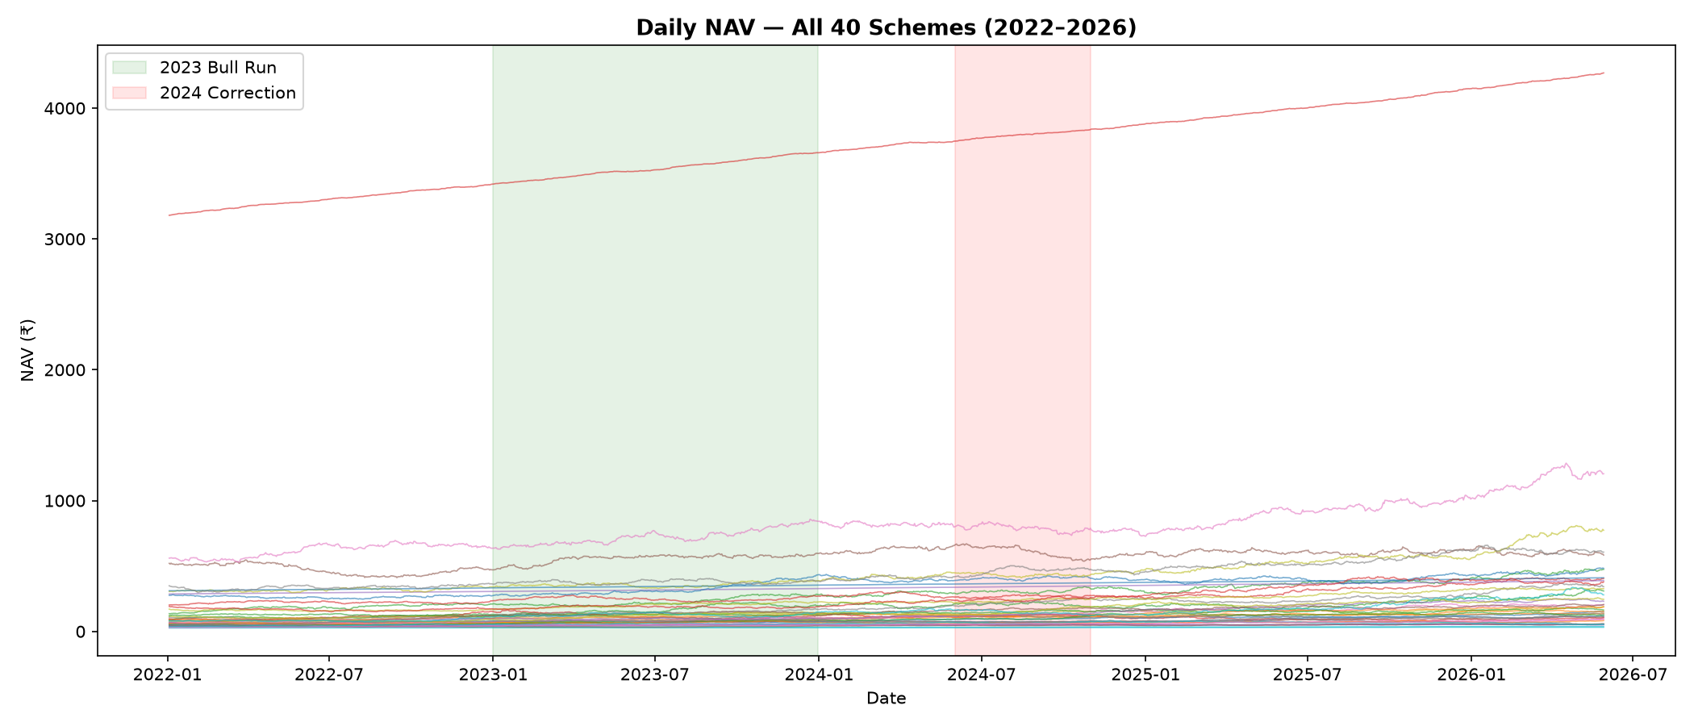
EDA Highlights — NAV Trends (2022–2026)
Post-2022 correction recovery observed across categories, with equity funds outperforming debt and hybrid segments. Green/red bands mark the 2023 bull run and 2024 correction.
5

Slide 6
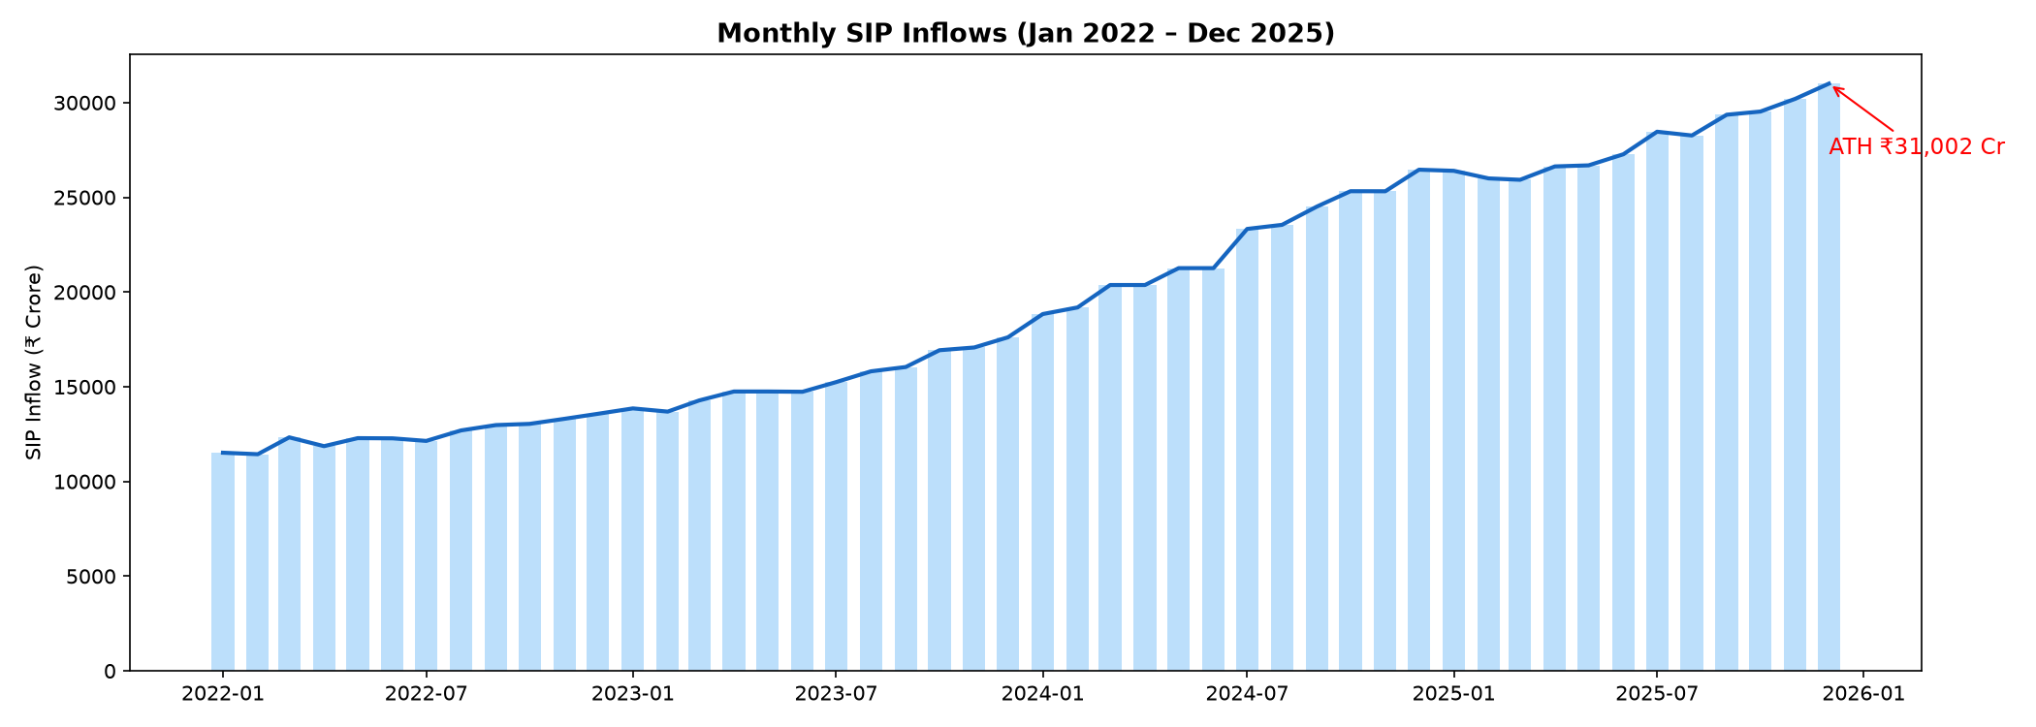
EDA Highlights — SIP Inflow Trend
Monthly SIP inflows grew consistently from 2022, peaking at an all-time high of ₹31,002 Cr in December 2025 — reflecting strong and growing retail participation.
6

Slide 7
Performance Metrics — Methodology
All ratios annualized on 252 trading days · Risk-free rate Rf = 6.5% (RBI repo rate proxy)
Sharpe Ratio
(Mean daily return − Rf) / Std Dev × √252
Sortino Ratio
Same, but denominator uses downside deviation only
Alpha / Beta
OLS regression (scipy.stats.linregress) vs Nifty 100
Max Drawdown
min(NAV / running_max − 1), with worst-date range
Fund Scorecard (0–100): 30% 3yr return + 25% Sharpe + 20% Alpha + 15% expense ratio (inverse) + 10% max drawdown (inverse)
7

Slide 8
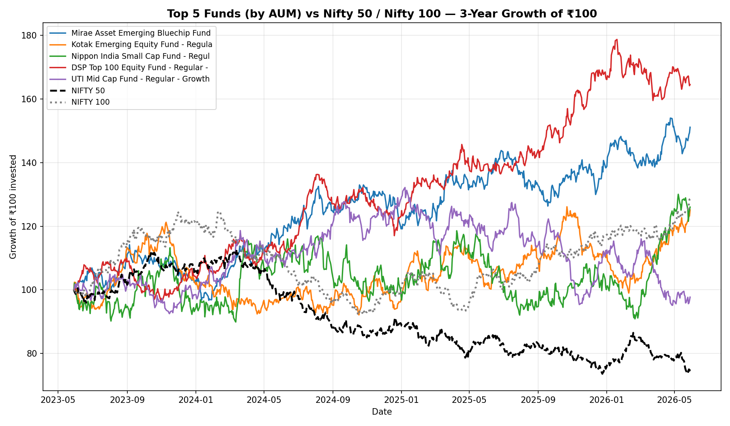
Performance Metrics — Benchmark Comparison
Top 5 funds by AUM tracked against Nifty 50 / Nifty 100 over a 3-year horizon (growth of ₹100 invested)
8

Slide 9
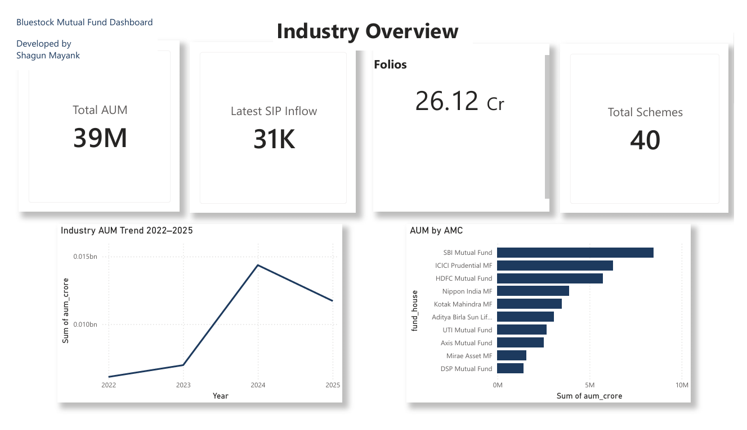
Dashboard — Industry Overview
Total AUM, SIP inflows, folios, and scheme count as KPI cards, with industry AUM trend and AUM by AMC
9

Slide 10
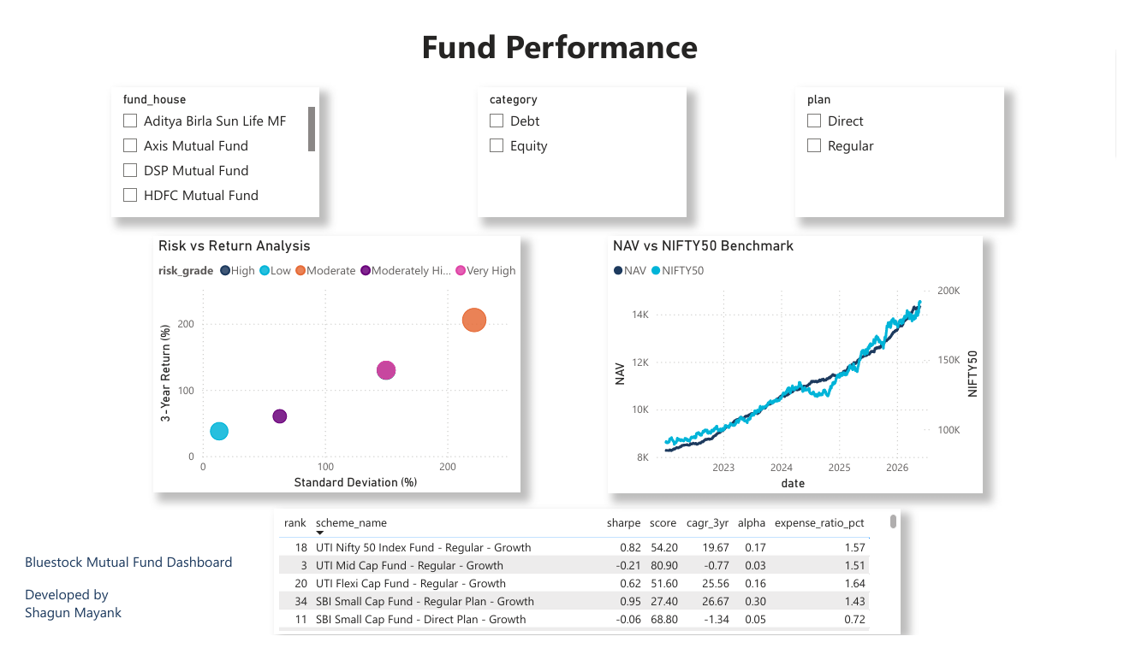
Dashboard — Fund Performance
Risk vs return scatter, NAV vs Nifty 50 benchmark, and a sortable fund scorecard — with fund house, category, and plan slicers
10

Slide 11
Key Findings
1
Tail Risk Concentration — small/mid-cap funds show the highest downside exposure (VaR -2.7%, CVaR -3.2% for weakest performers).
2
SIP Persistency Weakness — ~98% of investors with 6+ SIPs show payment gaps exceeding 35 days, a major retention risk.
3
Diversification Misalignment — several "diversified" equity funds carry HHI > 0.25, indicating hidden sector concentration.
4
Investor cohorts differ — 2024 entrants show 12% higher retention and 18% larger average ticket size than 2025 entrants.
11

Slide 12
Thank You
Bluestock Mutual Fund Analytics Platform — Final Capstone Presentation
Shagun
github.com/Shagun0514/CapStone_Internship_Project

