Slide 1

Network Dead Zone Detector
Mini-project presentation
Computer Networks Laboratory (CSE20110)
Department of Computer Engineering and Technology
Prathamesh Bhadange – 1262243768 Yasir Patel – 1262243772
Shagun Bhati – 1262243778 Sukhmeet Singh – 1262243781
Group [No.] Panel E Batch: E1
Faculty: Dr.Swati
Academic Year: 2026–2027
Presentation date: 21 October 2026
Computer Networks Laboratory CSE20110
15 seconds
Notes:
Suggested time: 15 seconds. Replace all bracketed placeholders and prompts with your own project details. Keep explanations brief. Total time across slides 1–7 is 5 minutes, including the demonstration. Slide 8 is for reference during questions. Logo source: https://mitwpu.edu.in/uploads/images/MIT-WPU-logo-1.webp. Introduce only the title and team; do not read every PRN.

Slide 2
Problem and Objectives
Problem
Problem: Wi-Fi dead zones occur when signal strength becomes weak or connectivity is unreliable due to distance, walls, interference, or poor router placement. Identifying these areas manually makes network troubleshooting difficult.
Target Users & Scope: The project is designed for home users and network technicians to record signal measurements, identify weak-coverage areas, visualize readings on floor plans, and explore possible solutions to improve Wi-Fi coverage.
Objectives
Record network signal-strength observations at different locations.
Classify weak-signal areas using configurable thresholds.
Visualize measurements on a floor plan and help users identify possible network improvements, where supported by the implementation.
.
Computer Networks Laboratory CSE20110
40 seconds
Notes:
Suggested time: 40 seconds. Replace all bracketed placeholders and prompts with your own project details. Keep explanations brief. Total time across slides 1–7 is 5 minutes, including the demonstration. Slide 8 is for reference during questions.

Slide 3
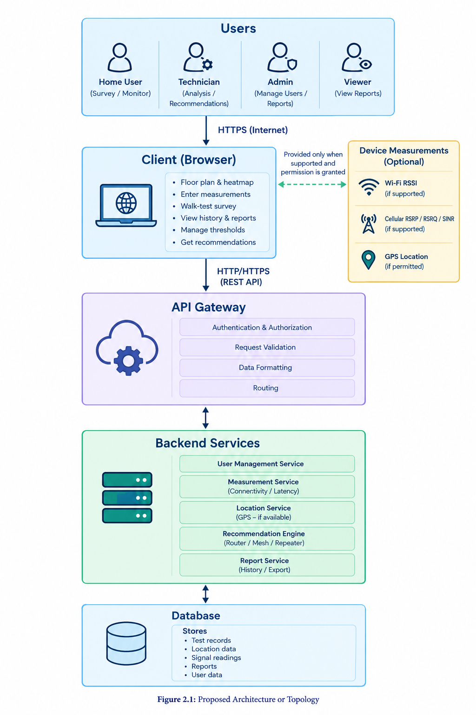
Proposed Design and Tools
1. Proposed Design
User Interface: Web dashboard for entering network measurements and viewing results.
Signal Analysis Module: Analyses RSSI values to identify weak-signal areas.
Visualization Module: Displays signal strength and dead zones on a floor plan, if supported.
Backend and Data Storage: Processes requests and stores survey records, where implemented.
Recommendation Module: Suggests possible ways to improve Wi-Fi coverage.
2. Tools and Technologies
Component | Technology / Tool
Frontend | HTML, CSS, JavaScript or framework used
Backend | Node.js / Express, if used
Data exchange | REST API and JSON, if implemented
Communication protocol | HTTP / HTTPS
Development tools | Visual Studio Code, web browser
Network measurement | RSSI values in dBm
Computer Networks Laboratory CSE20110
45 seconds
Notes:
Suggested time: 45 seconds. Replace all bracketed placeholders and prompts with your own project details. Keep explanations brief. Total time across slides 1–7 is 5 minutes, including the demonstration. Slide 8 is for reference during questions. Explain the diagram and only the most relevant design decisions. Use an actual project diagram with readable labels.

Slide 4
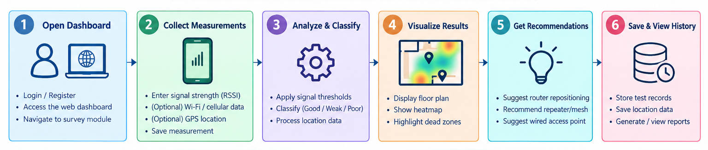
Implementation and Working
Workflow
Implementation
Frontend: Web-based dashboard for entering network measurements and viewing results.
Backend: Processes requests received from the frontend through an API.
Signal Analysis: Classifies signal strength using RSSI values and predefined thresholds.
Visualization: Displays weak-signal locations and a heatmap where supported.
Recommendations: Provides suggestions to improve Wi-Fi coverage based on detected weak areas.
Troubleshooting
Problem | Solution
Frontend unable to connect to backend | Check the backend status, API URL and port configuration.
Incorrect signal classification | Verify the RSSI input and configured signal-strength thresholds.
Heatmap or results not displayed | Check the measurement data, location inputs and browser console for errors
Computer Networks Laboratory CSE20110
55 seconds
Notes:
Suggested time: 55 seconds. Replace all bracketed placeholders and prompts with your own project details. Keep explanations brief. Total time across slides 1–7 is 5 minutes, including the demonstration. Slide 8 is for reference during questions.

Slide 5
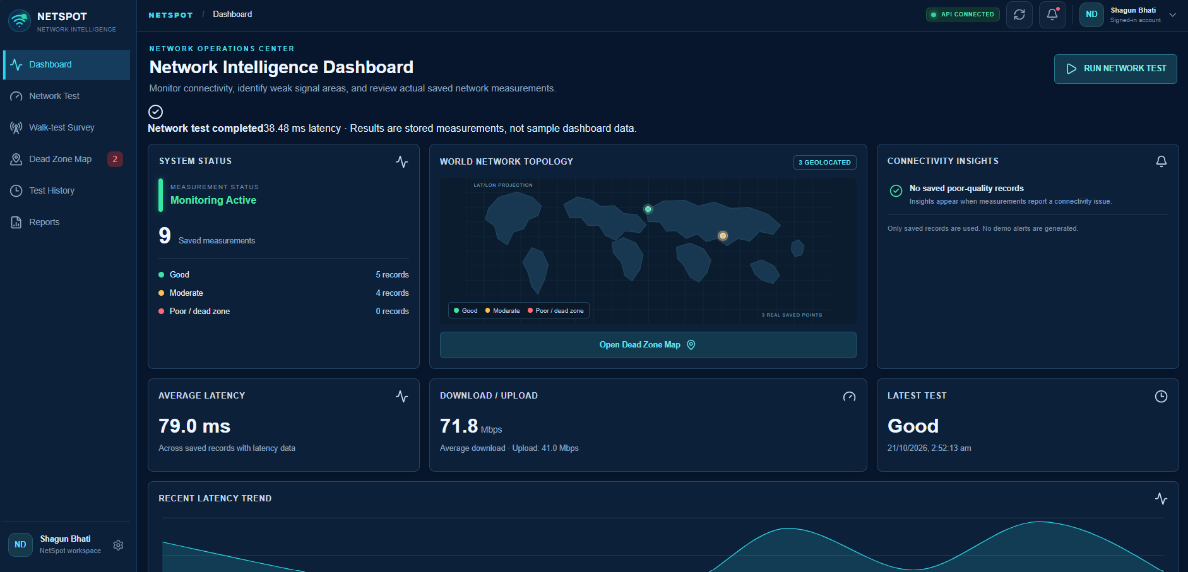
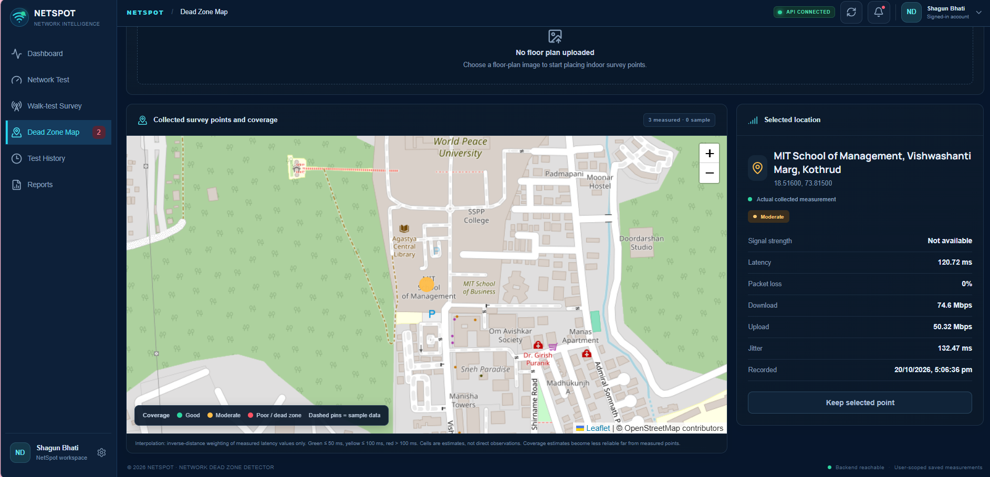
Testing and Results
Test | Expected Result | Observed Result
Valid signal input | Correct signal classification | Passed — signal classified correctly
Invalid or missing input | Validation message or suitable error | Passed — invalid input handled appropriately
Floor-plan visualization | Measurements shown at selected locations | Passed — measurements displayed at the correct locations
Saved test history | Previously saved records retrieved | Passed — saved records retrieved successfully
Recommendation generation | Suggestions based on signal strength | Passed — relevant recommendations generated
Backend API connectivity | Successful communication between frontend and backend | Passed — API requests and responses handled successfully
Test: [Input and test condition]
Expected: [Expected behaviour]
Observed: [Actual result and interpretation]
Objectives achieved: [Evidence linked to objectives]
Computer Networks Laboratory CSE20110
50 seconds
Notes:
Suggested time: 50 seconds. Replace all bracketed placeholders and prompts with your own project details. Keep explanations brief. Total time across slides 1–7 is 5 minutes, including the demonstration. Slide 8 is for reference during questions. Show actual evidence. Explain the output and mention any failed or partial tests. Do not invent performance figures.

Slide 6
Working Demonstration
Function to demonstrate
Core Feature: Detect and visualize weak Wi-Fi signal areas using signal measurements and floor-plan mapping.
1. Launch the Application
Start the frontend and backend services.
Open the Network Dead Zone Detector dashboard in the browser.
2. Run the Survey
Open the floor-plan or survey interface.
Enter a Wi-Fi signal-strength value (RSSI) for a selected location.
3. Display and Explain the Output
Show the signal classification based on configured thresholds.
Display the measurement on the floor-plan heatmap, if supported.
Explain the recommendation provided for improving weak coverage, if available.
Computer Networks Laboratory CSE20110
65 seconds
Notes:
Suggested time: 65 seconds. Replace all bracketed placeholders and prompts with your own project details. Keep explanations brief. Total time across slides 1–7 is 5 minutes, including the demonstration. Slide 8 is for reference during questions. Prepare the project before the timer starts. Keep the demo to about one minute. Keep a screenshot or short recording ready as a backup, and identify it as recorded evidence if used.

Slide 7
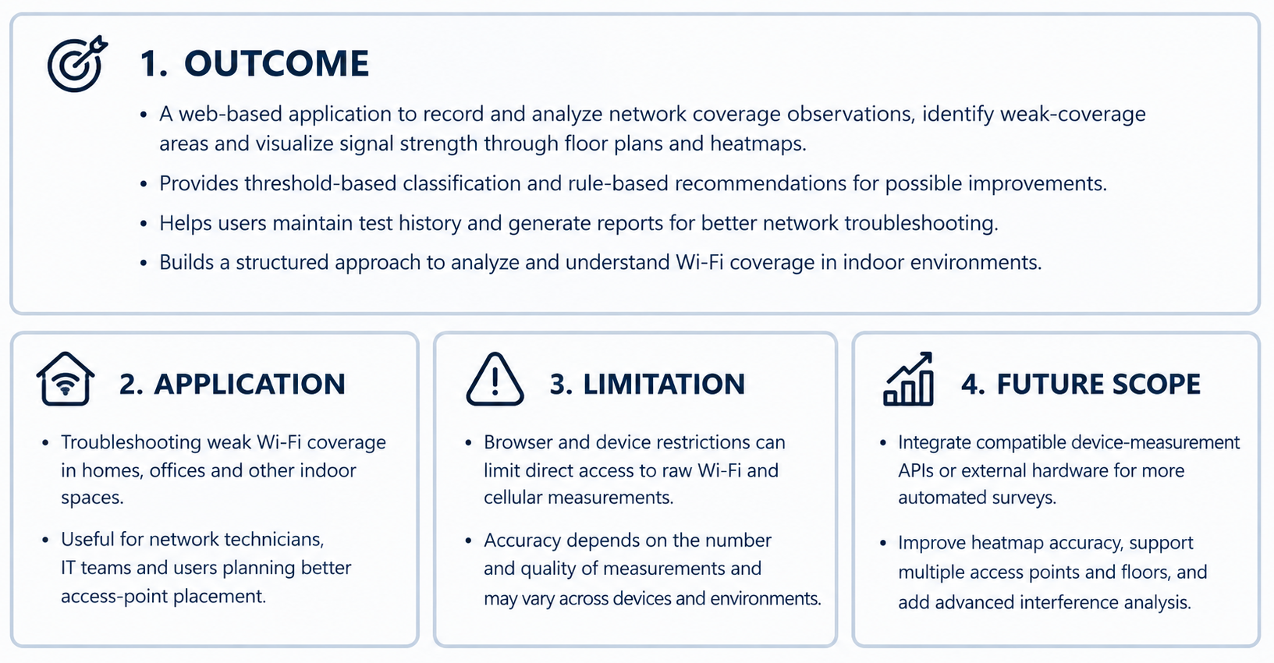
Conclusion and Contributions
MEMBER NAME | CONTRIBUTION
Shagun Bhati-1262243778 | Designed the system architecture.
Sukhmeet Singh-1262243781 | Implemented the detection logic.
Prathamesh Bhadange-1262243768 | Handled network configuration and testing
Yasir Patel-1262243772 | Prepared documentation and results.
Notes:
Suggested time: 30 seconds. Replace all bracketed placeholders and prompts with your own project details. Keep explanations brief. Total time across slides 1–7 is 5 minutes, including the demonstration. Slide 8 is for reference during questions.

Slide 8
References
[1] R. Fielding, M. Nottingham, and J. Reschke, “HTTP Semantics,” RFC 9110, Internet Engineering Task Force (IETF), June 2022. Available: https://www.rfc-editor.org/rfc/rfc9110.html
[2] Mozilla Developer Network (MDN), “Geolocation API.” Available: https://developer.mozilla.org/en-US/docs/Web/API/Geolocation_API
[3] Mozilla Developer Network (MDN), “Fetch API.” Available: https://developer.mozilla.org/en-US/docs/Web/API/Fetch_API
[4] IEEE, “IEEE 802.11 Wireless LAN Standards.” Refer to the official IEEE 802.11 Working Group resources: https://www.ieee802.org/11/
.
Computer Networks Laboratory CSE20110
Backup slide
Notes:
Suggested time: Backup slide. Replace all bracketed placeholders and prompts with your own project details. Keep explanations brief. Total time across slides 1–7 is 5 minutes, including the demonstration. Slide 8 is for reference during questions.

