Slide 1

Predicting Coronary Heart Disease Risk Using Machine Learning
A Logistic Regression Approach Using the Framingham Heart Study Dataset
Presented by: Shagun Shaw

Slide 2


Introduction & Motivation: The Global Challenge of CVD
Cardiovascular Disease Burden
Importance of Early Prediction
Cardiovascular disease (CVD) remains a leading cause of death worldwide, impacting millions of lives and placing significant strain on healthcare systems.
Early and accurate risk prediction is crucial for timely interventions, enabling preventative measures and improved patient outcomes.
Project Objective
Our aim is to develop a robust model that can predict 10-year Coronary Heart Disease (CHD) risk using readily available clinical and demographic data.

Slide 3

Dataset Overview: The Framingham Heart Study
Source & Size
1
The Framingham Heart Study: A renowned longitudinal cohort study. Initial sample size: 4,240 patients.
Key Features
2
15 variables, including age, sex, smoking status, blood pressure, cholesterol, BMI, and glucose levels.
Target Variable
3
TenYearCHD (binary: 0 = No risk, 1 = At risk), representing the presence or absence of CHD within 10 years.

Slide 4

Data Preprocessing - Part 1: Handling Missing Values
Impact on Dataset Size
Education Column Dropped
The 'education' column was removed due to 105 missing values, deemed non-critical for this prediction model.
Original Samples: 4,240
Final Dataset: 3,809
CigsPerDay & BPMeds Imputation
Missing values in 'cigsPerDay' and 'BPMeds' were filled with 0, a logical imputation assuming no smoking or blood pressure medication use.
Glucose & TotChol Imputation
'Glucose' and 'totChol' missing values were imputed using their respective median values to preserve data distribution.
Remaining Missing Data
Any remaining rows with missing data after the above steps were subsequently dropped to ensure data integrity.

Slide 5

Data Preprocessing - Part 2: Outlier Detection
Distribution Analysis
Quantile-Based Filtering
Histograms were utilised to visually inspect the distribution of key numerical features, aiding in the identification of extreme outliers.
A quantile-based filtering approach (5th-95th percentile) was applied to 'glucose' levels and 'total cholesterol'.
Rationale for Removal
This process removed extreme values that could potentially skew the logistic regression model, ensuring a more robust and accurate prediction.

Slide 6

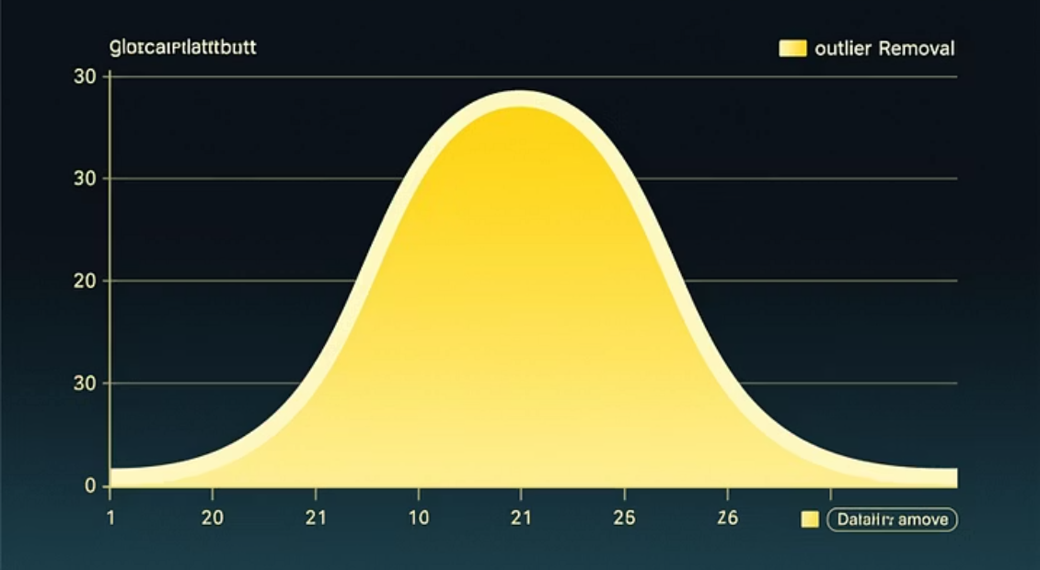
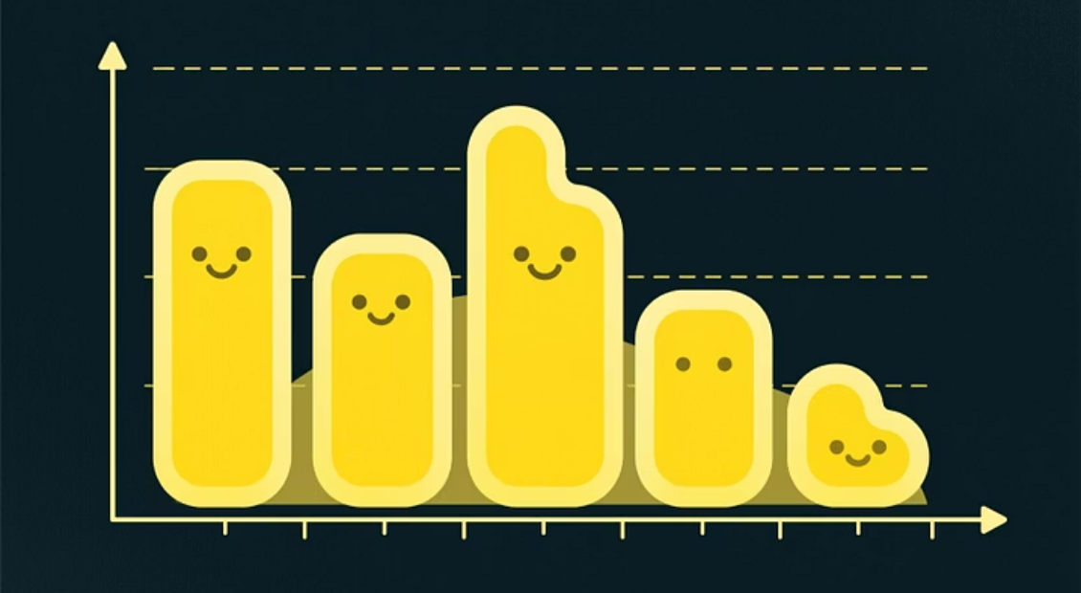

Exploratory Data Analysis: Data Quality Improvement
Visualisations highlight the significant improvement in data quality for critical features after outlier removal.
These visual insights confirm the effectiveness of our outlier detection strategy.

Slide 7
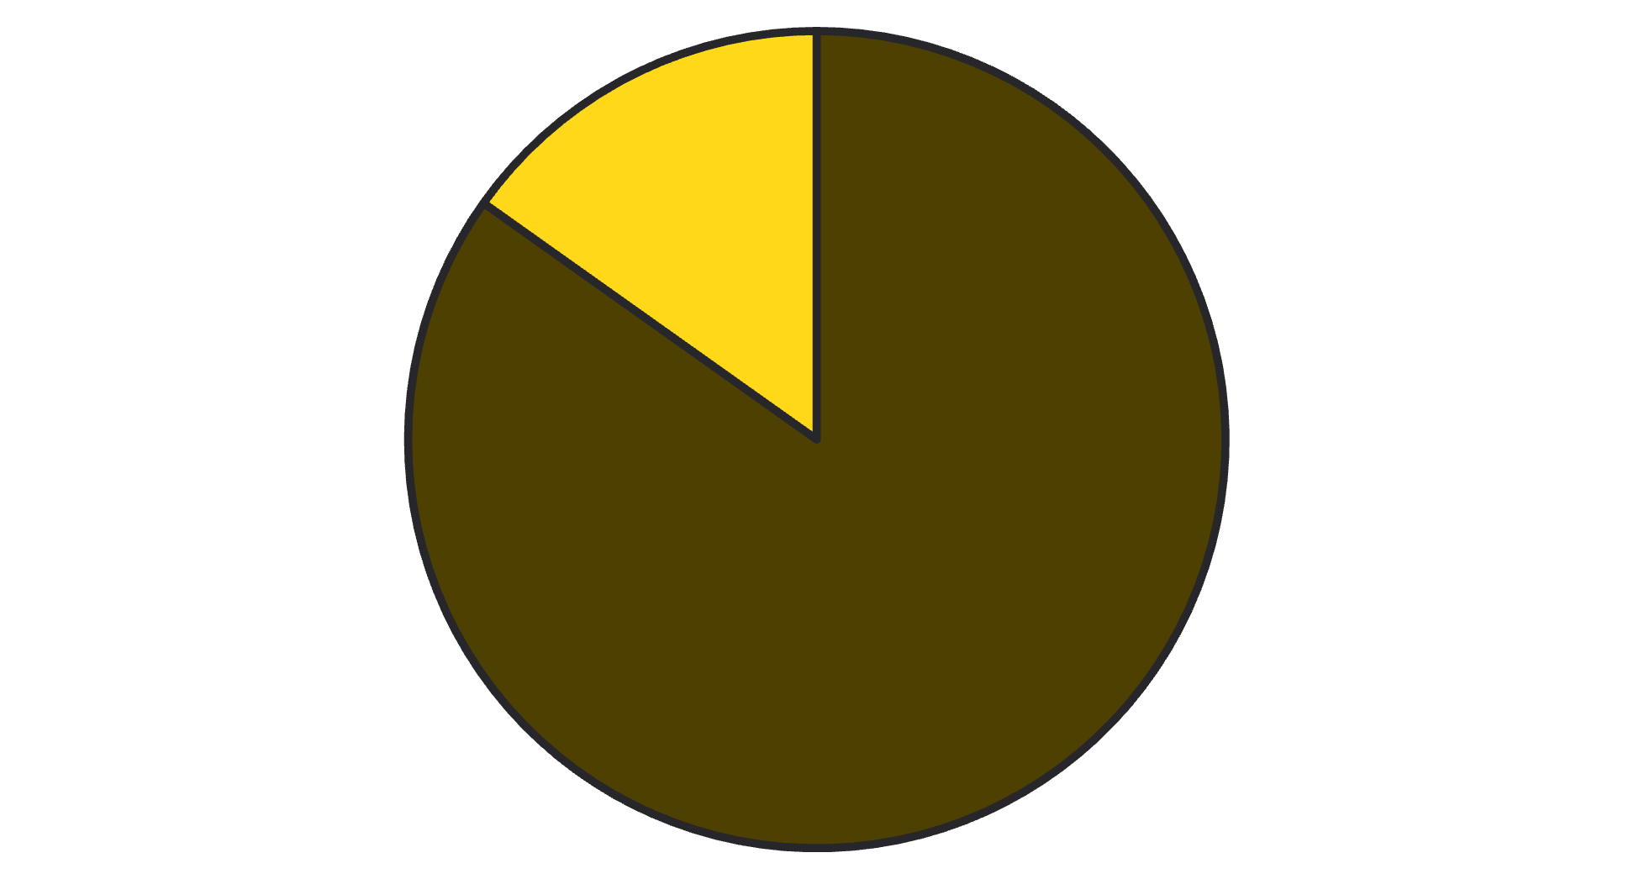

Class Distribution: Understanding Imbalance
Observations
The target variable, TenYearCHD, shows a significant class imbalance.
The 'No Risk' class (0) is considerably larger than the 'At Risk' class (1).
Potential Impact
This imbalance can lead to models that perform well on the majority class but poorly on the minority class, potentially missing crucial positive predictions.
No Risk (0)
At Risk (1)

Slide 8

Model Development: Logistic Regression Approach
Algorithm Choice
1
We selected Logistic Regression for its interpretability and suitability for binary classification tasks common in medical contexts.
Train-Test Split
2
The dataset was split 70-30, with stratification to maintain the original class distribution in both training and testing sets.
Sample Distribution
3
Training Samples: 2,666
Testing Samples: 1,143

Slide 9


Model Performance: Initial Accuracy Assessment
85.39%
The model achieved an overall accuracy of 85.39% on the test set.
This suggests the model correctly predicts CHD risk in approximately 85% of cases.
While this accuracy appears promising, it's crucial to examine detailed metrics to understand performance across both classes, especially given the class imbalance.

Slide 10
Model Performance: Detailed Metrics & Key Observation
Class
Precision
Recall
F1-score
0 (No Risk)
85%
100%
92%
1 (At Risk)
75%
4%
7%
Key Observation:
The model demonstrates excellent performance in identifying the 'No Risk' class (Class 0), achieving 100% recall. However, it struggles significantly with the 'At Risk' class (Class 1), showing a very low recall of only 4%. This indicates a major challenge in detecting patients who are genuinely at risk of CHD.

