Slide 1


SMART PILL DISPENSER
Presented by: Shagun Yadav
B.Tech. (IT)-1
A2305322007

Slide 2
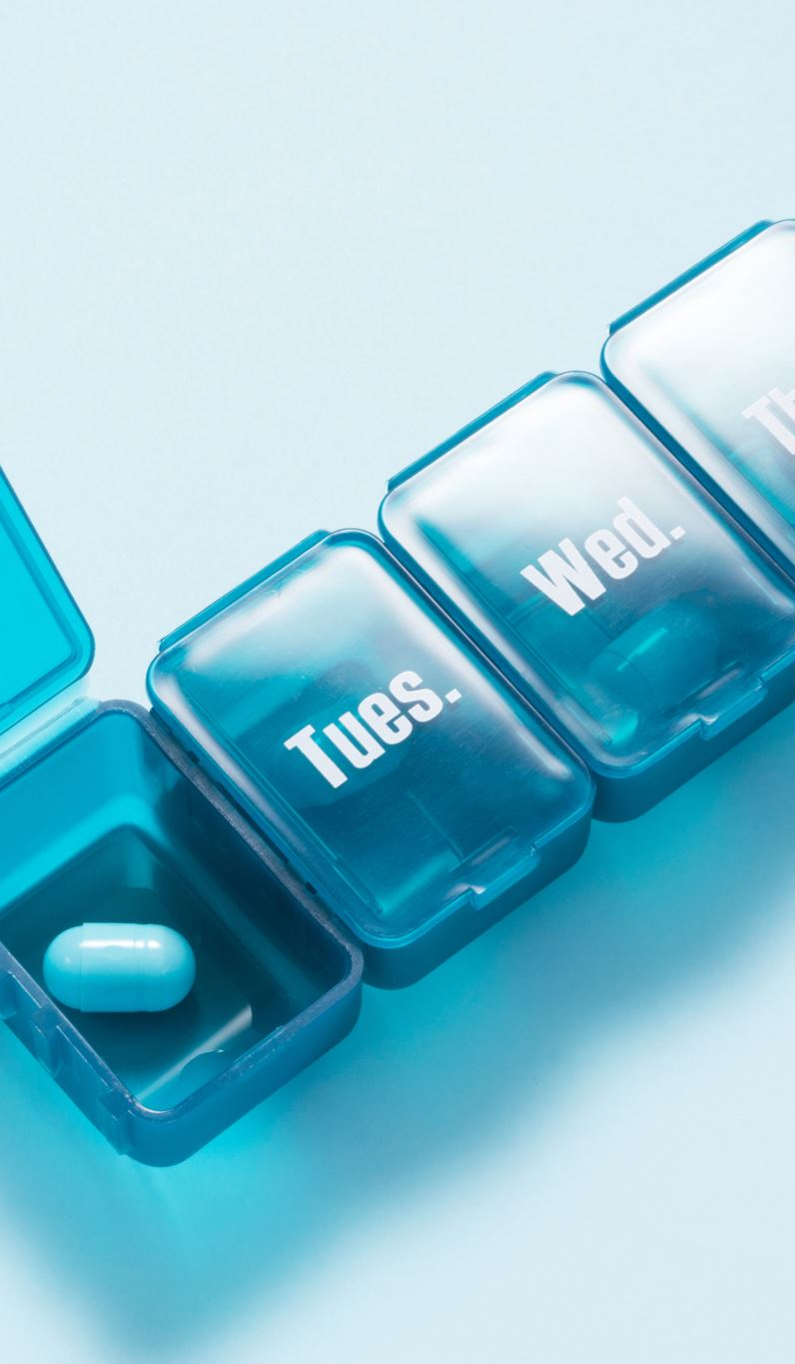
Problem Statement
The Smart Pill Dispenser addresses the problem of medication non-adherence among patients, especially the elderly. Manual tracking often results in missed or incorrect dosages. Our goal is to automate pill dispensing with alerts and tracking.

Slide 3

Data Flow
User sets schedule via web interface (HTML hosted on ESP8266).
Schedule stored in ESP8266 memory or Firebase.
At the scheduled time, servo motor (MG995) activates to dispense pill.
User can view logs and manage schedule online.

Slide 4
Hardware Devices Used
• ESP8266 NodeMCU
• MG995 Servo Motor
• Power Supply (5V)
• Pill Container Mechanism

Slide 5
Working and Features
• Web interface to set pill schedule and days.
• ESP8266 serves HTML + stores time schedule.
• Servo activates on schedule to dispense pills.
• Logs can be viewed on the interface.

Slide 6
Conclusion and Scope
• Conclusion:
The Smart Pill Dispenser reduces human error in medication routines, enabling better adherence.
• Scope:
- Integration with mobile app
- Refill alert system
- AI-based health monitoring & recommendation

Slide 7
Thank You

