Slide 1



CE 5316 – Machine Learning for CE
Key-Phrase Extraction for Identifying Stakeholder Values in Transportation Resilience Literature
Final Project
Spring 2026
For: Jinzhu Yu, Ph.D.
By: Shah Salah Uddin Chowdhury

Slide 2
CONTENTS
Project Backgrounds
Objectives & Methods
Data Collection
ML Model Development
Model Validation & Robustness Check
Results & Discussions
Key Takeaways & Future Research

Slide 3


Backgrounds
Increasing disasters are causing widespread disruptions and damage to transportation infrastructure
Infrastructure Recovery requires understanding stakeholder priorities
Identifying stakeholder concerns manually is time-consuming and biased
Profitability
Mobility
Equity
Backgrounds
Application of text analytics and machine learning approaches
3

Slide 4
Backgrounds
Methods for Stakeholder Concern Identification
Approach
Example
Limitations
Manual Review
Expert Reading
Slow, Subjective
Topic Modeling
LDA/NMF
Broad Topics
Supervised ML
Labeled Data
Backgrounds
RF/RNN
Key-Phrase Extraction
KeyBERT
Interpretable Phrases
Adopts an unsupervised key-phrase extraction approach
for clearer concept identification
4

Slide 5

Objectives & Methods
1
Develop a KeyBERT-based
unsupervised ML framework
2
Evaluate extraction relevance,
consistency, and robustness
Preprocessing text corpus
KeyBERT phrase extraction
Stakeholder-value mapping
Precision@10 review
Support ranking
Robustness checks
Objectives & Methods
5

Slide 6






Dataset Collection
Topic Definition
Literature Search
Paper Screening
Full Text Collection
Dataset Creation
Final
Corpus
Research
Topic
Trans. Recovery
Disaster
Stakeholder Concern
.
.
.
Keyword Combination
Trans. Recovery AND Disaster
Stakeholder Concern AND Transportation
Inclusion Criteria
Peer Reviewed Journals
Conference Papers
Public Documents
Manual Review
Review to Ensure Relevance & Quality
Extracted Fields
Title
Keywords
Full Text
Summary
20⁺ Papers
3 Text Fields
Completed CSV file for NLP
Data Collection
6

Slide 7






Methodology
Data Collection
Literature Corpus Created from Academic Sources
Pre-Processing
Cleaning
Normalization
Tokenization
Stopword Removal
Modeling
KeyBERT-based KeyPhrase Extraction & Stakeholder Value Mapping
Evaluation
Precision @10
Support Ranking
Relevance Assessment
Visualization
Bar Charts
Category Rankings
Key Insights
Robustness Check
Sensibility Analysis
Parameter Variation
Stability of Results
Methodology
7

Slide 8
KeyBERT Framework Development
1. Text Corpus Input
Merged title + keywords + full text
2. Candidate Phrase Generation
Create 1-3 gram phrase candidates
3. Embedding Processing
Generate semantic vectors using sentence transformer (miniLM)
4. Similarity Ranking
Use cosine similarity between document and phrase embeddings
5. Output Derivation
Return top ranked phrases and map to stakeholder value categories
Transportation Text
Candidate Phrases (resilience, recovery…)
Transformer Encoder (all- MiniLM-L6–v2)
Similarity Ranking (cosine similarity)
KeyBERT Framework
Top Key-Phrases (ranked outputs)
Value Categories (equity, safety…)
Parameter | Value
Top_n | 20
ngram | 1-3
Diversity | 0.7
8

Slide 9

Model Validation & Robustness Check
Manual Precision @10 Review
Parameter Stability Checks
Category | Precision @10
Sustainability | 1.00
Adaptability | 1.00
Responsiveness | 1.00
Recoverability | 0.90
Safety | 0.83
Equity | 0.80
Accessibility | 0.70
Alternative extraction settings were tested (e.g. top_n, diversity)
Core category rankings remained consistent
Sustainability and Adaptability remained dominant themes
Validation & Robustness Check
Indicates stable and reliable unsupervised framework behavior
Overall Validation Result:
KeyBERT produced relevant, interpretable, and stable stakeholder-value outputs
9

Slide 10
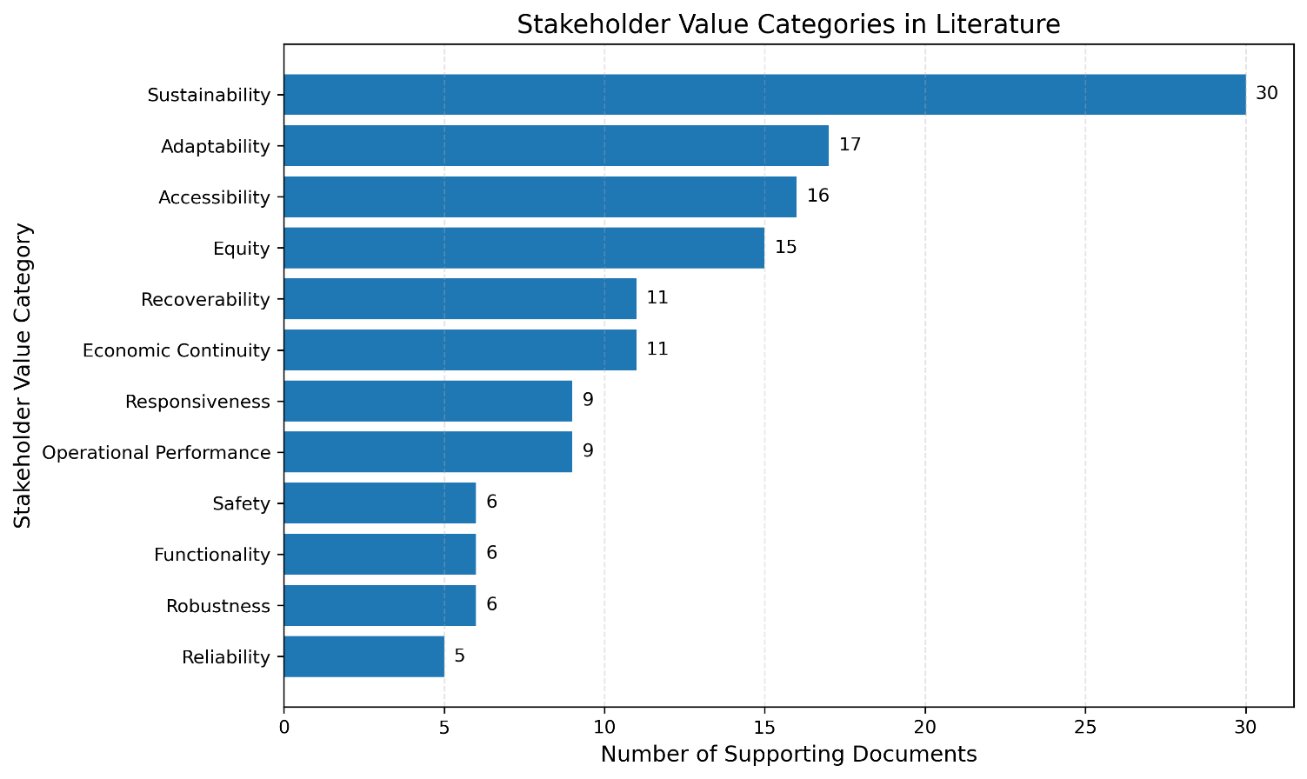
Results & Discussion
Discovered Stakeholder Value Categories
Key Insights
Major Themes (High Support)
Sustainability is the most frequently emphasized value in the literature
Adaptability, Accessibility, and Equity are also strongly represented
Results & Discussion
Moderate Themes
Recoverability, Economic Continuity, and Responsiveness appear in a moderate number of documents
Lower Support Themes
Surprisingly, traditional engineering dimensions receive comparatively lower emphasis in the current literature
10

Slide 11


Key Takeaways & Future Research
Key Takeaways
Developed a KeyBERT-based unsupervised NLP framework
Extracted stakeholder-value themes from transportation resilience literature
Sustainability, Adaptability, Accessibility, and Equity were dominant values
Key Takeaways & Future Research
Results were validated through Precision@10 and robustness checks
Future Research
Expand corpus with agency reports and project documents
Compare with BERTopic / supervised transformer models
11

Slide 12

QUESTIONS
or
SUGGESTIONS?

