Slide 1
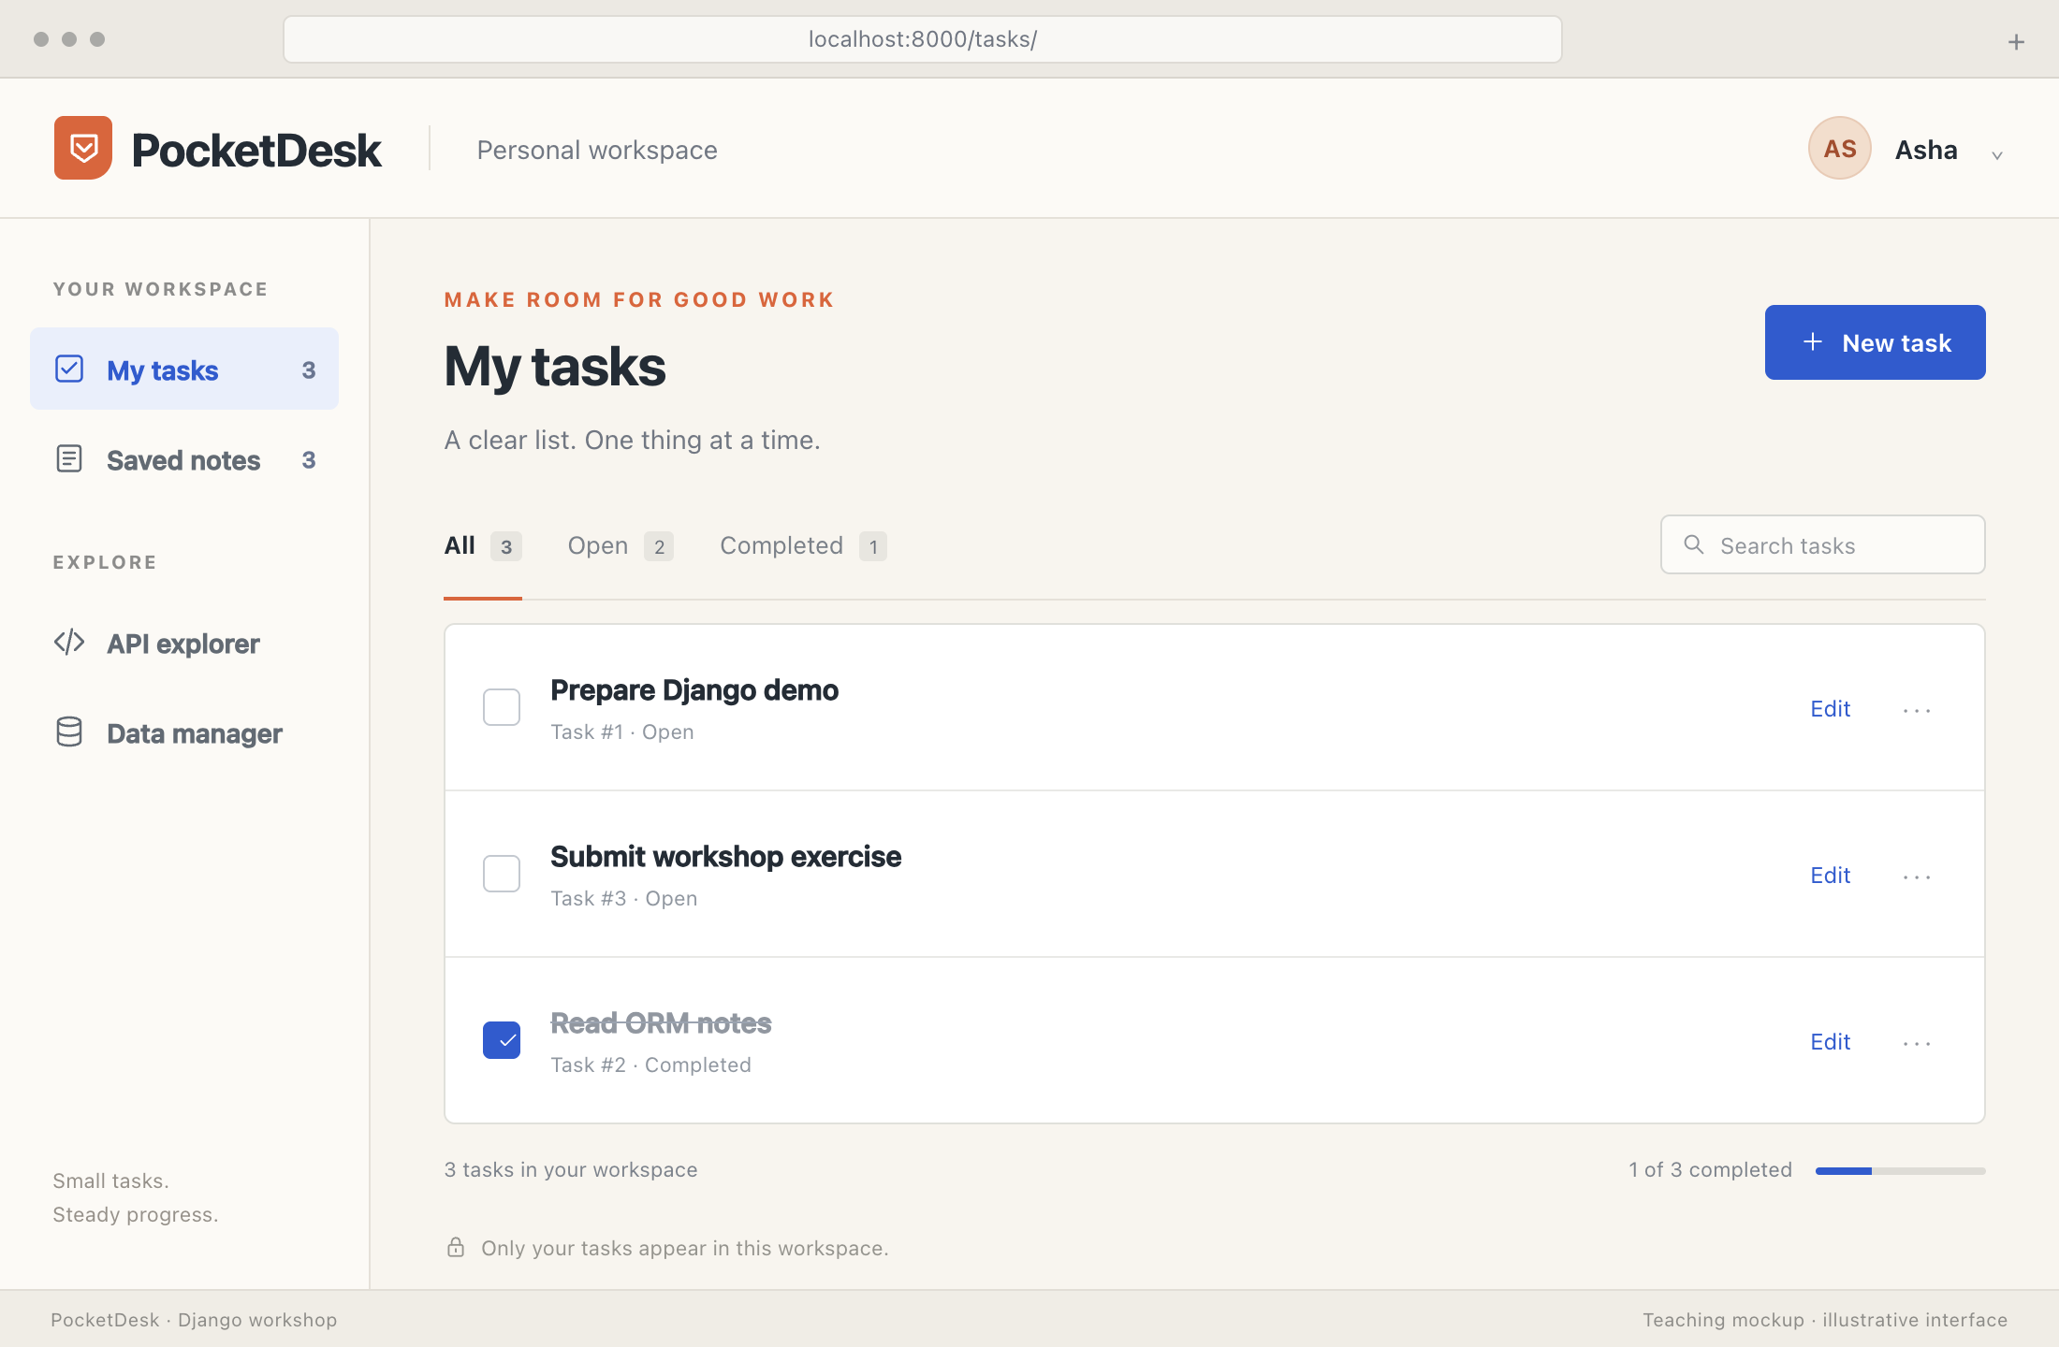
A HANDS-ON DJANGO WORKSHOP
Beyond
Web Page
Build Modern Web
Application with Django
A personal TODO list. Saved notes. One REST API.
Bhavya Shah
Notes:
Beyond Web Page
Welcome the audience. Follow the supplied topic flow and practical teaching approach, using the revised PocketDesk project requested for this presentation. PocketDesk combines a personal TODO list with useful key/value notes exposed through a REST API. Audience: diploma-level learners with basic Python and HTML familiarity. Teaching baseline: Python 3.13 and Django 5.2 LTS. The application examples use fictional accounts and notes. Useful notes can include a library location, a project URL or an assignment reference. PocketDesk is not a password manager and this workshop does not implement encryption for note values.
Revision mapping: original slide 1.
TEACHING: Ask learners to predict the result before revealing the next explanation. Use the click sequence where available.
SCREENSHOTS: PocketDesk screens are purpose-built teaching mockups using fictional Asha records; illustrative expected results, not captured live execution.
Sources
User-provided presenter profile
Topic Flow.jpg
Session Content Document.docx

Slide 2
Your presenter
Bhavya Shah
7+
Python, Django & secure REST APIs
years building enterprise
applications
MCA · Government MCA College, Ahmedabad
Master’s score: 9.5
NAMO e-TAB / Mobile Attendance System
COGENT Fees Collection under KCG
Experience with SQL optimization, cloud, ERP delivery and full-stack integration.
BHAVYA SHAH / DJANGO WORKSHOP
02
Notes:
Bhavya Shah

Slide 3
Learning path
Topics we’ll cover
01
How web applications work
02
Django and data
Browser, Python and the backend
Setup, MTV, models and ORM
03
A personal TODO application
04
Identity and security
Forms, validation and CRUD
Login, ownership and protected requests
05
Tasks and notes through REST
06
Deployment
DRF, JSON and Postman
GitHub, configuration and persistent data
BHAVYA SHAH / DJANGO WORKSHOP
03
Notes:
Topics we’ll cover
Follow the ordering in Topic Flow.jpg. The session document provides the detailed practical approach. This is a modular teaching deck, not a claim that the full sequence fits in a single hour. Before starting, ask who has used Python functions, HTML forms and a terminal. Official GTU claims are not independently verified because the original syllabus is not attached. GitHub, Vercel and production practices are recommended industry extensions in the supplied teaching plan.
Revision mapping: original slide 4.
TEACHING: Ask learners to predict the result before revealing the next explanation. Use the click sequence where available.
SCREENSHOTS: PocketDesk screens are purpose-built teaching mockups using fictional Asha records; illustrative expected results, not captured live execution.
Sources
Topic Flow.jpg
Session Content Document.docx

Slide 4
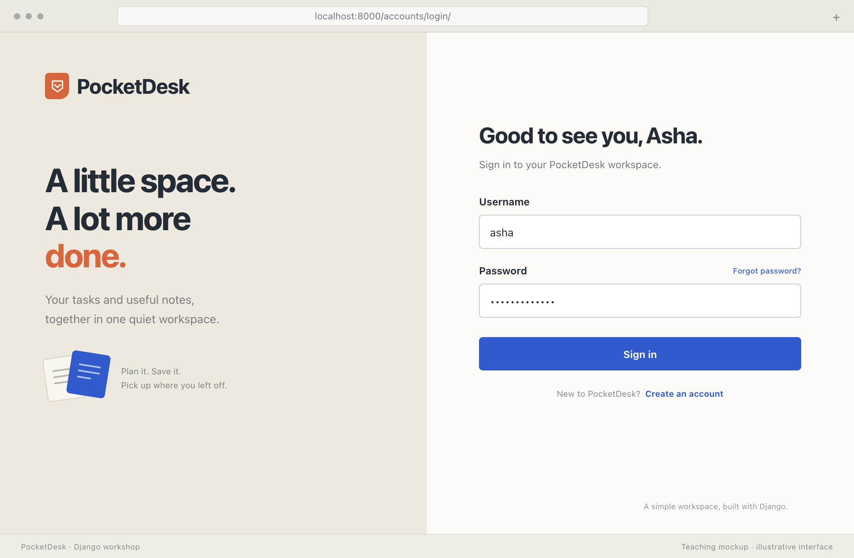
01 / Web foundations
What happens after Login?
Pause before clicking.
Browser
Sends the login form over HTTPS.
Django
Checks the credentials and establishes a
session.
Your workspace
Queries records owned by your account.
BHAVYA SHAH / DJANGO WORKSHOP
04
Notes:
What happens after Login?
Ask learners to predict the work behind the Login button. The login screen is an illustrative PocketDesk interface. The browser displays HTML and submits form data. Django checks credentials using the authentication system and establishes a session. An authenticated task view then filters records with owner=request.user. Successful authentication and permission to read a particular record are separate checks. Only fictional credentials should appear in the demo.
Revision mapping: original slide 5.
TEACHING: Ask learners to predict the result before revealing the next explanation. Use the click sequence where available.
SCREENSHOTS: PocketDesk screens are purpose-built teaching mockups using fictional Asha records; illustrative expected results, not captured live execution.
Sources
https://docs.djangoproject.com/en/5.2/topics/auth/default/
https://docs.djangoproject.com/en/5.2/topics/security/

Slide 5
01 / Web foundations
A login page becomes an application
The screen is only the beginning.
A page
Displays a form.
An application
Checks identity, remembers a session and
retrieves your data.
BHAVYA SHAH / DJANGO WORKSHOP
05
Notes:
A login page becomes an application
Compare a styled login form with the complete working login flow. HTML, CSS and JavaScript provide the interface. They do not independently validate a user against the application database. A static prototype may look the same as the real app. Sessions, persistence and access checks supply the application behavior. Websites can mix static pages and application features.
Revision mapping: original slide 6.
TEACHING: Ask learners to predict the result before revealing the next explanation. Use the click sequence where available.
SCREENSHOTS: PocketDesk screens are purpose-built teaching mockups using fictional Asha records; illustrative expected results, not captured live execution.
Sources
https://docs.djangoproject.com/en/5.2/topics/auth/default/
https://docs.djangoproject.com/en/5.2/intro/tutorial01/

Slide 6
01 / Web foundations
A web request and its response
Browser
→
URL route
→
View + model
→
Response
GET /tasks/
Find the matching view.
Load Asha’s tasks.
Return HTML + 200 OK.
Every interaction is a conversation: request in, response out.
BHAVYA SHAH / DJANGO WORKSHOP
06
Notes:
A web request and its response
Trace a request from left to right, then trace the response back. An HTTP request contains a method, path, headers and sometimes a body. A response includes a status, headers and a body. Database access is common but not required for every request. Generated conceptual illustration. Sources: Django request/response tutorial.
Revision mapping: original slide 7.
TEACHING: Ask learners to predict the result before revealing the next explanation. Use the click sequence where available.
SCREENSHOTS: PocketDesk screens are purpose-built teaching mockups using fictional Asha records; illustrative expected results, not captured live execution.
Sources
https://docs.djangoproject.com/en/5.2/intro/tutorial01/

Slide 7
01 / Web foundations
A little Python behind My Tasks
Python function
Printed result
def progress(tasks):
total = len(tasks)
{'done': 1, 'total': 2}
done = sum(task["completed"] for task in tasks)
return {"done": done, "total": total}
tasks = [
{"title": "Prepare Django demo", "completed": False},
{"title": "Read ORM notes", "completed": True},
]
print(progress(tasks))
Calculate a result before adding HTTP.
BHAVYA SHAH / DJANGO WORKSHOP
07
Notes:
A little Python behind My Tasks
The output is the exact Python dictionary representation for the shown two-item list. Boolean True counts as 1 and False as 0 in this small example. Change completed and predict the total. The function does not depend on Django. Later a view can compute equivalent counts from an owner-filtered QuerySet.
Complete code excerpt:
def progress(tasks):
total = len(tasks)
done = sum(task["completed"] for task in tasks)
return {"done": done, "total": total}
tasks = [
{"title": "Prepare Django demo", "completed": False},
{"title": "Read ORM notes", "completed": True},
]
print(progress(tasks))
Revision mapping: original slide 8.
TEACHING: Ask learners to predict the result before revealing the next explanation. Use the click sequence where available.
SCREENSHOTS: PocketDesk screens are purpose-built teaching mockups using fictional Asha records; illustrative expected results, not captured live execution.
Sources
https://docs.python.org/3/tutorial/controlflow.html#defining-functions

Slide 8
01 / Web foundations
A framework supplies the common parts
A framework connects the pieces.
Component | Flask | Django
HTTP routing | Core framework | Core framework
Data and forms | Choose integrations | ORM and forms included
Accounts and admin | Choose integrations | Auth and admin included
Django gives this workshop a consistent starting structure.
BHAVYA SHAH / DJANGO WORKSHOP
08
Notes:
A framework supplies the common parts
A framework handles recurring web-development tasks while developers implement product rules. Django supplies an ORM, forms, authentication and admin. Flask has a smaller core and composes additional capabilities through integrations and extensions. Neither is universally better. Both support applications of different sizes. Explain the tradeoff through PocketDesk requirements rather than an abstract feature competition.
Revision mapping: original slide 9.
TEACHING: Ask learners to predict the result before revealing the next explanation. Use the click sequence where available.
SCREENSHOTS: PocketDesk screens are purpose-built teaching mockups using fictional Asha records; illustrative expected results, not captured live execution.
Sources
https://docs.djangoproject.com/en/5.2/intro/tutorial01/
https://docs.djangoproject.com/en/5.2/topics/forms/modelforms/
https://flask.palletsprojects.com/en/stable/

Slide 9
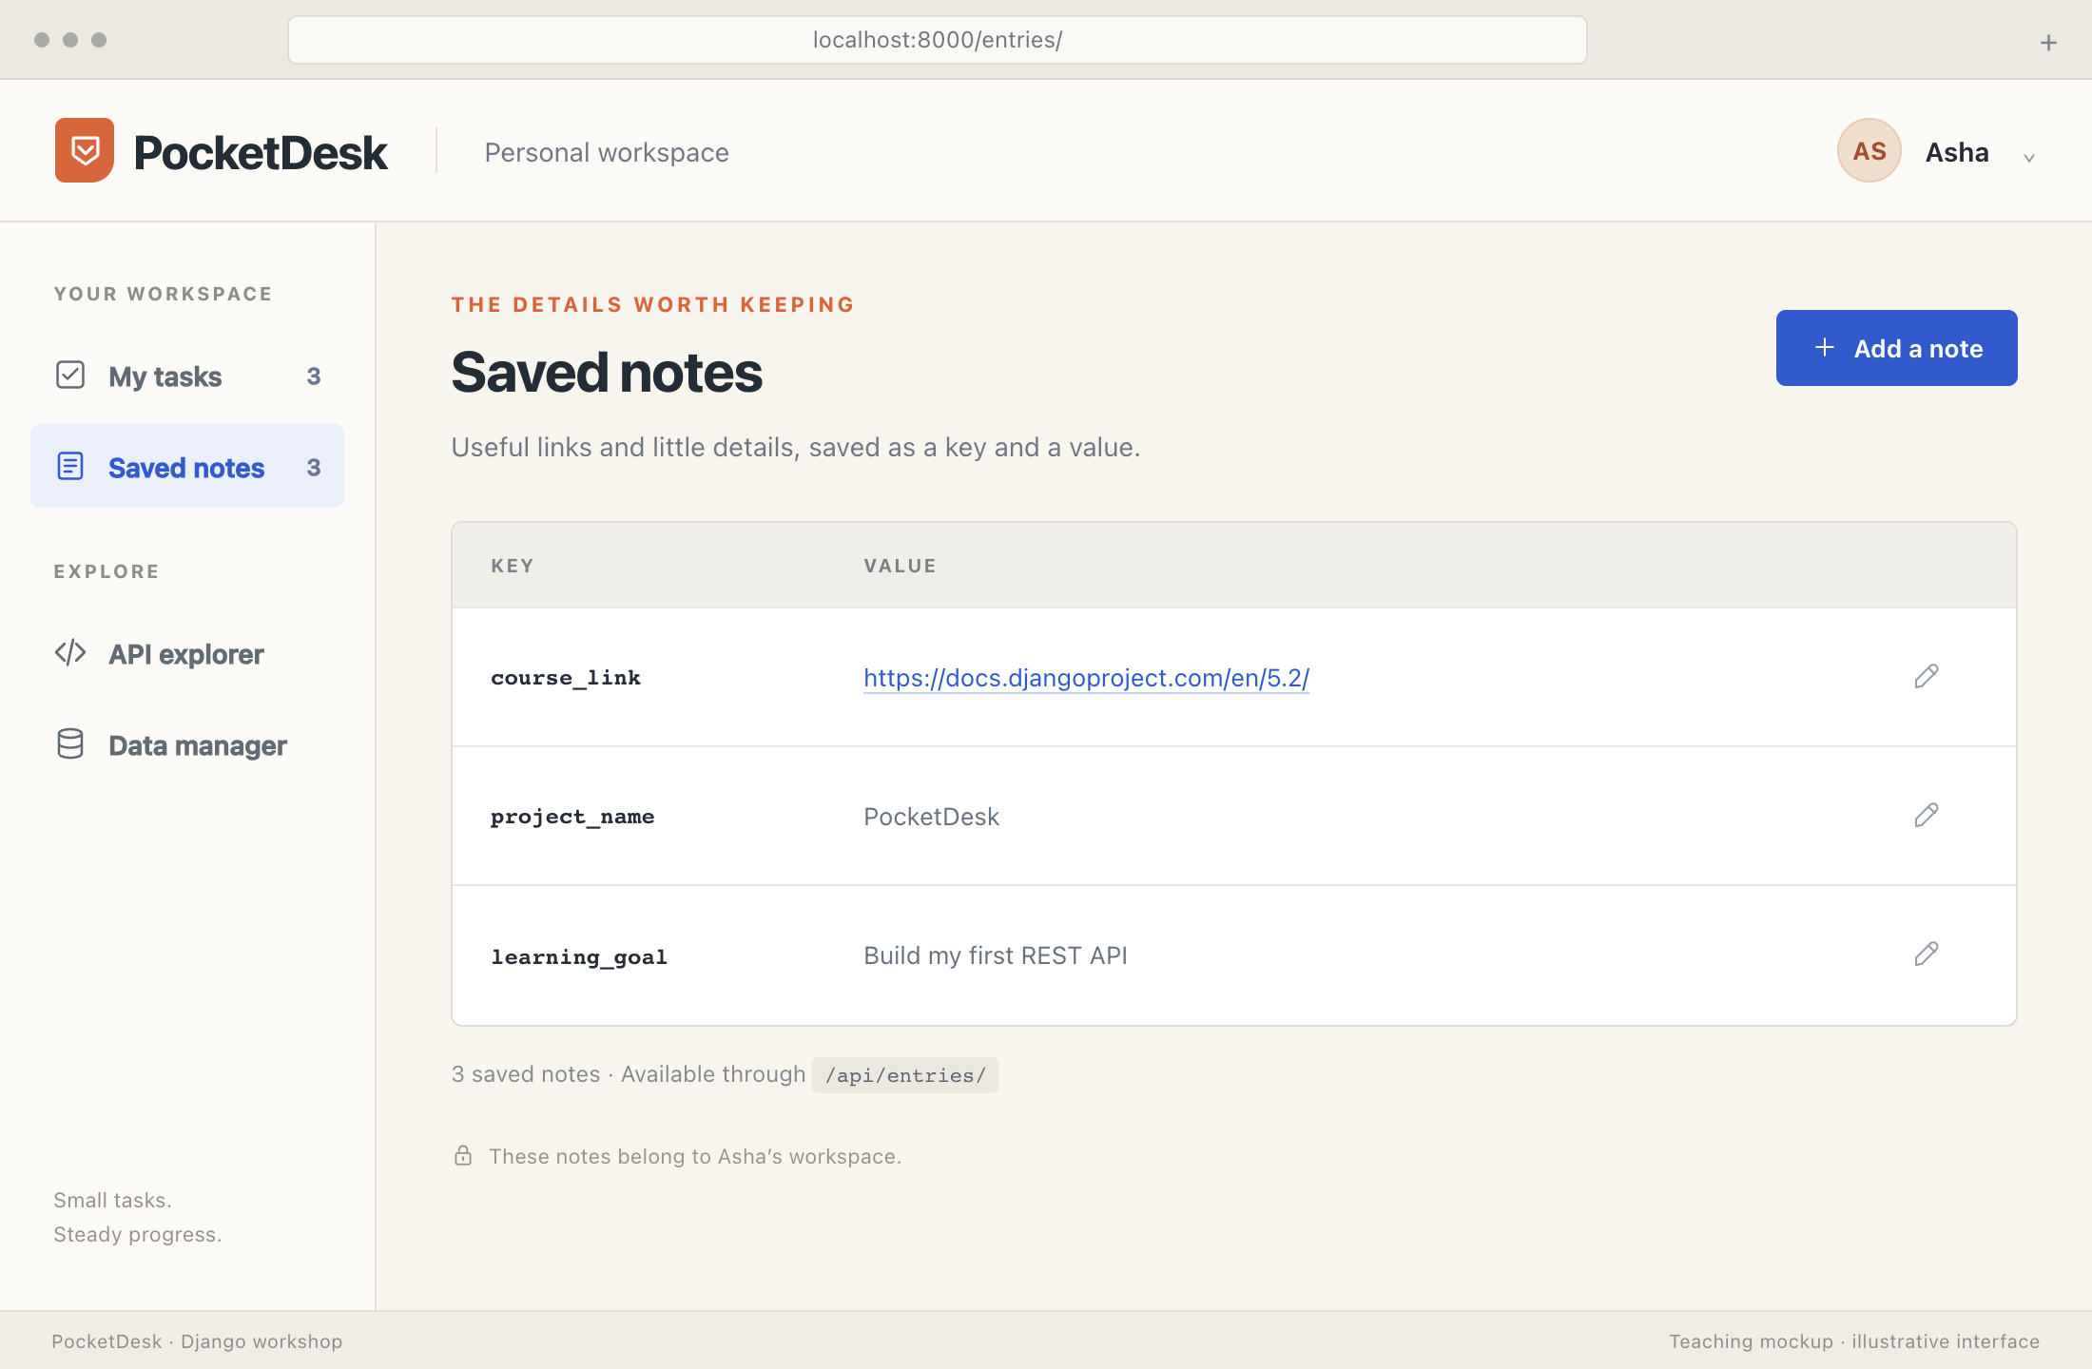
01 / Web foundations
PocketDesk: tasks and useful notes
Do the work
Keep the details
Personal TODOs, private saved data — available in HTML and JSON.
BHAVYA SHAH / DJANGO WORKSHOP
09
Notes:
PocketDesk: tasks and useful notes
PocketDesk is a small personal productivity application. Task has title, completed and owner. Entry stores key, value and owner, with one key per owner. Asha and Bob can each have an entry called course_link without seeing one another’s data. The browser TODO workflow is the first complete feature. The REST section adds API access to tasks and useful notes. The illustrated entry screen communicates the product idea; the supplied Entry implementation focuses on the API. Use fictional notes, not passwords, API secrets or sensitive records. This workshop does not provide a password manager or encryption for values.
Revision mapping: original slide 11.
TEACHING: Ask learners to predict the result before revealing the next explanation. Use the click sequence where available.
SCREENSHOTS: PocketDesk screens are purpose-built teaching mockups using fictional Asha records; illustrative expected results, not captured live execution.
Sources
User-requested revised PocketDesk example
https://docs.djangoproject.com/en/5.2/topics/db/models/
https://www.django-rest-framework.org/api-guide/permissions/

Slide 10
02 / Django and data
Django project setup, step by step
Isolate
→
Install
→
Scaffold
→
Prepare
→
Run
Create a virtual
environment.
Add Django to this
project.
Create project + app.
Configure apps and
migrate.
Request a page in the
browser.
.venv → Django → config/ + tasks/ → database → http://127.0.0.1:8000/
Each command creates something you can inspect. The next slide runs the sequence.
BHAVYA SHAH / DJANGO WORKSHOP
10
Notes:
Django project setup, step by step
Before the workshop install Python, an editor, Git and Postman. Node.js/npm is needed only for the later Vercel CLI commands. A project supplies configuration; an app groups a domain’s code. Register tasks.apps.TasksConfig in the generated INSTALLED_APPS list. Built-in auth and session migrations come before the Task model. runserver serves local development only. Stop the server with Ctrl+C before entering another management command, or use a second terminal with the same environment.
Complete code excerpt:
python -m venv .venv
# macOS / Linux
source .venv/bin/activate
# Windows PowerShell alternative
# .venv\Scripts\Activate.ps1
python -m pip install "Django>=5.2,<5.3"
django-admin startproject config .
python manage.py startapp tasks
python manage.py migrate
python manage.py runserver
Revision mapping: original slide 13.
TEACHING: Ask learners to predict the result before revealing the next explanation. Use the click sequence where available.
SCREENSHOTS: PocketDesk screens are purpose-built teaching mockups using fictional Asha records; illustrative expected results, not captured live execution.
Sources
https://docs.djangoproject.com/en/5.2/intro/tutorial01/
https://docs.djangoproject.com/en/5.2/faq/install/

Slide 11
02 / Django and data
Setup commands and the first page
Terminal in a new PocketDesk folder
First browser check
python -m venv .venv
source .venv/bin/activate
http://127.0.0.1:8000/
Django installation success page
python -m pip install "Django>=5.2,<5.3"
django-admin startproject config .
python manage.py startapp tasks
# Register tasks.apps.TasksConfig in settings.py
python manage.py migrate
python manage.py runserver
Python 3.13 with the latest Django 5.2 patch.
BHAVYA SHAH / DJANGO WORKSHOP
11
Notes:
Setup commands and the first page
Before the workshop install Python, an editor, Git and Postman. Node.js/npm is needed only for the later Vercel CLI commands. A project supplies configuration; an app groups a domain’s code. Register tasks.apps.TasksConfig in the generated INSTALLED_APPS list. Built-in auth and session migrations come before the Task model. runserver serves local development only. Stop the server with Ctrl+C before entering another management command, or use a second terminal with the same environment. The on-slide activation example uses macOS/Linux. In Windows PowerShell use .venv\Scripts\Activate.ps1. If python is unavailable, use python3 to create the environment. App registration is a settings.py edit, not a terminal command. Freeze the tested environment in requirements.txt before deployment.
Complete code excerpt:
python -m venv .venv
# macOS / Linux
source .venv/bin/activate
# Windows PowerShell: .venv\Scripts\Activate.ps1
python -m pip install "Django>=5.2,<5.3"
django-admin startproject config .
python manage.py startapp tasks
# In settings.py, append "tasks.apps.TasksConfig"
# to INSTALLED_APPS. Keep the generated apps.
python manage.py migrate
python manage.py runserver
The visible code is a teaching excerpt. The complete version above includes surrounding imports and context.
TEACHING: Ask learners to predict the result before revealing the next explanation. Use the click sequence where available.
SCREENSHOTS: PocketDesk screens are purpose-built teaching mockups using fictional Asha records; illustrative expected results, not captured live execution.
Sources
https://docs.djangoproject.com/en/5.2/intro/tutorial01/
https://docs.djangoproject.com/en/5.2/faq/install/

Slide 12
02 / Django and data
Project and app structure
Path | Responsibility
manage.py | Project commands
config/settings.py | Application configuration
config/urls.py | Project-level routes
tasks/models.py | Data definitions
tasks/views.py | Request-handling logic
tasks/templates/tasks/ | HTML templates
A project holds configuration. An app groups a domain’s features.
BHAVYA SHAH / DJANGO WORKSHOP
12
Notes:
Project and app structure
Create tasks/urls.py and tasks/forms.py as the application grows. The generated config/wsgi.py and config/asgi.py are deployment entrypoints. Keep the generated Django apps and middleware. In settings.py, append "tasks.apps.TasksConfig" to INSTALLED_APPS. Later append rest_framework. Do not replace the generated list with only these names.
Revision mapping: original slide 14.
TEACHING: Ask learners to predict the result before revealing the next explanation. Use the click sequence where available.
SCREENSHOTS: PocketDesk screens are purpose-built teaching mockups using fictional Asha records; illustrative expected results, not captured live execution.
Sources
https://docs.djangoproject.com/en/5.2/intro/tutorial01/

Slide 13
02 / Django and data
The first route
tasks/views.py and config/urls.py
GET /
# tasks/views.py
from django.http import HttpResponse
HTTP 200
PocketDesk is running
def home(request):
return HttpResponse("PocketDesk is running")
# Add inside config/urls.py urlpatterns
path("", home, name="home"),
Django matches the path and calls home(request).
BHAVYA SHAH / DJANGO WORKSHOP
13
Notes:
The first route
In config/urls.py retain admin and path imports, add from tasks.views import home, and add the shown home route inside urlpatterns. The complete excerpt retains the admin route. The route string does not start with a slash. This first response shows routing before introducing the database. Later add include() for tasks and authentication routes. Expected browser output: PocketDesk is running.
Complete code excerpt:
# tasks/views.py
from django.http import HttpResponse
def home(request):
return HttpResponse("PocketDesk is running")
# config/urls.py: add to the generated routes
from tasks.views import home
urlpatterns = [
path("", home, name="home"),
path("admin/", admin.site.urls),
]
The visible code is a teaching excerpt. The complete version above includes surrounding imports and context.
Revision mapping: original slide 15.
TEACHING: Ask learners to predict the result before revealing the next explanation. Use the click sequence where available.
SCREENSHOTS: PocketDesk screens are purpose-built teaching mockups using fictional Asha records; illustrative expected results, not captured live execution.
Sources
https://docs.djangoproject.com/en/5.2/intro/tutorial01/

Slide 14
02 / Django and data
Django’s Model, View and Template
URLconf
→
View
→
Model
→
Template
Chooses task_list.
Coordinates the work.
Queries the database.
Builds the HTML.
request → view → Task.objects.filter(owner=request.user)
→ render(template, context) → response
BHAVYA SHAH / DJANGO WORKSHOP
14
Notes:
Django’s Model, View and Template
URLconf selects a view. The view may query models through the ORM and render a template with context. The template produces HTML that the view returns in an HTTP response. A Django view is request-handling Python code. It is not synonymous with the HTML user interface. An API view can return JSON without a template. Generated conceptual diagram.
Revision mapping: original slide 16.
TEACHING: Ask learners to predict the result before revealing the next explanation. Use the click sequence where available.
SCREENSHOTS: PocketDesk screens are purpose-built teaching mockups using fictional Asha records; illustrative expected results, not captured live execution.
Sources
https://docs.djangoproject.com/en/5.2/intro/tutorial01/
https://docs.djangoproject.com/en/5.2/ref/templates/language/

Slide 15

02 / Django and data
MTV: data, display and decisions
M
Model
Stores and queries data.
T
Template
Presents HTML using context.
V
View
Remember the channel.
Remember the three parts.
Coordinates the request and response.
MVT and MTV name the same components — not the request’s execution order.
BHAVYA SHAH / DJANGO WORKSHOP
15
Notes:
MTV: data, display and decisions
Django documentation commonly uses MTV: Model, Template, View. MVT names the same three components in a different order. This memory aid describes responsibilities, not the execution order. URLconf selects a view. The view may ask models for data, then render a template. The model is more than a table definition and the view can return JSON without a template. Ask learners to identify which file changes for a new data field, new page layout and an access rule.
TEACHING: Ask learners to predict the result before revealing the next explanation. Use the click sequence where available.
SCREENSHOTS: PocketDesk screens are purpose-built teaching mockups using fictional Asha records; illustrative expected results, not captured live execution.
Sources
https://docs.djangoproject.com/en/5.2/intro/tutorial01/
https://docs.djangoproject.com/en/5.2/topics/db/models/
https://docs.djangoproject.com/en/5.2/ref/templates/language/
MTV logo: MTV/Paramount; asset via https://github.com/picons/redundant-logos/blob/main/mtv-stawahicle.default.svg . Educational mnemonic; no affiliation.

Slide 16
02 / Django and data
Task: the data behind one TODO
tasks/models.py
Schema after migration
class Task(models.Model):
Column | Purpose
id | Primary key
title | Up to 200 characters
completed | Boolean, initially False
owner_id | User foreign key
title = models.CharField(max_length=200)
completed = models.BooleanField(default=False)
owner = models.ForeignKey(
settings.AUTH_USER_MODEL,
on_delete=models.CASCADE,
)
def __str__(self):
return self.title
Every task belongs to one account.
BHAVYA SHAH / DJANGO WORKSHOP
16
Notes:
Task: the data behind one TODO
Place this class in tasks/models.py with imports from django.conf and django.db shown in the complete code. Django adds an id primary key. completed defaults to False. owner links to settings.AUTH_USER_MODEL. CASCADE deletes the tasks if their owner is deleted, so real applications must deliberately choose an appropriate deletion policy. The result describes the schema after applying migrations, not an automatic database change when the Python file is saved. The form and API later require at least three non-whitespace title characters.
Complete code excerpt:
from django.conf import settings
from django.db import models
class Task(models.Model):
title = models.CharField(max_length=200)
completed = models.BooleanField(default=False)
owner = models.ForeignKey(
settings.AUTH_USER_MODEL,
on_delete=models.CASCADE,
)
def __str__(self):
return self.title
The visible code is a teaching excerpt. The complete version above includes surrounding imports and context.
Revision mapping: original slide 17.
TEACHING: Ask learners to predict the result before revealing the next explanation. Use the click sequence where available.
SCREENSHOTS: PocketDesk screens are purpose-built teaching mockups using fictional Asha records; illustrative expected results, not captured live execution.
Sources
https://docs.djangoproject.com/en/5.2/topics/db/models/
https://docs.djangoproject.com/en/5.2/topics/migrations/

Slide 17
02 / Django and data
Migrations record schema changes
Terminal
Typical first migration output
# After adding tasks to INSTALLED_APPS
python manage.py makemigrations tasks
Migrations for tasks:
tasks/migrations/0001_initial.py
+ Create model Task
Applying tasks.0001_initial... OK
python manage.py migrate
# Useful inspection commands
python manage.py showmigrations tasks
python manage.py sqlmigrate tasks 0001
python manage.py check
makemigrations writes a plan. migrate applies it.
BHAVYA SHAH / DJANGO WORKSHOP
17
Notes:
Migrations record schema changes
Add tasks.apps.TasksConfig to INSTALLED_APPS before creating migrations. Run makemigrations tasks and migrate after defining Task. The shown output is a representative initial migration; the exact filename and operations depend on the project state. Use showmigrations and sqlmigrate to inspect the plan. Commit models and migration files together. SQLite is the initial local database. Migrations do not replace backups.
Complete code excerpt:
# After adding tasks to INSTALLED_APPS
python manage.py makemigrations tasks
python manage.py migrate
# Useful inspection commands
python manage.py showmigrations tasks
python manage.py sqlmigrate tasks 0001
python manage.py check
Revision mapping: original slide 18.
TEACHING: Ask learners to predict the result before revealing the next explanation. Use the click sequence where available.
SCREENSHOTS: PocketDesk screens are purpose-built teaching mockups using fictional Asha records; illustrative expected results, not captured live execution.
Sources
https://docs.djangoproject.com/en/5.2/topics/migrations/

Slide 18
02 / Django and data
ORM: create, query and update a task
First create asha, then python manage.py shell
Changes to this record
from django.contrib.auth import get_user_model
Operation | Stored state
create() | Prepare Django demo / False
save() | Prepare Django demo / True
delete() | Record removed
from tasks.models import Task
owner = get_user_model().objects.get(username="asha")
task = Task.objects.create(
title="Prepare Django demo", owner=owner,
)
Task.objects.filter(owner=owner, completed=False)
task.completed = True
task.save()
task.delete()
Python operations become database queries.
BHAVYA SHAH / DJANGO WORKSHOP
18
Notes:
ORM: create, query and update a task
Before the shell demo run python manage.py createsuperuser --username asha and complete the prompts. Then run python manage.py shell. The create call inserts a task with completed=False. The filter finds Asha’s unfinished tasks. save updates the same row and delete removes it. These displayed states explain the database effect, not literal console output. QuerySets are lazy. Model.save does not automatically call full_clean. Use disposable local records and retain ownership filters in request-handling code. The admin demo that follows creates fresh records for the browser examples.
Complete code excerpt:
from django.contrib.auth import get_user_model
from tasks.models import Task
owner = get_user_model().objects.get(username="asha")
task = Task.objects.create(
title="Prepare Django demo", owner=owner,
)
Task.objects.filter(owner=owner, completed=False)
task.completed = True
task.save()
task.delete()
Revision mapping: original slide 19.
TEACHING: Ask learners to predict the result before revealing the next explanation. Use the click sequence where available.
SCREENSHOTS: PocketDesk screens are purpose-built teaching mockups using fictional Asha records; illustrative expected results, not captured live execution.
Sources
https://docs.djangoproject.com/en/5.2/topics/db/queries/
https://docs.djangoproject.com/en/5.2/ref/models/instances/

Slide 19
02 / Django and data
The ORM still talks SQL
You write Python
Representative SQLite SQL
qs = Task.objects.filter(
SELECT "tasks_task"."id", "tasks_task"."title"
owner_id=1, completed=False
FROM "tasks_task"
).values("id", "title")
→
WHERE (NOT "tasks_task"."completed"
sql, params = qs.query.sql_with_params()
AND "tasks_task"."owner_id" = %s)
QuerySets are lazy.
Evaluation runs the SQL.
id | title
1 | Prepare Django demo
Bound parameters: (1,)
Values are passed separately from SQL.
BHAVYA SHAH / DJANGO WORKSHOP
19
Notes:
The ORM still talks SQL
This is representative SQL from Django’s SQLite backend for the shown values query. Aliases, predicate order and exact SQL may vary with version and backend. Django’s SQL compiler uses %s placeholders; the SQLite adapter binds them using its underlying driver convention. params=(1,) contains the owner id. QuerySet.query is useful for inspecting the query object; str(qs.query) is a debugging representation and should not be copied as safe executable SQL. query.sql_with_params() separates SQL and parameter values for inspection. It is an internal query API, useful for teaching/debugging rather than a stable public application interface. Inspecting the query does not execute it. Evaluating the QuerySet does. The example row assumes Asha has created that task again after the earlier delete demonstration. SQLite Boolean expressions may appear as NOT completed rather than a bound False parameter. This is not a promise of production-identical SQL.
Complete code excerpt:
qs = Task.objects.filter(
owner_id=1, completed=False
).values("id", "title")
sql, params = qs.query.sql_with_params()
TEACHING: Ask learners to predict the result before revealing the next explanation. Use the click sequence where available.
SCREENSHOTS: PocketDesk screens are purpose-built teaching mockups using fictional Asha records; illustrative expected results, not captured live execution.
Sources
https://docs.djangoproject.com/en/5.2/topics/db/queries/
https://docs.djangoproject.com/en/5.2/topics/db/sql/
https://docs.djangoproject.com/en/5.2/topics/security/

Slide 20
02 / Django and data
Django admin
tasks/admin.py
Admin: three task records
from django.contrib import admin
Task | Done | Owner
Prepare Django demo | False | asha
Submit workshop exercise | False | asha
Read ORM notes | True | asha
from .models import Task
@admin.register(Task)
class TaskAdmin(admin.ModelAdmin):
list_display = ("title", "completed", "owner")
search_fields = ("title",)
list_filter = ("completed",)
Create three tasks owned by asha for the next page.
BHAVYA SHAH / DJANGO WORKSHOP
20
Notes:
Django admin
At this point import and register Task only. Create the asha superuser before entering /admin/. Add Prepare Django demo with completed=False and Read ORM notes with completed=True, both owned by asha. After the later Entry model exists, add from .models import Entry and admin.site.register(Entry). The admin is an internal management interface. Superusers can see every account’s records. Owner-scoped portal views do not automatically restrict Django admin querysets, so grant admin permissions deliberately. Also create Submit workshop exercise with completed=False, owned by asha. The result table summarizes the three records; the public list sorts open tasks before completed tasks.
Complete code excerpt:
from django.contrib import admin
from .models import Task
@admin.register(Task)
class TaskAdmin(admin.ModelAdmin):
list_display = ("title", "completed", "owner")
search_fields = ("title",)
list_filter = ("completed",)
Revision mapping: original slide 20.
TEACHING: Ask learners to predict the result before revealing the next explanation. Use the click sequence where available.
SCREENSHOTS: PocketDesk screens are purpose-built teaching mockups using fictional Asha records; illustrative expected results, not captured live execution.
Sources
https://docs.djangoproject.com/en/5.2/ref/contrib/admin/

Slide 21
02 / Django and data
A view retrieves My Tasks
tasks/views.py
Asha’s template context
from django.contrib.auth.decorators import login_required
title | completed
Prepare Django demo | False
Submit workshop exercise | False
Read ORM notes | True
from django.shortcuts import render
from .models import Task
@login_required
def task_list(request):
tasks = Task.objects.filter(
owner=request.user
).order_by("completed", "id")
return render(request, "tasks/list.html", {
"tasks": tasks,
})
Only return tasks owned by request.user.
BHAVYA SHAH / DJANGO WORKSHOP
21
Notes:
A view retrieves My Tasks
This view requires a signed-in user. For the early demo sign in through /admin/ as asha. The browser session is shared with the portal. Later the identity chapter adds the public login template. Without login, login_required redirects to the configured login route; that route is added later. The next slide wires /tasks/ to this view. The table shows representative records created in the admin. Keep the owner filter even if the page looks empty. Check the record’s owner instead.
Complete code excerpt:
from django.contrib.auth.decorators import login_required
from django.shortcuts import render
from .models import Task
@login_required
def task_list(request):
tasks = Task.objects.filter(
owner=request.user
).order_by("completed", "id")
return render(request, "tasks/list.html", {
"tasks": tasks,
})
Revision mapping: original slide 21.
TEACHING: Ask learners to predict the result before revealing the next explanation. Use the click sequence where available.
SCREENSHOTS: PocketDesk screens are purpose-built teaching mockups using fictional Asha records; illustrative expected results, not captured live execution.
Sources
https://docs.djangoproject.com/en/5.2/topics/auth/default/
https://docs.djangoproject.com/en/5.2/topics/http/shortcuts/
https://docs.djangoproject.com/en/5.2/topics/db/queries/

Slide 22
02 / Django and data
The template displays My Tasks
tasks/templates/tasks/list.html
GET /tasks/
<h1>My tasks</h1>
<ul>
{% for task in tasks %}
<li>
{{ task.title }}
{% if task.completed %}Done{% else %}Open{% endif %}
</li>
{% empty %}
<li>No tasks yet.</li>
{% endfor %}
</ul>
Illustrative UI detail
The loop renders each task and its status.
BHAVYA SHAH / DJANGO WORKSHOP
22
Notes:
The template displays My Tasks
Create tasks/urls.py with from django.urls import path; from . import views; app_name="tasks"; urlpatterns=[path("",views.task_list,name="list")]. Add path("tasks/",include("tasks.urls")) in config/urls.py after importing include. Visit /tasks/ with the asha admin session. The illustrated screen includes later styling and actions; this excerpt supplies the list contents. Django templates autoescape normal variable output. Do not mark untrusted task titles safe.
Complete code excerpt:
<h1>My tasks</h1>
<ul>
{% for task in tasks %}
<li>
{{ task.title }}
{% if task.completed %}Done{% else %}Open{% endif %}
</li>
{% empty %}
<li>No tasks yet.</li>
{% endfor %}
</ul>
Revision mapping: original slide 22.
TEACHING: Ask learners to predict the result before revealing the next explanation. Use the click sequence where available.
SCREENSHOTS: PocketDesk screens are purpose-built teaching mockups using fictional Asha records; illustrative expected results, not captured live execution.
Sources
https://docs.djangoproject.com/en/5.2/ref/templates/language/
https://docs.djangoproject.com/en/5.2/intro/tutorial01/
https://docs.djangoproject.com/en/5.2/topics/security/

Slide 23
02 / Django and data
A shared layout and stylesheet
base.html and tasks/list.html
Styled PocketDesk page
<!-- tasks/templates/base.html -->
{% load static %}
<link rel="stylesheet" href="{% static 'tasks/app.css' %}">
<header>PocketDesk</header>
<main>{% block content %}{% endblock %}</main>
<!-- tasks/templates/tasks/list.html -->
{% extends "base.html" %}
{% block content %}
<h1>My tasks</h1>
<!-- Place the task loop here -->
{% endblock %}
Illustrative UI detail
Every page can reuse the PocketDesk header and CSS.
BHAVYA SHAH / DJANGO WORKSHOP
23
Notes:
A shared layout and stylesheet
These excerpts belong in separate files. Place CSS in tasks/static/tasks/app.css. The complete base template also needs doctype, html lang, head, charset, viewport, title and body. extends must be the first template tag in a child template. Keep APP_DIRS=True and tasks registered in INSTALLED_APPS. The screenshot illustrates a possible stylesheet, not CSS generated automatically by Django. Static files and uploaded media have different production storage needs.
Complete code excerpt:
<!-- tasks/templates/base.html -->
{% load static %}
<link rel="stylesheet" href="{% static 'tasks/app.css' %}">
<header>PocketDesk</header>
<main>{% block content %}{% endblock %}</main>
<!-- tasks/templates/tasks/list.html -->
{% extends "base.html" %}
{% block content %}
<h1>My tasks</h1>
<!-- Place the task loop here -->
{% endblock %}
Revision mapping: original slide 23.
TEACHING: Ask learners to predict the result before revealing the next explanation. Use the click sequence where available.
SCREENSHOTS: PocketDesk screens are purpose-built teaching mockups using fictional Asha records; illustrative expected results, not captured live execution.
Sources
https://docs.djangoproject.com/en/5.2/ref/templates/language/
https://docs.djangoproject.com/en/5.2/howto/static-files/

Slide 24
02 / Django and data
Checkpoint: your first task list
Can you trace “Prepare Django demo” from its row to the page?
1
Create three tasks for asha in the admin.
2
Show open tasks before completed tasks at /tasks/.
Done when: you can identify the model, view, template and route.
BHAVYA SHAH / DJANGO WORKSHOP
24
Notes:
Checkpoint: your first task list
Give learners time to reproduce the first working list. Ask for a narration of browser request, URL, view, QuerySet, template and response. Challenge: show an empty state for an account with no tasks. Troubleshoot app registration, migrations, URL patterns, template paths and record owner. Source: supplied practical teaching approach applied to the revised PocketDesk example.
Revision mapping: original slide 24.
TEACHING: Ask learners to predict the result before revealing the next explanation. Use the click sequence where available.
SCREENSHOTS: PocketDesk screens are purpose-built teaching mockups using fictional Asha records; illustrative expected results, not captured live execution.
Sources
https://docs.djangoproject.com/en/5.2/intro/tutorial01/
Session Content Document.docx

Slide 25
02 / Django and data
Entry: a key and the note it identifies
tasks/models.py, after Task
Example entries
class Entry(models.Model):
owner | key | value
asha | course_link | https://docs.djangoproject.com/en/5.2/
bob | course_link | https://docs.python.org/3/
key = models.CharField(max_length=80)
value = models.TextField()
owner = models.ForeignKey(
settings.AUTH_USER_MODEL, on_delete=models.CASCADE
)
class Meta:
constraints = [models.UniqueConstraint(
fields=["owner", "key"],
name="unique_owner_entry_key",
)]
Asha and Bob may both use course_link.
BHAVYA SHAH / DJANGO WORKSHOP
25
Notes:
Entry: a key and the note it identifies
Place Entry below Task using the existing settings and models imports. Run makemigrations tasks and migrate again, then import/register Entry in admin if needed. The uniqueness constraint is the pair owner/key, not key globally. The UI example stores course_link with a useful note. Exact key comparison and case sensitivity follow the configured database collation; do not promise a universal case-insensitive key policy. The later serializer validates duplicates for useful feedback, while the database constraint protects integrity. This workshop stores ordinary note text and does not implement encryption or a password vault.
Complete code excerpt:
class Entry(models.Model):
key = models.CharField(max_length=80)
value = models.TextField()
owner = models.ForeignKey(
settings.AUTH_USER_MODEL,
on_delete=models.CASCADE,
)
class Meta:
constraints = [
models.UniqueConstraint(
fields=["owner", "key"],
name="unique_owner_entry_key",
)
]
def __str__(self):
return self.key
The visible code is a teaching excerpt. The complete version above includes surrounding imports and context.
Revision mapping: original slide 63.
TEACHING: Ask learners to predict the result before revealing the next explanation. Use the click sequence where available.
SCREENSHOTS: PocketDesk screens are purpose-built teaching mockups using fictional Asha records; illustrative expected results, not captured live execution.
Sources
https://docs.djangoproject.com/en/5.2/topics/db/models/
https://docs.djangoproject.com/en/5.2/ref/models/constraints/
https://docs.djangoproject.com/en/5.2/topics/migrations/

Slide 26
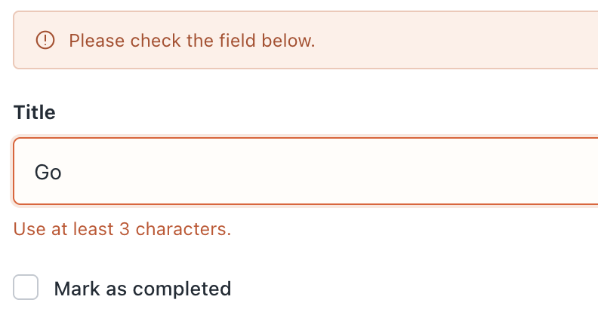
03 / Forms and CRUD
A form validates a task title
tasks/forms.py
Title “Go” fails validation
class TaskForm(forms.ModelForm):
class Meta:
model = Task
fields = ["title", "completed"]
def clean_title(self):
value = self.cleaned_data["title"].strip()
if len(value) < 3:
raise forms.ValidationError(
"Use at least 3 characters."
)
return value
Illustrative UI detail
The form accepts title and completed only.
BHAVYA SHAH / DJANGO WORKSHOP
26
Notes:
A form validates a task title
Imports: from django import forms; from .models import Task. ModelForm supplies a required title field limited to 200 characters and a completed checkbox. Django strips ordinary CharField whitespace and rejects a blank title before clean_title. The custom hook also rejects one- or two-character titles. Use Go for the illustrated error. Extra submitted owner fields do not become model form fields. Server code assigns owner. Browser validation can be bypassed, so demonstrate the server response.
Complete code excerpt:
from django import forms
from .models import Task
class TaskForm(forms.ModelForm):
class Meta:
model = Task
fields = ["title", "completed"]
def clean_title(self):
value = self.cleaned_data["title"].strip()
if len(value) < 3:
raise forms.ValidationError("Use at least 3 characters.")
return value
The visible code is a teaching excerpt. The complete version above includes surrounding imports and context.
Revision mapping: original slide 25.
TEACHING: Ask learners to predict the result before revealing the next explanation. Use the click sequence where available.
SCREENSHOTS: PocketDesk screens are purpose-built teaching mockups using fictional Asha records; illustrative expected results, not captured live execution.
Sources
https://docs.djangoproject.com/en/5.2/topics/forms/modelforms/

Slide 27
03 / Forms and CRUD
A valid form creates a task
tasks/views.py
The new task appears in My Tasks
form = TaskForm(
request.POST if request.method == "POST" else None
)
if request.method == "POST" and form.is_valid():
task = form.save(commit=False)
task.owner = request.user
task.save()
return redirect("tasks:list")
return render(request, "tasks/form.html", {"form": form})
Illustrative UI detail
Validate, assign the user, save, then redirect.
BHAVYA SHAH / DJANGO WORKSHOP
27
Notes:
A valid form creates a task
The display is the body of the complete @login_required task_create view in tasks/views.py. Imports: render and redirect from django.shortcuts, login_required from django.contrib.auth.decorators, and TaskForm from .forms. GET shows an empty form. Invalid POST redisplays values and errors. Valid POST sets the trusted owner and saves, then redirects using Post/Redirect/Get. Constraints and transaction handling remain necessary for concurrency-sensitive rules.
Complete code excerpt:
@login_required
def task_create(request):
form = TaskForm(
request.POST if request.method == "POST" else None
)
if request.method == "POST" and form.is_valid():
task = form.save(commit=False)
task.owner = request.user
task.save()
return redirect("tasks:list")
return render(request, "tasks/form.html", {
"form": form,
})
The visible code is a teaching excerpt. The complete version above includes surrounding imports and context.
Revision mapping: original slide 26.
TEACHING: Ask learners to predict the result before revealing the next explanation. Use the click sequence where available.
SCREENSHOTS: PocketDesk screens are purpose-built teaching mockups using fictional Asha records; illustrative expected results, not captured live execution.
Sources
https://docs.djangoproject.com/en/5.2/topics/forms/modelforms/
https://docs.djangoproject.com/en/5.2/topics/http/shortcuts/
https://docs.djangoproject.com/en/5.2/topics/auth/default/

Slide 28
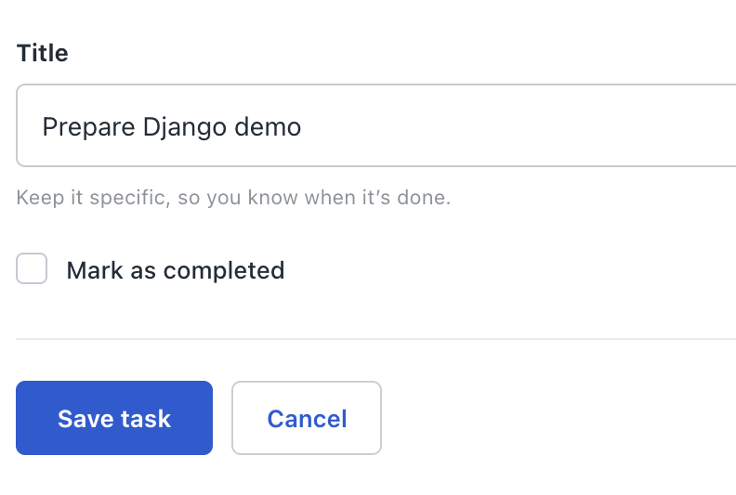
03 / Forms and CRUD
The browser sends the form
tasks/templates/tasks/form.html
Task details
{% extends "base.html" %}
{% block content %}
<h1>Task details</h1>
<form method="post">
{% csrf_token %}
{{ form.as_p }}
<button type="submit">Save task</button>
</form>
<a href="{% url 'tasks:list' %}">Cancel</a>
{% endblock %}
Illustrative UI detail
A state-changing form includes the CSRF token.
BHAVYA SHAH / DJANGO WORKSHOP
28
Notes:
The browser sends the form
The template uses the current URL as its form action, so create and edit can reuse it. form.as_p renders controls, labels and errors. Submit a blank title and then Go to observe different validation messages. The styled form screenshot illustrates one presentation of these controls. Keep labels associated with inputs and display server errors. Preserve CSRF middleware.
Complete code excerpt:
{% extends "base.html" %}
{% block content %}
<h1>Task details</h1>
<form method="post">
{% csrf_token %}
{{ form.as_p }}
<button type="submit">Save task</button>
</form>
<a href="{% url 'tasks:list' %}">Cancel</a>
{% endblock %}
Revision mapping: original slide 27.
TEACHING: Ask learners to predict the result before revealing the next explanation. Use the click sequence where available.
SCREENSHOTS: PocketDesk screens are purpose-built teaching mockups using fictional Asha records; illustrative expected results, not captured live execution.
Sources
https://docs.djangoproject.com/en/5.2/topics/forms/modelforms/
https://docs.djangoproject.com/en/5.2/ref/templates/language/
https://docs.djangoproject.com/en/5.2/topics/security/

Slide 29
03 / Forms and CRUD
The same form edits a task
tasks/views.py
After Save: the same row changes
# Inside task_edit(request, pk)
Field | Stored value
id | 1
title | Prepare Django demo
completed | True
task = get_object_or_404(
Task, pk=pk, owner=request.user
)
form = TaskForm(
request.POST if request.method == "POST" else None,
instance=task,
)
if request.method == "POST" and form.is_valid():
form.save()
return redirect("tasks:list")
instance=task updates the selected row.
BHAVYA SHAH / DJANGO WORKSHOP
29
Notes:
The same form edits a task
In tasks/views.py retain TaskForm, Task, login_required, render and redirect imports and add get_object_or_404. The owner-filtered lookup returns 404 for absent or other-owner records. Pass instance=task to both bound and unbound forms so valid data updates that row. Without instance, a valid form would create a new row. Editing the completed checkbox uses the same form validation as creation.
Complete code excerpt:
@login_required
def task_edit(request, pk):
task = get_object_or_404(
Task, pk=pk, owner=request.user
)
form = TaskForm(
request.POST if request.method == "POST" else None,
instance=task,
)
if request.method == "POST" and form.is_valid():
form.save()
return redirect("tasks:list")
return render(request, "tasks/form.html", {"form": form})
The visible code is a teaching excerpt. The complete version above includes surrounding imports and context.
Revision mapping: original slide 28.
TEACHING: Ask learners to predict the result before revealing the next explanation. Use the click sequence where available.
SCREENSHOTS: PocketDesk screens are purpose-built teaching mockups using fictional Asha records; illustrative expected results, not captured live execution.
Sources
https://docs.djangoproject.com/en/5.2/topics/forms/modelforms/
https://docs.djangoproject.com/en/5.2/topics/http/shortcuts/
https://docs.djangoproject.com/en/5.2/topics/auth/default/

Slide 30
03 / Forms and CRUD
Deletion requires a deliberate POST
tasks/views.py and a row action
Expected requests
@login_required
@require_POST
GET /tasks/1/delete/ 405
POST owned task 302 to /tasks/
POST other user task 404
def task_delete(request, pk):
task = get_object_or_404(
Task, pk=pk, owner=request.user
)
task.delete()
return redirect("tasks:list")
The request method and record ownership both matter.
BHAVYA SHAH / DJANGO WORKSHOP
30
Notes:
Deletion requires a deliberate POST
Import require_POST from django.views.decorators.http. The Python excerpt is in tasks/views.py; the form belongs inside the task loop in tasks/list.html. For an authenticated user, GET returns 405. POST with a valid CSRF token deletes only the current user’s record and redirects. An anonymous request first redirects to login because login_required is the outer decorator. Use disposable demo data. A real UI should explain the consequence before deletion and may include a confirmation page.
Complete code excerpt:
@login_required
@require_POST
def task_delete(request, pk):
task = get_object_or_404(
Task, pk=pk, owner=request.user
)
task.delete()
return redirect("tasks:list")
<!-- Inside the task loop -->
<form method="post" action="{% url 'tasks:delete' task.pk %}">
{% csrf_token %}
<button type="submit">Delete</button>
</form>
The visible code is a teaching excerpt. The complete version above includes surrounding imports and context.
Revision mapping: original slide 29.
TEACHING: Ask learners to predict the result before revealing the next explanation. Use the click sequence where available.
SCREENSHOTS: PocketDesk screens are purpose-built teaching mockups using fictional Asha records; illustrative expected results, not captured live execution.
Sources
https://docs.djangoproject.com/en/5.2/topics/http/shortcuts/
https://docs.djangoproject.com/en/5.2/topics/http/decorators/
https://docs.djangoproject.com/en/5.2/topics/security/

Slide 31
03 / Forms and CRUD
URLs connect the task actions
tasks/urls.py
Browser endpoints
app_name = "tasks"
URL | Action
/tasks/ | List
/tasks/new/ | Create
/tasks/1/edit/ | Edit
/tasks/1/delete/ | POST delete
urlpatterns = [
path("", views.task_list, name="list"),
path("new/", views.task_create, name="create"),
path("<int:pk>/edit/", views.task_edit, name="edit"),
path(
"<int:pk>/delete/", views.task_delete, name="delete"
),
]
Templates and redirects use tasks:create or tasks:edit.
BHAVYA SHAH / DJANGO WORKSHOP
31
Notes:
URLs connect the task actions
In config/urls.py use from django.urls import path, include and retain admin and home routes. Add a Create link to tasks:create and an Edit link to tasks:edit with task.pk inside the list loop. Test /tasks/, /tasks/new/, /tasks/1/edit/ and a POST to the delete route using IDs that exist for the current owner.
Complete code excerpt:
from django.urls import path
from . import views
app_name = "tasks"
urlpatterns = [
path("", views.task_list, name="list"),
path("new/", views.task_create, name="create"),
path("<int:pk>/edit/", views.task_edit, name="edit"),
path("<int:pk>/delete/", views.task_delete, name="delete"),
]
# config/urls.py: include in urlpatterns
# path("tasks/", include("tasks.urls")),
The visible code is a teaching excerpt. The complete version above includes surrounding imports and context.
Revision mapping: original slide 30.
TEACHING: Ask learners to predict the result before revealing the next explanation. Use the click sequence where available.
SCREENSHOTS: PocketDesk screens are purpose-built teaching mockups using fictional Asha records; illustrative expected results, not captured live execution.
Sources
https://docs.djangoproject.com/en/5.2/intro/tutorial01/
https://docs.djangoproject.com/en/5.2/topics/http/urls/

Slide 32
03 / Forms and CRUD
Search and pagination for My Tasks
Body of task_list()
GET /tasks/?q=django&page=1
query = request.GET.get("q", "").strip()
id | Matching title
1 | Prepare Django demo
tasks = Task.objects.filter(owner=request.user)
if query:
tasks = tasks.filter(title__icontains=query)
page = Paginator(tasks.order_by("completed", "id"), 10)
page_obj = page.get_page(request.GET.get("page"))
return render(request, "tasks/list.html", {
"tasks": page_obj,
"page_obj": page_obj,
"q": query,
})
Filter your own records, then limit the page size.
BHAVYA SHAH / DJANGO WORKSHOP
32
Notes:
Search and pagination for My Tasks
Import Paginator from django.core.paginator and retain @login_required. Replace the earlier task_list body with this version. Add a GET search form with input name=q value="{{ q }}". Preserve q in page links using q|urlencode. For next_page_number first check page_obj.has_next, with the corresponding previous check for backward navigation. Completed status followed by id provides stable ordering. The UI illustration may contain more demo records; the query django returns only matching task titles. Challenge: add an Open/Done filter using an explicit allowlist of values.
Complete code excerpt:
query = request.GET.get("q", "").strip()
tasks = Task.objects.filter(owner=request.user)
if query:
tasks = tasks.filter(title__icontains=query)
page = Paginator(tasks.order_by("completed", "id"), 10)
page_obj = page.get_page(request.GET.get("page"))
return render(request, "tasks/list.html", {
"tasks": page_obj,
"page_obj": page_obj,
"q": query,
})
Revision mapping: original slide 31.
TEACHING: Ask learners to predict the result before revealing the next explanation. Use the click sequence where available.
SCREENSHOTS: PocketDesk screens are purpose-built teaching mockups using fictional Asha records; illustrative expected results, not captured live execution.
Sources
https://docs.djangoproject.com/en/5.2/topics/db/queries/
https://docs.djangoproject.com/en/5.2/topics/pagination/

Slide 33
03 / Forms and CRUD
Lab: a useful TODO workflow
Your task list should save valid input and explain rejected input.
1
Create a task, mark it done and find it by title.
2
Submit “Go”, then a blank title. Confirm no invalid change saves.
Challenge: filter Open and Done tasks without losing search.
BHAVYA SHAH / DJANGO WORKSHOP
33
Notes:
Lab: a useful TODO workflow
Use a disposable task to practice the POST delete form. Expected evidence: a working list, edit flow, validation message and search result. Open/Done should map to True or False explicitly; do not treat arbitrary non-empty query strings as True. All queries must keep owner=request.user. Source: the supplied practical sequence adapted to PocketDesk.
Revision mapping: original slide 32.
TEACHING: Ask learners to predict the result before revealing the next explanation. Use the click sequence where available.
SCREENSHOTS: PocketDesk screens are purpose-built teaching mockups using fictional Asha records; illustrative expected results, not captured live execution.
Sources
https://docs.djangoproject.com/en/5.2/topics/forms/modelforms/
https://docs.djangoproject.com/en/5.2/topics/db/queries/
Session Content Document.docx

Slide 34
04 / Identity and security
Built-in login routes
config/urls.py and config/settings.py
Protected pages redirect to Login
# config/urls.py
path("accounts/", include("django.contrib.auth.urls")),
# config/settings.py
LOGIN_URL = "login"
LOGIN_REDIRECT_URL = "tasks:list"
LOGOUT_REDIRECT_URL = "login"
# Application view
@login_required
def task_list(request):
...
Illustrative UI detail
Django supplies views and session handling.
BHAVYA SHAH / DJANGO WORKSHOP
34
Notes:
Built-in login routes
The URL pattern is an addition inside urlpatterns, not a standalone file. Keep generated auth/session middleware and installed apps. The built-in auth URLs include login, logout and password management views, but Django does not create a public sign-up page automatically. Password reset flows also need templates and email configuration. Do not use the ellipsis body as a replacement for the existing list implementation.
Complete code excerpt:
# config/urls.py
path("accounts/", include("django.contrib.auth.urls")),
# config/settings.py
LOGIN_URL = "login"
LOGIN_REDIRECT_URL = "tasks:list"
LOGOUT_REDIRECT_URL = "login"
# Application view
@login_required
def task_list(request):
...
Revision mapping: original slide 33.
TEACHING: Ask learners to predict the result before revealing the next explanation. Use the click sequence where available.
SCREENSHOTS: PocketDesk screens are purpose-built teaching mockups using fictional Asha records; illustrative expected results, not captured live execution.
Sources
https://docs.djangoproject.com/en/5.2/topics/auth/default/

Slide 35
04 / Identity and security
Login and logout templates
registration/login.html and base.html
PocketDesk login form
<!-- tasks/templates/registration/login.html -->
<form method="post">
{% csrf_token %}
{{ form.as_p }}
<input type="hidden" name="next" value="{{ next }}">
<button type="submit">Log in</button>
</form>
<!-- base.html, when user.is_authenticated -->
<form method="post" action="{% url 'logout' %}">
{% csrf_token %}
<button type="submit">Log out</button>
</form>
Illustrative UI detail
Use a POST form with a CSRF token.
BHAVYA SHAH / DJANGO WORKSHOP
35
Notes:
Login and logout templates
The login template can extend base.html and put this form in the content block. Wrap the logout form with {% if user.is_authenticated %} and offer a login link otherwise. Avoid hand-written password comparison or password storage. Demonstrate logout, a protected-page redirect and a successful login. The standard LoginView validates redirect destinations.
Complete code excerpt:
<!-- tasks/templates/registration/login.html -->
<form method="post">
{% csrf_token %}
{{ form.as_p }}
<input type="hidden" name="next" value="{{ next }}">
<button type="submit">Log in</button>
</form>
<!-- base.html, when user.is_authenticated -->
<form method="post" action="{% url 'logout' %}">
{% csrf_token %}
<button type="submit">Log out</button>
</form>
The visible code is a teaching excerpt. The complete version above includes surrounding imports and context.
Revision mapping: original slide 34.
TEACHING: Ask learners to predict the result before revealing the next explanation. Use the click sequence where available.
SCREENSHOTS: PocketDesk screens are purpose-built teaching mockups using fictional Asha records; illustrative expected results, not captured live execution.
Sources
https://docs.djangoproject.com/en/5.2/topics/auth/default/

Slide 36
04 / Identity and security
A basic registration view
tasks/views.py
Successful signup
from django.contrib.auth.forms import UserCreationForm
Password saved as a hash
302 redirect to /accounts/login/
def signup(request):
form = UserCreationForm(
request.POST if request.method == "POST" else None
)
if request.method == "POST" and form.is_valid():
form.save()
return redirect("login")
return render(request, "registration/signup.html", {
"form": form,
})
The form creates a user. You choose who may sign up.
BHAVYA SHAH / DJANGO WORKSHOP
36
Notes:
A basic registration view
This example assumes Django’s default User model. Add path("signup/",views.signup,name="signup") to tasks/urls.py. Create tasks/templates/registration/signup.html with a POST form, csrf_token, form.as_p and a submit button. Keep the generated password validators. Signup redirects to the named login view. Public signup is reasonable for a personal learning demo, but real systems may need account verification, abuse controls or invitations. The example does not implement those features.
Complete code excerpt:
from django.contrib.auth.forms import UserCreationForm
def signup(request):
form = UserCreationForm(
request.POST if request.method == "POST" else None
)
if request.method == "POST" and form.is_valid():
form.save()
return redirect("login")
return render(request, "registration/signup.html", {
"form": form,
})
Revision mapping: original slide 35.
TEACHING: Ask learners to predict the result before revealing the next explanation. Use the click sequence where available.
SCREENSHOTS: PocketDesk screens are purpose-built teaching mockups using fictional Asha records; illustrative expected results, not captured live execution.
Sources
https://docs.djangoproject.com/en/5.2/topics/auth/default/

Slide 37
04 / Identity and security
Login identifies you. Ownership limits your records.
The same access rule on every query
Bob requests Asha’s task
# Authentication: is there a signed-in user?
@login_required
GET /tasks/1/edit/
404 Not Found
Asha’s task stays unchanged
def task_edit(request, pk):
# Authorization: may this user access this record?
task = get_object_or_404(
Task, pk=pk, owner=request.user
)
...
# Collection visibility uses the same policy
Task.objects.filter(owner=request.user)
Apply owner=request.user on lists and object lookups.
BHAVYA SHAH / DJANGO WORKSHOP
37
Notes:
Login identifies you. Ownership limits your records.
Create a task with Asha, sign in as Bob and request its edit URL directly. Bob must not read or change the record. Hiding a button in HTML does not enforce permissions. The database lookup combines pk with owner. Lists, counts, edit/delete views and APIs must apply the same rule. Here 404 deliberately avoids confirming whether another account’s record exists.
Complete code excerpt:
# Authentication: is there a signed-in user?
@login_required
def task_edit(request, pk):
# Authorization: may this user access this record?
task = get_object_or_404(
Task, pk=pk, owner=request.user
)
...
# Collection visibility uses the same policy
Task.objects.filter(owner=request.user)
Revision mapping: original slide 36.
TEACHING: Ask learners to predict the result before revealing the next explanation. Use the click sequence where available.
SCREENSHOTS: PocketDesk screens are purpose-built teaching mockups using fictional Asha records; illustrative expected results, not captured live execution.
Sources
https://docs.djangoproject.com/en/5.2/topics/auth/default/
https://www.django-rest-framework.org/api-guide/permissions/

Slide 38

04 / Identity and security
Two different checks stop two different requests
01 / Forged form
403 Forbidden
A browser sends a POST
without a valid CSRF token.
POST /tasks/new/
Rejected before
the view runs.
CSRF check
02 / Someone else’s task
404 Not Found
Bob is signed in, but the
task belongs to Asha.
POST /tasks/1/edit/
Asha’s record
stays unchanged.
Owner lookup
Also keep template escaping and parameterized queries: they address different attacks.
BHAVYA SHAH / DJANGO WORKSHOP
38
Notes:
Two different checks stop two different requests
Use a conceptual, controlled local demonstration with fictional records. Do not target a real service. A malicious page can cause a browser to attempt a cookie-authenticated request; a correctly used CSRF token helps reject unauthorized cross-site form submissions. CSRF protection does not establish record ownership. A legitimate signed-in Bob with a valid CSRF token still needs authorization, which our owner-scoped lookup enforces. Token-authenticated API clients use the configured token policy; do not claim that Django CSRF middleware covers every authentication scheme. Template autoescaping and ORM parameterization mitigate different risks, with limitations. Never turn off CSRF or mark user content safe merely to make a demo work.
Revision mapping: original slide 37.
ANIMATION: Click 1 sends the forged POST toward the CSRF check. Click 2 reveals 403 Forbidden: the request is rejected before the view changes data. Click 3 sends Bob’s validly authenticated request toward an owner-scoped lookup. Click 4 reveals 404: Asha’s task stays unchanged. A valid CSRF token does not replace object ownership checks.
SCREENSHOTS: PocketDesk screens are purpose-built teaching mockups using fictional Asha records; illustrative expected results, not captured live execution.
Sources
https://docs.djangoproject.com/en/5.2/topics/security/
https://docs.djangoproject.com/en/5.2/topics/auth/default/
https://www.django-rest-framework.org/api-guide/authentication/
https://www.django-rest-framework.org/api-guide/permissions/
Shield icon: Twemoji graphics, Twitter Inc. and contributors, CC BY 4.0. https://github.com/twitter/twemoji

Slide 39
04 / Identity and security
A session preference and a success message
views.py and base.html excerpts
After the redirect
# After a successful save, before redirect
from django.contrib import messages
Visible message:
Task saved.
Session preference:
task_filter = "open"
messages.success(request, "Task saved.")
# A non-sensitive interface preference
request.session["task_filter"] = "open"
task_filter = request.session.get("task_filter", "all")
<!-- base.html -->
{% for message in messages %}
<p>{{ message }}</p>
{% endfor %}
A session remembers a preference. A message confirms an action.
BHAVYA SHAH / DJANGO WORKSHOP
39
Notes:
A session preference and a success message
These are Python and HTML excerpts in separate files. Put messages.success after saving and before redirecting. Keep generated SessionMiddleware, AuthenticationMiddleware and MessageMiddleware. Database-backed sessions usually store server-side data and a session-id cookie; other backends differ. Signed-cookie session data is signed, not encrypted. Store durable TODOs and Entry values in the database, not in session preferences. If using task_filter later, validate it against supported values.
Complete code excerpt:
# After a successful save, before redirect
from django.contrib import messages
messages.success(request, "Task saved.")
# A non-sensitive interface preference
request.session["task_filter"] = "open"
task_filter = request.session.get("task_filter", "all")
<!-- base.html -->
{% for message in messages %}
<p>{{ message }}</p>
{% endfor %}
Revision mapping: original slide 38.
TEACHING: Ask learners to predict the result before revealing the next explanation. Use the click sequence where available.
SCREENSHOTS: PocketDesk screens are purpose-built teaching mockups using fictional Asha records; illustrative expected results, not captured live execution.
Sources
https://docs.djangoproject.com/en/5.2/topics/http/sessions/
https://docs.djangoproject.com/en/5.2/ref/contrib/messages/

Slide 40
04 / Identity and security
Middleware wraps the request
tasks/middleware.py
Response header
class TrainingHeaderMiddleware:
def __init__(self, get_response):
X-Training-App: PocketDesk
self.get_response = get_response
def __call__(self, request):
response = self.get_response(request)
response["X-Training-App"] = "PocketDesk"
return response
# Append to MIDDLEWARE in config/settings.py
# "tasks.middleware.TrainingHeaderMiddleware",
Inspect the header in browser developer tools.
BHAVYA SHAH / DJANGO WORKSHOP
40
Notes:
Middleware wraps the request
Use a harmless header to demonstrate the lifecycle. Request middleware runs in configured order and response processing unwinds in reverse. Placement matters for security, sessions and authentication. Keep built-in middleware in place. Cross-cutting logging should avoid credentials and personal data. This example does not implement authentication or security itself.
Complete code excerpt:
class TrainingHeaderMiddleware:
def __init__(self, get_response):
self.get_response = get_response
def __call__(self, request):
response = self.get_response(request)
response["X-Training-App"] = "PocketDesk"
return response
# Append to MIDDLEWARE in config/settings.py
# "tasks.middleware.TrainingHeaderMiddleware",
Revision mapping: original slide 39.
TEACHING: Ask learners to predict the result before revealing the next explanation. Use the click sequence where available.
SCREENSHOTS: PocketDesk screens are purpose-built teaching mockups using fictional Asha records; illustrative expected results, not captured live execution.
Sources
https://docs.djangoproject.com/en/5.2/topics/http/middleware/

Slide 41
04 / Identity and security
A test protects the ownership rule
tasks/tests.py, test method excerpt
python manage.py test
def test_other_owner_cannot_edit(self):
other = User.objects.create_user("bob")
Ran 1 test
OK
task = Task.objects.create(
title="Prepare Django demo", owner=other,
)
self.client.force_login(self.user)
response = self.client.get(reverse(
"tasks:edit", args=[task.pk]
))
self.assertEqual(response.status_code, 404)
A signed-in user cannot edit someone else’s task.
BHAVYA SHAH / DJANGO WORKSHOP
41
Notes:
A test protects the ownership rule
Place the method in a django.test.TestCase subclass in tasks/tests.py. Import TestCase, reverse from django.urls, get_user_model, and Task. Set User=get_user_model(). In setUp create self.user=User.objects.create_user("asha"). The test runner creates a separate test database; these users do not appear in the development database. Add POST update/delete denial tests that also check unchanged stored values. Django TestClient does not enforce CSRF by default; use Client(enforce_csrf_checks=True) for that specific check. The output assumes this is the only test in the sample project.
Complete code excerpt:
def test_other_owner_cannot_edit(self):
other = User.objects.create_user("bob")
task = Task.objects.create(
title="Prepare Django demo", owner=other,
)
self.client.force_login(self.user)
response = self.client.get(reverse(
"tasks:edit", args=[task.pk]
))
self.assertEqual(response.status_code, 404)
Revision mapping: original slide 40.
TEACHING: Ask learners to predict the result before revealing the next explanation. Use the click sequence where available.
SCREENSHOTS: PocketDesk screens are purpose-built teaching mockups using fictional Asha records; illustrative expected results, not captured live execution.
Sources
https://docs.djangoproject.com/en/5.2/topics/testing/tools/

Slide 42
04 / Identity and security
Lab: two accounts, two task lists
Can Bob see or change a task that Asha created?
1
Create one task per account and test each list.
2
Try the other task’s edit and delete URLs directly.
Done when: rejected requests leave the data unchanged.
BHAVYA SHAH / DJANGO WORKSHOP
42
Notes:
Lab: two accounts, two task lists
Use fictional Asha and Bob accounts. Test through the interface and direct URLs. For deletion use a POST with the signed-in user’s own CSRF token so the ownership check is the behavior under test. Challenge: automate a rejected POST and assert that the title or completion state did not change. Source: supplied practical teaching approach.
Revision mapping: original slide 41.
TEACHING: Ask learners to predict the result before revealing the next explanation. Use the click sequence where available.
SCREENSHOTS: PocketDesk screens are purpose-built teaching mockups using fictional Asha records; illustrative expected results, not captured live execution.
Sources
https://docs.djangoproject.com/en/5.2/topics/auth/default/
https://docs.djangoproject.com/en/5.2/topics/testing/tools/
Session Content Document.docx

Slide 43
05 / REST APIs
HTTP methods for task records
Method | Endpoint | Success
GET | /api/tasks/ | 200 and a collection
POST | /api/tasks/ | 201 and the new task
GET | /api/tasks/7/ | 200 and one task
PUT / PATCH | /api/tasks/7/ | 200 and the updated task
DELETE | /api/tasks/7/ | 204 without a body
PUT replaces the writable representation. PATCH changes selected fields.
BHAVYA SHAH / DJANGO WORKSHOP
43
Notes:
HTTP methods for task records
HTTP semantics describe intent; endpoints must still validate inputs and enforce permissions. GET should not change server state. These examples reflect the DRF ModelViewSet used later. 400 indicates invalid input, 404 absent or deliberately inaccessible records, and 500 a server failure. Actual unauthorized responses depend on the authentication scheme.
Revision mapping: original slide 42.
TEACHING: Ask learners to predict the result before revealing the next explanation. Use the click sequence where available.
SCREENSHOTS: PocketDesk screens are purpose-built teaching mockups using fictional Asha records; illustrative expected results, not captured live execution.
Sources
https://www.django-rest-framework.org/api-guide/viewsets/
https://developer.mozilla.org/en-US/docs/Web/HTTP/Reference/Methods

Slide 44
05 / REST APIs
A serializer describes the task API
tasks/serializers.py
Example JSON representation
from rest_framework import serializers
from .models import Task
{
"id": 1,
"title": "Prepare Django demo",
"completed": false
}
class TaskSerializer(serializers.ModelSerializer):
class Meta:
model = Task
fields = ["id", "title", "completed"]
read_only_fields = ["id"]
# python -m pip install djangorestframework
# Append "rest_framework" to INSTALLED_APPS
Clients send title and completed. The server chooses owner.
BHAVYA SHAH / DJANGO WORKSHOP
44
Notes:
A serializer describes the task API
Install djangorestframework in the active environment and append rest_framework to the generated INSTALLED_APPS list. ModelSerializer turns Task objects into primitive values that the response renderer can encode as JSON, and validates incoming data. Python uses False; JSON uses false. The serializer and HTML ModelForm are separate input paths. Add the title-length validation shown later before treating the API as feature-complete.
Complete code excerpt:
from rest_framework import serializers
from .models import Task
class TaskSerializer(serializers.ModelSerializer):
class Meta:
model = Task
fields = ["id", "title", "completed"]
read_only_fields = ["id"]
# python -m pip install djangorestframework
# Append "rest_framework" to INSTALLED_APPS
Revision mapping: original slide 43.
TEACHING: Ask learners to predict the result before revealing the next explanation. Use the click sequence where available.
SCREENSHOTS: PocketDesk screens are purpose-built teaching mockups using fictional Asha records; illustrative expected results, not captured live execution.
Sources
https://www.django-rest-framework.org/api-guide/serializers/
https://www.django-rest-framework.org/

Slide 45
05 / REST APIs
The API uses the same ownership rule
tasks/api.py
Example owned record: HTTP 200
from rest_framework import permissions, viewsets
from .models import Task
[
{"id": 1,
"title": "Prepare Django demo",
"completed": false}
]
from .serializers import TaskSerializer
class TaskViewSet(viewsets.ModelViewSet):
serializer_class = TaskSerializer
permission_classes = [permissions.IsAuthenticated]
def get_queryset(self):
return Task.objects.filter(
owner=self.request.user
).order_by("id")
def perform_create(self, serializer):
serializer.save(owner=self.request.user)
get_queryset limits every standard object lookup.
BHAVYA SHAH / DJANGO WORKSHOP
45
Notes:
The API uses the same ownership rule
IsAuthenticated alone does not implement record ownership. The scoped queryset restricts retrieve/update/delete as well as list. perform_create ensures owner cannot come from client data. Keep serializer fields explicit. More complex object permission policies may require a dedicated permission class in addition to queryset filtering. This is a coherent minimal teaching policy.
Complete code excerpt:
from rest_framework import permissions, viewsets
from .models import Task
from .serializers import TaskSerializer
class TaskViewSet(viewsets.ModelViewSet):
serializer_class = TaskSerializer
permission_classes = [permissions.IsAuthenticated]
def get_queryset(self):
return Task.objects.filter(
owner=self.request.user
).order_by("id")
def perform_create(self, serializer):
serializer.save(owner=self.request.user)
The visible code is a teaching excerpt. The complete version above includes surrounding imports and context.
Revision mapping: original slide 44.
TEACHING: Ask learners to predict the result before revealing the next explanation. Use the click sequence where available.
SCREENSHOTS: PocketDesk screens are purpose-built teaching mockups using fictional Asha records; illustrative expected results, not captured live execution.
Sources
https://www.django-rest-framework.org/api-guide/viewsets/
https://www.django-rest-framework.org/api-guide/permissions/
https://www.django-rest-framework.org/api-guide/generic-views/

Slide 46
05 / REST APIs
The router creates task endpoints
config/urls.py additions
Router output
from django.urls import include, path
Route | Actions
/api/tasks/ | List and create
/api/tasks/<id>/ | Read, update and delete
from rest_framework.routers import DefaultRouter
from tasks.api import TaskViewSet
router = DefaultRouter()
router.register(
"tasks", TaskViewSet, basename="task"
)
# Add to the existing urlpatterns
urlpatterns += [
path("api/", include(router.urls)),
path("api-auth/", include("rest_framework.urls")),
]
Register TaskViewSet once under tasks.
BHAVYA SHAH / DJANGO WORKSHOP
46
Notes:
The router creates task endpoints
The explicit basename is needed because the ViewSet defines get_queryset instead of a class-level queryset. The browsable API login uses session authentication. Keep the existing tasks, admin and accounts routes. Import TaskViewSet from tasks.api before registering it. API clients must use the configured authentication method. The testing setup later adds local token authentication.
Complete code excerpt:
from django.urls import include, path
from rest_framework.routers import DefaultRouter
from tasks.api import TaskViewSet
router = DefaultRouter()
router.register(
"tasks", TaskViewSet, basename="task"
)
# Add to the existing urlpatterns
urlpatterns += [
path("api/", include(router.urls)),
path("api-auth/", include("rest_framework.urls")),
]
The visible code is a teaching excerpt. The complete version above includes surrounding imports and context.
Revision mapping: original slide 45.
TEACHING: Ask learners to predict the result before revealing the next explanation. Use the click sequence where available.
SCREENSHOTS: PocketDesk screens are purpose-built teaching mockups using fictional Asha records; illustrative expected results, not captured live execution.
Sources
https://www.django-rest-framework.org/api-guide/routers/

Slide 47
05 / REST APIs
Search and pages in the API
tasks/api.py additions
Paginated response shape
from rest_framework import filters
from rest_framework.pagination import PageNumberPagination
{"count": 1, "next": null,
"previous": null,
"results": [{"id": 1,
"title": "Prepare Django demo",
"completed": false}]}
class TaskPagination(PageNumberPagination):
page_size = 10
# Add inside TaskViewSet
pagination_class = TaskPagination
filter_backends = [filters.SearchFilter]
search_fields = ["title"]
# GET /api/tasks/?search=django&page=1
The filter receives the already-scoped QuerySet.
BHAVYA SHAH / DJANGO WORKSHOP
47
Notes:
Search and pages in the API
Define TaskPagination before TaskViewSet or import it. The three attributes shown after the comment belong inside TaskViewSet. Their indentation is omitted only to keep the excerpt focused. Keep the owner-scoped get_queryset. DRF SearchFilter uses search by default; the HTML page uses q. Pagination changes the response from a top-level list to an object with count, next, previous and results. The shown response assumes one matching task.
Complete code excerpt:
from rest_framework import filters
from rest_framework.pagination import PageNumberPagination
class TaskPagination(PageNumberPagination):
page_size = 10
# Add inside TaskViewSet
pagination_class = TaskPagination
filter_backends = [filters.SearchFilter]
search_fields = ["title"]
# GET /api/tasks/?search=django&page=1
Revision mapping: original slide 46.
TEACHING: Ask learners to predict the result before revealing the next explanation. Use the click sequence where available.
SCREENSHOTS: PocketDesk screens are purpose-built teaching mockups using fictional Asha records; illustrative expected results, not captured live execution.
Sources
https://www.django-rest-framework.org/api-guide/filtering/
https://www.django-rest-framework.org/api-guide/pagination/

Slide 48
05 / REST APIs
The API rejects the same invalid title
Inside TaskSerializer
400 Bad Request
def validate_title(self, value):
value = value.strip()
{"title": ["Use at least 3
characters."]}
if len(value) < 3:
raise serializers.ValidationError(
"Use at least 3 characters."
)
return value
# POST body: {"title": "Go"}
# Response: 400 Bad Request
The HTML form and the API both require a useful title.
BHAVYA SHAH / DJANGO WORKSHOP
48
Notes:
The API rejects the same invalid title
Indent validate_title inside TaskSerializer alongside Meta. The generated CharField already trims whitespace and rejects blank values; this hook adds the three-character minimum. A whitespace-only title can produce the standard blank-field error before this hook runs. The example Go produces the illustrated message. Test valid titles, blank titles, whitespace-only titles and two-character titles on both input paths. A shared model validator can reduce duplication as the project grows, with tests to confirm each entry point.
Complete code excerpt:
def validate_title(self, value):
value = value.strip()
if len(value) < 3:
raise serializers.ValidationError(
"Use at least 3 characters."
)
return value
# POST body: {"title": "Go"}
# Response: 400 Bad Request
Revision mapping: original slide 47.
TEACHING: Ask learners to predict the result before revealing the next explanation. Use the click sequence where available.
SCREENSHOTS: PocketDesk screens are purpose-built teaching mockups using fictional Asha records; illustrative expected results, not captured live execution.
Sources
https://www.django-rest-framework.org/api-guide/serializers/
https://docs.djangoproject.com/en/5.2/topics/forms/modelforms/

Slide 49
05 / REST APIs
Postman authentication for the lab
Local token setup
Authenticated API request
# Add "rest_framework.authtoken" to INSTALLED_APPS
python manage.py migrate
Authorization: Token <test-token>
GET /api/tasks/ 200
python manage.py drf_create_token asha
# TaskViewSet: add TokenAuthentication first
authentication_classes = [
TokenAuthentication,
SessionAuthentication,
]
# Postman Authorization header
# Authorization: Token <your-local-test-token>
Send a private token in the Authorization header.
BHAVYA SHAH / DJANGO WORKSHOP
49
Notes:
Postman authentication for the lab
This slide combines shell and Python excerpts. Import TokenAuthentication and SessionAuthentication from rest_framework.authentication in tasks/api.py. Add authentication_classes inside the ViewSet. TokenAuthentication is first, so this configured API normally returns 401 for unauthenticated requests. SessionAuthentication alone often returns 403 and requires CSRF on unsafe authenticated requests. DRF tokens are a simple lab mechanism, not an automatic recommendation for every production identity architecture. Never commit or share the token.
Complete code excerpt:
# Add "rest_framework.authtoken" to INSTALLED_APPS
python manage.py migrate
python manage.py drf_create_token asha
# TaskViewSet: add TokenAuthentication first
authentication_classes = [
TokenAuthentication,
SessionAuthentication,
]
# Postman Authorization header
# Authorization: Token <your-local-test-token>
Revision mapping: original slide 48.
TEACHING: Ask learners to predict the result before revealing the next explanation. Use the click sequence where available.
SCREENSHOTS: PocketDesk screens are purpose-built teaching mockups using fictional Asha records; illustrative expected results, not captured live execution.
Sources
https://www.django-rest-framework.org/api-guide/authentication/

Slide 50
05 / REST APIs
Postman creates and checks a task
POST {{base_url}}/api/tasks/
201 Created
// JSON body
{"title": "Prepare Django demo", "completed": false}
{
"id": 1,
"title": "Prepare Django demo",
"completed": false
}
// Post-response script
pm.test("Task created", () => {
pm.response.to.have.status(201);
const body = pm.response.json();
pm.expect(body.completed).to.eql(false);
pm.collectionVariables.set("task_id", body.id);
});
Reuse {{task_id}} for GET, PATCH and DELETE.
BHAVYA SHAH / DJANGO WORKSHOP
50
Notes:
Postman creates and checks a task
Set base_url to http://127.0.0.1:8000 and provide a private token variable. The request header is Authorization: Token {{token}}. Choose raw JSON with Content-Type: application/json. JSON and the JavaScript test go into separate Postman tabs. Do not paste // comments into the JSON body. The response id is generated by the database and may differ between runs. Follow with PATCH {"completed":true} and assert the returned status. Keep the token out of exported collections.
Complete code excerpt:
// Body tab: paste only this JSON object
{
"title": "Prepare Django demo",
"completed": false
}
// Post-response script tab
pm.test("Task created", () => {
pm.response.to.have.status(201);
const body = pm.response.json();
pm.expect(body.completed).to.eql(false);
pm.collectionVariables.set("task_id", body.id);
});
The visible code is a teaching excerpt. The complete version above includes surrounding imports and context.
Revision mapping: original slide 49.
TEACHING: Ask learners to predict the result before revealing the next explanation. Use the click sequence where available.
SCREENSHOTS: PocketDesk screens are purpose-built teaching mockups using fictional Asha records; illustrative expected results, not captured live execution.
Sources
https://learning.postman.com/docs/tests-and-scripts/write-scripts/test-scripts/
https://www.django-rest-framework.org/api-guide/authentication/

Slide 51
05 / REST APIs
API test matrix
Case | Expected result | What it proves
Valid task | 201 and a new id | The write path works
Title “Go” | 400 and a field error | Validation runs
No credentials | 401 in token-first setup | Authentication runs
Another owner’s id | 404 | Records remain isolated
DELETE then GET | 204, then 404 | Deletion takes effect
Test failure cases as deliberately as successful requests.
BHAVYA SHAH / DJANGO WORKSHOP
51
Notes:
API test matrix
The 401 expectation assumes TokenAuthentication is first and the request sends neither a token nor a valid session. A logged-in browsable API may authenticate through the fallback SessionAuthentication even without a token. Test with a clean Postman cookie jar. Other configurations can return 403. Also test title-only PATCH, status updates, search and pagination. Failed writes must leave records unchanged. Do not parse JSON from a 204 body.
Revision mapping: original slide 50.
TEACHING: Ask learners to predict the result before revealing the next explanation. Use the click sequence where available.
SCREENSHOTS: PocketDesk screens are purpose-built teaching mockups using fictional Asha records; illustrative expected results, not captured live execution.
Sources
https://www.django-rest-framework.org/api-guide/authentication/
https://www.django-rest-framework.org/api-guide/permissions/
https://www.django-rest-framework.org/api-guide/viewsets/

Slide 52
05 / REST APIs
Lab: TODOs through a second client
Can Postman complete a task that the browser created?
1
Find your task, PATCH completed=true and refresh the browser.
2
Test an invalid title and another account’s task id.
Both clients should see the same authorized database state.
BHAVYA SHAH / DJANGO WORKSHOP
52
Notes:
Lab: TODOs through a second client
Use the same owner account for the browser and token. Create a collection with no real secrets embedded. Run create/read/update/delete twice using fresh disposable records. Ask a learner to distinguish model, serializer, ViewSet and router. Then introduce the Entry API as another resource using the same foundations.
Revision mapping: original slide 51.
TEACHING: Ask learners to predict the result before revealing the next explanation. Use the click sequence where available.
SCREENSHOTS: PocketDesk screens are purpose-built teaching mockups using fictional Asha records; illustrative expected results, not captured live execution.
Sources
https://www.django-rest-framework.org/api-guide/viewsets/
https://www.django-rest-framework.org/api-guide/permissions/
Session Content Document.docx

Slide 53
05 / REST APIs
The Entry API protects each user’s keys
tasks/serializers.py, after TaskSerializer
Request JSON
class EntrySerializer(serializers.ModelSerializer):
owner = serializers.HiddenField(
{"key": "course_link",
"value":
"https://docs.djangoproject.com/en/5.2/"}
Owner comes from the signed-in account.
default=serializers.CurrentUserDefault()
)
class Meta:
model = Entry
fields = ["id", "key", "value", "owner"]
validators = [UniqueTogetherValidator(
queryset=Entry.objects.all(),
fields=["owner", "key"],
)]
owner is a hidden server-derived value.
BHAVYA SHAH / DJANGO WORKSHOP
53
Notes:
The Entry API protects each user’s keys
Retain the serializers import and add UniqueTogetherValidator from rest_framework.validators and Entry from .models. HiddenField supplies request.user through CurrentUserDefault and does not accept an owner chosen by the client or expose owner in the response. ViewSets provide the request context automatically. The generated key field limits input to 80 characters. The composite validator gives a validation error if the same account repeats a key, while another account may use the same key. Updates exclude the current instance during the uniqueness check. The database constraint remains necessary for concurrent requests; a production API should translate any race-time integrity failure into an appropriate client response. Ordinary key/value notes are not a secure secret vault.
Complete code excerpt:
from rest_framework.validators import UniqueTogetherValidator
from .models import Entry
class EntrySerializer(serializers.ModelSerializer):
owner = serializers.HiddenField(
default=serializers.CurrentUserDefault()
)
class Meta:
model = Entry
fields = ["id", "key", "value", "owner"]
read_only_fields = ["id"]
validators = [UniqueTogetherValidator(
queryset=Entry.objects.all(),
fields=["owner", "key"],
)]
The visible code is a teaching excerpt. The complete version above includes surrounding imports and context.
TEACHING: Ask learners to predict the result before revealing the next explanation. Use the click sequence where available.
SCREENSHOTS: PocketDesk screens are purpose-built teaching mockups using fictional Asha records; illustrative expected results, not captured live execution.
Sources
https://www.django-rest-framework.org/api-guide/serializers/
https://www.django-rest-framework.org/api-guide/validators/
https://docs.djangoproject.com/en/5.2/ref/models/constraints/

Slide 54
05 / REST APIs
A second REST resource: useful notes
tasks/api.py and config/urls.py additions
Entry endpoints
class EntryViewSet(viewsets.ModelViewSet):
Request | Result
POST /api/entries/ | Create a key/value note
GET /api/entries/ | List your notes
PATCH /api/entries/1/ | Change your note value
serializer_class = EntrySerializer
permission_classes = [permissions.IsAuthenticated]
# Same token/session authentication as TaskViewSet
def get_queryset(self):
return Entry.objects.filter(
owner=self.request.user
).order_by("key", "id")
# config/urls.py
router.register("entries", EntryViewSet, basename="entry")
Every Entry lookup starts with owner=request.user.
BHAVYA SHAH / DJANGO WORKSHOP
54
Notes:
A second REST resource: useful notes
Use the existing viewsets, permissions, TokenAuthentication and SessionAuthentication imports in tasks/api.py. The full code explicitly configures the same token-first authentication as tasks. Its display excerpt omits the attribute values for space. Register EntryViewSet in config/urls.py before accessing router.urls. Standard retrieve/update/delete actions also use the scoped queryset. POST accepts key and value, while the serializer receives owner from the request; perform_create makes that assignment explicit. The example collection is not paginated unless pagination is configured on EntryViewSet. In Postman test create, duplicate own key, another user with the same key, other-owner detail denial, and PATCH value. Use ordinary fictional notes. This is REST CRUD for Entry, not a claim that the illustrated HTML Entry screen has been fully implemented.
Complete code excerpt:
from .models import Entry
from .serializers import EntrySerializer
class EntryViewSet(viewsets.ModelViewSet):
serializer_class = EntrySerializer
permission_classes = [permissions.IsAuthenticated]
authentication_classes = [
TokenAuthentication, SessionAuthentication,
]
def get_queryset(self):
return Entry.objects.filter(
owner=self.request.user
).order_by("key", "id")
def perform_create(self, serializer):
serializer.save(owner=self.request.user)
# config/urls.py: before include(router.urls)
# from tasks.api import EntryViewSet
router.register("entries", EntryViewSet, basename="entry")
The visible code is a teaching excerpt. The complete version above includes surrounding imports and context.
TEACHING: Ask learners to predict the result before revealing the next explanation. Use the click sequence where available.
SCREENSHOTS: PocketDesk screens are purpose-built teaching mockups using fictional Asha records; illustrative expected results, not captured live execution.
Sources
https://www.django-rest-framework.org/api-guide/viewsets/
https://www.django-rest-framework.org/api-guide/routers/
https://www.django-rest-framework.org/api-guide/permissions/
https://www.django-rest-framework.org/api-guide/authentication/

Slide 55
06 / Production
A repository without local secrets
.gitignore
Include
.venv/
__pycache__/
Python source, templates, static source
and migrations.
*.py[cod]
.env
.env.*
Exclude
!.env.example
db.sqlite3
Local environments, credentials and
generated artifacts.
staticfiles/
.vercel/
# Keep source and migration files in Git.
# .env.example contains names and placeholders only.
Python source, templates, static source and migrations.
BHAVYA SHAH / DJANGO WORKSHOP
55
Notes:
A repository without local secrets
Ignoring a file does not remove it from existing Git history. If a secret is committed, rotate the secret and follow the repository’s history-cleanup procedure. Do not demonstrate by exposing a real key. Static source CSS belongs in Git; collectstatic output does not. The user-facing sample data must not include real learner information.
Complete code excerpt:
.venv/
__pycache__/
*.py[cod]
.env
.env.*
!.env.example
db.sqlite3
staticfiles/
.vercel/
# Keep source and migration files in Git.
# .env.example contains names and placeholders only.
Revision mapping: original slide 52.
TEACHING: Ask learners to predict the result before revealing the next explanation. Use the click sequence where available.
SCREENSHOTS: PocketDesk screens are purpose-built teaching mockups using fictional Asha records; illustrative expected results, not captured live execution.
Sources
https://git-scm.com/docs/gittutorial
https://git-scm.com/docs/gitignore

Slide 56
06 / Production
Git and GitHub workflow
Terminal
Expected repository contents
git init
git status
tasks/ and config/
templates and static source
migration files and requirements.txt
git add .
git diff --staged
git commit -m "Add validated task CRUD"
git branch -M main
git remote add origin <YOUR_GITHUB_REPOSITORY_URL>
git push -u origin main
Inspect the staged diff and exclude secrets.
BHAVYA SHAH / DJANGO WORKSHOP
56
Notes:
Git and GitHub workflow
These commands describe the classroom workflow, not an instruction that an existing repository must be reinitialized or repointed. Replace the angle-bracket placeholder with the learner’s own empty repository URL, without the brackets. Authenticate through the current GitHub-supported method. Commit dependency files after testing the workshop environment. Do not commit credentials or local tokens.
Complete code excerpt:
git init
git status
git add .
git diff --staged
git commit -m "Add validated task CRUD"
git branch -M main
git remote add origin <YOUR_GITHUB_REPOSITORY_URL>
git push -u origin main
Revision mapping: original slide 53.
TEACHING: Ask learners to predict the result before revealing the next explanation. Use the click sequence where available.
SCREENSHOTS: PocketDesk screens are purpose-built teaching mockups using fictional Asha records; illustrative expected results, not captured live execution.
Sources
https://git-scm.com/docs/gittutorial
https://docs.github.com/en/get-started/importing-your-projects-to-github/adding-locally-hosted-code-to-github

Slide 57
06 / Production
A small feature branch
Terminal
Example pull request
git switch -c feature/task-status-filter
Add Open / Done task filtering
Checks: own records, search, invalid
status
# Implement and test Open / Done filtering
python manage.py test
git add tasks/
git diff --staged
git commit -m "Add task status filter"
git push -u origin feature/task-status-filter
# Open a pull request on GitHub.
Explain the behavior and its verification.
BHAVYA SHAH / DJANGO WORKSHOP
57
Notes:
A small feature branch
Demonstrate a small diff rather than a huge final upload. Learners can use a pull request to explain a feature and its tests. Avoid destructive reset commands in introductory exercises. If working alone, the review habit still helps detect accidental secrets and unrelated changes.
Complete code excerpt:
git switch -c feature/task-status-filter
# Implement and test Open / Done filtering
python manage.py test
git add tasks/
git diff --staged
git commit -m "Add task status filter"
git push -u origin feature/task-status-filter
# Open a pull request on GitHub.
Revision mapping: original slide 54.
TEACHING: Ask learners to predict the result before revealing the next explanation. Use the click sequence where available.
SCREENSHOTS: PocketDesk screens are purpose-built teaching mockups using fictional Asha records; illustrative expected results, not captured live execution.
Sources
https://git-scm.com/docs/gittutorial
https://docs.github.com/en/pull-requests/collaborating-with-pull-requests/proposing-changes-to-your-work-with-pull-requests/about-pull-requests

Slide 58
06 / Production
Configuration for deployment
config/settings.py additions
Variable examples
import os
Name | Value type
DJANGO_SECRET_KEY | Secret
DEBUG | False
DJANGO_ALLOWED_HOSTS | Actual hostnames
SECRET_KEY = os.environ["DJANGO_SECRET_KEY"]
DEBUG = os.environ.get("DEBUG", "False").lower() == "true"
ALLOWED_HOSTS = [
h.strip() for h in
os.environ["DJANGO_ALLOWED_HOSTS"].split(",")
if h.strip()
]
STATIC_URL = "/static/"
STATIC_ROOT = BASE_DIR / "staticfiles"
SESSION_COOKIE_SECURE = not DEBUG
CSRF_COOKIE_SECURE = not DEBUG
Keep secrets outside Git and DEBUG off in production.
BHAVYA SHAH / DJANGO WORKSHOP
58
Notes:
Configuration for deployment
These are additions to the generated settings, not a full replacement. Once SECRET_KEY uses os.environ[], management commands require the variable. A .env file is not read automatically by Python or Django; export variables in the shell or use a deliberately configured loader. Set local DEBUG=True for HTTP development and local hosts localhost,127.0.0.1. Production uses DEBUG=False. ALLOWED_HOSTS contains hostnames without scheme. Configure CSRF_TRUSTED_ORIGINS with actual HTTPS origins only when required by the deployment. Verify proxy HTTPS behavior before adding SECURE_PROXY_SSL_HEADER or redirect settings.
Complete code excerpt:
import os
SECRET_KEY = os.environ["DJANGO_SECRET_KEY"]
DEBUG = os.environ.get("DEBUG", "False").lower() == "true"
ALLOWED_HOSTS = [
h.strip() for h in
os.environ["DJANGO_ALLOWED_HOSTS"].split(",")
if h.strip()
]
STATIC_URL = "/static/"
STATIC_ROOT = BASE_DIR / "staticfiles"
SESSION_COOKIE_SECURE = not DEBUG
CSRF_COOKIE_SECURE = not DEBUG
The visible code is a teaching excerpt. The complete version above includes surrounding imports and context.
Revision mapping: original slide 55.
TEACHING: Ask learners to predict the result before revealing the next explanation. Use the click sequence where available.
SCREENSHOTS: PocketDesk screens are purpose-built teaching mockups using fictional Asha records; illustrative expected results, not captured live execution.
Sources
https://docs.djangoproject.com/en/5.2/howto/deployment/checklist/
https://vercel.com/docs/frameworks/full-stack/django

Slide 59
06 / Production
Persistent PostgreSQL data
config/settings.py, production database
Production database tables
import dj_database_url
Table | Stores
tasks_task | TODOs and owners
tasks_entry | Keys, values and owners
auth_user | Accounts
DATABASES = {
"default": dj_database_url.parse(
os.environ["DATABASE_URL"],
conn_max_age=0,
)
}
# Install into the active environment
# python -m pip install "psycopg[binary]" dj-database-url
# python -m pip freeze > requirements.txt
Tasks and entries live in PostgreSQL after deployment.
BHAVYA SHAH / DJANGO WORKSHOP
59
Notes:
Persistent PostgreSQL data
The production database excerpt replaces the default SQLite DATABASES configuration in production. Keep a documented local configuration or use a local PostgreSQL database when rehearsing deployment. Local SQLite data does not automatically move to PostgreSQL. Install a supported PostgreSQL driver and pin tested dependencies. conn_max_age=0 is a conservative workshop setting; pooling depends on provider/runtime behavior. Keep the connection string secret. Database migrations must target the intended environment.
Complete code excerpt:
import dj_database_url
DATABASES = {
"default": dj_database_url.parse(
os.environ["DATABASE_URL"],
conn_max_age=0,
)
}
# Install into the active environment
# python -m pip install "psycopg[binary]" dj-database-url
# python -m pip freeze > requirements.txt
Revision mapping: original slide 56.
TEACHING: Ask learners to predict the result before revealing the next explanation. Use the click sequence where available.
SCREENSHOTS: PocketDesk screens are purpose-built teaching mockups using fictional Asha records; illustrative expected results, not captured live execution.
Sources
https://github.com/jazzband/dj-database-url
https://docs.djangoproject.com/en/5.2/howto/deployment/checklist/
https://vercel.com/kb/guide/is-sqlite-supported-in-vercel

Slide 60
06 / Production
Production application architecture
Browser
→
Vercel
→
PostgreSQL
Uses the public HTTPS URL.
Runs the Django app.
Persists application data.
Static assets are served from the CDN. Secrets stay in environment variables.
BHAVYA SHAH / DJANGO WORKSHOP
60
Notes:
Production application architecture
GitHub provides source code. Vercel hosts the Django application and serves collected static assets through its CDN. An external PostgreSQL service stores persistent records. Uploaded media needs suitable persistent object storage. This is a conceptual deployment diagram, not a live deployment or a statement of platform pricing. Generated illustration.
Revision mapping: original slide 57.
TEACHING: Ask learners to predict the result before revealing the next explanation. Use the click sequence where available.
SCREENSHOTS: PocketDesk screens are purpose-built teaching mockups using fictional Asha records; illustrative expected results, not captured live execution.
Sources
https://vercel.com/docs/frameworks/full-stack/django
https://vercel.com/kb/guide/is-sqlite-supported-in-vercel

Slide 61
06 / Production
Django deployment on Vercel
1
Prepare the repository
Keep manage.py, tested requirements.txt, migrations and a .python-version file containing 3.13.
2
Import the GitHub project
Select the directory containing manage.py and confirm Django detection.
3
Configure and deploy
Set secrets, allowed hosts and DATABASE_URL in the correct environment.
BHAVYA SHAH / DJANGO WORKSHOP
61
Notes:
Django deployment on Vercel
Current official Vercel documentation supports zero-configuration Django detection. It reads WSGI_APPLICATION or ASGI_APPLICATION and uses ASGI when both are configured. For a standard project retain WSGI_APPLICATION="config.wsgi.application". No legacy /api wrapper or redirect-based vercel.json boilerplate is needed. STATIC_ROOT enables automatic collectstatic and CDN serving. The chosen .python-version must be supported by Vercel and compatible with the project. This is an industry extension recommended by the supplied session plan, not an independently verified GTU requirement.
Revision mapping: original slide 58.
TEACHING: Ask learners to predict the result before revealing the next explanation. Use the click sequence where available.
SCREENSHOTS: PocketDesk screens are purpose-built teaching mockups using fictional Asha records; illustrative expected results, not captured live execution.
Sources
https://vercel.com/docs/frameworks/full-stack/django
https://vercel.com/docs/functions/runtimes/python
https://vercel.com/changelog/zero-configuration-django-support

Slide 62
06 / Production
A controlled database release step
Terminal, after linking the Vercel project
Release evidence
npm install --global vercel@latest
vercel login
Committed migrations applied
Deployment warnings reviewed
Public URL smoke-tested
vercel link
vercel env run -e production -- \
python manage.py migrate --noinput
vercel env run -e production -- \
python manage.py check --deploy
# Deploy through Git integration or the CLI
vercel --prod
Confirm the environment, apply migrations, then verify.
BHAVYA SHAH / DJANGO WORKSHOP
62
Notes:
A controlled database release step
Prerequisite: install a supported Node.js/npm version for the Vercel CLI. Commands use the current Vercel CLI. The multiline continuation syntax is for macOS/Linux shells; enter each command on one line in other shells. vercel env run injects the selected environment variables into the command. Run in the active Python environment with project dependencies installed and database network access. A fresh PostgreSQL database has no local users or API tokens. Create the intended production test account using a controlled command, such as vercel env run -e production -- python manage.py createsuperuser, then generate the appropriate test token if using TokenAuthentication. Local users and tokens do not transfer automatically. Production migrations require a backup/rollback and compatible release plan for established systems. The instructional sequence does not imply that arbitrary destructive migrations are safe. Do not run production migrations on every preview build.
Complete code excerpt:
npm install --global vercel@latest
vercel login
vercel link
vercel env run -e production -- \
python manage.py migrate --noinput
vercel env run -e production -- \
python manage.py check --deploy
# Deploy through Git integration or the CLI
vercel --prod
Revision mapping: original slide 59.
TEACHING: Ask learners to predict the result before revealing the next explanation. Use the click sequence where available.
SCREENSHOTS: PocketDesk screens are purpose-built teaching mockups using fictional Asha records; illustrative expected results, not captured live execution.
Sources
https://vercel.com/docs/cli/env
https://docs.djangoproject.com/en/5.2/howto/deployment/checklist/
https://vercel.com/docs/cli/link

Slide 63
06 / Production
Production smoke tests
Area | Check | Evidence
Interface | Pages and CSS over HTTPS | Browser result
Data | A task and an entry persist | Values survive a reload
Access | Login and other-owner denial | Expected redirect / 404
API | Task and Entry collections | Successful and rejected requests
Operations | DEBUG off and logs reviewed | Deployment checks
A successful build is the start of verification.
BHAVYA SHAH / DJANGO WORKSHOP
63
Notes:
Production smoke tests
Re-test the actual public URL, not only localhost. For Postman, change base_url and the environment-specific test token together. Fresh PostgreSQL has no local accounts or tokens, so create the intended test account there before checking login or API access. Confirm CSRF behavior, hostnames, database migrations and static assets. Inspect logs for an induced harmless 404 and for unexpected server errors. Do not expose detailed debug pages publicly. Keep uploaded media outside ephemeral function storage. Long-running jobs need an appropriate background-work design.
Revision mapping: original slide 60.
TEACHING: Ask learners to predict the result before revealing the next explanation. Use the click sequence where available.
SCREENSHOTS: PocketDesk screens are purpose-built teaching mockups using fictional Asha records; illustrative expected results, not captured live execution.
Sources
https://docs.djangoproject.com/en/5.2/howto/deployment/checklist/
https://vercel.com/docs/frameworks/full-stack/django

Slide 64
06 / Production
Common errors and the next check
Symptom | Likely check
404 on your route | Project include(), route order and path
TemplateDoesNotExist | Template path, app registration, APP_DIRS
No such table | Correct database and applied migrations
403 on a form POST | CSRF token, origin, cookies and session
DisallowedHost / deployment 500 | Actual hosts, environment variables and logs
Read the error, locate the layer, reproduce the smallest failing request.
BHAVYA SHAH / DJANGO WORKSHOP
64
Notes:
Common errors and the next check
Use this as an audience troubleshooting exercise. These are common starting points, not guaranteed diagnoses. Do not fix a CSRF error by globally disabling CSRF. Do not set DEBUG=True on the public deployment to investigate. Review controlled logs and reproduce safely. For module import errors verify dependencies, working directory and Python version.
Revision mapping: original slide 61.
TEACHING: Ask learners to predict the result before revealing the next explanation. Use the click sequence where available.
SCREENSHOTS: PocketDesk screens are purpose-built teaching mockups using fictional Asha records; illustrative expected results, not captured live execution.
Sources
https://docs.djangoproject.com/en/5.2/howto/deployment/checklist/
https://docs.djangoproject.com/en/5.2/ref/templates/language/
https://docs.djangoproject.com/en/5.2/topics/security/

Slide 65
Beyond the core workshop
What makes PocketDesk a web application
01
02
A dependable user workflow
A maintainable service
Useful state survives a page refresh and
access follows the signed-in account.
Validated input, tests and repeatable
deployment keep the behavior
understandable.
BHAVYA SHAH / DJANGO WORKSHOP
65
Notes:
What makes PocketDesk a web application
Modern does not require a particular JavaScript framework. Django templates can provide an effective web application. Add a separate frontend, asynchronous interactions, caching, background tasks or real-time features when a requirement justifies them. Measure performance before choosing optimizations. This is instructional synthesis based on the completed application.
Revision mapping: original slide 62.
TEACHING: Ask learners to predict the result before revealing the next explanation. Use the click sequence where available.
SCREENSHOTS: PocketDesk screens are purpose-built teaching mockups using fictional Asha records; illustrative expected results, not captured live execution.
Sources
https://docs.djangoproject.com/en/5.2/howto/deployment/checklist/
https://docs.djangoproject.com/en/5.2/topics/testing/tools/

Slide 66
Final practical
Final lab: your own useful feature
Deliver an Open/Done task filter and a working Entry API.
1
Test search, status filtering and isolation between accounts.
2
Create a useful note through Postman, update its value and verify it after deployment.
Evidence: a working URL, tests and a small reviewable change.
BHAVYA SHAH / DJANGO WORKSHOP
66
Notes:
Final lab: your own useful feature
Use the supplied practical evidence approach with PocketDesk. Ask learners to explain the request lifecycle, form/API validation and ownership checks. A minimal status filter accepts only open, done or all; it preserves existing search and pagination. For Entry test duplicate keys within one account, the same key across different accounts and another owner’s id. Commit the code and migrations, review the changes, deploy to the intended environment and verify persistence. Keep actual secrets out of the sample notes.
Revision mapping: original slide 64.
TEACHING: Ask learners to predict the result before revealing the next explanation. Use the click sequence where available.
SCREENSHOTS: PocketDesk screens are purpose-built teaching mockups using fictional Asha records; illustrative expected results, not captured live execution.
Sources
Session Content Document.docx
https://docs.djangoproject.com/en/5.2/topics/testing/tools/
https://www.django-rest-framework.org/api-guide/permissions/

Slide 67
Recap
PocketDesk, end to end
01
02
One feature, two clients
A clear responsibility in each layer
A browser page and a REST client work with
the same task records.
Models describe data. Views enforce
access. Templates and serializers present it.
BHAVYA SHAH / DJANGO WORKSHOP
67
Notes:
PocketDesk, end to end
Return to the login question and ask learners to explain why Asha sees Asha’s tasks. Ask which layer changes to add a field, restyle a page or protect a record. Invite one next feature: due dates, tags or a note-search endpoint. Add complexity only after the current workflow is working and tested. Source: the supplied practical teaching approach applied to PocketDesk.
Revision mapping: original slide 65.
TEACHING: Ask learners to predict the result before revealing the next explanation. Use the click sequence where available.
SCREENSHOTS: PocketDesk screens are purpose-built teaching mockups using fictional Asha records; illustrative expected results, not captured live execution.
Sources
Session Content Document.docx

Slide 68
Further learning
Documentation for the next practical
Django 5.2 tutorial
docs.djangoproject.com
Models and QuerySets
docs.djangoproject.com
Forms and authentication
docs.djangoproject.com
Django REST Framework
www.django-rest-framework.org
Django deployment checklist
docs.djangoproject.com
Django on Vercel
vercel.com
BHAVYA SHAH / DJANGO WORKSHOP
68
Notes:
Documentation for the next practical
These links are official technical references, except where a package maintainer source is cited separately in relevant notes. Consult the version matching the installed framework. Teaching baseline: Django 5.2 LTS, Python 3.13. Platform behavior checked against current official Vercel documentation in September 2026. Source URLs throughout the deck are in the corresponding speaker notes.
Revision mapping: original slide 66.
TEACHING: Ask learners to predict the result before revealing the next explanation. Use the click sequence where available.
SCREENSHOTS: PocketDesk screens are purpose-built teaching mockups using fictional Asha records; illustrative expected results, not captured live execution.
Sources
https://docs.djangoproject.com/en/5.2/intro/tutorial01/
https://docs.djangoproject.com/en/5.2/topics/db/models/
https://docs.djangoproject.com/en/5.2/topics/forms/modelforms/
https://www.django-rest-framework.org/
https://docs.djangoproject.com/en/5.2/howto/deployment/checklist/
https://vercel.com/docs/frameworks/full-stack/django

Slide 69
Reference material
Sources behind the teaching sequence
Supplied teaching references
Topic Flow.jpg · Session Content Document.docx
Introduction to Django Framework
Knoldus / Sanjay Rathore — SlideShare
Web Development with Python and Django
Michael Pirnat — SlideShare
Introduction to Django
James Casey — SlideShare
Django Powerpoint
Scribd reference presentation
Current syntax, image credits and platform guidance are cited in the slide notes.
BHAVYA SHAH / DJANGO WORKSHOP
69
Notes:
Sources behind the teaching sequence
Supplied files: Topic Flow.jpg and Session Content Document.docx. The original GTU syllabus cited inside the session document was not attached, so the deck follows the supplied teaching plan without claiming independent syllabus verification. Presenter details are user supplied. Reference decks inform topic selection and historical context; technical examples are newly written with current Django syntax. Generated illustrations serve as conceptual teaching graphics, not product screenshots. The revised PocketDesk TODO and key/value notes domain follows the presenter’s later instructions while preserving the supplied topic sequence. Its screenshots are illustrative teaching interfaces. Technical behavior and complete code excerpts are explained in the relevant notes.
Revision mapping: original slide 67.
TEACHING: Ask learners to predict the result before revealing the next explanation. Use the click sequence where available.
SCREENSHOTS: PocketDesk screens are purpose-built teaching mockups using fictional Asha records; illustrative expected results, not captured live execution.
Sources
Topic Flow.jpg
Session Content Document.docx
https://www.slideshare.net/slideshow/introduction-to-django-framework/250578492
https://www.slideshare.net/slideshow/web-development-with-python-and-django/15979401
https://www.slideshare.net/slideshow/introduction-to-django/2109905
https://www.scribd.com/presentation/637335937/Django-powerpoint

Slide 70
Questions and discussion
What will you build next?
Build something you will use tomorrow.
Bhavya Shah
shahbhavya5800@gmail.com
9106724858
linkedin.com/in/shahbhavyak/
BHAVYA SHAH / DJANGO WORKSHOP
70
Notes:
What will you build next?
Invite questions about concepts, implementation and deployment. Contact details supplied by Bhavya Shah: shahbhavya5800@gmail.com, 9106724858, https://www.linkedin.com/in/shahbhavyak/. Close by asking learners to explain one feature they would add to PocketDesk and which layer would change.
Revision mapping: original slide 68.
TEACHING: Ask learners to predict the result before revealing the next explanation. Use the click sequence where available.
SCREENSHOTS: PocketDesk screens are purpose-built teaching mockups using fictional Asha records; illustrative expected results, not captured live execution.
Sources
User-provided contact information

Slide 71
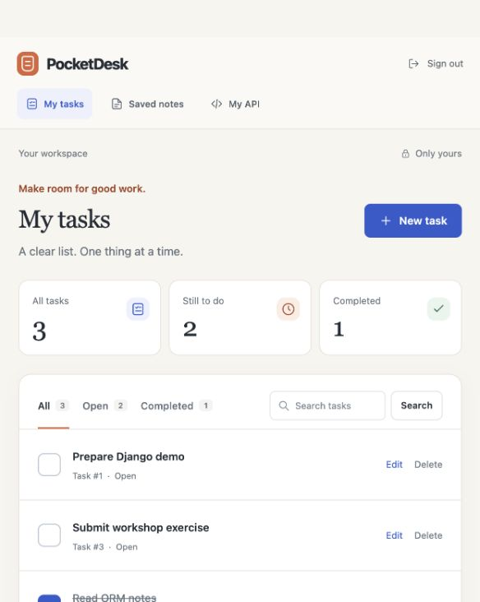
07 / Live project companion
PocketDesk, now a working application
The project you can run
Personal tasks
Saved key-value notes
Session login and token REST
Owner-protected data
Complete Python source
README and deployment guide
Tests and database migrations
Actual local application with fictional demo records
BHAVYA SHAH / DJANGO WORKSHOP
71
Notes:
This companion turns the teaching examples into a runnable repository. Open pocketdesk/README.md first. The code adds a separate entries app, real saved-note pages, timestamps, uniform pagination, normalized keys and production safeguards. The core workshop remains a progression of small teaching excerpts. The project has not been deployed to a public Vercel account. Do not put secrets into note values.
Source of truth: pocketdesk/README.md and the Python project delivered with this presentation. Screenshots in this appendix are captured from the running local Django app with fictional demonstration data. They do not claim a live Vercel deployment. The earlier 70 slides retain their original teaching excerpts and illustrative screenshots.

Slide 72
07 / Live project companion
The delivered project structure
Directory or file | Responsibility
manage.py and config/ | Commands, settings, routes, WSGI and middleware
accounts/ | Account creation and login-related behavior
tasks/ | TODO model, forms, HTML views, API and tests
entries/ | Key-value model, validation, HTML views and API
templates/ and static/ | Shared layout, responsive pages and local assets
docs/ | Screenshots, API, architecture and deployment
requirements.txt and vercel.json | Runtime dependencies and deployment configuration
Each app keeps data, browser behavior and REST code in separate files.
BHAVYA SHAH / DJANGO WORKSHOP
72
Notes:
Within tasks and entries, models.py defines persisted fields, forms.py validates HTML input, views.py handles browser requests, serializers.py validates JSON, api.py defines REST actions, urls.py defines HTML routes, migrations/ versions schema, and tests cover observable behavior. Entry lives in a separate app here instead of sharing tasks/models.py as in the minimal workshop excerpt. The actual project uses root-level templates/. See docs/TEACHING_MAP.md for slide-to-file mappings.
Source of truth: pocketdesk/README.md and the Python project delivered with this presentation. Screenshots in this appendix are captured from the running local Django app with fictional demonstration data. They do not claim a live Vercel deployment. The earlier 70 slides retain their original teaching excerpts and illustrative screenshots.

Slide 73
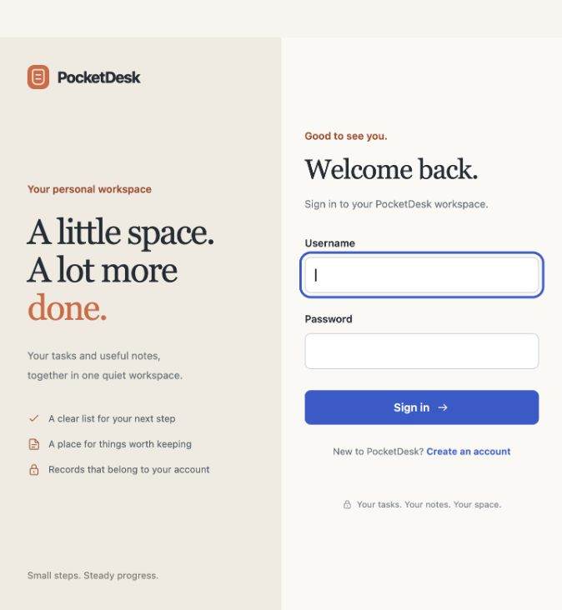
07 / Live project companion
Local setup and your first login
Terminal inside pocketdesk/
python3.13 -m venv .venv
source .venv/bin/activate
python -m pip install -r requirements-dev.txt
python scripts/init_local.py
python manage.py migrate
python manage.py runserver
Open http://127.0.0.1:8000/
Create a local account, then sign in.
Full Windows commands and environment
explanations are in README.md.
BHAVYA SHAH / DJANGO WORKSHOP
73
Notes:
Prerequisite Python 3.13. On Windows use py -3.13 -m venv .venv and .venv\Scripts\Activate.ps1. The initializer creates a private local .env and preserves an existing file. The application starts empty. Optional seed_demo creates fictional local data only when DEBUG=True and needs an explicitly supplied password. Do not run startproject again inside the delivered repository. The repo already contains its models and migrations. SQLite is for local learning only. Never use runserver as the Vercel production entrypoint.
Source of truth: pocketdesk/README.md and the Python project delivered with this presentation. Screenshots in this appendix are captured from the running local Django app with fictional demonstration data. They do not claim a live Vercel deployment. The earlier 70 slides retain their original teaching excerpts and illustrative screenshots.

Slide 74
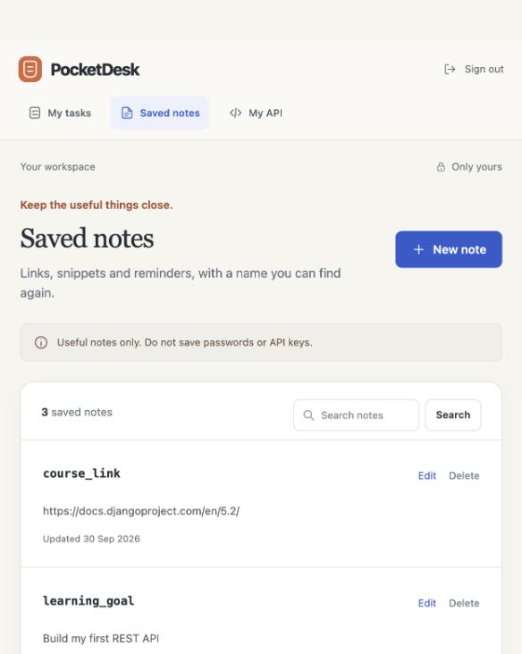
07 / Live project companion
Saved notes in the browser and REST
One useful key
POST /api/entries/
{
"key": "course_link",
"value": "Django workshop"
}
GET /api/entries/by-key/
?key=course_link
Keys are unique per account.
Values are ordinary text.
No passwords or API secrets.
BHAVYA SHAH / DJANGO WORKSHOP
74
Notes:
The browser and API both store Entry rows. Each key is normalized to lowercase, with 1–80 ASCII letters, digits, underscores or hyphens. Values contain 1–5,000 characters after trimming. The composite owner/key uniqueness constraint protects integrity and concurrent duplicate writes return a validation error. Two users may both own course_link. To update a value use PATCH /api/entries/<actual-id>/. This is not a password manager and does not encrypt values end to end. The line break before ?key is for slide readability, not part of the actual URL.
Source of truth: pocketdesk/README.md and the Python project delivered with this presentation. Screenshots in this appendix are captured from the running local Django app with fictional demonstration data. They do not claim a live Vercel deployment. The earlier 70 slides retain their original teaching excerpts and illustrative screenshots.

Slide 75
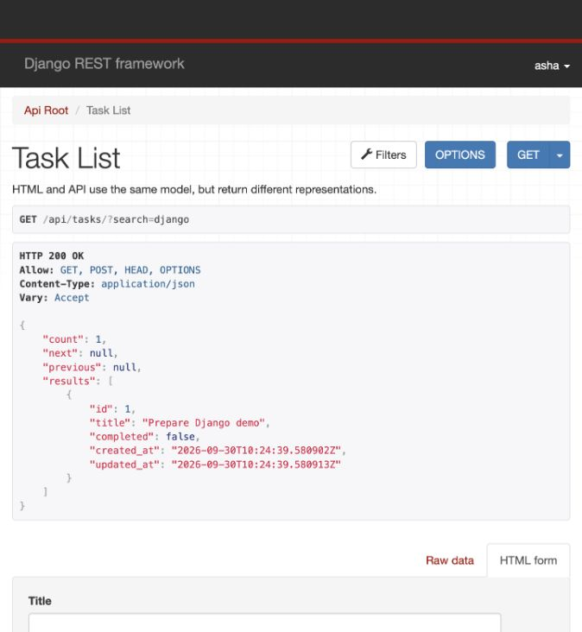
07 / Live project companion
The real API contract
Private client token
python manage.py drf_create_token asha
Authorization: Token <private-token>
GET /api/tasks/?search=django
PATCH /api/tasks/<id>/
{"completed": true}
201 Created
400 Invalid input
401 No usable credentials
404 No owned record
204 Deleted, no response body
Paginated lists include count and results.
BHAVYA SHAH / DJANGO WORKSHOP
75
Notes:
Use TokenAuthentication followed by SessionAuthentication, as in the workshop. Tokens are provisioned through the management command rather than a public password-to-token endpoint. Never project or commit the token printed by the command. Use HTTPS outside localhost. Browser sessions require CSRF on unsafe requests. DRF simple tokens do not expire automatically; use drf_create_token --reset username to rotate, or remove a token in admin to revoke. README and docs/API.md describe the full contract. IDs and timestamps are assigned at runtime.
Source of truth: pocketdesk/README.md and the Python project delivered with this presentation. Screenshots in this appendix are captured from the running local Django app with fictional demonstration data. They do not claim a live Vercel deployment. The earlier 70 slides retain their original teaching excerpts and illustrative screenshots.

Slide 76
07 / Live project companion
Vercel configuration and persistent data
Production setting | Purpose
DEBUG=False | Disable debug error pages
DJANGO_SECRET_KEY | A fresh private signing key
DATABASE_URL | External PostgreSQL connection using SSL
DJANGO_ALLOWED_HOSTS | Exact deployment and custom-domain hostnames
DJANGO_CSRF_TRUSTED_ORIGINS | Exact HTTPS origins for browser form submissions
PUBLIC_SIGNUP_ENABLED=False | Provision intended users before opening registration
Root Directory: pocketdesk Python: 3.13 Entry: config.wsgi:application
Vercel serves collected static assets. PostgreSQL stores application state.
BHAVYA SHAH / DJANGO WORKSHOP
76
Notes:
Set real values in Vercel environment settings, separately for Preview and Production. Do not put secrets into this slide or commit a .env file. Verify the exact names in .env.example and config/settings.py. Vercel discovers manage.py and the WSGI entrypoint and automatically runs collectstatic when STATIC_ROOT is set. Do not store production state in SQLite, local files or process memory. Use separate preview and production databases and a provider pooled URL for runtime traffic. Sources: https://vercel.com/docs/frameworks/full-stack/django and https://vercel.com/docs/functions/runtimes/python . Checked 30 September 2026.
Source of truth: pocketdesk/README.md and the Python project delivered with this presentation. Screenshots in this appendix are captured from the running local Django app with fictional demonstration data. They do not claim a live Vercel deployment. The earlier 70 slides retain their original teaching excerpts and illustrative screenshots.

Slide 77
07 / Live project companion
A controlled deployment lifecycle
01
Configure
Link the project. Add exact hosts, secrets and PostgreSQL.
02
Prepare the database
Review migrations and apply them to the intended environment.
03
Deploy
Build the Django function and collect static assets.
04
Verify
Test login, private CRUD, REST, CSS and persistence.
No migrations at request time. No production database in preview builds.
BHAVYA SHAH / DJANGO WORKSHOP
77
Notes:
Follow docs/VERCEL.md, not a screenshot of another account. For a first launch, configure the project and database, run migrate deliberately through vercel env run -e production -- python manage.py migrate, then deploy production and provision an intended account. For updates, take backups and use backward-compatible schema changes so existing workers remain valid during rollout. Use a direct database endpoint for DDL if required by your provider. Vercel CLI login, project creation, DB provisioning and publication require your account and decisions; this delivered project does not perform them. Source: https://vercel.com/docs/cli/env .
Source of truth: pocketdesk/README.md and the Python project delivered with this presentation. Screenshots in this appendix are captured from the running local Django app with fictional demonstration data. They do not claim a live Vercel deployment. The earlier 70 slides retain their original teaching excerpts and illustrative screenshots.

Slide 78
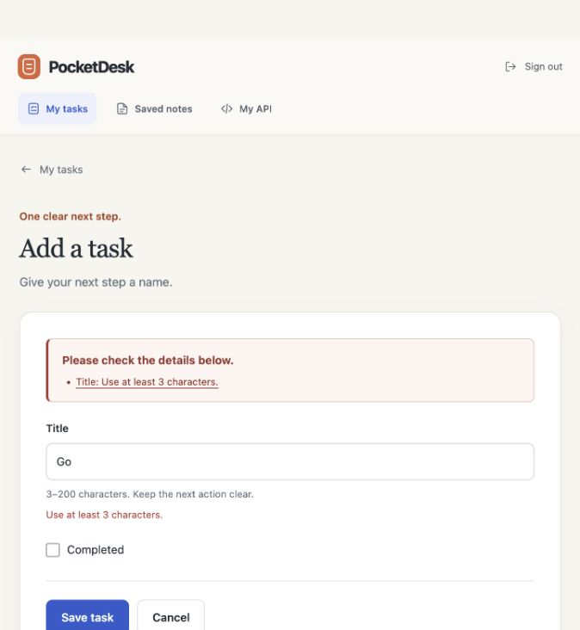
07 / Live project companion
A repeatable live demonstration
Run the checks
python manage.py check
python manage.py makemigrations --check
python manage.py test \
--settings=config.test_settings
ruff check .
Asha creates a task.
The API marks it completed.
The browser shows the new state.
Bob cannot access Asha’s record.
README.md, docs/API.md and docs/VERCEL.md
contain the full commands and troubleshooting.
BHAVYA SHAH / DJANGO WORKSHOP
78
Notes:
Use disposable local demo records and two separate accounts. Show an invalid title such as Go returning a validation error without creating a task. Then create a valid task, obtain a local test token privately, change completed with the API, and refresh the browser. Attempt to fetch the task as another user and observe 404. Run local tests and repeat the staging smoke checklist against PostgreSQL before production use. Automated local checks do not prove a successful public deployment. See docs/VERIFICATION.md for actual completed checks and environmental limits.
Source of truth: pocketdesk/README.md and the Python project delivered with this presentation. Screenshots in this appendix are captured from the running local Django app with fictional demonstration data. They do not claim a live Vercel deployment. The earlier 70 slides retain their original teaching excerpts and illustrative screenshots.

