Slide 1
CNN BASED CHARACTER RECOGNITION FOR ISOLATED HANDWRITTEN GUJARATI CHARACTERS AND NUMERALS
-Prepared By:
Shah Devanshi – 20IT128
Shah Heli – 20IT130
Students of 2nd year, 3rd semester.
-Guided By:
Sanket Suthar
Assi.Professor at IT department

Slide 2
Content
Definition and need of the project
Project plan
Software, Hardware and language requirements at Character Recognition
Flowchart of the project
Brief description of Image segmentation and Character recognition
Brief description of CNN (Convolutional neural network)
Information related to datasets
References
Conclusion

Slide 3
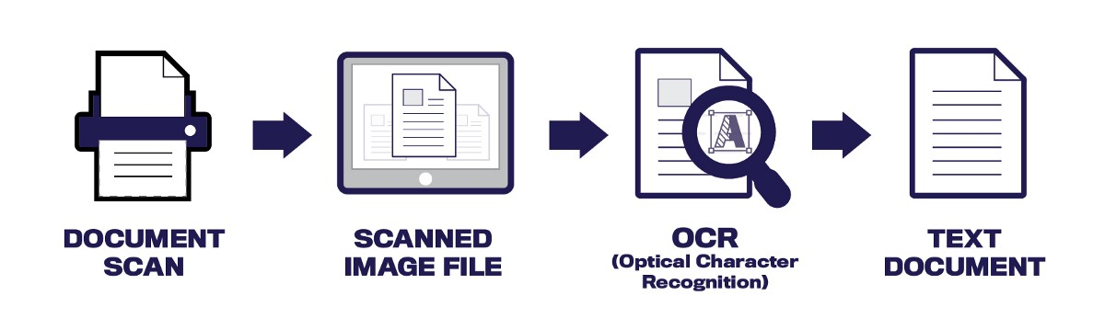
Definition and Need of project
We are continuing this project in our regional language i.e. Gujarati.
This project can be used for the recognition of the text from the image scanned material with the help of device like OCR (Optical Character Recognition).
There are many OCR devices for different languages yet not for Gujarati language so we are focusing on it. So we are understanding and willing to explore in this field.

Slide 4
Project Plan
 | Task
31st July | Finding definition for the project
7th august – 13th august | Understanding of definition
14th august – 28th august | Gathered sample datasets() from different age groups via different pens for different variations of Gujarati characters and numerals.
29th august – 11th September | Learning concepts of Python required for box detection of images and later on working on the code.
12th September – 31st October | Gathering of remaining datasets and understanding concept of CNN.
1st November – 8th November | Started working on the code of CNN with the reference of Bengal, Tamil and Devanagari language.
9th November – 12th November | Trying to resolve the error in the code of CNN

Slide 5
Software, Hardware And Language Requirements for Character Recognition
Software Requirement: PyCharm (64-bit)
Hardware Requirement: Minimum 8 GB RAM laptop
Minimum i3 or i5/i7 processor
Scanner for scanning data sets
GPU for checking accuracy of datasets through CNN code.
Language requirement: Python and some concepts related to OpenCV, neural networking and machine learning.

Slide 6
Flowchart of the project
Collection of datasets from different age groups
Examining the Datasets
Working on the code of image segmentation
Checking the accuracy of collected datasets
Understanding the code of CNN and running on GPU
Image segmentation by image processing

Slide 7
Information Related To Datasets
A collection of related sets of information that is composed of separate elements but can be manipulated as a unit by a computer.
In our project we need to collect datasets for all 35 base characters, with 12 modifiers and numerals.
We can see sample of datasets on the next slide.

Slide 8
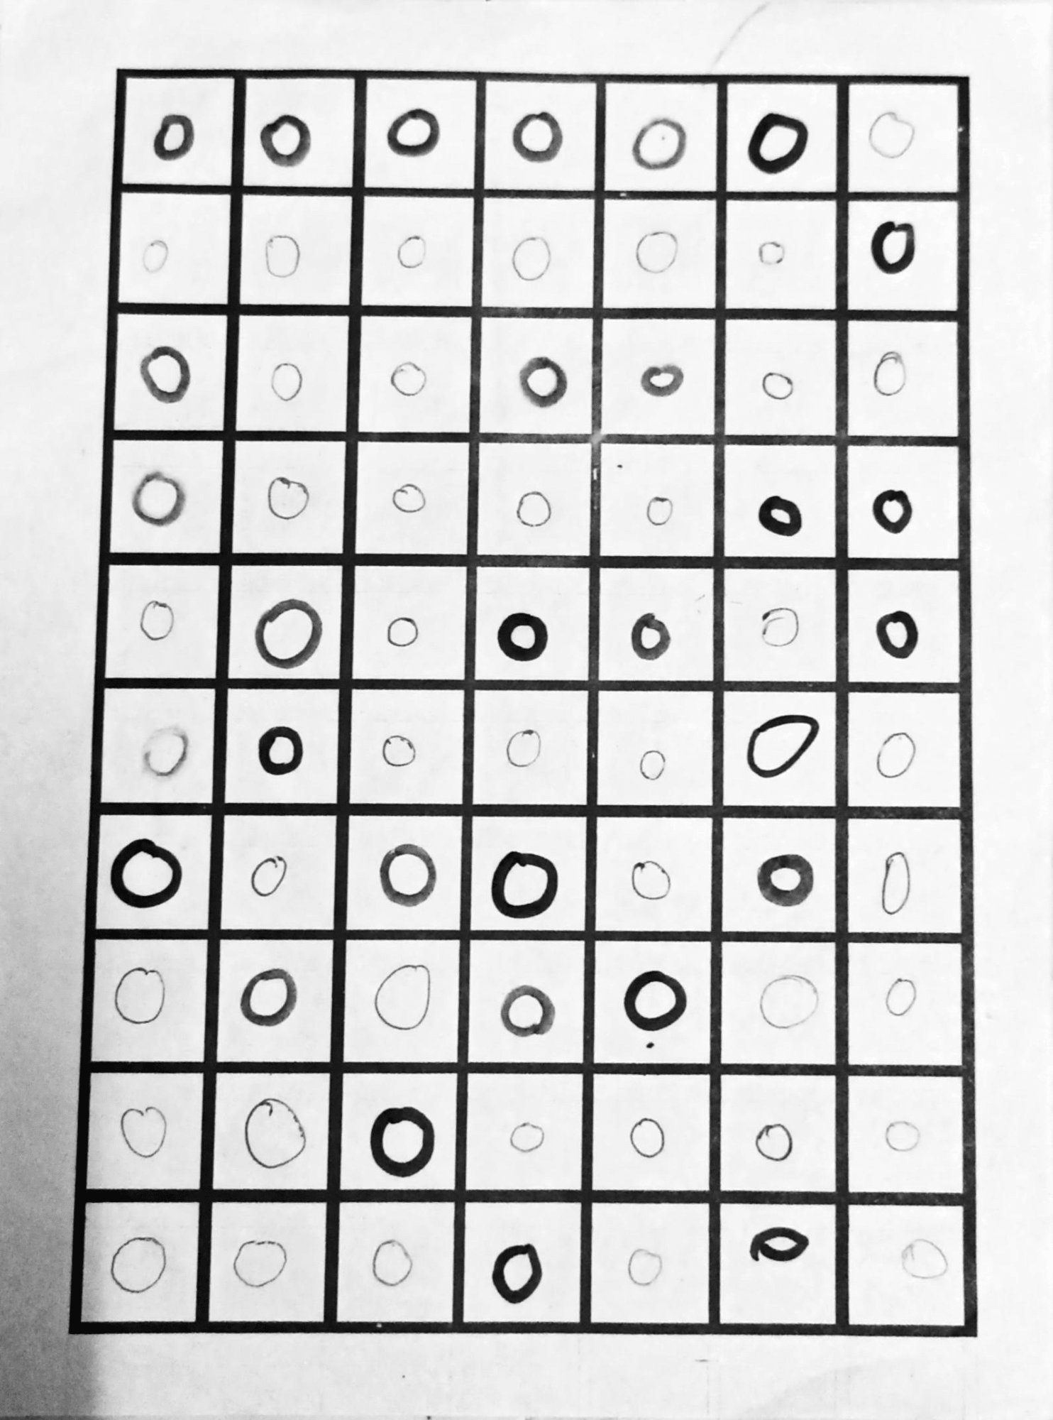
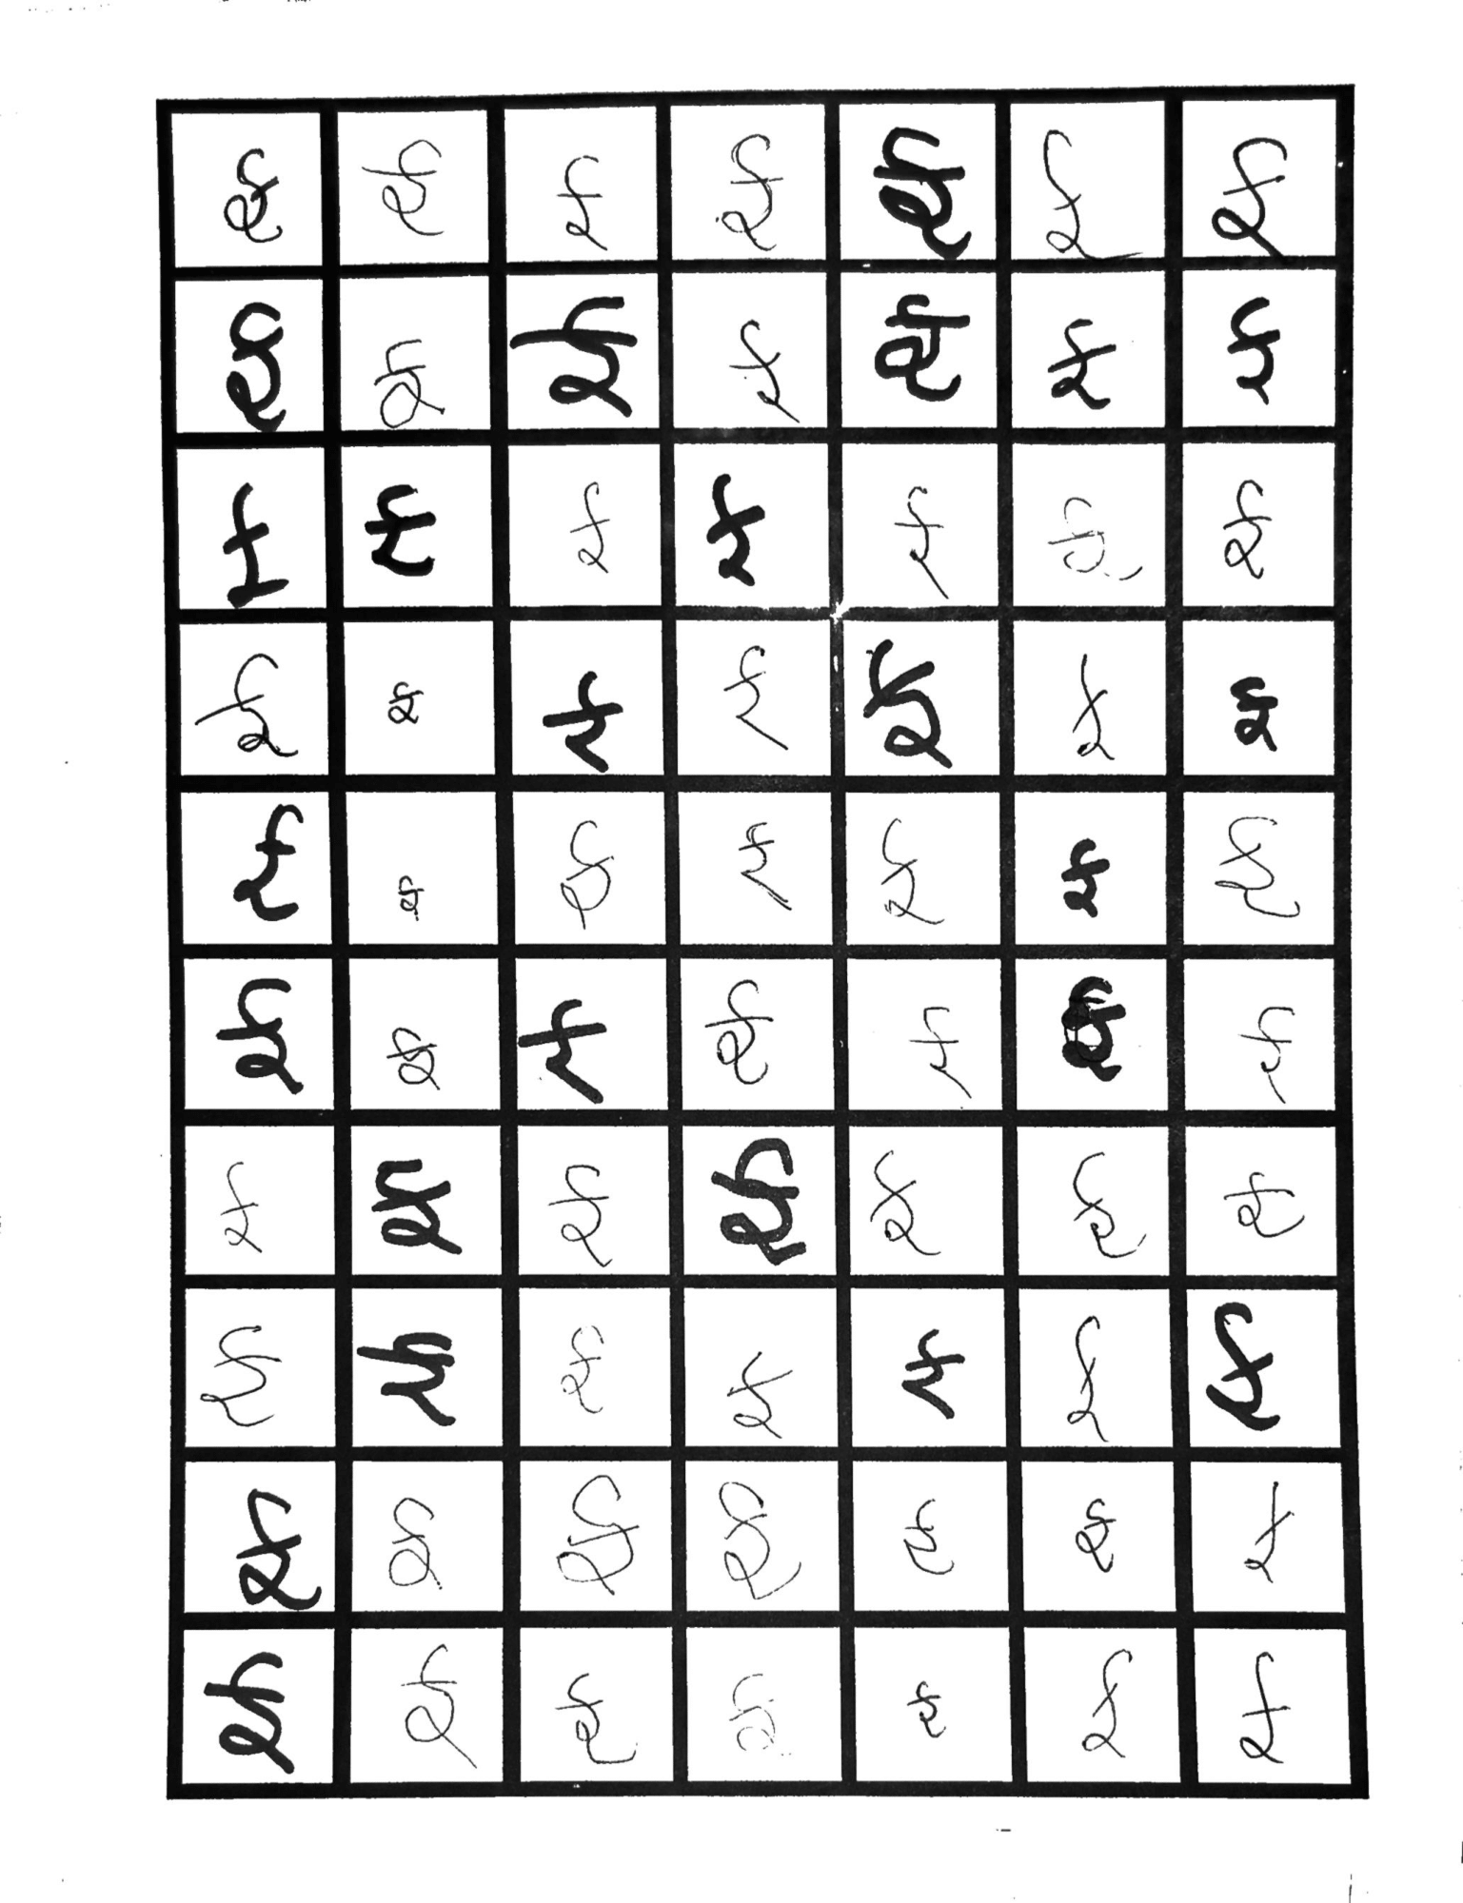
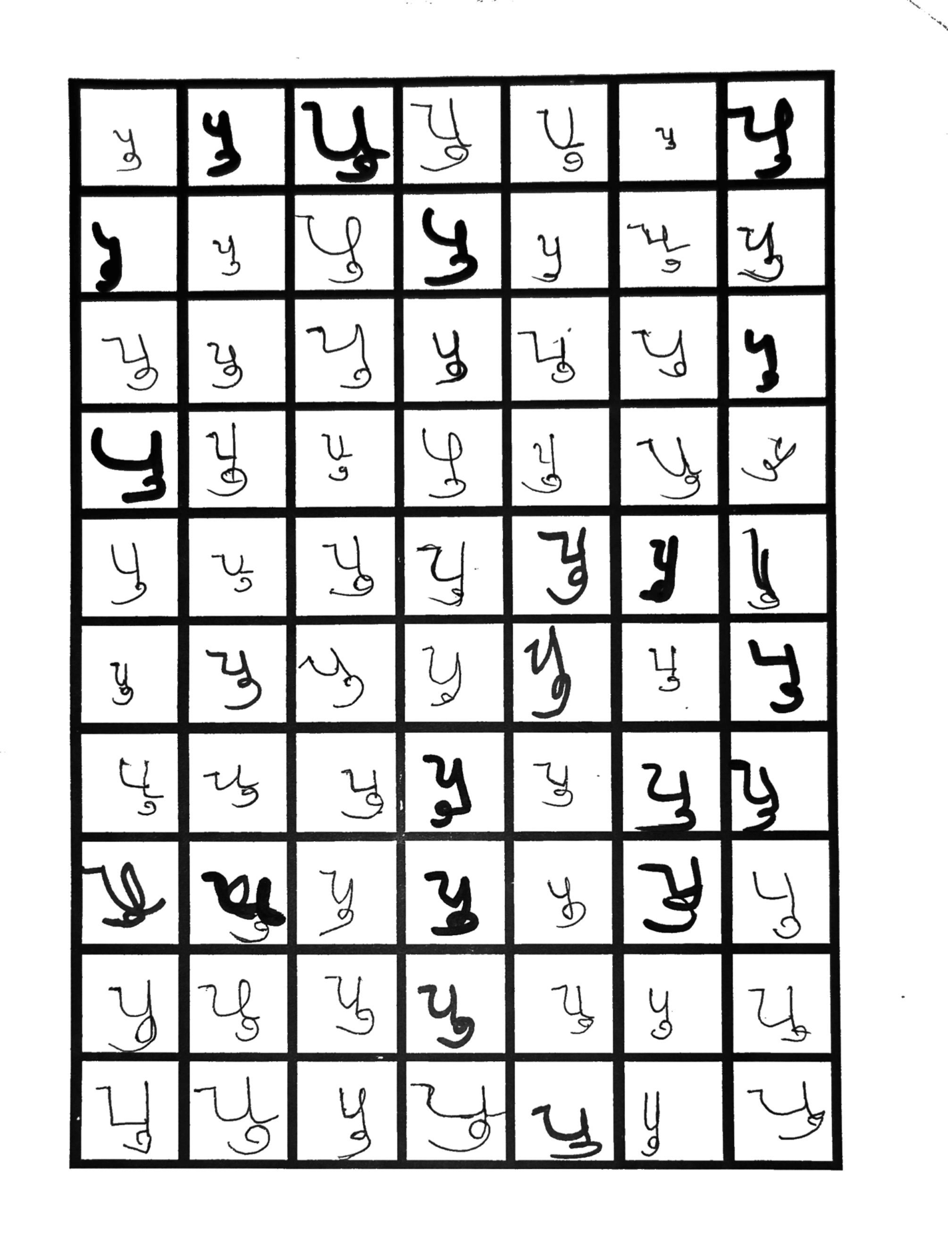

Slide 9
Journey Of Collecting Datasets
Datasets of Gujarati language were collected by making different age group people write with using different thickness of pens so that we can obtain maximum number of variations with noisiness and blurriness.
In datasets we need to collect 350 samples for each base character, modifiers and numerals as well.
350 is not a fixed value but that is our minimum requirement so that more variations can build the project more accurate.
In current situation we are done with numerals and almost with each and every base characters and many of the modifiers. We are trying to collect remaining datasets as soon as possible.

Slide 10
Brief Description Of Character Recognition And Image Segmentation

Slide 11
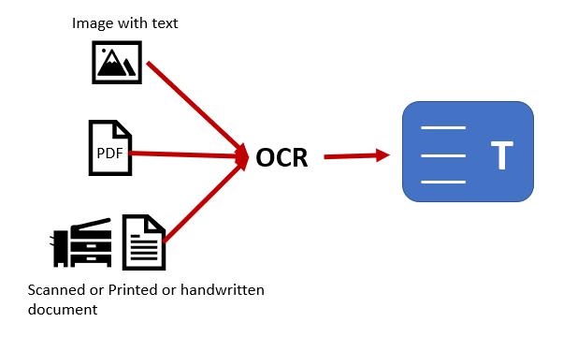
Character Recognition
Character recognition is the recognition of the text through the scanned material that must be in Image format.
Through the device like OCR, we can recognize the letters from scanned image and letters gathered and forms word and words gathers and forms the sentences and these is how character recognizing works.

Slide 12
Information Related To Segmentation
Division any image into separate parts or sections.
There are many types of segment such as:
Market segmentation, Line segmentation, Image segmentation, etc
In our project we are focusing on Image Segmentation.
It extracts the objects of our interest, for further processing such as description or recognition.
Segmentation techniques are used to isolate the desired object from the image in order to perform analysis of the object.

Slide 13

Image Segmentation
Image segmentation for characters is an operation that seeks to decompose an image of a sequence of characters into sub-images of individual symbols.
There are many types of image segmentation techniques among them we are focusing on:
Thresholding Segmentation
Edge-Based Segmentation

Slide 14
Thresholding Segmentation
Thresholding is a type of image segmentation, where we change the pixels of an image to make the image easier to analyze.
In thresholding, we convert an image from color or grayscale into a binary image i.e., one that is simply black and white.

Slide 15
Edge based Segmentation
In edge-based segmentation, an edge filter is applied to the image, pixels are classified as edge or non-edge depending on the filter output, and pixels which are not separated by an edge are allocated to the same category.

Slide 16
Now, Let us look over a code of box detection used for image segmentation

Slide 17
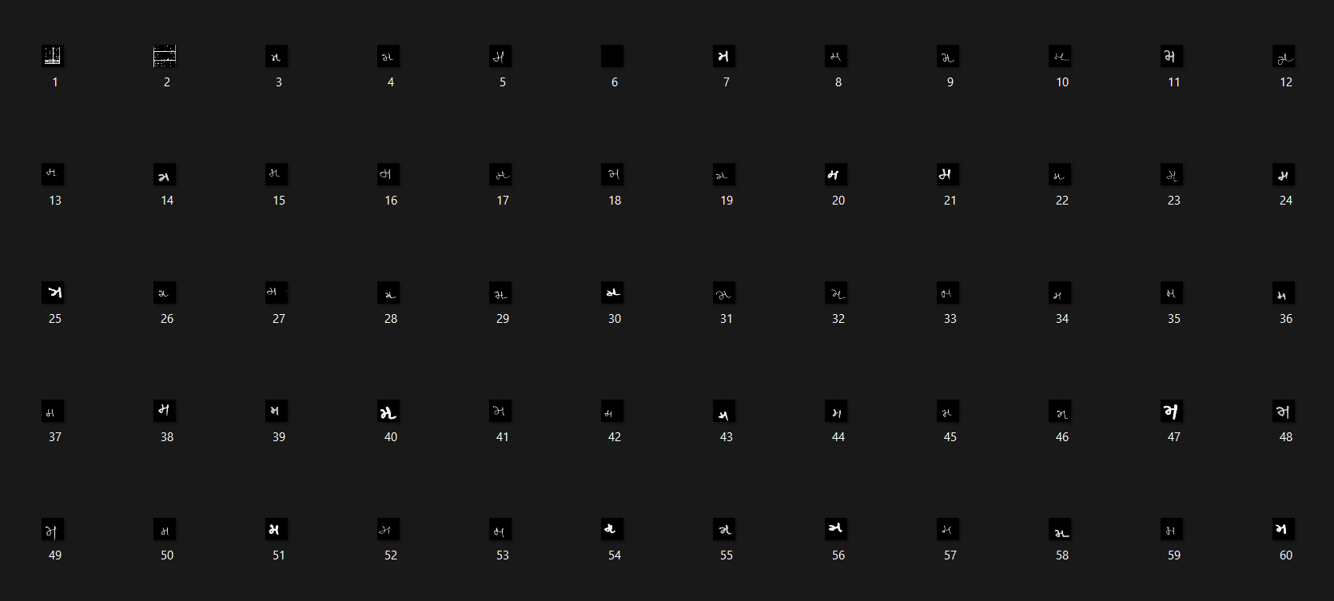
The Result Which Is Obtained By The Box detection Code For Particular Literal

Slide 18
What is CNN?
CNN stands for Convolutional Neural Network.
It is a neural network that has one or more convolutional layers which are used for image processing, classification, segmentation, etc.
CNN is a kind of filter over the input.
CNN is a type of Artificial neural network used in image recognition and processing which is specified for particular fixed pixels.

Slide 19
Let Us Know How Does Computers Read Images
Computers understand only binary language which is in 0’s and 1’s.
Machine reads the data referring to backslash (\) and frontslash (/).
Any character or any object inside an image will make a shape with the use of \ and / in the square boxes.
So, the machines (computers) read images in the form of sequence of bits.
If any 3x3 matrix is found it will convert it into 2x2 matrix then in sequence form and then it will interpret the image and object inside the image.

Slide 20
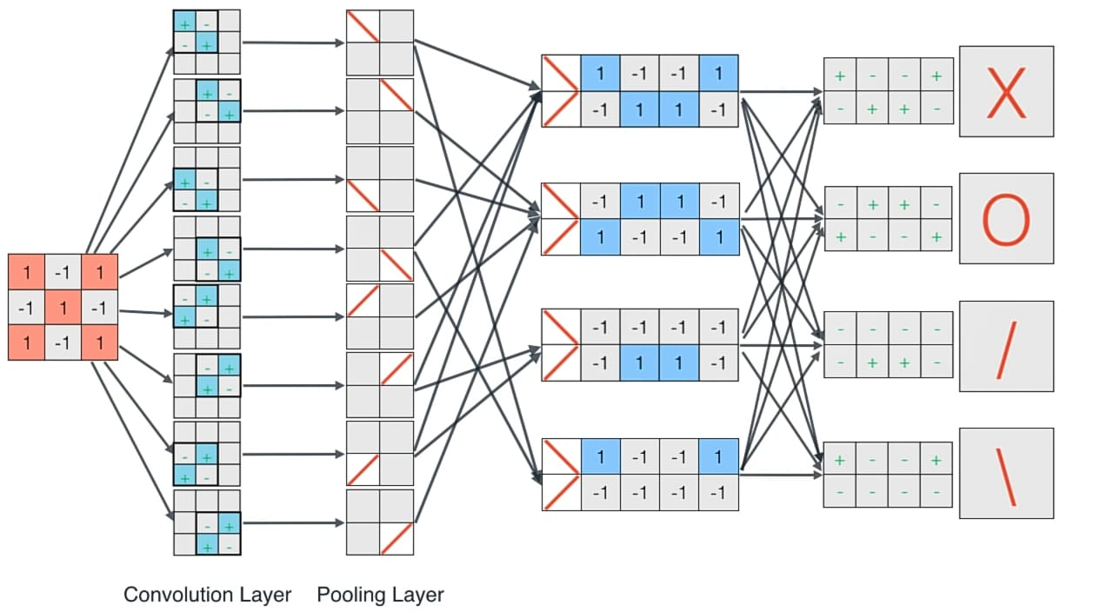
Example:

Slide 21
Some of the concepts in CNN
There are three basic concepts that we need to know before understanding the code.
Convolutional layer
Pooling layer
Fully connected layer

Slide 22
Brief Information of concepts in CNN
Convolutional: Convolution is the first layer to extract features from an input image. Convolution preserves the relationship between pixels by learning image features using small squares of input data. It is a mathematical operation that takes two inputs such as image matrix and a filter or kernel.
Pooling Layer: Pooling layers are used to reduce the dimensions of the feature maps. Thus, it reduces the number of parameters to learn and the amount of computation performed in the network. The pooling layer summarizes the features present in a region of the feature map generated by a convolution layer.
Fully Connected Layer: Fully Connected Layer is simply, feed forward neural networks. Fully Connected Layers form the last few layers in the network. The input to the fully connected layer is the output from the final Pooling or Convolutional Layer, which is flattened and then fed into the fully connected layer.

Slide 23
Let us go through a CNN code for checking accuracy of isolated gujarati handwritten characters

Slide 24
References
https://www.researchgate.net/publication/49592833_A_Review_of_Research_on_Devnagari_Character_Recognition
https://www.researchgate.net/publication/350489483_Bangla_Handwritten_Character_Recognition_Using_Extended_Convolutional_Neural_Network
https://youtu.be/2-Ol7ZB0MmU

Slide 25
Conclusion
Our project shows an effective utilization of proposed version of CNN model to classify or recognize gujarati handwritten characters and provides better result.
Code we are working on can be used for making devices like OCR which will convert scanned image text written in gujarati language to any desired language.

Slide 26


