Slide 1
CIVIC & COMMUNITY ENGAGEMENT
Empowering Society Through
Welfare and Environmental Stewardship
Shah Faisal (23I-0058) | Hamad Khan (23I-3095)
Supervisor: Miss. Hina Hafeez | Al-Khidmat Foundation Islamabad | Group 10 – SE-A

Slide 2
Project Overview
Organization
Al-Khidmat Foundation Islamabad
Duration
8 Weeks (Feb 27 – Apr 15, 2026)
Beneficiaries
65+ community members
Activities
Iftar Drive, Plantation, Teaching, AI App Development
SDGs Aligned
SDG 1, 2, 3, 4, 13

Slide 3
SDG Alignment
SDG 1: No Poverty
SDG 2: Zero Hunger
Food support via Iftar Drive for 40+ underprivileged families
Nutritious Iftar meals distributed in G-7/2 Islamabad
SDG 4: Quality Education
SDG 13: Climate Action
Teaching session for 25 children at CPC Khanapul
15 trees planted in Swabi for environmental conservation

Slide 4
WEEK 1
Online Orientation Session
27 February 2026

Slide 5
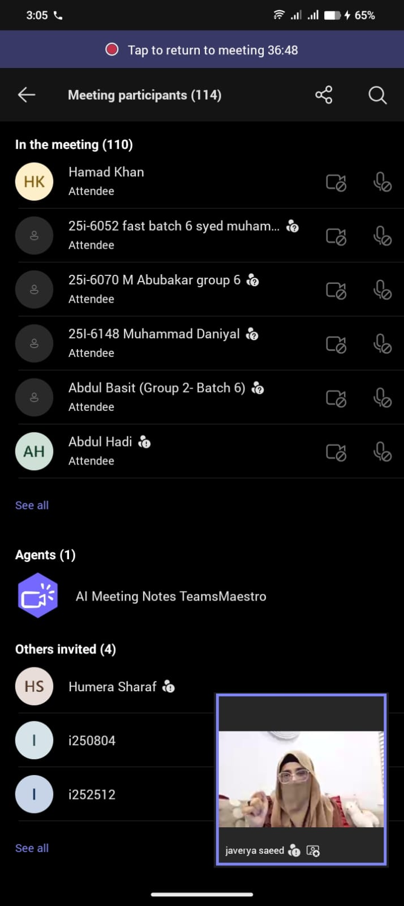
Week 1 – Online Orientation Session
Official kickoff of the Civics & Community Engagement project
Attended via Microsoft Teams with 110+ participants
Supervised by field coordinator at Al-Khidmat Foundation
Received project guidelines, community activity schedule, and ethical protocols
Teams assigned to different community engagement activities

Slide 6
WEEK 2
Iftar Drive – G-7/2 Islamabad
4 March 2026

Slide 7
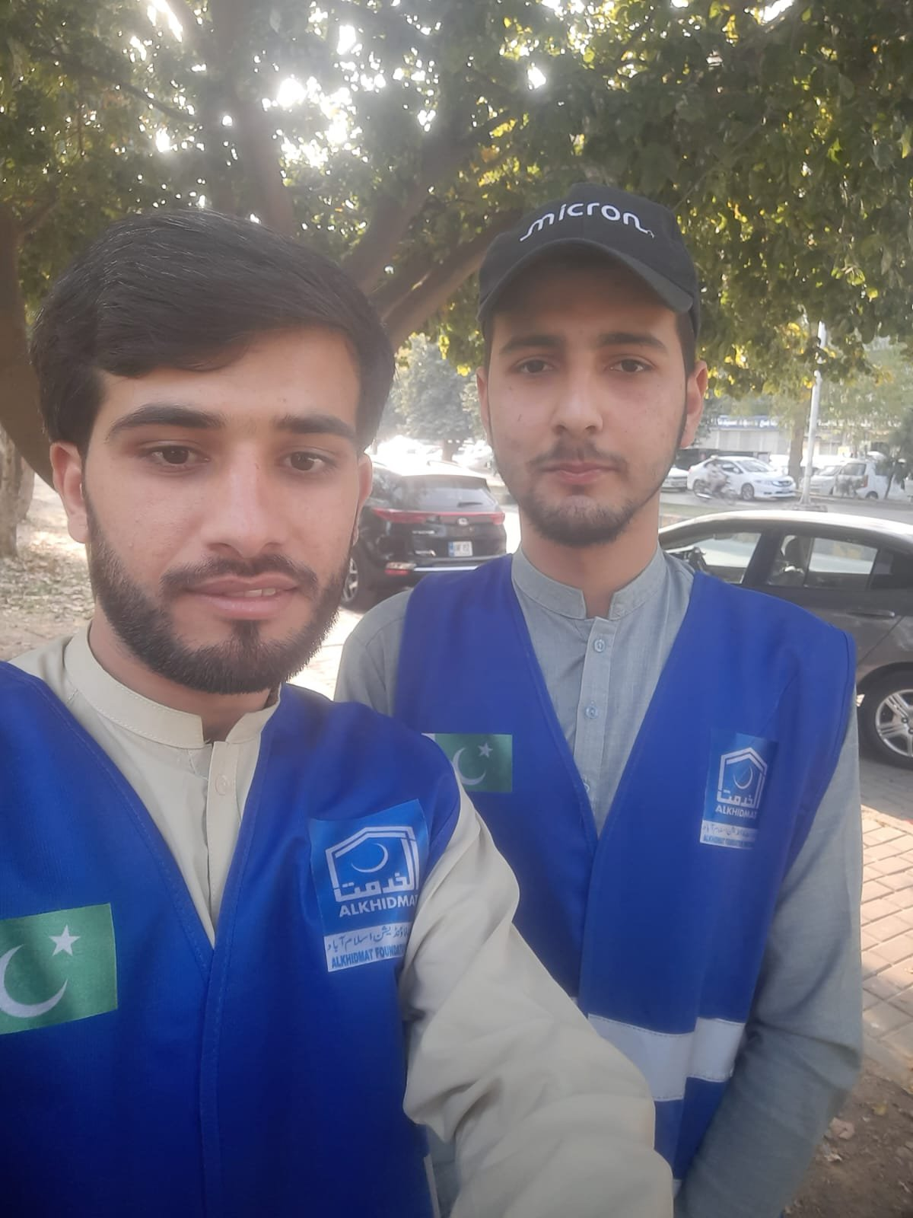
Week 2 – Iftar Drive at G-7/2 Islamabad
Organized food drive during the holy month of Ramadan
Served 40+ underprivileged community members
Prepared and distributed Iftar packages including fruits, dates, and meals
Partnered with Al-Khidmat volunteers in blue vests
Addressed SDG 1 (No Poverty) and SDG 2 (Zero Hunger)
Activity conducted with full cultural sensitivity

Slide 8
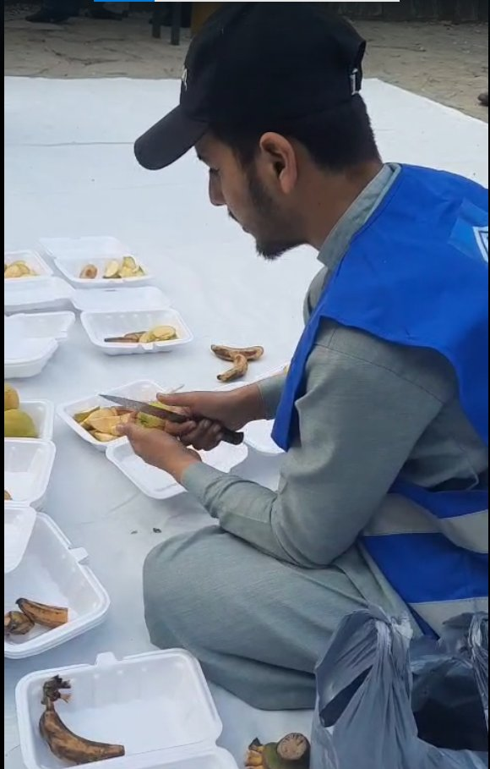
Week 2 – Iftar Drive: Activity Photos
Preparing Iftar packages
Volunteers ready to serve

Slide 9
WEEK 3
Online Seminar – Peak Performance
11 March 2026

Slide 10
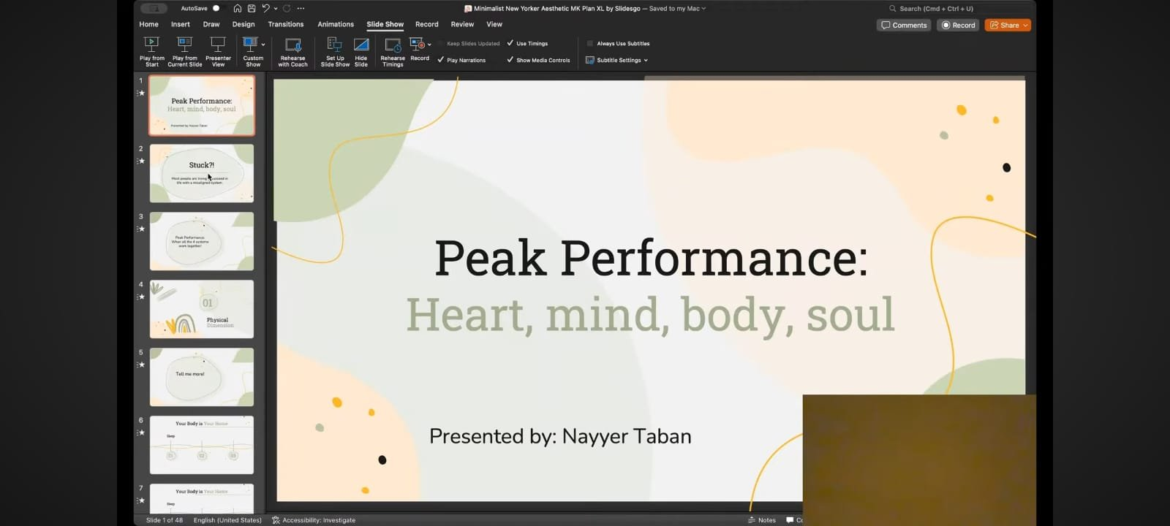
Week 3 – Peak Performance Seminar
Online seminar: 'Peak Performance: Aligning the Four Dimensions'
Delivered by speaker Nayyer Taban via Microsoft Teams
114 participants from multiple groups attended
Topics: Physical, Mental, Emotional, and Spiritual wellbeing
Concept: 'Energy flows where the Focus goes'
Connected to broader health and community awareness goals

Slide 11
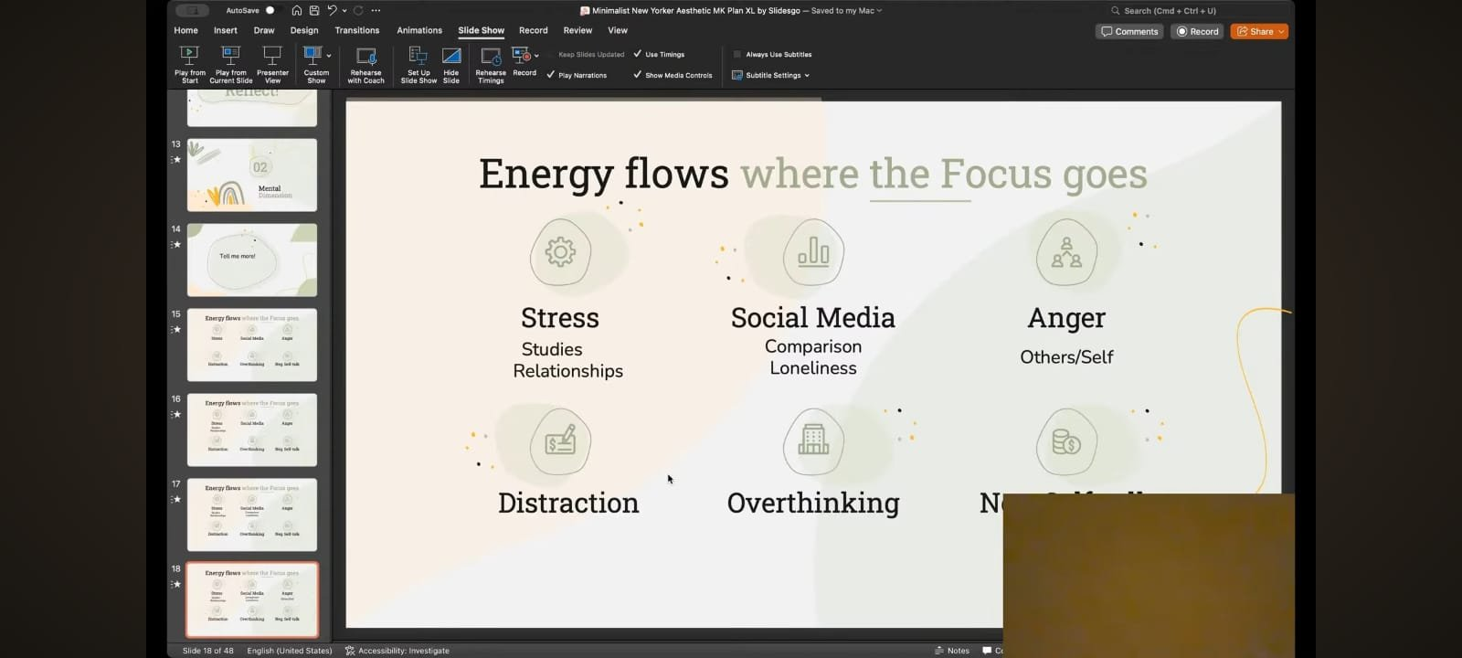
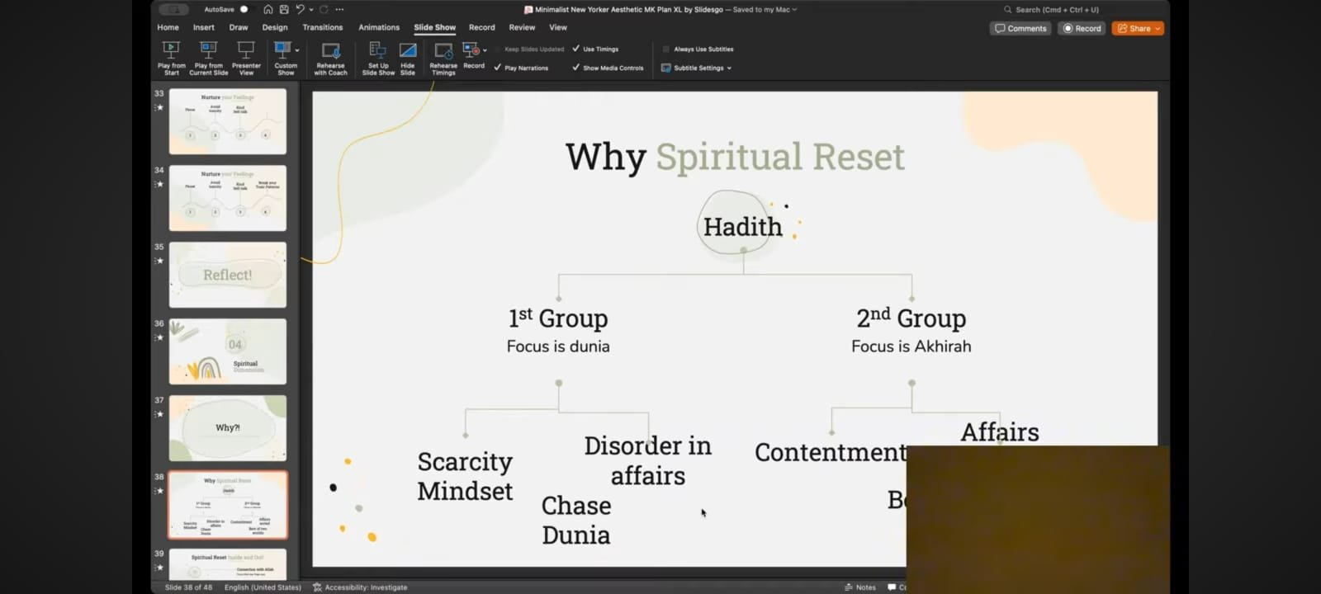
Week 3 – Seminar Screenshots
Peak Performance slide content
Spiritual Reset framework

Slide 12
WEEK 4
Plantation Activity – Swabi
18 March 2026

Slide 13
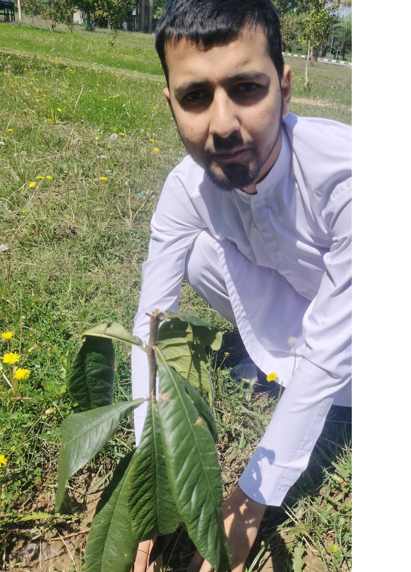
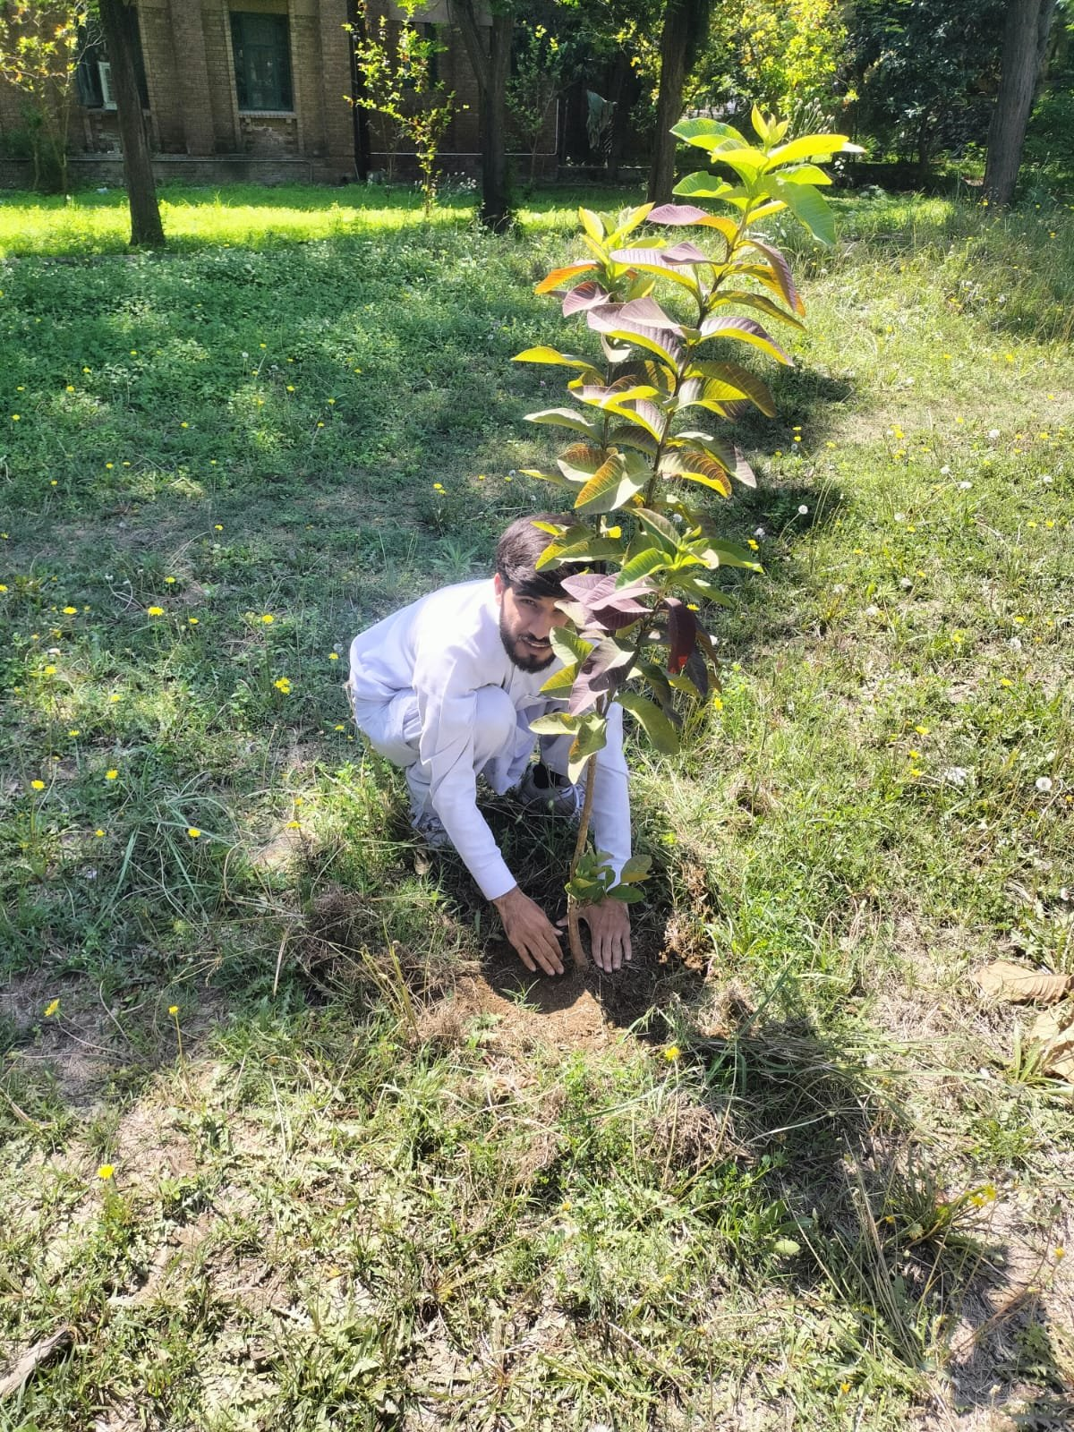
Week 4 – Plantation Activity in Swabi
Planting saplings
Tree planted and secured

Slide 14
Week 4 – Environmental Stewardship
Plantation drive conducted in Swabi (hometown)
Planted 15 trees contributing to local green cover
Species chosen suitable for local climate
Aligned with SDG 13 – Climate Action
Promoted environmental awareness among local community
Physical effort and community volunteering spirit demonstrated

Slide 15
WEEK 5
Teaching at Children Protection Center
25 March 2026

Slide 16
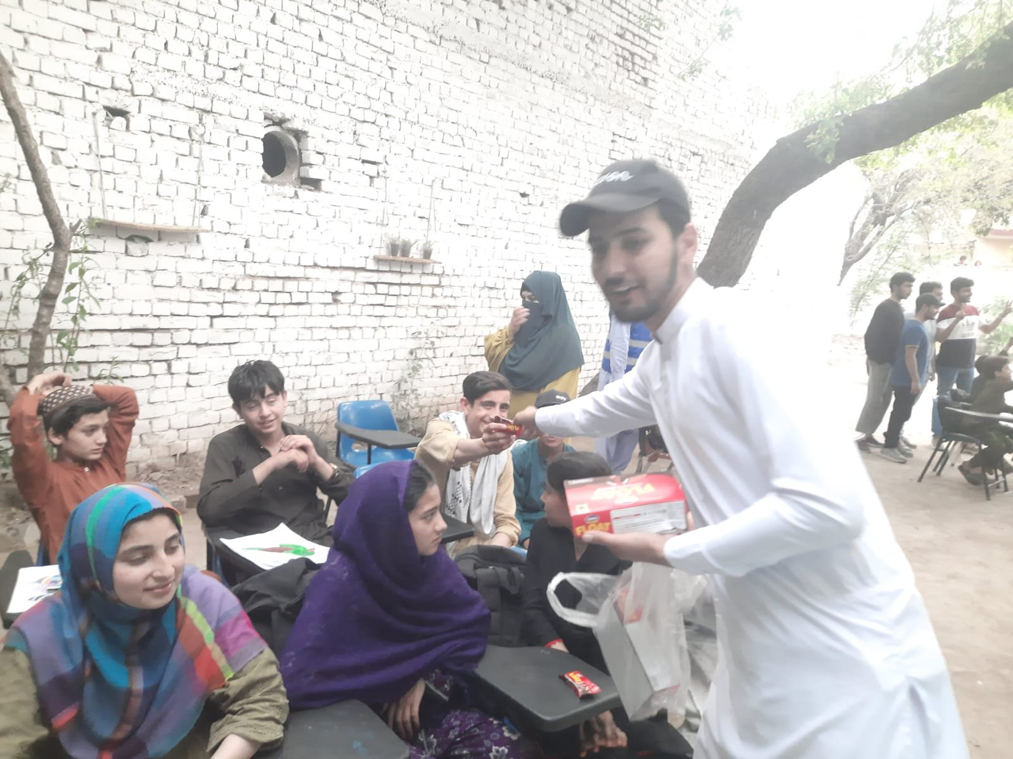
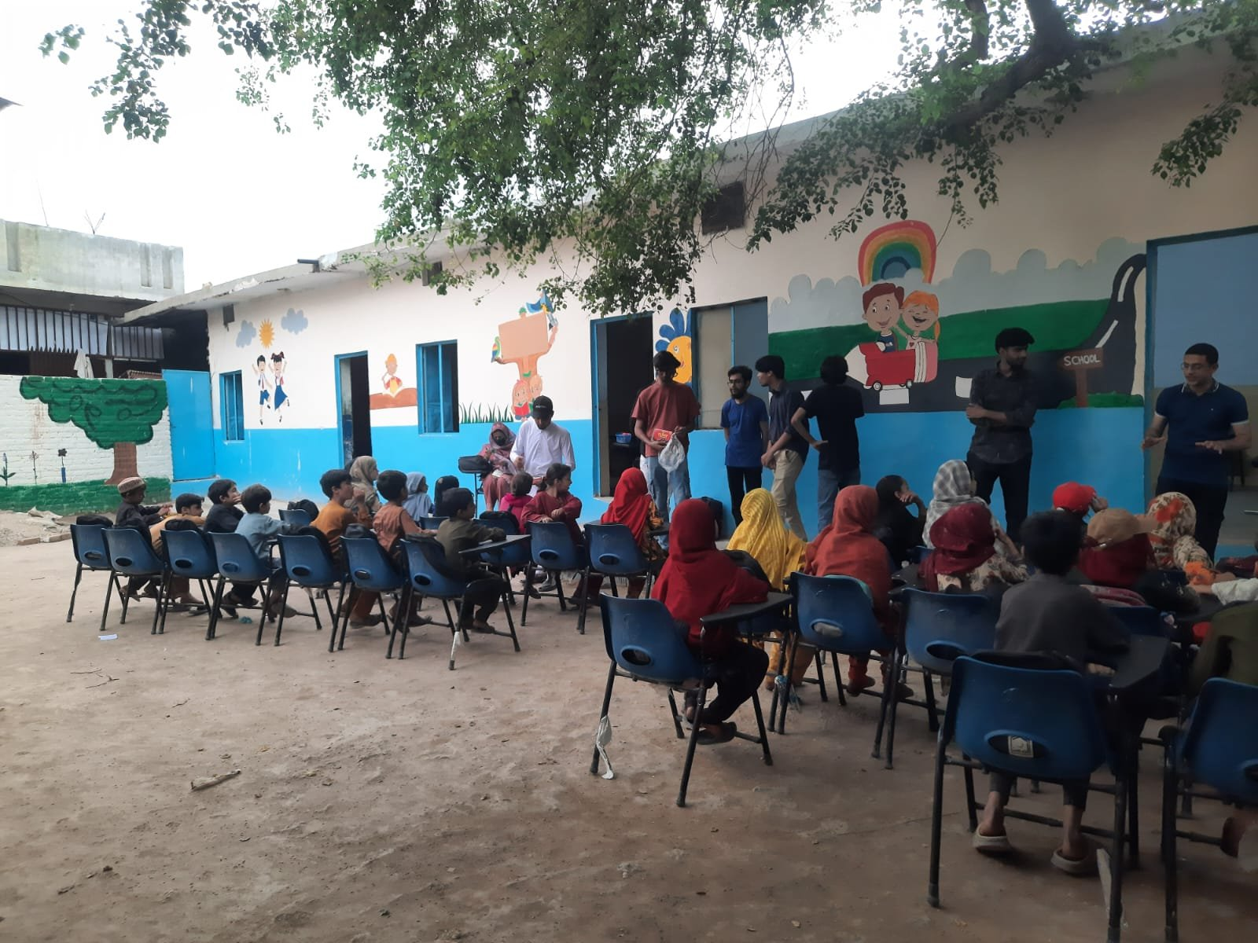
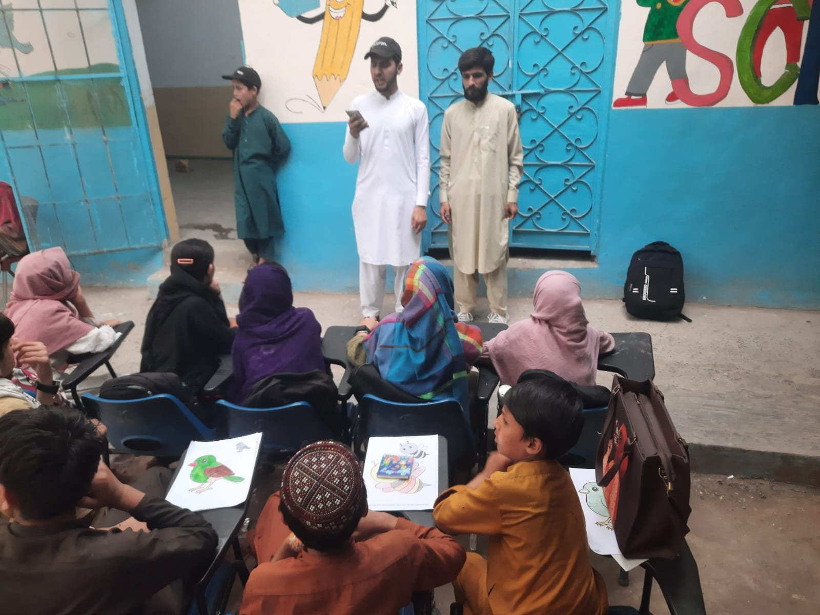
Week 5 – CPC Visit: Activity Photos

Slide 17
Week 5 – Children Protection Center, Khanapul
Conducted interactive teaching session for 25 students (Grade 4 & 5)
Taught basic concepts through drawings and activities
Distributed snacks and educational materials as incentives
Initial hesitancy from children overcome through engaging activities
Directly addressed SDG 4 – Quality Education
Provided emotional support and mentorship to vulnerable children

Slide 18
WEEK 6
Requirements Gathering
1 April 2026

Slide 19
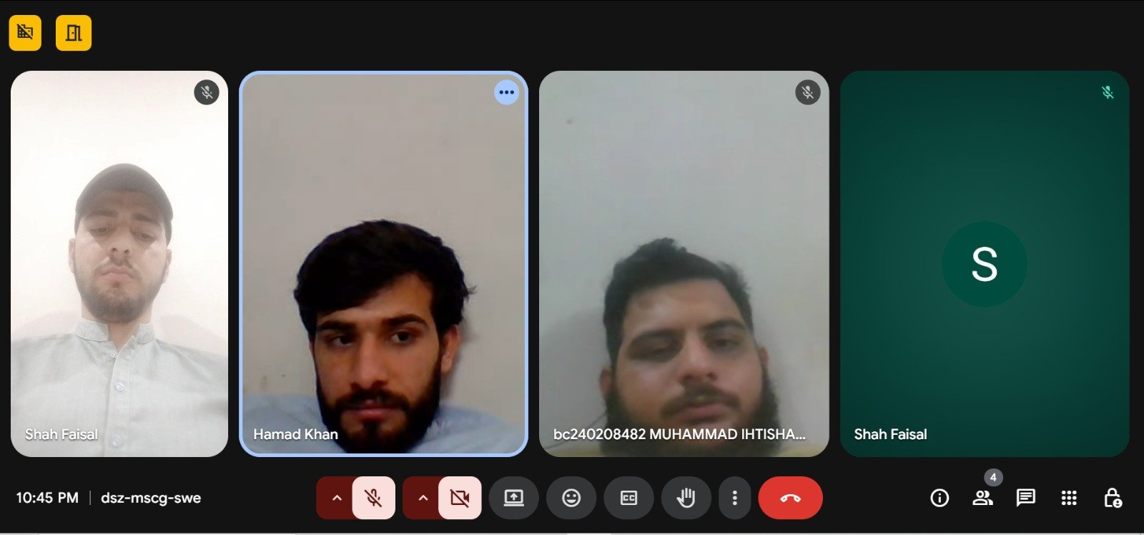
Week 6 – Community App Requirements Gathering
Online meeting with professional software engineer (Funerary Technology)
Discussed scope of AI-powered medical image analysis application
Gathered functional & non-functional requirements
Defined app architecture: React + TypeScript frontend, AI backend
Identified target users: community members needing quick health assessment
App named: MedScan AI (medeye-assist)

Slide 20
WEEK 7
Development Phase
8 April 2026

Slide 21
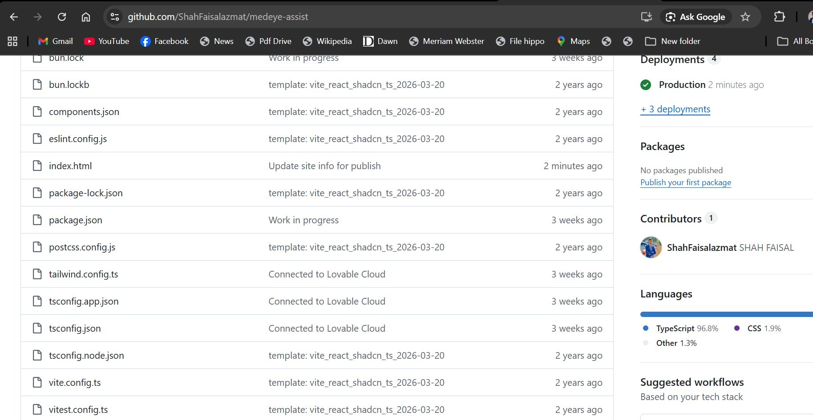
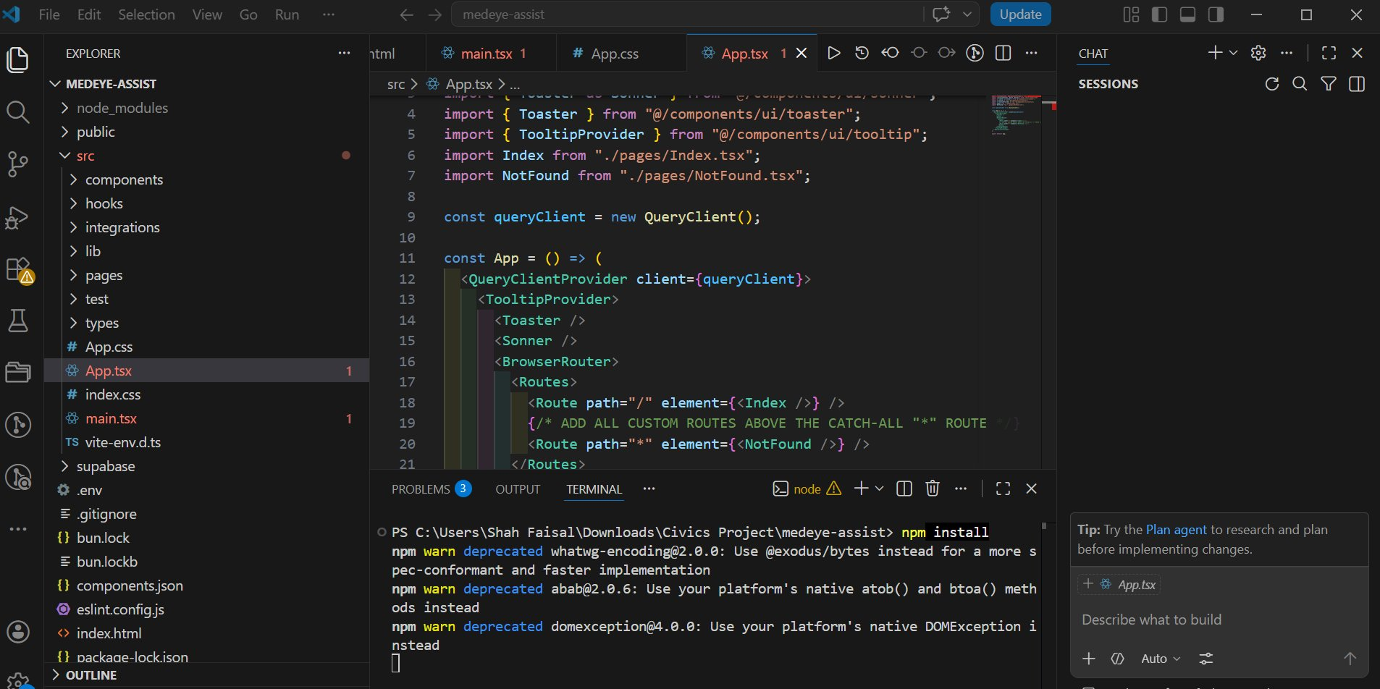
Week 7 – Source Code Development
VS Code – React/TypeScript codebase
GitHub repository management

Slide 22
Week 7 – AI Application Development
Tech Stack: React, TypeScript, Tailwind CSS, Supabase
Integrated AI-powered image analysis for skin/medical conditions
GitHub repository: ShahFaisalazmat/medeye-assist
4 deployments tracked on Vercel cloud platform
Components: Image upload, AI confidence score, analysis, recommendations
Code reviewed and optimized with AI-assisted development tools

Slide 23
WEEK 8
Testing & Deployment
15 April 2026

Slide 24
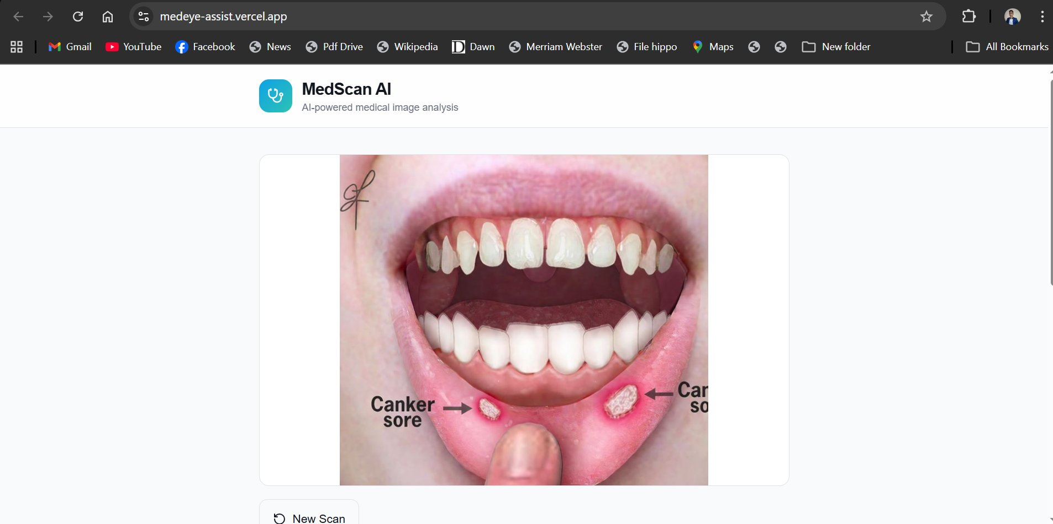
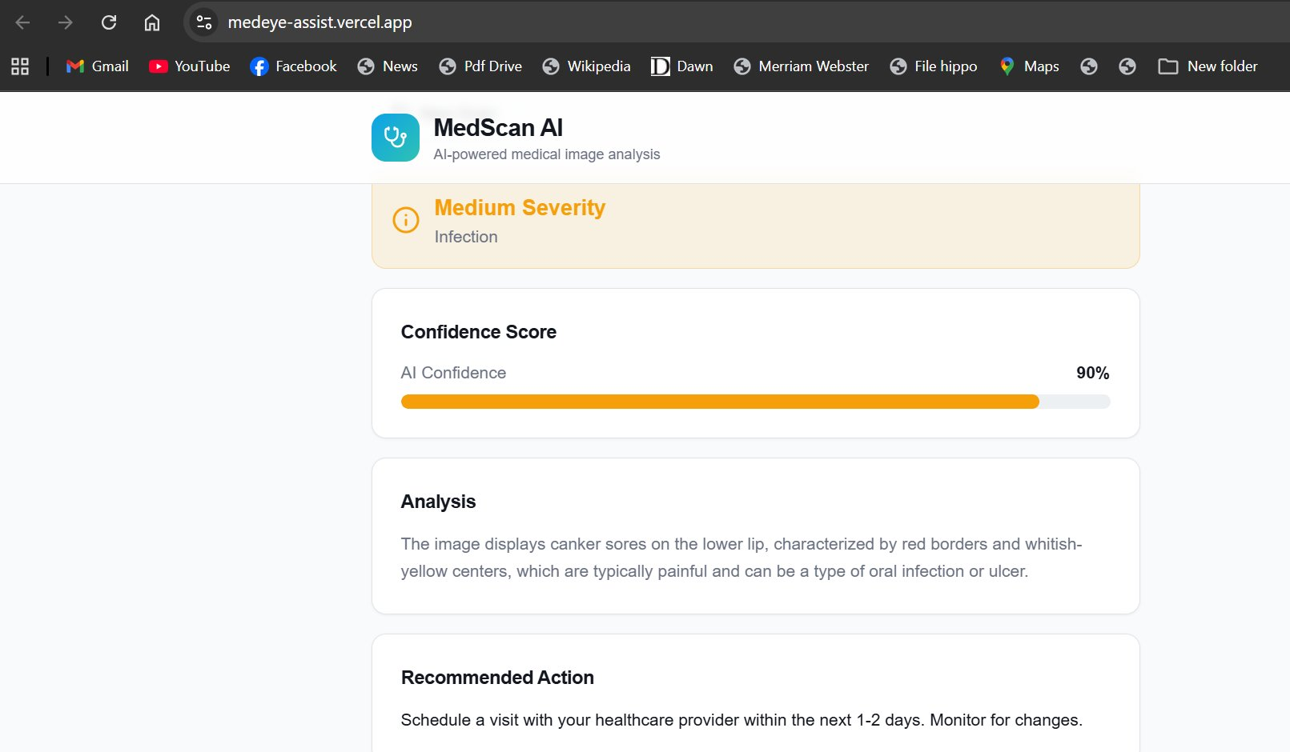
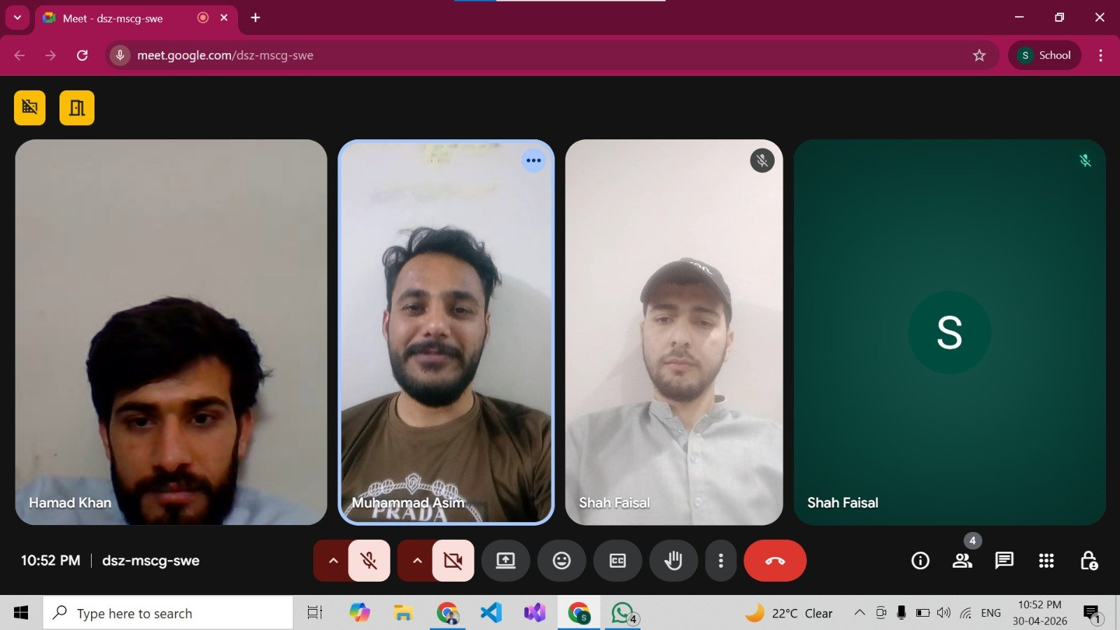
Week 8 – Application Live: MedScan AI

Slide 25
Week 8 – MedScan AI: Live Application
Application deployed at medeye-assist.vercel.app
AI analyzes uploaded medical images (skin, oral conditions, etc.)
Provides: Severity level, confidence score (up to 90%), detailed analysis
Recommends next steps (e.g., 'See healthcare provider within 1-2 days')
Team coordination via Google Meet deployment review session
Project successfully delivered and version-controlled on GitHub

Slide 26
Project Impact & Outcomes
65+
40+
15
Community Members Reached
Families Served at Iftar Drive
Trees Planted (Swabi)
25
4
8
Children Taught at CPC
SDGs Addressed
Weeks of Fieldwork

Slide 27
Challenges & Solutions
⚠ Logistical Issues – Iftar Drive
✓ Pre-planned food quantities; Al-Khidmat volunteers assisted coordination
⚠ Inclement Weather – Plantation
✓ Monitored forecast, rescheduled to favorable window in Swabi
⚠ Technical Hurdles – AI App
✓ Iterative debugging, AI-assisted coding, modular architecture
⚠ Children's Hesitancy – CPC
✓ Ice-breaking activities, drawings, snacks; patience and empathy

Slide 28
Lessons Learned & Skills Gained
Community engagement requires adaptability and cultural sensitivity
Technical skills: React, TypeScript, AI API integration, GitHub workflow
Teamwork across physical fieldwork and digital development
Empathy and patience essential when working with vulnerable communities
NGO collaboration enhances reach and impact of student projects
Iterative development and testing crucial for software reliability

Slide 29
Recommendations
For Future Students
For Al-Khidmat Foundation
Start NGO coordination early
Document all activities with photos/videos
Choose SDG-aligned projects with measurable impact
Integrate student volunteers into long-term programs
Expand CPC teaching sessions to cover more children
Leverage AI tools for community health screening

Slide 30
Thank You
Questions & Discussion
Shah Faisal (23I-0058) | Hamad Khan (23I-3095)
Group 10 – Section A | Miss. Hina Hafeez

