Slide 1
BloodLink – AI-Based Blood Donor Matching System
Complete Business Plan Presentation
AI • Healthcare • Mobile • Analytics

Slide 2
Team & Roles
CEO
CTO
CMO
CFO
COO
ShahJahan
Maqsood
Zubair
Razzaq
shafiq

Slide 3
Problem Statement
Critical delays cause preventable deaths.
No intelligent, real-time matching system.
Low donor consistency and poor coordination.
Donors are called only after a shortage occurs

Slide 4


The Solution: BloodLink Ecosystem
For Hospitals
For Donors
Hospitals use the dashboard to track inventory, manage quality assurance logs, and schedule donor drives. This gives us the verified, real-time data needed for accurate matching
The Donor Mobile App gives every citizen the power to be a lifesaver. Users can instantly declare availability or receive urgent, localized notifications. It's fast, simple, and verifiable

Slide 5
Business Description
Two-sided platform: Donor App + Hospital Web Portal.
Real-time intelligent blood supply management.
Secure cloud backend and AI-powered decision engine.

Slide 6
Description of Industry
    Industry Types
Healthcare Technology (Health-Tech)
Social Enterprise
BloodLink uses software and data analytics to improve a critical function within the healthcare system
Although BloodLink operates on a commercial B2B model, its main goal is the public good, which is to reduce preventable deaths.
As a Social Enterprise, it uses market based strategies like subscriptions

Slide 7
Future outlook and trends of the Industry
Digitalization and AI Integration:
The global blood management software market is expected to grow significantly, with a CAGR of 7.8% to 10.2% or higher. The broader digital health market is growing at around 19-21% CAGR, driven by the need for better IT and automation.
Focus on Efficiency:
Hospitals and blood centers are increasingly using AI for inventory management.
Donor Retention
people are very open to mobile apps for tracking donations and receiving encouragement.

Slide 8
Trends and market forecasts
Market
Trends
The Blood Management Software Market is expected to grow to about $3.89 billion to $7.226 billion by 2034, showing significant opportunity.
The Digital Health Market should surpass $1.5 trillion by 2032, creating a large and quickly growing environment for BloodLink to work in.
AI-driven analytics
Patient Safety

Slide 9
Technology Plan
Mobile App (Flutter/React Native).
Backend: Firebase
AI Matching: Python, TensorFlow.
Cloud hosting:we use Microsoft Aure
Security: Encryption

Slide 10
Technology Architecture
Donor Mobile App → AI Engine → Cloud Database.
Hospital Dashboard → Backend API → Matching.
Gamification engine for donor rewards.
Real-time alert system.

Slide 11
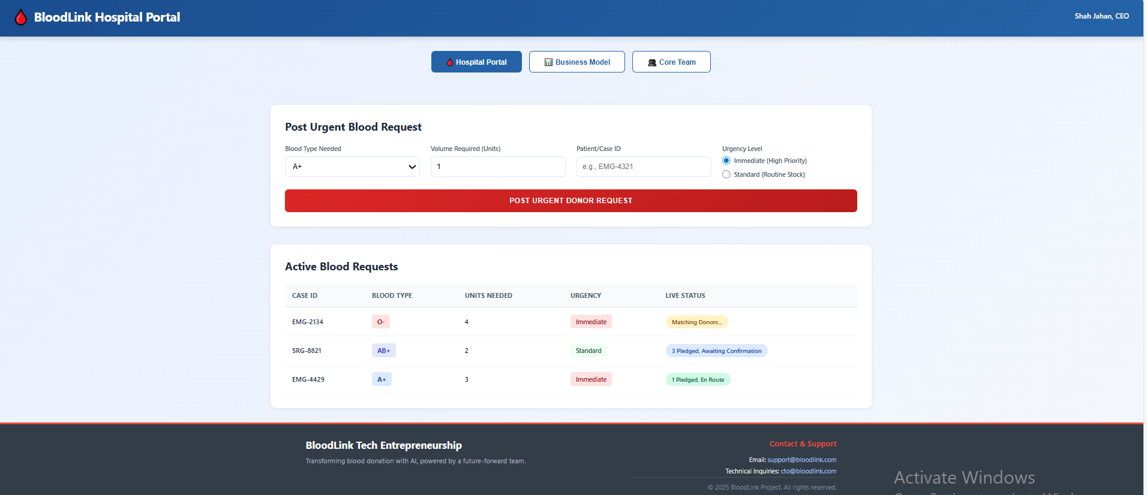
Hospital Web Portal

Slide 12
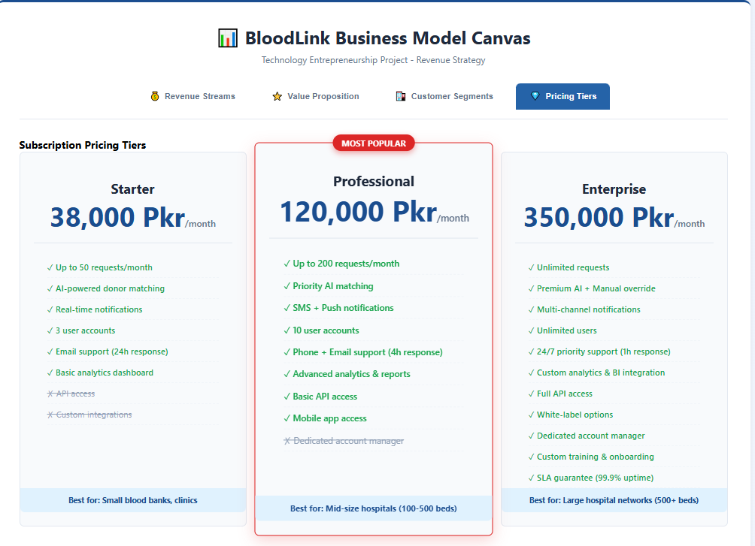
PRICING TIERS

Slide 13
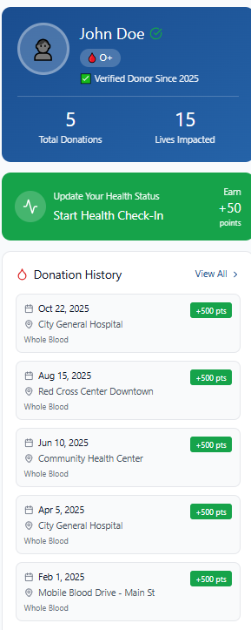
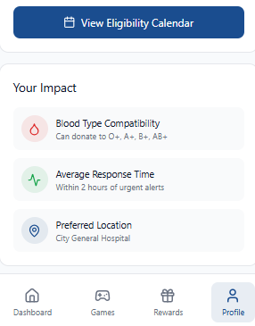
Donar Mobile App

Slide 14
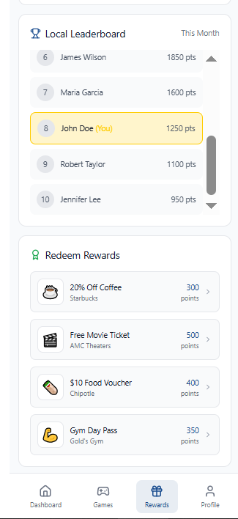
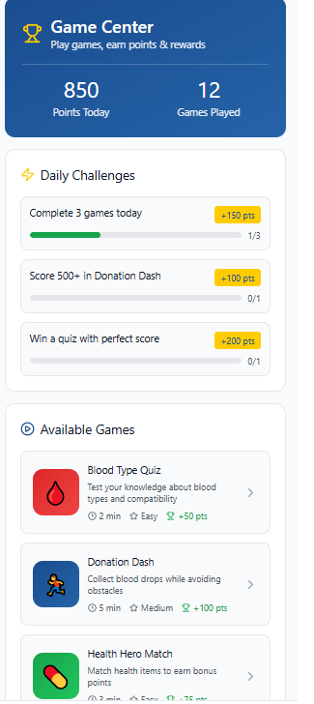
Donar Mobile App

Slide 15
BloodLink vs. Existing Systems
Feature | BloodLink | Existing Systems | Advantage
Matching Mechanism | AI-powered, real-time predictive matching | Manual or basic database lookup | Faster & more accurate matches
Donor Engagement | Gamified app with rewards & leaderboards | Minimal engagement tools | Higher donor retention
Integration | API-ready for hospital EHR systems | Mostly standalone | Seamless hospital adoption
Data Updates | Real-time donor & inventory updates | Delayed batch processing | Better coordination & planning
Scalability | Cloud-native microservices | On-premise/static apps | Supports national & global scale

Slide 16
Commercialization Requirements
A. Development Needs
Human Resources:
AI Engineer • Mobile Developer • Backend Developer • uI/uX Designer • Cloud Architect
Infrastructure:
Cloud hosting (AWS) • Scalable DB (Firebase) • (GitHub/GitLab)
B. Testing & validation
Beta testing with 3–5 pilot hospitals
Continuous feedback loops for AI improvements
Load testing to ensure high-traffic performance
C. Regulatory & Compliance
Health data compliance: GDPR HIPAA
Ethical review for bias-free AI decisions
Local health-tech certification requirements

Slide 17
Marketing Plan – Overview
Target: Hospitals, Clinics, Blood Banks, Donors.
Pricing: Subscription for hospitals, free for donors.
Promotion: Social media, CSR, medical drives.

Slide 18
Market Segment
Healthcare Institutions (B2B)
These include:
Hospitals
Clinics
Public and private blood banks
They require a fast and reliable system for matching blood requirements with available donors.
Their main pain points are delays, shortages, and inefficient databases.

Slide 19
Pricing
Subscription Model for Healthcare Institutions (B2B)
Starter Plan – PKR 38000
Professional Plan – PKR 120000
Enterprise Plan – PKR 350000
Free Service for Donors (B2C)
CSR sponsorship acquisition

Slide 20
Distribution
Digital App Stores
Google Play Store
Apple App Store
This ensures accessibility for all smartphone users.
Web Platform
Hospitals will access the system through a secure web dashboard for:
Urgent donor requests
AI-based matching interface
Direct B2B Sales
A dedicated sales team will onboard hospitals, giving:
Technical support
Training sessions
Health-Tech Conferences

Slide 21
Promotion
To grow awareness and adoption, BloodLink will use multiple promotion methods:
Subscription Model for Healthcare Institutions (B2B)
University Drives – Awareness events, Medical camps
Corporate Social Responsibility (CSR) Programs
Social Media Campaigns
In-App Referral Rewards

Slide 22
Product or Service
BloodLink offers two core services:
AI-Based Blood Matching System
Identifies nearest eligible donors
Real-time alerts for emergencies
Reduces response time from hours to minutes
Gamified Donor Engagement System
Points, badges, milestones
Redeemable rewards
Monthly and annual leaderboards
These features encourage long-term donor participation.

Slide 23
Financial Plan – Overview
Initial funding from founders.
Additional CSR sponsorships.
Minimum viable operational cost.

Slide 24
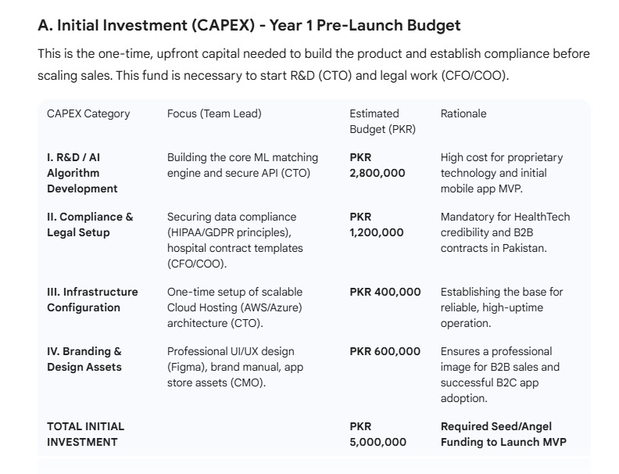
Initial Investment (CAPEX) – Year 1 Pre-Launch Budget

Slide 25
Revenue Model
Hospital subscription fees.
CSR sponsorship packages.
Advertisements on Mobile App

Slide 26
Hospital Subscription Plans (B2B Revenue Model)
Tier | Customers% | Hospitals (Out of 50) | Monthly Fee (PKR) | Annual Fee (PKR) | Total Annual Revenue (PKR)
Starter | 40% | 20 | 38,000 | 456,000 | 9,120,000
Professional | 40% | 20 | 120,000 | 1,440,000 | 28,800,000
Enterprise | 20% | 10 | 350,000 | 4,200,000 | 42,000,000
Totals | 100% | 50 | — | — | 79,920,000

Slide 27
Cost Structure
AI development & maintenance.
Cloud hosting charges.
Marketing & outreach.
Team salaries & operations.
Rewards System

Slide 28
5-Year Operating Expenses & Net Income
Operating Expense (PKR) | Year 1 | Year 2 | Year 3 | Year 4 | Year 5
Salaries & HR | 6,500,000 | 9,800,000 | 14,000,000 | 19,500,000 | 25,000,000
Tech Maintenance | 1,500,000 | 2,500,000 | 4,000,000 | 5,750,000 | 7,500,000
Cloud Hosting | 600,000 | 1,500,000 | 2,500,000 | 4,000,000 | 5,500,000
Marketing & Acquisition | 1,200,000 | 2,500,000 | 4,000,000 | 5,250,000 | 6,500,000
Donor Rewards | 500,000 | 1,200,000 | 1,800,000 | 2,950,000 | 4,000,000
G&A / Admin | 800,000 | 1,500,000 | 1,500,000 | 2,000,000 | 2,500,000
Total OPEX | 11,100,000 | 19,000,000 | 27,800,000 | 39,400,000 | 51,000,000
Net Income | 70,220,000 | 142,940,000 | 230,300,000 | 304,400,000 | 420,500,000

Slide 29
Pro Forma Financials (Summary)
Projected revenue growth over 3–5 years.
Expected break-even within Year 2–3.
Scalable low-cost cloud infrastructure.
High long-term social impact.

Slide 30
5-Year Revenue Forecast
Revenue Stream (PKR) | Year 1 | Year 2 | Year 3 | Year 4 | Year 5
Hospital Subscriptions | 79,920,000 | 159,840,000 | 255,600,000 | 340,800,000 | 468,000,000
CSR / Sponsorships | 1,000,000 | 1,500,000 | 1,700,000 | 2,000,000 | 2,300,000
In-App Ads | 400,000 | 600,000 | 800,000 | 1,000,000 | 1,200,000
Total Revenue | 81,320,000 | 161,940,000 | 258,100,000 | 343,800,000 | 471,500,000

Slide 31
Operational Plan
Donor onboarding and verification.
Hospital staff training and setup.
24/7 system monitoring.
Continuous AI model optimization.

Slide 32
Operational Workflow
Hospital request → AI processes → Donor matched.
Donor notification → confirmation → donation.
Hospital updates dashboard → completion.

Slide 33
Organizational Plan
CEO – Strategy, Vision, Partnerships.
CTO – Technology, AI, App Development.
COO – Operations, Hospital Relations.
CMO – Donor Engagement, Marketing.
CFO – Financial Modeling, Funding, Budget.

Slide 34
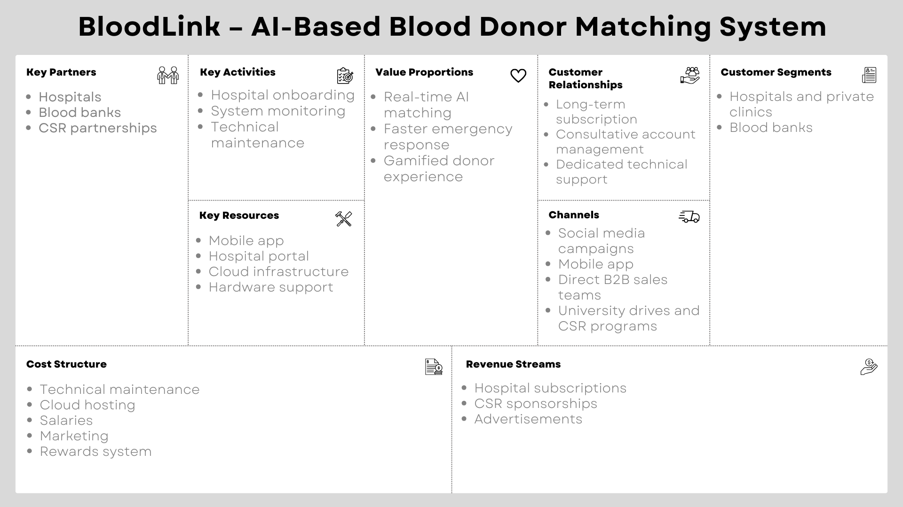
Business Model Canvas

Slide 35
Conclusion
BloodLink revolutionizes blood donation.
Fast, accurate, and life-saving technology.
Scalable national solution for Pakistan.
High social value and strong business model.

Slide 36

Thank
You

