Slide 1
Let's Get Scratching!
An Intro to Scratch for Cool Kids

Slide 2
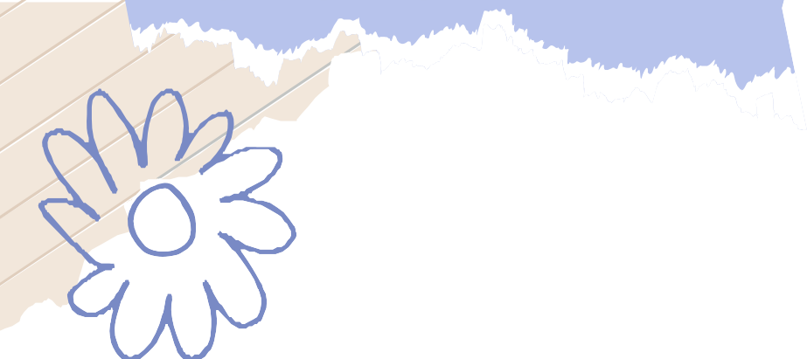

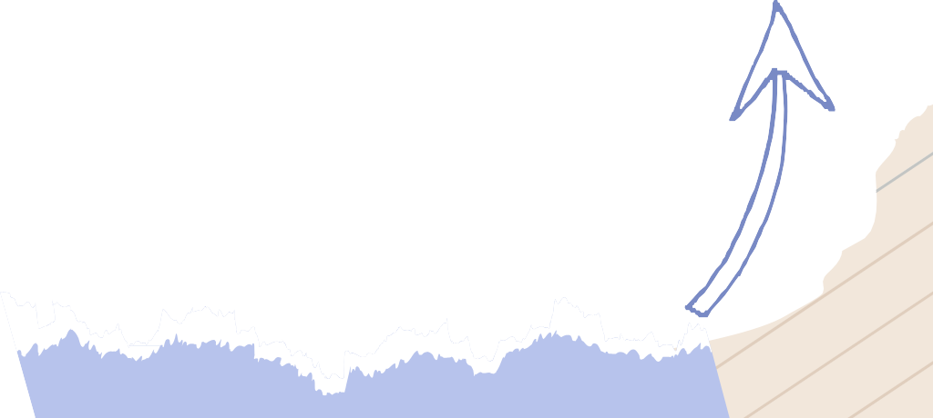
Welcome to
Are you ready to code and have some fun?
Let's dive into the colorful world of Scratch, where you can create your own interactive stories, games, and animations.
Get ready to unleash your creativity and imagination!

Slide 3

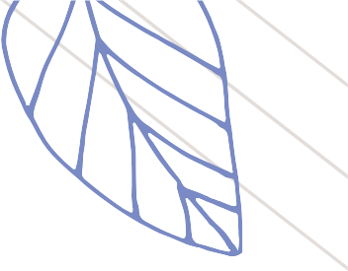
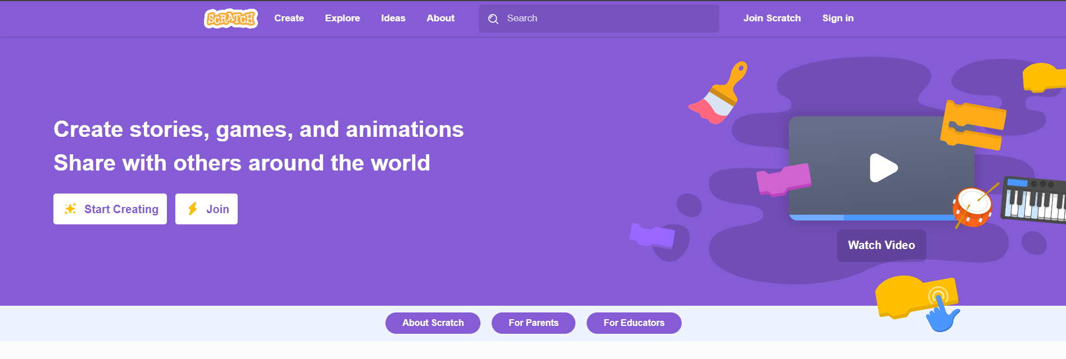


Creating a Scratch Account
Visit http://www.scratch.mit.edu
The following interface will appear:
Click on “Join Scratch” in the top right corner.

Slide 4
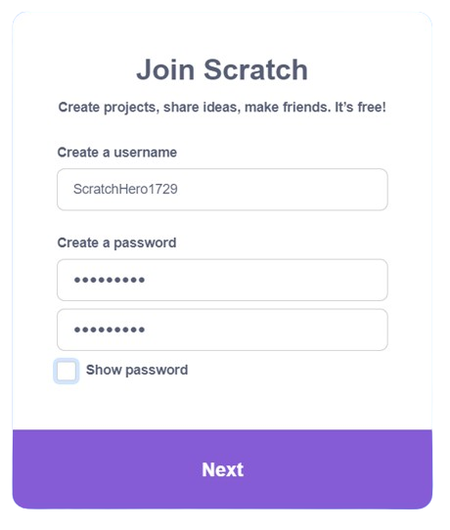
Creating a Scratch Account
Think of a fun and memorable username that represents you. Make sure it's one-of-a-kind and easy for you to remember.
Select a password that combines letters, numbers, and special characters to ensure your account is secure.
Proceed by clicking the "Next" button to continue to the next step.

Slide 5
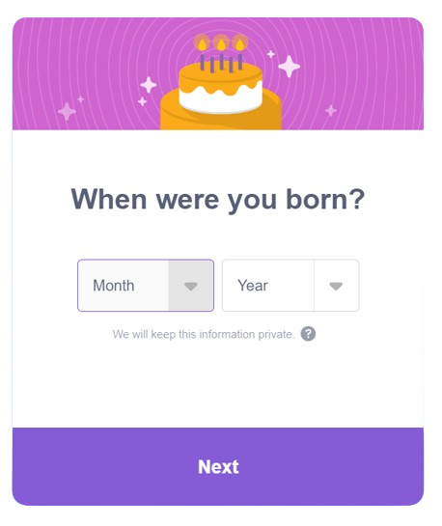
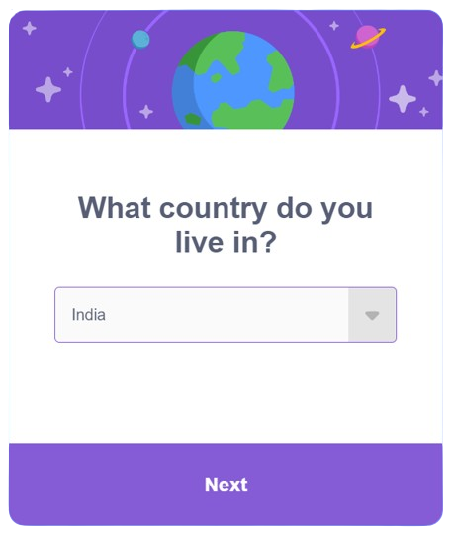
Creating a Scratch Account
Once you click next, select your country from the drop down.
Proceed by clicking the "Next“ button to continue to the next step.
Fill you month and year of birth.
Then click next to proceed to next step.

Slide 6
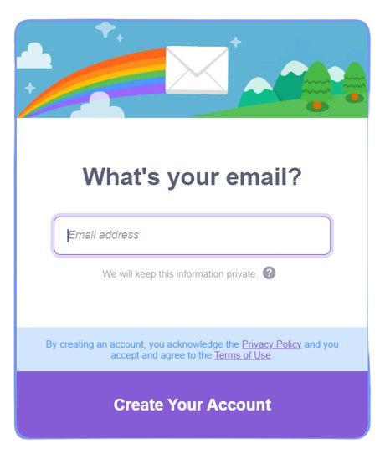
Creating a Scratch Account
Type your email address in the space provided.
Proceed by clicking the “Create Your Account“ button to finish creating your account.
Congratulations, you have created your scratch account!

Slide 7


Thanks!
Do you have any questions?
shahmeraj510@gmail.com
+91 7006560568

