Slide 1
Let's Get Scratching!
Interacting with Scratch Cat

Slide 2
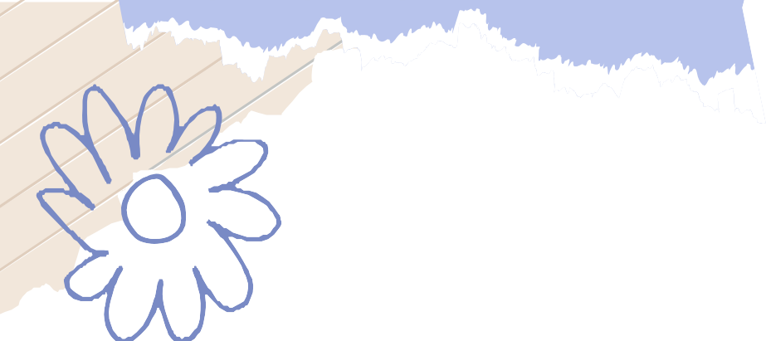
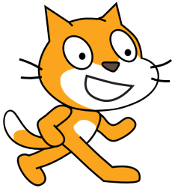

Meet the Scratch Cat!
Scratch Cat is the default sprite in Scratch.
What is a sprite?
A sprite in Scratch is a character or object that you can program to move, talk, and interact with other sprites.
Interesting! We can do the same with our cat.

Slide 3
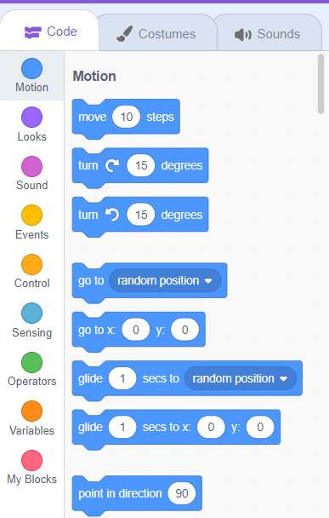
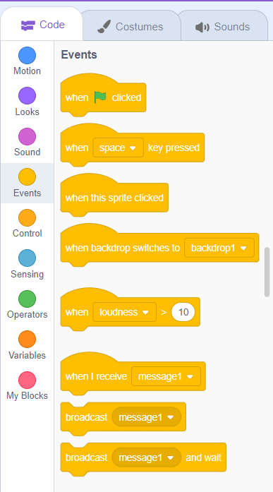
Starting an Event
Begin by opening the project you created in the last class. Excited to continue?
Take a look at the left side of your screen. This panel is where all the magic happens!
Find and click on the "Events" tab in the left panel. Events are what make your project interactive!

Slide 4

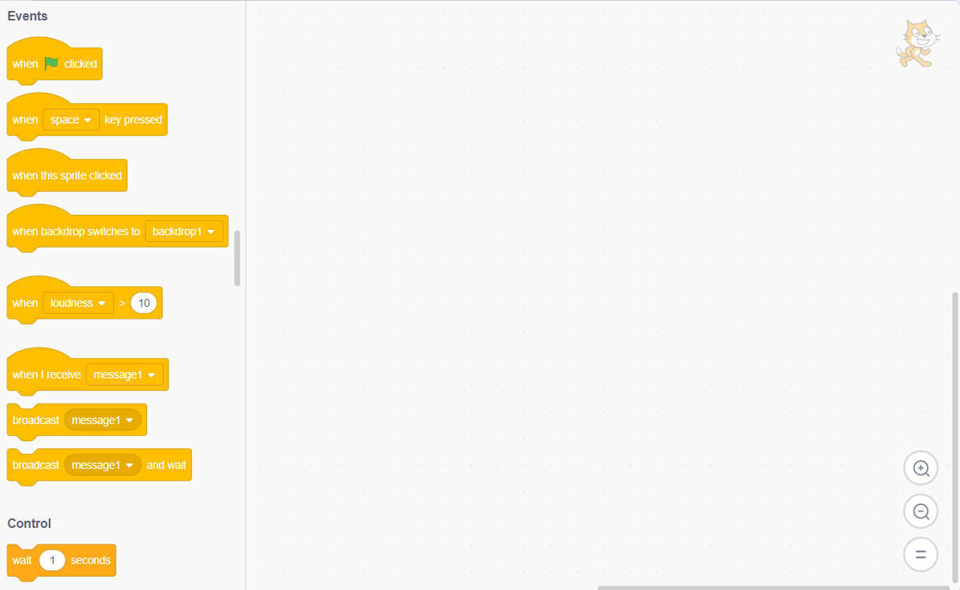
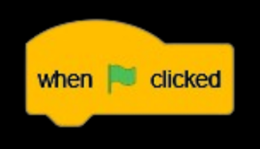
Starting an Event
Now, drag the "when clicked" block into the scripting area.
Every time you click the green flag, this event will start your code. Try it out and see what happens!

Slide 5
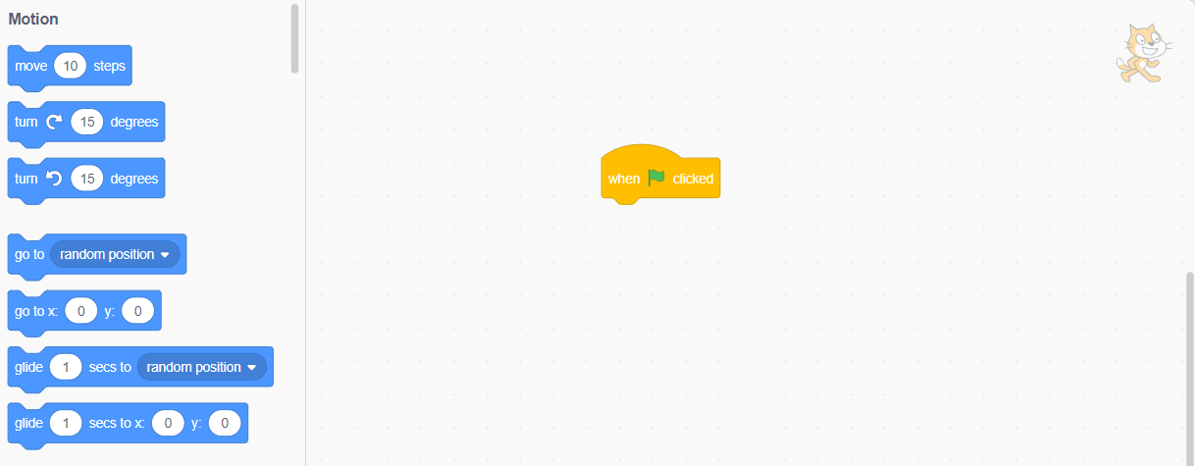
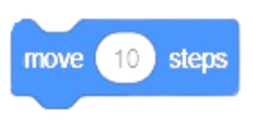
Making our Scratch Cat move
Go to “motion” tab.
Now, drag the “move 10 steps" block into the scripting area.
Place it beneath the previous block.

Slide 6
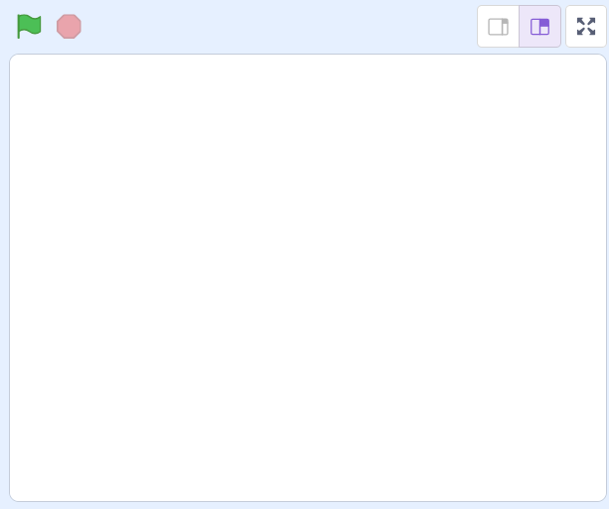
Making our Scratch Cat move
Click the green flag to start the event. Ready, set, go!
Congratulations! You did it! The cat moved! How cool is that?
Try clicking the green flag again. What else can you make the cat do?
Can you add a new block to make the cat talk or jump?

Slide 7
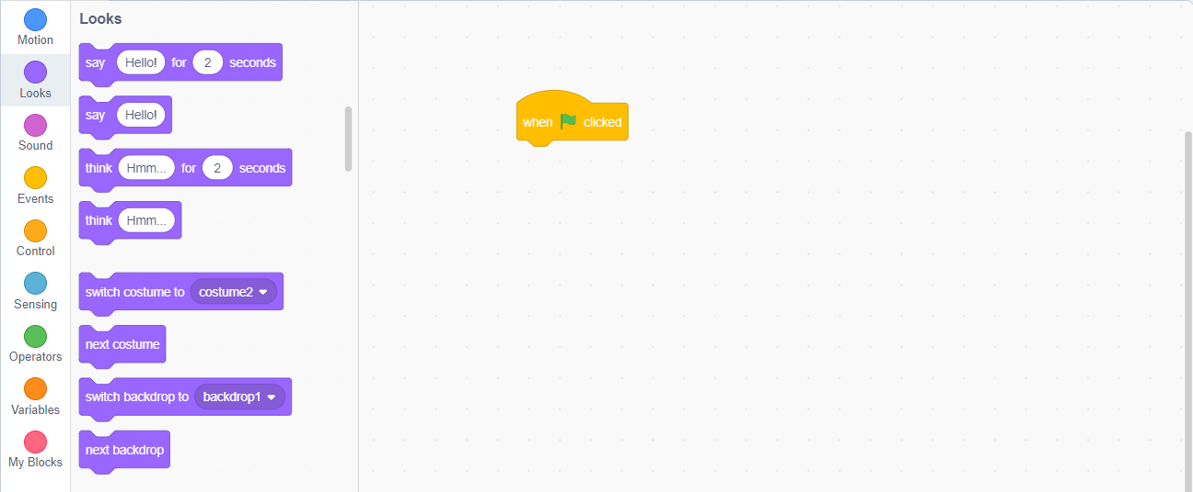
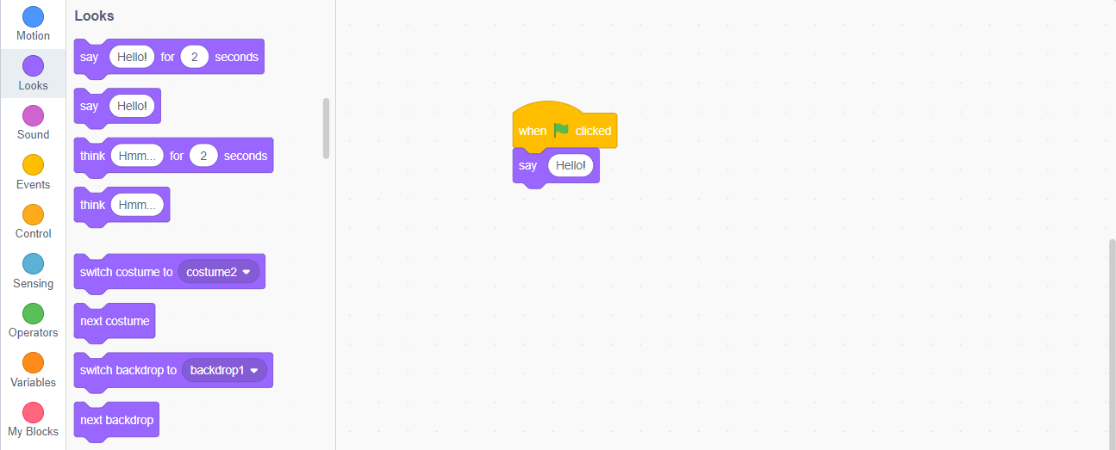
Chatting with the Cat!!
How do you make the cat welcome you?
Jump into the “Looks” tab.
Drag the “say “hello!” block into scripting area and place it right below the “when flag clicked” block.
Replace “hello” text with any welcome text of your choice.

Slide 8
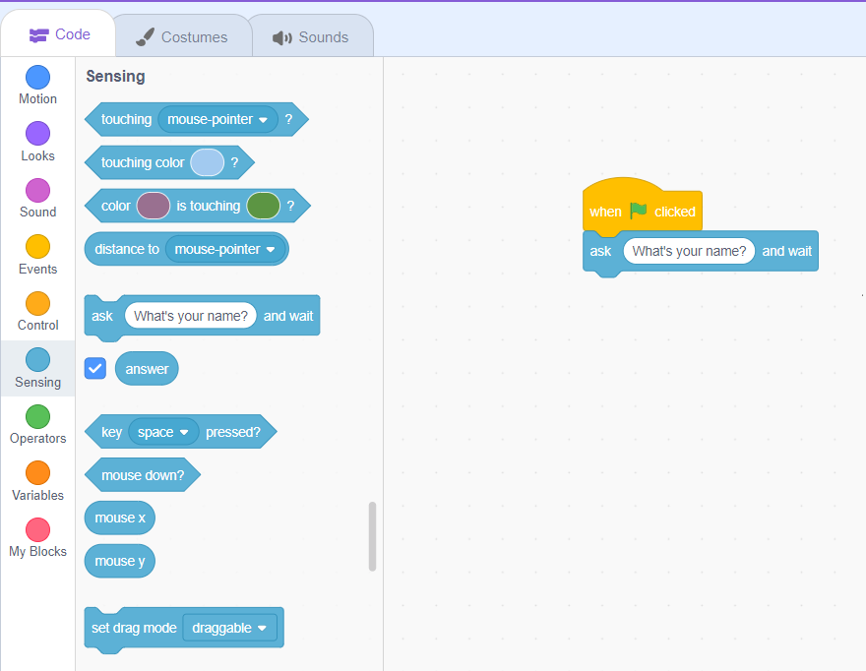
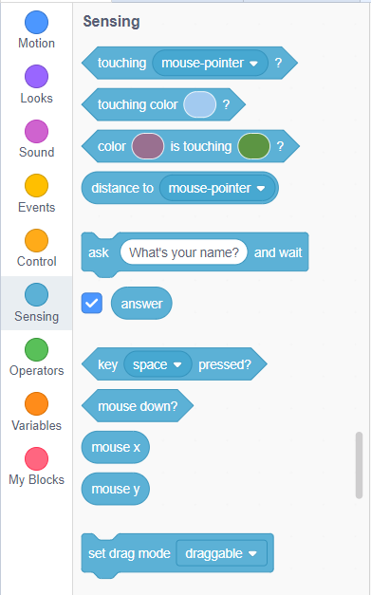
Chatting with the Cat!!
Can you make the cat ask you your name?
Click on the “Sensing” tab.
Drag “ask What’s your name? and wait” block into the scripting area and place it below the “when flag clicked” block.

Slide 9
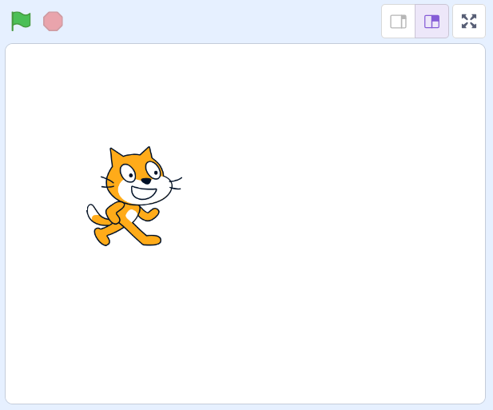


Chatting with the Cat!!
Now click the green flag to get things rolling!
Scratch Cat will ask, "What is your name?“
Enter your name in the text box that pops up.
Where is the name stored?
Can the cat greet you back with your name?
Scratch Hero

Slide 10
Concept of Variables
Meet the “answer" Container: Your inputs are saved in a special spot called “answer“.
What is a container?
Just like you need a bottle to hold water, We need something to hold our information.
These data holders are called variables. They keep all your important info safe and sound!

Slide 11
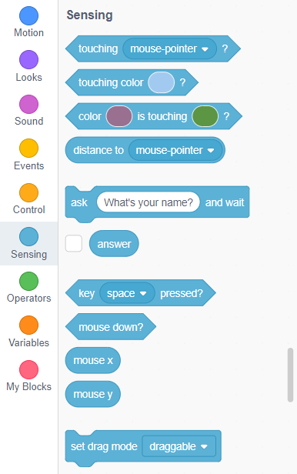
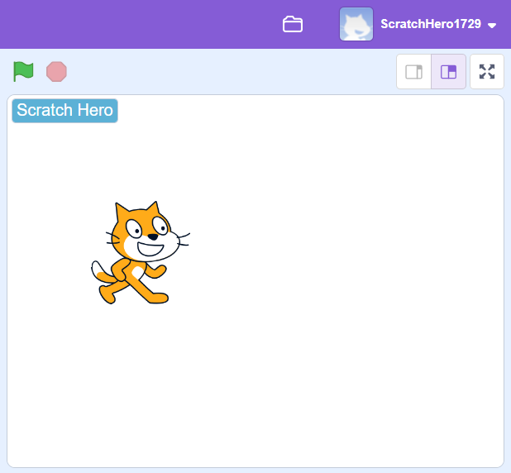
Retrieving our name back
Click on the "Sensing" tab to explore some cool blocks.
Tick the small box next to the "answer" block.
Now look at the stage, what do you see?
Did you see your name?
You Did It! Awesome! You’ve made your project interactive!

Slide 12
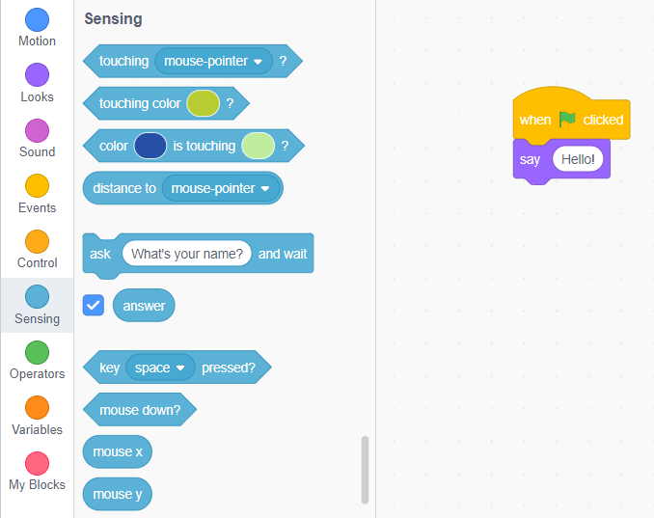
Say my Name!
Let's get the cat to say your name!
How do we make cat to say something?
Remember the "Say Hello" Block? It's time to use it again!
Pull the "say [hello]" block into the scripting area.
Head to the "Sensing" tab and grab the "answer" block.

Slide 13
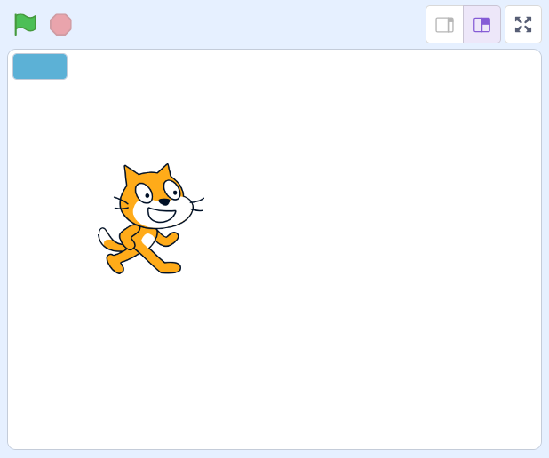
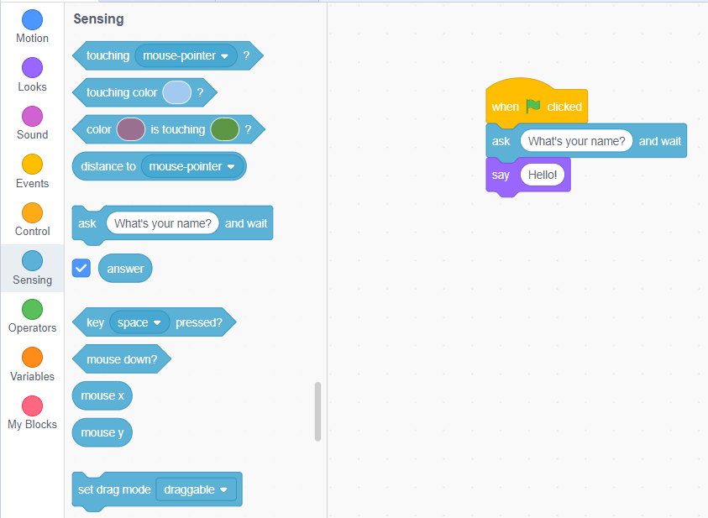
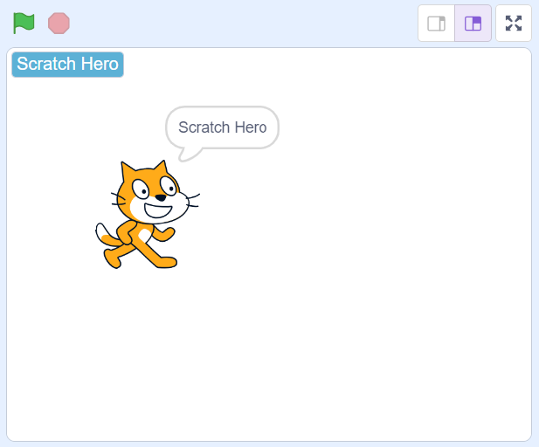
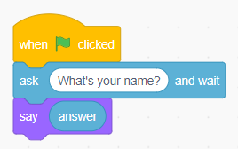
Say my Name!
Drag the “answer” block and drop it over the “hello” text.
Now click the green flag and see the magic.
Congratulations! The cat displayed your name.

Slide 14

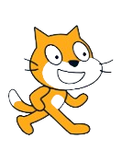

Keep on Scratching!
You've just scratched the surface of the amazing world of Scratch!
Keep on exploring, experimenting, and creating.
Remember, the only limit is your imagination.
Get ready to unleash your creativity and be a coding superstar!

Slide 15


Thanks!
Do you have any questions?
shahmeraj510@gmail.com
+91 7006560568

