Slide 1
Let's Get Scratching!
More on Variables

Slide 2
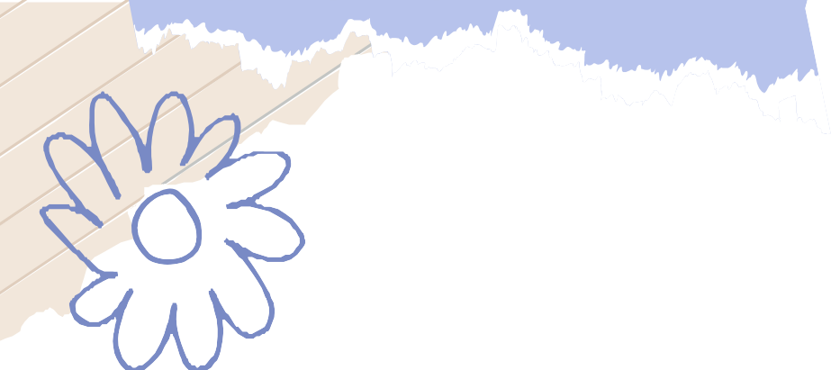
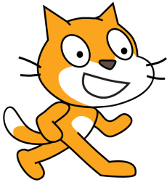
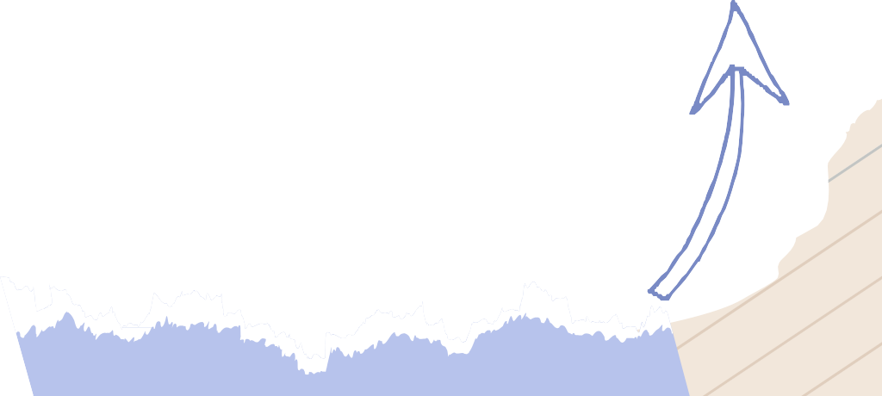
Variables: A Quick Recap
In the last lesson, we discussed about variables.
Variables are simply containers that store information.
What kind of information can they store?
Can they keep track of your age? Your height? Your grades? Your name?
Absolutely! Variables can store all kinds of information

Slide 3
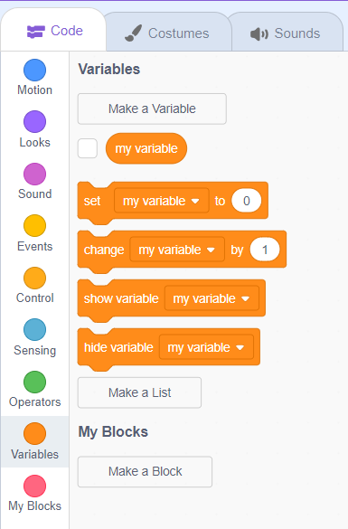
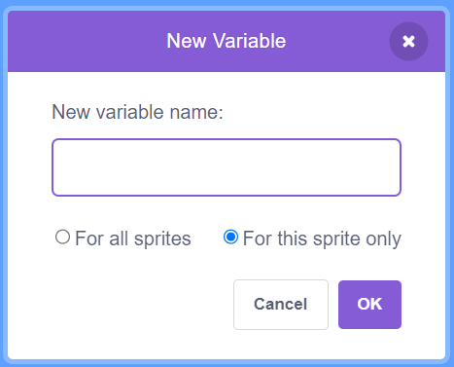
Creating our own variables
Let’s create a variable that stores our age.
Head on to the variables tab.
Next, click on “Make a variable” to enter the variable name.
When prompted, type in "my_age" as the name for your age variable.
Check “For this sprite only” button.
my_age

Slide 4
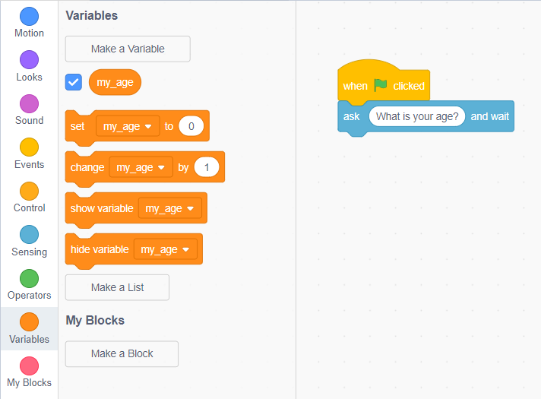
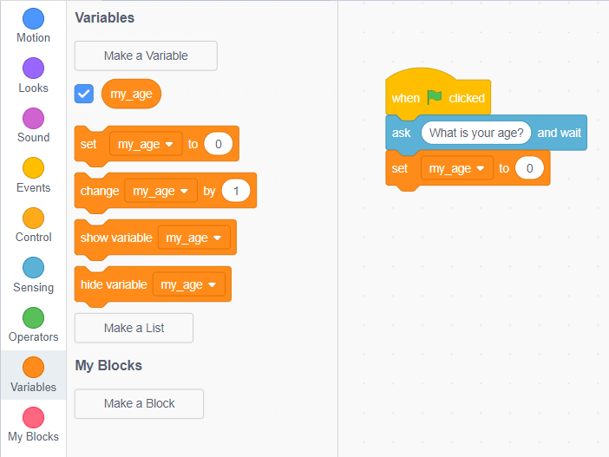
Assigning Value to Variable
Great, you have created a variable to store your age.
It is time to assign value to it.
Go to “Variables”.
Drag “set [my_age] to” block into the scripting area.
Now we want to store user input in “my_age” variable.

Slide 5
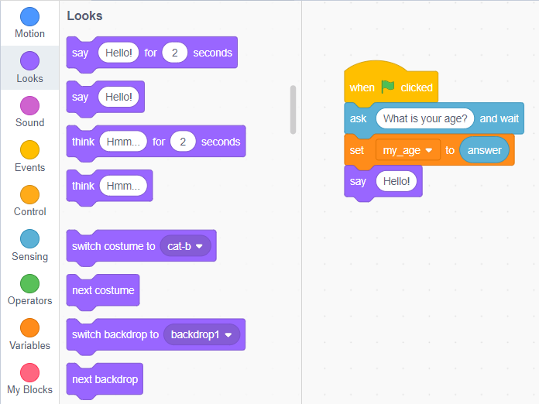
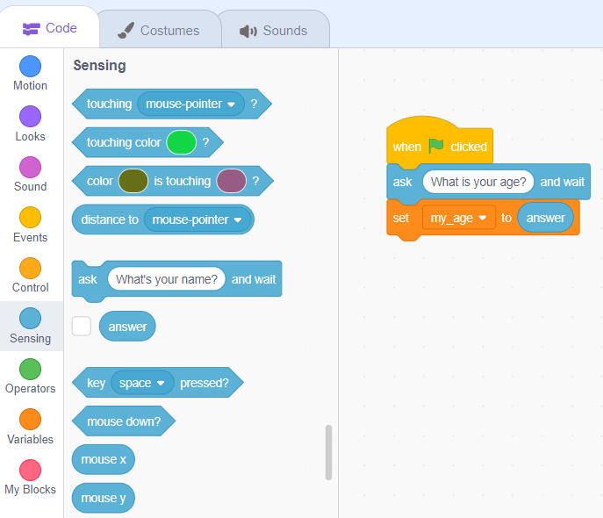
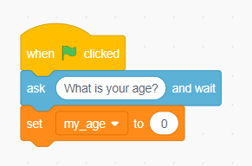
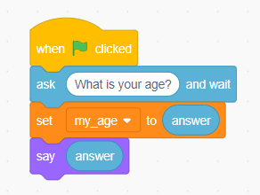
Assigning Value to Variable
Notice that by default,”my_age” variable is set to 0.
To set it equal to user input, drag the ”answer” from sensing tab and drop it onto the “0”.
Now try displaying the variable on the stage!
Drag the “say [Hello]” block from the “Looks” tab.
Now replace “Hello” with “answer”.

Slide 6
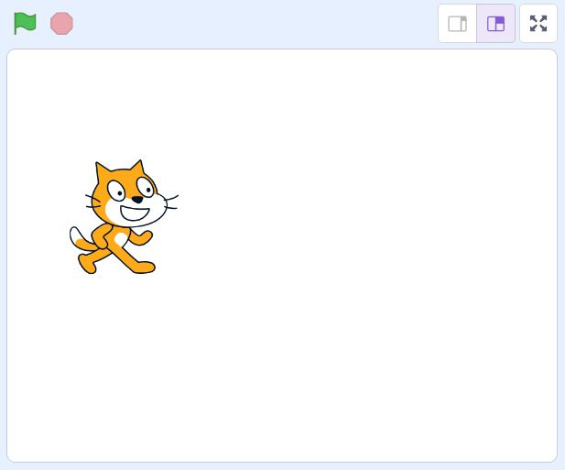
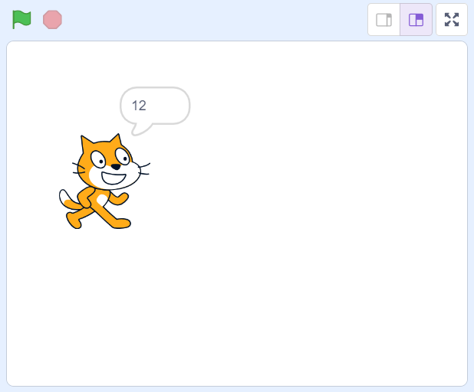


Displaying the variable on stage
Click on the green flag to trigger the event.
When prompted, input your.
Once you hit enter, the cat will display your age!
Congratulations, the cat has displayed your age!
12

Slide 7
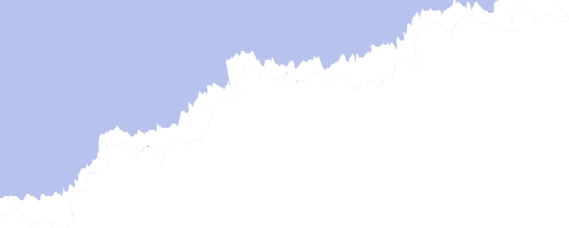
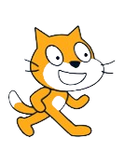
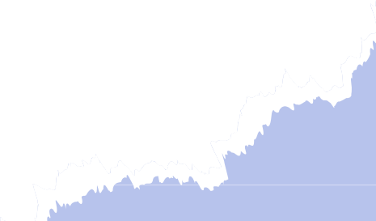
Keep on Scratching!
You've just scratched the surface of the amazing world of Scratch!
Keep on exploring, experimenting, and creating.
Remember, the only limit is your imagination.
Get ready to unleash your creativity and be a coding superstar!

Slide 8

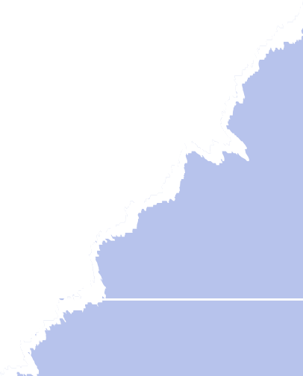
Thanks!
Do you have any questions?
shahmeraj510@gmail.com
+91 7006560568

