Slide 1
Let's Get Scratching!
Fun with Operators

Slide 2

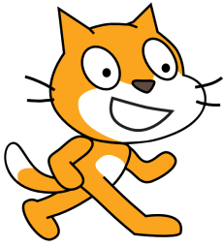

Operators: An Overview
You are already familiar with many of operators.
Tools that perform operations on variables and values.
Operators can be arithmetic, logical, or comparison.
Addition, subtraction, multiplication, and division are arithmetic operators.

Slide 3
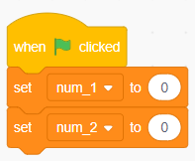
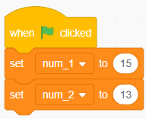
Arithmetic Operators
Let’s perform a simple addition operator between two variable.
You are already familiar with creating variables.
Create two variables num_1 and num_2.
By default, the variables are set to 0.
Set the num_1 and num_2 equal to the numbers you want to add.

Slide 4
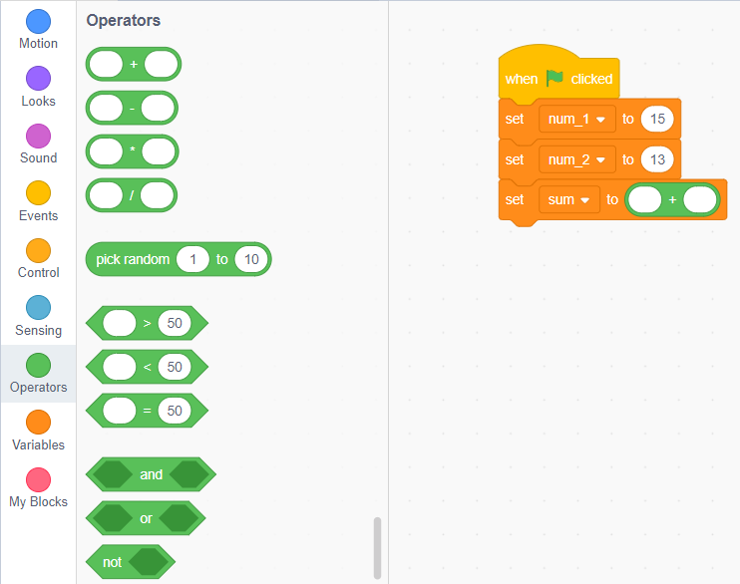
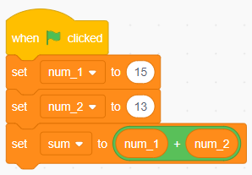
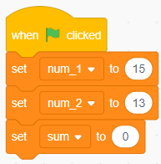
Arithmetic Operators
Now create a variable “sum” to store the sum of these numbers.
Head on the “operators” tab and drag the addition block to the right of “sum” variable.
Now drag “num_1” and “num_2” into the empty spaces of the addition block.
The “sum” variable is now set to “num_1 + num_2”.

Slide 5
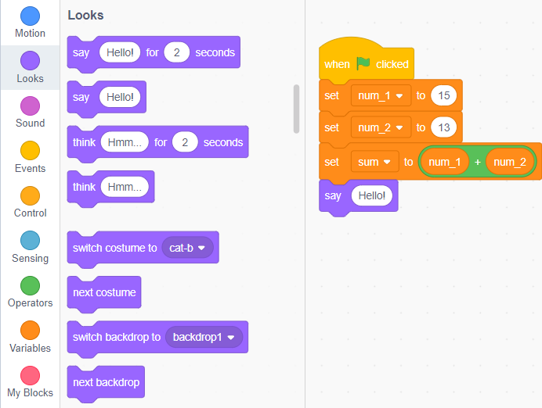
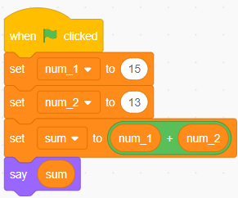
Arithmetic Operators
Can you make the cat to display the value of “sum” variable?
You already know how to display variables.
Go to the looks section and drag the “say [hello]” block into the scripting area.
Now replace “hello” of the “say [hello]” block with “sum” variable.

Slide 6
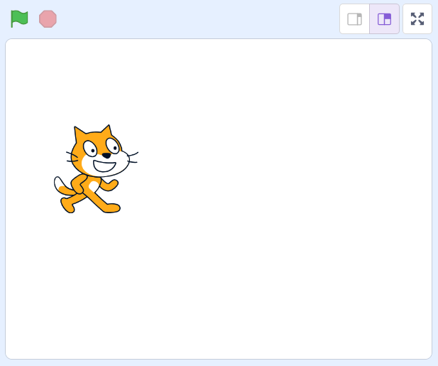

Arithmetic Operators
Now head to the stage.
Click the green flag and watch the magic unfold!
See the value stored in the sum variable pop up on the screen.
🎉Congratulations! You've just learned how to add two numbers and store the result.

Slide 7
Arithmetic Operators
Now it is time to play with other arithmetic operators.
As a challenge, create two variables, num_1 and num_2.
Have our friendly cat prompt you to input two numbers.
Calculate the difference and the product of the two numbers and store the result.
Display the difference and the product and of the two numbers on stage.

Slide 8
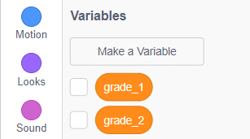
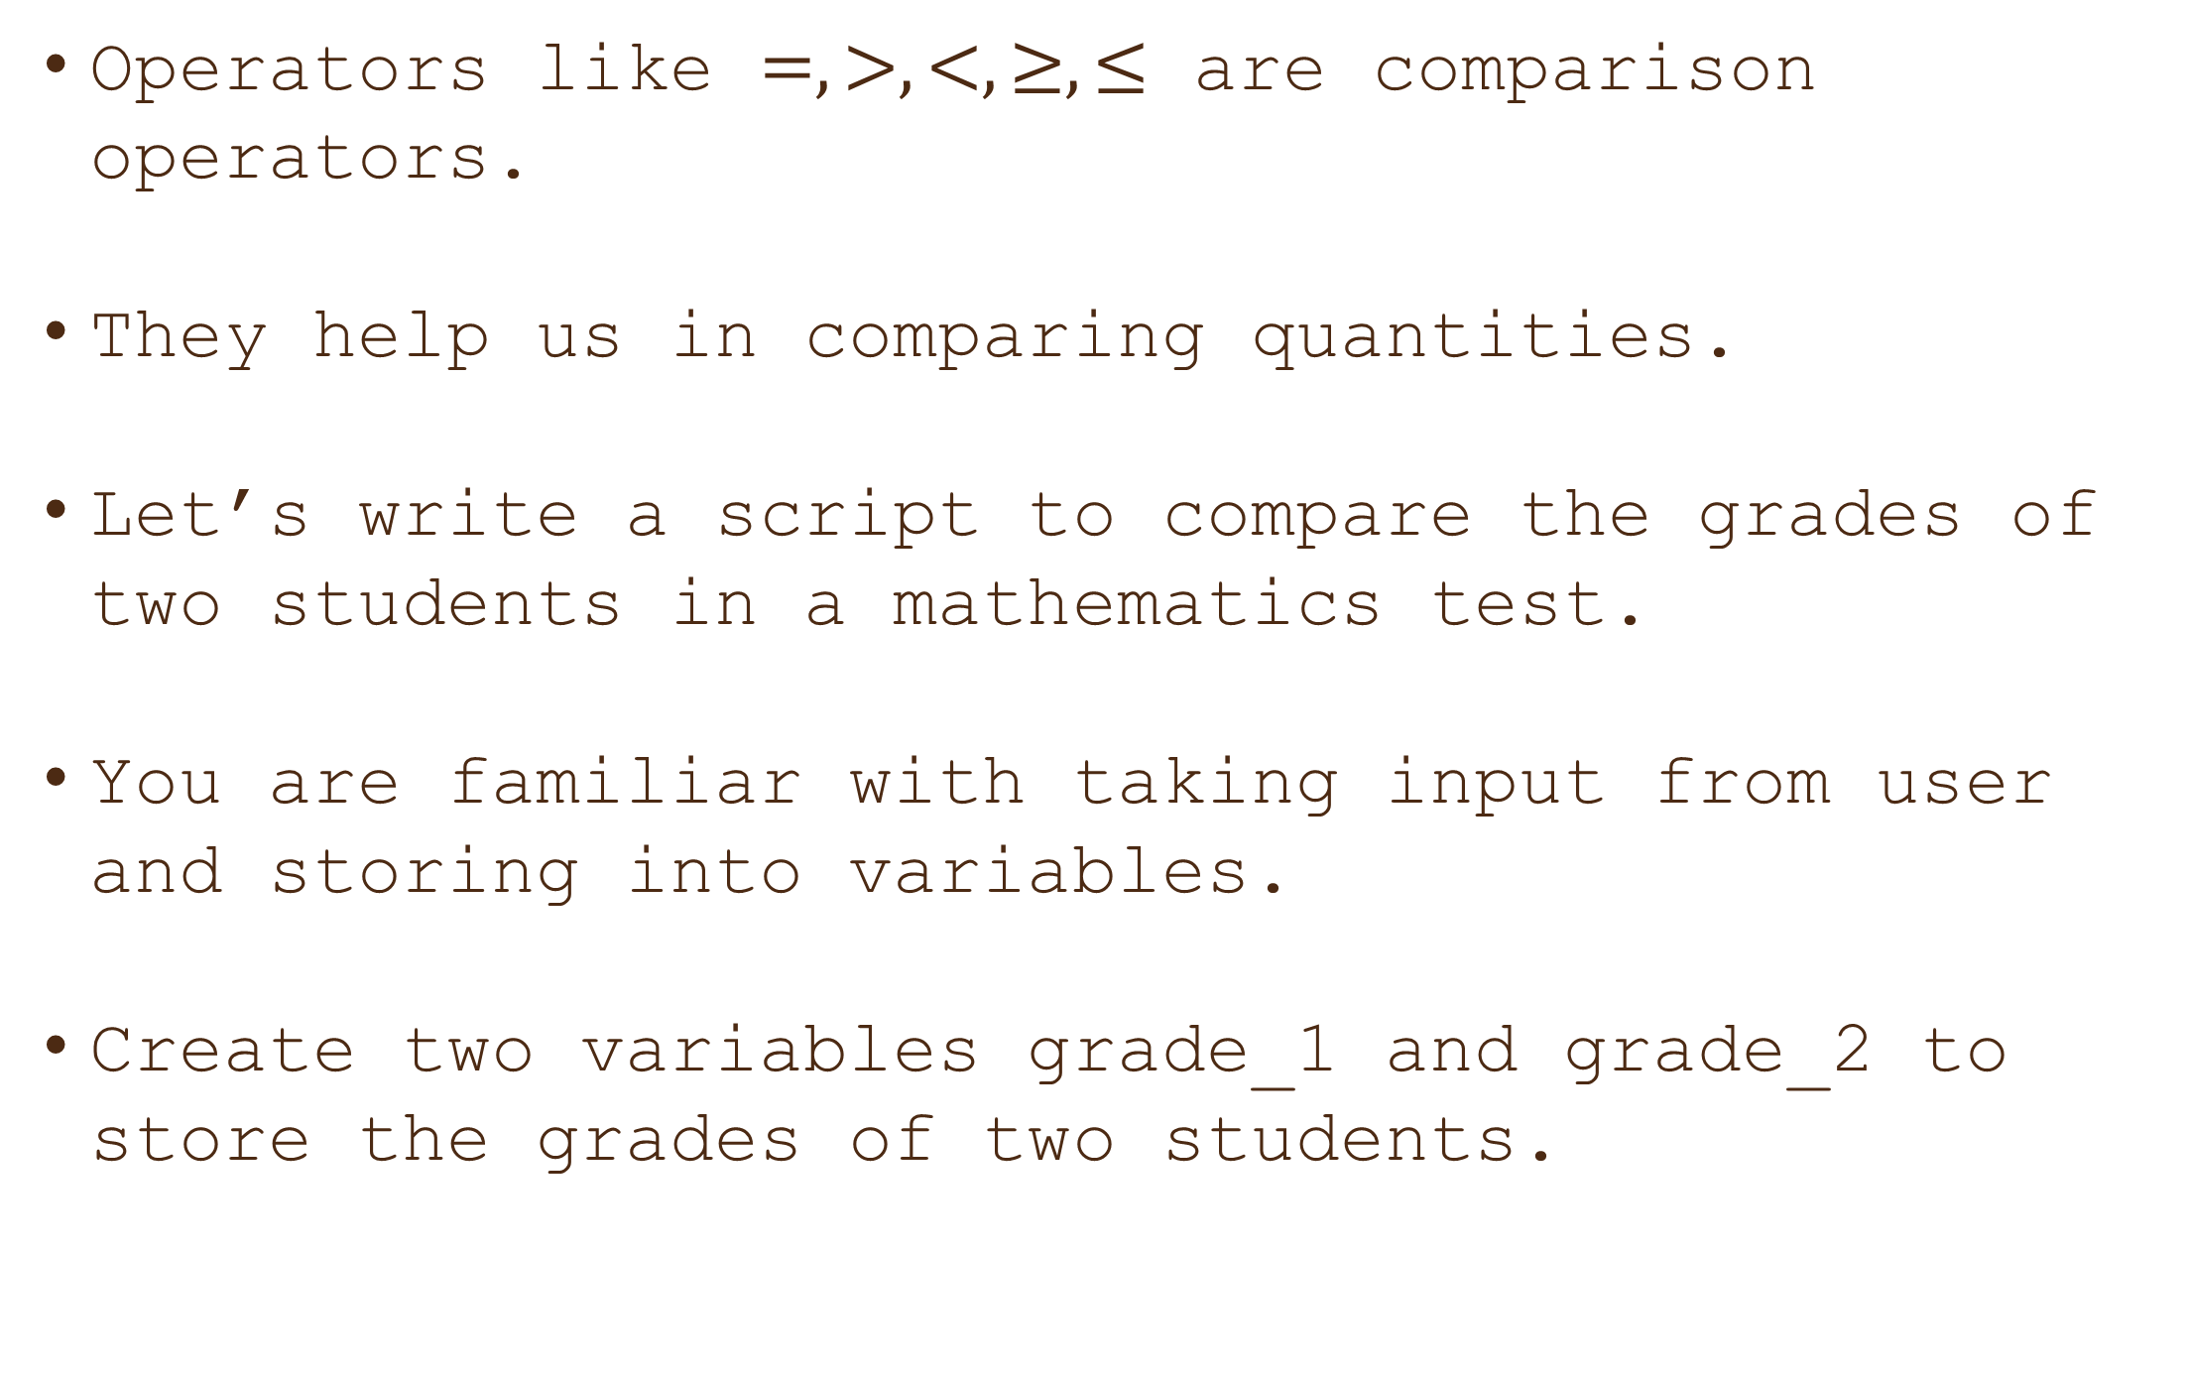
Comparison Operators
Operators like $=, >, <, ≥, ≤$ are comparison operators.
They help us in comparing quantities.
Let’s write a script to compare the grades of two students in a mathematics test.
You are familiar with taking input from user and storing into variables.
Create two variables grade_1 and grade_2 to store the grades of two students.

Slide 9
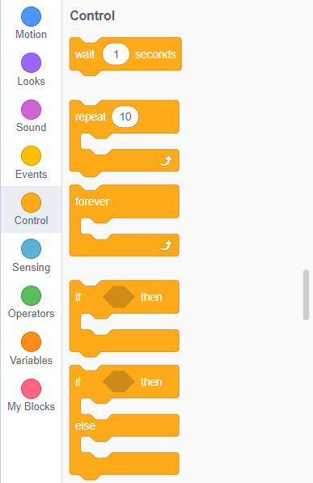
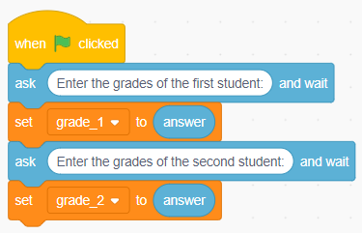
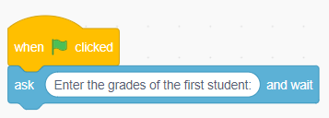
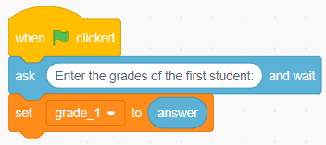
Comparison Operators
Ask the user to input the grades of the first student.
Store the input in “grade_1” variable.
Do the same for the second student’s grades.
Head to the “control” tab and drag the if-else block into the scripting area.
If grade_1 is greater than grade_2,display that the first student has higher grades.

Slide 10
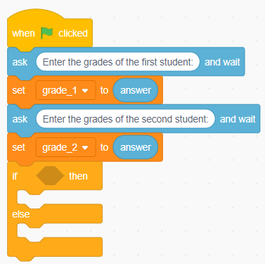
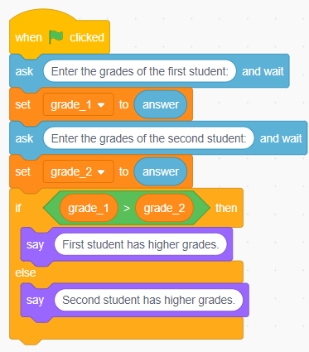
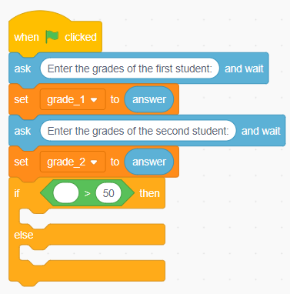
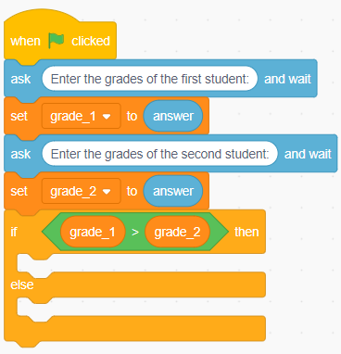
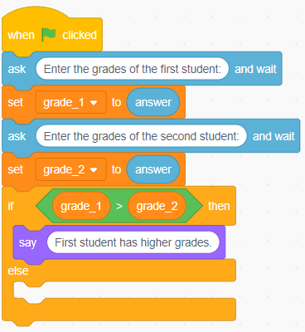
Comparison Operators
Else, display that the second student has higher grades.
Drop the “greater than” block in the space to the right of “if” construct.
Now put “grade_1” and “grade_2” into the comparison block to compare the grades.
If “grade_1” is greater than “grade_2”, display the result accordingly.
Similarly, set the “else” part also.

Slide 11
Comparison Operators
Now hit the green flag to see the magic.
As prompted, input the details.
See if the comparison results are correct.
🎉 Congratulations! You've mastered how to use comparison operators.

Slide 12
Joining two variables
Can make the cat display the following: “Your age is: [your_age]
Where [your_age] is the age entered by the user.
For this, we use the “join” block in operators section.
“Join” block joins two variables together.
Remember, numbers are written without double quotes, while sentences are enclosed in double quotes.
For example, “12” is treated as a word, while 12 is a number.

Slide 13
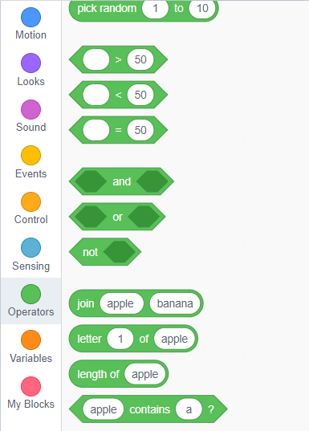
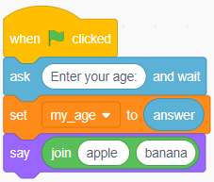
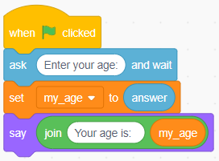
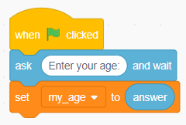
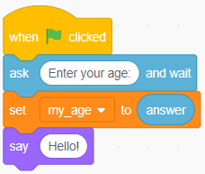
Joining two variables
Store the age of user in [my_age] variable.
Drag the “say [Hello!]” block into the scripting area.
Go to the operators block and drag “join” block.
Drop it inside the “say [Hello!]” block.
Replace “apple” with “Your age is:” and “banana” with [my_age] variable.

Slide 14
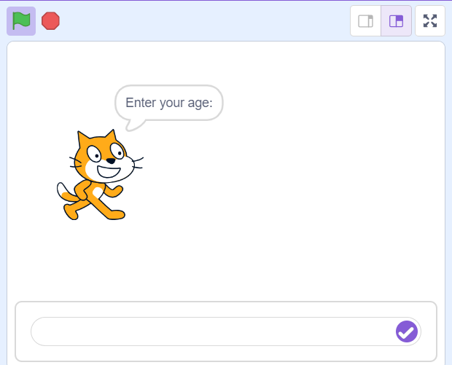
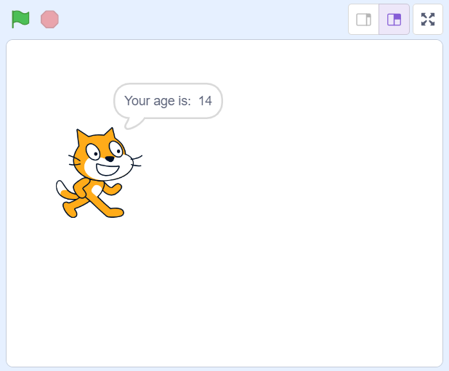
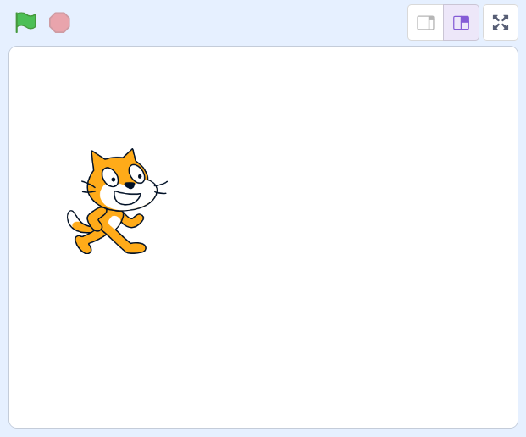
Joining two variables
Head to the stage.
Hit the green flag button to start the event.
The cat will prompt you to enter your age.
Input your age when prompted.
Once you hit enter, the cat will display: “Your age is: 14”.
14

Slide 15
Challenge
Set num1 to a random number between 1 and 10.
Create a new scratch project.
Make three variables: `num1`, `num2`, and `result`.
Set `num1` and `num2`, to a random number between 1 and 10.
Decide an operator, say multiplication for the fun game.
Calculate the product of ‘num1` and `num2` and store the result in the `result` variable.
Make the cat display: “What is [num1] + [num2]?”

Slide 16
Challenge
Set num1 to a random number between 1 and 10.
Have the cat prompt the user to enter their answer and store it in `user_answer`.
Compare `user_answer` with `result`.
If they match, display a congratulatory message like “Correct! Well done!”
If they don't match, display a message like “Oops! The correct answer is [result].”
Save your project with the name “Fun with Math.”

Slide 17
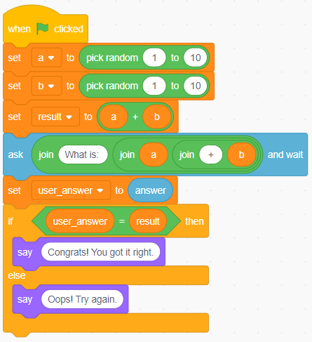
Solution to Challenge
Set num1 to a random number between 1 and 10.
Align the blocks as shown to solve the challenge.

Slide 18

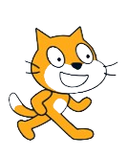

Keep on Scratching!
You've just scratched the surface of the amazing world of Scratch!
Keep on exploring, experimenting, and creating.
Remember, the only limit is your imagination.
Get ready to unleash your creativity and be a coding superstar!

Slide 19


Thanks!
Do you have any questions?
shahmeraj510@gmail.com
+91 7006560568

