Slide 1
Let's Get Scratching!
Fun with Loops

Slide 2

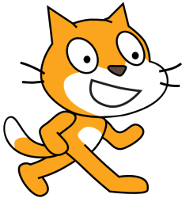

Moving the Cat in a Square
You already know how to move the cat 100 steps.
Now use the “turn [] degrees” block to rotate the cat 90 degrees right.
Again, move the cat the same number of steps.
Turn it 90 degrees right again.
Then move further 100 steps.

Slide 3
Moving the Cat in a Square
Turn the cat 90 degree up.
Then move 100 steps further and again turn 90 degrees.
Now hit the green flag, you will see that the cat moves in a square.
Well done, you have made the cat move in a square.
Can we make this even easier by using fewer blocks? Let's find out how!

Slide 4
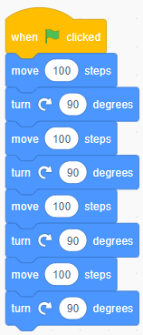
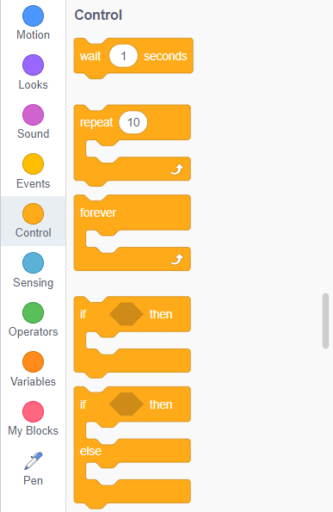
Simplifying the structure
Notice that we have repeated the same set of blocks four times.
The blocks “move [100] steps” and “turn [90] degrees” are repeated four times.
So, we want to use these two blocks four times to avoid repetition.
Head to the “control” tab.
Drag the “repeat” block into the scripting area.

Slide 5
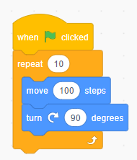
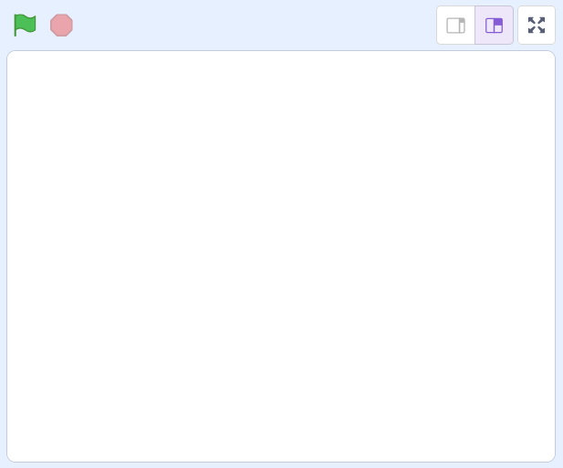

Simplifying the structure
Now drop “move [100] steps” and “turn [90] degrees” blocks inside the “repeat [10]” block.
Replace 10 with 4, since we want to repeat the process only 4 times.
Now click on the green flag and observe that the cat move in a square!
Congratulations, you have utilized the power of loops to shorten the script.
10
4
100
90

Slide 6
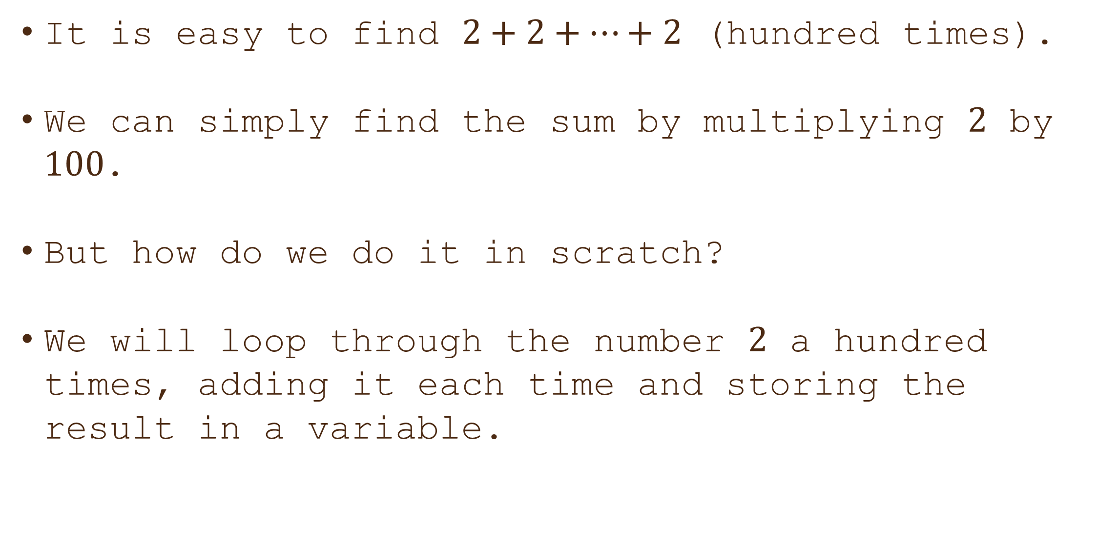

Can you add $2$ hundred times?
It is easy to find $2+2+…+2$ (hundred times).
We can simply find the sum by multiplying $2$ by $100$.
But how do we do it in scratch?
We will loop through the number $2$ a hundred times, adding it each time and storing the result in a variable.

Slide 7
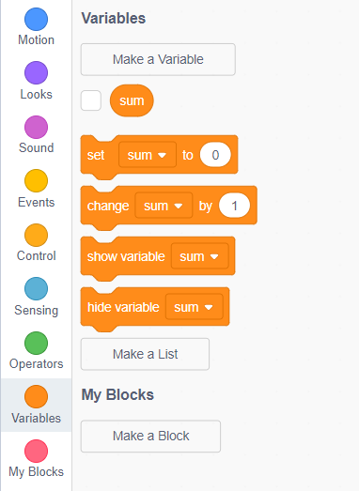
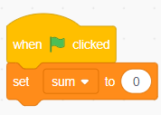
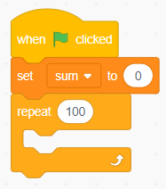


Can you add $2$ hundred times?
Create a variable `sum` to store the total sum.
Set the `sum` variable to $0$ initially, as no numbers have been added to it yet.
Now we need to add 2 a hundred times.
To do this, drag the "repeat" block and set it to repeat the loop a hundred times.

Slide 8
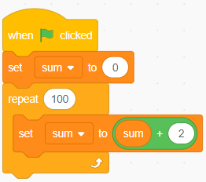
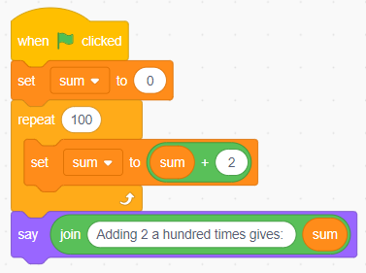
Can you add $2$ hundred times?
What goes inside the "repeat" block?
Inside the "repeat" block, we will increment the sum variable by 2 in each iteration of the loop.
Thus, set “sum” equal to “sum+2” inside the “repeat” block.
Finally, display the output on the stage, using the “say [Hello]” block.

Slide 9
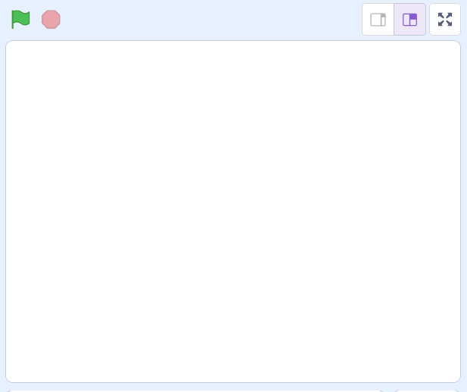


Can you add $2$ hundred times?
Head to the stage, the scratch cat is ready to help you!
Click on the “green flag” button to start the event!
The cat has correctly displayed the sum.
Congratulations, you did it right!

Slide 10
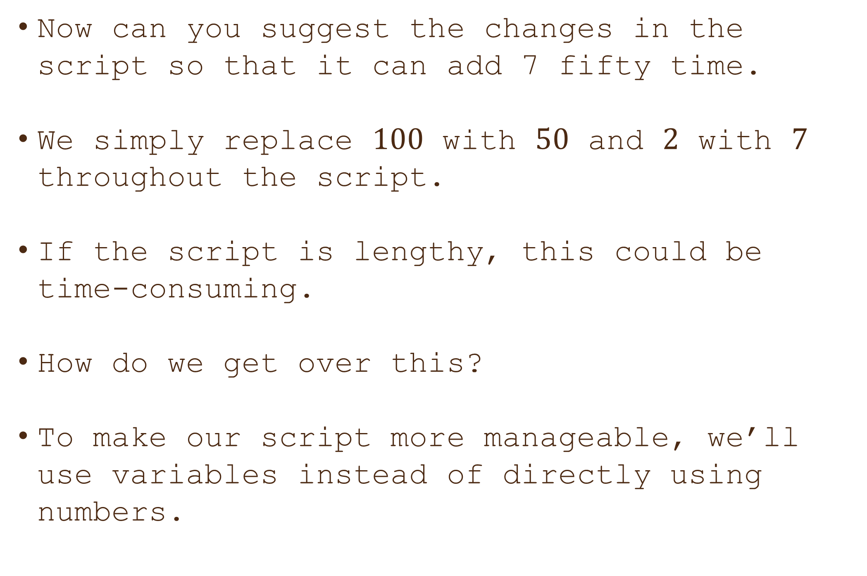

Can you add $7$ fifty times?
Now can you suggest the changes in the script so that it can add 7 fifty time.
We simply replace $100$ with $50$ and $2$ with $7$ throughout the script.
If the script is lengthy, this could be time-consuming.
How do we get over this?
To make our script more manageable, we’ll use variables instead of directly using numbers.
50
2

Slide 11
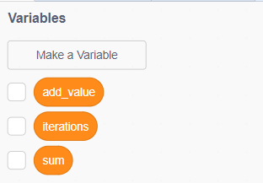
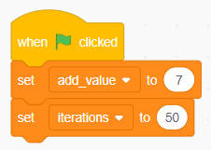
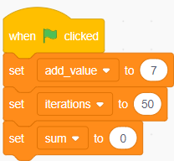

Can you add $7$ fifty times?
Create Three New Variables: `iterations`: to store the number of times to loop. `add_value`: to store the value to be added each time. `sum`: to store the total sum of `add_value`
Since we want to add $7$ fifty times, set `add_value` to $7$ and `iterations` to $50$.
Also, initialize the `sum` variable to $0$.

Slide 12
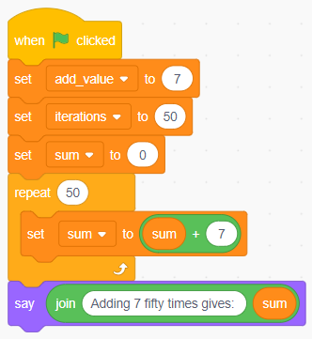
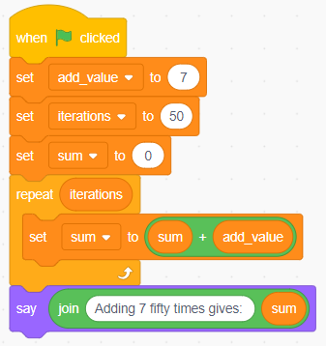


Can you add $7$ fifty times?
Append the previous “repeat” block to the new script.
Replace 50 with “iterations” block and 7 with the “add_value” block in the script.
Run the script to see if it works fine.
Now do find the sum $11+11+…+11$ sixty times, what changes should we made in the script?
We only need to update the two variables: `add_value` and `iterations`.

Slide 13
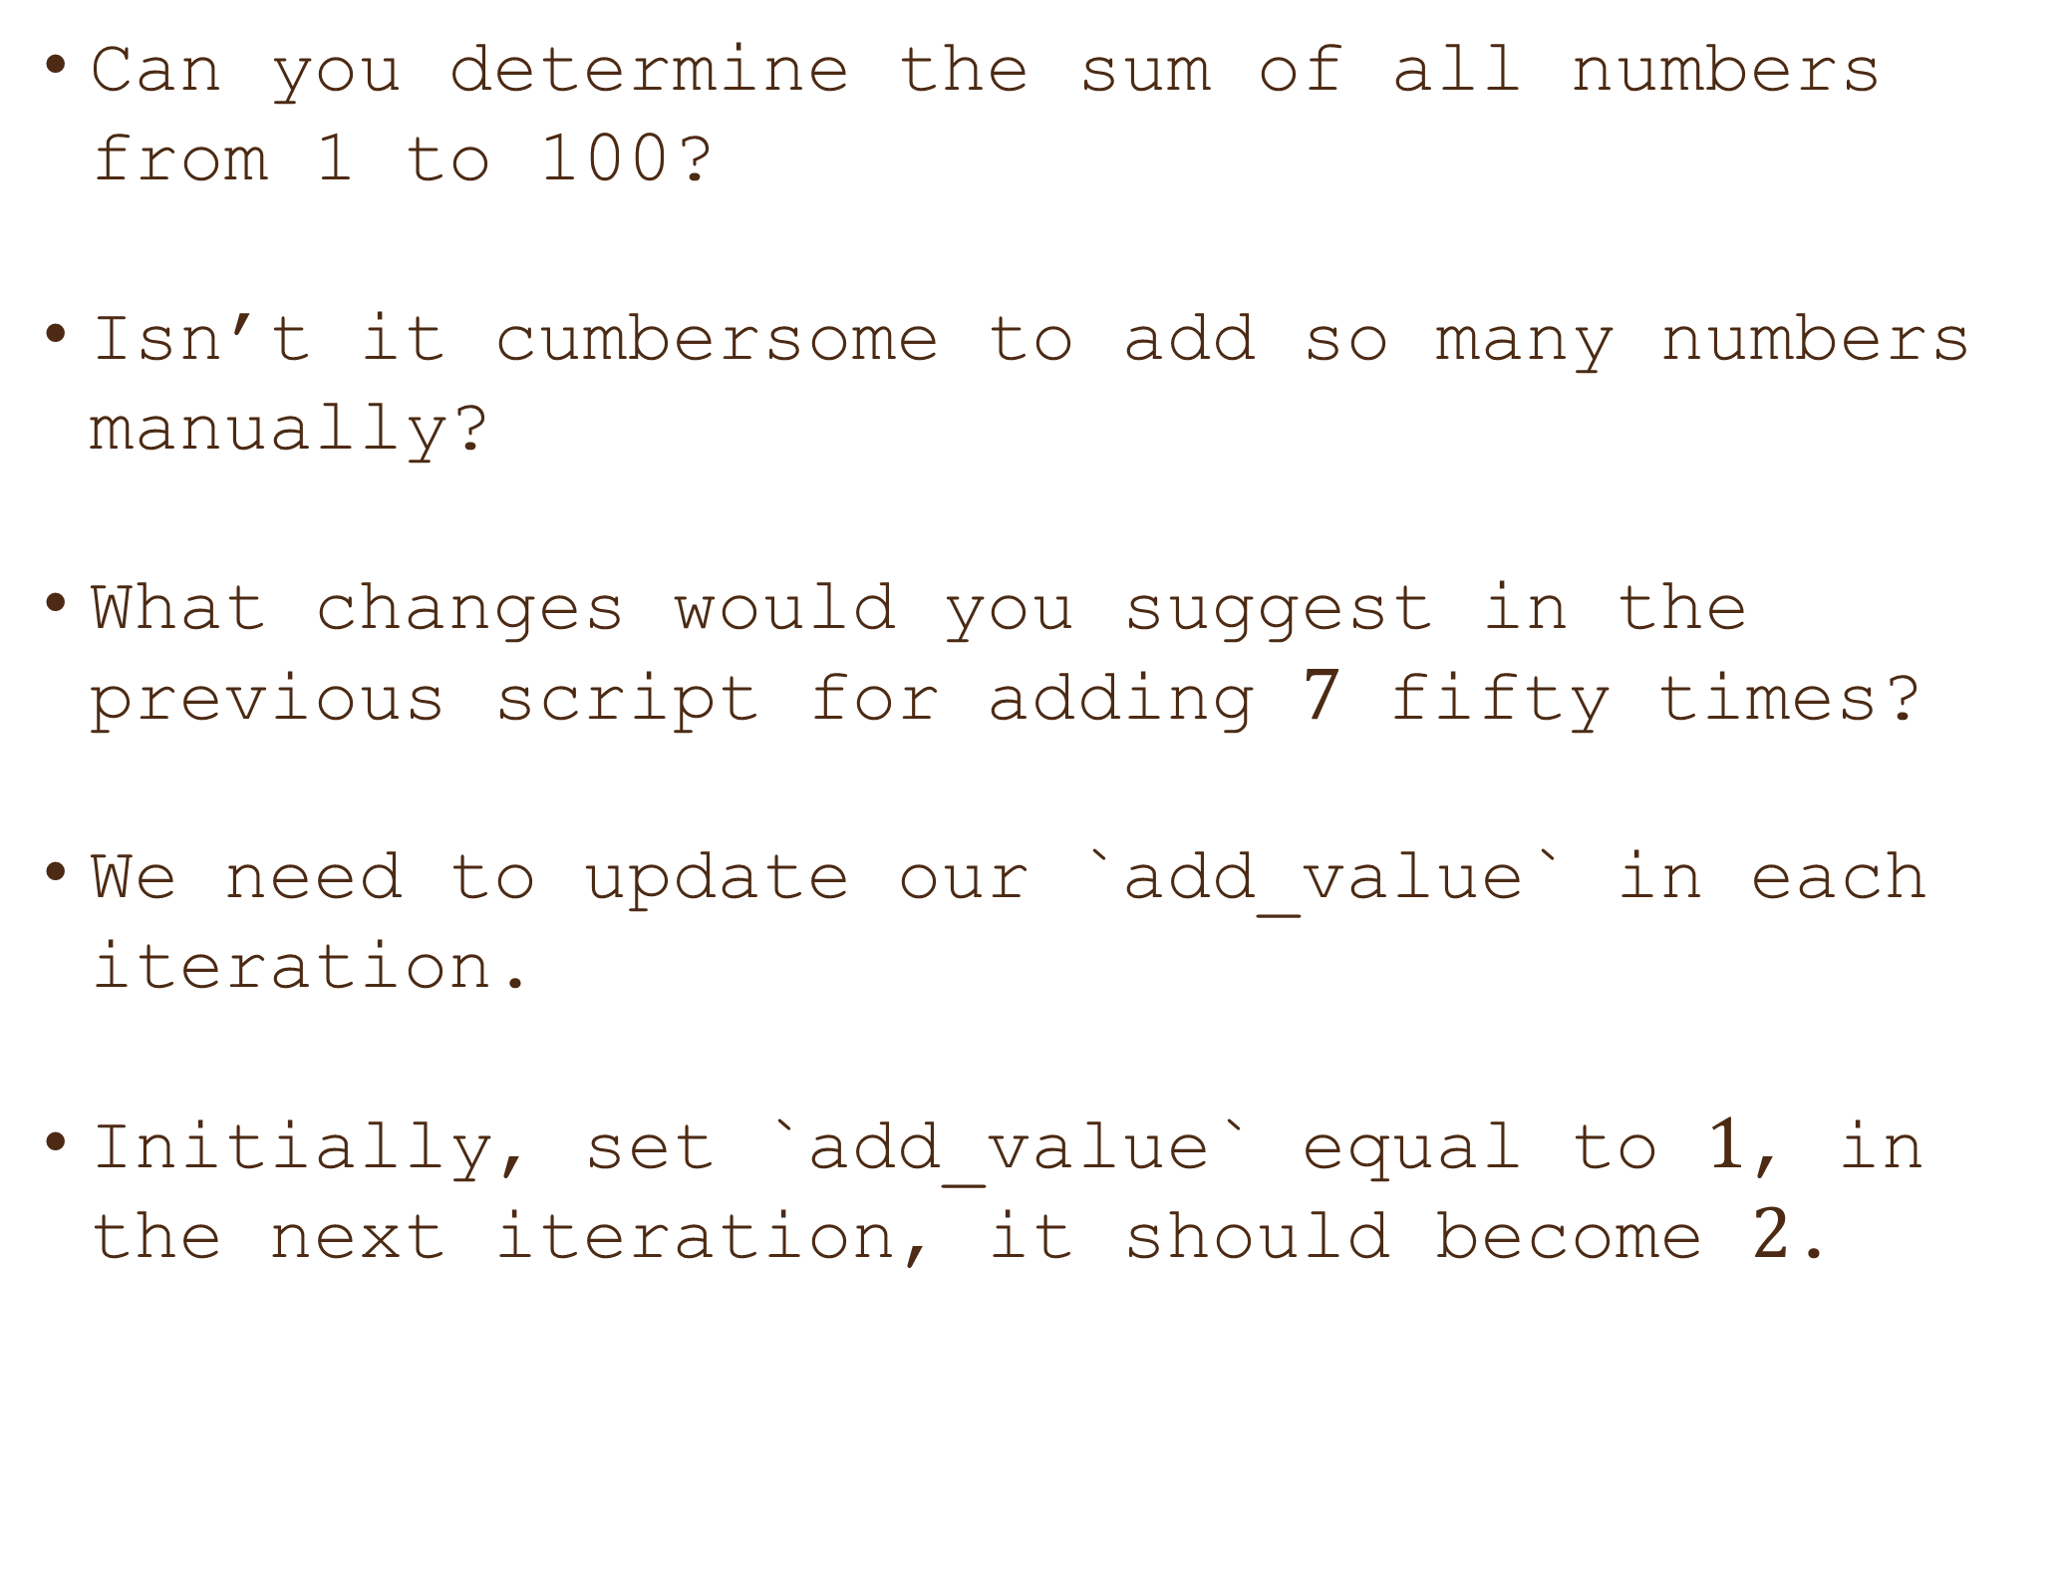

Can you find : $1+2+3+…+100$?
Can you determine the sum of all numbers from 1 to 100?
Isn’t it cumbersome to add so many numbers manually?
What changes would you suggest in the previous script for adding $7$ fifty times?
We need to update our `add_value` in each iteration.
Initially, set `add_value` equal to $1$, in the next iteration, it should become $2$.
1

Slide 14
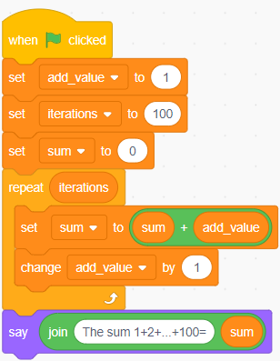
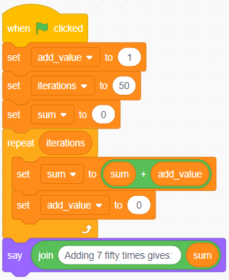
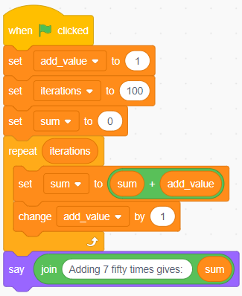
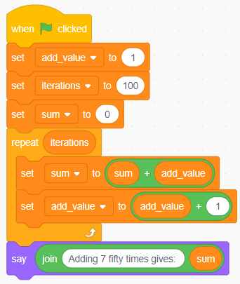
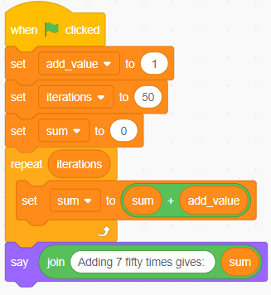

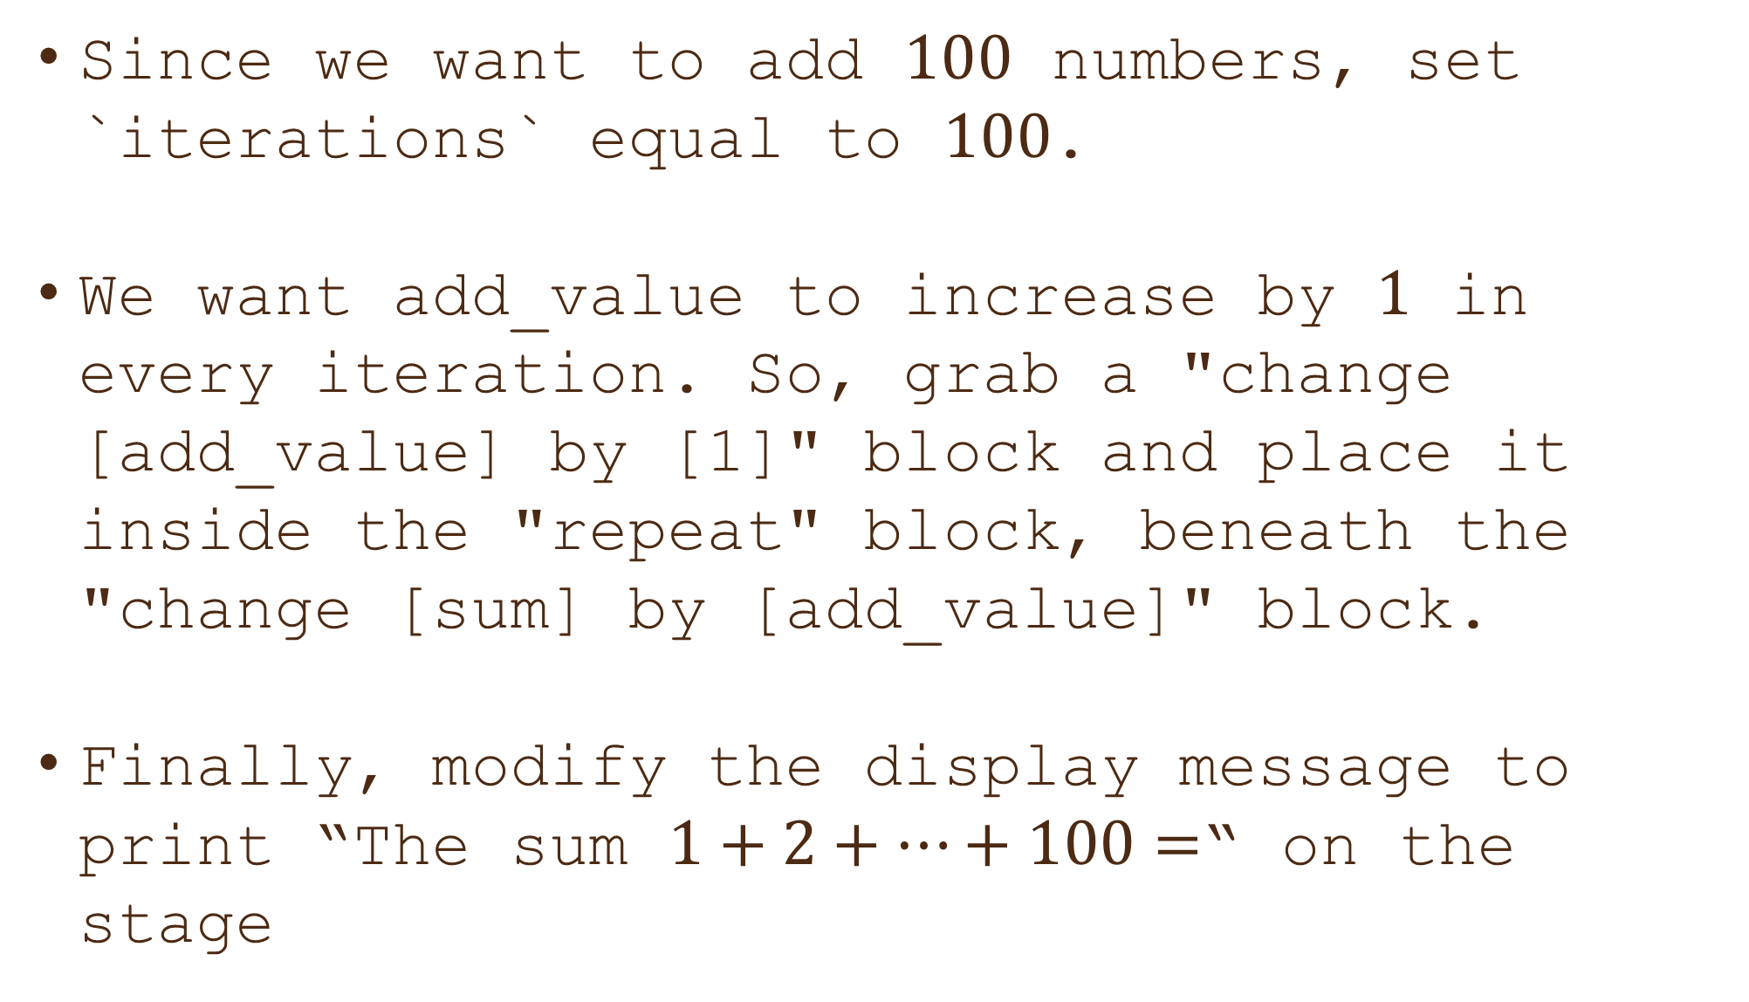
Can you find : $1+2+3+…+100$?
Since we want to add $100$ numbers, set `iterations` equal to $100$.
We want add_value to increase by $1$ in every iteration. So, grab a "change [add_value] by [1]" block and place it inside the "repeat" block, beneath the "change [sum] by [add_value]" block.
Finally, modify the display message to print “The sum $1+2+…+100=$“ on the stage

Slide 15


Can find the sum: $1+2+3+…+100$?
Head to the stage, the scratch cat is ready to help you!
Click on the “green flag” button to start the event!
The cat has correctly displayed the sum.
Congratulations, you did it right!

Slide 16

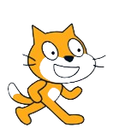
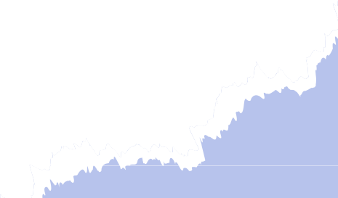
Keep on Scratching!
You've just scratched the surface of the amazing world of Scratch!
Keep on exploring, experimenting, and creating.
Remember, the only limit is your imagination.
Get ready to unleash your creativity and be a coding superstar!

Slide 17


Thanks!
Do you have any questions?
shahmeraj510@gmail.com
+91 7006560568

