Slide 1
Let's Get Scratching!
Conditional Statements

Slide 2
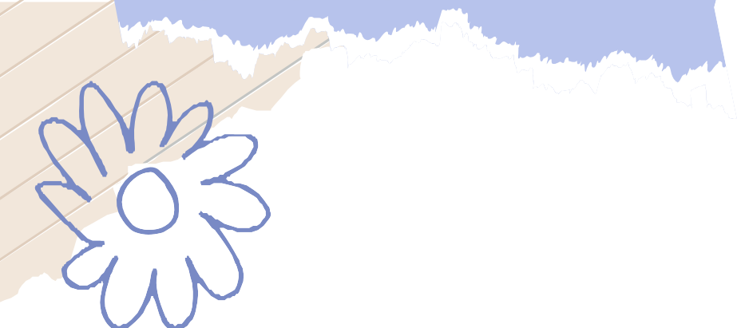
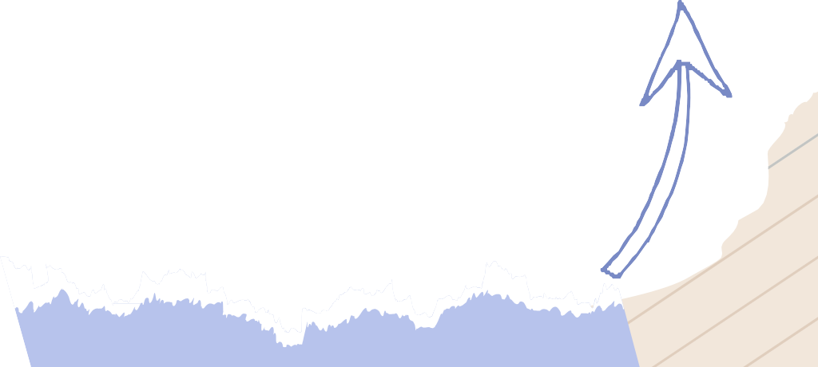
Conditionals: An Example
Imagine you are at a pedestrian crossing, and you want to cross the street safely.
You need to decide when it's safe to cross based on the traffic light.
If the light is green for pedestrians, you can cross.
Else, if it is red, you will wait till it turns green.

Slide 3
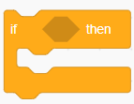
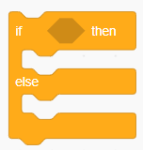
Conditionals: An Example
In this scenario, your decision is conditional, as it depends on a particular condition.
Similarly, in scratch, conditional statements allow a script to take different actions based on whether a condition is true or false.
In Scratch, these are often used with the "if" and "if-else" blocks.

Slide 4
Making the Cat Move Based on Key Press:
Can you make Scratch Cat move right when the right arrow key is pressed and move left when the left arrow key is pressed.
You are already familiar with motion of the cat.
Can you build the logic for this?
The logic is very simple, we will check if the user clicks right or left arrow and move the cat accordingly.

Slide 5
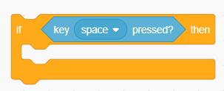
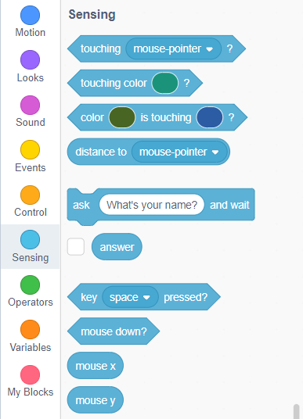
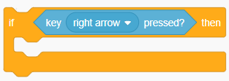
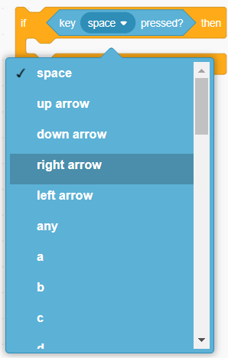
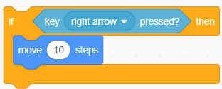
Making the Cat Move Based on Key Press:
Grab the “if [] then” block into the scripting area.
Head to the sensing tab and drag the “key [] pressed?” block into the “if [] then” condition.
Select “right arrow” from the drop down.
What should be inside the “if [key <up arrow> pressed?] then” block?
We will make the cat move forward when right key is pressed.

Slide 6
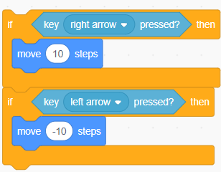
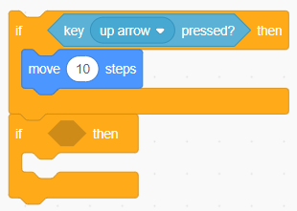
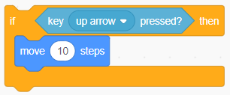
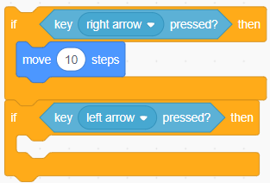
Making the Cat Move Based on Key Press:
Now can you complete the rest of the script.
You need to another “if [] then” block and fill in it accordingly.
Drag the “key [] pressed?” into the “if [] then” block and select an appropriate choice from the drop down.
How so you make the cat move backwards?
Try changing [10] to [-10] inside the “move [] steps block”.

Slide 7
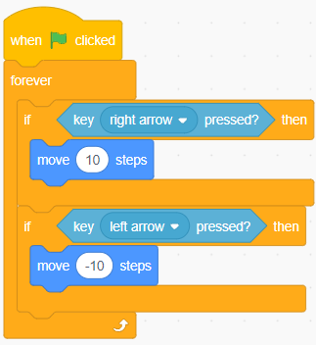
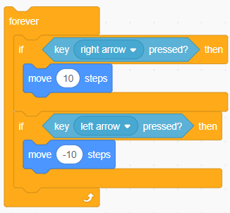
Making the Cat Move Based on Key Press:
We want this script to run forever. How do we do that?
It’s simple! Just drag the entire script inside the “forever” block.
To start the event, add “when [green flag] clicked” block at the top of the script.
Click the flag and try moving the cat.
Congratulations, you have done a challenging job.

Slide 8
A Simple Challenge
As a challenge, can you add few more functionalities to your awesome project?
The new script should work for up and down arrows key as well.
When down or up arrow is clicked, the cat should move up and down respectively.
All the best for you assignment.

Slide 9
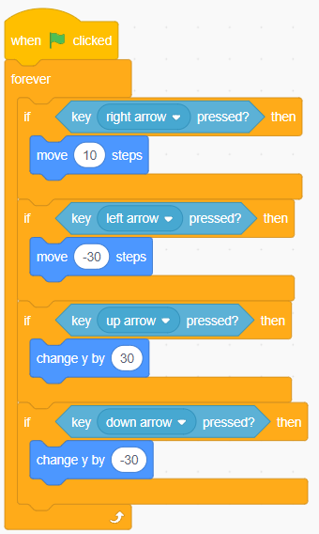
Solution to the Challenge

Slide 10

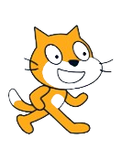

Keep on Scratching!
You've just scratched the surface of the amazing world of Scratch!
Keep on exploring, experimenting, and creating.
Remember, the only limit is your imagination.
Get ready to unleash your creativity and be a coding superstar!

Slide 11

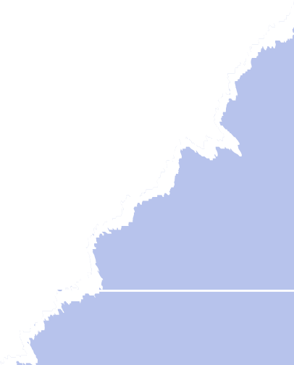
Thanks!
Do you have any questions?
shahmeraj510@gmail.com
+91 7006560568

