Slide 1
Let's Get Scratching!
Lists

Slide 2


Can you Name your three classmates?
Suppose the teacher asked you to store the names of three of your class mates.
How would you do it in scratch?
Remember, we know how to store a single name.
So, it shouldn’t be hard to store few more names.
You would probably make three variables for three names.

Slide 3
Can you Name your three classmates?
As a challenge, write a script to store the names of three of your classmates.
What if the teacher asks you to store 10 names? Or 20 names?
Will you create 10 or 20 variable?
That would be tedious and time consuming.
This is where ‘lists’ come to our rescue.

Slide 4
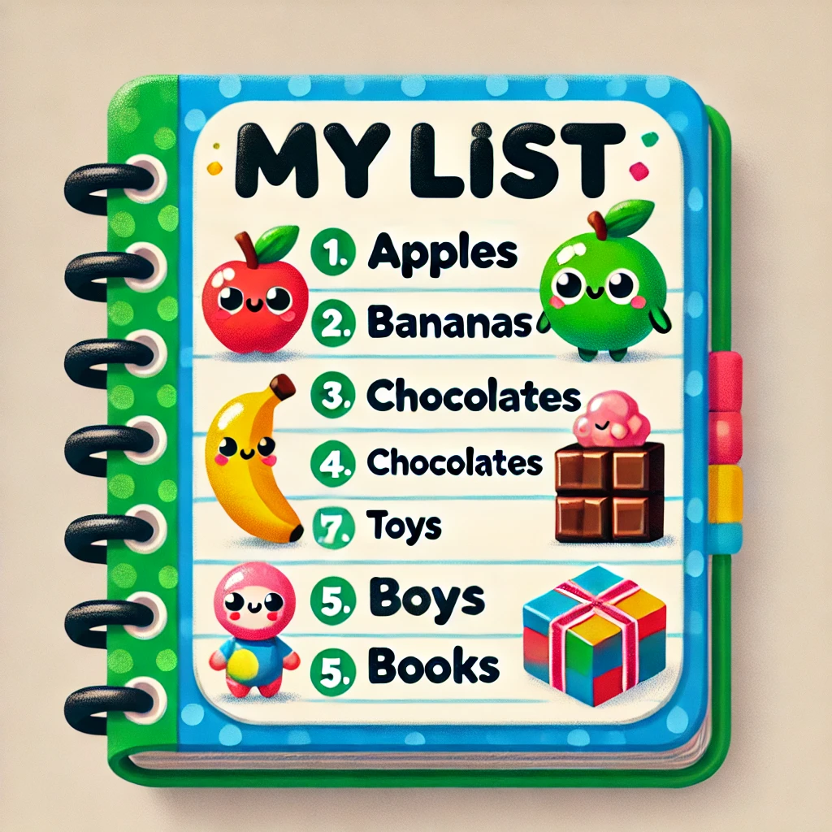
What is a list?
A list is like a big bucket that can hold lots of things!
Isn’t that great? You can store a lot of names in without creating variables for each name.
Let’s rewrite our previous script using a list.

Slide 5
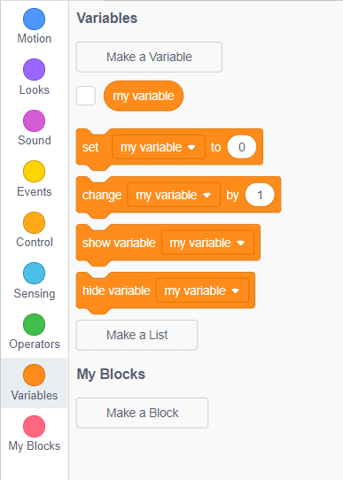
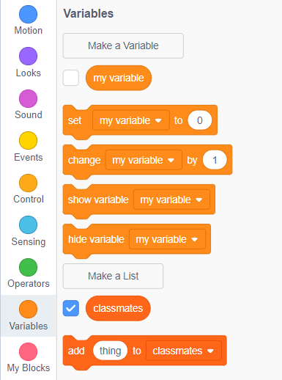
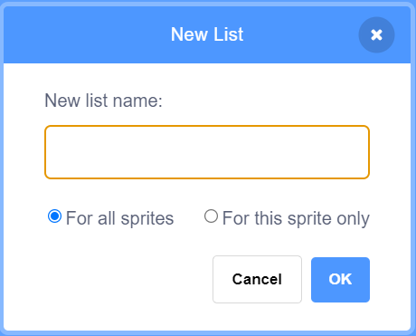
Creating a list
A Head to the variables section and click on “Make List”.
Input the name of the list in the space provided and click “OK”.
Notice in the variables tab, a new list names “classmates” has been created.
You have successfully created a list!
classmates

Slide 6
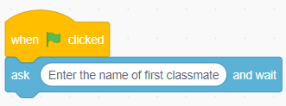
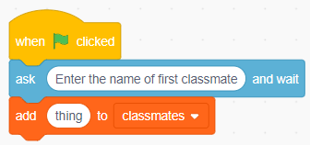
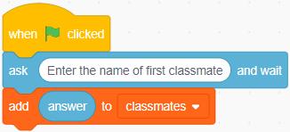
Adding Things to a List
You know how to make the cat ask you something.
Let’s create a script that prompts the user to input the names of class mates.
Next, drag the “Add [thing] to [classmates]” into the scripting area.
Replace “thing” with the “answer” block.

Slide 7
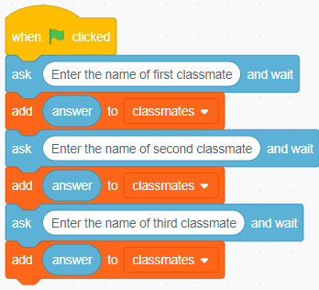
Adding Things to a List
The first classmate’s name has been added to the list.
Can you do the same for the other two classmates?
You may end up with something like this.
Can you minimize using a lot of blocks here?

Slide 8
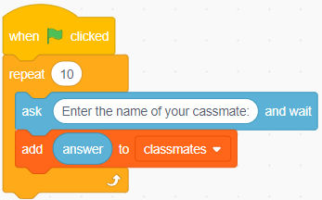

Minimizing the Script
How about using a loop instead of repeating the two block thrice?
This way, we can store large number of things in a list efficiently.
Put these two blocks inside a “repeat” block.
Since we want to store three names, replace $10$ with $3$.

Slide 9
Minimizing the Script
Now try running the script and see what happens.
The cat will prompt you to enter the names thrice.
Each time enter the name of your classmate.
The names will be stored in the list, ‘classmates’.
You can use “say [hello]” block to display the names on the screen.

Slide 10
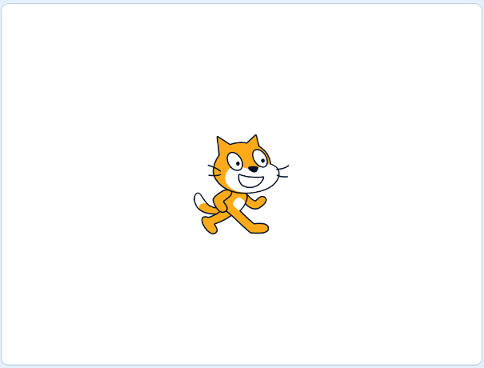
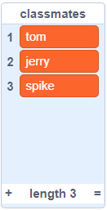
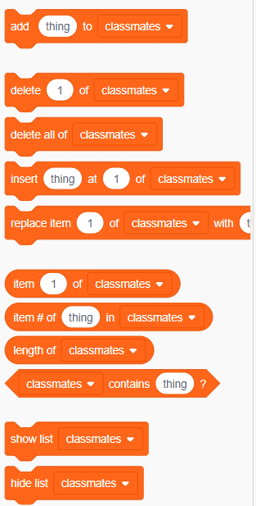
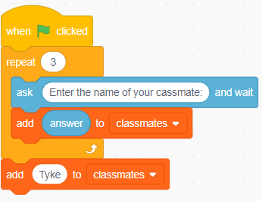
More on Lists
You can see the items in the list once you fill names in it.
Can you add few more things to it?
In the variables section, notice that we can do a lot of operations on the list we created.
Drag the “add [thing] to [classmate] at the end of your script, and replace [thing] with the name of your classmate.

Slide 11
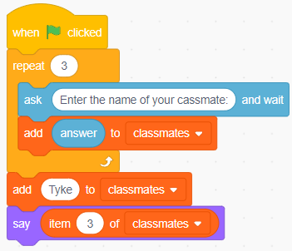
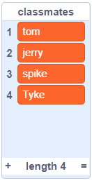
Indexing a List
Notice that each item in the list has a number associated with it.
[tom] is the first element of list.
Can you fetch the third element of the list?
Well, you can use “item [3] of [classmate]” block for the same.

Slide 12
A Little Challenge!
Congratulations! You've got a great grasp on lists.
Now let's put your skills to the test with a fun challenge!
Delete the second item from the list.
Insert ‘Quacker’ at second position.
Replace ‘Tyke’ with ‘Lightning Cat’.
Find the index of ‘Lightning Cat’.
Finally, check if the list contains ‘Jerry’.

Slide 13

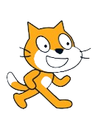

Keep on Scratching!
You've just scratched the surface of the amazing world of Scratch!
Keep on exploring, experimenting, and creating.
Remember, the only limit is your imagination.
Get ready to unleash your creativity and be a coding superstar!

Slide 14


Thanks!
Do you have any questions?
shahmeraj510@gmail.com
+91 7006560568

