Slide 1
Attendance System using One-Shot Learning
Subject: Machine Learning

Slide 2
Presenters
Shah Muahmmad
Anusha
Farhana Noor

Slide 3
Agenda of the presentation
Abstract
Introduction
Problem Statement
Proposed Methodology
Dataset Discussion
Major Outcomes
Project Timeline
Conclusion

Slide 4
Abstract
Technology: to make things quicker and easy and save time in every sector of life
Same for the attendance system
Paper based, Biometric attendance systems are common, but time consuming
Can be rectified using facial recognition
But the problem is DATA.
So, we use One-Shot Learning Siamese Model to tackle this problem.

Slide 5
Introduction
Motivation
Problem Identification
Scope
Objectives
Contribution

Slide 6
Problem Statement
Attendance is the essential activity for any educational institution
Advance systems, biometric and face recognition
But the problem is, Machine learning algorithms needs a lot of data for acceptable accuracy
So, our proposed system will use One-Shot Learning with Siamese Model
Why One-Shot Learning Approach?

Slide 7
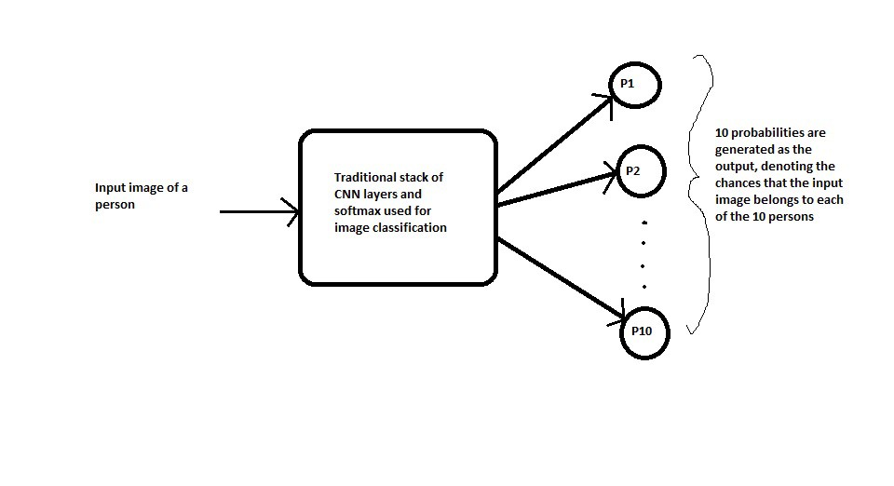
Proposed Methodology
The propose system will use One-Shot Learning approach Siamese Network.
Traditional CNN model working flow diagram

Slide 8
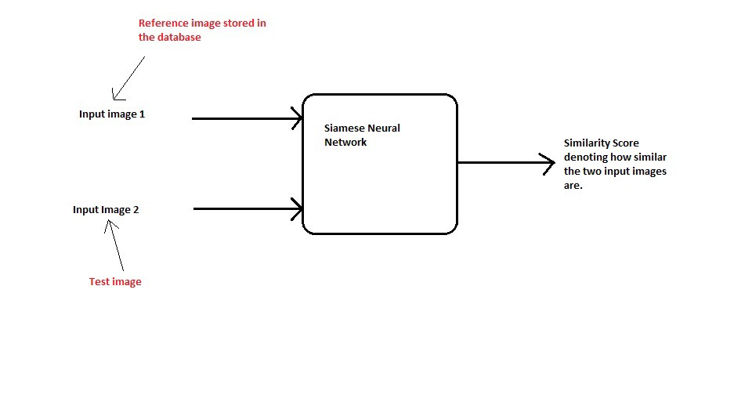
Proposed Methodology
Siamese network help to address the one shot learning problem.
The general work flow of the Siamese network

Slide 9
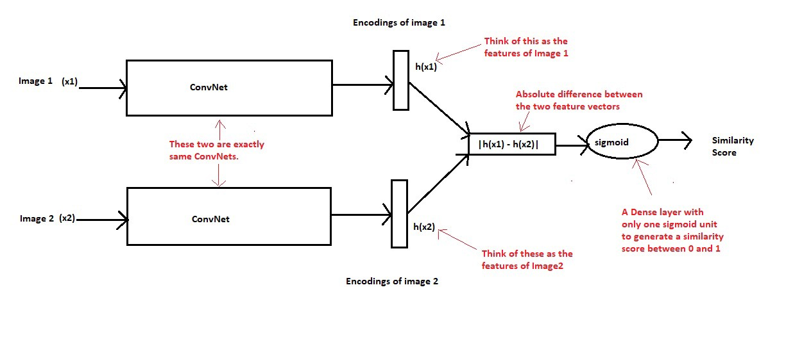
How Siamese Model Works

Slide 10
Dataset Discussion
As we are using one-shot learning approach, so the dataset will not be as huge as we need for the traditional machine learning algorithms
We will make our own dataset for the proposed system.
Firstly to gather data from students of our class.
Will convert each student’s picture to 28x28
Will use python tools and libraries like OpenCV to make our own dataset from the data provided
At last we will test our project on this dataset and will fine tune the model if there is need to.

Slide 11
Major Outcomes
The proposed system will not require huge data for the person identification and verification rather it would take one sample for the training and the recognition of the person.
The proposed system will be a web application which can be accessed from anywhere on web.
The final system will be working on real time, which means that it will take the real time pictures from the webcam and will be used to recognize it.

Slide 12
Project Timeline
Months / Phases | 20 April-10 May | 11 May - 20 May | 21 May - 20 June | 21 June - 25 June | 26 June – 30 June
Planning
Design
Coding
Testing
Delivery

Slide 13
Conclusion
To reiterate all of the above discussion, we can say that we have reached the point where the technology does everything we need it to do.
We will use one-shot learning approach for the attendance system that would be more scalable, flexible and intelligent.
Siamese network will be used for greater accuracy and less data requirements.
We will be having a web application (using flask) which will capture the user from webcam real-time and will give the result.

Slide 14


