Slide 1

ADVENTURE HARDWARE G.
DATA VISUALIZATION & FORECASTING
DELIVERED BY ALEJANDRA FERNANDEZ-RICO REINOSO ON BEHALF OF PAIRVIEW LIMITED

Slide 2

Table of Contents
Business Overview
Executive Summary
Financial and Demographic performance
Market Share & Competitors
Market Basket Analysis
5 Years Sales Forecast
AHG Strategy
Conclusion, Recommendations and Acknowledgement

Slide 3
Business Overview
Adventure Hardware Group (AHG) is a global manufacturing organization with operations in America, Europe and Asia. AHG is online specialty retailer and reseller of road bikes, mountain bikes, touring bikes, components, accessories, and clothing. We deliver the personalized service of the best local shops, but with a dynamic, interactive experience only possible on the web — specially designed to make you knowledgeable and confident about every product we sell.
4 Years in Business
26.95K
Customers
10 Regions
2 Channel
Online &
Reseller
3 Bike Types

Slide 4
Executive Summary
2
• Across the globe, AGH sales have grown 101% since the end of 2011 to 2013 (62% Online and 119% Reseller).
• There is a clear shift, between May 2013 and July 2013, the number of Online transactions increased exponentially by 370%.
• This change is explained by the introduction of the product categories "Accessories and Clothing" that have led to an exponential increase in transactions sales. Additionally, in a lower proportion as of November 2013, a change in the bicycle market is seen, surpassing online sales to resellers.
• The Bike Market represents 86% of the sales. It is distributed by the following channels:
o Online: It represents 26% of sales, however the Profit is positive for 119% of total sales. There is no product over these
years sold with negative margins.
o Reseller: It represents 60% of sales, however the Profit is negative for 34% of total sales. The average Profit has been a loss
of 216$ per transactions. List Price > Unit Price -- Average Reduction List Price = 43%.
• Australia is the region with the highest online sales since 2011 with a total of 31% of total online sales and Southwest in US is the region with the highest sales reseller since 2011 with a total of 23% over total online sales.
• Highlight the category of E-Bike. According to The Persistence Market Research report; “By the end of 2016, hybrid bicycles are anticipated to be the leading segment of the market and is expected to account for over 38% share of the market in terms of value, followed by the road and mountain segments. The e-bike segment is foreseen to reflect a compound annual growth rate of 4%, to reach a market valuation of US$ 24.43 Billion by 2024.

Slide 5
Executive Summary
2
• 5 year forecasts predict:
o Online: UK, France, Germany, “SW US”, “NW US”, Canada, Australia and “SW US” and show an increment of 134%, 130%, 124%, 87%, 84%, 76% and 56% respectively in revenues. “SE US”, “Central US” and “NE US” Sales are practically null.
o Reseller: UK, France, “NW US”, Canada, “NE US”, “SW US” and “Central US" show an increment of 114%, 46%, 41%, 119%,41%, 99% and 97% respectively in revenues. Australia & Germany 5-year estimates are not reliable.
• Market Basket Analysis: The products that must be sold together based on profitability are the following: o Online – MTB with Tire & Tubes / Road B. with Tire & Tubes / Helmets with Tire & Tubes. o Reseller – MTB with MTB Frames & Short & Pedals.

Slide 6
Table of Contents
Business Overview
Executive Summary
Financial and Demographic performance
Market Share & Competitors
Market Basket Analysis
5 Years Sales Forecast
AHG Strategy
Conclusion, Recommendations and Acknowledgement

Slide 7
Financial and Demographics performance
3
Summary of Financial Information
Is there a shift towards Digital?
Is the business making profit?
Customer Demographics – Online
Which areas AHG should improve?

Slide 8
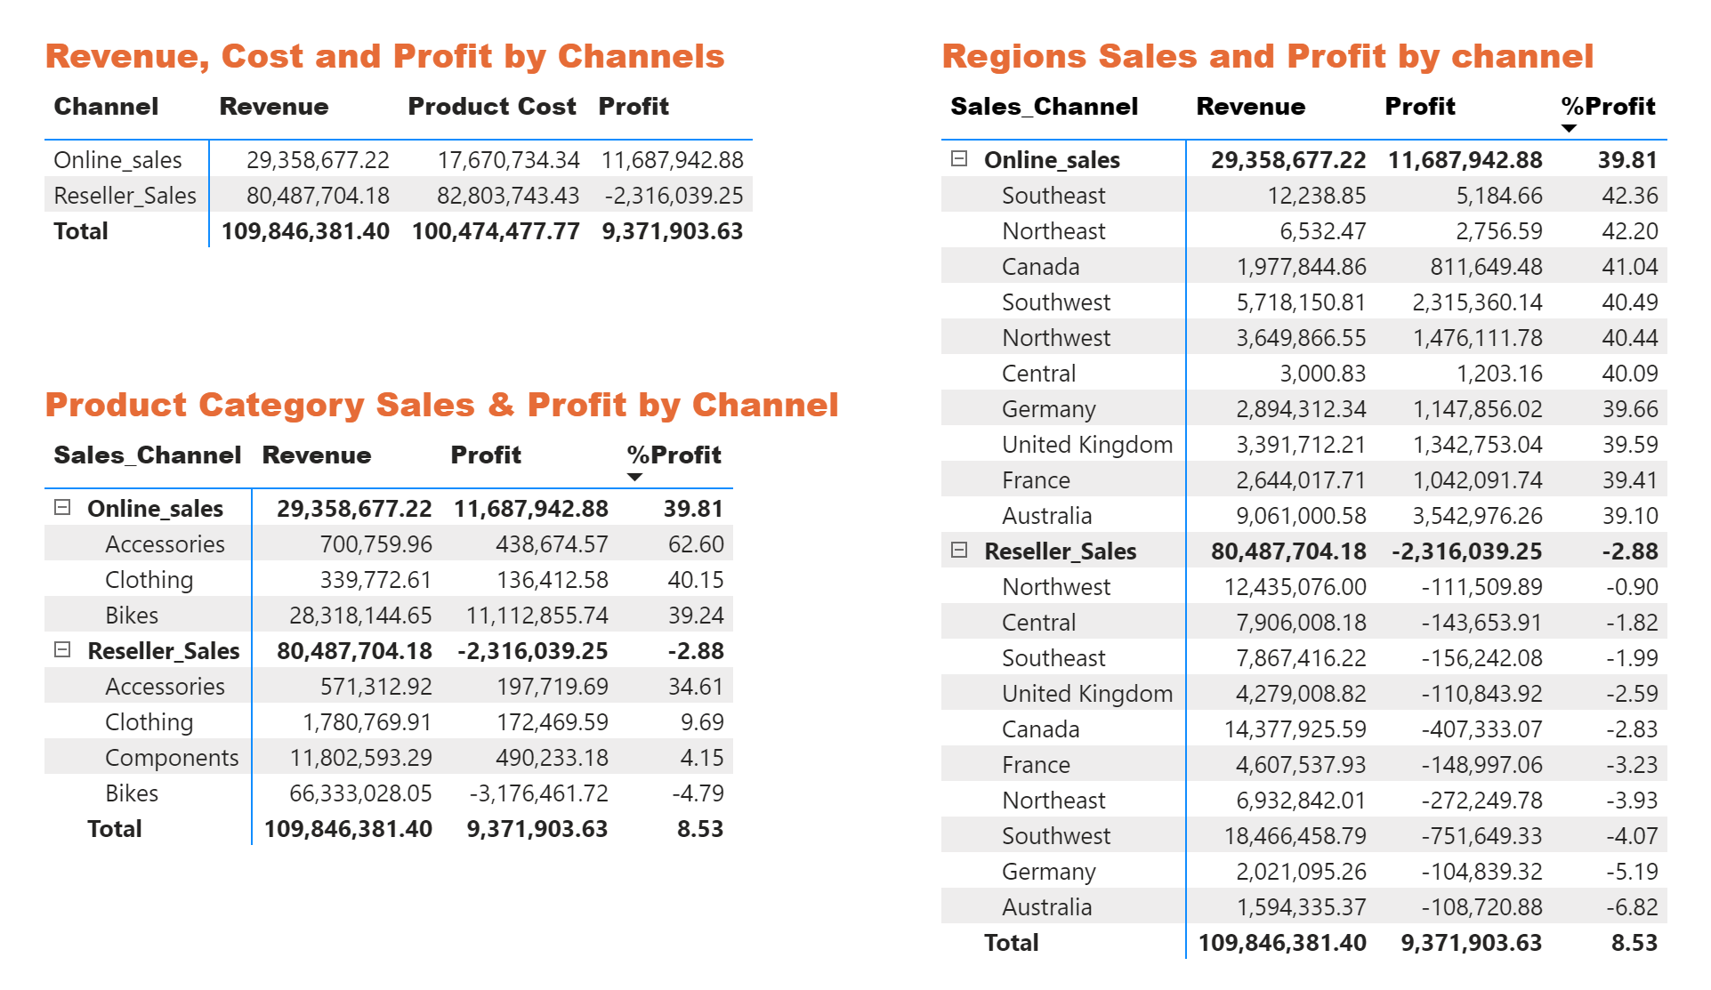
Summary of Financial Info – Data from 2011 to 2014
3.1
Comments
• Reseller: It represents 73% of sales, however the Profit is negative by – 2.88%.
• Online: It represents 27% of sales, however the Profit is positive + 39.81%.
• Bikes Category: It represents 86% of the sales, however the Online Market is profitable whereas Reseller is negative.
• Regions: Online Market - Australia is the largest seller with 31% of sales being also the most profitable region with 38% of the total profit. Reseller Market - The US and Canada have the largest sales by difference (84% of total Sales). Overall there is no profit in Reseller Market.

Slide 9
Is there a shift towards Digital?
3.1
YES

Slide 10
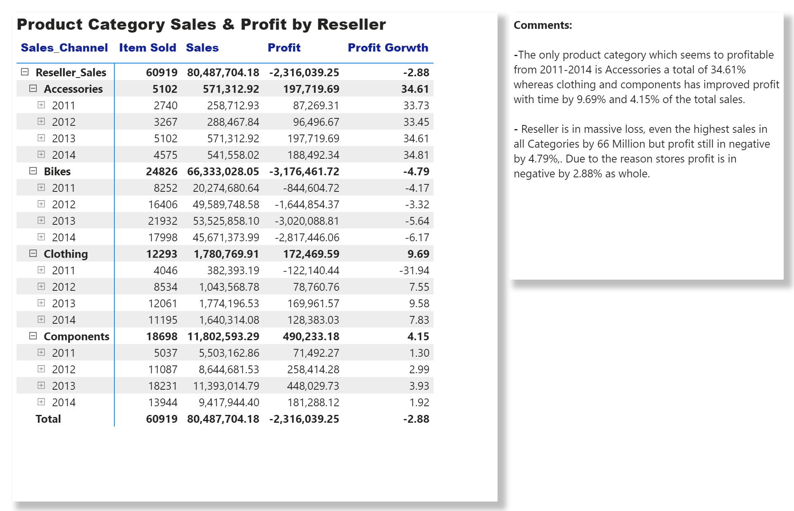
Is there a shift towards Digital?
3.1

Slide 11
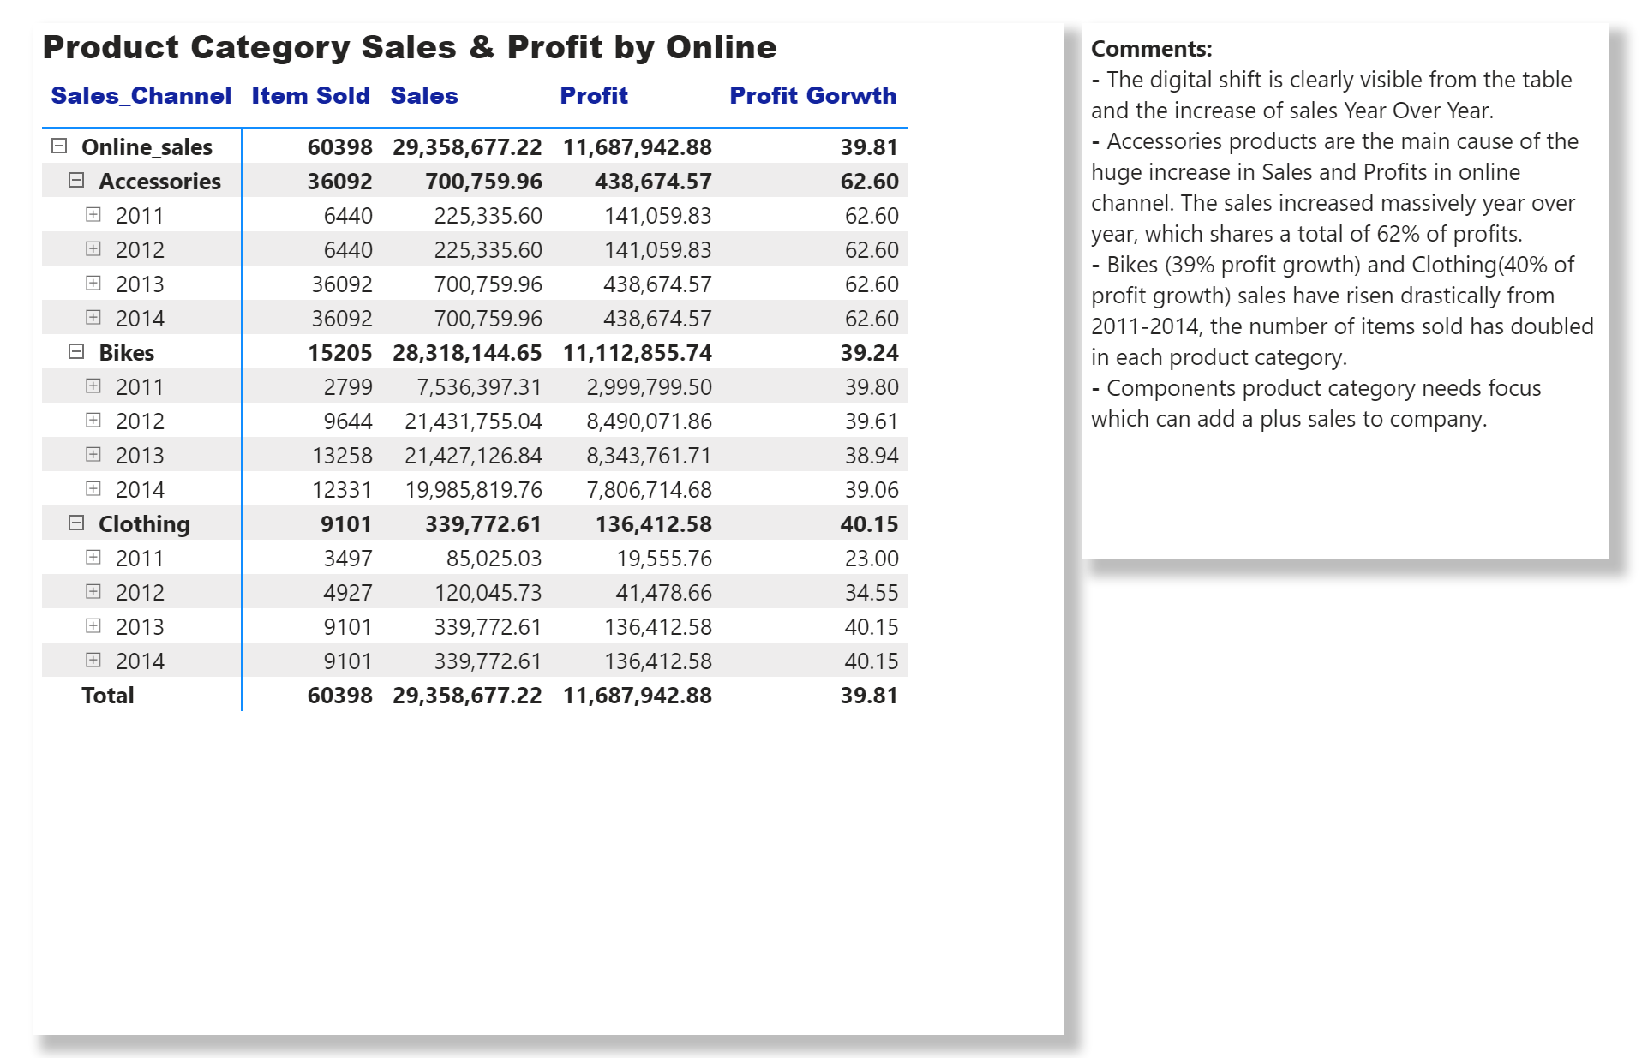
Is there a shift towards Digital?
3.1

Slide 12
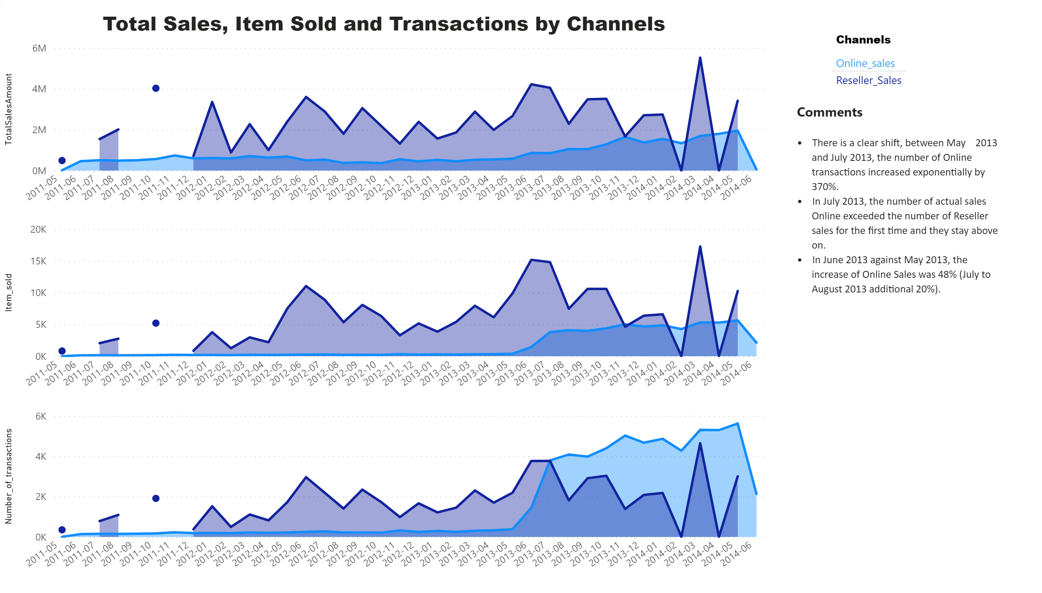

Is there a shift towards Digital?
3.1

Slide 13
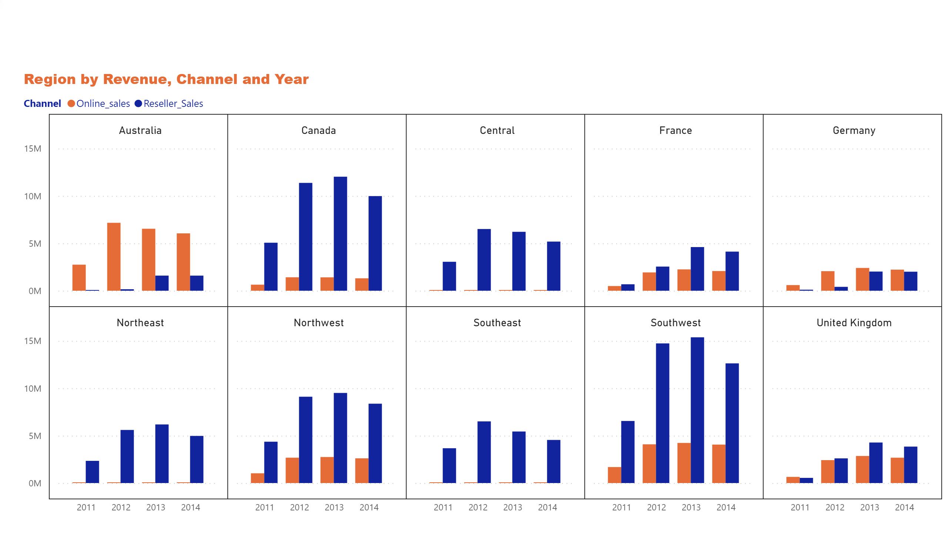
Is there a shift towards Digital? What’s Driving Shift?
3.1
Comments
• The relevant change is that in 2014, being a very bad exercise for AHG's sales, the Online market behaved
better than the Reseller.
• The only region with a relevant conversion from the Reseller to the Online market is Australia.
• Overall Online Sales is increasing YOY except central, Northeast and Southeast where AHG needs to introduce new stratifies.

