Slide 1
What if the World of AI & Finance Collide?
Nikesh Shah
Advisor: Dr. Angela Kohlhaas

Slide 2
Content
History of Stock Return Prediction
Fama-French Five-Factor Model
How can Machine Learning be used?
Models I used for prediction
Linear Regression
Random Forest Regression
Neural Network
What is next?

Slide 3

Importance of Stock Return Predictions
Crucial for investors and financial analysts for informed decision making
Manage Risks

Slide 4
How it started
Simple fundamental Analysis
Technical Analysis
Combining the two we get the Fama-French Five-Factor Model
Machine Learning
Notes:
Fundamental Analysis based on principle that a company’s true value by evaluating company’s past performance as well as the credibility of its accounts. Uses company’s financial info and performance ratio
Pioneered by notable investors like Warren Buffett
Technical Analysis: Uses historical market data (price and volume of trade) to identify trends and patterns.
Machine learning uses both as well to get more in-depth understanding of the complex non-linear patters.

Slide 5
Fama-French Five-Factor Model Background
Developed by Eugene Fama & Kenneth French
Used to explain portfolio return
Explains over 90% if the return
Advantages over Machine learning:
  Uses market data
  Compares different pools of companies and their performances.
Notes:
Decrese the number of slides for fama french

Slide 6
The Five Factors
Market Risk Premium
Size (Small minus Big)
Value (High Minus Low)
Profitability (Robust Minus Weak)
Investment (Conservative Minus Aggressive)

Slide 7
Market Risk Premium
Measures the difference between the overall market’s return and risk-free rate.
  Market’s Return is the aggregated return of a broad market portfolio (e.g. S&P 500)
  Risk-free rate is the return of an investment free of risk (e.g. U.S. Treasury bills)
Notes:
U.S. Treasury bills are risk-free due to government backing

Slide 8
Size (SMB – Small minus Big)
Represents the difference in returns between small-cap stocks and large-cap stocks.
Historically, small-cap companies tend to outperform large-cap companies.
P.S. Cap means market capitalization (Price of share multiplied with number of outstanding shares)
Notes:
Outstanding shares is the number of shares that are held by its shareholders

Slide 9
Value (High minus Low)
Difference in returns between stocks with high book-to-market ratio and those with small.
Book-to-Market ratio is the ratio between company’s book value to its market value.
Helps determine undervalued or overvalued stock.

Slide 10
Profitability (Robust minus Weak)
Difference in returns between firms with high profitability and those with low.
Quantified using ratios like operating income to assets, return on equity (ROE), or earnings before interest and taxes (EBIT) relative to book equity.

Slide 11
Investment (Conservative minus Aggressive)
Captures the companies investment behavior in assets such as property, plant, and equipment.
Historically, firms who expand their assets rapidly (aggressive investment) experience lower future returns compared to conservative investment.

Slide 12
The Model
R_{it} — R_{Ft} = a_{i} + b_{i}(R_{Mt} — R_{Ft}) + s_{i}SMB_{t} + h_{i}HML_{t} + r_{i}RMW_{t} + c_{i}CMA_{t} + e_{it}
R_{it} — R_{Ft} = Excess return (difference between actual return and expected return based on market)
  R_{it} = Return on portfolio i for period t
  R_{ft} = risk-free rate at time t (expected return)
R_{Mt} – R_{ft} = Market Risk Premium at time t
SMB = Return spread of small minus large stocks (Size)
HML = Return spread of cheap minus expensive stocks (Value)
RMW = Return spread of the most profitable firms minus the least profitable (Profitability)
CMA = Return spread of firms that invest conservatively minus aggressively (Investment)

Slide 13
Why Machine Learning?
With increase in computing power, prediction has moved to the technological realm.
Analysis fundamental and technical variables to get more in-depth understanding of the complex non-linear patters.
Has unlimited potential to predicting (addition of sentiment analysis)
Notes:
Explain Why machine learning

Slide 14
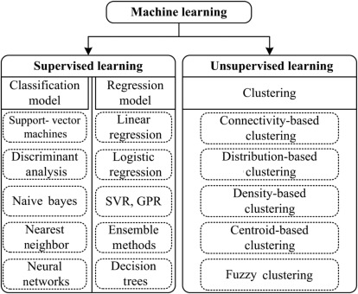

Slide 15
Data Gathering
Used London Stock Exchange Group (LSEG) to get company information such as income statements, balance sheet, and cash flow
Monthly stock return data from investing.com
Micro-economic factors from Federal Reserve Economic Data (FRED)

Slide 16
Limitations
Unlike Fama-French model, we do not have:
Market data
Risk factors
Does not take multiple company's’ data only focuses on one
Limited data sources available for free

Slide 17
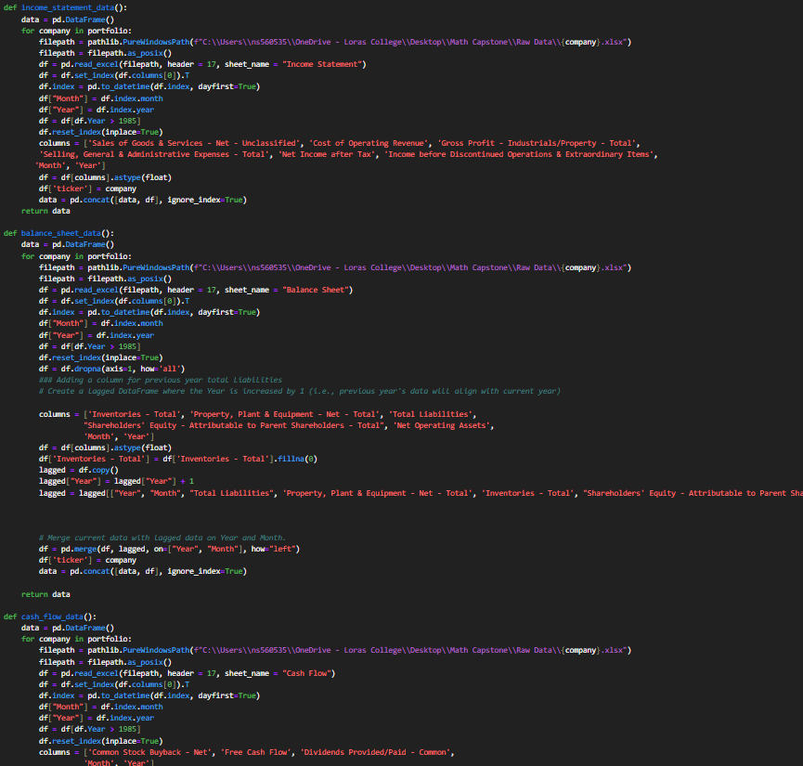
Data cleaning
Gathered important variables from the income statement, cashflow, and balance sheet
Calculated ratios from those variables
Merged data with micro-economic factors

Slide 18
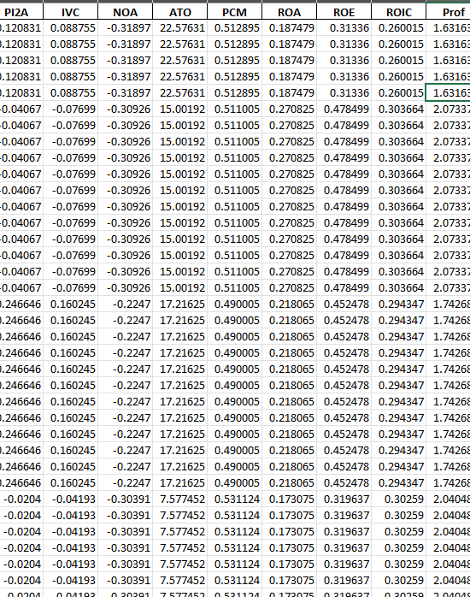
Training Data
Target variable is Change % of the price every month
Three micro-economic factors
Twenty Financial ratio
Lagged returns to capture momentum

Slide 19
Methods used
Multi-Linear regression
Random forest
Deep learning using neural networks

Slide 20
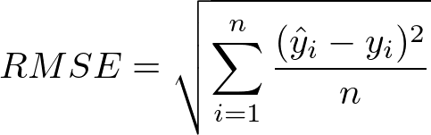
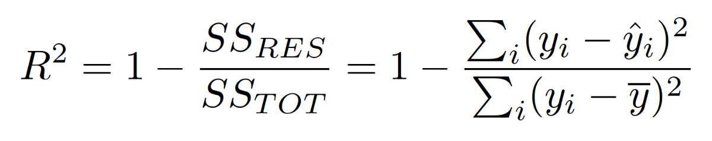
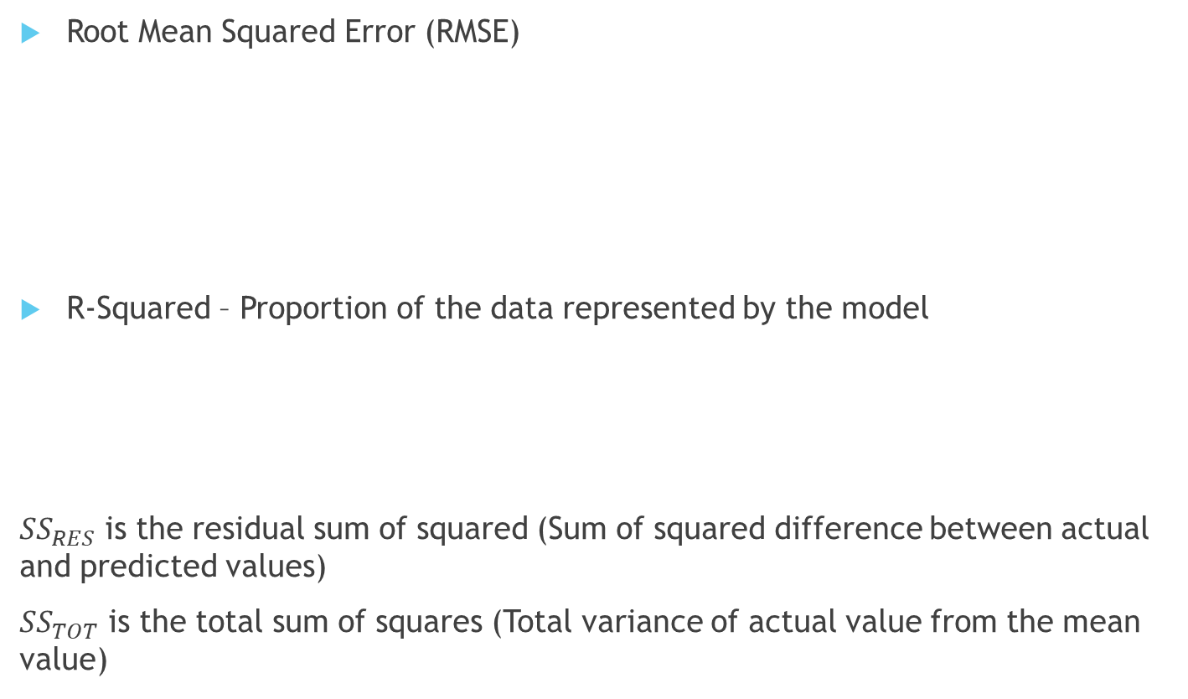
Evaluation metrics
Root Mean Squared Error (RMSE)
R-Squared – Proportion of the data represented by the model
${SS}_{RES}$ is the residual sum of squared (Sum of squared difference between actual and predicted values)
${SS}_{TOT}$ is the total sum of squares (Total variance of actual value from the mean value)

Slide 21
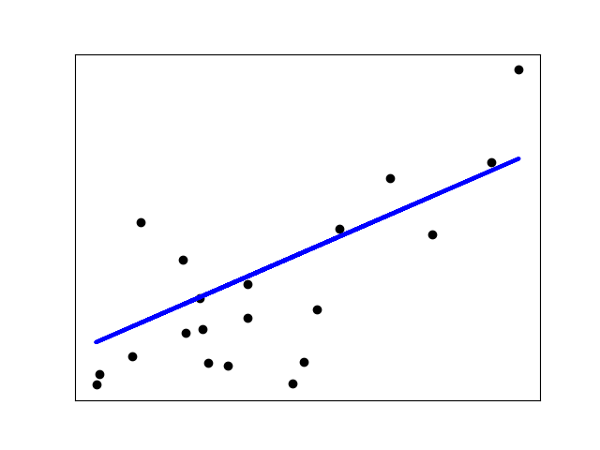
Linear regression
Statistical model to analyze linear relationship between the outcome and the variables
Drawbacks
  Assumes Linearity
  Assumes observations are independent

Slide 22

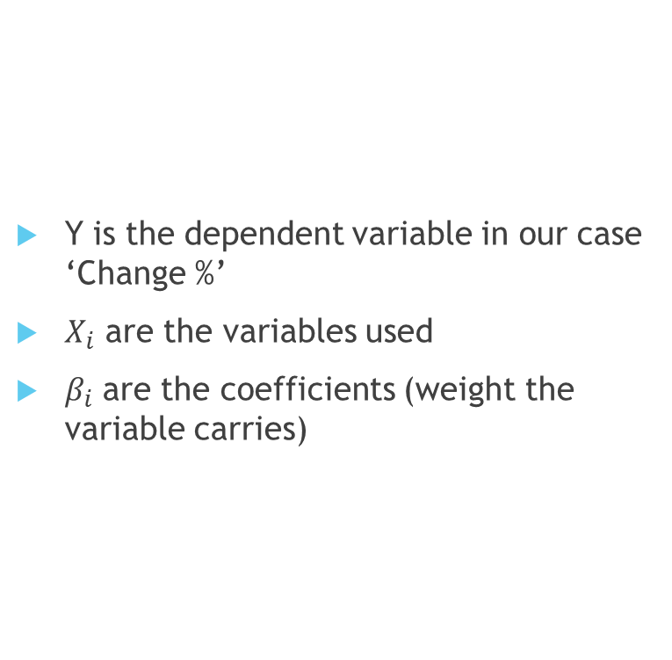
Multi-Linear Regression
Y is the dependent variable in our case ‘Change %’
$X_{i}$ are the variables used
$β_{i}$ are the coefficients (weight the variable carries)

Slide 23
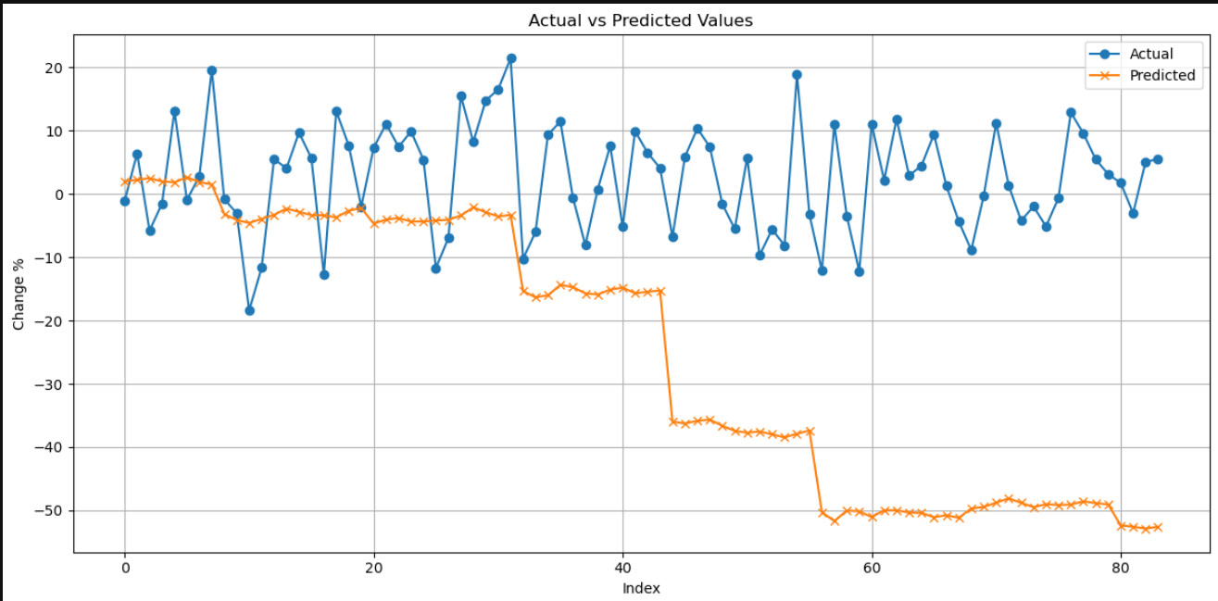
Linear regression for Stock Return Prediction

Slide 24
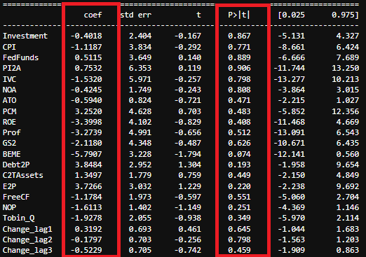

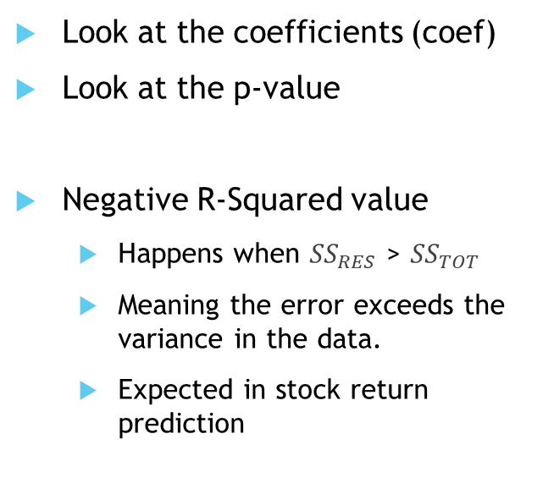
Model Summary
Look at the coefficients (coef)
Look at the p-value
Negative R-Squared value
  Happens when ${SS}_{RES}$ > ${SS}_{TOT}$
  Meaning the error exceeds the variance in the data.
  Expected in stock return prediction
Notes:
Include Rsquared equation here.

Slide 25
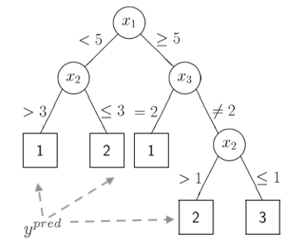

Decision Trees
Partitions the dataset into disjoint regions
Keeps splitting until value of max_depth
Optimization through Residual Sum of Squares for the split

Slide 26
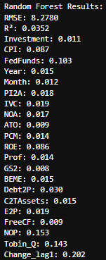
Model Summary
Feature importance
What percent of data is represented by this model?

Slide 27
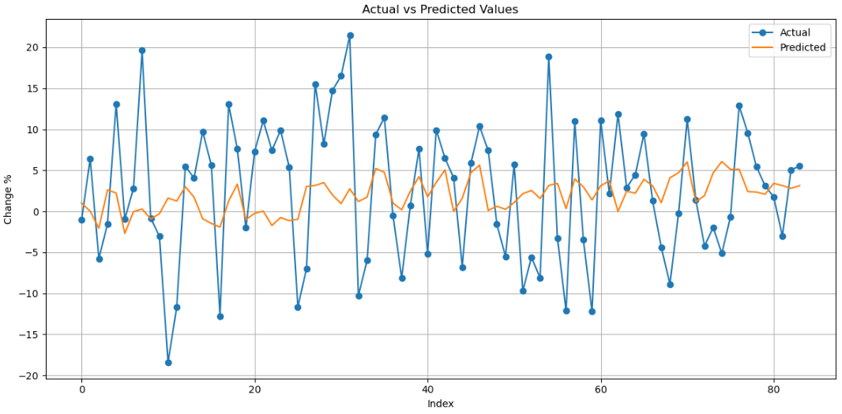

Slide 28

Neural Networks
Computational models inspired by the structure of the human brain
Consists of interconnected layers of nodes that process data through weighted connections
More of a black box as we know the input layer and the output layer but there are hidden layers in the middle

Slide 29
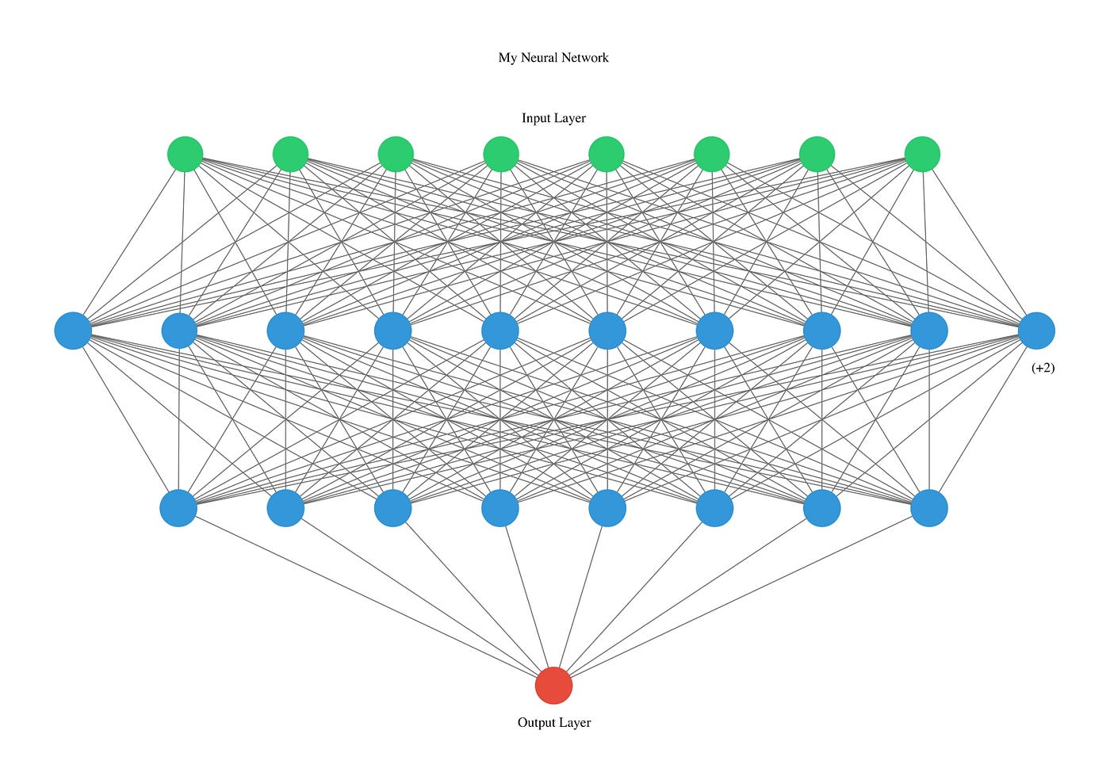
Neural Networks
Advantages
  Capable of capturing complex, non-linear relationships
  Highly adaptable
Limitations
  Computationally extensive
  May lead to overfitting

Slide 30
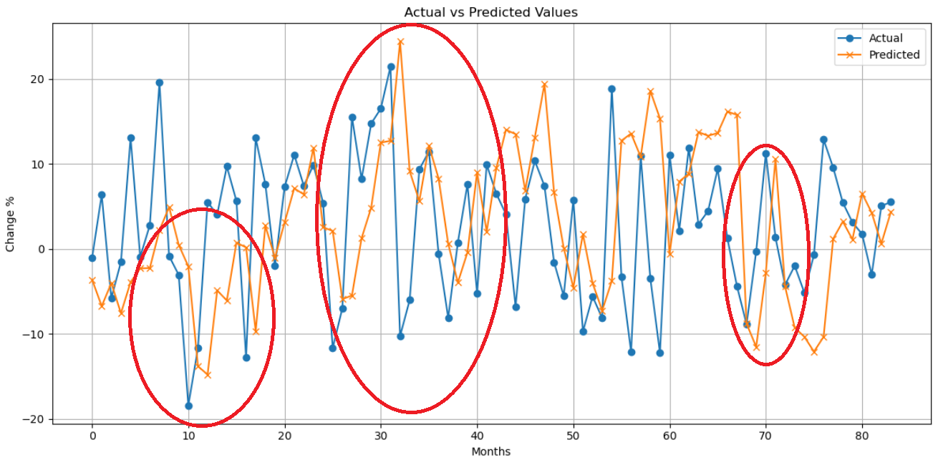

Slide 31
What is next?
So far this is 30% of the work.
Pay to get access to other variables (e.g. Market Data)
Integrate sentiment analysis
Natural Language processing (NLP) on Newsletters and twitter feed.
Notes:
Talk about how we can use use ensemble methods to combine multiple ML models together
Add NLP to read news (Sentiment Analysis)
Add market and microeconomic indicators

Slide 32
Thank you.
Questions?

