Slide 1
DAILYNEWS
JIGAR SHAH (FY6440)

Slide 2
Project Details
Brings the latest news to the users/guests.
Keywords(tags) filtered to news to easily identify to their relevant news sections
Comments section to involve users
Guest users can read latest news without signing up, but they need to login if they wish to post.
Frequent publisher and commenters are highlighted with most number of news

Slide 3
Overview
Data Statistics
Functionality
Performance
User Interface

Slide 4
Data Statistics
Posts Collection: body, permalink, author, title, tags, comments, comments.body, comments.email, comments.author and date
User Collection: _id(username), password and email
Sessions Collection: _id(cookie), username
Datasets: Actual data has been populated to test functionality of site along with dummy data to test the efficiency of the system, summing up to above 1000 documents(25MB)

Slide 5
Data Model
Users Collection
Login
Posts Collection
Sessions Collection

Slide 6
Technologies
NoSQL Database: MongoDB
Language: JAVA
Driver: JDBC
Editor: Notepad++
IDE: Intellj Idea

Slide 7
Functionality
Basic CRUD operation based on my project requirements
Latest news posts based on posting dates
News posted by specific user in most recent fashion
Deleting news by specific user
Session Management
Page specific to user with personal greetings implemented by storing cookie

Slide 8
Advanced Functionality (Cont’d)
Frequently used tags
This gives most used keywords that are tagged to the post giving a feel of type of post.
Along with tags we also have link to page that list all the news having that tag.
Top Publishers
This gives the authors who have published most number of post.
Top Commenters
Get authors who have commented most number of times in the entire collection.
Get total number of comments related to that post

Slide 9
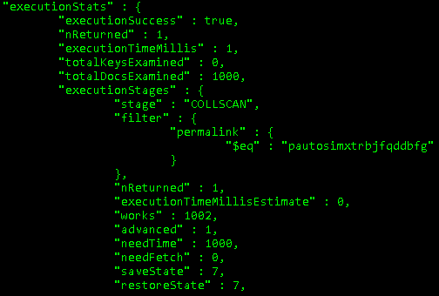
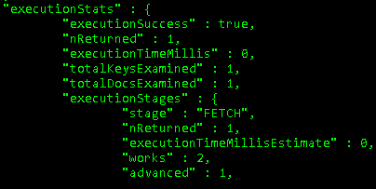
Performance
Indexes

Slide 10
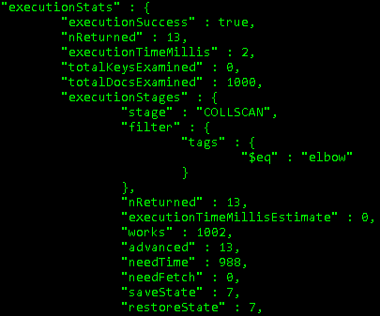
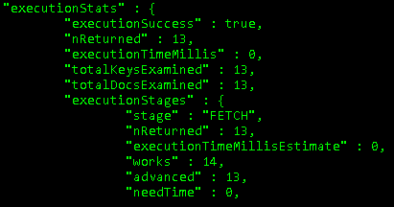
Performance (Cont’d)
Indexes

Slide 11
User Interface
HTML5
CSS3
Bootstrap
Responsive Web Design
User friendly

Slide 12
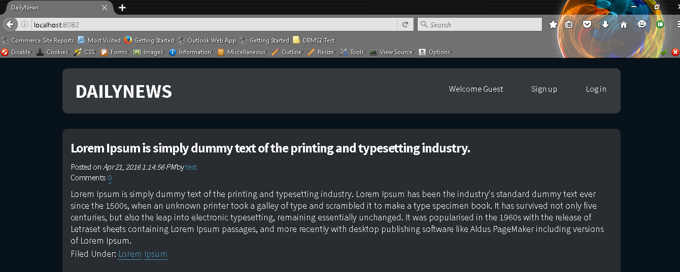
Homepage showing latest news

Slide 13
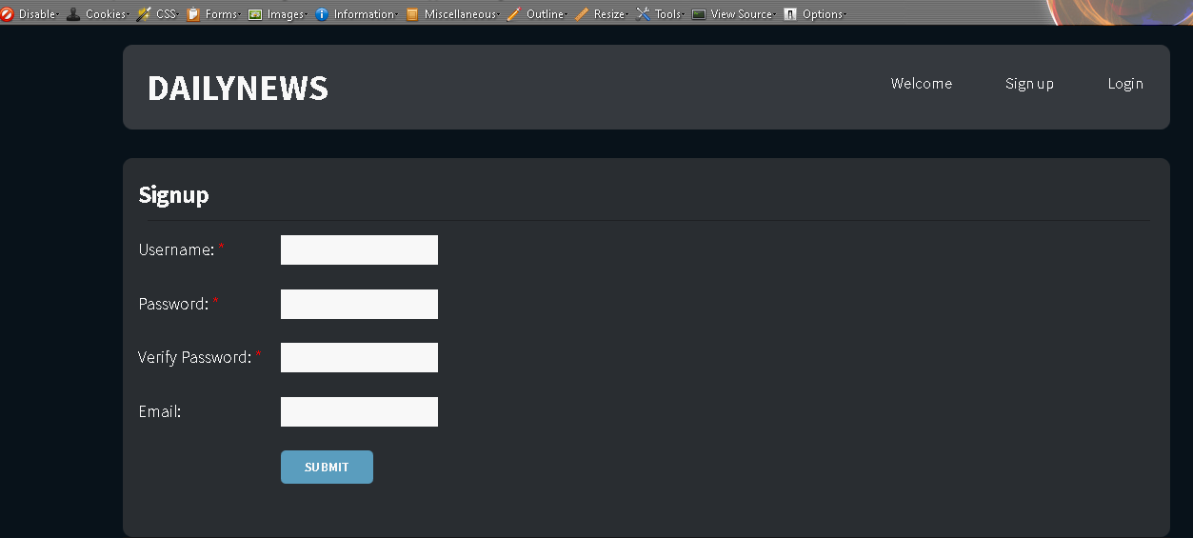
Signup with form validation

Slide 14
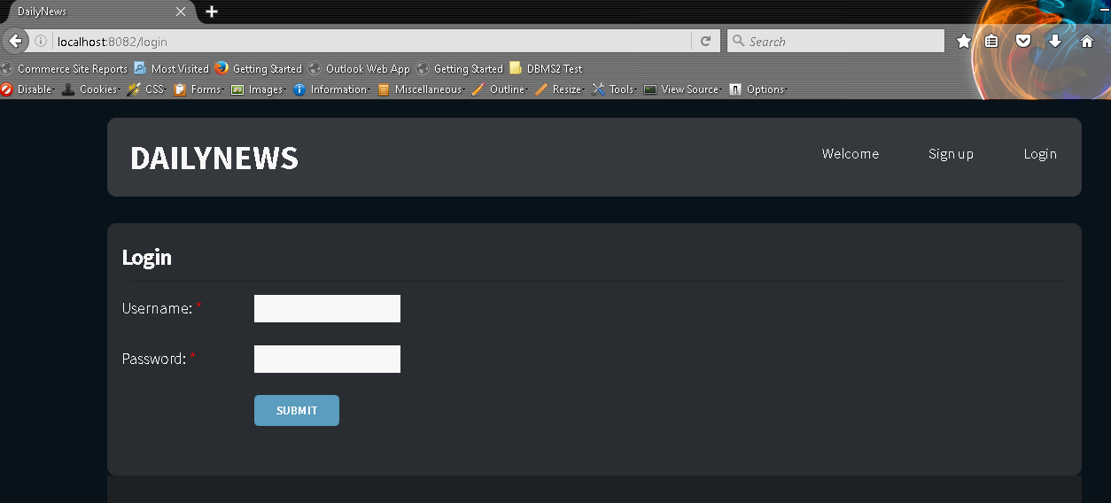
Login with form validation

Slide 15
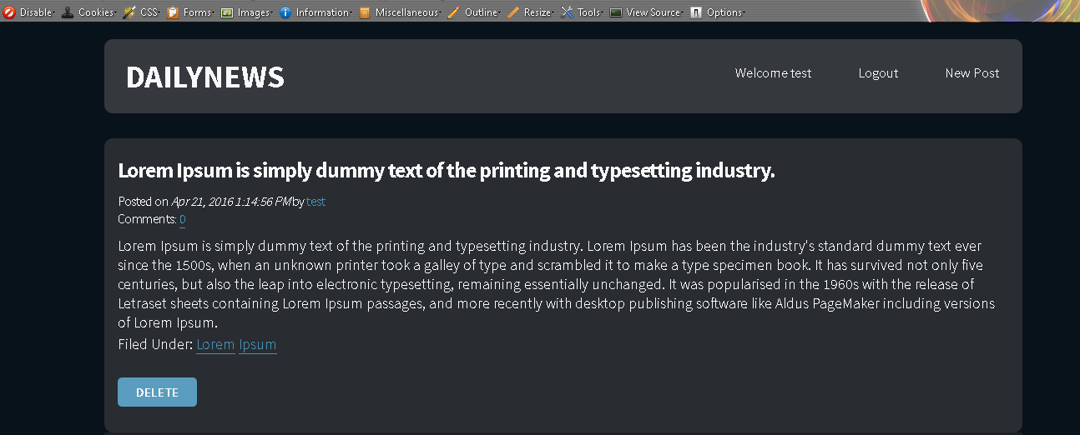
User welcome page showing latest posts by him and deleting button

Slide 16
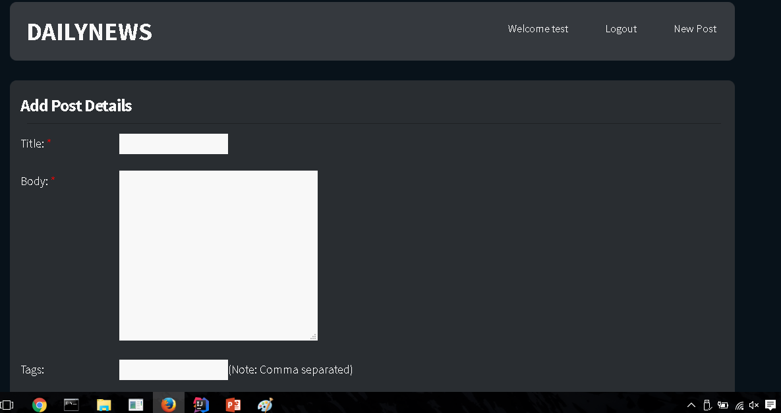
New Post

Slide 17
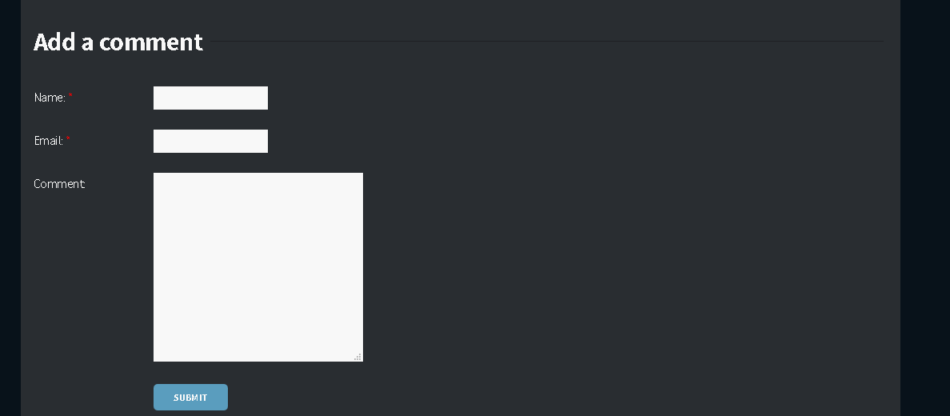
Add a comment to the post

Slide 18
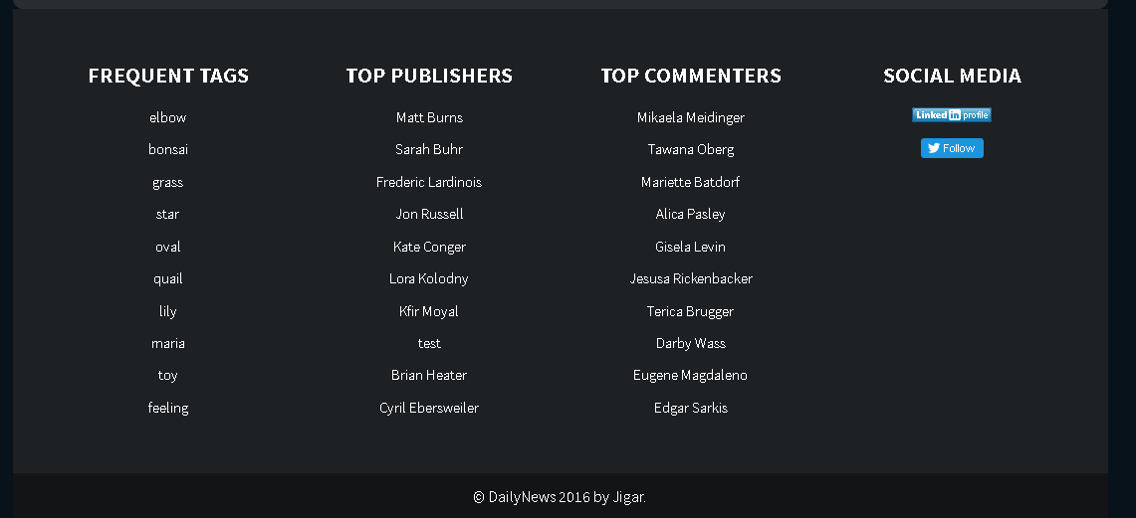
Frequent Tags, Top Publishers and Top Commenters

Slide 19
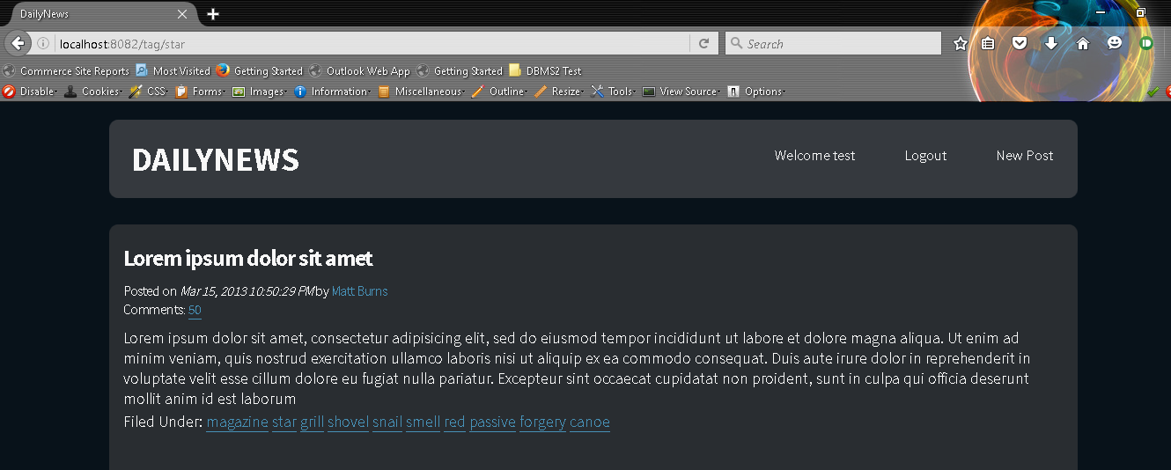
Latest News by Tags

Slide 20
Thank You

