Slide 1




Projet Python For Data Analysis
SAGOUMI Khalil
DIA 5
Année Scolaire : 2020-2021
SHAH Parth

Slide 2

Introduction
Dataset : Heart Disease UCI
We are given a dataset of 303 patients suffering or not from heart disease. We have many informations about the patients such as their age, sex, resting blood pressure, etc
The aim is to predict whether a patient has a heart disease or not, while applying Machine Learning to these features.
Since the output is categorical, i.e it takes only 2 values :
0 (no heart disease) or 1 (with heart disease)
It is a Classification Problem

Slide 3
EDA
There are 14 attributes :
age
sex
chest pain type (4 values)
resting blood pressure
serum cholestoral in mg/dl
fasting blood sugar > 120 mg/dl
resting electrocardiographic results (values 0,1,2)
maximum heart rate achieved
exercise induced angina
oldpeak = ST depression induced by exercise relative to rest
the slope of the peak exercise ST segment
number of major vessels (0-3) colored by flourosopy
thal: 3 = normal; 6 = fixed defect; 7 = reversable defect

Slide 4
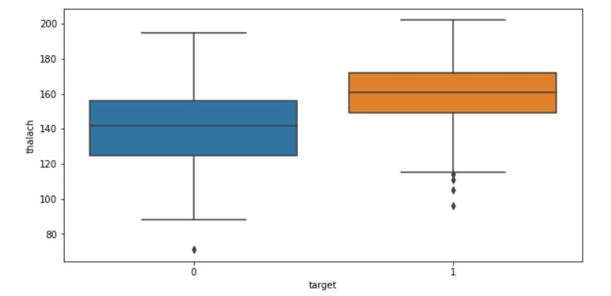
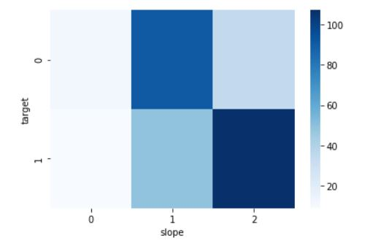
EDA
It can be seen that patients suffering from heart disease have higher heart rates and the more the slope of the peak is high, the more are chances to have a heart disease.

Slide 5
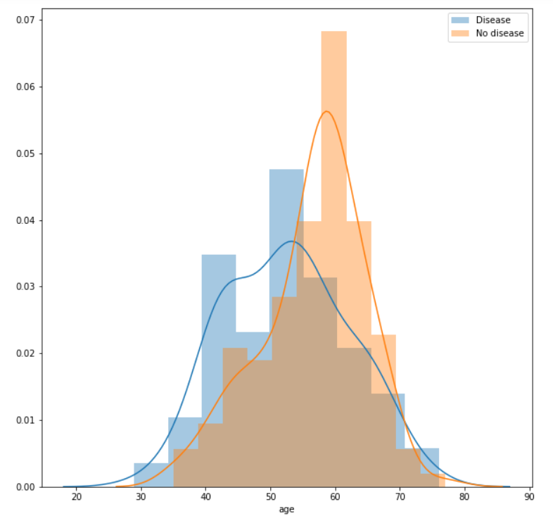
As we get older, we suffer from many diseases.
However, it seems that it is not the case for heart disease.
Patients between 40 to 55 years old are more likely to have a disease compared to those between 55 to 65.

Slide 6
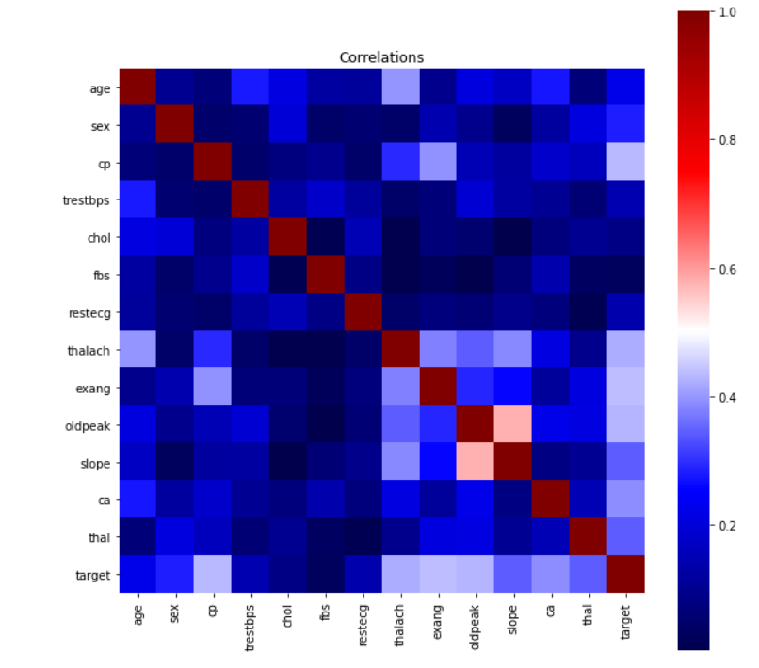
Correlations
In the following correlation matrix, one correlation strikes our attention among others : the one between oldpeak and slope
This makes sense since oldpeak represents the ST depression induced by exercise relative to rest and the slope represents the slope of the peak exercise ST segment
Both of them are connected hence the correlation.
Other variables have a non-existent or low correlation.

Slide 7

Preprocessing
Encoding :
There were many categorical features in our dataset such as the chest pain (cp), the slope,etc
So we used the function get_dumnies to encode them

Slide 8
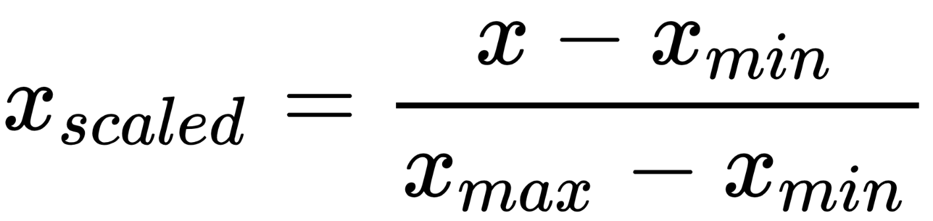
Scaling :
Then, we normalized our features so that each variable, which may be measured on a different scale, contribute equally to our model. To do so we used the function MinMax to scale them.
Here is the data scaled :
Splitting :
Finally, we splitted our dataset by alloting 80% for the training set and 20% for the testing set.

Slide 9
Modelisation
Since it is a classification problem, we trained many classification algorithms. Here are the scores obtained :
The best performance was obtained with SVM and Logistic Regression.

Slide 10
Optimisation
Thereafter, we tuned our models using GridSearchCV. We changed the hyperparameters in order to train models with the best parameters. As we can see, the scores improved for some models. The best model that responds to our problem is SVM.

Slide 11
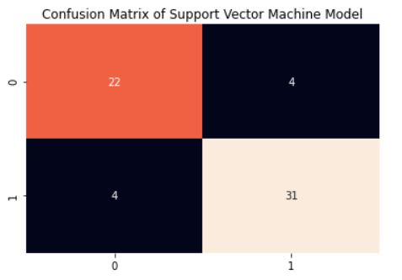
Confusion Matrix
Here is the confusion matrix of
our SVM Model.
We can calculate some metrics:
Recall = 22/26 = 0,84
Precision = 22/26 = 0,84
Accuracy = 53/61 = 0,87

Slide 12
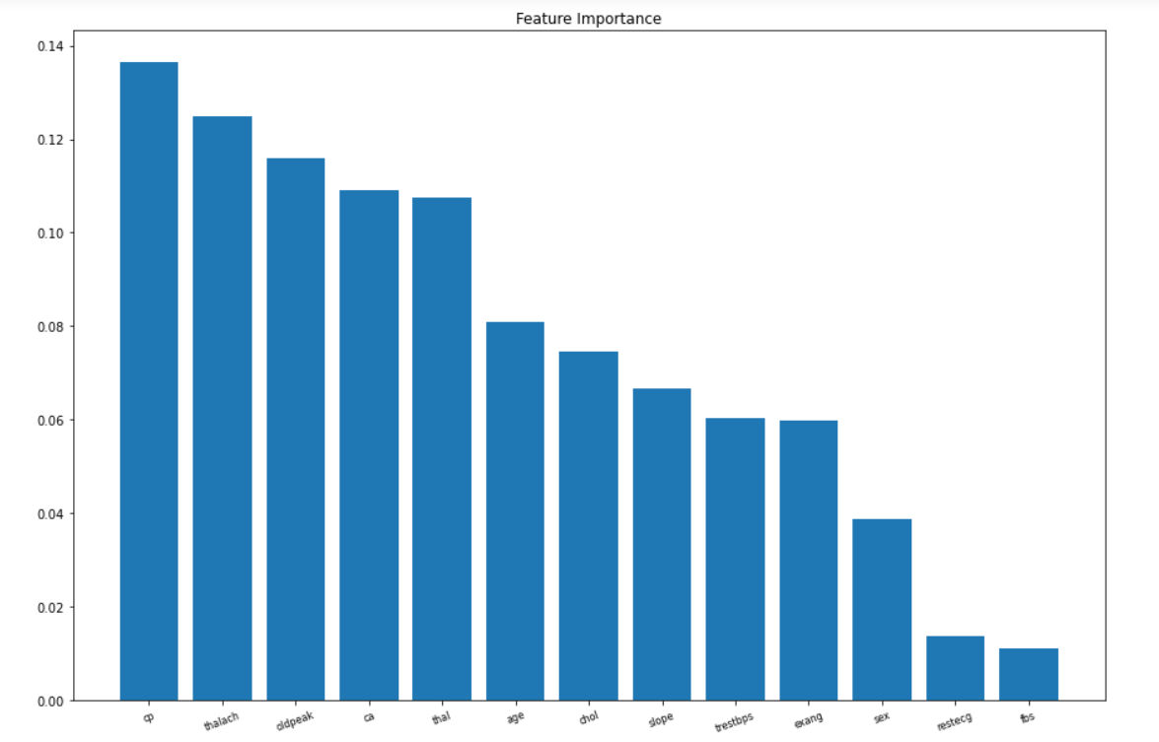
Flask API
In order to deploy our Flask API, we needed to know which features will be kept as inputs. Those variables must be relevant and important to our model. Random Forest has a parameter named features_importance that indicates which variables plays a big role. Thus, we looked for it in our built Random Forest model.

Slide 13
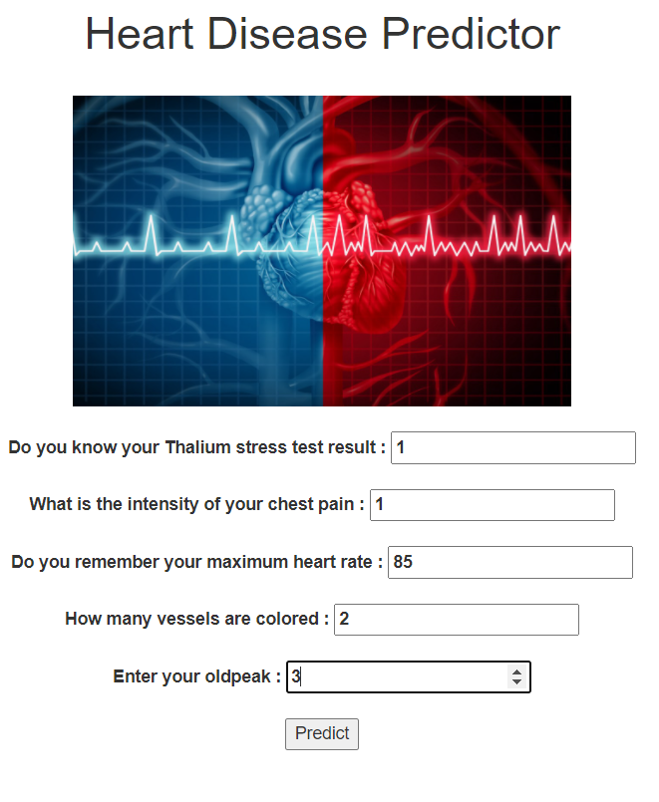

Test of the API
We created an appropriate output with images in case the person is suffering from heart disease or not.
If we enter low values in our application, we expect the person to be healthy:

Slide 14
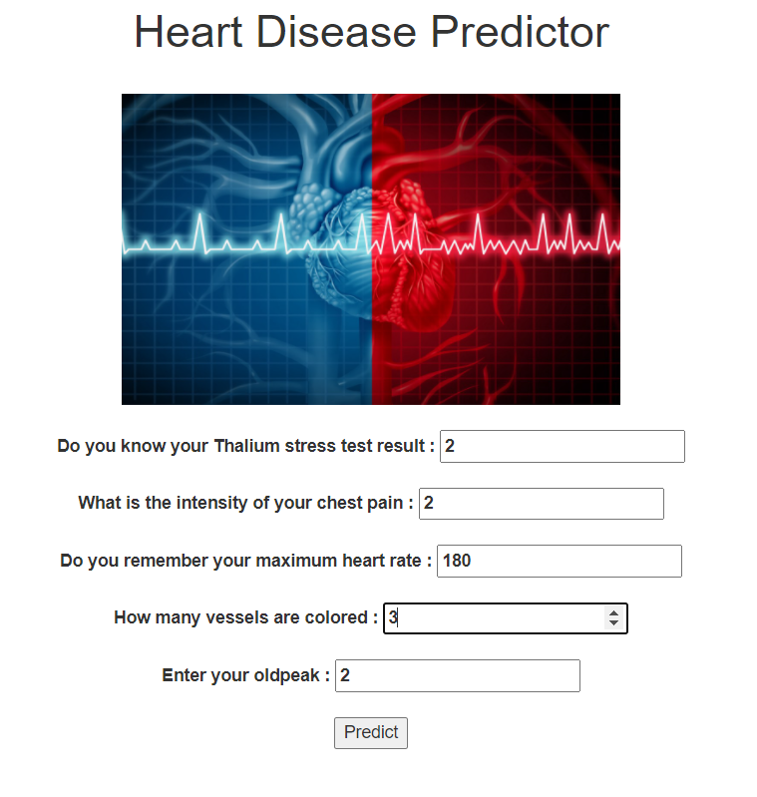

Now, if we enter high values, the person is more likely to have a heart disease.

