Slide 1
Data Science Methods for Clean Energy Research

Slide 2
Outline
Intro tree methods
Definition and properties
Regression trees
Classifier trees
Methods to improve decision trees
Bagging, random forests, boosting
Python project
Wrap up

Slide 3
Decision trees: Example
Example of a decision tree: predicts the Log salary of a baseball player using number of years that he has played in the major leagues and the number of hits that he made in the previous year.

Slide 4
Decision trees: Nomenclature
cutpoint
Branches
Internal nodes
Terminal nodes
or “leaves”
Nodes: a point where we make a decision (quantitative or qualitative (class) comparisons
Branch: connections between nodes

Slide 5
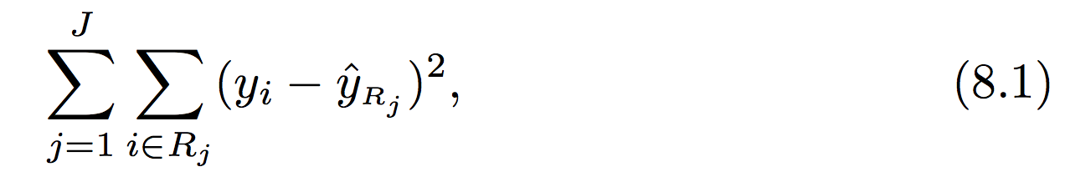
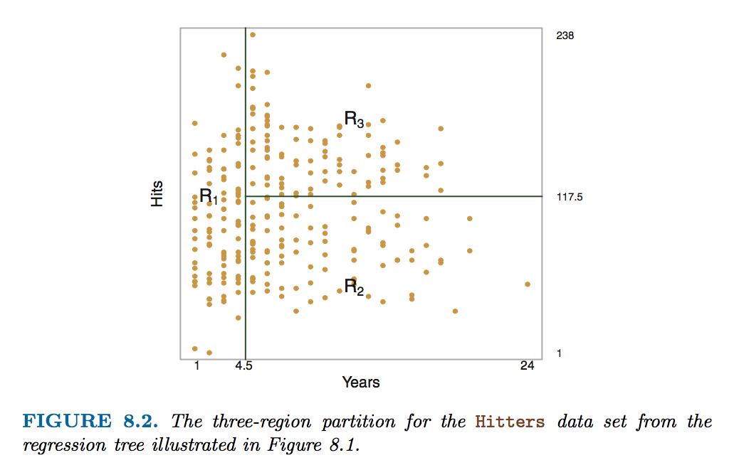

Building a regression tree
The regression tree is divided into three regions (R1-R3) based on sub-divisions of the feature space
The goal is to find the cutpoints (s) that minimize the RSS
This is done iteratively by first finding the biggest decreases in RSS by appropriately selecting which predictor (j) and cutpoint give the biggest decrease in RSS…
average
^ RSS for a single region for predictor j
^ Cutpoint breaks it into two regions
^ The total RSS is minimized (8.3)

Slide 6
Options for tree building
Approach on the last page is known as “top down” or “greedy” → goes after the biggest reductions in RSS first (recursive binary splitting)
Does not simulate all possible trees, so possible you are not finding the minimum RSS

Slide 7
Options for tree building
Approach on the last page is known as “top down” or “greedy” → goes after the biggest reductions in RSS first (recursive binary splitting)
Does not simulate all possible trees, so possible you are not finding the minimum RSS
Also possible that trees designed in this approach can lead to overfitting (too much bias)
The procedure of “tree pruning” can address this (not natively supported in sklearn) -> add number of terminal nodes to the cost function

Slide 8
Regression trees vs Classification trees
Concepts are similar
The DT leaves have your qualitative class assignment, not a quantitative prediction
Error metric is based on the classification error rate not RSS , just as in KNN and related methods. (RSS -> Gini index or Entropy)
Read ISL 8.1.2 for details

Slide 9
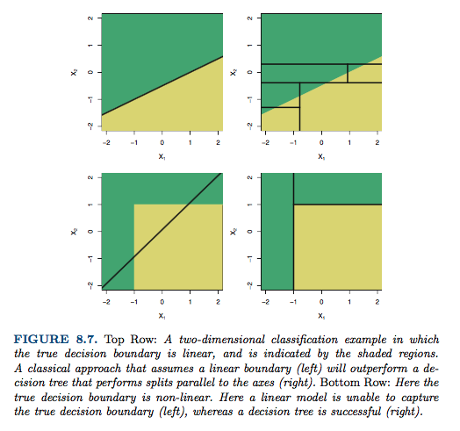
Big picture concepts in building a tree
Decision trees are constructed as an alternative to regression models we have seen
Fig 8.7 shows some extreme examples of ”regression vs. classification” and comparisons

Slide 10
Big picture concepts in building a tree
Trees are easy to explain to non-experts
Trees can be displayed graphically (if small)
Trees are highly sensitive to training data
Deep trees are very likely to over fit

Slide 11
Building better trees with ensembles
Big picture ensemble concepts
Three common ensemble methods
Bagging
Random forests
Boosting

Slide 12
Ensemble methods (general)
The error of a DT is highly dependent on the training set used – sometimes much more than in regression
One way to avoid this is to use so-called ensemble methods
Conceptually very similar to resampling (bootstrap and cross-validation)
Recall main purpose of resampling: error estimation
In contrast, we go beyond error estimation to use ensemble methods for improved model training
Important: these methods get introduced in ISL in the context of DTs but can also be applied to other ML techniques

Slide 13
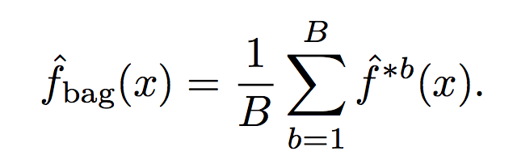
Application of ensemble methods to decision trees: Bagging
The bagging concept builds on bootstrap methods
Bagging algorithm
Build a model based on B individual bootstrap data sets
Make predictions f(x) for each model and average the predicted response
When applying bagging to the creation of DTs, you should grow trees with high bias (deep trees) as the bagging will reduce variance
Bagging classifier trees use “majority vote” (most common occurring response)

Slide 14
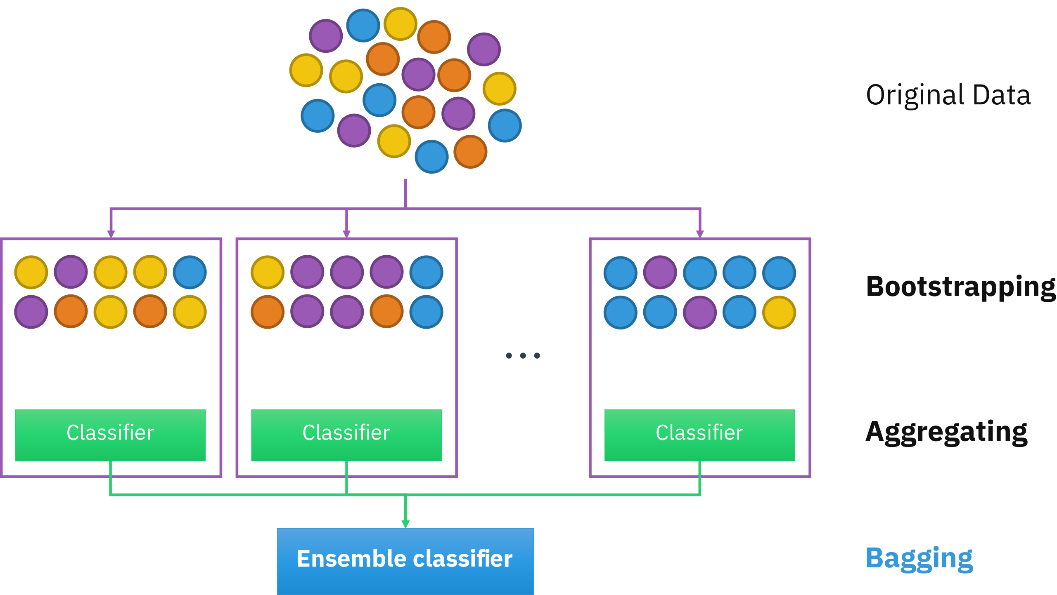
Application of ensemble methods to decision trees: Bagging

Slide 15
Application of ensemble methods to decision trees: Random Forest
Bagging methods work well, but the bootstrap sets can still be highly correlated, leading to increased training set error
Predictors with a lot of information gain will be at the top of most bagged trees, making them less independent
To reduce correlation, the random forest method uses a random subset of predictors at each split (node) in the tree
Heuristic is that m ~ √p predictors are randomly chosen at each split, other predictors are ignored
The random DT is combined with bagging to create a random forest

Slide 16
Application of ensemble methods to decision trees: Boosting
Boosting builds trees sequentially.
Unlike fitting a single large decision tree, which amounts to fitting the data hard and potentially overfitting, the boosting approach learns slowly.
Given the current model, we fit a decision tree to the residuals r (not y) from the model.
Each tree is small (one split often works).

Slide 17
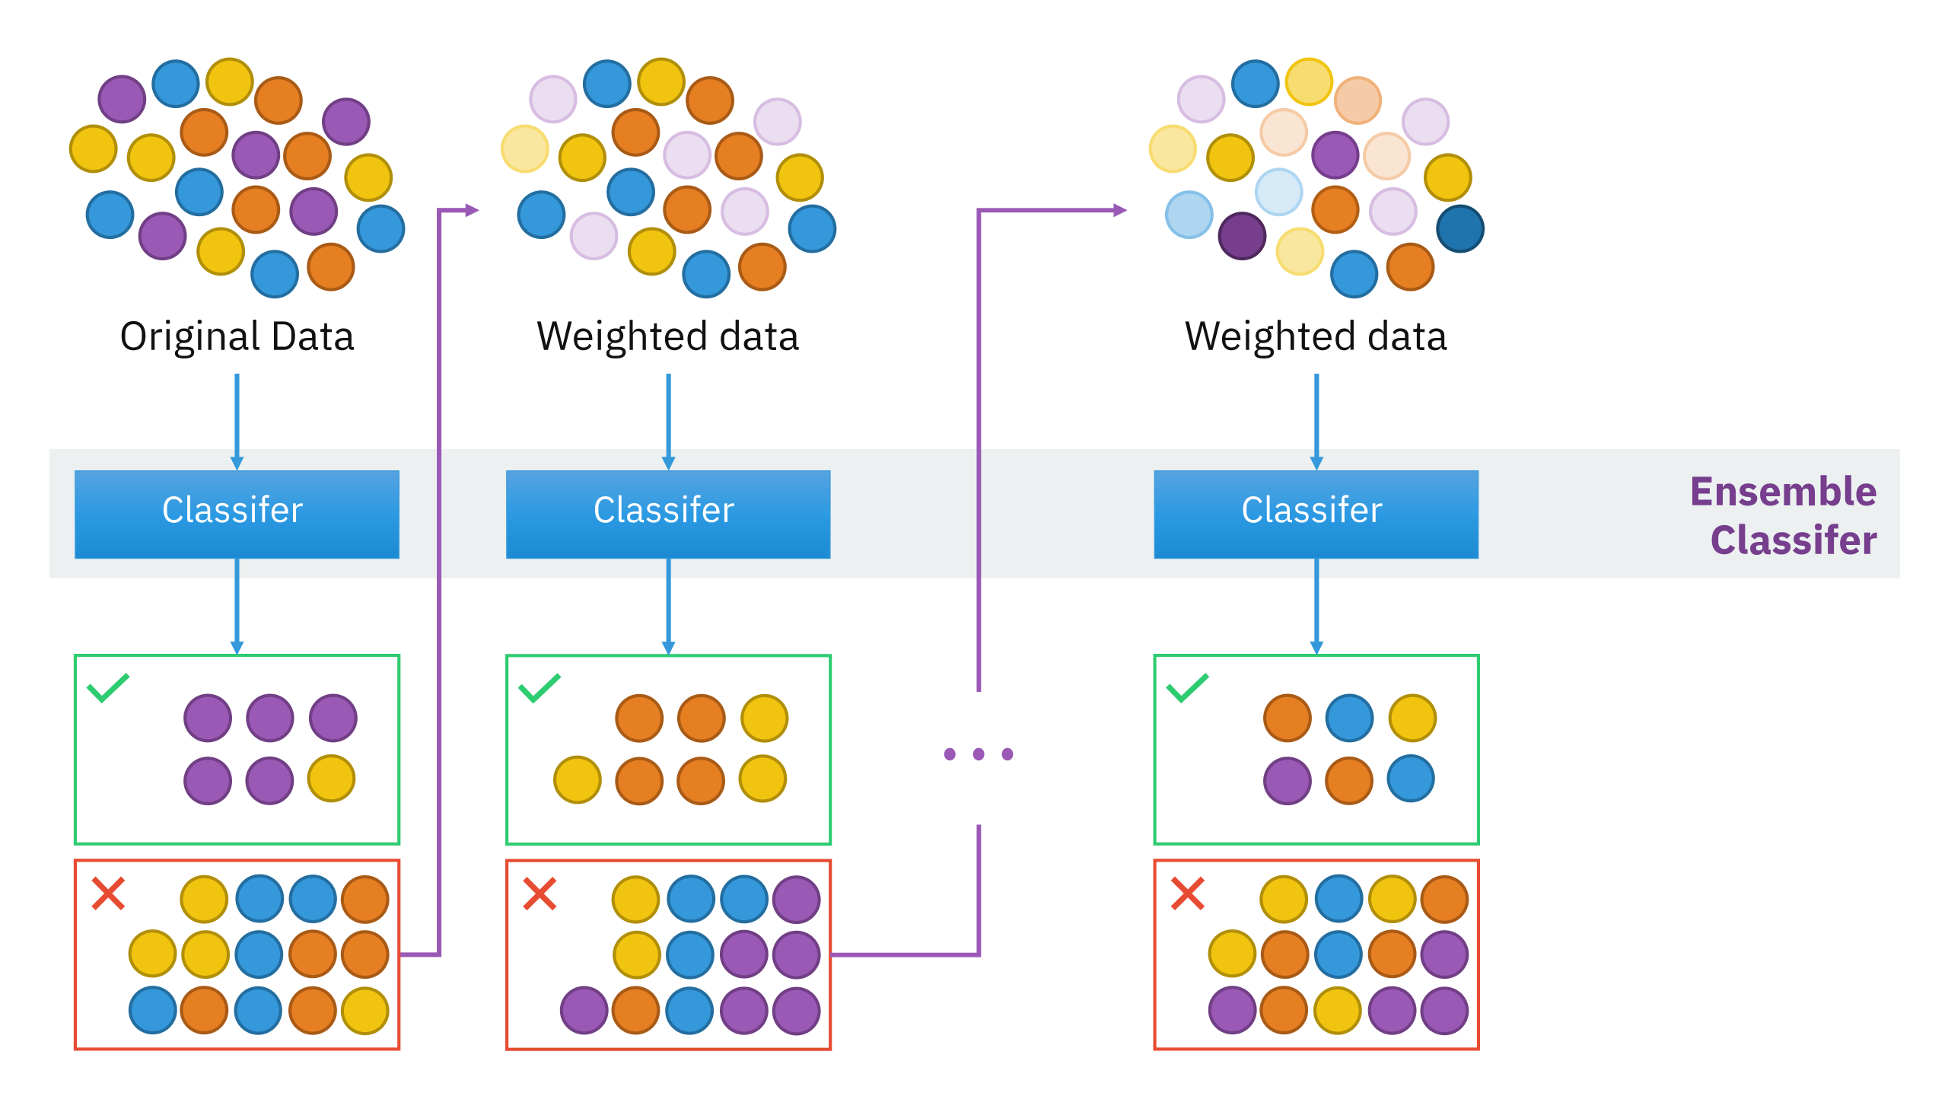
Application of ensemble methods to decision trees: Boosting
Tunable parameters:
1. Number of Splits (~1 is common)
2. “Shrinkage” parameter (0.001 - 0.01 is common)
3. Number of trees (100-1000 is common)

Slide 18
In class Python project: Teams of 2
If you finish early:
Use bagging or boosting to improve tree prediction
You should use the UCI data set and look to predict the Y1 (heating load) response vs all 8 predictors (X1-X8)
Break the data into 80% (training), 20% (testing)
Use a Python package that can perform decision tree regression
Make a plot of testing/training error vs. max tree depth (discuss what you expect the graph to look like first! Really. Draw a sketch!)

Slide 20
In class Python project: Teams of 2
If you finish early:
Study the properties of your tree at the depth you decided on
Visualize it: ask me for a code snippet
Study the sensitivity to the training test set size, random seed, etc.
Test set sensitivity is very important in DT creation!
Consider a bootstrap to enable true test MSE estimation
Compare error in DT regression to the best fits obtained from MLR, Ridge and LASSO
Discuss how you would pick a method to use in the future?
You should use the UCI data set and look to predict the Y1 (heating load) response vs all 8 predictors (X1-X8)
Break the data into 80% (training), 20% (testing)
Use a Python package that can perform decision tree regression
Make a plot of testing/training error vs. max tree depth (discuss what you expect the graph to look like first! Really. Draw a sketch!)
Don’t worry about differentiating validation vs test set data

Slide 21
Next week plan
Unsupervised learning methods, including Python
Neural networks OR ML methods for time series data
Which do you prefer?
Course evaluation and DIRECT update
Data Science Option , course numbers , Capstone projects

