Slide 1
Use cases & functional design

Slide 2
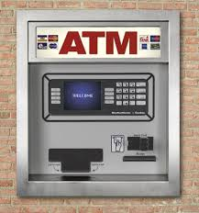
Running Example: Design of ATM

Slide 3
What Do We Do With ATMs?
Get cash
Deposit checks
Check balances
These are examples of Use Cases.
Implied use case – User authentication.

Slide 4
Describing a Use Case
Tell a user story
E.g. who is the user, what is their job role, etc.
What information the user provides
E.g., command entered with its options
What responses the system provides
E.g., prompts, plots, error messages
Authenticate User Use Case
User: Put ATM card in reader
ATM: Display 'Enter PIN'
User: Enters PIN on keyboard
ATM: [if correct] Show main menu
[if incorrect] Display 'Enter PIN'

Slide 5
Project proposal summaries

Slide 6
Project proposal summaries
One minute pitch of the project overview
Who are the potential users
What are the primary use cases
What are the stretch use cases
What data will you be using?
How much data do you have?
Where are the data coming from?
Are they available now?
Are the data labeled, unlabeled, etc.?

