Slide 1
Data Science Methods for Clean Energy Research
Feb 19, 2019
You will need the HCEPD_100K.csv file (or the path to it) for python example time today
Notes:
Linear regression is our starting point for more advanced methods.
Slight difference to what you’re used to though.
In normal descriptive statistics, we use regression parameters to describe our data.
In data science, we perform regression in a training dataset to make predictions on another dataset.

Slide 2
Outline
Simple linear regression
The model
The training
The error
In the coefficients
In the model
Making predictions with the model
Multiple regression

Slide 3
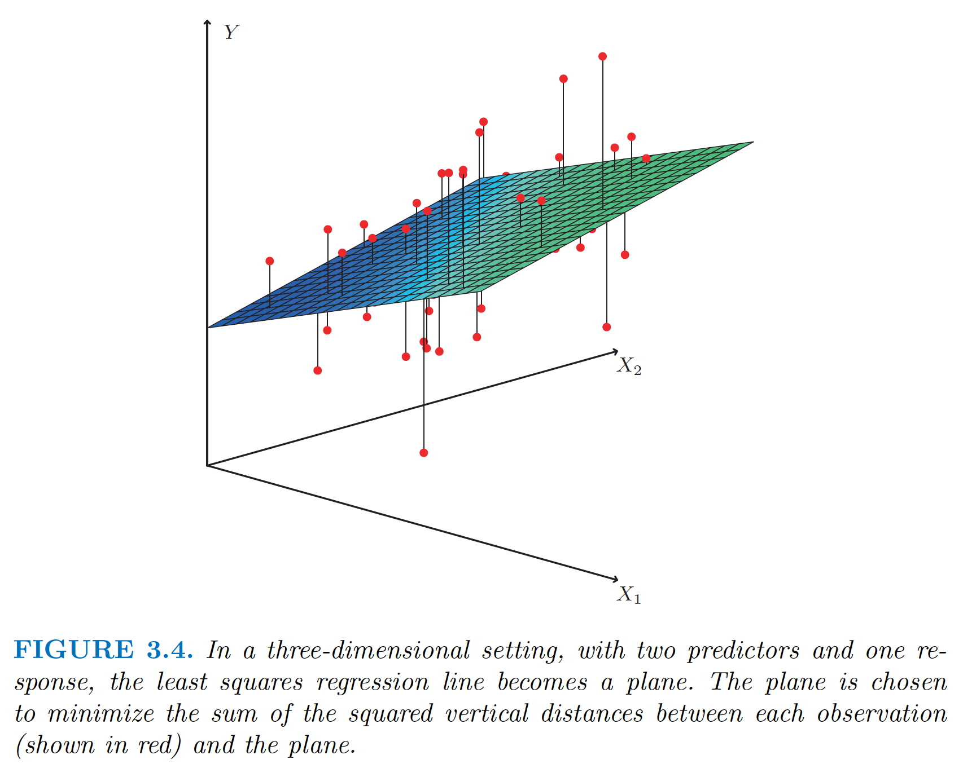
Multiple regression

Slide 4
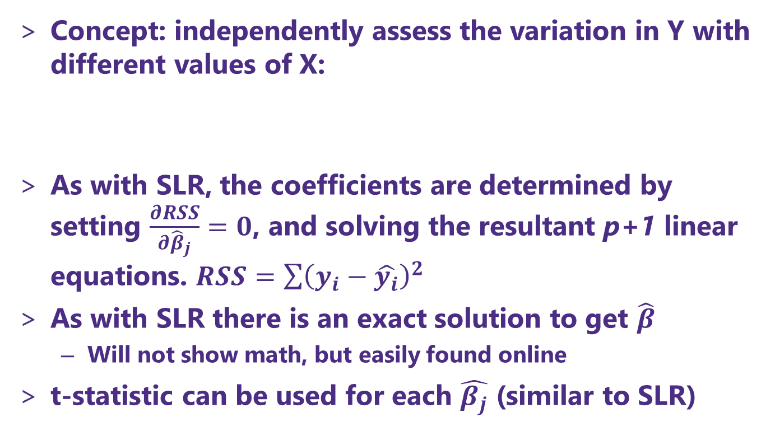


Multiple regression
Concept: independently assess the variation in Y with different values of X:
As with SLR, the coefficients are determined by setting $\frac{∂RSS}{∂{\hat{β}}_{j}}=0$, and solving the resultant p+1 linear equations. $RSS=\sum{{\left(y_{i}−\hat{y_{i}}\right)}^{2}}$
As with SLR there is an exact solution to get $\hat{β}$
Will not show math, but easily found online
t-statistic can be used for each $\hat{β_{j}}$ (similar to SLR)
True relation:
$$Y=β_{0}+Σ_{j=1,2 …, p }β_{j}X_{j}+ε$$
Model:
$$\hat{y}=\hat{β_{0}}+Σ_{j=1,2 …, p }\hat{β_{j}}X_{j}$$

Slide 5
Big picture concepts
Tempting to simply add one term for each feature in X and see how good of a fit we obtain, but that doesn’t give us much inference
There is a huge risk of overfitting with using a lot of parameters! (think about p>n)
We can use a new type of hypothesis test to find out if any of the parameters are significant
We can use some algorithms (selection algorithms) to try and reduce the number of parameters

Slide 6
Key questions with multi-parameter fits
four key questions in the context of an MLR fitting:
Is at least one of the predictors X1 , X2 , . . . , Xp useful in predicting the response?
Do all the predictors help to explain Y, or is only a subset of the predictors useful?
How well does the model fit the data?
Given a set of predictor values, what response value should we predict, and how accurate is our prediction?
Section 3.2.2 in ISL does an excellent job of discussing these four questions.
4 Q directly copied from ISL page 75!

Slide 7
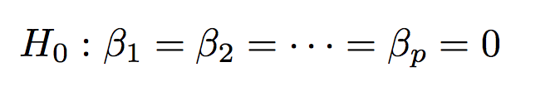
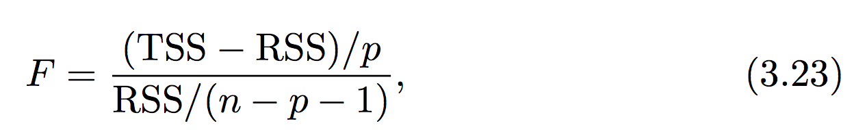
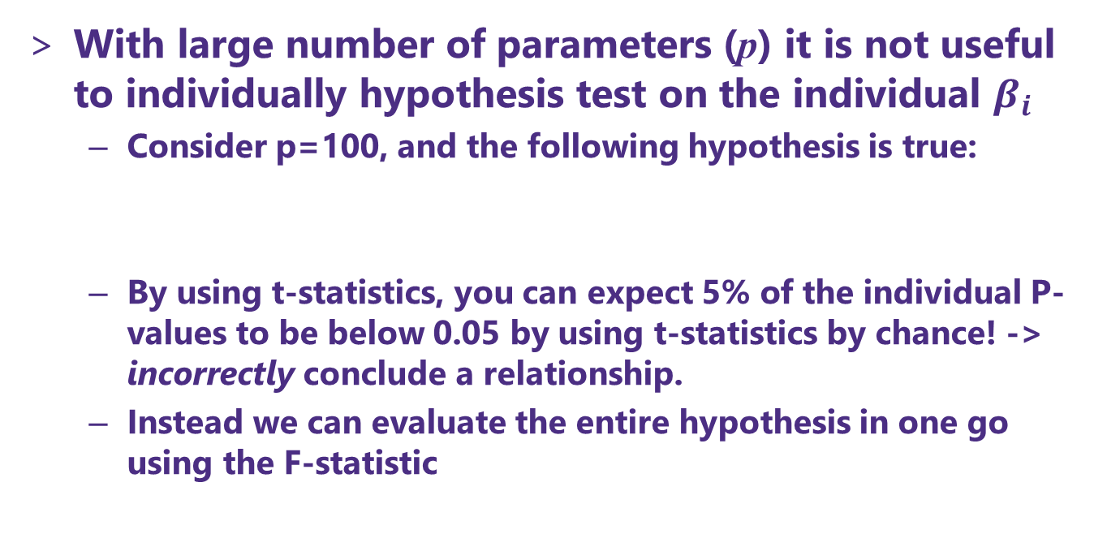


Multiple regression and the F-score
With large number of parameters (p) it is not useful to individually hypothesis test on the individual $β_{i}$
Consider p=100, and the following hypothesis is true:
By using t-statistics, you can expect 5% of the individual P-values to be below 0.05 by using t-statistics by chance! -> incorrectly conclude a relationship.
Instead we can evaluate the entire hypothesis in one go using the F-statistic
$$TSS=∑{\left(y_{i}−\overline{y}\right)}^{2}$$
$$RSS=∑{\left(y_{i}−{\hat{y}}_{i}\right)}^{2}$$

Slide 8
Multiple regression and the F-score
Provided H0 is true,
The F-statistic has a penalty for increasing the number of parameters (this should make sense!)
Like z- and t-statistic, we had a specific recipe to test the hypothesis at a certain significance level (e.g., α=0.05)
F ~ 1

Slide 9
Multiple regression and the F-score
How large does the F-statistic need to be before we can reject H0 and conclude that there is a relationship?
It turns out that the answer depends on the values of n and p.
n is large, an F-statistic that is just a little larger than 1 might still provide evidence against H0.
A larger F-statistic is needed to reject H0 if n is small.
Generally use stats software to find P(F) to get p-value

Slide 10
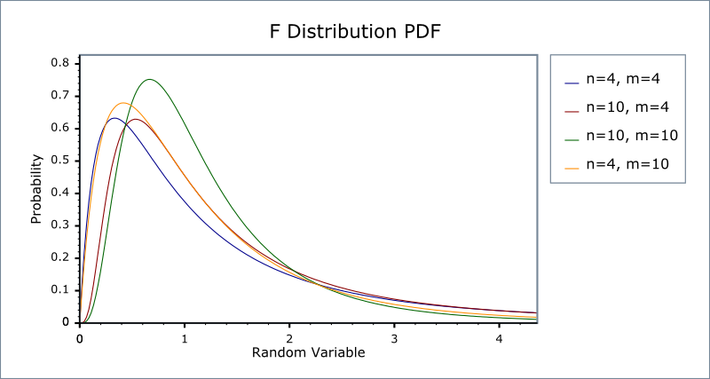
Multiple regression and the F-score

Slide 11

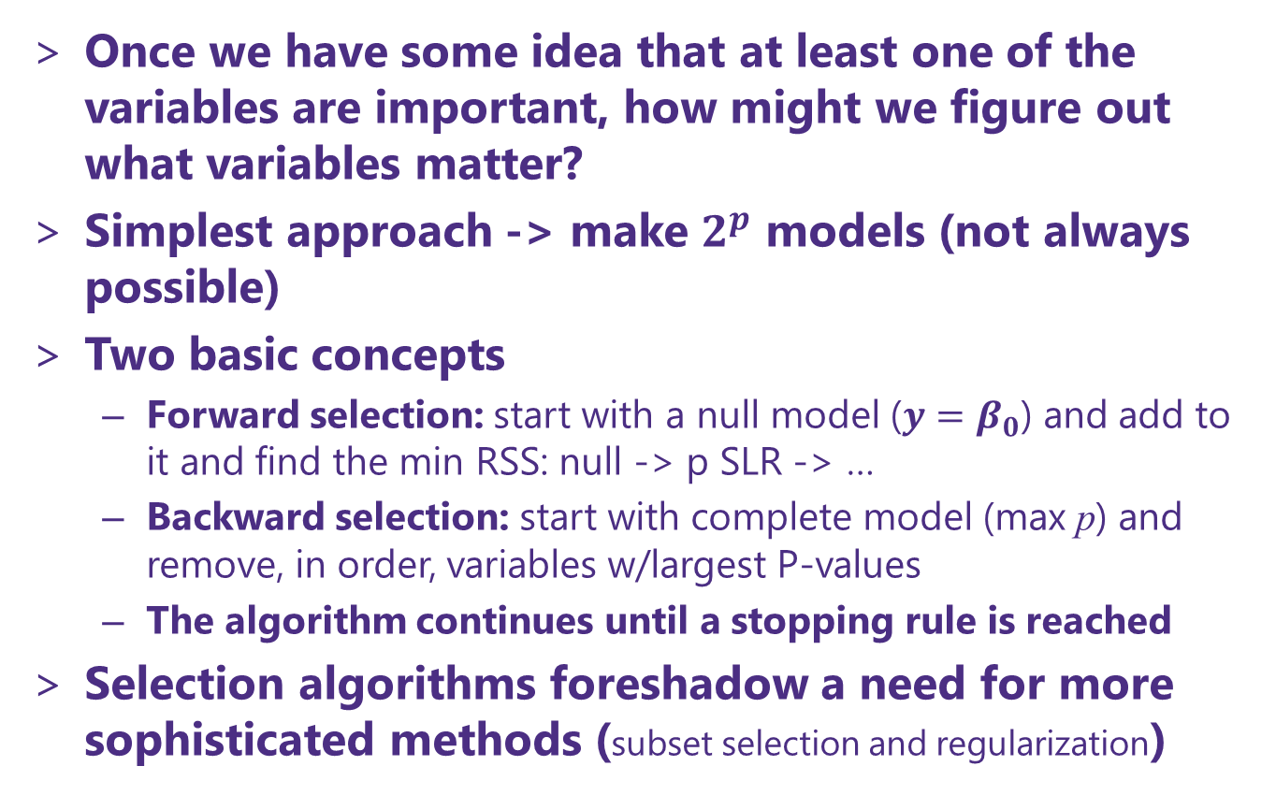
Which of the variables are important?
Once we have some idea that at least one of the variables are important, how might we figure out what variables matter?
Simplest approach -> make $2^{p}$ models (not always possible)
Two basic concepts
Forward selection: start with a null model (${y=β}_{0}$) and add to it and find the min RSS: null -> p SLR -> …
Backward selection: start with complete model (max p) and remove, in order, variables w/largest P-values
The algorithm continues until a stopping rule is reached
Selection algorithms foreshadow a need for more sophisticated methods (subset selection and regularization)
$$Y=β_{0}+Σ_{j=1,2 …, p }β_{j}X_{j}+ε$$

Slide 12
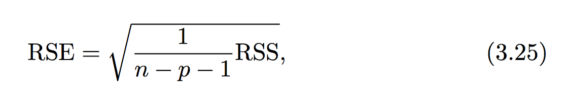
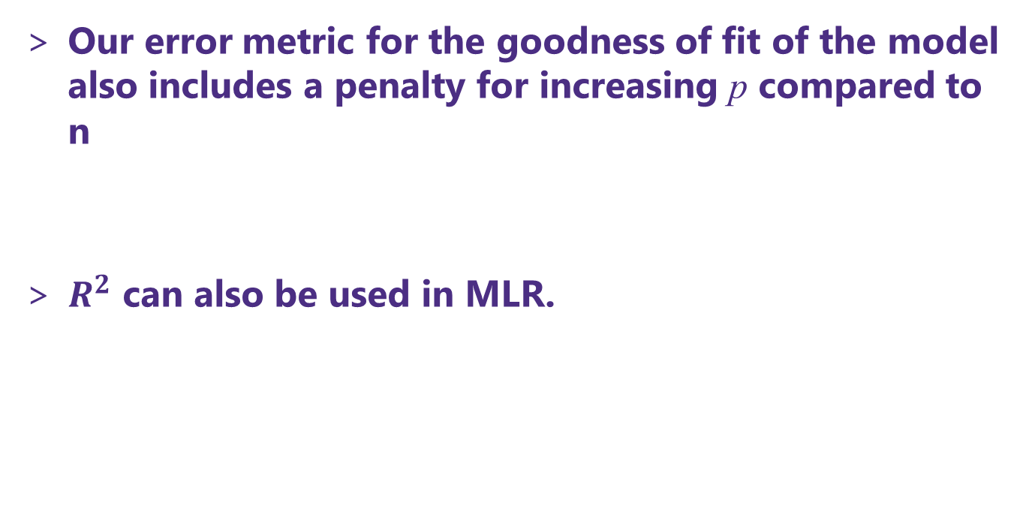
Residual standard error (RSE) in MLR
Our error metric for the goodness of fit of the model also includes a penalty for increasing p compared to n
$R^{2}$ can also be used in MLR.

Slide 13
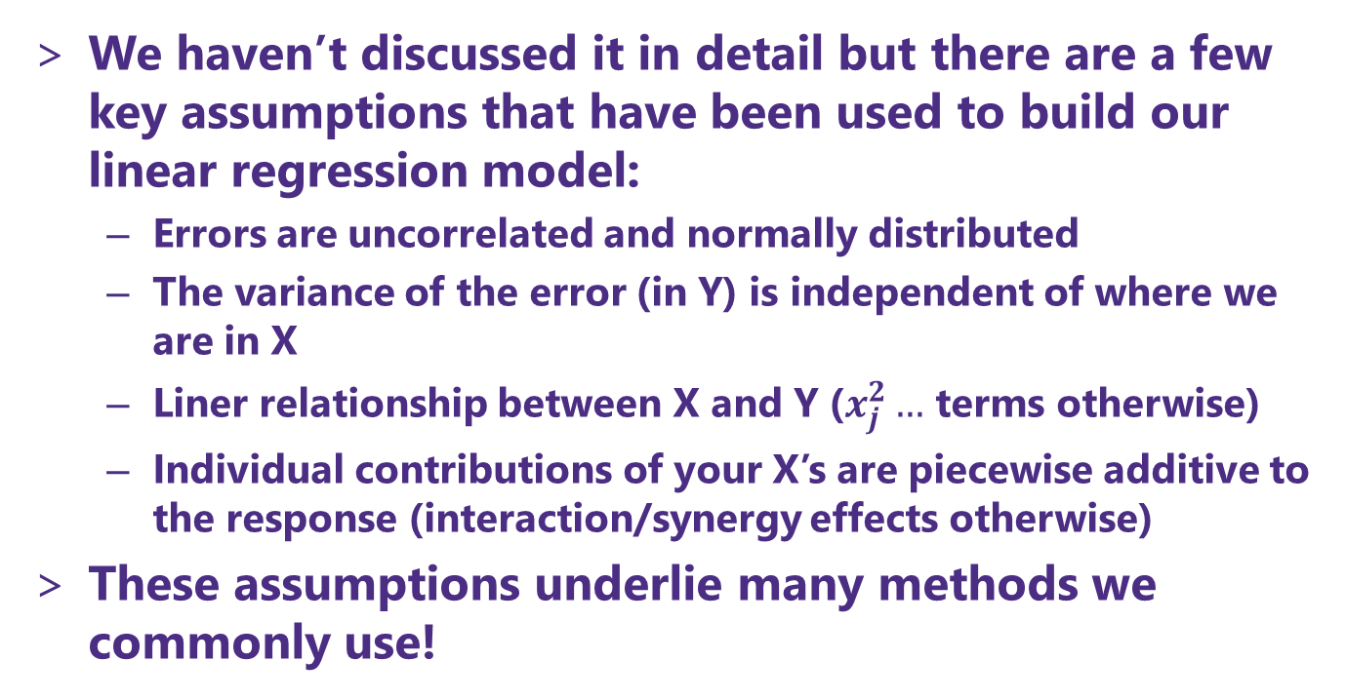
When good assumptions go bad
We haven’t discussed it in detail but there are a few key assumptions that have been used to build our linear regression model:
Errors are uncorrelated and normally distributed
The variance of the error (in Y) is independent of where we are in X
Liner relationship between X and Y ($x_{j}^{2}…$ terms otherwise)
Individual contributions of your X’s are piecewise additive to the response (interaction/synergy effects otherwise)
These assumptions underlie many methods we commonly use!

Slide 14
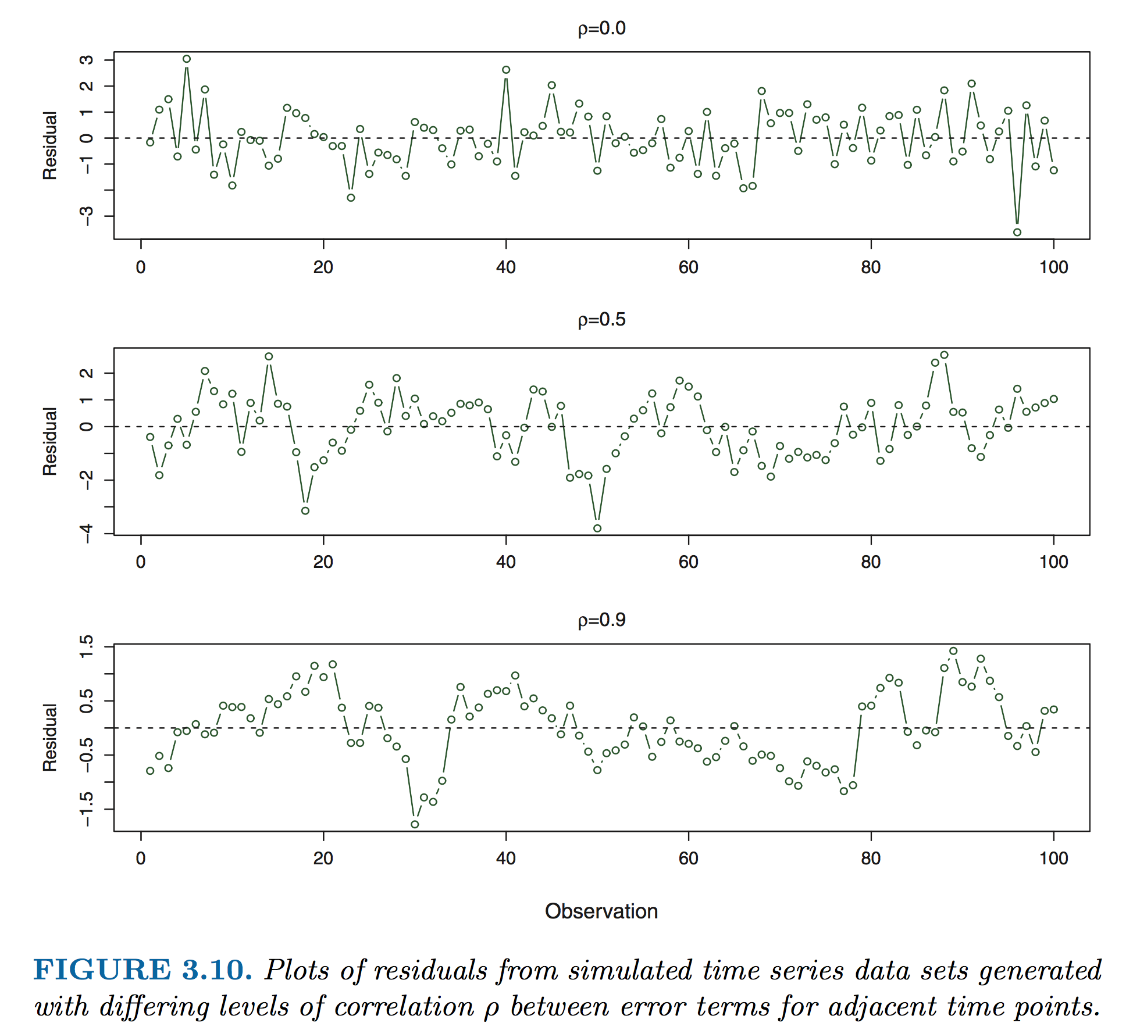
Understanding correlation in error
The most common way that error becomes correlated is with time series data

Slide 15
Identifying correlation in error
Note that the plot in the last slide was residual vs. observation (always a good idea to plot this in addition to a histogram of your residuals – both whether our assumptions are in line)
Introduction and practical implementation of methods to deal w/correlated errors is beyond scope of this class but we can discuss a few principles
The autocorrelation time is the correlation of a signal with a delayed copy of itself as a function of delay.
Fast Fourier transforms (FFT)

Slide 16
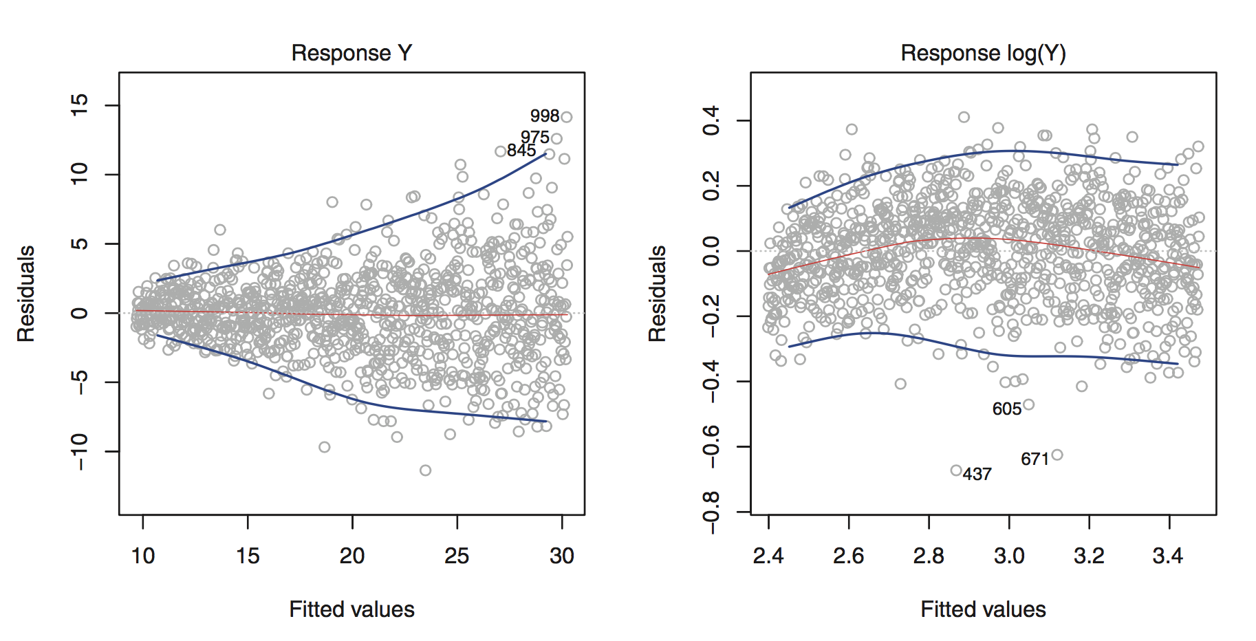

Nonlinear variance
This phenomena is known as heteroscedasticity
Transform data (as in Fig 3.11)
Weigh the observables by their variance (e.g., $y_{i,new}=y_{i }/σ$ )

Slide 17
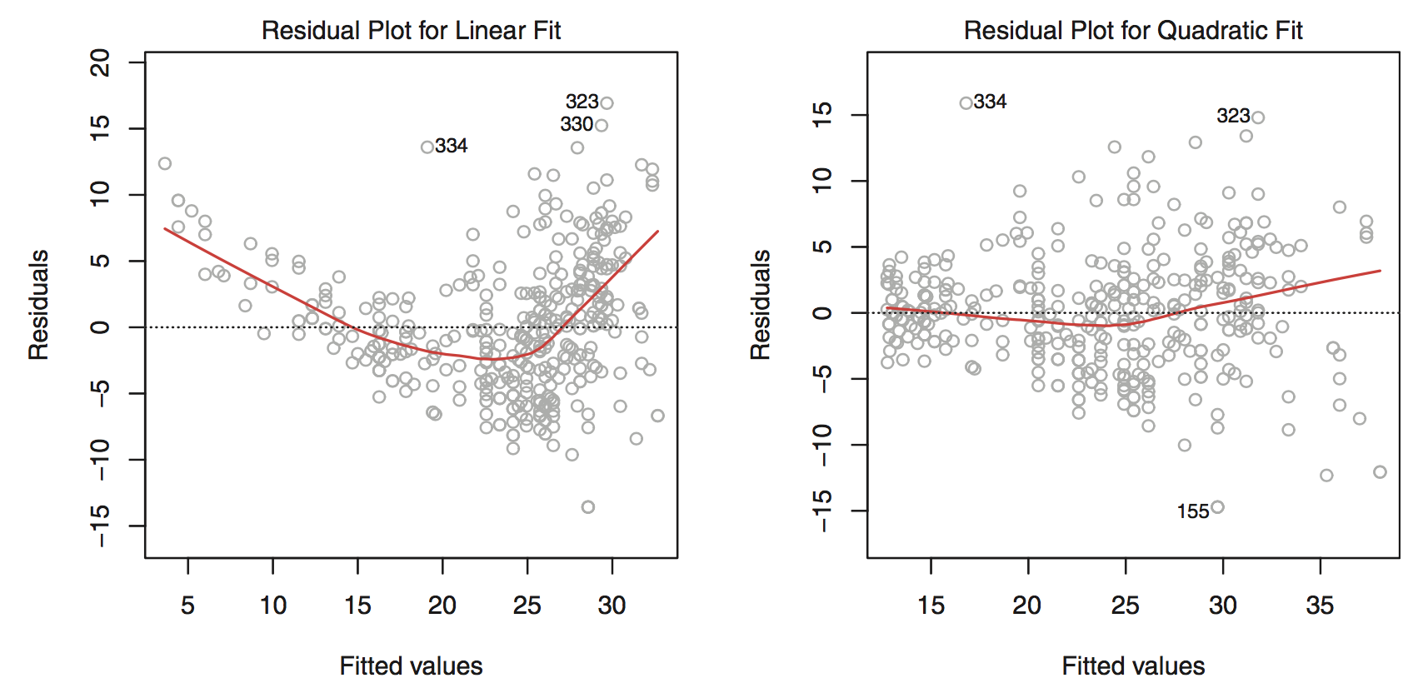
Nonlinear regression
Sometimes your variables have a clear non-linear dependence on the response
This is especially clear when you look at the residuals (ISL Fig 3.9)

Slide 18
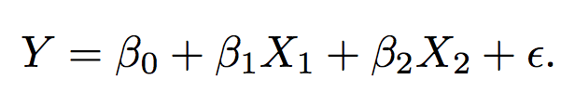
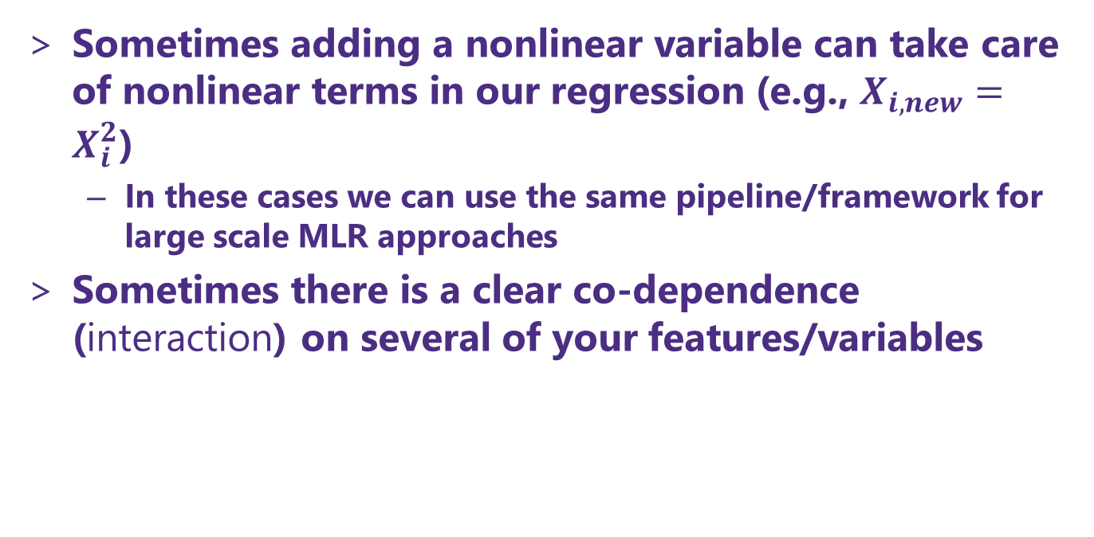
Nonlinear regression and Interaction effects
Sometimes adding a nonlinear variable can take care of nonlinear terms in our regression (e.g., $X_{i,new}=X_{i}^{2}$)
In these cases we can use the same pipeline/framework for large scale MLR approaches
Sometimes there is a clear co-dependence (interaction) on several of your features/variables

Slide 19
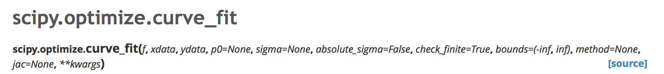
Where to go when you have a true nonlinear model to fit/train?
In general, the packages in scikit-learn work for general linear (single or multiple) or very specific types of nonlinear (e.g., splines) models of Y
The reason why has to do with speed of model solution and large training data set sizes
Other Python packages can also perform regression

Slide 20
Moving from exact solution to finding a minimum MSE
When we leave the world of ”exact solutions”, we are then confined to using numerical solutions to find the minimum value of MSE(β_{i})
Do we need an initial guess? (yes!)
What should it be?
A lot of our machinery for assessing the models still works just fine!

Slide 21
Other topics / suggestions
Chapter 3 of ISL is strongly suggested to read carefully (maybe multiple times)
Additional topics we didn’t cover
Outliers and high leverage points in your training set
Collinearity
More about nonlinear regression and interaction effects
AND MANY MORE!

Slide 22
Logistic Regression

Slide 23
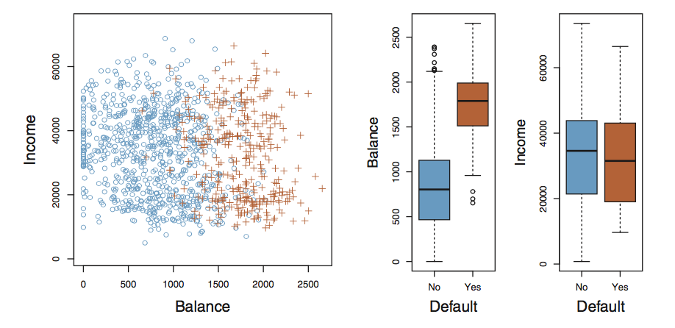
Classification with the logistic model
Performing regression on discrete classes is arbitrary (what are the outputs we assign to Yes/No and why?)
One caveat is the binary (two level response). Here we can always use a 0/1 coding!
Lets look at simple regression on this data

Slide 24
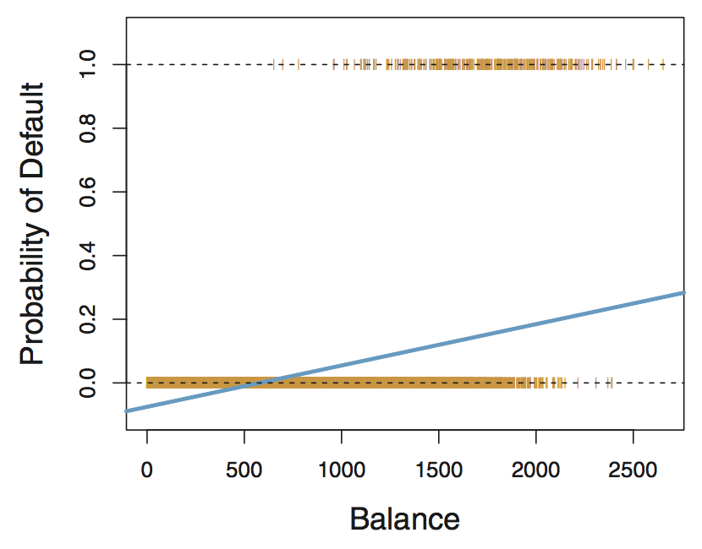
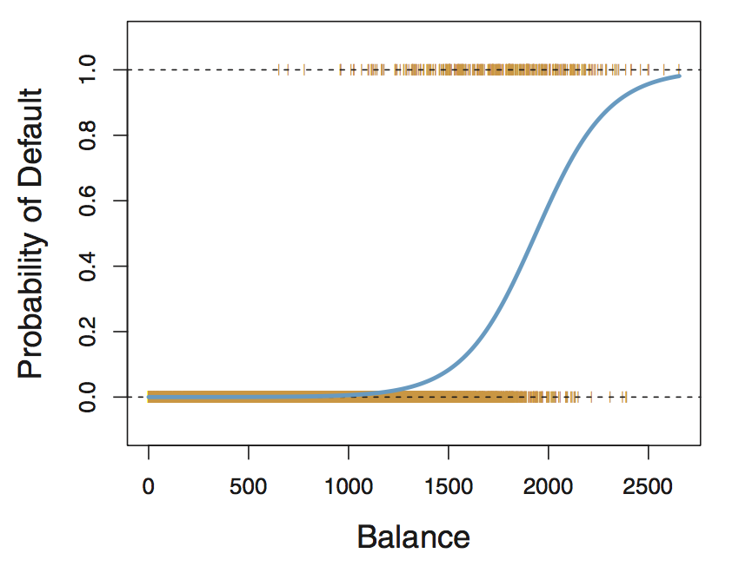

Classification with the logistic model
Fig 4.2 (left) shows us the outcome of simple linear regression using a 0/1 coding for the probability of default (0.0 or 1.0)
What does the model predict for Balance < $500?
Fig 4.2 (right) shows us the outcome of regression using a different functional form to describe situation where our variables are bounded between 0 and 1
This is modeled using the logistic function, which lets us sensibly answer this question: “what is the probability of default given some balance?”

Slide 25
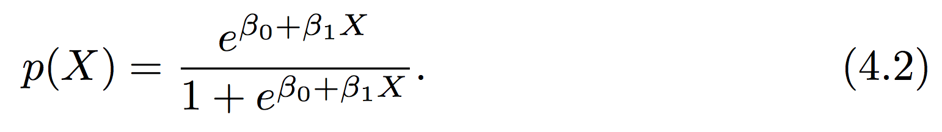
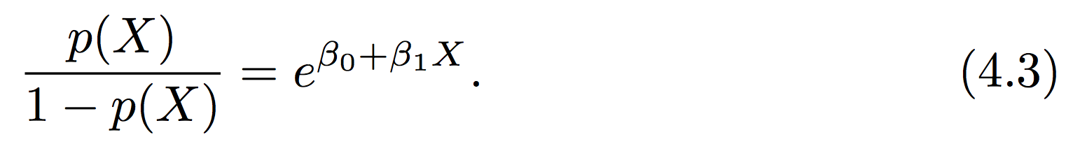
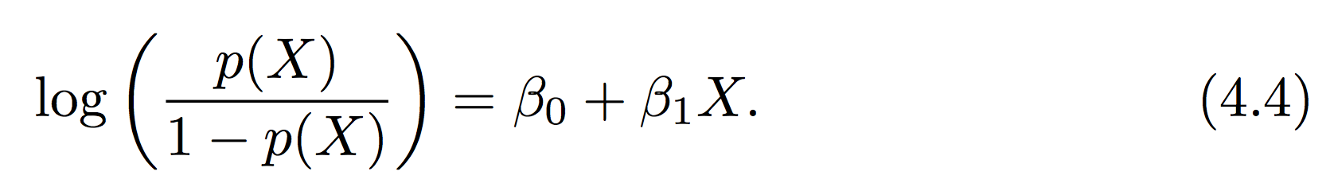
The logistic function
The logistic equation (4.2) provides a smooth transition between 0 and 1
Compare simple linear model and logistic eq
In terms of the “odds”
Can anyone define “odds”? If your probability of success is 1 in 5 (0.2) , your odds of success are 1 in 4: 0.2 / (1-.2) = .25
Log of the odds is the “logit”, relates the change in log of odds of success w/change in X
Notes:
Odds are the probability it happens, divided by the probability it doesn’t.
Probability scales from 0 to 1. Odds scales from 0 to infinite.
Use in horse racing. Better related to correct betting strategy.

Slide 26
Is the logistic model a classifier?
Yes!
Given a class situation “e.g., default vs. non-default”, the logistic model can take a set of training data and give a function that makes a prediction about what class a new or different input would be in
P < 0.5 = no default vs. P >= 0.5 default
We can also use a binary response (e.g., 0 vs 1) and train a multiple logistic model (e.g., many X_{i})

Slide 27
Basic concept of logistic regression
For reasons we won’t discuss in detail standard regression models don’t work well on the logistic equation.
But we still need to determine our coefficients: β_{i}
This is done through a procedure called maximum likelihood estimation
The basic idea is that we seek to find the set of β_{i} that maximizes the probability of making the correct prediction

Slide 28
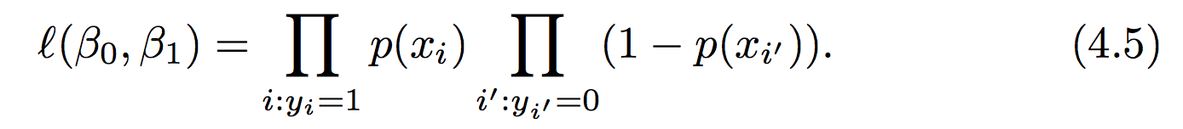
Simple illustration of MLE
The likelihood function can be defined in terms of the product of all the probabilities
In the case of the binary (0 vs 1) scenario:
Recall each probability is defined by our logistic eq:
We seek the values of β_{i} that maximize 4.5

Slide 29
Example and implementation in Python
We saw earlier that there is a python library “sklearn” (sci-kit learn), that can be used to perform machine learning techniques
Monday example: KNN
We will use many other ML methods from sklearn this quarter
Sometimes practice in class, sometimes practice on HW, sometimes example in class notes

Slide 30
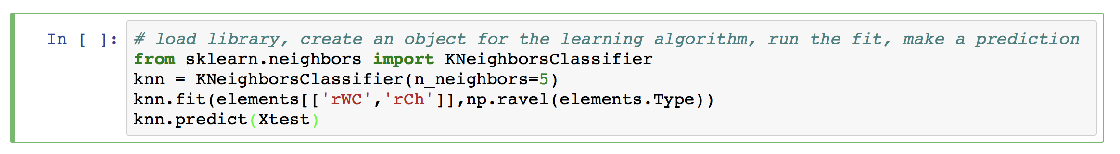
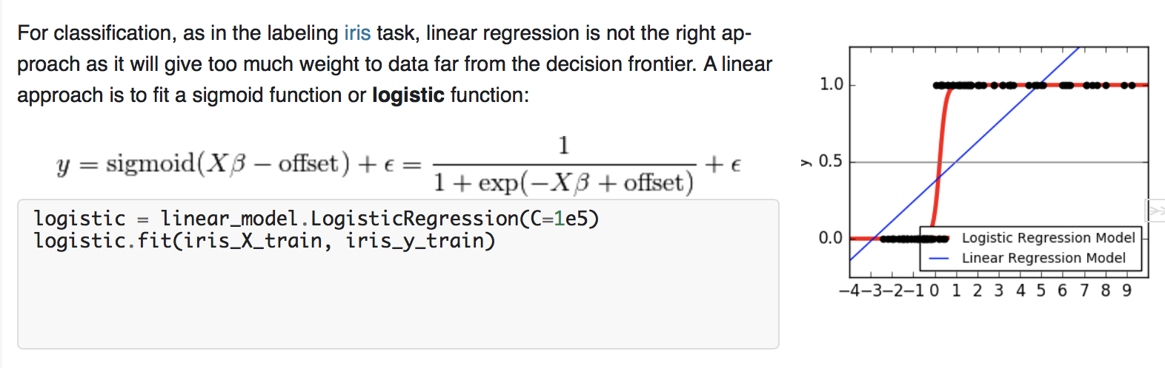
Example and implementation in Python
Recall key elements of our KNN model using sklearn:
Logistic regression is similar:
From sklearn tutorial

Slide 31
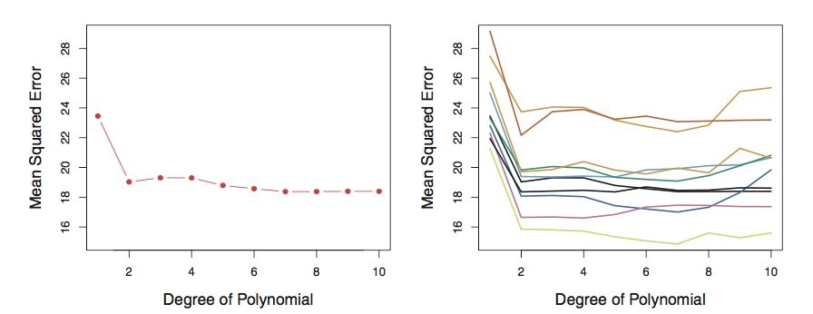
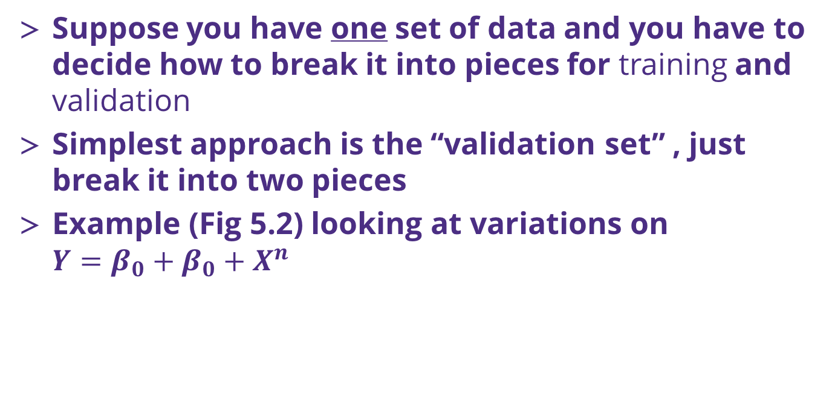
Cross Validation (k-fold)
Suppose you have one set of data and you have to decide how to break it into pieces for training and validation
Simplest approach is the “validation set” , just break it into two pieces
Example (Fig 5.2) looking at variations on $Y=β_{0}+β_{0}+X^{n}$
Left: training MSE vs n for one data set
Right: training MSE vs n for 10 validation sets
Riddle me this, how many ways are there to choose two 500 data sets from 1000?

Slide 32
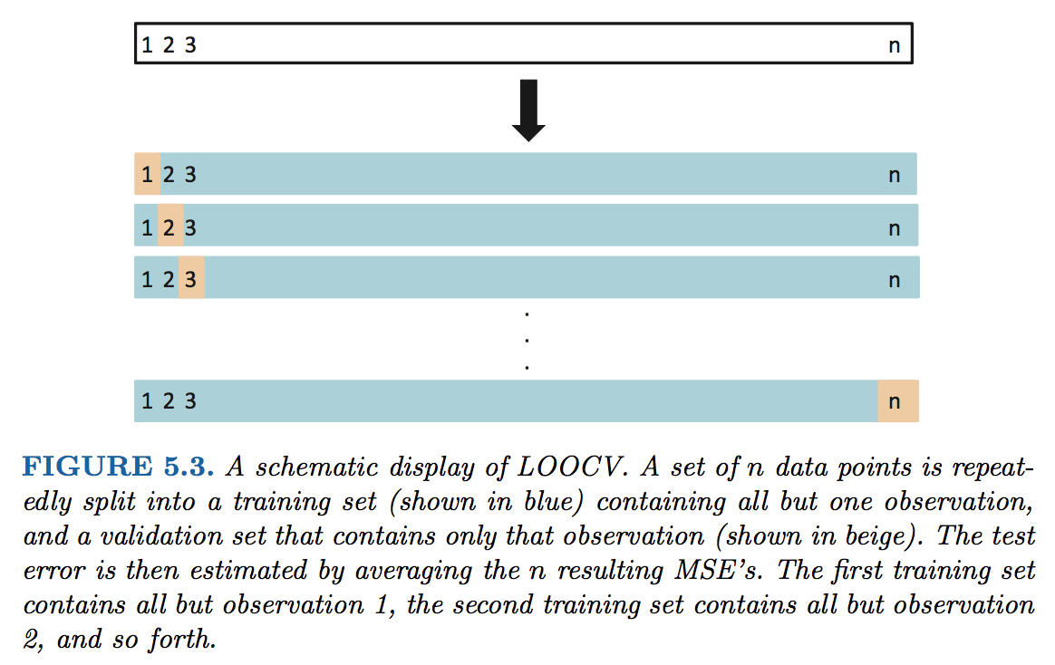
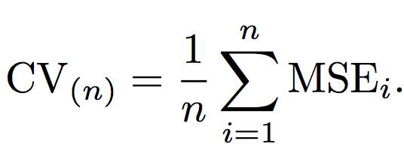
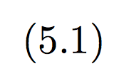
Cross Validation (k-fold)
Since you only use a portion of your data in the training, the ”validation set” approach will tend to overestimate your error!
Leave One Out Cross Validation approach

Slide 33
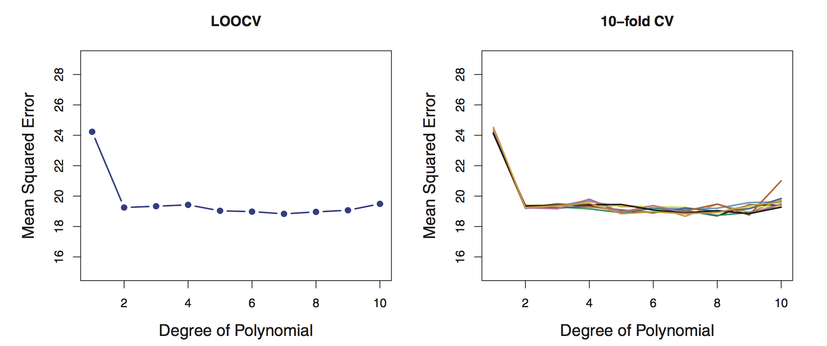
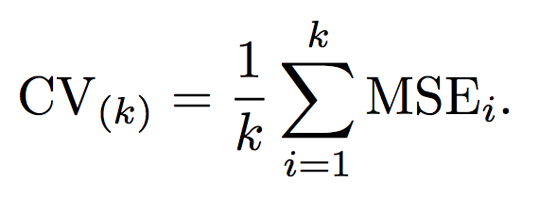

Cross Validation (k-fold)
LOOCV is way more accurate (Fig 5.4), but more computationally expensive!
An alternate is to break the data into larger pieces than n and n-1
We break it into “k” folds of data, e.g. 5-fold. The 1st set is saved for validation, remaining k-1 sets are used for training

Slide 34
Bias/variance tradeoff: use 5 or 10 folds
Bias
an error from erroneous assumptions in the learning algorithm. High bias can cause an algorithm to miss the relevant relations between features and target outputs (underfitting).
Variance
an error from sensitivity to small fluctuations in the training set. High variance can cause an algorithm to model the random noise in the training data, rather than the intended outputs (overfitting).
Bias variance tradeoff relates the simplification of a model to avoid overfitting to the complexity of a model to avoid underfitting.

Slide 35
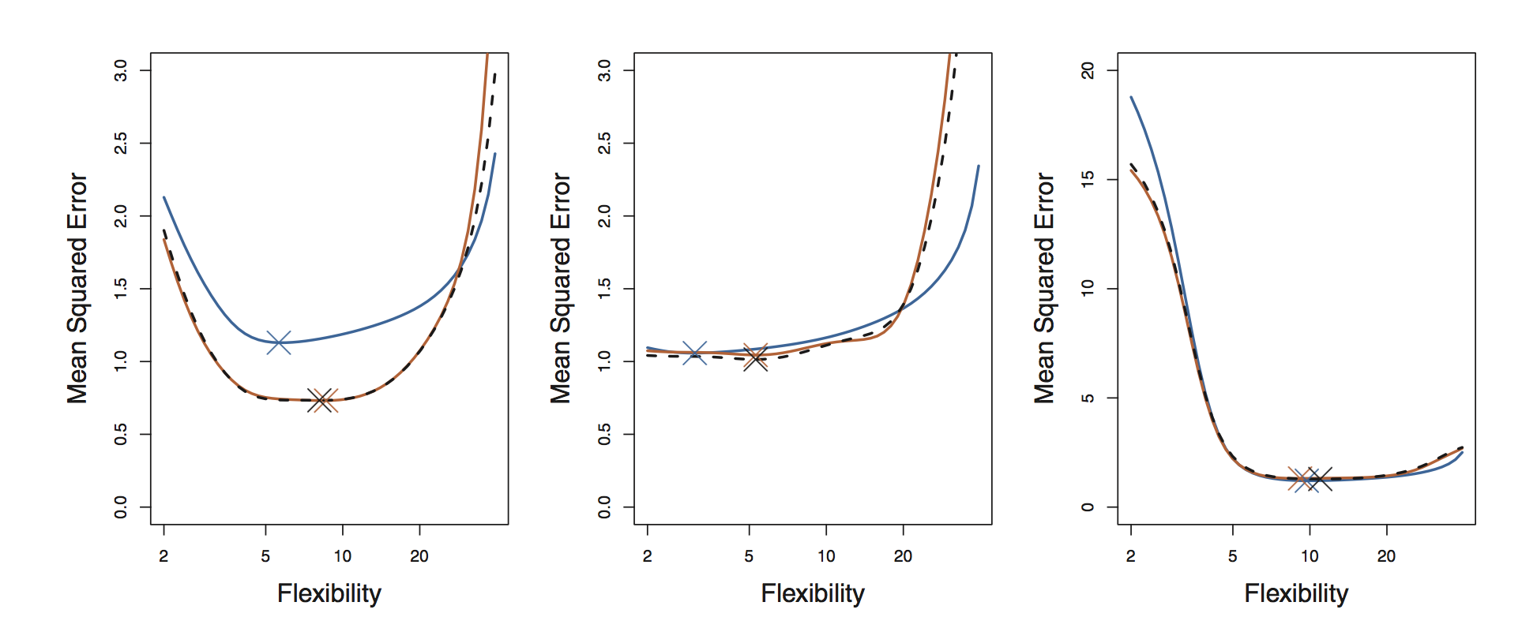
Bias/variance tradeoff: use 5 or 10 folds
Bias
Empirically people usually use 5 or 10 folds to avoid too much bias or variance in their resampling algorithm
This is a great way to get a true estimate of your model’s MSE
Fig 5.6 revisits Fig 2.9 in the context of k-fold cross validation

Slide 36
Logistic regression for classification

Slide 37
Classification with the logistic model
Key concepts
Consider the data below (ISL Fig 4.1), we are trying to make a guess as to whether someone will default on a loan on the basis of their bank account balance and income level
Questions?

