Slide 1
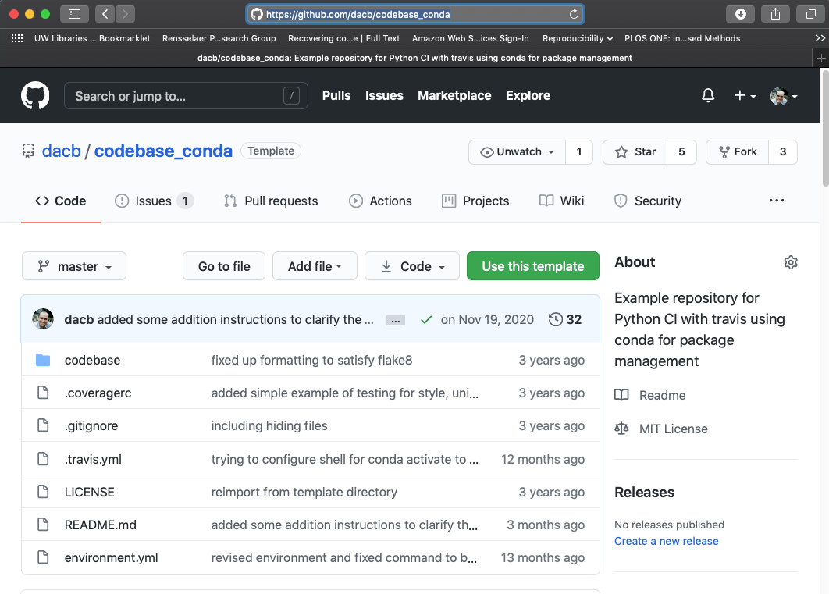
Agenda
What is continuous integration?
Why do I want continuous integration?
How can I use continuous integration?

Slide 2
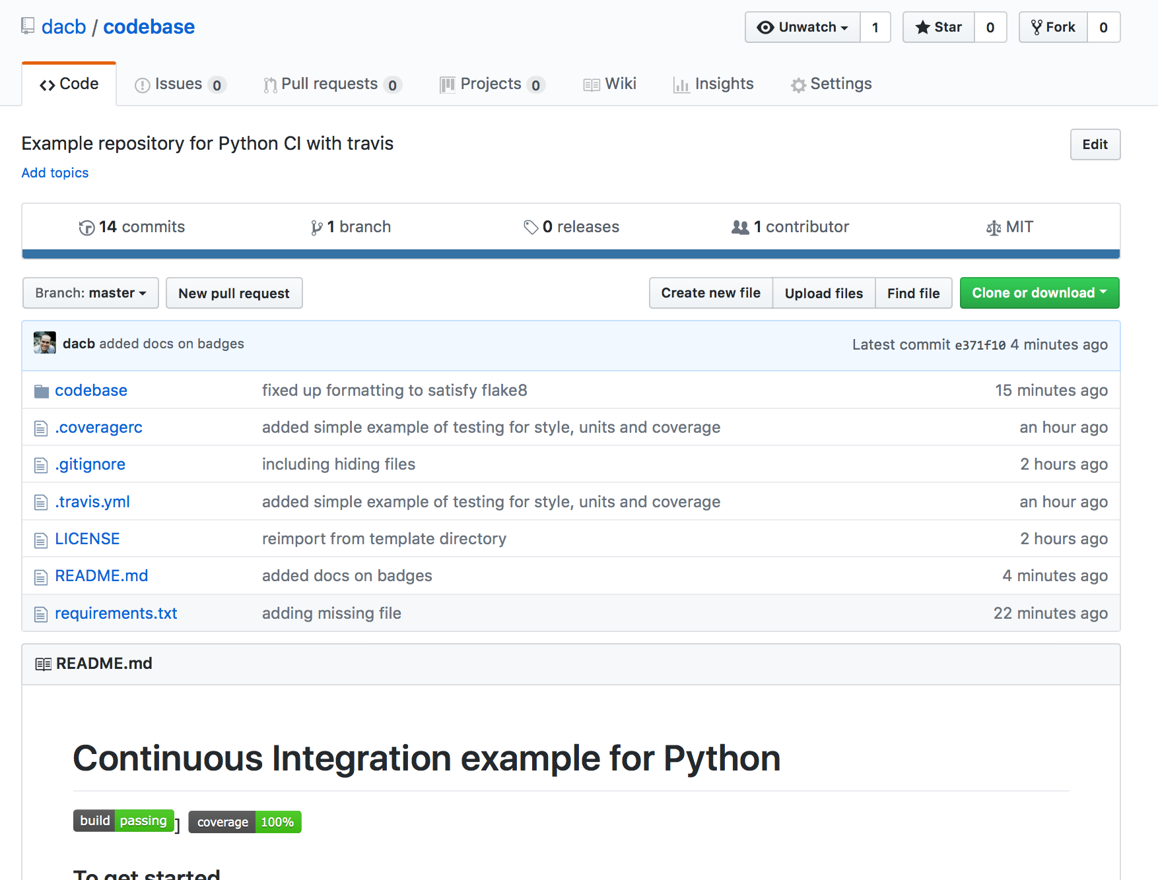
Agenda
What is continuous integration?
Why do I want continuous integration?
How can I use continuous integration?

Slide 3
Agenda
What is continuous integration?
Why do I want continuous integration?
How can I use continuous integration?

Slide 4
What is it?
Continuous Integration (CI)
Automated building and testing of a code base
Continuous
Building and testing is done “continuously” as the code is developed
Integration
“Integrating” changes from developers into code

Slide 5
What is it?
Semi-continuous
The build and test process typically happens after a push
Testing is not necessarily part of CI but nearly all teams integrate the two
Any code checks can be done as part of CI
Code style checkers (flake8)
Linters (pylint)

Slide 6
Related concepts…
Continuous Delivery
Practices that keep a master line of development ready for immediate deployment
Ensuring code passes automated build/testing
All configuration information and data is ready
Continuous Deployment
Automated continuous delivery
As soon as all the continuous delivery constraints are met, the application is automatically deployed

Slide 7
Related concepts…
“A rule of thumb in CD[elivery] is that every commit should be a release candidate but the release should be a political decision and done manually.”
http://blog.crisp.se/2013/02/05/yassalsundman/continuous-delivery-vs-continuous-deployment

Slide 8
Why do I want it?
CI automates building and testing
Provides rigourous quality checks on the master branch
Core component of Continuous Delivery and Deployment
Requires that a team performs more frequent “integrations”
Evidence shows that `conflicts` are resolved more rapidly

Slide 9
Why do I want it?
Bugs are identified earlier during development
Cost to fix bugs is exponentially related to when the bug is identified
Easier to identify offending code when it was written shortly before a defect was identified
You just wrote the code, it is fresh in your mind
CI checks on small units of work benefit the most from this
Some teams will run up to 50+ CI checks a day

Slide 10
Why do I want it?
Bugs are identified earlier during development
When a defect is identified after delivery the cost is enourmous, e.g.
Bug tracking, testing, re-testing, release notes, customer notification, down time
Damage to reputation or liability
https://spectrum.ieee.org/computing/software/why-software-fails

Slide 11
How does it work?
You have a public repository

Slide 12
How does it work?
You make some commits that form a coherent body of work, e.g. implement a feature
You push to GitHub
A GitHub hook spins up a new virtual instance using Travis CI and configures it according to your needs
Travis CI runs the commands you specify that do unit testing, coverage reports and style checks

Slide 13
How does it work?
If the commands fail with an error, the build is reported as failing
Some tools can return reports for review, e.g. pylint and coverage reports
The team is notified of the result, usually in email

Slide 14
How can I use it?
Some notes:
You need a public repository
Don‘t mine bitcoin, you have limited time
The build container is an Ubuntu 14.04
See the example repository:
https://github.com/dacb/codebase_conda
https://github.com/dacb/codebase (PIP)

