Slide 1



Software Engineering for Data Scientists
Knowledge and solutions for a changing world
Advancing data-intensive discovery in all fields
Be boundless
UW DIRECT
(数据集中研究促进清洁技术)
https://uwdirect.github.io
David A. C. Beck (dacb) & Ting Cao

Slide 2
Review
Questions from last week about:
Flow control
If else elif
For loops
Functions?

Slide 3
Strong
Weak
Weak
Strong
-1
-0.5
0
0.5
1
Negative correlation
Positive correlation

Slide 4
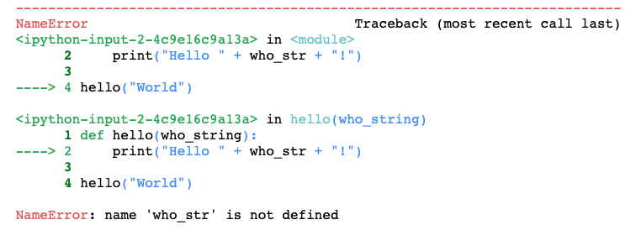
This function (i.e. the notebook)
called
this function
(our hello function)
Read the stack trace in this direction

Slide 5
Today
Importing your own code & local / globals
Start with an idea
No code (nothing)
Build a working tool (something)
Use .py files instead of only notebooks
Thinking about testing, errors, assertions
Prepare ENV 45s lecture for Monday
Scheduled: Jan 29, 2021 at 2:00 PM to 4:30 PM

