Slide 1



Data Science Methods for Cutting-edge Tech
Knowledge and solutions for a changing world
Advancing data-intensive discovery in all fields
Be boundless
UW DIRECT
https://uwdirect.github.io
Ting Cao
Materials Science & Engineering

Slide 2
Next…
Error bars
Hypothesis testing
Z-test
T-test

Slide 3
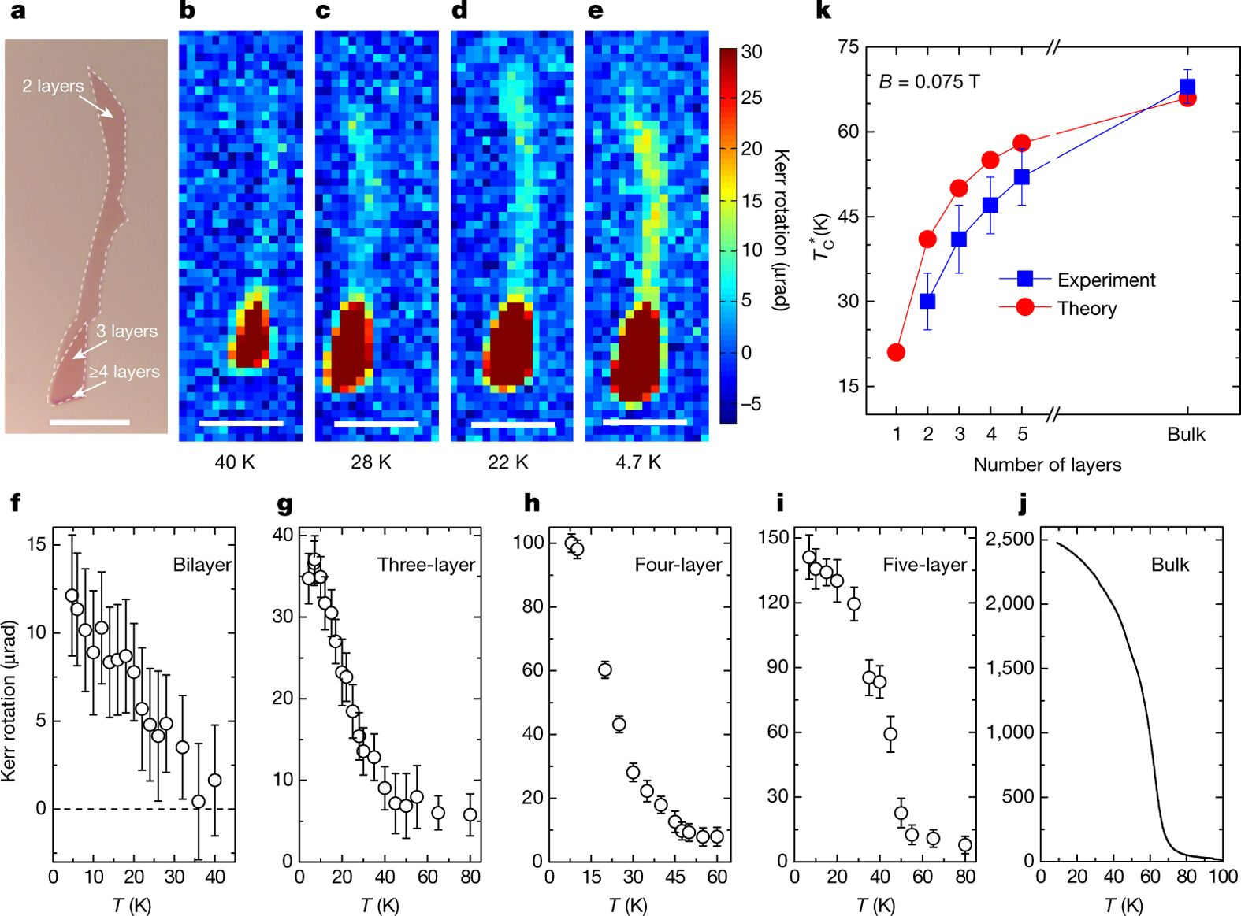
A typical Nature paper
Nature 546, 265–269 (2017)

Slide 4
What are these BARS?
Nature 546, 265–269 (2017)

Slide 5
Error bars
In this paper, error bars represent SD of samples.
Does Four layer (3rd panel) has less error than Bilayer (1st panel)?
Nature 546, 265–269 (2017)

Slide 6
Error bars
What is an error bar?
Some sub-domains of science and engineering have community standards about which type of error bar to use.
Nature Methods papers in 2012: “The type of error bars was nearly evenly split between s.d. and s.e.m. bars (45% versus 49%, respectively). In 5% of cases the error bar type was not specified in the legend. In only 1 case was 95% CI used.”
S.E.M? 95% CI%? What are these?
Error bars. Points of significance. Nature, 2013.

Slide 7
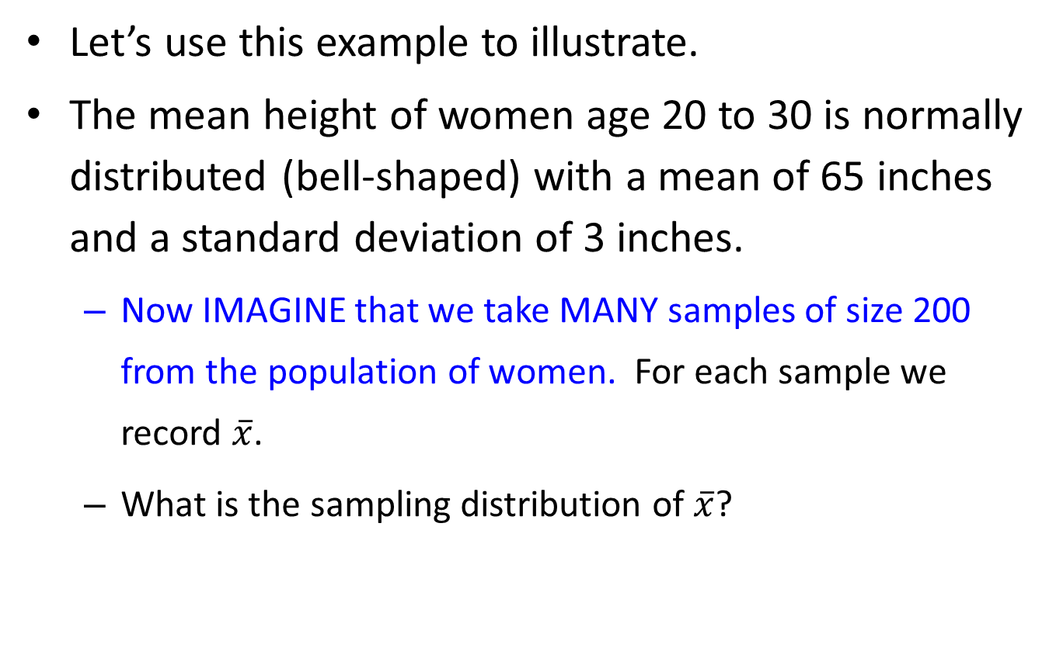
Standard Error of Mean (S.E.M.)
Let’s use this example to illustrate.
The mean height of women age 20 to 30 is normally distributed (bell-shaped) with a mean of 65 inches and a standard deviation of 3 inches.
Now IMAGINE that we take MANY samples of size 200 from the population of women. For each sample we record $\overline{x}$.
What is the sampling distribution of $\overline{x}$?

Slide 8

Distributions of X and $\overline{X}$
Original Population of Women: X= height of random woman
Distribution of Sample Means: X-bar = mean of random sample of size 200.

Slide 9
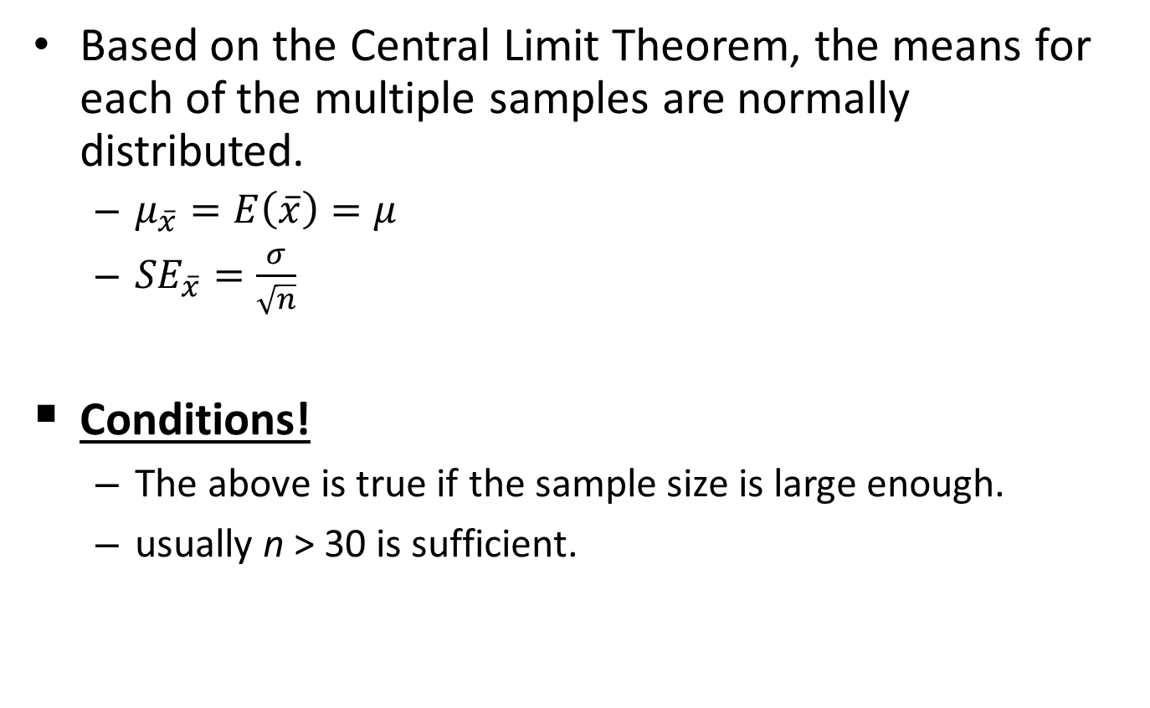
Standard Error of Means (S.E.M.)
Based on the Central Limit Theorem, the means for each of the multiple samples are normally distributed.
$μ_{\overline{x}}=E\left(\overline{x}\right)=μ$
${SE}_{\overline{x}}=\frac{σ}{\sqrt{n}}$
Conditions!
The above is true if the sample size is large enough.
usually n > 30 is sufficient.

Slide 10
SD vs. SEM
When represented as error bars:
s.d. error bars tell us about the spread of the sample/population, i.e. variation in data, not error in measurement (rigorously speaking).
s.e.m. error bars tell us about the amount of uncertainty (i.e., potential error) in the estimated mean.

Slide 11
Confidence Interval (CI)
Confidence interval is another way of conveying the amount of uncertainty in our estimate.
i.e., how confident we are about the estimate.
To understand confidence interval, we firstly need to talk about hypothesis testing and p-value.

