Slide 1
Statistical Hypothesis Testing
Yi Wang
Pennsylvania State University

Slide 2
Why we need hypothesis testing
Imagine the following scenarios:
When we get a sample mean, how likely is it to represent the population?
When we got two or more samples with different means, how do we decide whether these samples are the same?
How do we make decisions? What is the criterion/cutting point?
This is when we need hypothesis testing!

Slide 3

The Logic of Hypothesis Testing
Null Hypothesis ($H_{0}$):
We make a hypothesis about the potential conclusion.
Alternative Hypothesis ($H_{1}$):
What we prepare as the alternative if $H_{0}$ doesn’t hold.
$P\left(H_{1} is true\right)=1−[P{(H}_{0} is true)]$

Slide 4


The Logic of Hypothesis Testing
We then test $H_{0}$ with a series of statistical analyses.
The nature of these analyses is to determine the probability that $H_{0}$ is true.
If $P\left(H_{0} is true\right)$is too small, we will reject $H_{0}$and determine that $H_{1}$ is more likely to be true.
ATTENTION!!!
We NEVER say “accept $H_{0}$ (or $H_{1}$)” in statistics.
Because everything has a probability ☺

Slide 5

The Logic of Hypothesis Testing
E.g., we want to test whether UW students’ mean IQ score can represent the population.
$H_{0}$: Mean IQ of UW students is NOT different from the population.
$H_{1}$: Mean IQ of UW students is different from the population.
If $H_{0}$ is rejected, then ________.
If $H_{0}$ is NOT rejected, then ________.

Slide 6
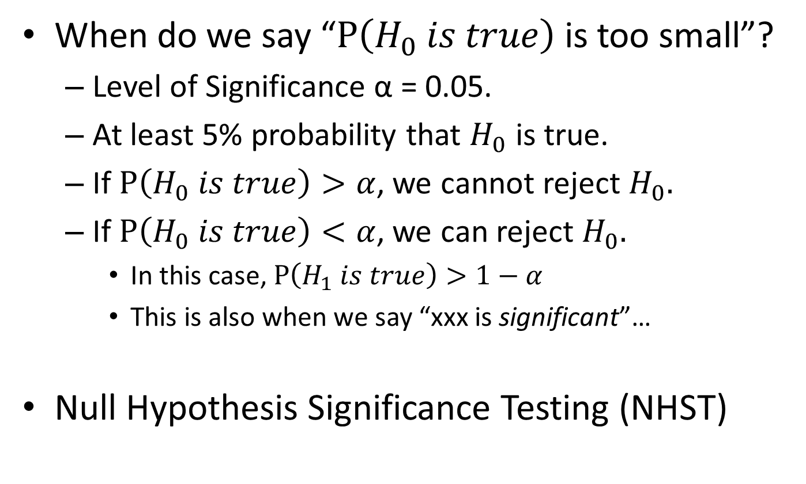
The Logic of Hypothesis Testing
When do we say “$P\left(H_{0} is true\right)$is too small”?
Level of Significance α = 0.05.
At least 5% probability that $H_{0}$ is true.
If $P\left(H_{0} is true\right)>α$, we cannot reject $H_{0}.$
If $P\left(H_{0} is true\right)<α$, we can reject $H_{0}.$
In this case, $P\left(H_{1} is true\right)>1−α$
This is also when we say “xxx is significant”…
Null Hypothesis Significance Testing (NHST)

Slide 7
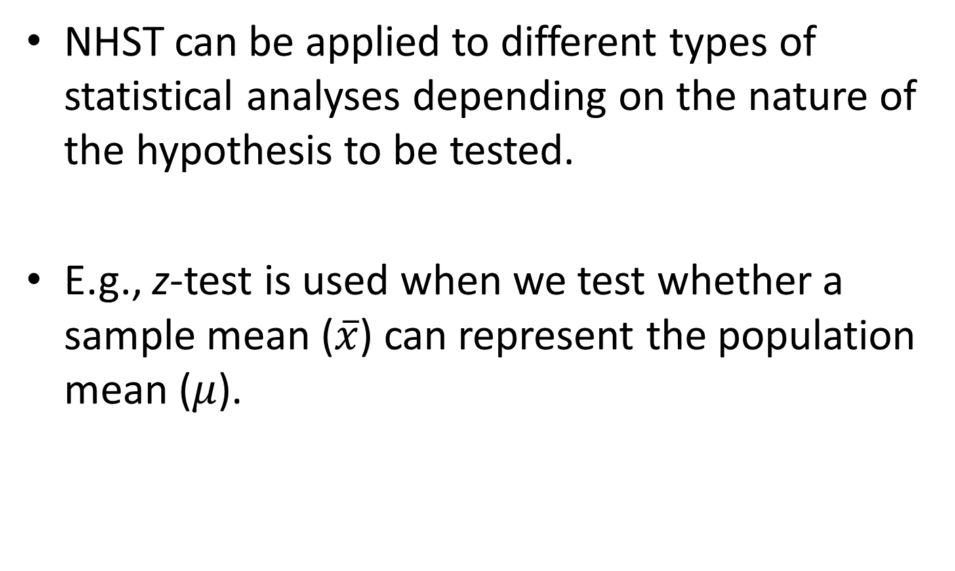
NHST with z-test
NHST can be applied to different types of statistical analyses depending on the nature of the hypothesis to be tested.
E.g., z-test is used when we test whether a sample mean ($\overline{x}$) can represent the population mean ($μ$).

Slide 8
An Illustrating Example
A light bulb company claims their product will last 3000 hours of use with a standard deviation of 150 hours.
Alex wanted to test this claim with the 5 bulbs he bought randomly. He found that on average the light bulbs lasted 2880 hours.
Do the sampled light bulbs demonstrate what the company claims about the product life?

Slide 9
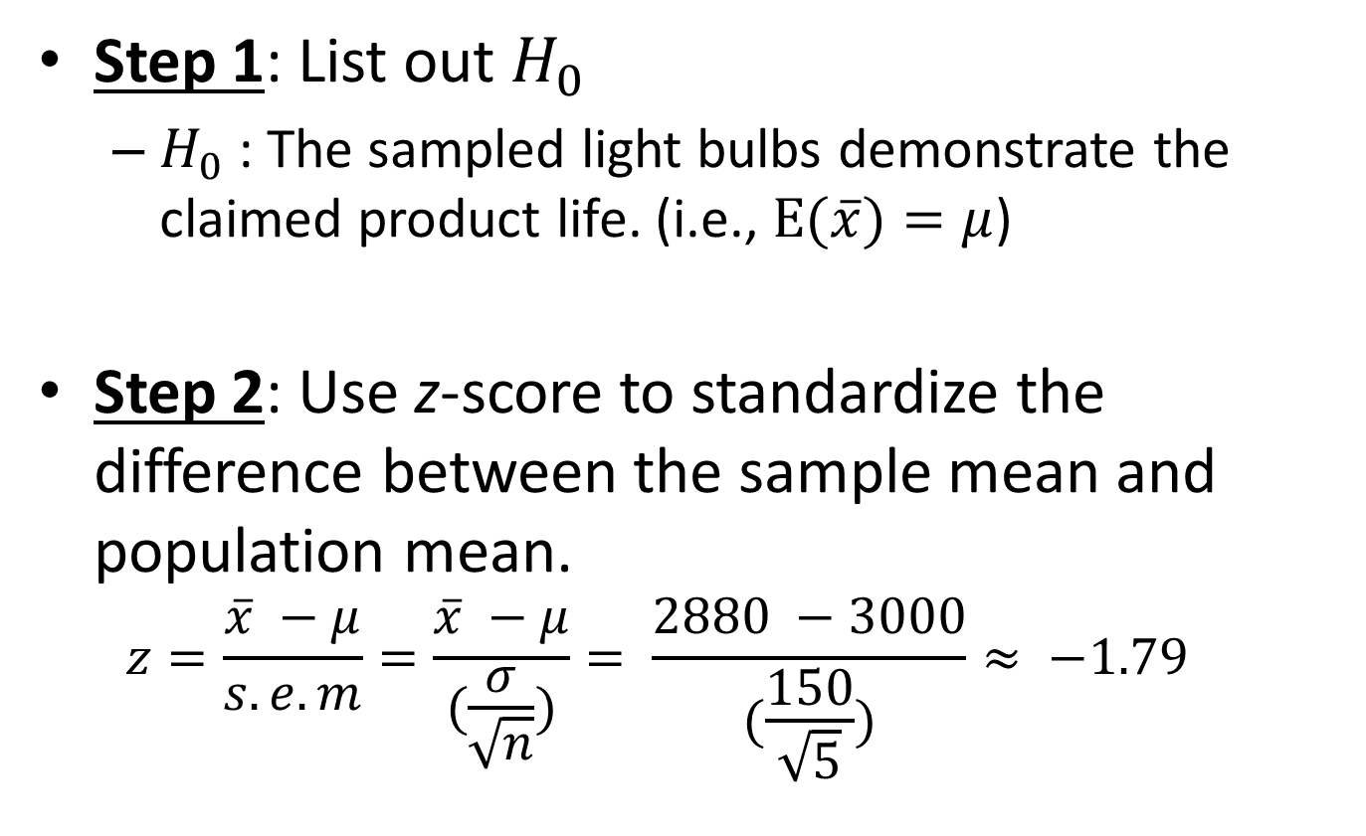
An Illustrating Example
Step 1: List out $H_{0}$
$H_{0}$: The sampled light bulbs demonstrate the claimed product life. (i.e., $E(\overline{x})=μ$)
Step 2: Use z-score to standardize the difference between the sample mean and population mean.
$$z=\frac{\overline{x} −μ}{s.e.m}=\frac{\overline{x} −μ}{(\frac{σ}{\sqrt{n}})}= \frac{2880 −3000}{(\frac{150}{\sqrt{5}})}≈ −1.79$$

Slide 10
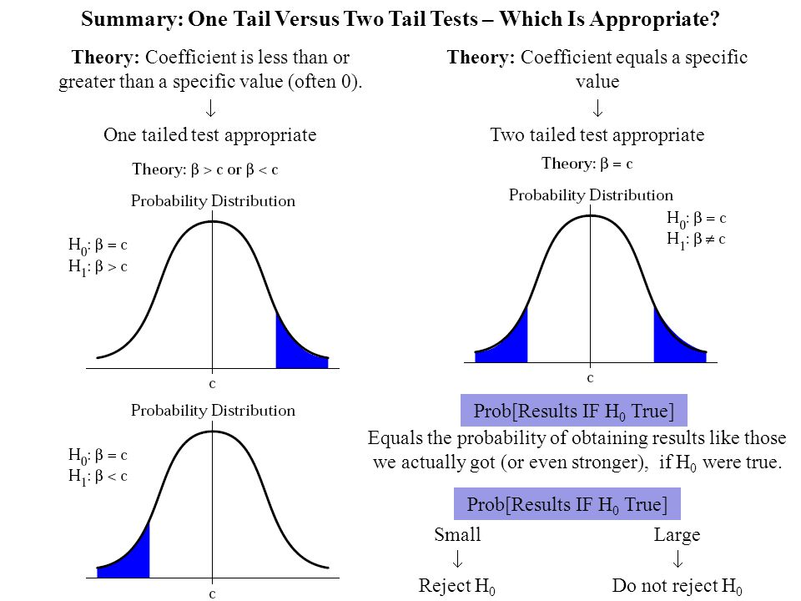

An Illustrating Example
Step 3: Find the probability (p-value) associated with the z-score and compare p with $α$.
NOTE: One-tailed vs. Two-tailed test
One-tailed test: $H_{1}$has direction$.$
$H_{1a}$: The sampled light bulbs have shorter product life than the claimed product life.
$p\left(H_{0} is true\right)=p\left(z<−1.79\right)=.037<α=.05$
Thus, we can reject $H_{0}$ based on a one-tailed test.

Slide 11
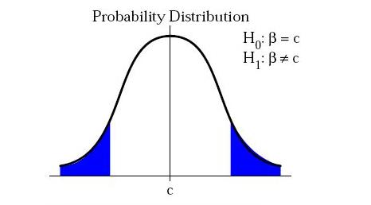

An Illustrating Example
Step 3: Find the probability (p-value) associated with the z-score and compare p with $α$
NOTE: One-tailed vs. Two-tailed test
Two-tailed test: $H_{1}$has no direction$.$
$H_{1}$: The sampled light bulbs do not demonstrate the claimed product life.
$p\left(H_{0} is true\right)=p\left(z≠−1.79\right)=.074>α=.05$
Thus, we cannot reject $H_{0}$ based on a two-tailed test.

Slide 12
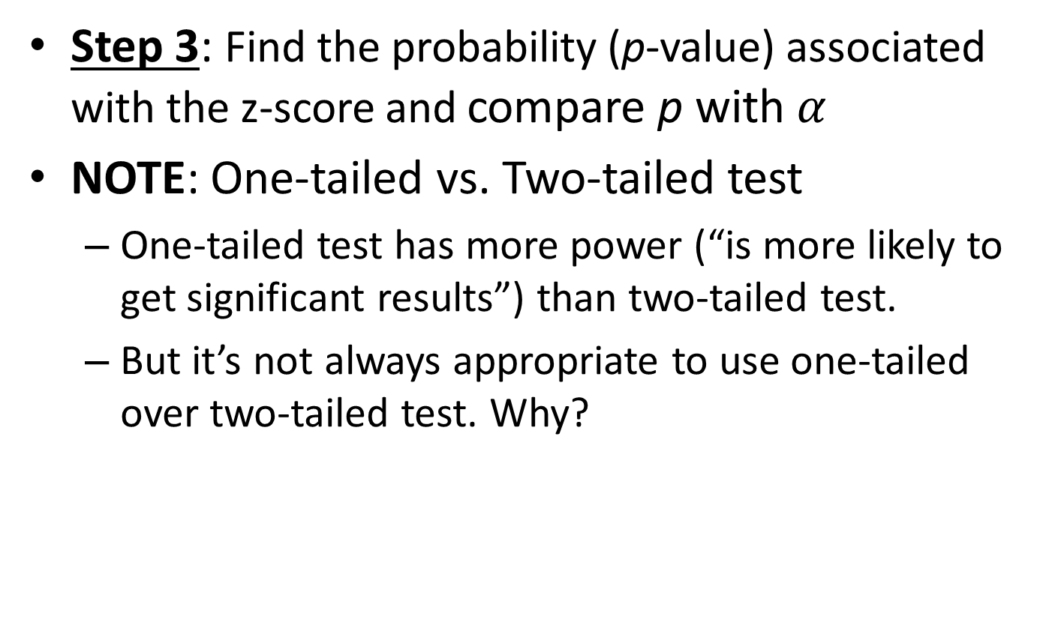
An Illustrating Example
Step 3: Find the probability (p-value) associated with the z-score and compare p with $α$
NOTE: One-tailed vs. Two-tailed test
One-tailed test has more power (“is more likely to get significant results”) than two-tailed test.
But it’s not always appropriate to use one-tailed over two-tailed test. Why?

Slide 13
More about NHST
Type I and Type II error
Effect size & confidence interval
Statistical power

Slide 14


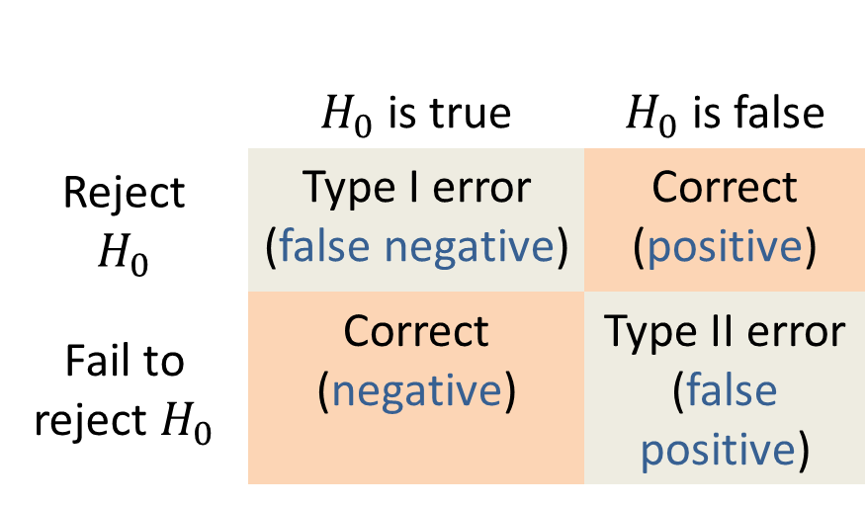

Type I & Type II Error
$H_{0}$: The person is NOT infected.
 | $H_{0}$ is true | $H_{0}$ is false
Reject $$H_{0}$$ | Type I error (false negative) | Correct (positive)
Fail to reject $H_{0}$ | Correct (negative) | Type II error (false positive)

Slide 15
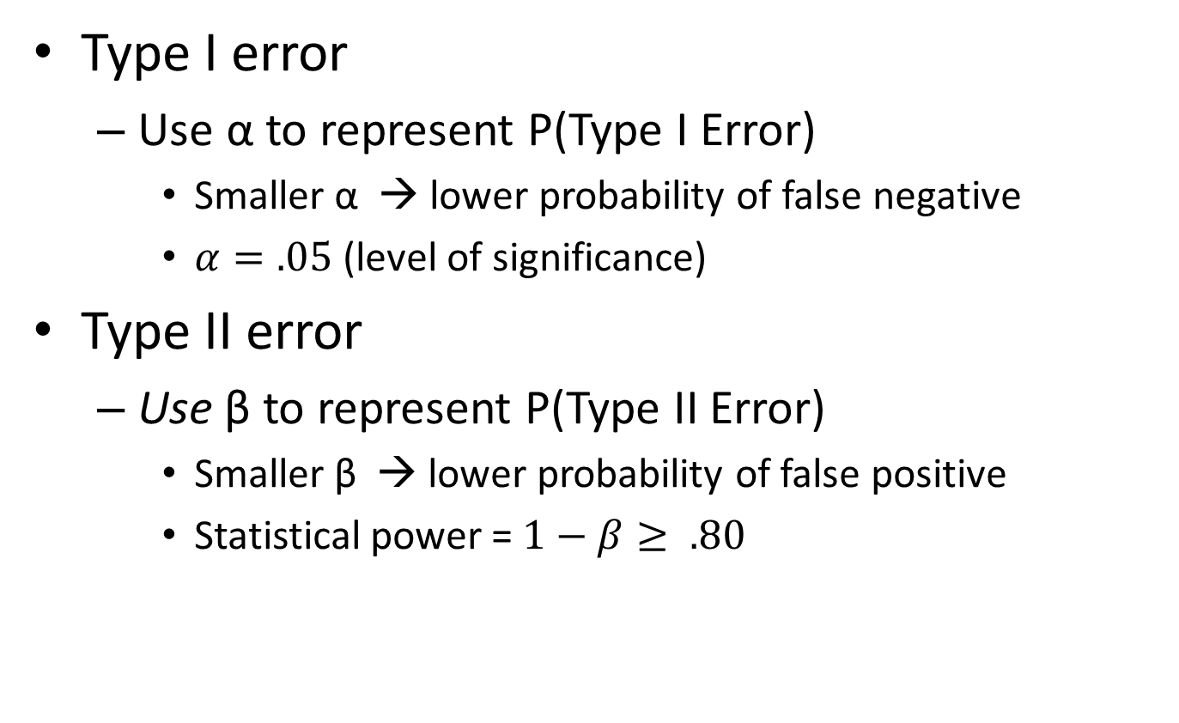
Type I & Type II Error
Type I error
Use α to represent P(Type I Error)
Smaller α → lower probability of false negative
$α=.05$ (level of significance)
Type II error
Use β to represent P(Type II Error)
Smaller β → lower probability of false positive
Statistical power = $1−β≥ .80$

Slide 16
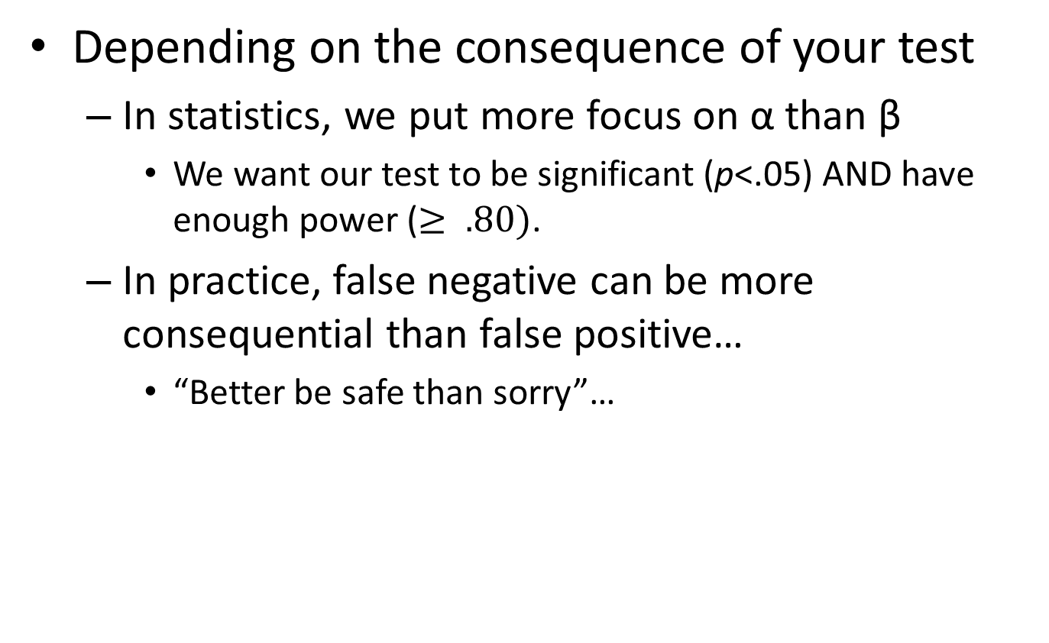
α versus β
Depending on the consequence of your test
In statistics, we put more focus on α than β
We want our test to be significant (p<.05) AND have enough power ($≥ .80)$.
In practice, false negative can be more consequential than false positive…
“Better be safe than sorry”…

Slide 17
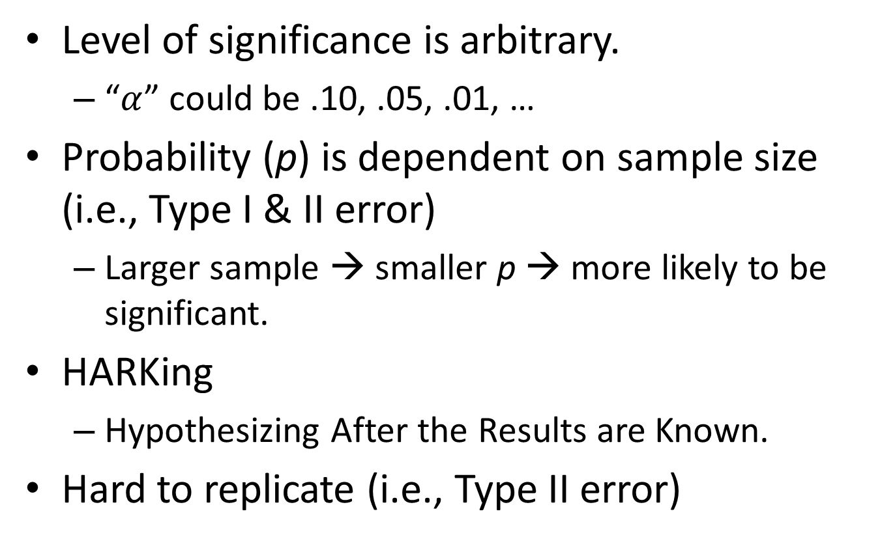
Caveats about NHST
Level of significance is arbitrary.
“$α$” could be .10, .05, .01, …
Probability (p) is dependent on sample size (i.e., Type I & II error)
Larger sample → smaller p → more likely to be significant.
HARKing
Hypothesizing After the Results are Known.
Hard to replicate (i.e., Type II error)

Slide 18
Alternatives to NHST
Statistical power
Effect size & confidence interval

Slide 19
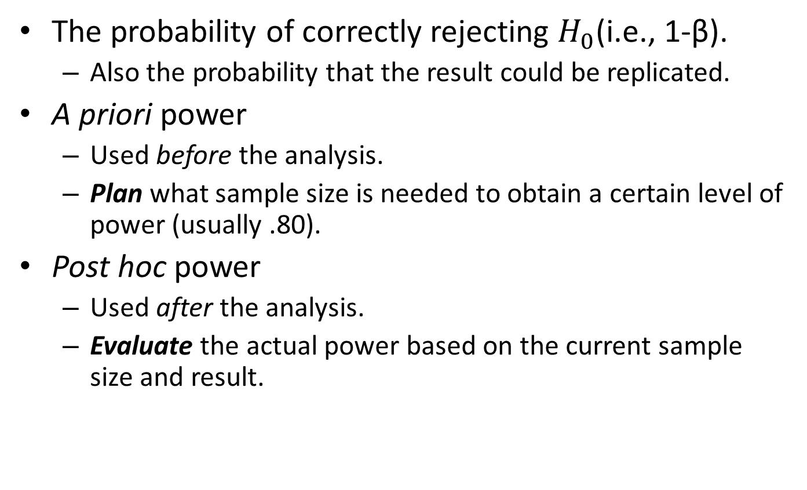
Statistical Power
The probability of correctly rejecting $H_{0}$(i.e., 1-β).
Also the probability that the result could be replicated.
A priori power
Used before the analysis.
Plan what sample size is needed to obtain a certain level of power (usually .80).
Post hoc power
Used after the analysis.
Evaluate the actual power based on the current sample size and result.

Slide 20

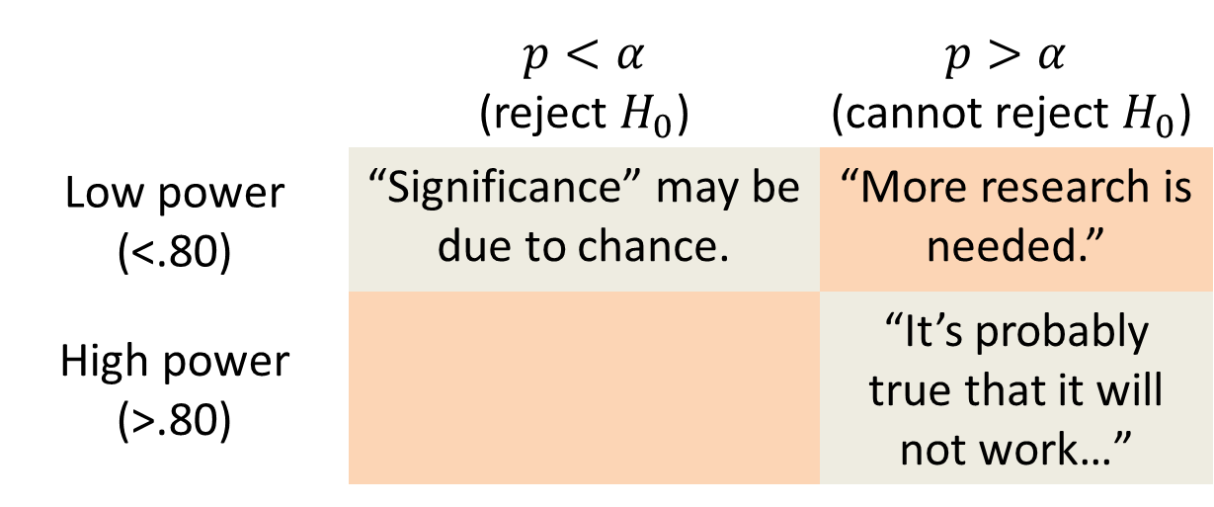
Statistical Power
Many journals now require to report statistical power in addition to the analyses.
 | $p<α$ (reject $H_{0}$) | $$p>α$$ $$\text{(}\text{cannot} \text{reject} H_{0}\text{)}$$
Low power (<.80) | “Significance” may be due to chance. | “More research is needed.”
High power (>.80) |  | “It’s probably true that it will not work…”

Slide 21
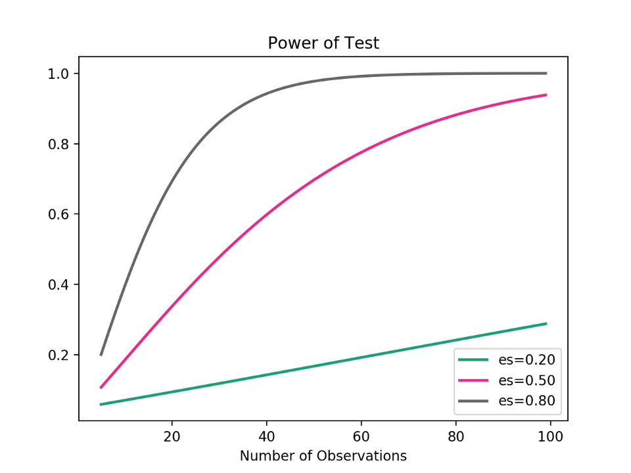
Caveats about Statistical Power
Sometimes you just cannot get enough power whatsoever.
It is still based on an NHST framework.
What if we just get rid of NHST altogether?

Slide 22
Effect Size & Confidence Interval
An alternative to NHST.
Effect size focuses on the magnitude of the effect, rather than its probability.
Confidence interval represents the effect size and the uncertainty surrounding that effect size.
95% Confidence Interval (95%CI)
Corresponds to α level of .05.
“There is 95% probability that the size of the effect will fall within this interval”.

Slide 23
An Illustrating Example
A light bulb company claims their product will last 3000 hours of use with a standard deviation of 150 hours.
Alex wanted to test this claim with the 5 bulbs he bought randomly. He found that on average the light bulbs lasted 2880 hours.
Do the sampled light bulbs demonstrate what the company claims about the product life?
Let’s redo the calculation using 95%CI.

Slide 24
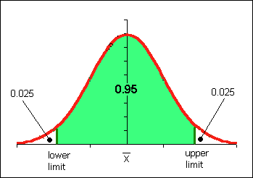
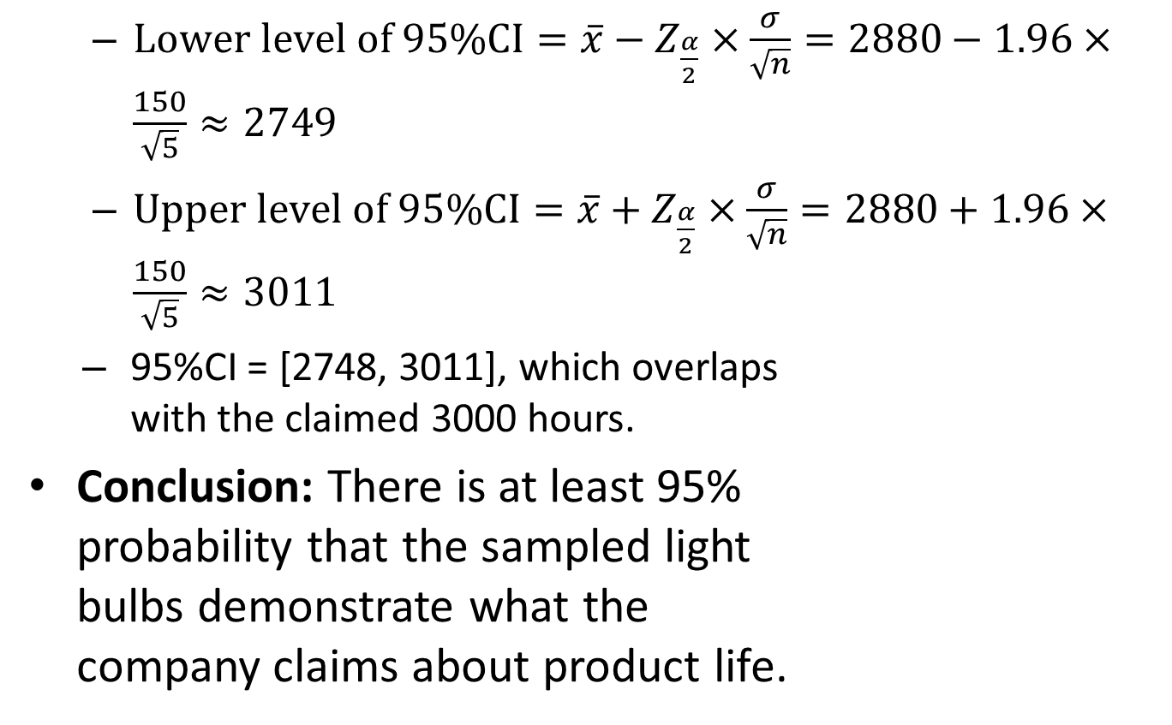
An Illustrating Example
$Lower level of 95\%CI=\overline{x}−Z_{\frac{α}{2}}×\frac{σ}{\sqrt{n}}=2880−1.96×\frac{150}{\sqrt{5}}≈2749$
$Upper level of 95\%CI=\overline{x}+Z_{\frac{α}{2}}×\frac{σ}{\sqrt{n}}=2880+1.96×\frac{150}{\sqrt{5}}≈3011$
95%CI = [2748, 3011], which overlaps with the claimed 3000 hours.
Conclusion: There is at least 95% probability that the sampled light bulbs demonstrate what the company claims about product life.

Slide 25
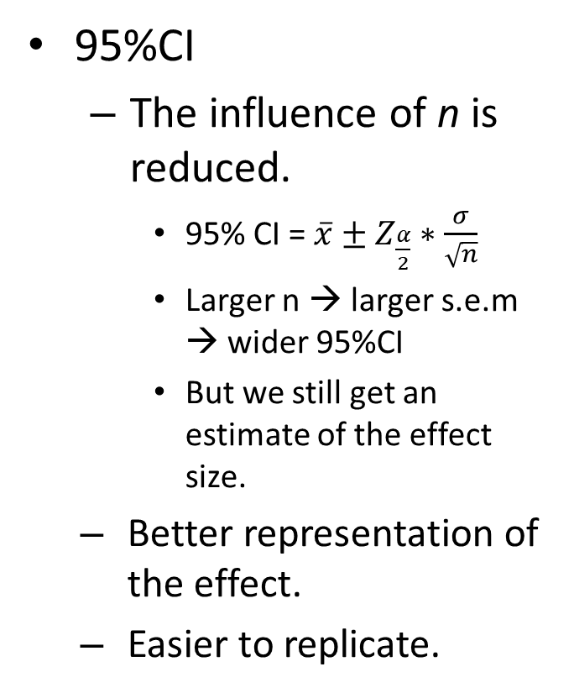
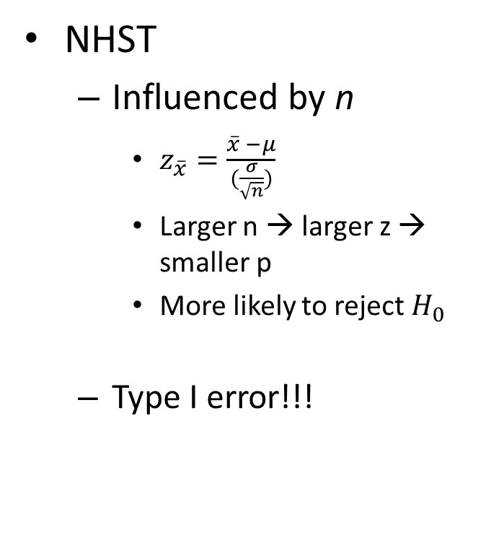
The benefit of 95% CI over NHST
NHST
Influenced by n
$z_{\overline{x}}=\frac{\overline{x} −μ}{(\frac{σ}{\sqrt{n}})}$
Larger n → larger z → smaller p
More likely to reject $H_{0}$
Type I error!!!
95%CI
The influence of n is reduced.
95% CI = $\overline{x}±Z_{\frac{α}{2}}∗\frac{σ}{\sqrt{n}}$
Larger n → larger s.e.m → wider 95%CI
But we still get an estimate of the effect size.
Better representation of the effect.
Easier to replicate.

Slide 26
Other Statistics
We just talked about how NHST and 95%CI can be applied to z-test.
They can also be applied to many other statistical tests.
T-test (coming up next)
ANOVA/MANOVA/ANCOVA etc.
Various types of regression
Structural equation modeling
Multi-level analysis
Etc. etc. etc…

Slide 27
T statistic

Slide 28
CONTENTS
01
t-statistics Intro
02
t-test for 2 individual samples
03
t-test for 2 related samples
Notes:
模板来自于 http://meihua.docer.com/

Slide 29
T-statistics Intro
Sometimes, we don’t have all the necessary information about the population.
E.g., we can’t get the sd of the population.
We need to use sample statistics to make inferences about the population.
Relies on Student’s t-distribution.

Slide 30
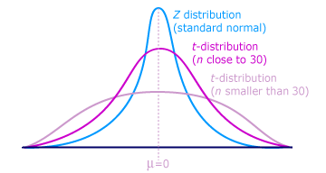

Student’s t-Distribution
Probability density function
$f\left(t\right)=\frac{Γ\left(\frac{v+1}{2}\right)}{ \sqrt{vπ}Γ\left(\frac{v}{2}\right)}{\left(1+\frac{t^{2}}{v}\right)}^{−\frac{v+1}{2}}$
Where v is the degrees of freedom (v=n-1) and $Γ$ is the gamma function.
The PDF of t-distribution is lower and wider than normal distribution.
As degrees of freedom grows, t-distribution approaches z-distribution.

Slide 31
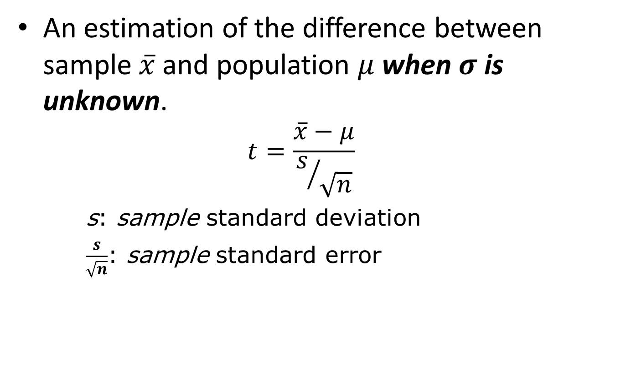
One-sample T-test
An estimation of the difference between sample $\overline{x}$ and population $μ$ when $σ$ is unknown.
$$t=\frac{\overline{x}−μ}{s/{\sqrt{n}}}$$
s: sample standard deviation
$\frac{s}{\sqrt{n}}$: sample standard error

Slide 32
An Illustrating Example
A researcher randomly sampled 30 graduates of an MBA program and recorded data concerning their starting salaries. The sample mean salary is $97,000 (s = 9500). It is known that the average salary for MBA graduates in the population is $108,000.
Is it true that the sampled MBA graduates have significantly lower average salaries than the population?

Slide 33
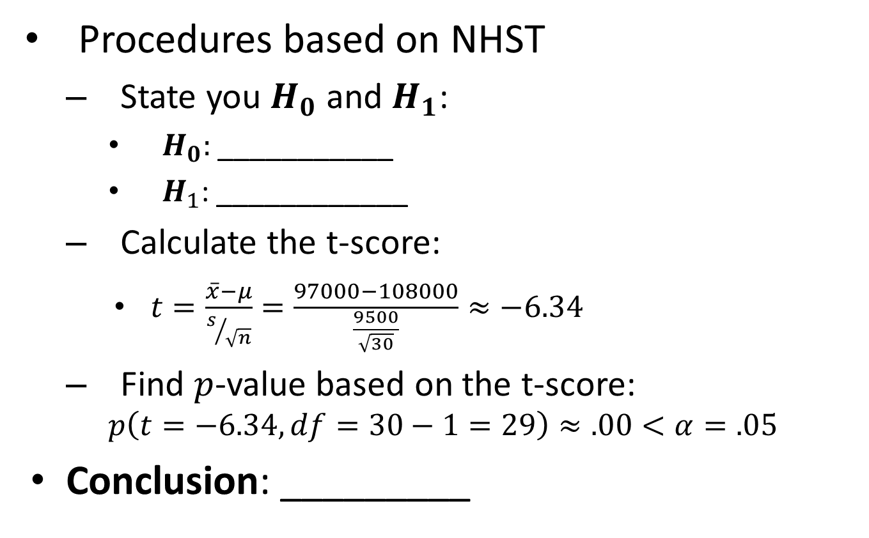
An Illustrating Example
Procedures based on NHST
State you $H_{0}$ and $H_{1}$:
$H_{0}:$___________
$H_{1}$: ____________
Calculate the t-score:
$t=\frac{\overline{x}−μ}{s/{\sqrt{n}}}=\frac{97000−108000}{\frac{9500}{\sqrt{30}}}≈−6.34$
Find $p$-value based on the t-score:
$$p\left(t=−6.34, df=30−1=29\right)≈.00<α=.05$$
Conclusion: _________

Slide 34
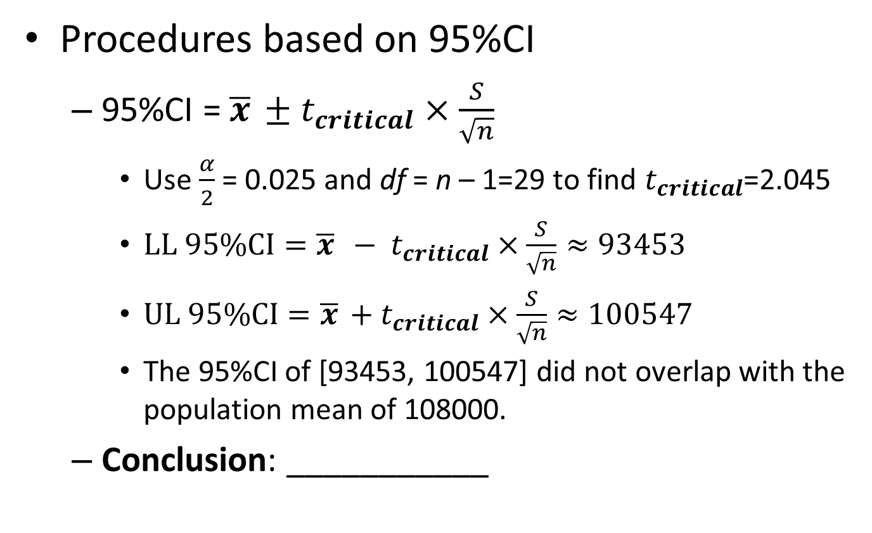
An Illustrating Example
Procedures based on 95%CI
95%CI = $\overline{x}$ $± t_{critical}×\frac{S}{\sqrt{n}}$
Use $\frac{α}{2}$ = 0.025 and df = n – 1=29 to find $t_{critical}$=2.045
$LL 95\%CI=\overline{x} − t_{critical}×\frac{S}{\sqrt{n}}≈93453$
$UL 95\%CI=\overline{x}$ $+ t_{critical}×\frac{S}{\sqrt{n}}≈100547$
The 95%CI of [93453, 100547] did not overlap with the population mean of 108000.
Conclusion: ___________

Slide 35
Two-sample T-test
An estimation of the difference between 2 samples.
When samples are independent
When samples are paired/related

Slide 36
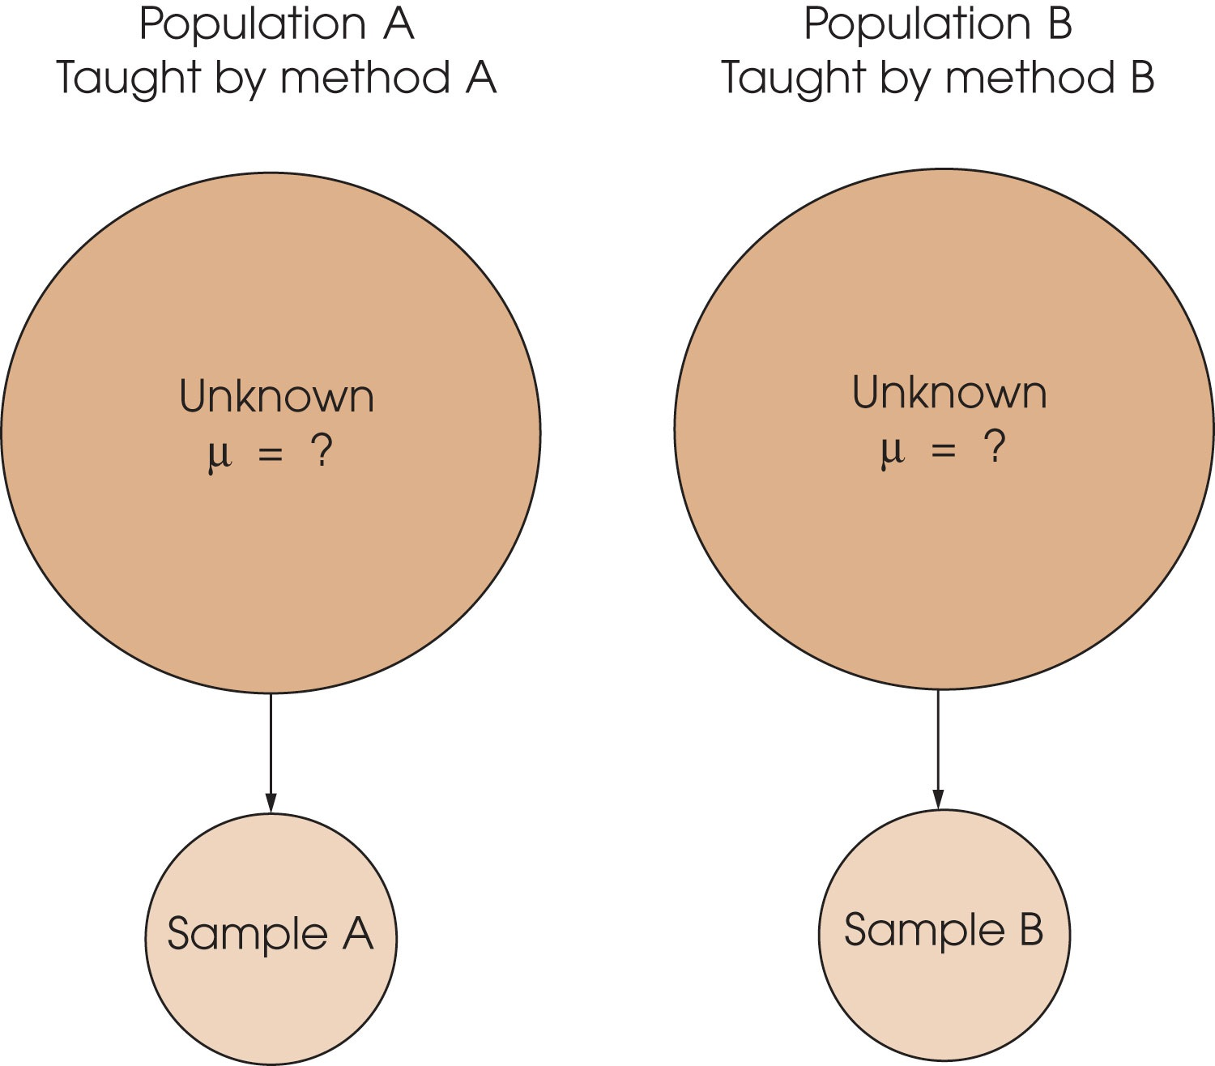
Independent-Samples Designs
Estimate the mean difference between two populations using data from 2 different samples

Slide 37
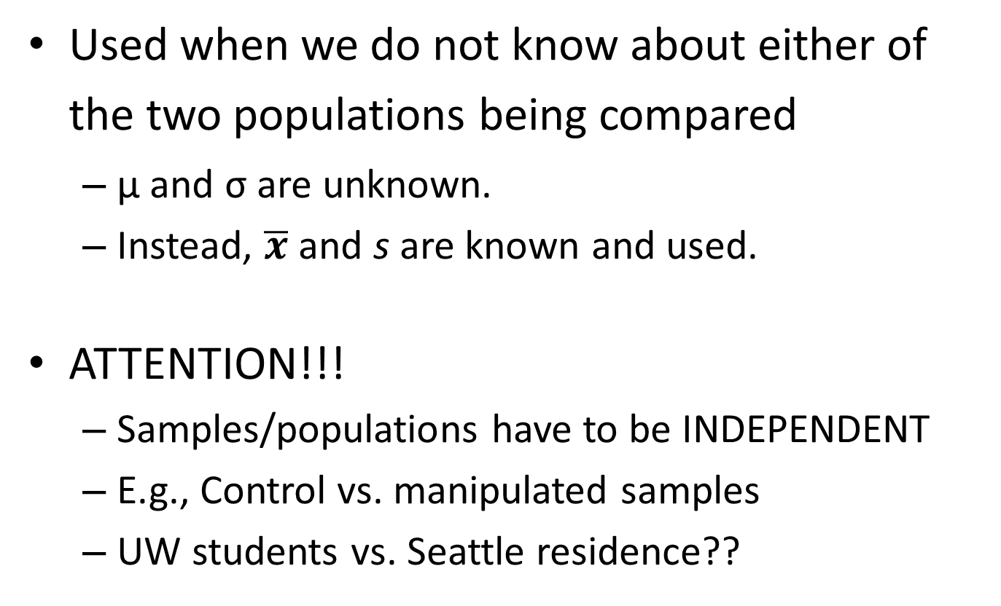
Independent-Samples Designs
Used when we do not know about either of the two populations being compared
μ and σ are unknown.
Instead, $\overline{x}$ and s are known and used.
ATTENTION!!!
Samples/populations have to be INDEPENDENT
E.g., Control vs. manipulated samples
UW students vs. Seattle residence??

Slide 38
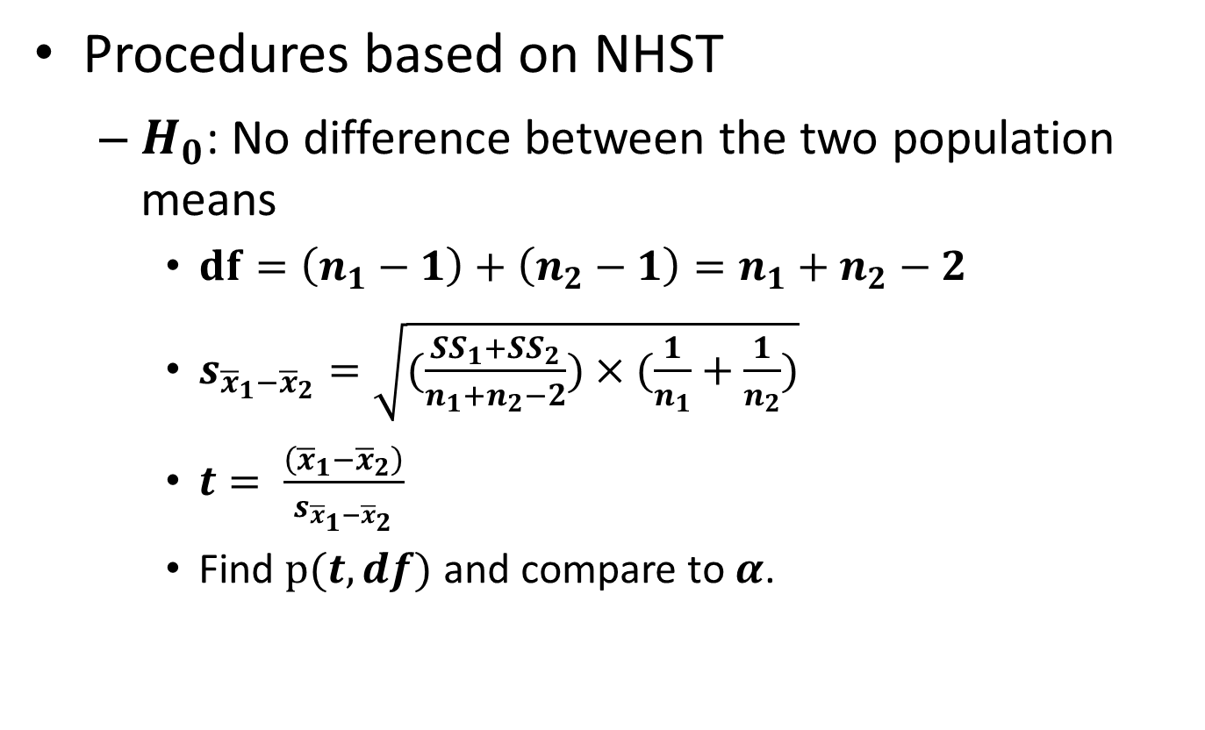
Independent-Samples t-test
Procedures based on NHST
$H_{0}$: No difference between the two population means
$df=\left(n_{1}−1\right)+$ $\left(n_{2}−1\right)=n_{1}+n_{2}−2$
$s_{{\overline{x}}_{1}−{\overline{x}}_{2}}=\sqrt{(\frac{{SS}_{1}+{SS}_{2}}{n_{1}+n_{2}−2})×(\frac{1}{n_{1}}+\frac{1}{n_{2}})}$
$t= \frac{\left({\overline{x}}_{1}−{\overline{x}}_{2}\right)}{s_{{\overline{x}}_{1}−{\overline{x}}_{2}}}$
Find $p(t, df)$ and compare to $α$.

Slide 39

Independent-Samples t-test
You can also use confidence interval to determine significance
95% CI = $\overline{x}$ $± t_{critical}×\frac{S}{\sqrt{n}}$
Use $\frac{α}{2}$ = 0.025 and df = $n_{1}+n_{2}−2$to find $t_{critical}$

Slide 40
Related-Samples Designs
Estimate the mean difference between two related groups
The data consist of two scores for the same group
E.g., A single group of students take SAT twice, do they have significantly different scores?
E.g., Do the patients’ health improve before and after the treatment?

Slide 41
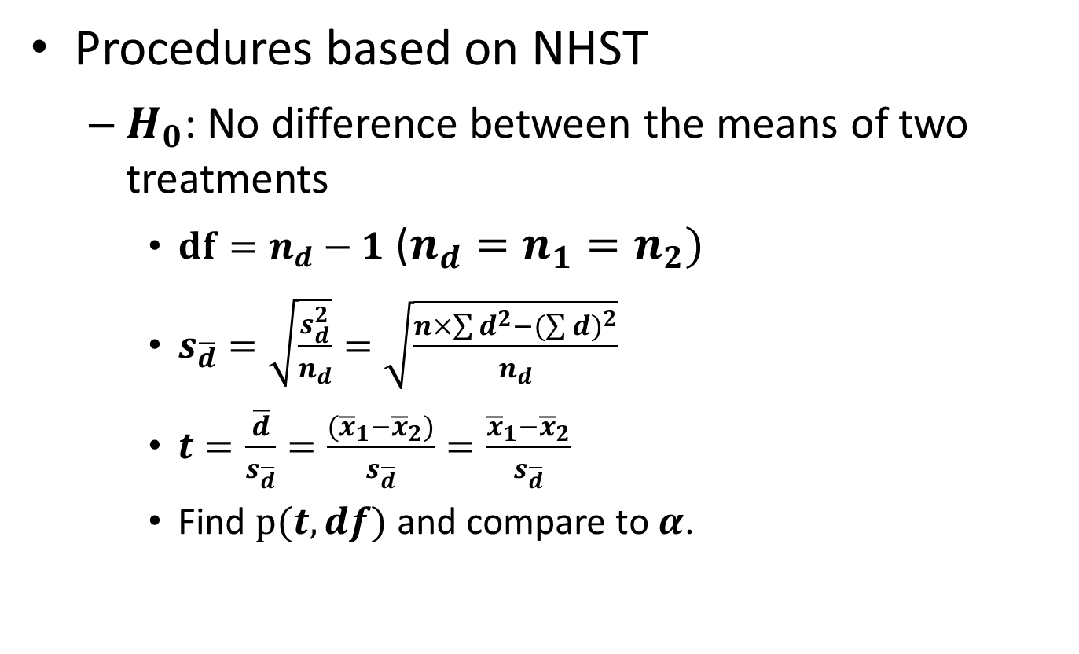
Related-Samples t-test
Procedures based on NHST
$H_{0}$: No difference between the means of two treatments
$df=n_{d}−1$ ($n_{d}=n_{1}=n_{2})$
$s_{\overline{d}}=\sqrt{\frac{s_{d}^{2}}{n_{d}}}=\sqrt{\frac{n×\sum{d^{2}}−{(\sum{d})}^{2}}{n_{d}}}$
$t=\frac{\overline{d}}{s_{\overline{d}}}=\frac{({\overline{x}}_{1}−{\overline{x}}_{2})}{s_{\overline{d}}}=\frac{{\overline{x}}_{1}−{\overline{x}}_{2}}{s_{\overline{d}}}$
Find $p(t, df)$ and compare to $α$.

Slide 42
Now put them together…
Think about different types of t-tests we’ve learned so far…
Sample vs. population
Known sample mean & SD, population mean
Two independent samples
Known sample means & SDs
Two paired/related samples
Repeated tests
Known sample means & SD of the difference between tests.

