Slide 1
Data Science Methods for Clean Energy Research
Feb 28, 2019

Slide 2
Outline
Cross validation
Bootstrap (HW4)
Wrap up

Slide 3
Resampling methods (CH5, ISL)
How to assess a model without big test set
Resampling concept
Doing more with your data
Repeatedly drawing samples from a training set and refitting a model for each sample
Obtain additional information about the fitted model
Trade computational expense for data

Slide 4
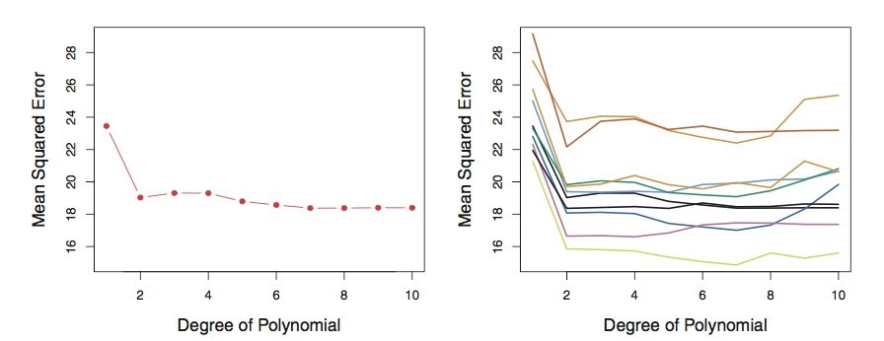

Test-train split, hold-out set, validation-set
Suppose you have one set of data and you have to decide how to break it into pieces for training and validation
Simplest approach is the “validation set” , just break it into two pieces
Example (Fig 5.2) looking at MSE as a function of d
$$\hat{y}=\hat{β_{0}}+\hat{β_{1}}x+\hat{β_{2}}x^{2}+…+\hat{β_{d}}x^{d}$$
Left: validation set MSE vs n for one data set
Right: validation set MSE vs n for 10 different random splits
Notes:
Mean squared error as a function of degree of polynomial.

Slide 5
Validation set approach
Riddle me this, how many ways are there to choose two 500 data sets from 1000?
Since you only use a portion of your data in the training, the ”validation set” approach will tend to perform worse (i.e., overestimate your test error rate)!
Left: training MSE vs n for one data set
Right: training MSE vs n for 10 validation sets

Slide 6
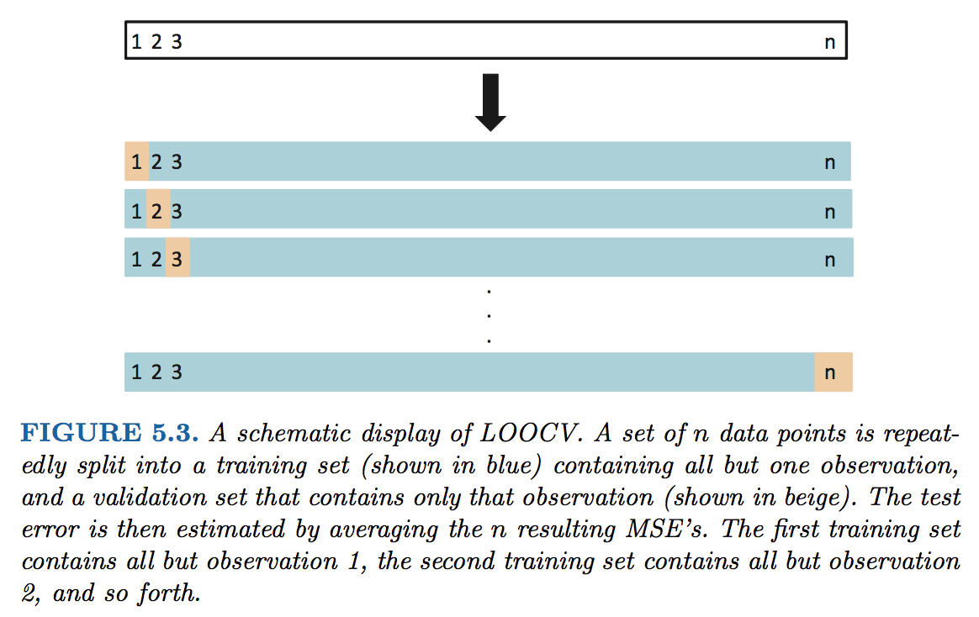
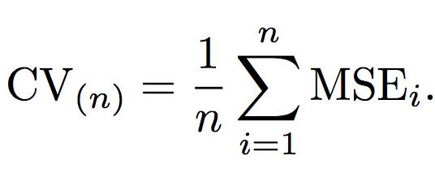
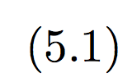





Cross Validation (LOOCV)
Leave One Out Cross Validation (LOOCV) approach
$$MSE_{i}={\left(y_{i}−\hat{y_{i}}\right)}^{2}$$
$$MSE_{1}$$
$$MSE_{2}$$
$$MSE_{3}$$
$$MSE_{n}$$

Slide 7
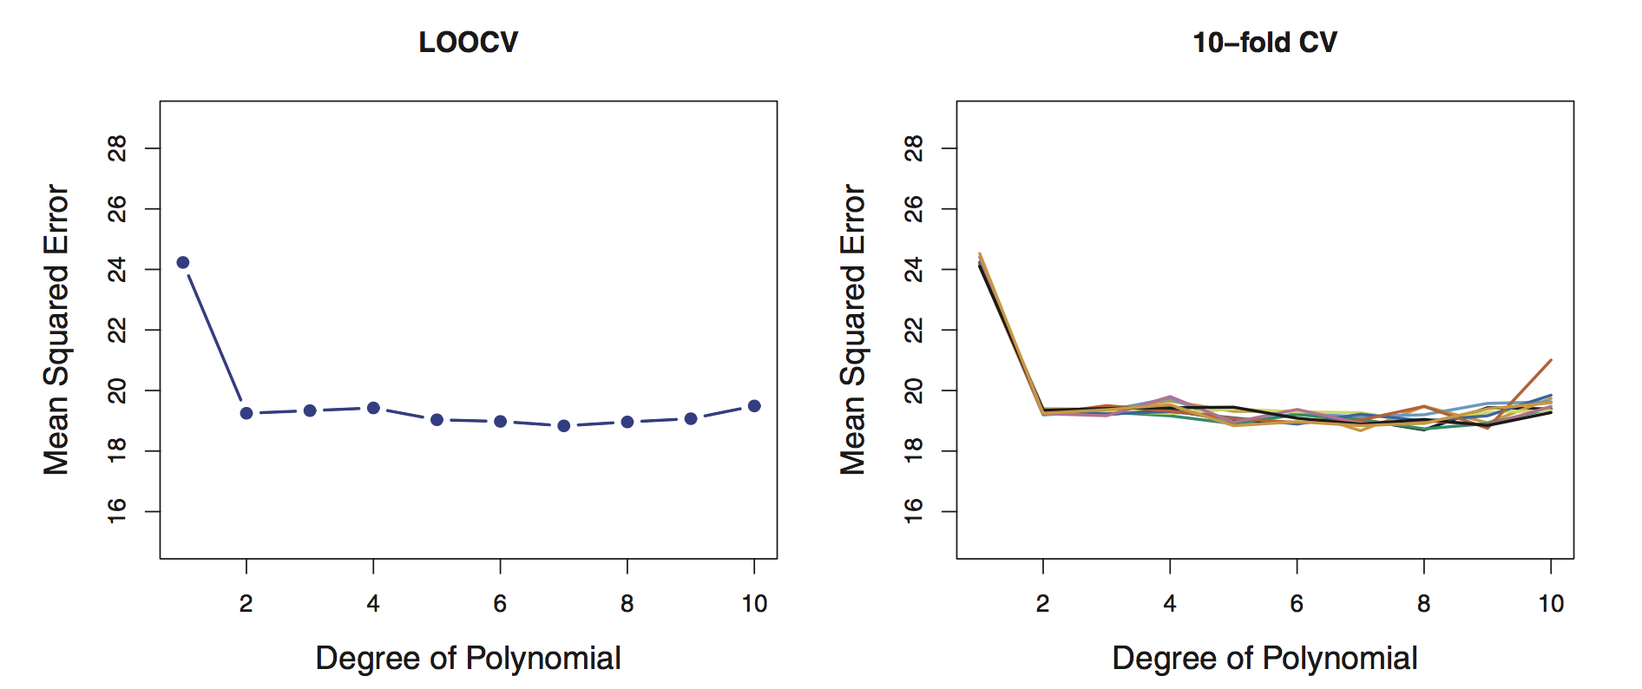
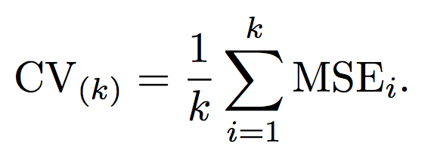

Cross Validation (k-fold)
LOOCV is way more accurate, but more computationally expensive -> (train n models)!
An alternate is to break and group the data into larger pieces.
We break it into “k” folds of data, e.g. 5-fold. The 1st set is saved for validation, remaining k-1 sets are used for training. -> (train k models)!

Slide 8
Bias/variance tradeoff: use 5 or 10 folds
Bias
an error from erroneous assumptions in the learning algorithm. High bias can cause an algorithm to miss the relevant relations between features and target outputs (underfitting).
Variance
an error from sensitivity to small fluctuations in the training set. High variance can cause an algorithm to model the random noise in the training data, rather than the intended outputs (overfitting).
Bias variance tradeoff relates the simplification of a model to avoid overfitting to the complexity of a model to avoid underfitting.

Slide 9
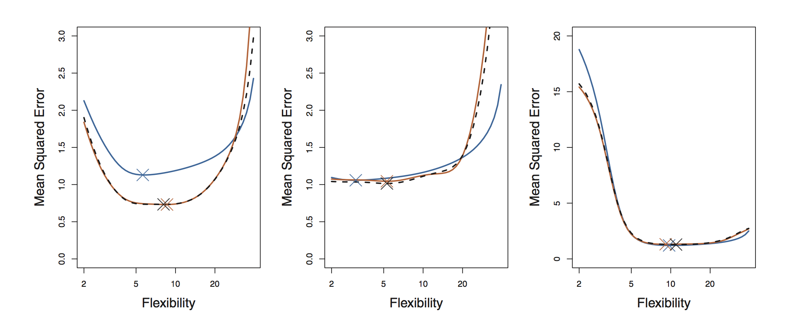
Bias/variance tradeoff: use 5 or 10 folds
Empirically people usually use 5 or 10 folds to avoid too much bias or variance in their resampling algorithm
This is a great way to get a true estimate of your model’s MSE
CV does not yield a new estimate, but evaluates the model itself
Fig 5.6 revisits Fig 2.9 in the context of k-fold cross validation

Slide 10
Bootstrap
The bootstrap is one of the most versatile tools you will use in statistical analysis of data sets
It involves resampling with replacement from your data set
Algorithm:
Randomly draw n data points, with replacement, from your training data set (size = n).
Train your model and calculate coefficients/parameters
Repeat sampling many times (usually 1000), and calculate the variance of your coefficients

Slide 11
Bootstrap
Estimate variance and confidence intervals of
Your predictions
Your coefficients
Your …
But why?
We already can get 95% CI of coeffecients
In SLR, sure, but with more complex or non-linear models harder.

Slide 12
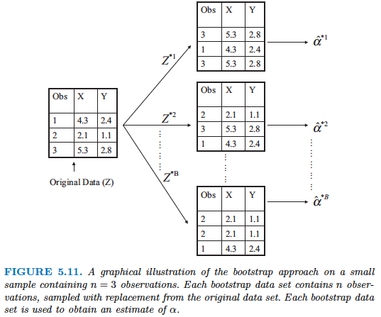
Bootstrap

Slide 13
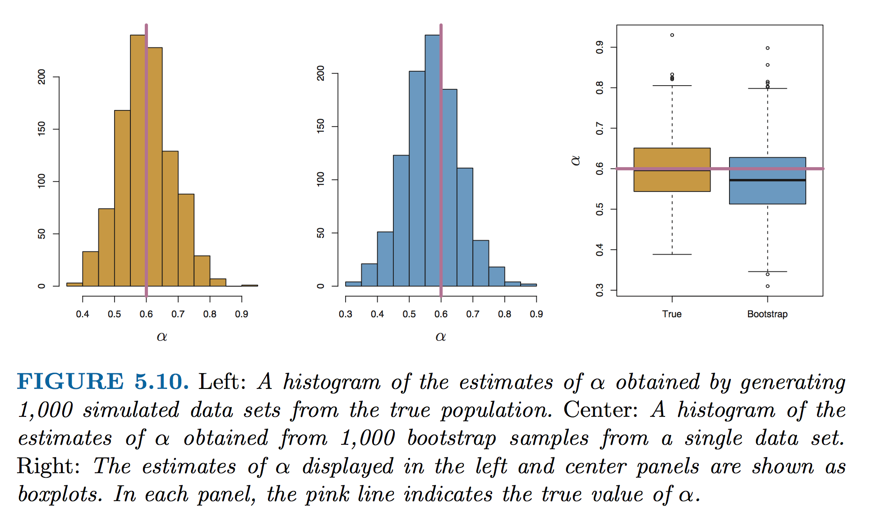
The power of the bootstrap in one figure
Fig 5.10, estimates of some parameter, α

Slide 14
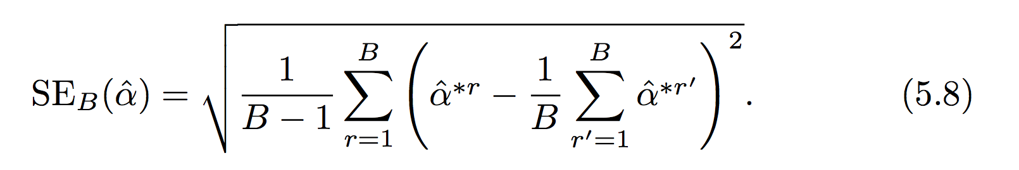
Take care
Depending on how large your bootstrap sample data set is, I recommend you avoid using the standard error formula (Eq 5.8) and instead you should use simply the standard deviation of the bootstrap estimates.
Can anyone explain why?
In this context α, could be any quantity from your training procedure (MSE, β, etc..)

Slide 15
Wrap up
Bootstrapping and cross-validation are near-universal in their applicability…
Let’s work on the Jupyter notebook

