Slide 1
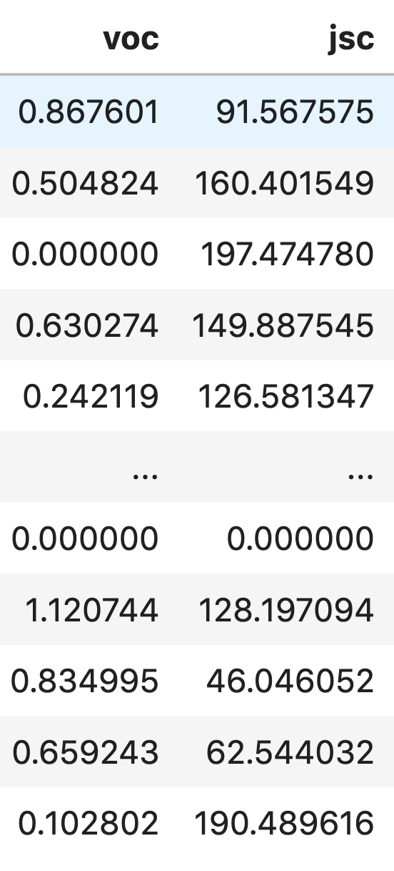

Slide 2



Types of Data:
Nominal (labels or categories)
Ordinal (ordered labels)
Quantitative (continuous)
F, D, C-, C, C+, B-, B, B+, A-, A
0

Slide 3
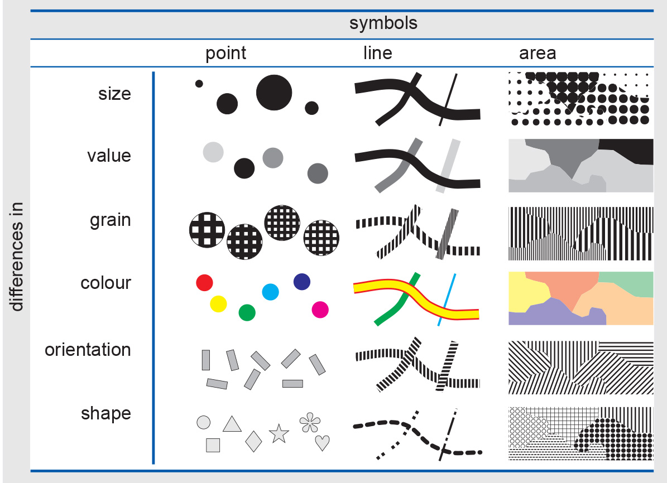
Types of Encoding:

Slide 4


Expressiveness: how much information can we convey
Effectiveness: how easy is the information to digest

Slide 5
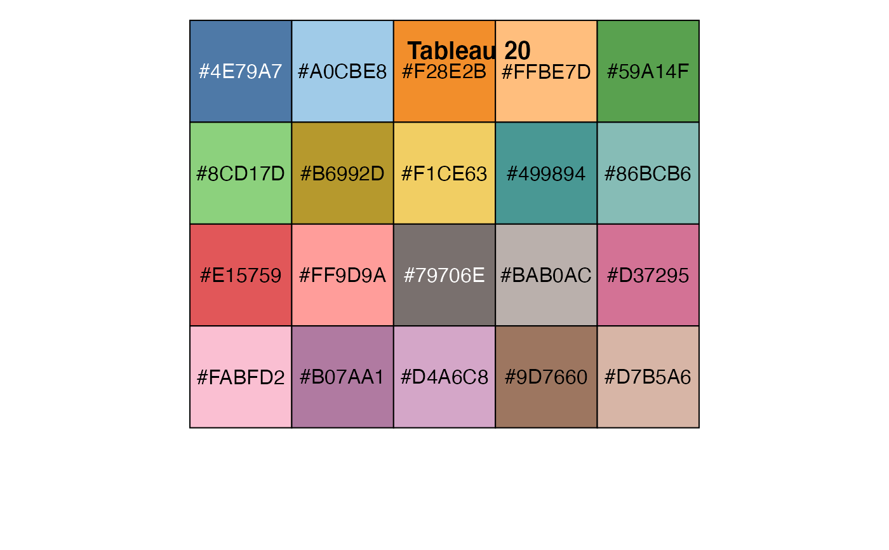

Slide 6
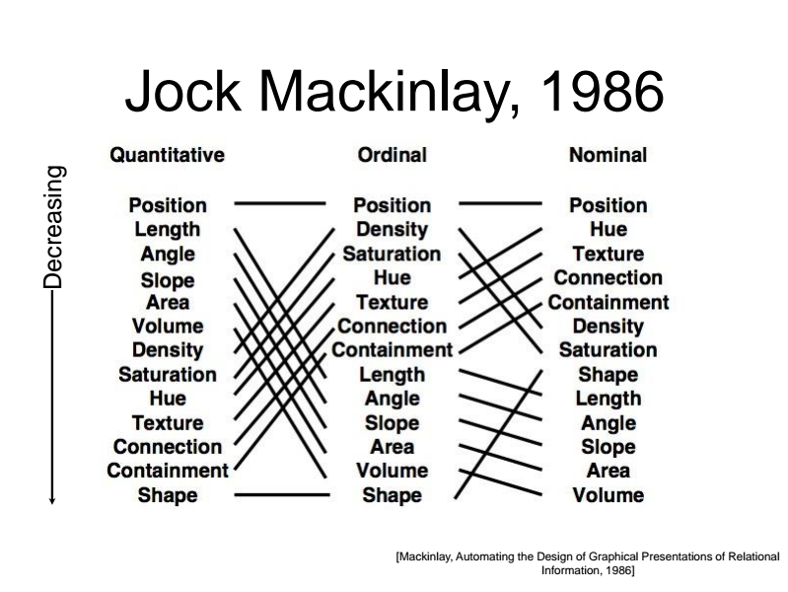

Slide 7
