Slide 1



Data Science Methods for Clean Energy Research (DSMCER) & Software Engineering for (SEMDS) Molecular Data Scientists
Knowledge and solutions for a changing world
Advancing data-intensive discovery in all fields
Be boundless
UW DIRECT
(Data Intensive Research Enabling Cutting-edge Tech)
https://uwdirect.github.io
Stéphanie Valleau
Chemical Engineering
Dave Beck (dacb)
eScience/Chemical Engineering
Notes:
In the SEDS portion of the class, we mostly focus on structure rather than content: knowing how to interact with the Shell, getting familiar with Github tools, etc. But in the DSMCER lectures, we’re going to focus more on content: on solving particular problems with the tools we learn about in SEDS. Know, the DSMCER material is also a set of tools that can be applied to a wide set of problems: and we aren’t going to get too mired down in any one domain science. But there is a difference.
Let me tell you about my experience with data science. I came to the University of Washington with absolutely no idea what “data science” meant. I had a little MatLab coding experience, but I found any type of computational work outright intimidating. So maybe a lot like you. And when I got started with programming, I was a little impatient with all this SEDS stuff. All this git add, git commit, git pull– it added nothing of value to my immediate problem! It didn’t help me analyze my data, etc. It only came over time working in the eScience Institute with data scientists that I began to see its value. So don’t give up yet.
Today, we’re going to focus on a subset of problems within data science, what we’re referring to as data visualization. So making pretty graphs. Kind of a fun one right?
By the end of today, I want you to feel comfortable using a few basic tools within three Python packages (Pandas, Matplotlib, and Seaborn) that can help you make some simple graphs.
I was you to feel comfortable accessing reference materials online to do more complex operations to make your graphs even prettier.
And I want to give you a few guiding principles when designing figures, plots, and graphs.
And ultimately, I want to convince you that you can and should try making your plots with Python instead of alternatives such as Excel or more sophisticated programs like GraphPad.

Slide 2
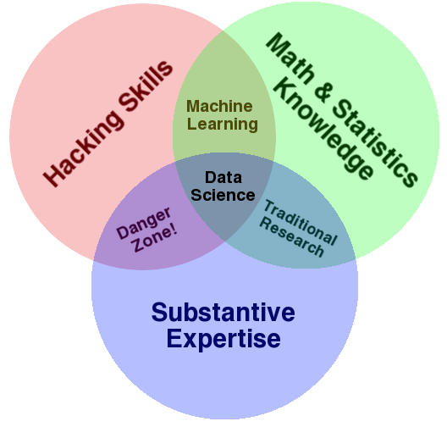
What is Data Science?
Software Engineering
DSMCER
http://www.forbes.com/sites/gilpress/2013/05/28/a-very-short-history-of-data-science

Slide 3
What is Software Engineering?
Engineering principles
Design
Development
Implementation
Testing
Maintenance
Documentation
Engineering vs. Programming
Solo vs. group? Programming is implementation?

Slide 4
What this class isn’t
A grad level CSE Software Engineering (SE) class
Full of SE theory
(Yes, there is theory in SE)
Assuming you have a lot of background in software development in Python
Boring!

Slide 5
What this class is!
Experience in creating reusable software artifacts for science, engineering & industry
Experience doing collaborative software development using real world tools
Elevates software engineering to the level of an engineering skill like technical writing, process engineering, etc.
Elevates software to a first class research product like publications, patents, and data

Slide 6
What you will learn
Python
Scientific software stack (AKA ecosystem)
numpy, pandas, matplotlib, …
Search, evaluate and integrate into your code externally developed packages
How to create your own Python packages
How to find help when you are stuck
scikit-learn
pandas
A software stack
numpy
Python
operating system

Slide 7
What you will learn
How to develop unit tests to validate your code
How to write software that can be read by people and machines
How to develop software that can be used by others, including
Open source code sharing on GitHub
Licensing guidelines
Documentation
Installation and setup tools

Slide 8
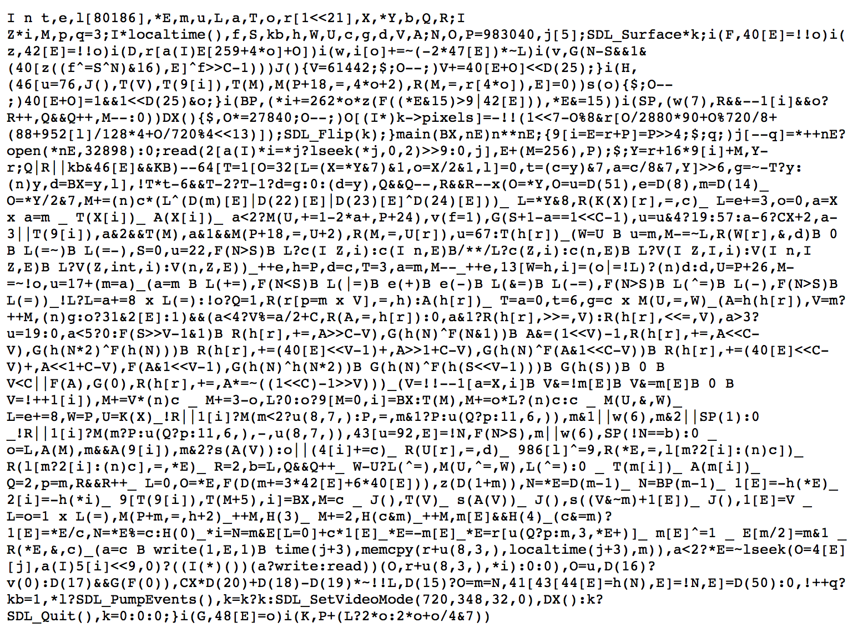
Software engineering
Your code should not look like this:

Slide 9
What you will learn
How to use version control to track code development

Slide 10
What you will learn
How to use functions
Avoid duplicated code
Codify repeated operations
How to write code in style
How to create technical specifications for what a piece of software will do
How to code effectively in teams
How to communicate about code

Slide 11
Course structure
Coding basics in Python (~2 weeks)
Command line interaction
Jupyter notebooks (formerly known as iPython)
Version control
Practical Software Engineering (~3 weeks)
Debugging and unit tests
Documentation
Programming style
Technical design and specifications

Slide 12
Course structure
Coding in teams (~1 week)
The role of version control
Technology reviews
Standups
Group based project work (remainder)
https://github.com/nicolet5/chachies
https://github.com/Luochenghuang/TEMANN
https://github.com/chennnnnyize/Generative-Molecules
https://github.com/awild82/SSPINN

Slide 13
On to content!

Slide 14
File system basics
File – container of data
Directory – container of files and directories
Directories are organized into a tree
Directory (AKA dir)
Sub-directory
Data
README
File
HCEPDB.csv
File

Slide 15
GUI vs. Command line
Graphical User Interface (GUI)
Command Line Interface (CLI)

Slide 16
Why pointy clicky bad
How do you preserve a record of your actions?
Using the command line you get history
You can collect your commands into a ‘script’ that can be reused to exactly duplicate your procedure

Slide 17
Command line tools
What is the command line?
Also known as a ‘shell’
Most common shell is bash (what we will use)
Bourne Again Shell
Reimplementation of a shell from 1977
Every OS/X Mac
Every Linux box in the world
Every supercomputer
’Programming’ language itself
‘scripting’ language
Ken Thompson

Slide 18
Command line tools
Where is the command line?
Mac (pre-installed)
Applications -> Utilities -> Terminal
Windows (after install Git / Bash)
Start -> Git -> Git Bash
Give it a go! Open a shell window.

Slide 19
Command line tools
Commands take ‘arguments’
Stuff after the command name
Arguments alter the function of the command
E.g. specify what file to use as input or output
Many commands accept the special argument to return help, usually one of
--help
-help
-h
-omghelpmeImlost

Slide 20
Command line tips and tricks
Tab completion is your friend
When entering a file arguments
When entering directory pathes
Hitting tab will autocomplete the filename!
I will pester you about this

Slide 21
Commands for files & dirs
By category
Create
Directory: mkdir
File: various (e.g., cp, touch)
View contents
Directory: ls
File: cat
Remove
Directory: rmdir
File: rm

Slide 22
Quick review from Tue
What do the following commands do?
ls
mkdir
cp
rm
touch
cat
rmdir
cat
more / less

Slide 23
Web from the command line?
Can we interact with the web from the CLI?
YES!
curl
Stands for “Copy URL”
URL = uniform resource locator
E.g. http://, https://, file://, ftp://, …
Let’s play with curl!

Slide 24
Data!
Harvard Clean Energy Project: http://faculty.washington.edu/dacb/HCEPDB_moldata.zip
DO NOT REDISTRIBUTE!
DO NOT USE THIS DATA IN YOUR RESEARCH WITHOUT CREDITING
HARVARD CLEAN ENERGY POJECT
Variable / column | Data type | Units / description | Example
id | integer | CEPD id code | 655365
SMILES_str | string | SMILES | C1C=CC=C1c1cc2
stoich_str | string | stoichiometry | C18H9N3OSSe
mass | float | AMU | 394.3151
pce | float | power conv. effec. | 5.16195320211971
voc | float | open circ. voltage | 0.86760078740294
jsc | float | short circ. density | 91.5675749599
e_homo_alpha | float | high occ. mol. orb. | -5.46760078740294
e_gap_alpha | float | LUMO-HOMO | 2.02294443593306
e_lumo_alpha | float | low occ. mol. orb. | -3.444656351469
tmp_smiles_str | string | SMILES | C1C=CC=C1c1cc2

Slide 25
Data schema
“metadata” or schema
Data types
Units
“keys” (unique identifiers for molecules)

Slide 26
Demo
Navigate to a location
Create a project directory
Create a README
Download the HCEP data
Unpack the data
Look at the data
Automate the workflow

Slide 27
Useful shell commands
Command | Task | Example usage
ls | List files | ls
cp | Copy files | cp original_file new_file
mv | Move / rename files | mv original_file new_file
rm | Remove / delete files | rm original_file
cd | Change directory | cd some_directory
pwd | Print working / current directory | pwd
mkdir | Create directory | mkdir some_directory
rmdir | Remove / delete directory | rmdir some_directory
cat | View files | cat some_file
head | View begining of file | head some_file
tail | View end of file | tail some_file
grep | Search file for matching lines | grep search.text some_file
sort | Sort lines | sort some_file
uniq | Print unique lines | uniq some_file
diff | Compare to files | diff original_file new_file
unzip | Uncompress a file | unzip compressed_file.zip
curl | Download a file using its URL | curl some URL
Also see http://www.pixelbeat.org/cmdline.html or google ‘shell + command name’

