Slide 1
Data Science Methods for Clean Energy Research
Feb 11, 2019
Notes:
Linear regression is our starting point for more advanced methods.
Slight difference to what you’re used to though.
In normal descriptive statistics, we use regression parameters to describe our data.
In data science, we perform regression in a training dataset to make predictions on another dataset.

Slide 2
Outline
Regression
Simple linear regression
The model
The training
The error
In the coefficients
In the model
Making predictions with the model
Multiple regression

Slide 3
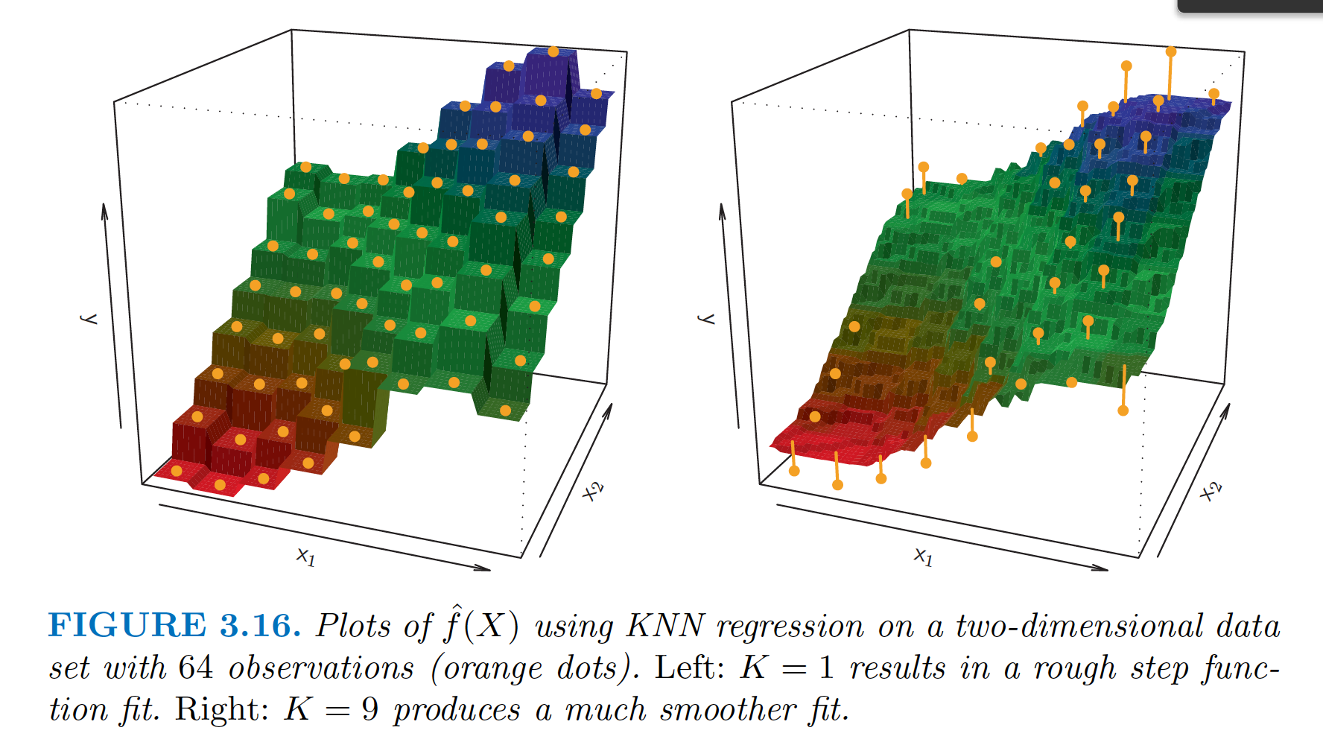
Regression
Notes:
We talked about KNN for classification problems, but what does that mean when you use it in a regression setting?
Here’s an example.
Think of it as a moving average.

Slide 4
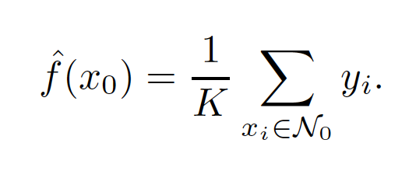
Regression with KNN
How would you do it?

Slide 5


Simple linear regression (SLR)
The regression framework (generic in supervised machine learning)
Propose a model
Define the error metric
Estimate the coefficients and assess the estimate
Determine the error in the model
$$Y=β_{0}+β_{1}X$$
The humble SLR
Distinguishing the estimates we make with the training data (hat) from the proposed actual coefficients/responses…
$$\hat{y}=\hat{f}\left(x\right)={\hat{β}}_{0}+{\hat{β}}_{1}x$$
Notes:
Regression problems have quantitative outputs.

Slide 6
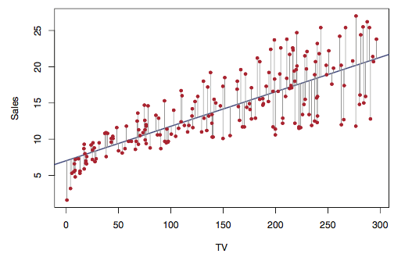
Simple linear regression (SLR)
Residuals
The difference between the observed value of the dependent variable (y) and the predicted value (ŷ) is called the residual (e).
Top: Fig 3.1 ISL

Slide 7
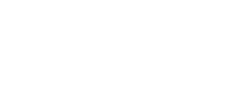

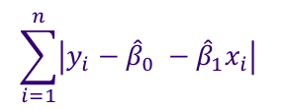
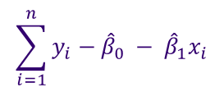
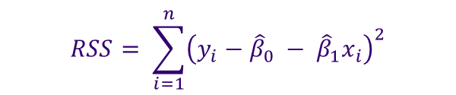
Once the SLR model is known, what is the error?
RSS: residual sum of squares
What about these?
$$RSS= \sum_{i=1}^{n}{{\left(y_{i}−{\hat{β}}_{0} − {\hat{β}}_{1}x_{i}\right)}^{2}}$$
$$\sum_{i=1}^{n}{y_{i}−{\hat{β}}_{0} − {\hat{β}}_{1}x_{i}}$$
$$\max_{N}\left|y_{i}−{\hat{β}}_{0} − {\hat{β}}_{1}x_{i}\right|$$
$$\sum_{i=1}^{n}{\left|y_{i}−{\hat{β}}_{0} −{\hat{β}}_{1}x_{i}\right| }$$
Top: Fig 3.1 ISL
Right: Figure 17.2 from Chapra and Canale numerical methods for Engineers

Slide 8

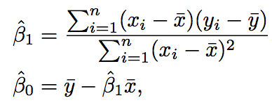


The method of “least squares” minimization
Given our model and some training data, we need to determine what values of our parameters $\hat{β}i$ minimize the error.
This is accomplished by determining $\frac{∂RSS}{∂{\hat{β}}_{0}}$ and $\frac{∂RSS}{∂{\hat{β}}_{1}}$ setting equal to zero and solving:
Notes:
Because the RSS is differentiable in the case of SLR, we can take the derivative.

Slide 9
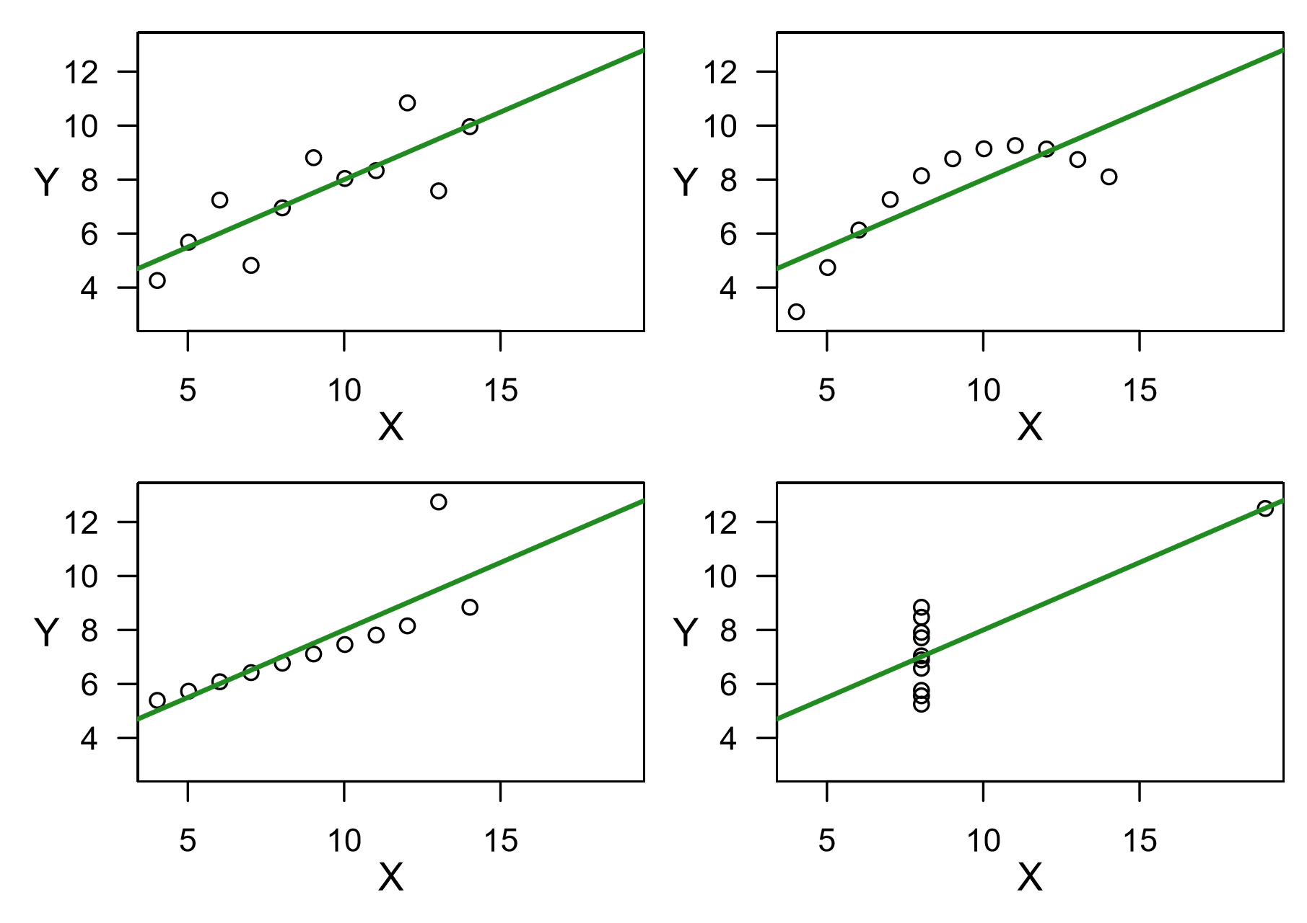
A warning: not all regressions are equivalent
All the summary lines have intercept=3.0, slope=0.5
Adapted from K. Rice (2017)

Slide 10
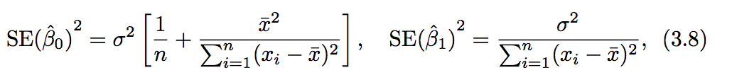
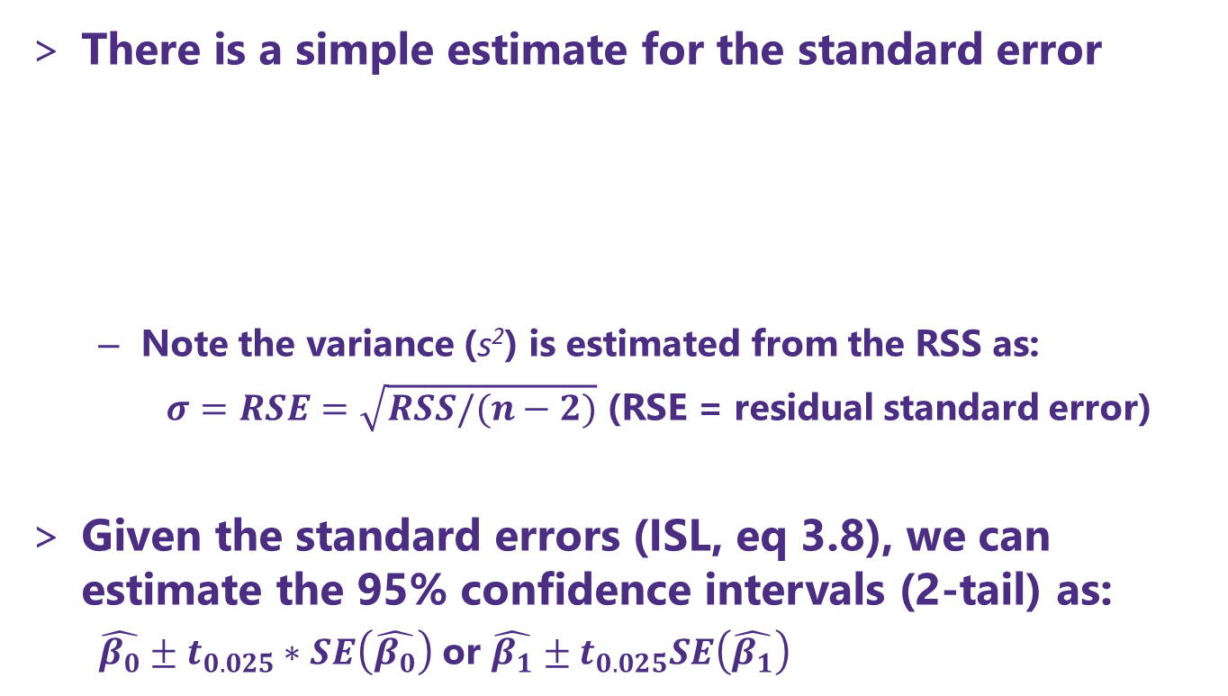
Ways to estimate the uncertainty in the coefficients
There is a simple estimate for the standard error
Note the variance (s²) is estimated from the RSS as:
$σ=RSE=\sqrt{RSS/(n−2)}$ (RSE = residual standard error)
Given the standard errors (ISL, eq 3.8), we can estimate the 95% confidence intervals (2-tail) as:
$\hat{β_{0}}±t_{0.025}∗SE\left(\hat{β_{0}}\right)$ or $\hat{β_{1}}±t_{0.025}SE\left(\hat{β_{1}}\right)$
For $SE({\hat{β}}_{0})$ This is similar to the central limit theorem at $\overline{x}=0$
Notes:
The SE for the slope is smaller when the data are more spread out along x axis
The SE for the intercept is the same as that of the mean if mean(x) is 0.

Slide 11

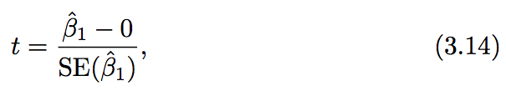


Hypothesis testing on the coefficients
Once we have our estimated coefficient values we test the hypothesis
If this hypothesis true, then our model is simply: $y=β_{0}+ε$ ,i.e., there is no correlation between x and y!
Recall: $t=\frac{\overline{x}−μ}{\text{sample} \text{standard} \text{error}}$

Slide 12
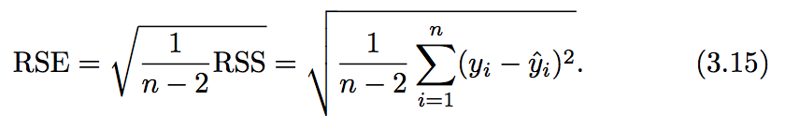
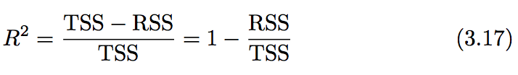

Accuracy of the model – how are we doing overall?
Residual standard error
A measure of the lack of fit of your model (in units of Y!)
R² statistic
A scale invariant measure (0-1 range) that explains ”the proportion of the variability of Y that is explained by X”
TSS (total sum of squares) measures the total variance in the response Y, and can be squares thought of as the amount of inherent variability.

Slide 13
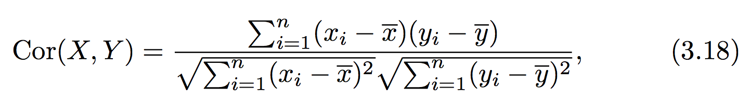
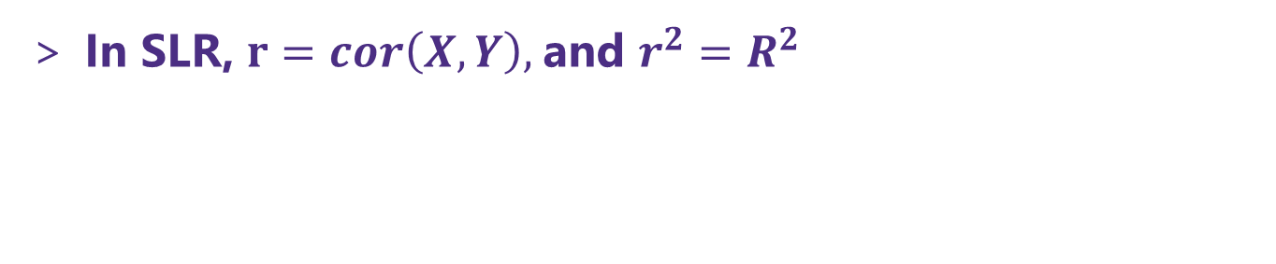
The correlation
(we will need this in multiple regression)
Recall the basic descriptor – correlation coefficient or simply correlation, which we use to describe trends in our data and relationship between variables
In SLR, $r=cor\left(X,Y\right),$and $r^{2}=R^{2}$

Slide 14
Quick example of SLR and P-value calculation with scikit-learn
Grab the notebook for today and practice some SLR

