Slide 1
Statistical learning:
Given a vector of inputs X, and an output quantity y, a function exists such that
Random error (mean 0, effects on y not capture by X)
Unknown function

Slide 2

Features: X
$
Labels: y
$$$
Some ML Model
...
Example
Parameters:
Are the model
Do the math
Hyperparameters:
Format of model
Dictate the final parameters

Slide 3



Architecture
Hyperparameters: choices we make
Feature Engineering
Parameters: learned through training

Slide 4
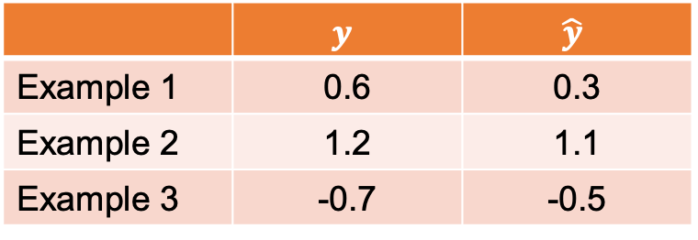
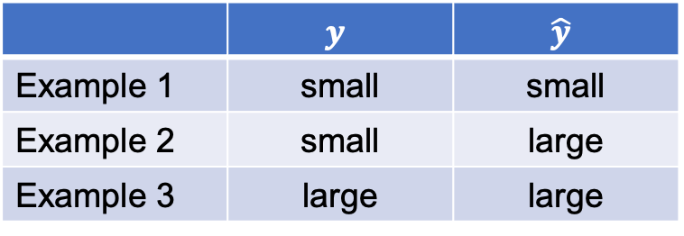
Nominal Labels:
Classification
Quantitative Labels:
Regression
 | $$y$$ | $$\hat{y}$$
Example 1 | small | small
Example 2 | small | large
Example 3 | large | large
 | $$y$$ | $$\hat{y}$$
Example 1 | 0.6 | 0.3
Example 2 | 1.2 | 1.1
Example 3 | -0.7 | -0.5
Accuracy on this data: 66%
Mean Absolute Error on this data: 0.2

Slide 5
Features:
QAF used
HBD used
Molar ratio
$
Labels: is the sample solid?
$$$
Some ML Model

Slide 6
Test set:
Use to evaluate and communicate performance
Development (dev) set:
Use for training and optimizing model

Slide 7
Training distro
Test distro
Model is unfamiliar with mixtures with high mol fraction. Not a fair test.
0.0
1.0
Mol fraction QAS

Slide 8
?
A
B
?
?

Slide 10
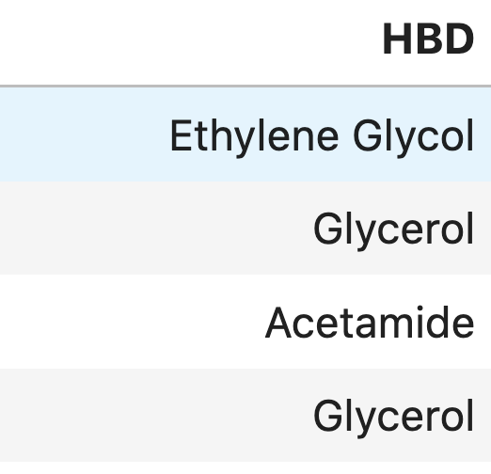
Is Ethylene Glycol | Is Glycerol | Is Acetamide
1 | 0 | 0
0 | 1 | 0
0 | 0 | 1
0 | 1 | 0
For each example: One “1” and the rest are “0”

