Slide 1



Software Engineering for Molecular Data Scientists
Knowledge and solutions for a changing world
Advancing data-intensive discovery in all fields
Be boundless
UW DIRECT
(Data Intensive Research Enabling Cutting-edge Tech)
https://uwdirect.github.io
David A. C. Beck (dacb)
Chemical Engineering & eScience Institute

Slide 2
Data!
Harvard Clean Energy Project: http://faculty.washington.edu/dacb/HCEPDB_moldata.zip
DO NOT REDISTRIBUTE!
DO NOT USE THIS DATA IN YOUR RESEARCH WITHOUT CREDITING
HARVARD CLEAN ENERGY POJECT
Variable / column | Data type | Units / description | Example
id | integer | CEPD id code | 655365
SMILES_str | string | SMILES | C1C=CC=C1c1cc2
stoich_str | string | stoichiometry | C18H9N3OSSe
mass | float | AMU | 394.3151
pce | float | power conv. effec. | 5.16195320211971
voc | float | open circ. voltage | 0.86760078740294
jsc | float | short circ. density | 91.5675749599
e_homo_alpha | float | high occ. mol. orb. | -5.46760078740294
e_gap_alpha | float | LUMO-HOMO | 2.02294443593306
e_lumo_alpha | float | low occ. mol. orb. | -3.444656351469
tmp_smiles_str | string | SMILES | C1C=CC=C1c1cc2

Slide 3
Data schema
“metadata” or schema
Data types
Units
“keys” (unique identifiers for molecules)

Slide 4


File system basics
File – container of data
Directory – container of files and directories
Directories are organized into a tree
Directory (AKA dir)
Sub-directory
Data
README
File
HCEPDB.csv
File

Slide 5
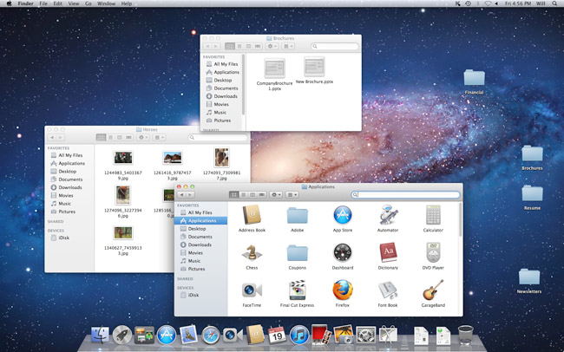
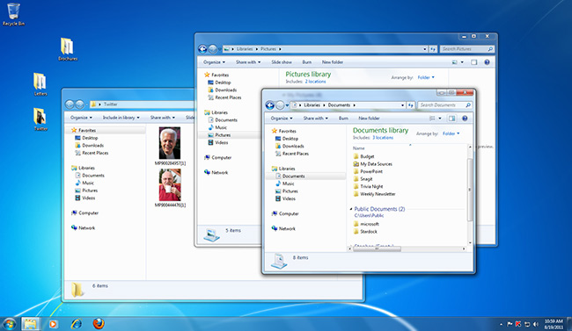
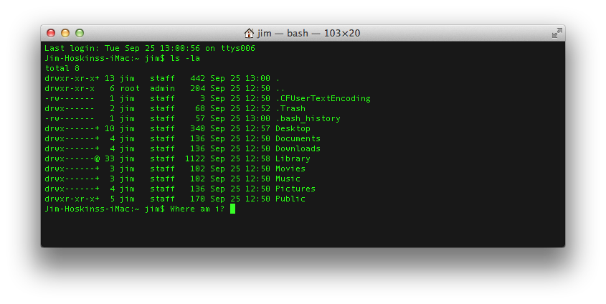
GUI vs. Command line
Graphical User Interface (GUI)
Command Line Interface (CLI)

Slide 6
Why pointy clicky bad
How do you preserve a record of your actions?
Using the command line you get history
You can collect your commands into a ‘script’ that can be reused to exactly duplicate your procedure

Slide 7
Command line tools
What is the command line?
Also known as a ‘shell’
Most common shell is bash (what we will use)
Bourne Again Shell
Reimplementation of a shell from 1977
Every OS/X Mac
Every Linux box in the world
Every supercomputer
’Programming’ language itself
‘scripting’ language
Ken Thompson

Slide 8
Command line tools
Where is the command line?
Mac (pre-installed)
Applications -> Utilities -> Terminal
Windows (after install WSL2)
Start -> Ubuntu OR better yet,
Start -> Windows Terminal (free install from MS store)
Give it a go! Open a shell window.

Slide 9
Command line tools
Commands take ‘arguments’
Stuff after the command name
Arguments alter the function of the command
E.g. specify what file to use as input or output
Many commands accept the special argument to return help, usually one of
--help
-help
-h
-omghelpmeImlost

Slide 10
Command line tips and tricks
Tab completion is your friend
When entering a file arguments
When entering directory pathes
Hitting tab will autocomplete the filename!
I will pester you about this

Slide 11
Commands for files & dirs
By category
Create
Directory: mkdir
File: various (e.g., cp, touch)
View contents
Directory: ls
File: cat
Remove
Directory: rmdir
File: rm

Slide 12
Quick review from Tue
What do the following commands do?
ls
mkdir
cp
rm
touch
cat
rmdir
cat
more / less

Slide 13
Web from the command line?
Can we interact with the web from the CLI?
YES!
curl
Stands for “Copy URL”
URL = uniform resource locator
E.g. http://, https://, file://, ftp://, …
Let’s play with curl!

Slide 14
Data!
Harvard Clean Energy Project: http://faculty.washington.edu/dacb/HCEPDB_moldata.zip
DO NOT REDISTRIBUTE!
DO NOT USE THIS DATA IN YOUR RESEARCH WITHOUT CREDITING
HARVARD CLEAN ENERGY POJECT
Variable / column | Data type | Units / description | Example
id | integer | CEPD id code | 655365
SMILES_str | string | SMILES | C1C=CC=C1c1cc2
stoich_str | string | stoichiometry | C18H9N3OSSe
mass | float | AMU | 394.3151
pce | float | power conv. effec. | 5.16195320211971
voc | float | open circ. voltage | 0.86760078740294
jsc | float | short circ. density | 91.5675749599
e_homo_alpha | float | high occ. mol. orb. | -5.46760078740294
e_gap_alpha | float | LUMO-HOMO | 2.02294443593306
e_lumo_alpha | float | low occ. mol. orb. | -3.444656351469
tmp_smiles_str | string | SMILES | C1C=CC=C1c1cc2

Slide 15
Data schema
“metadata” or schema
Data types
Units
“keys” (unique identifiers for molecules)

Slide 16
Demo
Navigate to a location
Create a project directory
Create a README
Download the HCEP data
Unpack the data
Look at the data
Automate the workflow

Slide 17
Useful shell commands
Command | Task | Example usage
ls | List files | ls
cp | Copy files | cp original_file new_file
mv | Move / rename files | mv original_file new_file
rm | Remove / delete files | rm original_file
cd | Change directory | cd some_directory
pwd | Print working / current directory | pwd
mkdir | Create directory | mkdir some_directory
rmdir | Remove / delete directory | rmdir some_directory
cat | View files | cat some_file
head | View begining of file | head some_file
tail | View end of file | tail some_file
grep | Search file for matching lines | grep search.text some_file
sort | Sort lines | sort some_file
uniq | Print unique lines | uniq some_file
diff | Compare to files | diff original_file new_file
unzip | Uncompress a file | unzip compressed_file.zip
curl | Download a file using its URL | curl some URL
Also see http://www.pixelbeat.org/cmdline.html or google ‘shell + command name’

