Slide 1
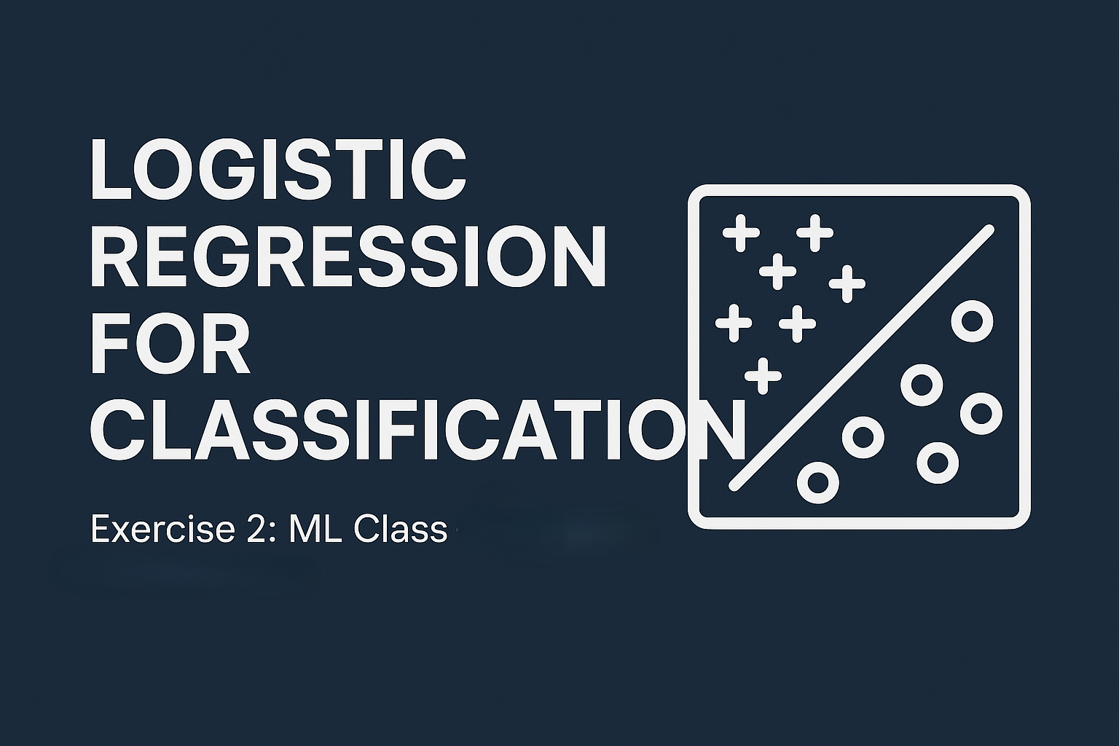
Shah Sayem Ahmad ID: 2122020043

Slide 2
Problem Statement
1. Exam Admission Prediction (Binary Classification)
- Predict admission based on two exam scores
2. Microchip QA (Regularized Logistic Regression)
- Predict microchip quality pass/fail from two test results
- Requires polynomial features + regularization

Slide 3
Datasets
📊 ex2data1.txt - Exam Scores
Format: Exam 1, Exam 2, Admission (0/1)
1 = Admitted, 0 = Not Admitted
⚙️ ex2data2.txt - Microchip Tests
Format: Test 1, Test 2, QA (0/1)
1 = Pass, 0 = Fail

Slide 4

Logistic Regression Model
✅ Logistic regression hypothesis Function:
$h_{\text{θ}}($x) = g(${\text{θ}}^{T}$x)
✅ Sigmoid Function: g(z) = $\frac{1}{1+e^{−z}}$
✅ Cost Function: J(θ) = $\frac{1 }{m}$Σ [-y log($h_{\text{θ}}$ (x)) - (1-y) log(1-$h_{\text{θ}}$ (x))]

Slide 5
Part 1: Linearly Separable Data
🧷 Data: Student Exam Scores
📈 Linear decision boundary separates admission outcomes
🎯 Prediction Example:
- Scores: (45, 85) => Admission Probability ≈ 0.77
- Training Accuracy: ~89%

Slide 6
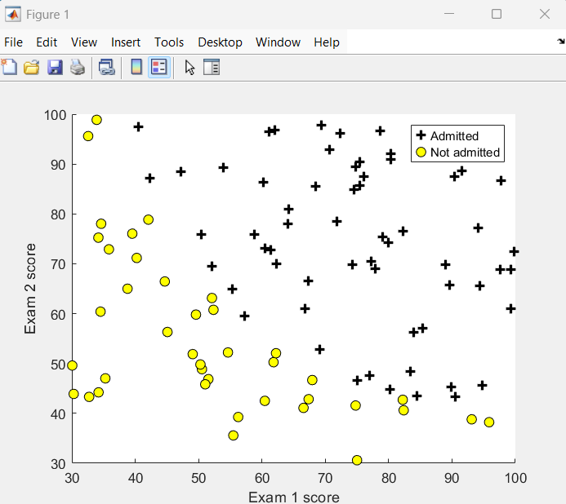
Visualizing the data

Slide 7
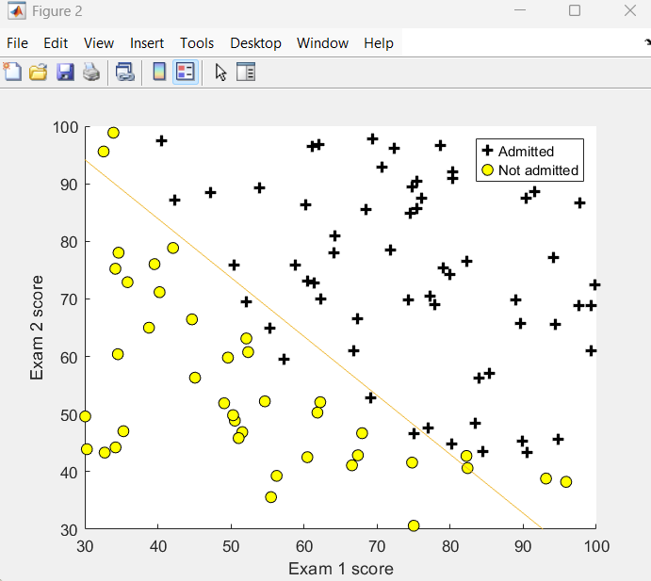
Training data with decision boundary

Slide 8

Part 2: Non-Linearly Separable Data
⚙️ Microchip QA Test
✅ Feature Mapping: Add more features from each data point
🔒 Regularization: Prevents overfitting with penalty term
Cost Function: J(θ) = $\frac{1 }{m}$Σ [-y log($h_{\text{θ}}$ (x)) - (1-y) log(1-$h_{\text{θ}}$ (x))] + (λ/2m) Σ θⱼ²
Here λ controls the amount of regularization

Slide 9
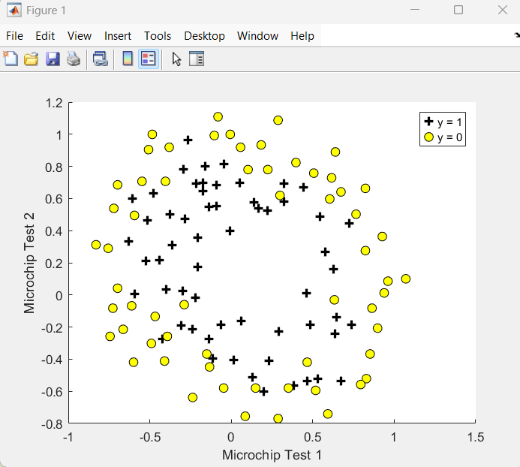
Visualizing the data

Slide 10
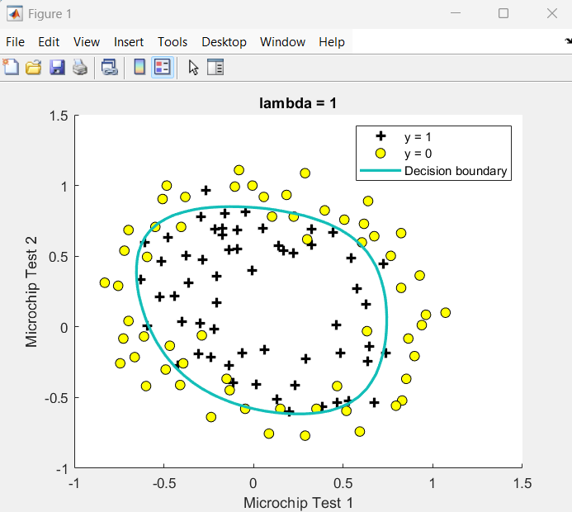
Training data with decision boundary(λ=1)

Slide 11
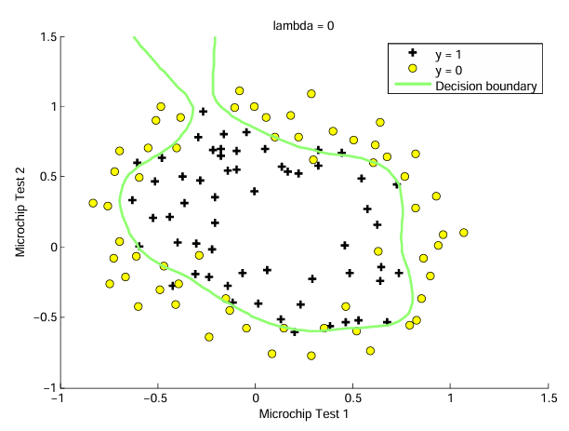
Training data with decision boundary(λ=0)-Overfitting

Slide 12
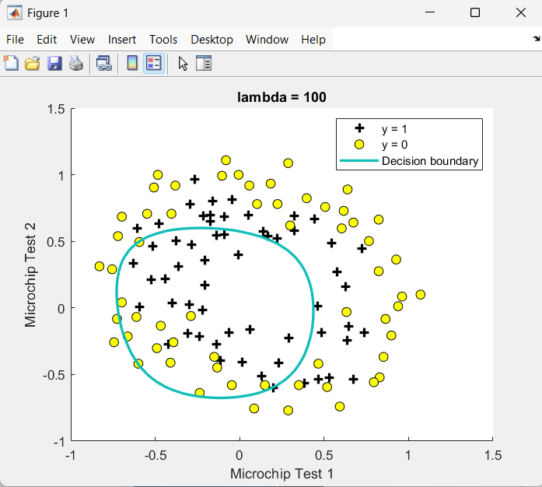
Training data with decision boundary(λ=100)-Underfitting

Slide 13
Model Evaluation with Varying λ
λ | Overfitting | Underfitting | Accuracy
0 | ✅ Likely | ❌ No | High training, low generalization
1 | ❌ No | ❌ No | ✅ Balanced
100 | ❌ No | ✅ Yes | Lower Accuracy

Slide 14
Final Output Summary
🔹 Linear Logistic Regression: Works for linearly separable data
🔹 Regularized Logistic Regression: Handles complex data with flexibility
🔹 Feature Mapping + Regularization = Powerful Classifier

Slide 15
Conclusion
✅ Logistic Regression is great for binary classification tasks
✅ Regularization helps avoid overfitting
✅ Polynomial features improve model expressiveness

