Slide 1

An In-Depth
Overview of Microsoft
Office Suite for Office Management​
Transforming Workplace Productivity with Microsoft Office​
Presented By​
Shah Sultana Takiya​
Enhancing Digital Government & Economy Project​

Slide 2

SHAH SULTANA TAKIYA
Linkedin: linkedin.com/in/shah-sultana-takiya-b34600339
Co Founder & CEO
Showkhinaloy
Course : IT Support for Office Management
Batch : IS 10
ID : 04
This presentation explores how Microsoft Office Suite enhances office management by streamlining tasks, improving collaboration, and boosting productivity. It demonstrates the practical use of key tools for efficient document management, data analysis, and communication within modern workplaces.
Presented By​
Shah Sultana Takiya​
Enhancing Digital Government & Economy Project​

Slide 3

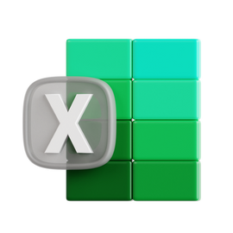
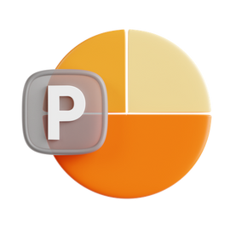



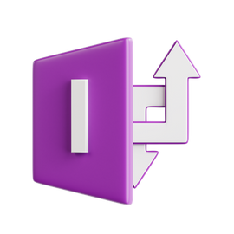

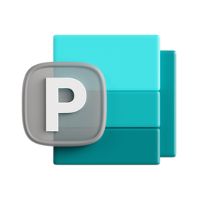

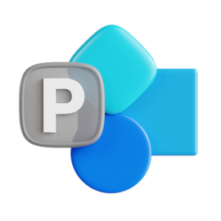



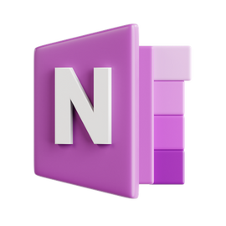

Microsoft Office Suite includes a variety of applications that can be highly useful for office management.
Here's an overview of how each application can contribute to effective office management:
In this presentation, we will explore the Microsoft Office Suite and its applications. Understanding these tools is essential for effective office management. We will cover key features, tips, and best practices to enhance productivity and collaboration in your workplace.

Slide 4
Overview of Office Applications
The Microsoft Office Suite consists of several applications, including Word, Excel, PowerPoint, and Outlook. Each tool serves a unique purpose, enabling users to create documents, analyze data, deliver presentations, and manage emails efficiently.
Transforming Workplace Productivity with Microsoft Office​

Slide 5
Leveraging Microsoft Word for Efficient Office Management
Creating, Editing, and Collaborating: Maximizing Office Efficiency with Microsoft Word
Microsoft Word plays a pivotal role in office management by providing a comprehensive suite of tools designed for document creation, editing, and collaboration. Office managers rely on Word for generating a wide variety of documents, from internal reports and meeting agendas to client proposals and official correspondence. The application’s rich formatting capabilities, including styles, templates, and advanced text formatting, ensure that all documents maintain a consistent and professional appearance. One of Word’s standout features is its ability to support collaboration. With tools like Track Changes, users can easily track revisions, ensuring that all team members are aligned on document updates. The Comments feature further enhances collaboration by allowing users to leave feedback or suggestions without altering the document's original content. This makes Word ideal for team-based projects where multiple contributors need to work on the same document. Additionally, Microsoft Word’s ability to integrate with other Microsoft Office Suite applications, such as Excel for embedding data or PowerPoint for creating presentation-ready documents, enhances its versatility. Whether managing reports, creating templates for common office tasks, or working on multi-page documents, Word’s robust set of features ensures efficiency, accuracy, and consistency in everyday office tasks.
Microsoft Word is an essential tool for office management, enabling efficient document creation, editing, collaboration, and formatting to produce professional and consistent materials.

Slide 6
Microsoft Word is a feature-rich word processing application used for creating, editing, and formatting text documents. Some of its key features include:
Text Formatting
Styles and Themes
Tables and Graphs
Spell and Grammar Check
Collaboration and Comments
Page Layout Options
References
Insert Media
Find and Replace
Track Changes
Mail Merge
Voice Typing
Hyperlinks
Smart Lookup
Document Protection
Version History
Overall, Microsoft Word is a powerful and user-friendly tool that meets a wide range of
document creation and editing needs.

Slide 7
Maximizing Office Efficiency with Microsoft Excel
Data Management, Financial Tracking, and Project Planning with Microsoft Excel
Microsoft Excel is a cornerstone tool in office management, offering a versatile platform for organizing, analyzing, and managing data. Its extensive features make it indispensable for a wide range of office tasks, including financial management, project planning, inventory tracking, and reporting. With its ability to handle large datasets, Excel allows office managers to keep track of important information like budgets, employee performance, expenses, and project timelines in a structured and efficient manner. Excel’s powerful functions—such as formulas, pivot tables, and advanced charting tools—allow users to quickly calculate totals, analyze trends, and visualize data. Office managers can easily create financial reports, budgets, and forecasts, automate complex calculations, and generate real-time insights that drive decision-making. Its ability to perform complex data analysis, including sorting, filtering, and summarizing information, makes it easier for managers to make informed choices that optimize office operations. Additionally, Excel plays a key role in collaboration and communication within teams. With cloud integration via Microsoft 365 and OneDrive, Excel documents can be shared and edited in real-time, enabling seamless collaboration across locations. Whether tracking office inventory, creating Gantt charts for project management, or generating reports for upper management, Excel’s robust suite of tools ensures productivity is maximized and processes are streamlined for optimal office performance.
Microsoft Excel is a powerful tool for office management, enabling efficient data organization, financial tracking,
project planning, and real-time collaboration to enhance productivity and decision-making.

Slide 8
Microsoft Excel is a robust spreadsheet application with a wide range of features designed for data analysis, manipulation, and visualization. Some of its key features include:
Cell Formatting
Formulas and Functions
Charts and Graphs
Data Sorting and Filtering
PivotTables and PivotCharts
Conditional Formatting
Data Validation
What-If Analysis
Collaboration and Sharing
Macros and VBA
Data Import and Export
Protecting Data
Dynamic Arrays
Power Query
Power Pivot
Templates
Microsoft Excel is a powerful spreadsheet tool that offers advanced features for data analysis, visualization, and automation, making it essential for managing and organizing information.

Slide 9
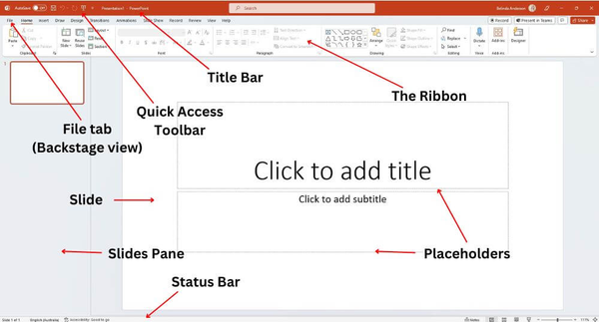
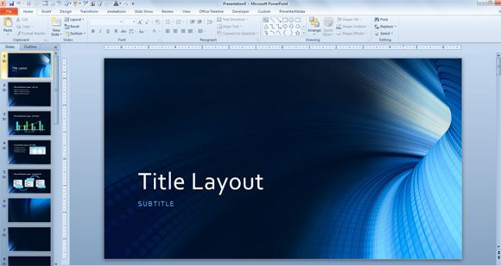
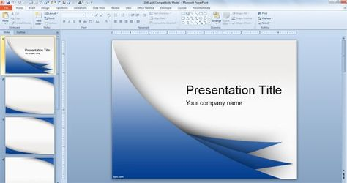
Enhancing Presentations with Microsoft PowerPoint
Create, Design, and Deliver Impactful Presentations with Microsoft PowerPoint
Microsoft PowerPoint is a powerful tool for creating visually compelling presentations that effectively communicate ideas, reports, and proposals in office management. With its wide array of templates, design options, and multimedia integration features, PowerPoint allows users to craft professional slideshows that engage audiences and convey key information clearly. It supports the inclusion of text, images, videos, charts, and graphs, enabling office managers to present complex data in a visually appealing and easily digestible format. PowerPoint’s collaboration features also allow multiple users to edit and comment on presentations in real-time, streamlining teamwork and feedback. Whether for internal meetings, client presentations, or training sessions, PowerPoint plays a vital role in making presentations impactful and effective.
Microsoft PowerPoint enables the creation of dynamic, professional presentations
to engage and inform audiences effectively.

Slide 10
Microsoft PowerPoint is a versatile presentation software with a range of features for creating dynamic and visually engaging presentations. Key features include:
Slide Layouts and Templates
Text Formatting and Styling
Multimedia Integration
Transitions and Animations
SmartArt and Icons
Presenter View
Collaboration and Sharing
Comments and Markup
Hyperlinks and Actions
Zoom and Navigation
Design Ideas
Recording Features
Exporting and Sharing
These features make Microsoft PowerPoint a powerful tool for creating professional, interactive, and visually compelling presentations.

Slide 11

Mastering Communication with Microsoft Outlook
Organize, Communicate, and Stay Connected
Microsoft Outlook is a powerful personal information management tool that integrates email, calendar, task, and contact management into a single platform. It’s designed to streamline your communication and productivity by allowing you to manage emails, schedule meetings, and track important tasks seamlessly. Integrated with Microsoft 365, Outlook ensures your information is synchronized across all devices, enhancing both collaboration and accessibility. With built-in security features like phishing protection and two-factor authentication, Outlook ensures your communication remains safe. Whether on desktop or mobile, Outlook offers an efficient and secure solution for managing emails and organizing your schedule.
Efficiently manage your emails, calendar, and tasks with Microsoft Outlook.

Slide 12
Microsoft Outlook is a comprehensive personal information management tool that primarily functions as an email client but also offers a wide range of features for productivity and organization.
Email Management
Calendar
Contacts
Tasks and To-Do Lists
Integration with Microsoft 365
Focused Inbox
Search Functionality
Email Templates
Rules and Automation
Security and Privacy
Conversation View
Attachment Handling
Shared Calendars
Mobile App
Add-ins
Extensions
These features make Microsoft Outlook a powerful and efficient tool for managing emails, scheduling, contacts, and tasks, both for personal and professional use.

Slide 13
Building Databases with Microsoft Access
Design, Manage, and Analyze Data with Ease
Microsoft Access is a powerful database management system that allows users to create and manage relational databases with ease. Ideal for both novice and experienced users, Access offers an intuitive interface to build custom databases for tracking and analyzing information. With its rich set of tools, users can design tables, queries, forms, and reports to organize and analyze data efficiently. Integrated with the Microsoft 365 suite, Access offers seamless data sharing and collaboration across platforms. Whether you're managing inventory, customer data, or project details, Microsoft Access empowers users to manage complex data with ease and precision.
Create, manage, and analyze data with the powerful features of Microsoft Access.

Slide 14
Microsoft Access is a database management system that allows users to store, manage, and analyze large amounts of data in an organized manner. Key features include
Cell Formatting
Formulas and Functions
Charts and Graphs
Data Sorting and Filtering
PivotTables and PivotCharts
Conditional Formatting
Data Validation
What-If Analysis
Collaboration and Sharing
Macros and VBA
Data Import and Export
Protecting Data
Dynamic Arrays
Power Query
Power Pivot
Templates
These features make Microsoft Access a powerful tool for creating and managing databases, ideal for individuals and small businesses requiring an accessible and scalable solution for storing and analyzing data.

Slide 15
Enhancing Collaboration with Microsoft Teams
Connect, Communicate, and Collaborate in Real-Time
Microsoft Teams is a collaboration platform that brings together chat, video conferencing, file storage, and application integration into one seamless experience. Designed to streamline teamwork, Teams allows users to communicate instantly through chat, hold virtual meetings, and share documents in real-time, all within a secure and organized environment. With tight integration with Microsoft 365, it ensures smooth access to files and tools that teams use every day, whether in the office or remotely. Teams also supports collaboration across organizational boundaries, making it ideal for businesses of all sizes to stay connected and productive. Enhanced features like task management, scheduling, and external collaboration make it a go-to solution for improving team communication and efficiency.
Streamline teamwork with Microsoft Teams—your hub for collaboration and communication.

Slide 16
Microsoft Teams is a collaboration platform designed to facilitate communication and teamwork within organizations. Key features of Microsoft Teams include:
Chat and Messaging
Video and Audio Calls
Channels and Teams
File Sharing and Collaboration
Task Management
Meetings and Scheduling
Document Collaboration
Customizable Tabs
Integrations and Bots
Security and Compliance
Live Events and Webinars
Guest Access
Activity Feed
Whiteboard
Mobile Apps
Desktop Apps
These features make Microsoft Teams an all-in-one hub for communication, collaboration, and productivity, particularly suited for businesses, schools, and organizations seeking to streamline team operations

Slide 17
Simplifying Forms and Data Collection with Microsoft InfoPath
Create, Manage, and Automate Forms with Ease
Microsoft InfoPath is a versatile tool for designing, distributing, and filling out electronic forms. Ideal for businesses and organizations, InfoPath enables users to create dynamic forms that can collect, manage, and validate data. It integrates seamlessly with Microsoft SharePoint and other Microsoft 365 tools, allowing for the automation of workflows and data storage in real time. With its rich set of templates, customization options, and support for XML data, InfoPath streamlines data collection and processing, making it easier for organizations to capture and manage information. Whether for employee surveys, customer feedback, or internal reports, InfoPath is designed to make form-based tasks simpler and more efficient.
Design and automate dynamic forms with Microsoft InfoPath for efficient data collection.

Slide 18
Microsoft InfoPath is a tool used for creating, distributing, filling out, and managing electronic forms within an organization. Key features of Microsoft InfoPath include:
Cell Formatting
Formulas and Functions
Charts and Graphs
Data Sorting and Filtering
PivotTables and PivotCharts
Conditional Formatting
Data Validation
What-If Analysis
Collaboration and Sharing
Macros and VBA
Data Import and Export
Protecting Data
Dynamic Arrays
Power Query
Power Pivot
Templates
Microsoft InfoPath was used in business environments for creating dynamic, data-driven forms but has been gradually phased out in favor of other tools like PowerApps, which offer more modern, cloud-based solutions for form creation and workflow automation.

Slide 19
Creating Interactive Presentations with Microsoft Sway
Design, Share, and Present Content with Ease
Microsoft Sway is a versatile tool that allows users to create dynamic, interactive presentations, reports, and personal stories. Unlike traditional presentation software, Sway uses a web-based, template-driven design to make it easy for anyone to create professional-looking content, regardless of design experience. With its intuitive interface, users can add text, images, videos, and social media content to create visually engaging and interactive presentations. Sway also offers collaboration features, allowing teams to work together in real-time, and its cloud-based nature ensures that presentations can be shared and accessed across devices seamlessly. Whether for business, education, or personal use, Microsoft Sway offers a creative and efficient way to present information.
Create engaging, interactive presentations with Microsoft Sway’s easy-to-use design tools.

Slide 20
Microsoft Sway is a cloud-based presentation and storytelling tool designed for creating visually appealing and interactive content. Key features of Microsoft Sway include:
Easy-to-Use Interface
Templates and Design Suggestions
Multimedia Integration
Responsive Layouts
Real-Time Collaboration
Interactive Features
Sharing and Embedding
Cloud Storage
Text and Visual Effects
Content Customization
Integration with Microsoft 365
Analytics and Insights
Accessibility Features
No Software Installation
Microsoft Sway is particularly useful for creating engaging presentations, reports, newsletters, and portfolios, providing an easy and efficient alternative to traditional tools like PowerPoint.

Slide 21
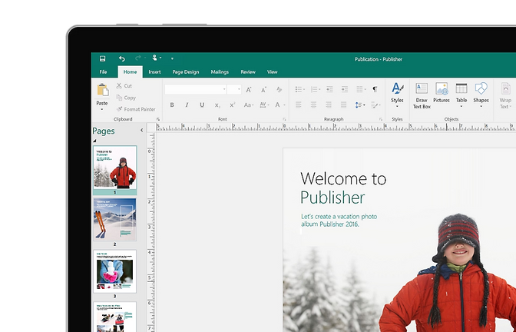
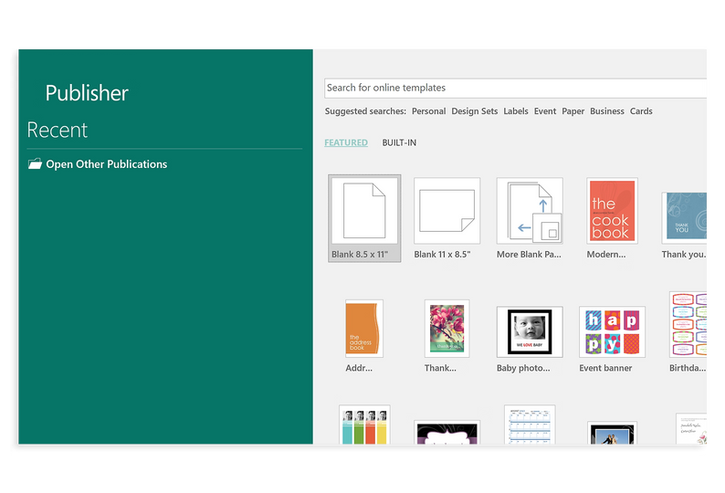
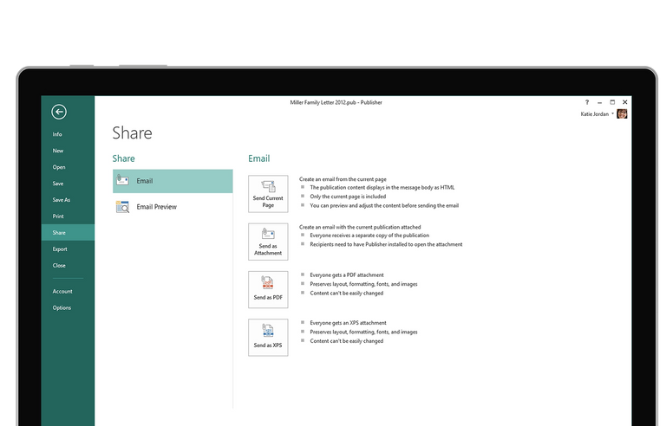
Microsoft Publisher
Create Professional-Quality Documents with Ease
Microsoft Publisher is a desktop publishing tool that helps users design and create professional-looking printed materials such as brochures, flyers, newsletters, posters, and more. With an intuitive drag-and-drop interface and a variety of customizable templates, it offers a straightforward way to design high-quality publications. Whether you need to create marketing collateral, business documents, or personal invitations, Publisher's easy-to-use features and advanced design tools make it a go-to application for creating visually appealing and polished documents.
Microsoft Publisher is a comprehensive tool that simplifies the process of creating high-quality, print-ready documents with ease, making it ideal for both personal and professional use.e

Slide 22
Microsoft Publisher
Create Professional-Quality Documents with Ease
Templates
Drag-and-Drop Interface
Customizable Layouts
Advanced Text Formatting
Picture and Graphic Insertion
Typography and Color Tools
Mail Merge
PDF and Image Export
Object Alignment and Grids
Professional Print Quality
Hyperlinks and Interactive Content
Import and Export Compatibility
Pre-Press Features
Microsoft Publisher is a comprehensive tool that simplifies the process of creating high-quality, print-ready documents with ease, making it ideal for both personal and professional use.

Slide 23
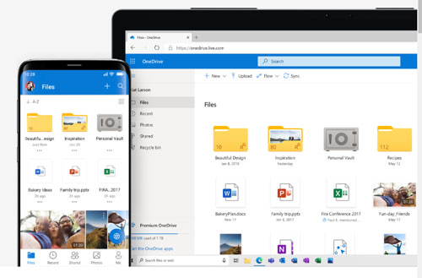

Microsoft OneDrive - Cloud Storage and File Sharing
Store, Share, and Access Your Files Anytime, Anywhere
Microsoft OneDrive is a powerful cloud storage service integrated with the Microsoft 365 suite, providing users with seamless file storage, sharing, and synchronization across multiple devices. OneDrive ensures that users can easily access their documents, photos, videos, and other files from any device with internet access. Whether you’re collaborating with colleagues, backing up important documents, or accessing personal files on the go, OneDrive offers a secure, user-friendly solution to manage your digital files.
Microsoft OneDrive provides secure, accessible, and flexible cloud storage that makes it easy to store, sync, and share files, while offering seamless integration with Microsoft 365 and other applications.

Slide 24
Microsoft OneDrive is a cloud storage service that allows users to store files online and access them from any device, anywhere. Here is a detailed breakdown of its features:
Cloud Storage
File Synchronization
File Sharing
Automatic Backup
Collaboration with Microsoft 365
Personal Vault
File Versioning
Offline Access
Search and Organization
Shared Libraries
Advanced Security
Integration with Other Apps
Mobile Apps
Personalized Storage Plans
Microsoft Sway is particularly useful for creating engaging presentations, reports, newsletters, and portfolios, providing an easy and efficient alternative to traditional tools like PowerPoint.

Slide 25
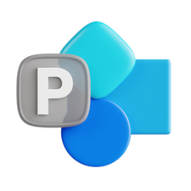
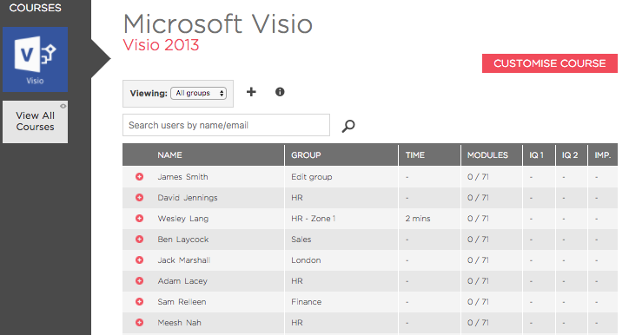
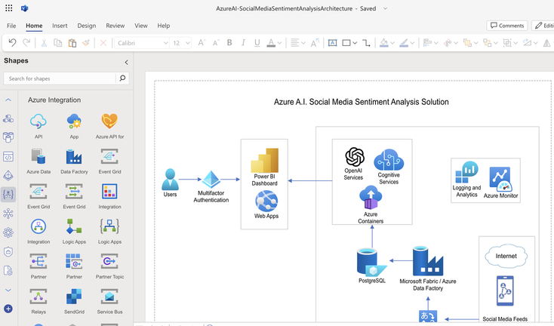
Microsoft Visio - Professional Diagramming and Visualization
Simplify Complex Ideas with Visual Clarity
Microsoft Visio is a powerful tool for creating professional-grade diagrams and visuals that simplify complex ideas and workflows. It supports a wide range of templates and stencils to help users design flowcharts, organizational charts, network diagrams, floor plans, and more. With its intuitive drag-and-drop interface and seamless integration with Microsoft 365, Visio makes it easier to visualize data, collaborate in real time, and enhance decision-making processes. Whether for business, engineering, or personal use, Visio is the ultimate tool for turning ideas into impactful visuals.
Microsoft Visio empowers users to create detailed and impactful diagrams that enhance communication, improve workflows, and simplify complex concepts for better decision-making.

Slide 26
Microsoft Visio is a diagramming and vector graphics application designed for creating professional diagrams, flowcharts, org charts, floor plans, and more. Below is a detailed breakdown
Diagram Templates
Drag-and-Drop Interface
Professional Stencils
Data Integration
Collaboration Tools
Customizable Layouts
Advanced Formatting Options
Flowchart Creation
Org Chart Builder
Integration with Microsoft 365
Cloud-Based Access
Floor Plans and CAD Integration
Presentation-Ready Diagrams
Scalable Use
Microsoft Visio empowers users to create detailed and impactful diagrams that enhance communication, improve workflows, and simplify complex concepts for better decision-making.

Slide 27
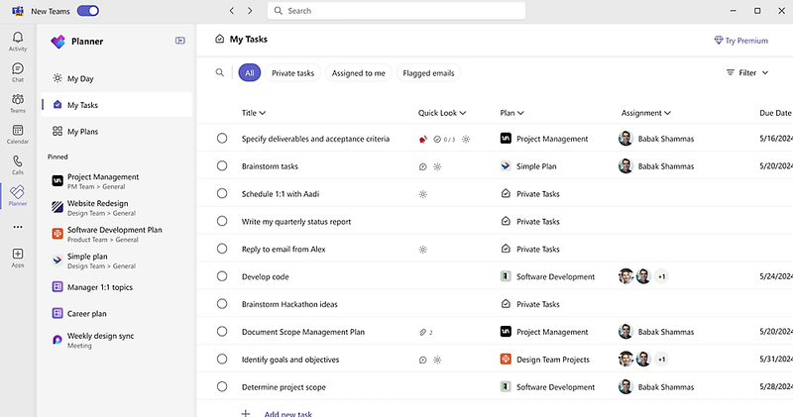
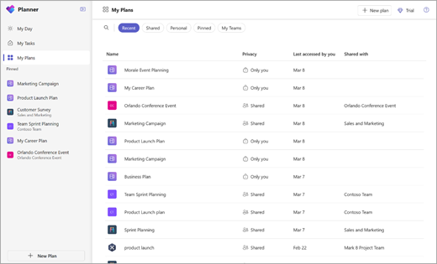
Microsoft Planner - Task Management and Team Collaboration
Organize, Assign, and Track Team Tasks with Ease
Microsoft Planner is a powerful task management and collaboration tool within the Microsoft 365 suite, helping teams efficiently organize their work and stay productive. It uses a simple and intuitive interface with a Kanban-style task board to create, assign, and track tasks. With Planner, team members can visualize project progress, communicate effectively, and meet deadlines. Whether you're managing a small project or coordinating across departments, Microsoft Planner ensures your team remains aligned and on track.
Microsoft Planner simplifies task management, enhances team collaboration, and keeps everyone aligned, making it an essential tool for managing projects efficiently in any organization.

Slide 28
Microsoft Planner is a task management tool designed to organize teamwork and streamline project execution through visual task boards and collaboration. Below is a comprehensive breakdown:
Visual Task Boards
Task Assignment
Progress Tracking
Integration with Microsoft 365
File Attachments
Comments and Notes
Notifications and Reminders
Charts and Dashboards
Collaborative Workspaces
Mobile and Web Access
Template Plans
Drag-and-Drop Functionality
Checklist Management
Security and Compliance
Microsoft Planner simplifies task management, enhances team collaboration, and keeps everyone aligned, making it an essential tool for managing projects efficiently in any organization.

Slide 29
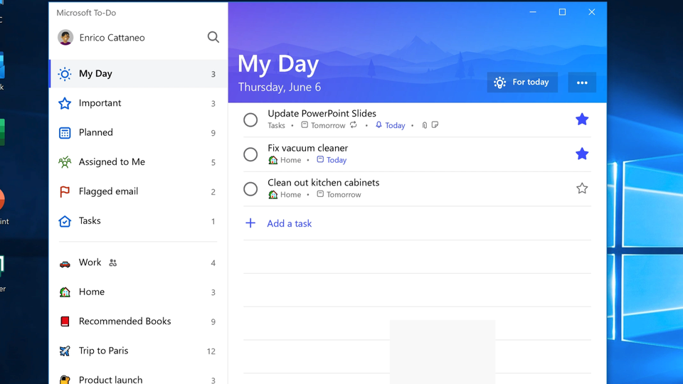
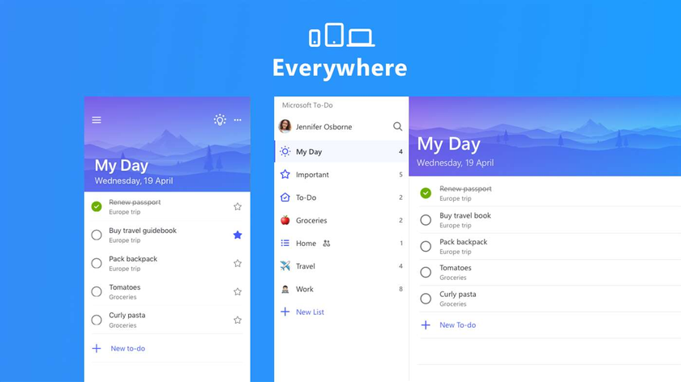
Microsoft To Do - Organize Your Day, Your Way
Simplify Task Management and Boost Productivity
Microsoft To Do is a simple yet powerful task management app that helps individuals and teams organize their tasks and prioritize their day. With features like smart lists, reminders, and seamless integration with Microsoft 365, To Do allows users to manage both personal and professional commitments in one place. Whether it's creating a grocery list, planning a project, or setting daily goals, Microsoft To Do is the ideal tool for staying on top of your tasks and achieving your objectives efficiently.
Microsoft To Do is the perfect tool for organizing tasks, managing priorities, and staying productive, no matter where life takes you.

Slide 30
Microsoft Sway is a cloud-based presentation and storytelling tool designed for creating visually appealing and interactive content. Key features of Microsoft Sway include:
Task Creation and Organization
Daily Planner
Reminders and Due Dates
Recurring Tasks
Smart Suggestions
Integration with Microsoft 365
Collaboration
Sync Across Devices
File Attachments
Customizable Themes
Focus Mode
Offline Access
Search Functionality
Secure and Private
Microsoft Sway is particularly useful for creating engaging presentations, reports, newsletters, and portfolios, providing an easy and efficient alternative to traditional tools like PowerPoint.

Slide 31

Microsoft Exchange - Enterprise Email and Calendaring Solution
Streamline Communication and Enhance Organizational Productivity
Microsoft Exchange is a robust email and calendaring platform designed to meet the needs of businesses and organizations of all sizes. It provides secure email services, shared calendars, and advanced collaboration tools to improve productivity and streamline communication. With Exchange, users can access their emails, contacts, and schedules from any device while benefiting from industry-leading security and compliance features. Whether used on-premises or as part of Microsoft 365, Exchange ensures reliable and efficient communication for modern workplaces.
Microsoft Exchange is the ultimate communication and collaboration platform, delivering secure, reliable, and scalable email and calendaring solutions for modern enterprises.

Slide 32
Microsoft Exchange - Enterprise Email and Calendaring Solution
Streamline Communication and Enhance Organizational Productivity
Enterprise Email Hosting
Shared Calendars
Contact Management
Email Archiving and Retention
Real-Time Sync
Advanced Security
Data Loss Prevention (DLP)
Offline Access
Mobile Access
Integration with Microsoft 365
Customization
Unified Messaging
eDiscovery and Compliance
Flexible Deployment Options
Mobile Access
Microsoft Exchange is the ultimate communication and collaboration platform, delivering secure, reliable, and scalable email and calendaring solutions for modern enterprises.

Slide 33
Microsoft OneNote - Your Digital Notebook for Ideas and Organization
Capture, Organize, and Share Your Notes Seamlessly
Microsoft OneNote is a versatile digital notebook designed for students, professionals, and anyone who needs a space to collect and organize their ideas. With OneNote, users can create rich, multimedia-enhanced notes, categorize them into sections, and access them anytime, anywhere. Its collaborative features allow teams to work on shared notebooks, making it an excellent tool for brainstorming, project management, and classroom learning. Whether you're planning a project, jotting down quick ideas, or studying for exams, OneNote makes organization and productivity effortless.
Microsoft OneNote simplifies note-taking and collaboration, empowering users to capture, organize, and share their thoughts effortlessly across devices.

Slide 34
Microsoft OneNote - Your Digital Notebook for Ideas and Organization
Capture, Organize, and Share Your Notes Seamlessly
Digital Note-Taking
Multimedia Integration
Organization Tools
Cross-Device Syncing
Handwriting Recognition
Collaboration Features
Tagging and Search
To-Do Lists and Checkboxes
Integration with Microsoft 365
Offline Access
Digital Note-Taking
Audio Notes
Customization Options
Web Clippin
Immersive Reader
Microsoft OneNote simplifies note-taking and collaboration, empowering users to capture, organize, and share their thoughts effortlessly across devices.

Slide 35
Microsoft Power BI - Transform Data into Actionable Insights
Empowering Businesses with Advanced Analytics and Interactive Visualizations
Microsoft Power BI is a robust business intelligence platform that enables users to connect to various data sources, create compelling visualizations, and derive actionable insights. Designed for professionals and organizations, Power BI offers powerful tools to analyze data in real time, uncover trends, and make informed decisions. Its seamless integration with Microsoft 365, Azure, and third-party platforms ensures flexibility and scalability, making it a critical solution for modern businesses aiming to leverage their data.
Microsoft Power BI transforms raw data into meaningful insights, enabling businesses to make smarter, data-driven decisions efficiently and collaboratively.

Slide 36
Microsoft Power BI - Transform Data into Actionable Insights
Empowering Businesses with Advanced Analytics and Interactive Visualizations
Interactive Dashboards
AI-Powered Insights
Integration with Microsoft 365
Scalability
Data Connectivity
Drag-and-Drop Interface
Natural Language Queries
Security and ComplianceEmbedded Analytics
Real-Time Analytics
Mobile Accessibility
Security and Compliance
Extensive API Support
Customizable Visualizations
Collaboration Tools
Microsoft Power BI transforms raw data into meaningful insights, enabling businesses to make smarter, data-driven decisions efficiently and collaboratively.

Slide 37
Key Takeaways from the Presentation
Recap of Microsoft Office Suite Benefits and Applications
This presentation provided an in-depth overview of Microsoft Office Suite, covering its core applications such as Word, Excel, PowerPoint, Outlook, Teams, Access, and OneNote. Key benefits like efficiency, integration, and cloud-based features in Office 365 were highlighted. Practical tips, case studies, and recent updates demonstrated its importance in modern office management. Microsoft Office Suite remains a vital tool for enhancing productivity, collaboration, and organizational success.
Microsoft Office Suite is an indispensable tool for modern office management, offering seamless integration, enhanced productivity, and innovative features to meet the evolving needs of businesses and teams.

Slide 38
Thank You

