Slide 1
Detecting Spam
Group 10
Jun Wu
Avinita Shetty
Vishwa Shah

Slide 2
Analyzing the data
There are total 48 attributes of type words
Total 6 attributes of type characters like C#
1 real attribute of type average of CAPITAL LETTERS
2 integer attributes of type total and longest of the length of CAPITAL
LETTERS

Slide 3
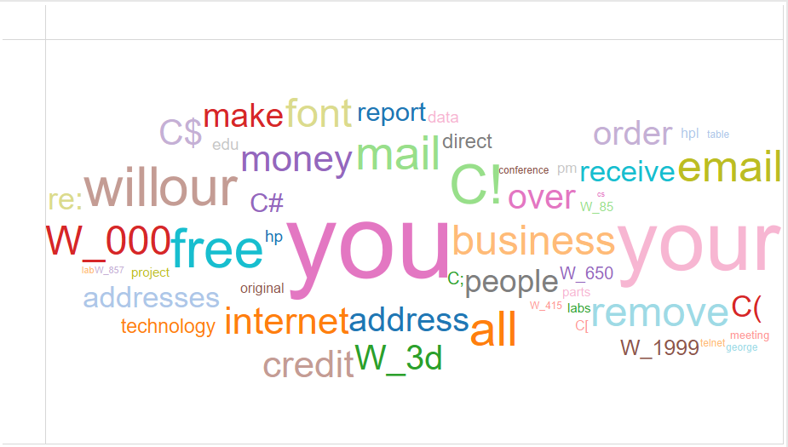
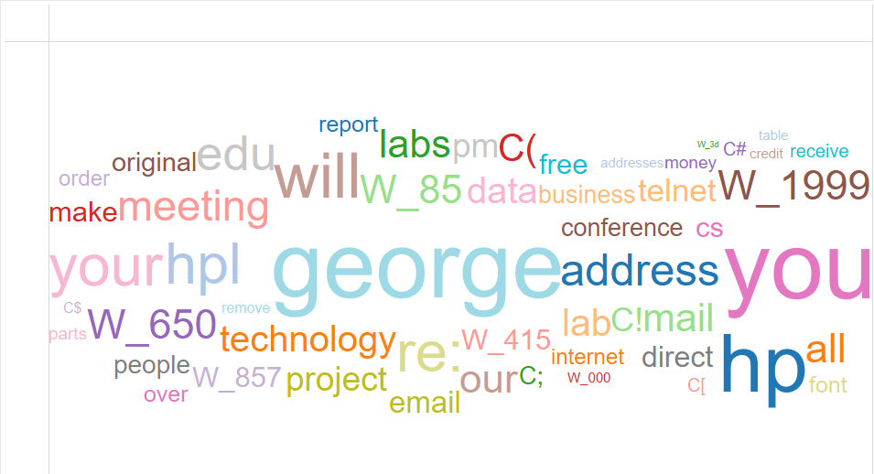
Word Cloud of Spam and Non-Spam words by average of the percentage of words
Spam
Non-Spam

Slide 4
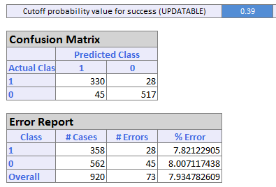
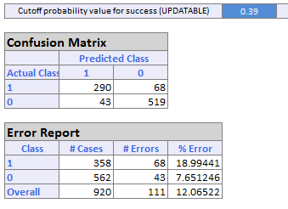
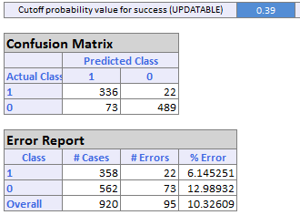
Model Performance
Initial Cutoff Probability of Success = 0.39 (39%)
Logistic Regression
CART
Random Forest

Slide 5
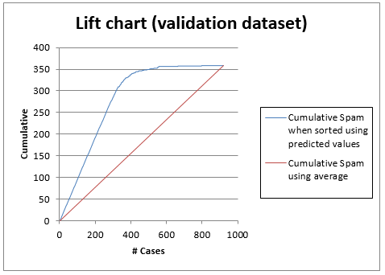
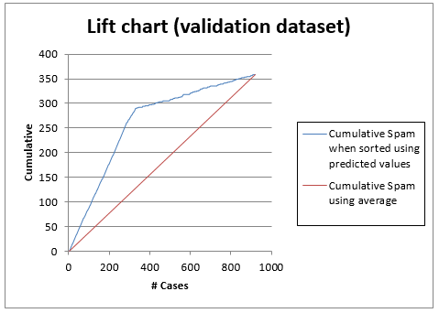
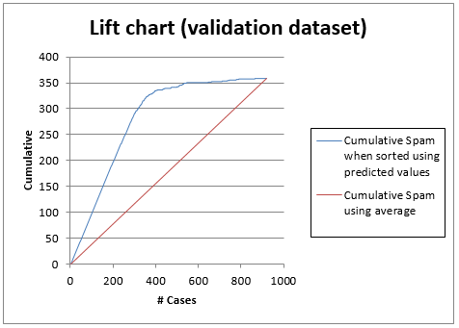
Logistic Regression
Lift Charts
CART
Random Forest

Slide 6
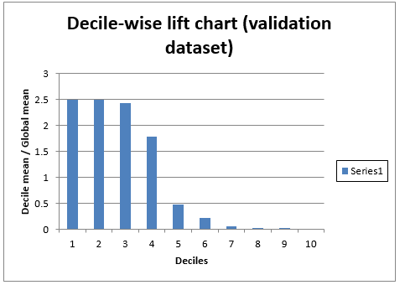
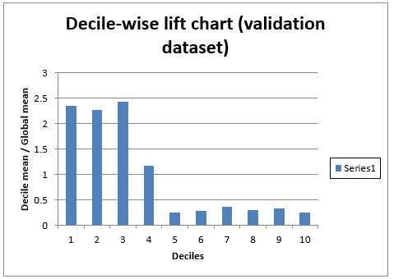
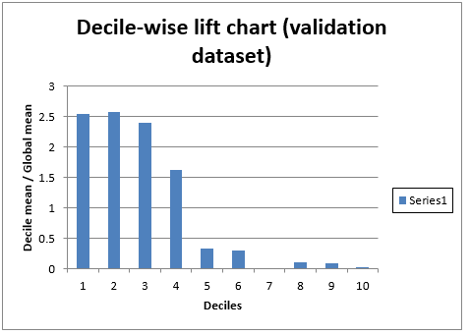
Logistic Regression
Decile-Wise Lift Charts
CART
Random Forest

Slide 7
Performance Evaluation
Cutoff Value = 0.39 (39%)
Linear Regression: 7.9%
CART: 18.99%
Random Forest: 6.14%

Slide 8
Model Recommendation
The overall error rate is less in Logistic Regression, but for detecting spam emails the error rate of class 1 is less in Random Forest.

