Slide 1

Integrated retail decisions with multiple selling periods and customer segments: Optimization and insights
Keywords: Assortment planning, Pricing and inventory, Dynamic lot-sizing, Optimization modeling, Mathematical programming
Author Name – Ahmed Ghoniem, Bacel Maddah
Journal - Omega
Notes:
Hello everyone, today I will present a literature review of the paper ‘Integrated Retail Decisions with Multiple Selling Periods and Customer Segments: Optimization and Insights.’ This study explores how retailers can optimize decisions across pricing, inventory, and assortment considering multiple selling periods and different customer segments

Slide 2
Table of Contents
Background
Methodology
Results & Discussion
Research Summary & Contribution

Slide 3



Research Context
Real-World Problem
Why It Matters
The Gap
Retailers (Walmart, JCPenney, Saks) face interconnected assortment, pricing, and inventory decisions. Typically optimized separately, missing joint synergies.
US grocery industry operates at 1.09% margins. Even small inefficiencies cause significant profit loss. Integrated optimization is business-critical.
Existing models rarely handle all factors: multiple products, customer segments, multi-period horizon, substitution effects, and operational costs simultaneously.
This research fills the critical gap with a unified optimization framework.
Notes:
The paper addresses the challenge retailers face in making integrated decisions for pricing, inventory, and assortment when customers are segmented and sales happen over multiple periods. Unlike static models, this approach considers how decisions in one period affect future periods, aiming to maximize overall profit

Slide 4
Research Objectives
Validation
Key Focus
Main Aim
Test with real consumer data, evaluate profit losses from myopic policies, generate interaction insights.
Transform nonlinear model to computationally efficient linear MIP enabling real-world scalability.
Develop scalable optimization model for joint determination of assortment, pricing, and inventory decisions under deterministic customer choice model.

Slide 5
Research Questions
1. How to optimally integrate pricing, assortment, and inventory decisions?
2. How do customer segments impact these decisions?
3. How to manage multiple selling periods dynamically?
Notes:
Due to the seasonality in demand and cost; the cannibalization effects between the different customer segments
Highlight the importance of integrating ordering with pricing and assortment decisions
Predictable seasonality of demand and cost is beneficial and can lead to significant increase in profitability if the retailer stocks wider assortments and higher shelf inventories

Slide 6
Table of Contents
Background
Methodology
Results & Discussion
Research Summary & Contribution

Slide 7

Methodology: From MINLP to Scalable MIP
Problem Formulation
Key Innovation
Multi-period mixed-integer nonlinear program (MINLP) jointly optimizing assortment, pricing, and inventory decisions with maximum-surplus deterministic consumer choice model.
Linearization of nonlinear constraints transforms the MINLP into computationally tractable linear MIP while preserving solution optimality.
Notes:
The study uses a mixed-integer linear programming model. It incorporates multiple customer segments and selling periods, aiming to maximize expected profit.
The model respects constraints such as inventory limits and service requirements.

Slide 8






Mathematical Modeling-MINLP
$$\max{\sum_{t=1}^{T}{\sum_{j=1}^{n}{\left(p_{jt}d_{jt}−K_{jt}y_{jt}−c_{jt}u_{jt}−h_{jt}I_{jt}\right)}}}−\sum_{j=1}^{n}{f_{j}z_{j}}$$
Objective:
$$\sum_{k=1}^{n}{\left(α_{ikt}−p_{kt}\right)x_{ikt}}≥\left(α_{ijt}−p_{jt}\right)z_{j}$$
Utility Choice:
$$\sum_{k=1}^{n}{\left(α_{ikt}−p_{kt}\right)x_{ikt}}≥0$$
Non-Negative Utility:
$$\sum_{j=0}^{n}{x_{ijt}}=1$$
Single Choice per Customer:
$$d_{jt}=\sum_{i=1}^{m}{s_{i}x_{ijt}}$$
Demand Definition:
Inventory Balance:
$$I_{jt}=I_{j,t−1}+u_{jt}−d_{jt}$$
$$I_{j0}+I_{jT}=0$$
No Initial/Final Inventory:
$$x_{ijt}≤z_{j}$$
Choice Requires Offering:
Setup Requires Offering:
$$y_{jt}≤z_{j}$$
$$p_{jt}≤z_{j}\max_{i}\left(α_{ijt}\right)$$
Price Upper Bound:
$$u_{jt}≤y_{jt}\left(T−t+1\right)\sum_{i=1}^{m}{s_{i}}$$
Production Capacity:
Variable Domains:
$$x,y,z ∈\{0,1\}, I,p,u ≥0$$
Notes:
Mixed-integer nonlinear programming model: the integration of assortment, pricing, and inventory decisions
Retailing decision context
Stylized model to gain insights into the optimal structure of these decisions
Background literature from marketing and operations management—consumer reservation prices
Data-driven and large scale retail problems
Maximize total profit over planning horizon
Integrated model:
The authors formulate a mathematical optimization model that jointly considers assortment, pricing, and inventory decisions across multiple periods.
It accounts for heterogeneous customer segments, which may have different willingness-to-pay, purchase probabilities, or sensitivities.
The objective function is: maximize the total retailer profit, (the difference between the total revenue and the total ordering, inventory, and assortment costs)

Slide 9

Mathematical Modeling-MIP
$$w_{jt}=p_{jt}z_{j},∀j,t$$
Auxiliary Variables
Objective
$$Σ_{t=1}^{T}Σ_{j=1}^{n}\left[Σ_{i=1}^{m}s_{i}g_{ijt}−K_{jt}y_{jt}−c_{jt}u_{jt}−h_{jt}I_{jt}\right]−Σ_{j=1}^{n}f_{j}z_{j}$$
$$Σ_{k=1}^{n}\left(α_{ikt}x_{ikt}−g_{ikt}\right)≥α_{ijt}z_{j}−w_{jt},∀i,j,t$$
Constraints:
$$Σ_{k=1}^{n}\left(α_{ikt}x_{ikt}−g_{ikt}\right)≥0,∀i,t$$
$$Σ_{j=0}^{n}x_{ijt}=1,∀i,t$$
$$g_{ijt}≤\max_{k}{α_{kjt}}x_{ijt},∀i,j,t$$
$$g_{ijt}≥p_{jt}−\max_{k}{α_{kjt}}\left(1−x_{ijt}\right),∀i,j,t$$
$$g_{ijt}≤p_{jt},∀i,j,t$$
$$w_{jt}≤{z_{j}max}_{i}{α_{ijt}},∀j,t$$
$$w_{jt}≥p_{jt}−\max_{i}{α_{ijt}}\left(1−z_{j}\right),∀j,t$$
$$w_{jt}≤p_{jt},∀j,t$$
$$I_{jt}=I_{j,t−1}+u_{jt}−Σ_{i=1}^{m}x_{ijt}s_{i},∀j,t$$
$$I_{j0}+I_{jT}=0,∀j$$
$$x_{ijt}≤z_{j},∀i,j,t$$
$$y_{jt}≤z_{j},∀j,t$$
$$p_{jt}≤{z_{j}max}_{i}{α_{ijt}},∀j,t$$
$$u_{jt}≤y_{jt}\left(T−t+1\right)Σ_{i=1}^{m}s_{i},∀j,t$$
$$x, y, z binary, I, g, p, u, w ≥ 0.$$
Notes:
The previous model poses signifina challenges because of the discreteness of several sets of decision variabels, nonlineariliest arising from the product of key decision variables

Slide 10
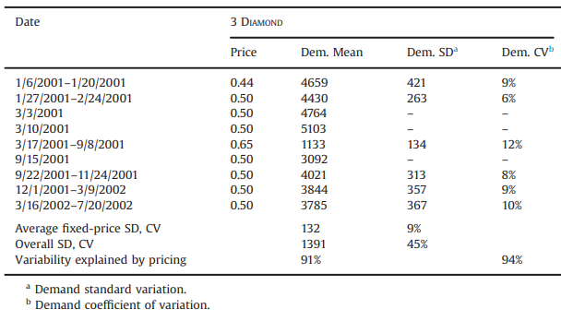
An Empirical Example on Tuna Category
Data & Calibration: historical tuna prices + sales → estimate segment-level reservation prices so model-predicted demand matches observed demand
Method:
  Maximum-surplus choice model
  calibrated customer segments
  MILP optimization over multiple selling periods.
Notes:
Validate the integrated pricing–assortment–inventory model using real retail data (canned tuna SKUs).
• What It Shows:
– Integrated decisions outperform sequential ones
– Coordinated pricing, assortment, and inventory improves profit
– Substitution and customer heterogeneity are essential to model
– Real-world feasibility of the approach demonstrated

Slide 11
Table of Contents
Background
Methodology
Results & Discussion
Research Summary & Contribution

Slide 12
Summary of Findings
The optimal assortment and pricing decisions do not exhibit a simple, intuitive structure
Suboptimal inventory policies significantly decrease profitability
Seasonality in demand and costs enables profit gains by increasing inventory and expanding assortments
Notes:
Due to the seasonality in demand and cost; the cannibalization effects between the different customer segments
Highlight the importance of integrating ordering with pricing and assortment decisions
Predictable seasonality of demand and cost is beneficial and can lead to significant increase in profitability if the retailer stocks wider assortments and higher shelf inventories

Slide 13
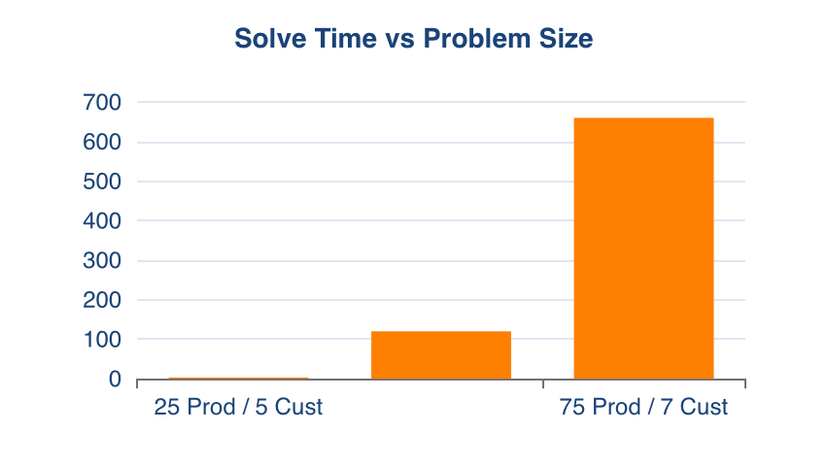
Computational Scalability Analysis
Computational Tractability Achievement
●
✓ Linearization enables exact solutions
●
✓ Polynomial time complexity for large problems
●
✓ Solved on standard commercial hardware
✓ Real-time optimization capability for retail decisions
●
●
✓ Outperforms heuristic approximations with guaranteed optimality
Model APO-1 demonstrates mathematical efficiency: no exponential blow-up despite combinatorial complexity.

Slide 14
Computational Performance & Scalability
25 products, 5 customers, 6 periods
50 products, 6 customers, 6 periods
75 products, 7 customers, 6 periods
< 3 seconds
< 2 minutes
< 11 minutes
✓ Model APO-1 solves large-scale problems efficiently for real retail applications

Slide 15


Key Insight 1: Complex Optimal Structure
Finding
Critical Implication
Optimal assortment and prices do NOT follow simple patterns. Simple heuristics cause 14% profit loss.
Prices ≠ reservation prices due to cannibalization between segments. Optimization tools are essential; analytical rules insufficient for real profit.

Slide 16
Profit Impact Quantification
Myopic Policies Cost
Seasonality Opportunity
Heuristic Approach
ZIP: -57 to -70% profit
Simple margin-based rules: -14% profit
BIP: -32 to -55% profit
Ignoring seasonality: -5 to -43%
Integrated optimization: Full profit recovery
Optimizing for it: +40% profit boost
Quantified evidence: Integrated optimization framework delivers $1M+ annual profit improvement for typical retail chains vs. disconnected decision-making.

Slide 17


Key Insight 2: Myopic Inventory Policies Cost Millions
Zero-Inventory Policy (ZIP)
Critical Finding
57-70% profit reduction
Myopic policies also distort optimal assortment composition. Integrated decision-making is vital for profitability.
Beginning-Inventory Policy (BIP)
32-55% profit reduction

Slide 18

Key Insight 3: Seasonality Creates Opportunity
Seasonality Benefit
Optimal Strategy
Static Cost
Anticipating demand/cost seasonality yields up to 40% profit boost
Wider assortments + higher inventory levels during low-cost periods
Ignoring seasonality causes 5-43% profit reduction. Dynamic planning essential.

Slide 19

Managerial Implications & Recommendations
Integration Critical
Simple Rules Fail
Invest in Tools
Small Gains Matter
Optimization systems anticipating seasonality needed
All three decisions essential for profitability
Myopic approaches leave significant profit on table
Thin-margin retail: every improvement counts significantly

Slide 20


Discussion: Insights & Extensions
Key Research Insights
Future Research Directions
●
Optimal solutions lack simple intuitive structure, requiring computational optimization
●
Vertical integration with suppliers
●
Multi-store and multi-supplier settings
●
Cannibalization effects between customer segments make pricing non-trivial
●
Probabilistic consumer choice models
Seasonality in both demand and costs creates massive profit opportunities
●
Incorporation of competitor responses
●
●
Real-time demand learning and dynamic pricing
●
Integrated decisions outperform decomposed approaches by 30-70%

Slide 21
Table of Contents
Background
Methodology
Results & Discussion
Research Summary & Contribution

Slide 22
Research Summary & Contribution
This research demonstrates that integrated optimization of assortment, pricing, and inventory decisions—accounting for multiple customer segments, product substitution, and seasonal variations—significantly outperforms traditional separate or myopic approaches.
Key contribution: Unified framework enables retailers to avoid millions in profit loss through optimized decision-making.

Slide 23
Thank You
Questions & Discussion

