Slide 1


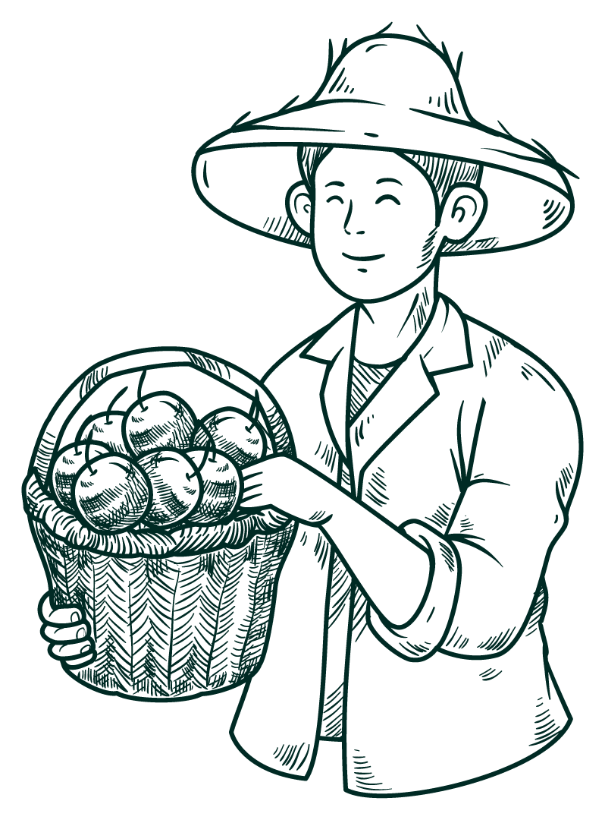




agriguide
-"The future of food starts with a seed."

Slide 2
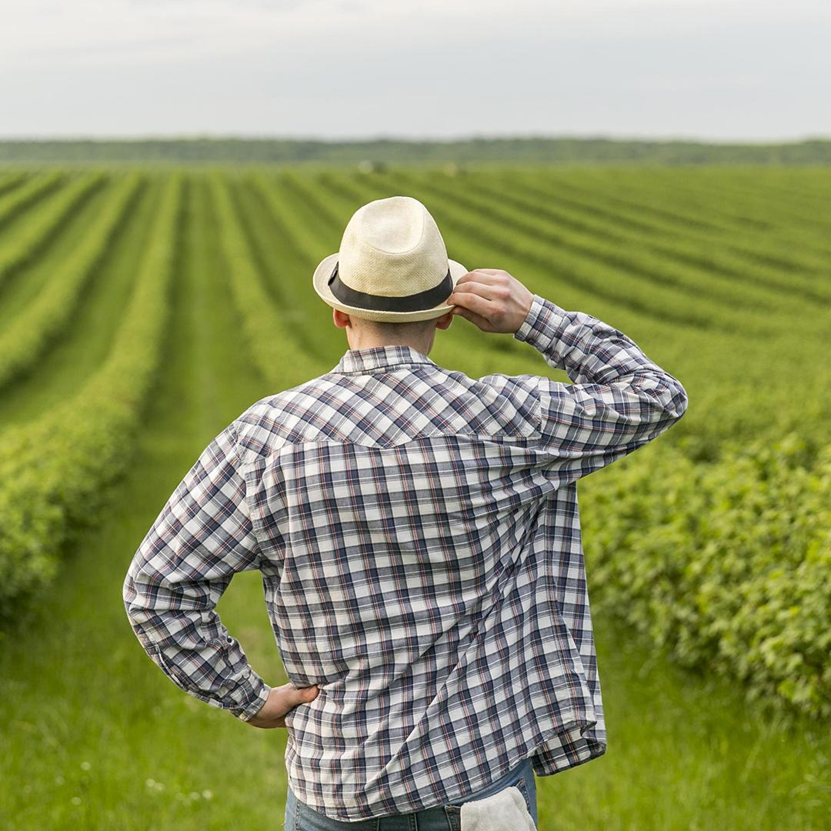
Introduction
"Empowering Farmers with Knowledge, Tools, and Insights“
AgriGuide is an innovative digital platform designed to enhance agricultural productivity and support farmers through cutting-edge tools, expert knowledge, and community-driven initiatives.

Slide 3


functionality
01
02
03
04
Crop Yield Prediction
Crop Yield Booster
Educational Content
Farmer Empowerment Initiatives

Slide 4


Crop Yield Prediction
What is IT?
Process
Crop Yield Prediction is the process of forecasting the quantity of crop production for a specific area based on various factors such as weather, soil health, and historical data.
Data Collection
Data Analysis
Yield Prediction
The farmer receives a report predicting an above-average yield due to favorable weather conditions and optimal soil health.

Slide 5
Crop Yield Booster
WHAT iS IT?
Benefits
Crop Yield Boosters are strategies, techniques, and products designed to enhance crop productivity and improve overall yield. These boosters focus on optimizing the growth conditions for crops and addressing any limiting factors that might reduce yield potential.
Increased Productivity
Sustainable Practices
Improved Crop Quality
Cost Efficiency

Slide 6

Farmer Empowerment Initiatives
Definition
Farmer empowerment refers to initiatives and programs designed to provide farmers with the resources, knowledge, skills, and support they need to enhance their productivity, improve their livelihoods, and make informed decisions.
Connecting farmers directly with buyers to improve profitability.
Providing financial resources for small-scale farmers.
Increased farmer autonomy, better decision-making, and enhanced livelihoods.

Slide 7
Educational Content
Definition
Educational content in agriculture encompasses resources, courses, and materials designed to educate farmers, students, and professionals on best practices, new technologies, and sustainable farming methods.
Types of Educational Content
E-books and Articles
Video Tutorials
Online Courses

Slide 8


Website image

Slide 9

News and Updates
Agricultural News
Research Summaries
Weather Alerts
Success Stories

Slide 10
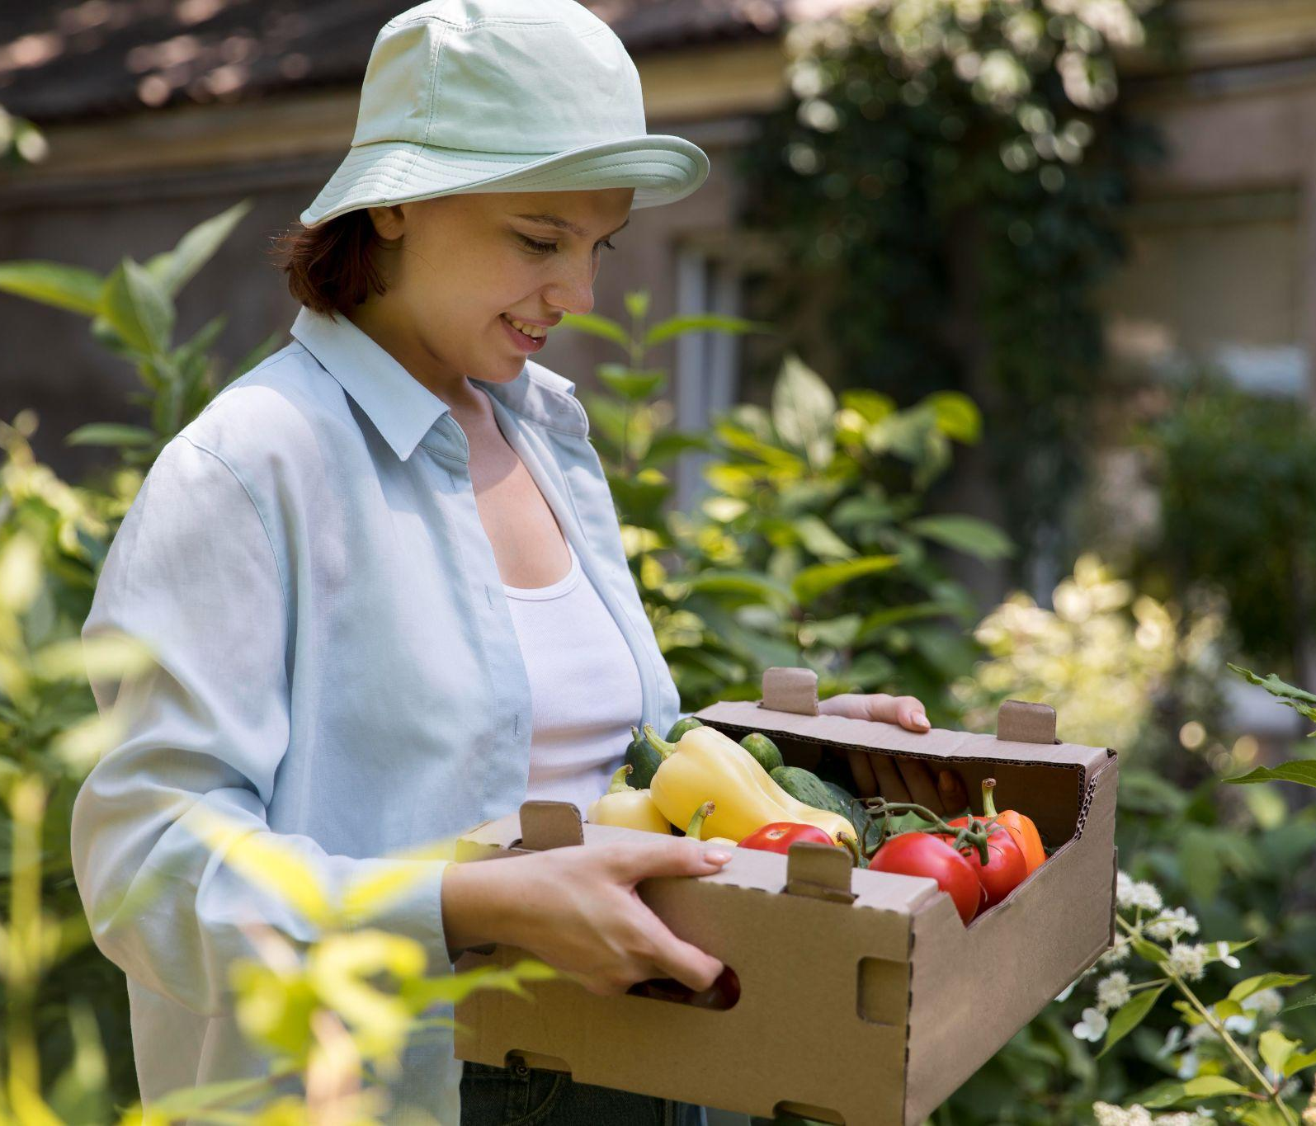
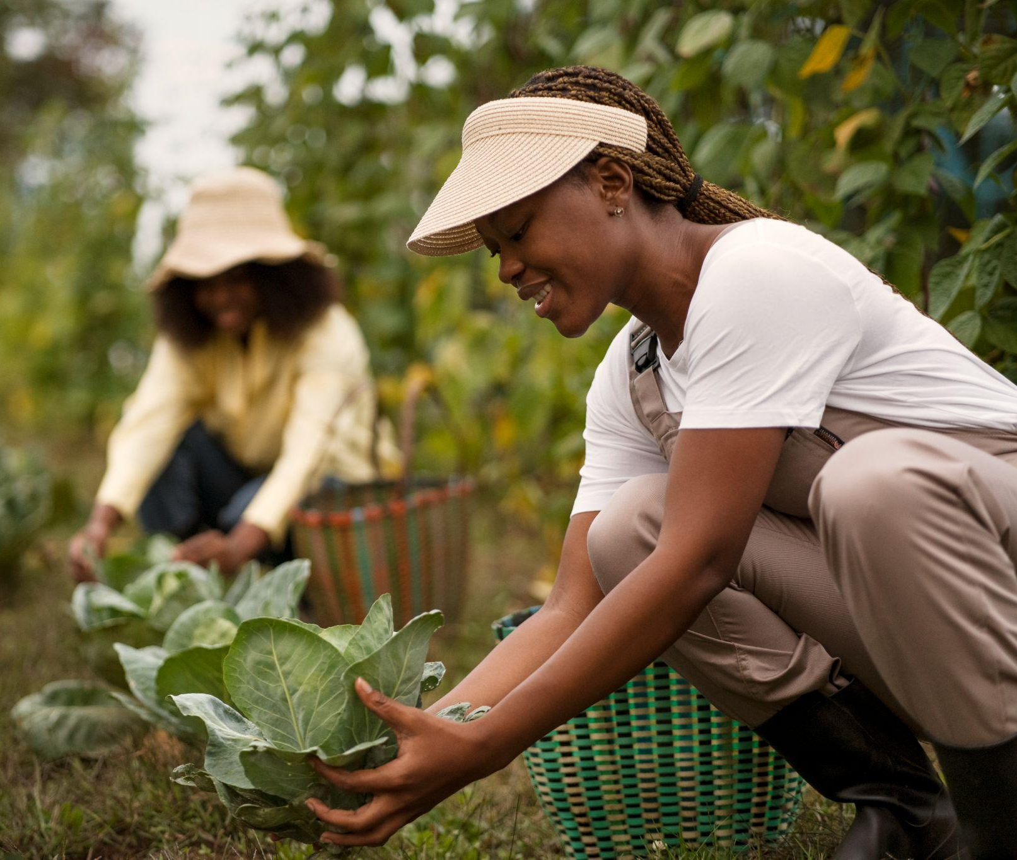
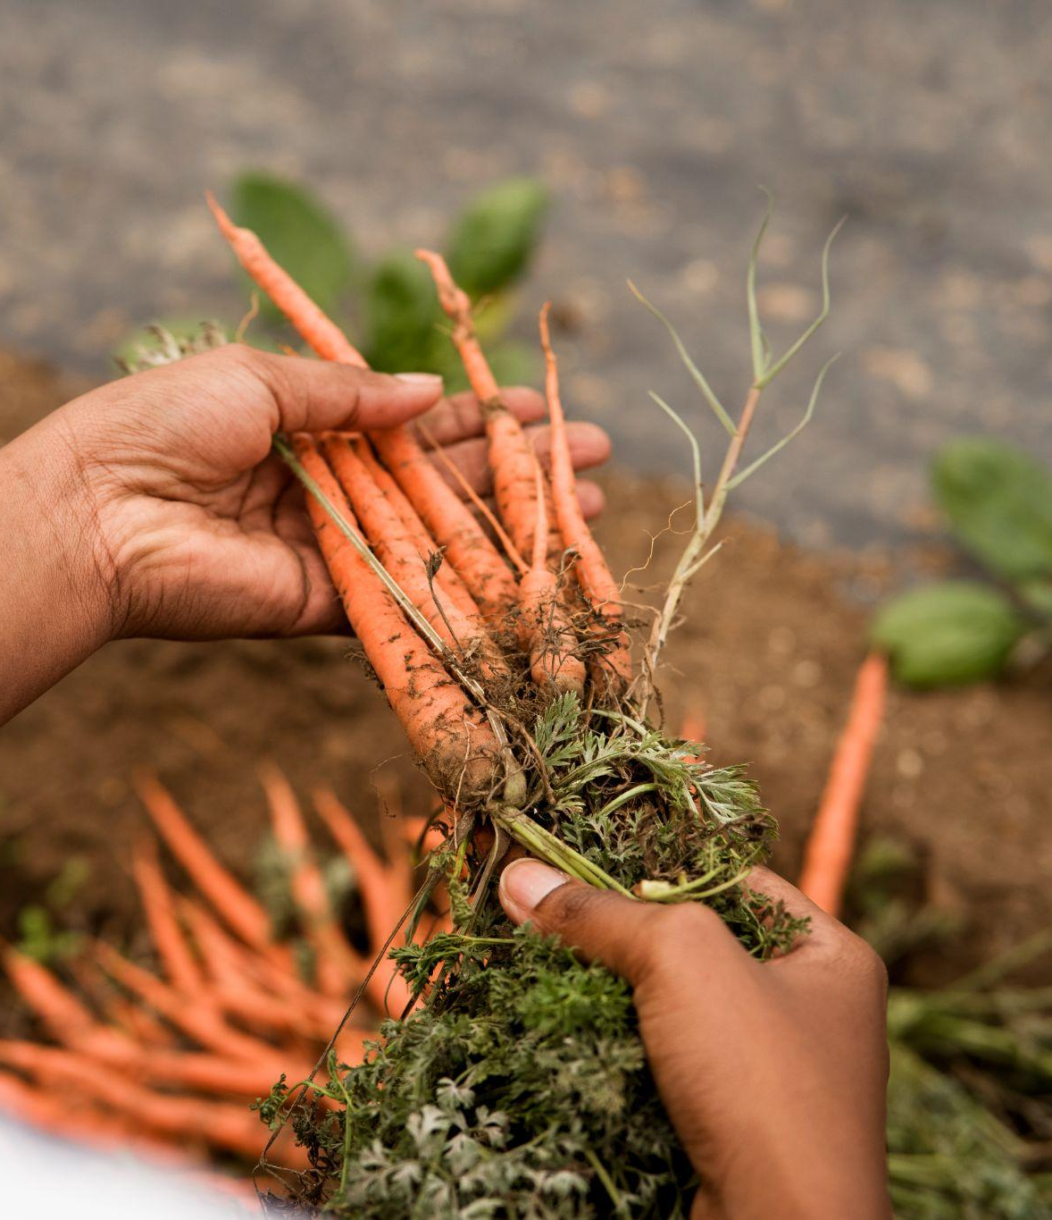
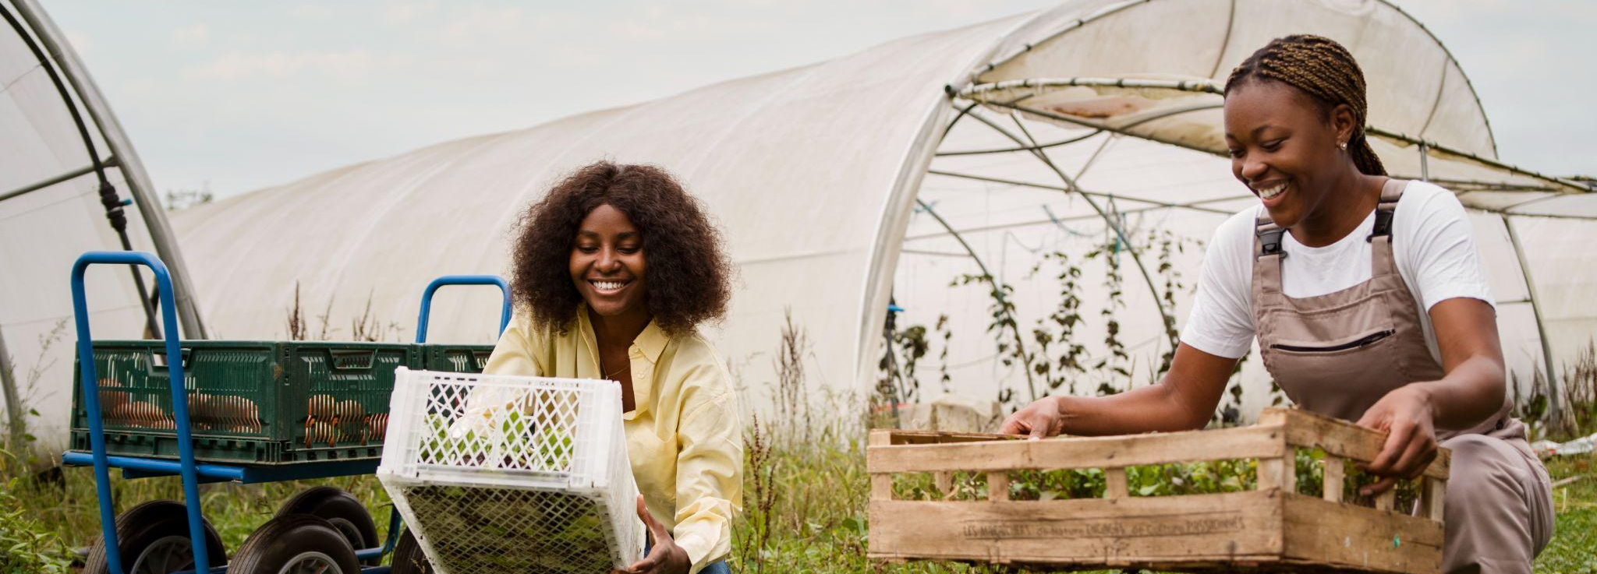
PHOTO SHOWCASE

Slide 11
Thanks!
Does anyone have any questions?
Please keep this slide as attribution

