Slide 1

Sparking Joy with
Shah Zafrani
shah.zafrani@slalom.com

Slide 2
Who is this guy? And why does he want to tell us about Apache Spark?
I’m currently using it for research at Kennesaw State University
I wanted to take the opportunity to learn more about it while preparing for the presentation
Bridging the gap between Custom Dev and IM&A
Disclaimer: I’m not an expert on Spark… yet
Spelling ^^

Slide 3
Objectives …
Get Developers familiar with Apache Spark in various contexts
Why you should be excited about Apache Spark
Explain how Apache Spark works
Demo a couple use-cases
Make sure all this food gets eaten
Please feel free to get seconds while I’m talking. I promise I won’t be offended
Feedback on the presentation and/or slides is appreciated.

Slide 4
What is Apache Spark? And what can it do?
Apache Spark is an open-source, distributed processing system used for big data workloads.
Used for
Batch and Streaming ETL Jobs
Machine Learning
Graph Computation
Facebook even uses it for content ranking
The possibilities are endless

Slide 5

Who uses Apache Spark?
Apple, MyFitnessPal, Ebay, OpenTable, Shopify, Trip Adviser, Credit Karma, Databricks, Baidu, AutoDesk, Amazon, 4Quant, Facebook,… you get the point. It’s everywhere!
Maybe your client uses Spark too $$$
Fun Fact: Taboola (aka the chumbox company) uses Spark
Funny enough, they don’t use their product on their own blog

Slide 6
But Why Apache Spark?
More than just Map Reduce
Spark utilizes in-memory caching
doesn't require intermediate writes to disk
Designed to handle Iterative Computations & Graph Algorithms
Fast real-time computation
Handle Big Data efficiently (more on that later)
Has APIs in Java, Scala, Python, and R
Can interface with data from:
HDFS
HBase
Cassandra
Hive,
any Hadoop InputFormat

Slide 7
Spark isn’t for you if…
Walls of text scare you
Spark is notorious for having verbose and cryptic error output. But don’t worry, there’s a method to its madness.
You hate the JVM
Yes, Spark is written in Scala and runs inside the JVM
You don’t need a sledgehammer to hang a picture frame
If a lambda function is all you need, use a lambda function

Slide 8
Where can I run Spark?
AWS
Elastic Map Reduce
AWS Glue
Plain old EC2
GCP: Cloud Dataproc
Azure: HDInsight
Locally: `brew install apache-spark; echo “hello big data”;`
Your neighbor’s spoiled kid’s gaming desktop… shhh, don’t tell
Pretty much anywhere you have admin rights and a JVM

Slide 9

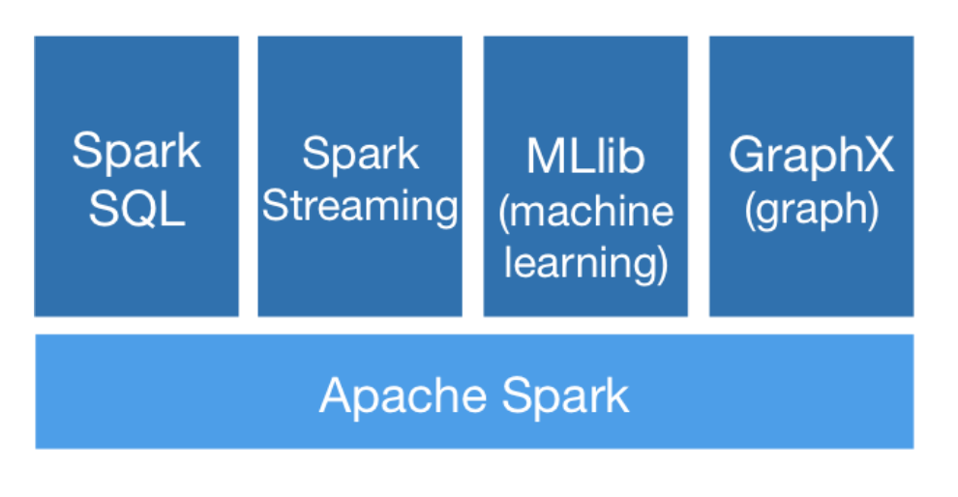
Spark Architectural Overview
Cluster Manager can be:
Apache Mesos
Spark Standalone
Hadoop Yarn
Kubernetes
Executor Process stay running for the duration of the application, and run tasks in different threads
Driver Program can be the Spark Shell, or it can be the entrypoint of your application.
Scala, Java, Python, and R can all be used to write Spark

Slide 10
Resilient Distributed Datasets
Partitioned and Immutable
Transformations and Actions
Transformation used to generate new RDDs (map, join, sample)
Actions apply computation to an RDD and pass the results back to the driver (reduce, collect, take)
Lazy Transformation
Computation isn’t performed until Actions are performed
Not to be confused with Dataframes!
Dataframes are also distributed, but they are structured

Slide 11
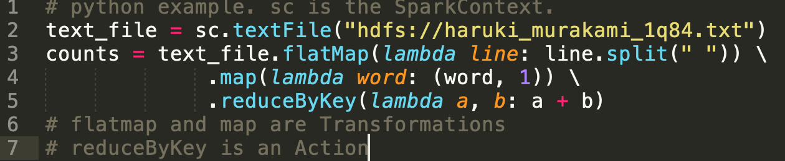
Word Count Example
Example Output:
Air : 255
Chrysalis : 204 The : 5,234
Sinfonietta : 45
With : 2,493 … etc

Slide 12

Demo Time

Slide 13
I want to know more…
Spark & the Blockchain
https://databricks.com/session/analyzing-blockchain-transactions-in-apache-spark
Gitbook on Spark Internals
https://jaceklaskowski.gitbooks.io/mastering-apache-spark/
https://www.edureka.co/blog/spark-architecture/
Spark a conversation with your friendly neighborhood IM&A or D&A Slalomite

