Slide 1

IOT Guard
IoT & WiFi Security Assessment Tool
Muhammad Shahab Qamar (54604) • Asim Khurshid (53653)
Supervisor: Mr. Yawar Abbas | Riphah International University
Cybersecurity
Python
IoT
Network Security

Slide 2
Agenda
01
Project Overview
Goals & purpose of IoTGuard
02
System Architecture
Layered design & data flow
03
Technology Stack
Tools, libraries & frameworks
04
Key Features
Scanning, analysis & UI
05
Security Analysis
CVE lookup, OWASP mapping
06
Reporting System
PDF, HTML & JSON exports
07
Conclusion
Achievements & future work

Slide 3
Project Overview
What is IoTGuard?
8+
IoTGuard is a comprehensive, desktop-based security assessment platform for WiFi networks and IoT devices. It combines multiple discovery techniques, port scanning, and vulnerability analysis in one unified tool.
Discovery Techniques
50+
Purpose
To provide network administrators, security researchers, and homeowners with a powerful tool to audit their networks for vulnerable IoT devices and misconfigurations.
IoT Ports Scanned
3
Key Strengths
✓ All-in-one security assessment platform
Report Formats
✓ No cloud dependency — data stays local
✓ Professional reporting for client delivery

Slide 4
Technology Stack
Tools, libraries & frameworks powering IoTGuard
Backend
GUI Framework
Network Scanning
› Python 3
› PyQt6
› Nmap
› SQLite
› Custom Widgets
› Scapy
› Threading
› Qt Signals
› ARP/ICMP/mDNS
APIs Integrated
Reporting
› CVE/NVD API
› PDF (FPDF)
› MAC Vendor API
› HTML Templates
› OWASP Top 10
› JSON Export

Slide 5





System Architecture
GUI Layer
PyQt6 User Interface — Dashboards, Device Cards, Filters
Scan Worker
Handles scanning in a separate thread with Qt signals
Scanner Modules
WiFi, Network, Bluetooth/BLE, Port Scanners
Intelligence Modules
CVE Lookup, CVSS Scoring, OWASP Mapping, Threat Detection
Storage Layer
SQLite Database & Cache — Persistent scan history

Slide 6
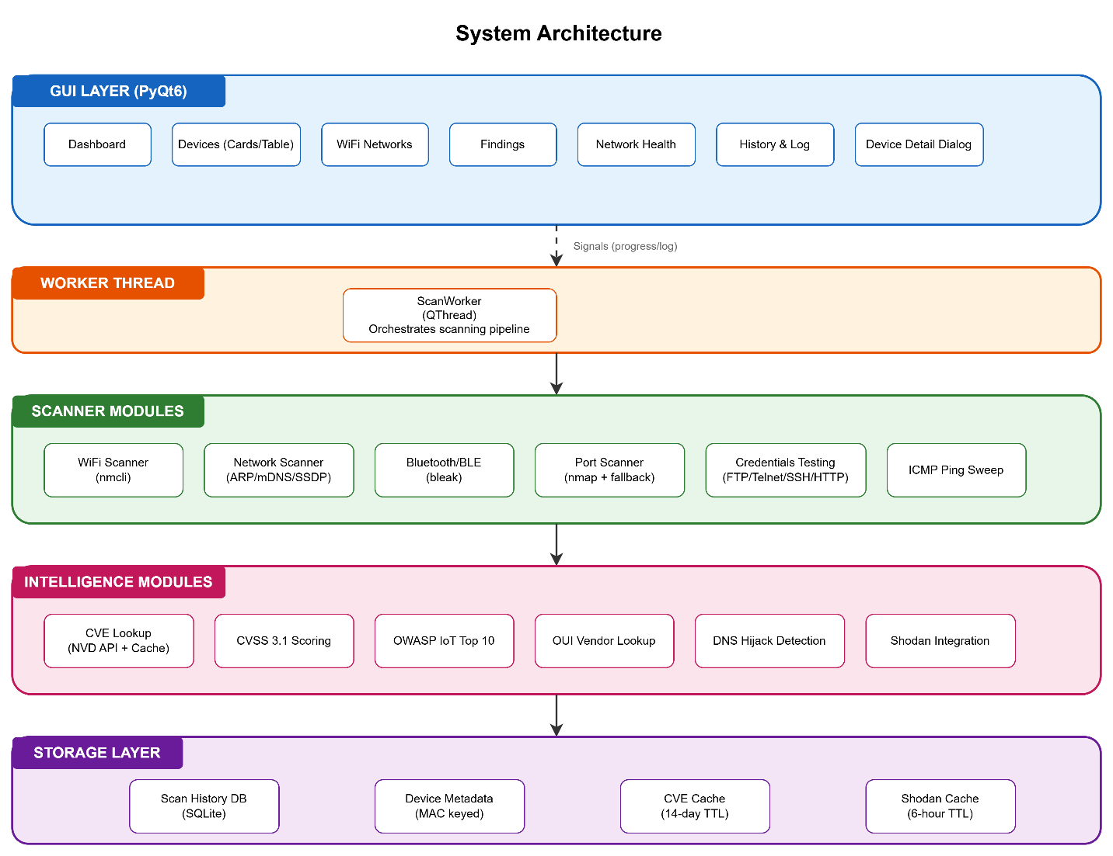

Slide 7
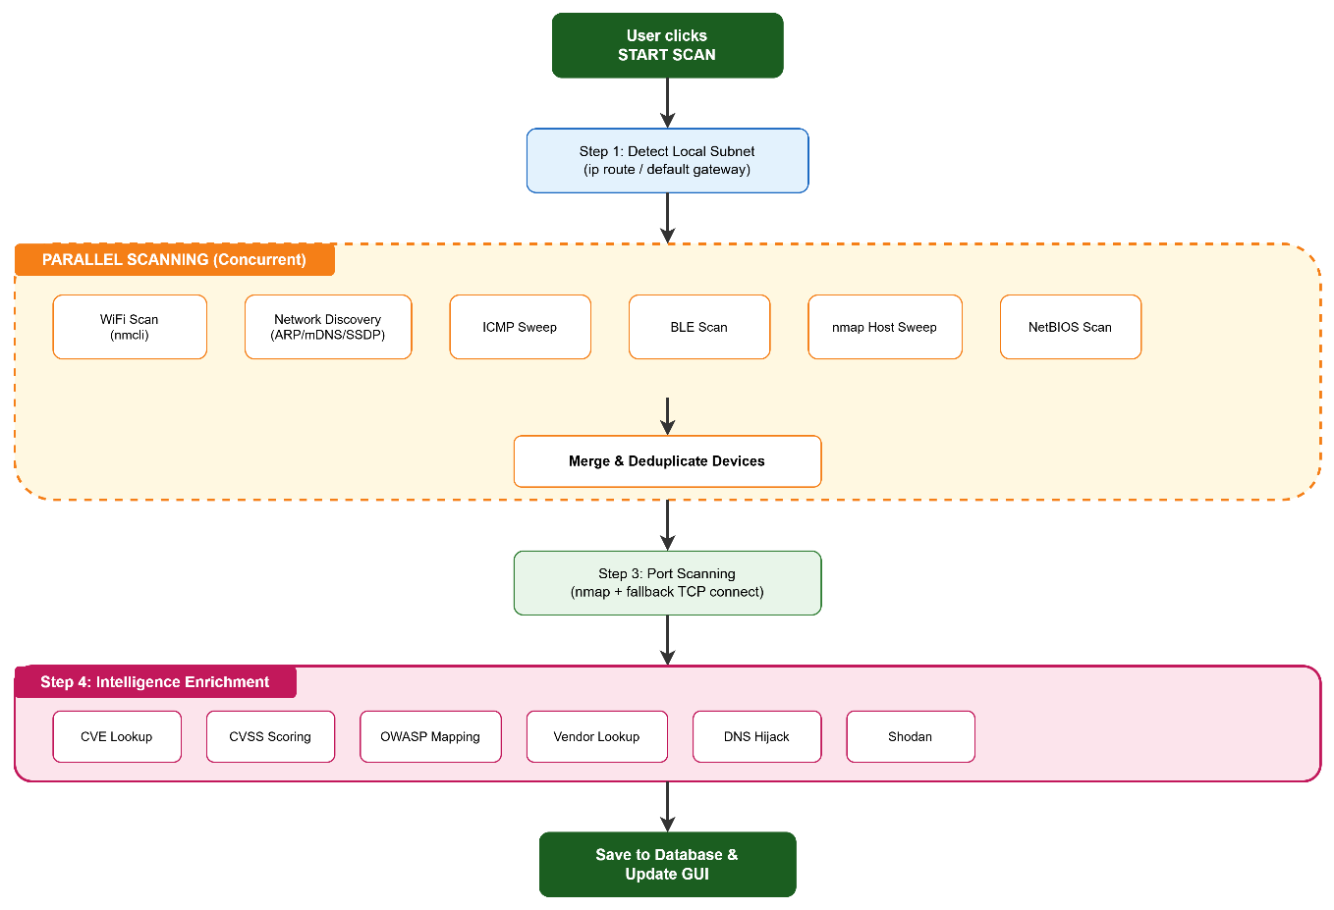

Slide 8



Key Features
WiFi Discovery
Device Discovery
Bluetooth / BLE
Scan and enumerate all devices on your local WiFi network
ARP, ICMP & mDNS techniques to find every device
Discover nearby Bluetooth and BLE devices need adapter
Port & Service Scan
Credential Testing
Dashboard & Charts
50+ IoT ports with nmap & fallback TCP scanner
Test SSH, FTP, Telnet for weak/default credentials
Real-time overview with risk charts and device cards

Slide 9
Security Analysis Features
CVE Vulnerability Lookup
OWASP IoT Top 10
Queries NVD/CVE databases for known vulnerabilities with CVSS scores and severity ratings
I1 Weak Passwords
I2 Insecure Network Services
OWASP IoT Top 10 Mapping
Maps detected issues to the 2018 OWASP IoT Top 10 categories for standardized reporting
I3 Insecure Ecosystem Interfaces
I4 Lack of Secure Update
Threat Detection
I5 Outdated Components
Identifies suspicious network configurations, weak services, and potential attack vectors
I6 Insufficient Privacy
Intruder Alert System
I7 Insecure Data Transfer
Real-time alerts when new unknown MAC addresses join the network between scans
I8 Lack of Device Mgmt

Slide 10

User Interface
Dashboard
Device Cards
Search & Filter
Charts showing device risk levels, scan progress, and network health overview
Cards with risk-colored borders, status dots, device icons, IP/MAC info
Filter devices by risk, status, device type, or search by IP/MAC/hostname
Intruder Alert Banner
Auto-Rescan Mode
Red banner alerts when new unknown devices join the network mid-scan
Continuously monitors the network and re-scans at configurable intervals

Slide 11

Reporting System
HTML Report
PDF Report
JSON Export
Portable
Professional
Analyst-Ready
Portable, shareable web-based reports with device cards, charts, and detailed vulnerability findings. Can be opened in any browser.
Professional-grade reports in PDF format with structured layout, suitable for client delivery and documentation.
Machine-readable structured data export for integration with SIEM tools, custom scripts, or further analysis pipelines.
📋 Scan History Tracking — All past scans stored in SQLite with timestamps for trend analysis and comparison

Slide 12

Project Achievements
Complete, end-to-end security assessment tool built from scratch
Clean, modular layered architecture for maintainability
Real-time device monitoring with live GUI updates
Professional reporting system (HTML, PDF, JSON)
Thread-safe asynchronous operations with Qt signals
Graceful fallbacks when dependencies are unavailable
Local-only data storage — no cloud, full privacy
Demonstrates strong practical cybersecurity skills

Slide 13
Conclusion & Future Work
Conclusion
Future Enhancements
IoTGuard is a powerful, production-quality security tool that addresses real cybersecurity challenges in IoT environments.
› Machine learning for anomaly detection
› Mobile app integration
✓ Comprehensive Discovery — 8 techniques
› Advanced automation features
✓ Intelligent CVE & CVSS Analysis
✓ OWASP IoT Top 10 Mapping
› Cloud dashboard option
✓ Professional Reporting System
› Plugin / extension system
IoTGuard is Ready for:
• Student Projects
• Network Admin Audits
• Home Network Security
• IoT Security Research
• Classroom Demos

Slide 14
Thank You
DEMONSTRATION
Muhammad Shahab Qamar (54604) • Asim Khurshid (53653)
Supervisor: Mr. Yawar Abbas | Riphah International University

