Slide 1
Hungary’s Electricity demand forecasting using LSTM and ARIMA
Shahab Sabzi

Slide 2
Literature review
[1] Adaptive Neuro-Fuzzy Inference System (ANFIS) to predict the electricity demand in Ghana
[2] simple moving average (SMA), weighted moving average (WMA), simple exponential smoothing (SES), Holt linear trend (HL), Holt-Winters (HW) and centered moving average (CMA)
[3] Combination of a decomposition model and state-space model
[4] ARIMA method, in EU countries
[5] SARIMA model for weekly peak demand forecasting in Australia

Slide 3
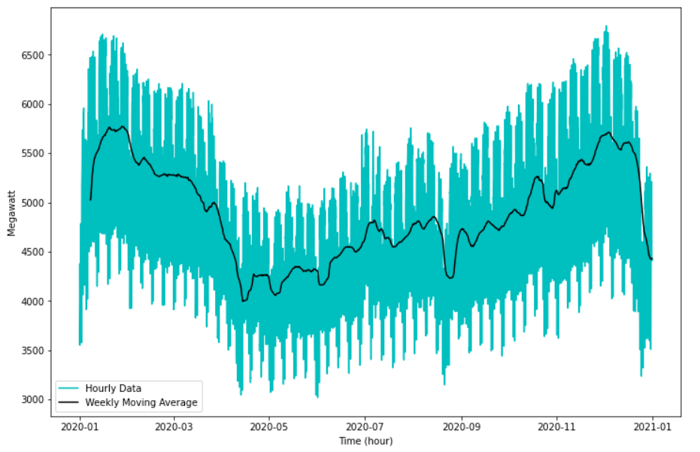
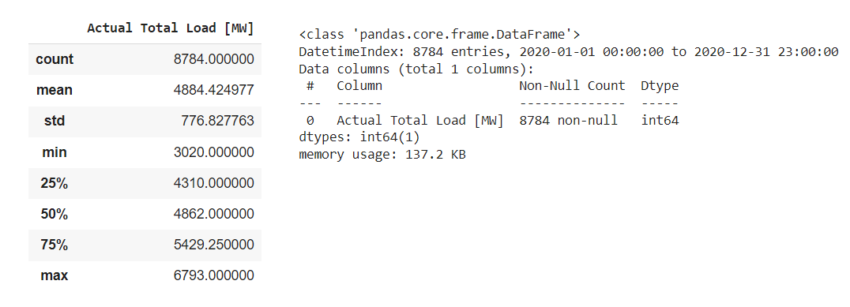
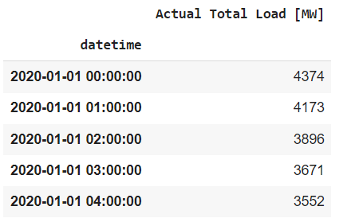
Dataset
Preprocessing:
data_2020 = data_2020.reset_index()
data_2020 = data_2020.drop(columns = "index", axis = 1)
data_2020 = data_2020.drop_duplicates(subset="Time (CET)")
data_2020 = data_2020.drop(columns = "Time (CET)", axis = 1)
data_2020['datetime'] = pd.date_range(start='01-01- 2020t00:00', periods=len(data_2020), freq="15min")
data_2020 = data_2020[['datetime', 'Actual Total Load [MW]’]]
hourly_2020 = data_2020.iloc[0::4, :]
Hungarian electricity demand
data as Time Series
15 minute intervals
Availability: from 2015 until now
Source: “ENTSO-E Transparency Platform.
” https://transparency.entsoe.eu
Used Data: Whole 2020, converted to hourly

Slide 4
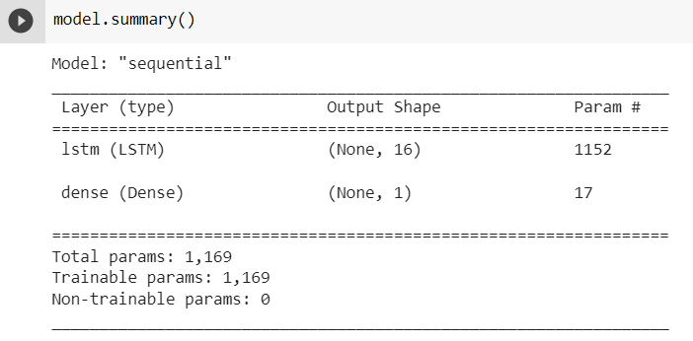
LSTM Model
Normalizing the data:
from sklearn.preprocessing import MinMaxScaler
values = data.values.reshape(-1,1)
values = values.astype('float32')
scaler = MinMaxScaler(feature_range=(0, 1))
data = scaler.fit_transform(values)
data.max(), data.min(), data.mean()
(0.99999994, 0.0, 0.49414918)
Creating X and Y
def make_timeseries_instances(data, seq_length=60):
X = []
Y = []
for start in range(0, data.shape[0]-seq_length):
X.append(data[start:start+seq_length])
Y.append(data[start+seq_length])
X = np.array(X)
Y = np.array(Y)
return X, Y
seq_length=60
X,Y = make_timeseries_instances(data, seq_length=seq_length)
X = np.atleast_3d(X)
Y = np.expand_dims(Y, axis=-1)
Developing the Model:
model = Sequential()
model.add(LSTM(16, input_shape=(seq_length, 1)))
model.add(Dense(1, activation='linear'))

Slide 5
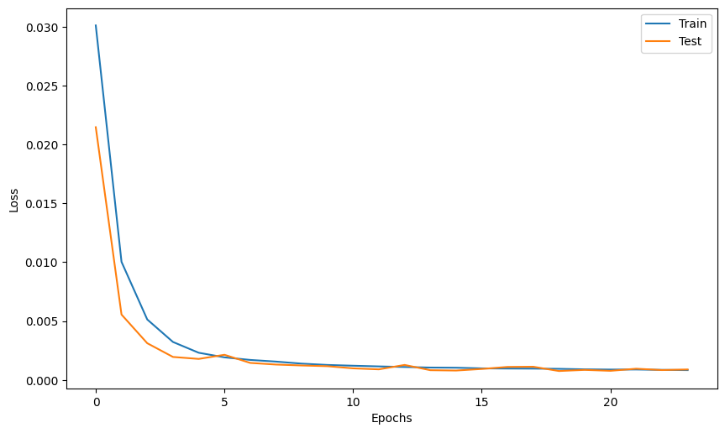
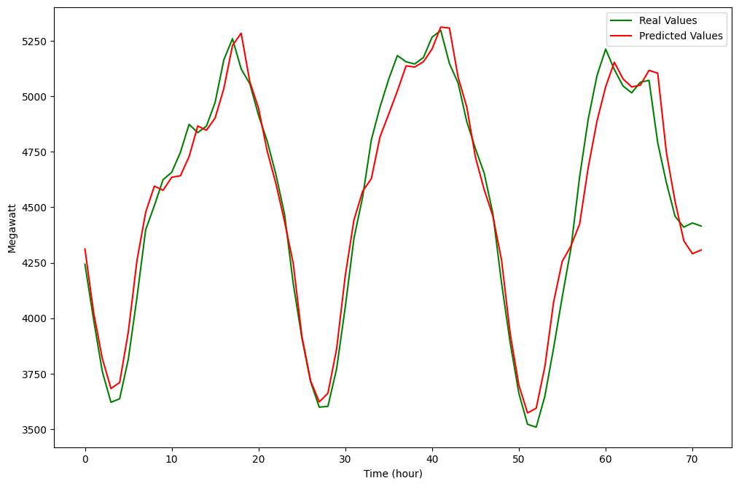
LSTM Model
Compiling the model:
model.compile(loss='mse', optimizer='adam', metrics=['mae'])
from tensorflow.keras.callbacks import EarlyStopping
es = EarlyStopping(monitor='val_loss',
patience=5, verbose=1,
restore_best_weights=True)
history = model.fit(X,Y, batch_size=32, validation_split=0.2, callbacks=[es], epochs=30)

Slide 6
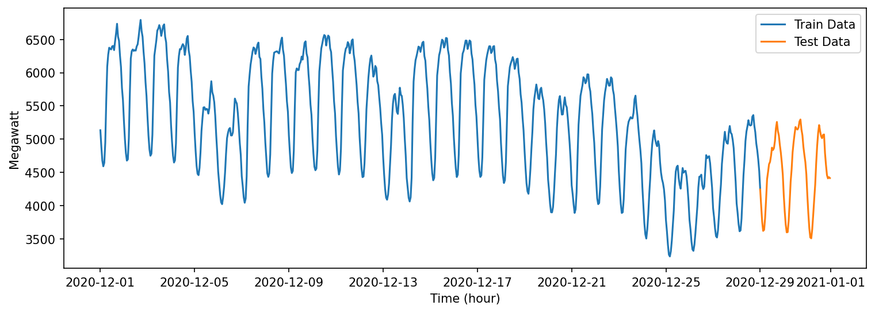
ARIMA Model
AutoRegressive Integrated Moving Average
december= hourly_2020.loc['12/1/2020 12:00:00 AM':'1/1/2021 12:00:00 AM']

Slide 7
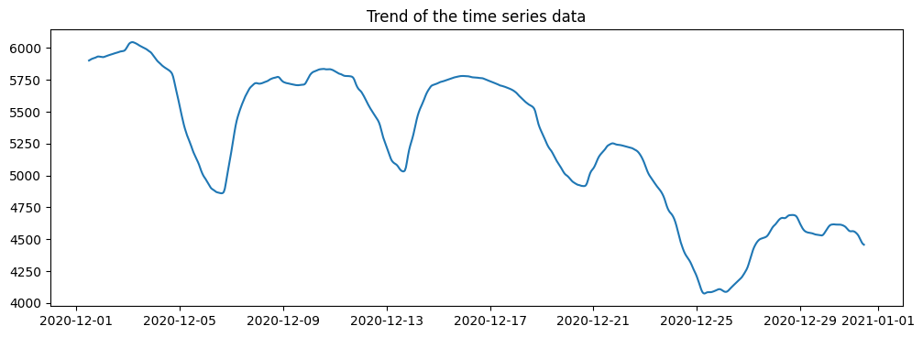
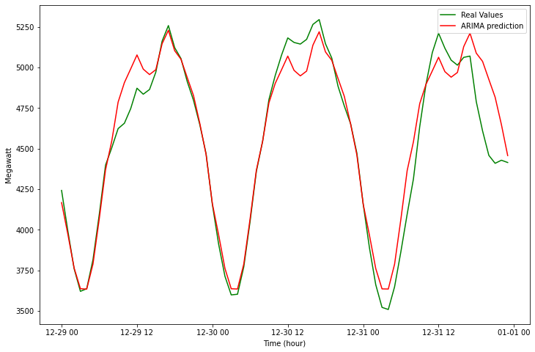
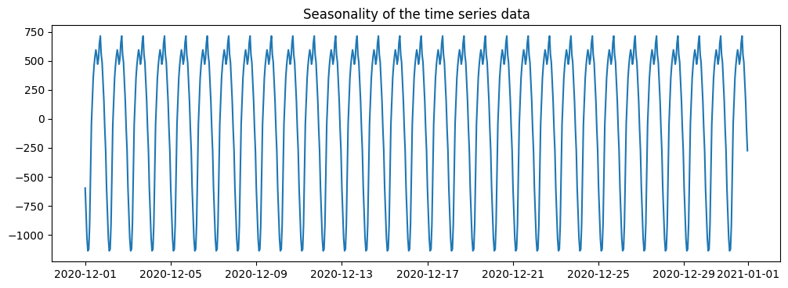
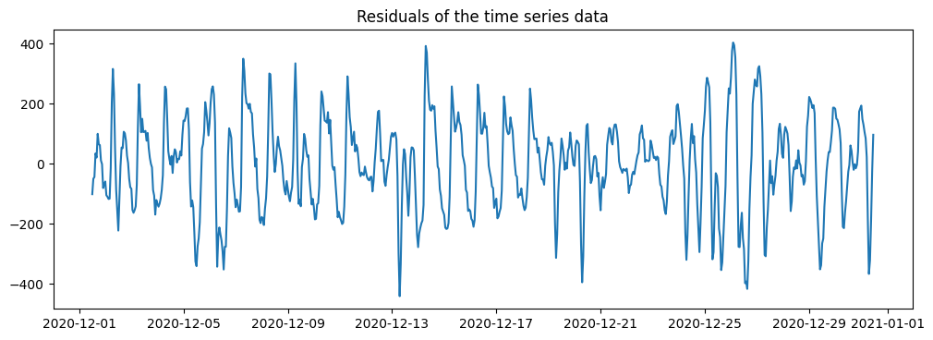
ARIMA Model
Finding ARIMA parameters (p,d,q):
stepwise_model = auto_arima(df,
start_p=1,
start_q=1,
max_p=3,
max_q=3,
m=12,
start_P=0,
seasonal=True,
d=1, D=1,
trace=True,
error_action='ignore',
suppress_warnings=True,
stepwise=True)
Best model:
ARIMA(order=(3, 1, 1)
seasonal_order=(1, 1, 2, 12)
Total fit time: 422.413 seconds
Fitting the model
stepwise_model.fit(train)
Make prediction:
forecast = stepwise_model.predict(n_periods=72)

Slide 8
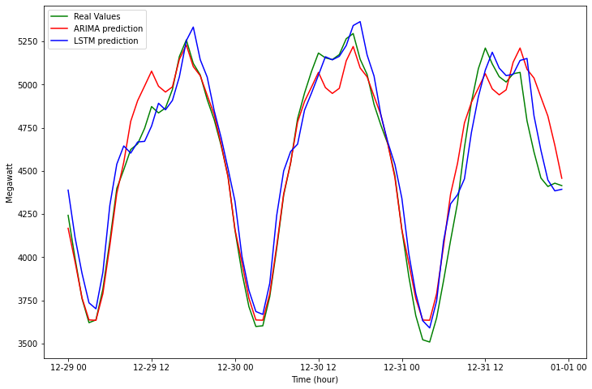
Comparison
Test RMSE for LSTM: 89.405
Test RMSE for ARIMA: 142.267
LSTM performs better than ARIMA “here”

Slide 9
References
[1] A. Acakpovi, A. T. Ternor, N. Y. Asabere, P. Adjei, and A.-S. Iddrisu, “Time Series Prediction of Electricity Demand Using Adaptive Neuro-Fuzzy Inference Systems,” Math. Probl. Eng., vol. 2020, p. e4181045, Aug. 2020, doi: 10.1155/2020/4181045.
[2] Y. W. Lee, K. G. Tay, and Y. Y. Choy, “Forecasting Electricity Consumption Using Time Series Model,” Int. J. Eng. Technol., vol. 7, no. 4.30, Art. no. 4.30, Nov. 2018, doi: 10.14419/ijet.v7i4.30.22124.
[3] Z. Hu, J. Ma, L. Yang, L. Yao, and M. Pang, “Monthly electricity demand forecasting using empirical mode decomposition-based state space model,” Energy Environ., vol. 30, no. 7, pp. 1236–1254, Nov. 2019, doi: 10.1177/0958305X19842061.
[4] J. W. Taylor and P. E. McSharry, “Short-Term Load Forecasting Methods: An Evaluation Based on European Data,” IEEE Trans. Power Syst., vol. 22, no. 4, pp. 2213–2219, Nov. 2007, doi: 10.1109/TPWRS.2007.907583.
[5] A. Eshragh, B. Ganim, T. Perkins, and K. Bandara, “The Importance of Environmental Factors in Forecasting Australian Power Demand,” ArXiv191100817 Stat, Oct. 2021, Accessed: Dec. 11, 2021. [Online]. Available: http://arxiv.org/abs/1911.00817

Slide 10
Thank you for your attention

