Slide 1
Electricity demand forecasting using LSTM and ARIMA
Shahab Sabzi

Slide 2
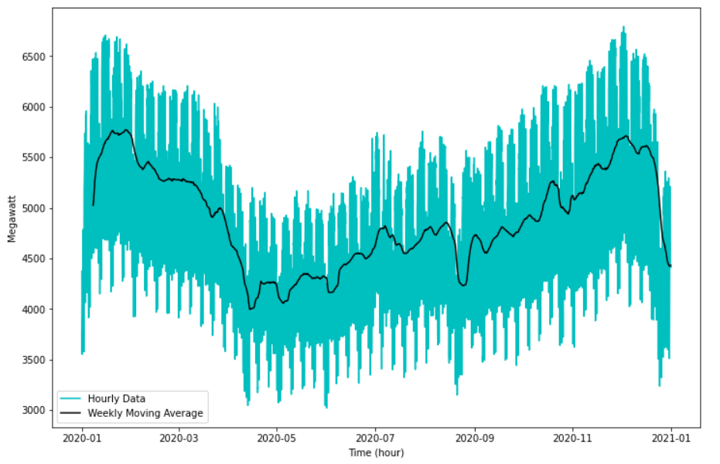
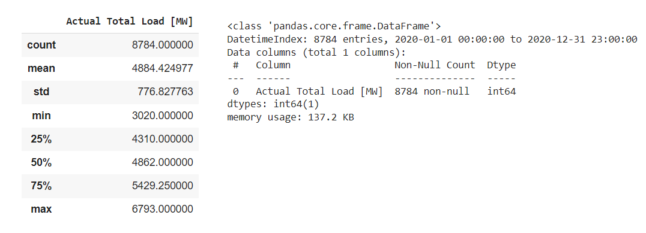
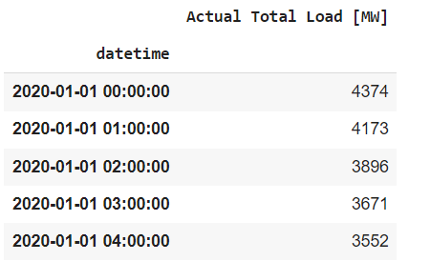
Dataset
Preprocessing:
data_2020 = data_2020.reset_index()
data_2020 = data_2020.drop(columns = "index", axis = 1)
data_2020 = data_2020.drop_duplicates(subset="Time (CET)")
data_2020 = data_2020.drop(columns = "Time (CET)", axis = 1)
data_2020['datetime'] = pd.date_range(start='01-01- 2020t00:00', periods=len(data_2020), freq="15min")
data_2020 = data_2020[['datetime', 'Actual Total Load [MW]’]]
hourly_2020 = data_2020.iloc[0::4, :]
Hungarian electricity demand
data as Time Series
15 minute intervals
Availability: from 2015 until now
Source: “ENTSO-E Transparency Platform.
” https://transparency.entsoe.eu
Used Data: Whole 2020, converted to hourly

Slide 3
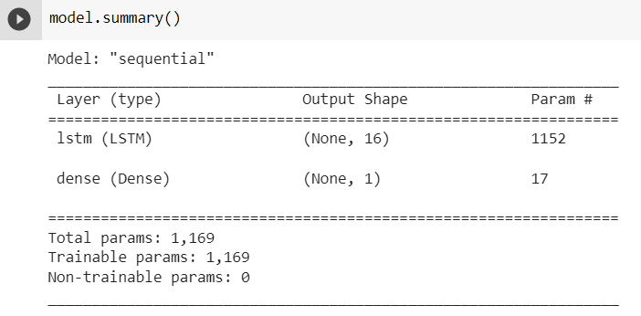
LSTM Model
Normalizing the data:
from sklearn.preprocessing import MinMaxScaler
values = data.values.reshape(-1,1)
values = values.astype('float32')
scaler = MinMaxScaler(feature_range=(0, 1))
data = scaler.fit_transform(values)
data.max(), data.min(), data.mean()
(0.99999994, 0.0, 0.49414918)
Creating X and Y
def make_timeseries_instances(data, seq_length=60):
X = []
Y = []
for start in range(0, data.shape[0]-seq_length):
X.append(data[start:start+seq_length])
Y.append(data[start+seq_length])
X = np.array(X)
Y = np.array(Y)
return X, Y
seq_length=60
X,Y = make_timeseries_instances(data, seq_length=seq_length)
X = np.atleast_3d(X)
Y = np.expand_dims(Y, axis=-1)
Developing the Model:
model = Sequential()
model.add(LSTM(16, input_shape=(seq_length, 1)))
model.add(Dense(1, activation='linear'))

Slide 4
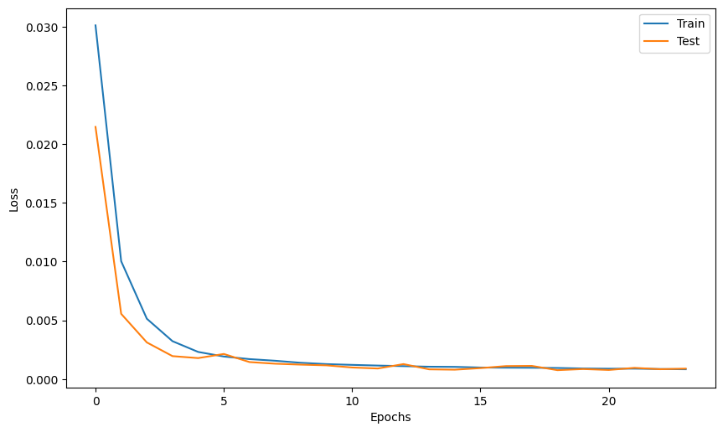
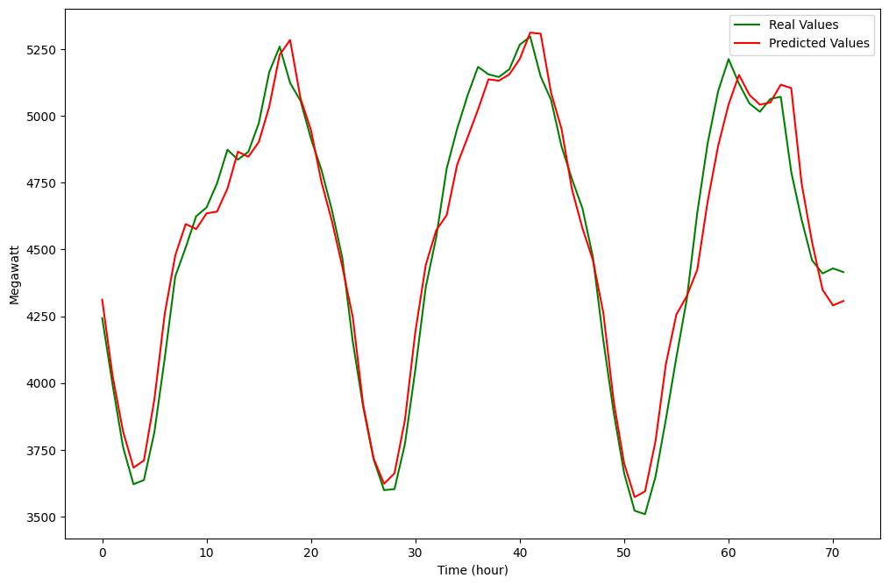
LSTM Model
Compiling the model:
model.compile(loss='mse', optimizer='adam', metrics=['mae'])
from tensorflow.keras.callbacks import EarlyStopping
es = EarlyStopping(monitor='val_loss',
patience=5, verbose=1,
restore_best_weights=True)
history = model.fit(X,Y, batch_size=32, validation_split=0.2, callbacks=[es], epochs=30)

Slide 5
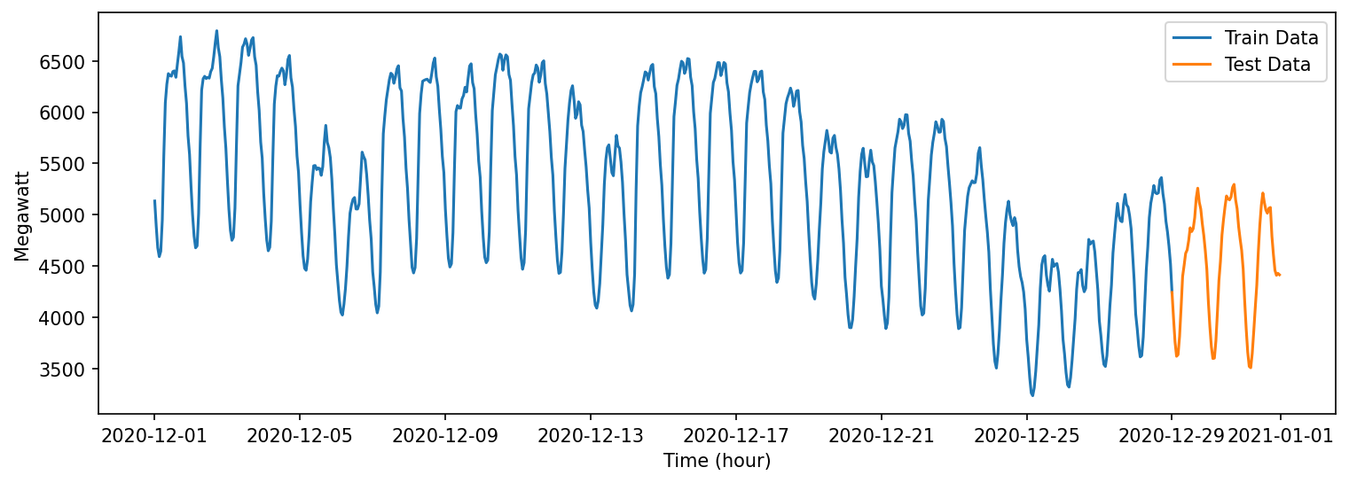
ARIMA Model
AutoRegressive Integrated Moving Average
december= hourly_2020.loc['12/1/2020 12:00:00 AM':'1/1/2021 12:00:00 AM']

Slide 6
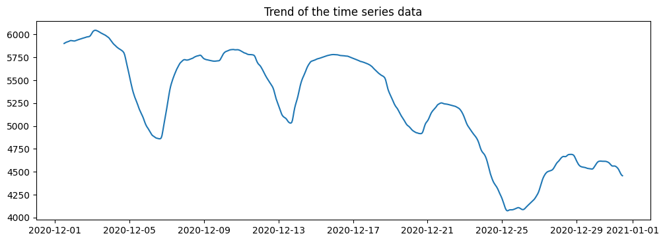
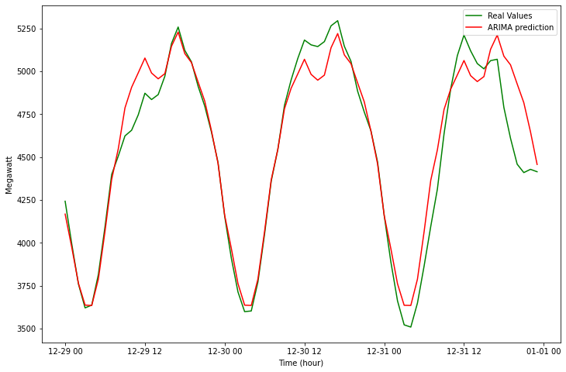
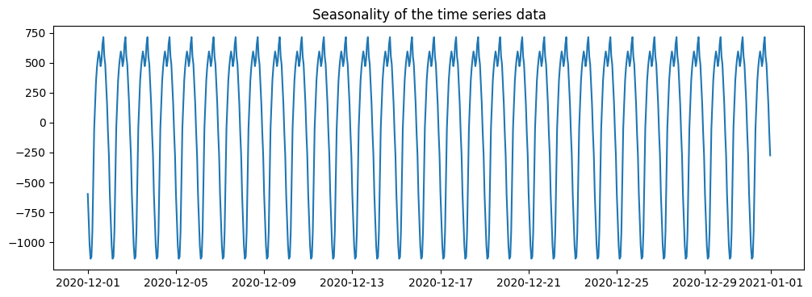
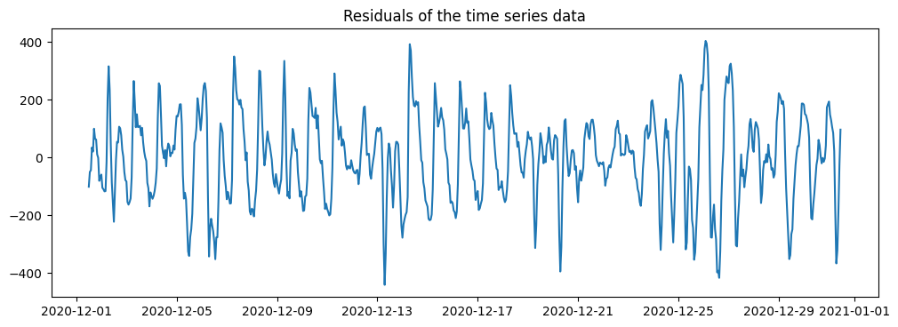
ARIMA Model
Finding ARIMA parameters (p,d,q):
stepwise_model = auto_arima(df,
start_p=1,
start_q=1,
max_p=3,
max_q=3,
m=12,
start_P=0,
seasonal=True,
d=1, D=1,
trace=True,
error_action='ignore',
suppress_warnings=True,
stepwise=True)
Best model:
ARIMA(order=(3, 1, 1)
seasonal_order=(1, 1, 2, 12)
Total fit time: 422.413 seconds
Fitting the model
stepwise_model.fit(train)
Make prediction:
forecast = stepwise_model.predict(n_periods=72)

Slide 7
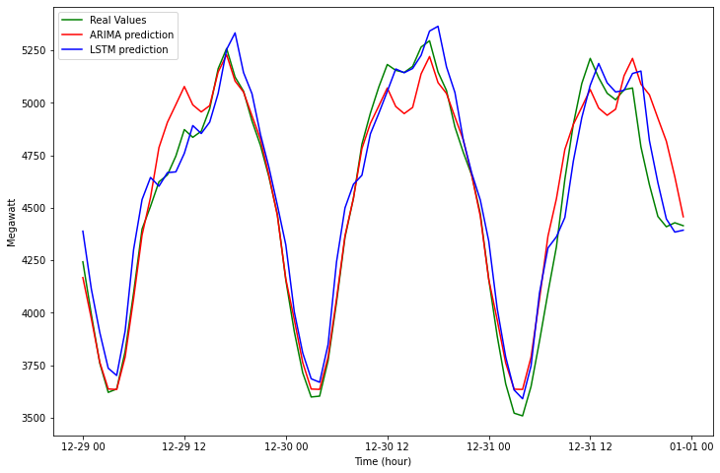
Comparison
Test RMSE for LSTM: 122.961
Test RMSE for ARIMA: 142.267
LSTM performs better than ARIMA “here”

Slide 8
Thank you for your attention

