Slide 1
House price analysis
Presented by :
Shahabaj Mujawar
Muzammil Momin
Rahul Bhagat
Intern At:
XCEL CORP, USA

Slide 2


COMPANY PROFILE:
Company Overview
Company Name: XCEL Corp
Industry: Information Technology & Services
Founded: 2005
Headquarters: Matawan, New Jersey, USA
Global Presence: Offices in the USA & R&D centers in India Employee Strength: 201-500 employees
Website: www.xcelcorp.com
About XCEL Corp:
Leading provider of end-to-end IT solutions, specializing in:
Data Analytics & Business Intelligence
Software Development
IT Consulting
Cloud Computing
AI & Machine Learning
ERP/CRM Solutions
Core Values:
✔ Innovation – Developing cutting-edge solutions
✔ Integrity – Commitment to honesty & transparency
✔ Customer-Centricity – Delivering unique solutions to clients
✔ Quality – Ensuring high standards across all services
✔ Collaboration – Promoting teamwork for success

Slide 3
COMPANY PROFILE:
Mission & Vision:
Mission: To empower businesses with innovative, high-quality technology solutions that drive growth.
Vision: To be a global leader in IT services, transforming businesses through technology.
Key Services Provided:
Data Analytics & BI – Extracting insights using Python, Power BI, Tableau, etc.
Software Development – Custom business software solutions.
IT Consulting – Aligning technology with business goals.
Cloud Computing – Secure and scalable cloud solutions.
AI & ML Solutions – Smart automation and data-driven decision-making.
ERP/CRM Solutions – Enhancing business operations with integrated systems.
Key Industries Served:
Banking, Financial Services & Insurance (BFSI)
Telecom, Media & Technology (TMT)
Retail & E-commerce
Healthcare & Life Sciences
Energy & Utilities

Slide 4

Internship Overview – Data Analytics at XCEL Corp
Company: XCEL Corp (IT & Data Analytics Solutions)
📌 Duration: 45 Days
📌 Role: Data Analytics Intern (Team Lead)
📌 Project: House Price Analysis Using Power BI
📌 Key Tools: Python (Pandas, NumPy, Matplotlib, Seaborn), Power BI, Jupyter Notebook, Anaconda
📌 Core Skills Gained:
Data Preprocessing & Cleaning: Handling missing data, transformations
Exploratory Data Analysis (EDA): Identifying trends & insights
Data Visualization: Using Power BI for dashboards & reports
Business Intelligence: Communicating insights to stakeholders
📌 Final Deliverable: Interactive Power BI dashboard analyzing House Price risk factors
📌 Key Learning Outcomes: Technical expertise, problem-solving, teamwork, and project management

Slide 5
Learning Objectives - Python for Data Analysis
🔹 Key Learning Areas:
✅ Data Manipulation:
Using Pandas for data cleaning, transformation, and handling missing values.
Utilizing NumPy for numerical computations and efficient data handling.
✅ Data Visualization:
Creating insightful visualizations using Matplotlib and Seaborn.
Understanding different types of charts (histograms, scatter plots, heatmaps, etc.).
✅ Exploratory Data Analysis (EDA):
Identifying trends, patterns, and outliers in datasets.
Performing feature selection and correlation analysis.
✅ Data Preprocessing:
Handling missing values, dealing with outliers, and normalizing data for analysis.

Slide 6
Weekly Report:
Week -1 | Learned fundamental concepts of Data Analytics and Python basics, including syntax, data types, and Pandas for data manipulation.
Week -2 | Focused on data preprocessing and cleaning using Pandas, handling missing values, duplicates, and outliers.
Week -3 | Conducted Exploratory Data Analysis (EDA) and created visualizations using Matplotlib and Seaborn.
Week -4 | Introduced to Power BI, learned data importing, cleaning, and creating interactive dashboards.
Week -5 | Advanced Power BI skills with DAX functions and data storytelling for effective insights communication.
Week -6 | Worked on a House Price Analysis project, conducted EDA, built a Power BI dashboard, and presented findings.

Slide 7


Internship Project – House price Analysis Project
Tools & Technologies Used:
✔ Python (Pandas, NumPy, Matplotlib, Seaborn) for data analysis & visualization
✔ Power BI for interactive dashboards
✔ Anaconda for managing the Python environment
✔ Jupyter Notebook for coding & analysis
🔹 Dataset Overview:
✔ 545 rows & 6 columns covering price, area , and furnishing status
✔ Key attributes: price, area, bedrooms, bathrooms, stories, parking etc.
✔ Target Variable: House price (based on different features)
🔹 Key Insights:
✔ Distribution of House Prices
✔ Plot of Area vs Price
✔ Price vs Stories

Slide 8
Internship Project - House price Analysis Project
My Contributions:
✔ Data Collection & Preprocessing – Cleaned missing data, handled outliers, transformed categorical data
✔ Data Visualization (Matplotlib & Seaborn) – Created heatmaps, scatter plots, and distribution graphs
✔ Power BI Dashboard Development – Built an interactive dashboard for stakeholders
✔ Exploratory Data Analysis (EDA) – Uncovered patterns, trends, and correlations in patient data
🔹 Key Achievements:
✔ Successfully built an end-to-end data analysis pipeline
✔ Presented insights using a Power BI dashboard
✔ Enhanced problem-solving and analytical skills

Slide 9
Internship Project - House price Analysis Project
Internship Experience & Learnings
🔹 Activities Performed: ✔ Problem-Solving: Worked with real-world data, tackled missing values, and optimized data preprocessing. ✔ Algorithm Implementation: Applied Python libraries (Pandas, NumPy, Seaborn) for Exploratory Data Analysis (EDA) and data manipulation. ✔ Data Visualization: Created compelling visual representations using Matplotlib and Seaborn. ✔ Business Intelligence: Designed interactive dashboards using Power BI for insightful reporting. ✔ Team Collaboration: Worked in a team environment, coordinated tasks, and ensured project completion. ✔ Housing Price Analysis: Conducted analysis on housing price dataset, comparing key features such as location, number of rooms, square footage, and price trends. 🔹 My Experience & Learnings: ✔ Hands-on Experience: Gained practical exposure to data analytics and visualization techniques. ✔ Technical Proficiency: Improved coding skills in Python and proficiency in Power BI. ✔ Data-Driven Decision Making: Developed analytical thinking to derive insights from data. ✔ Communication Skills: Enhanced ability to present data insights effectively. ✔ Problem-Solving Approach: Learned to handle real-world data challenges efficiently. ✔ Market Trends Understanding: Gained insights into factors influencing housing prices and their impact on real estate decisions.

Slide 10


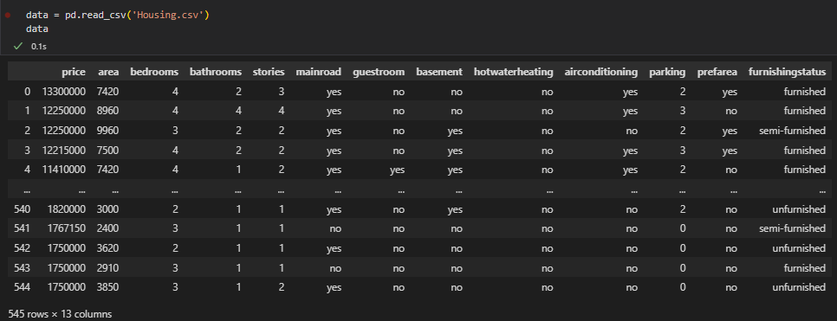
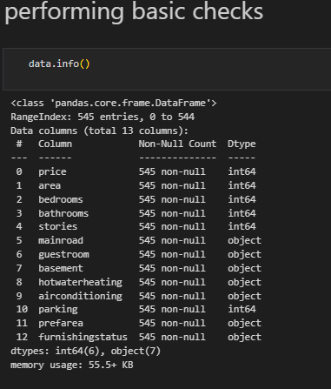


Internship Project - House price Analysis Project

Slide 11
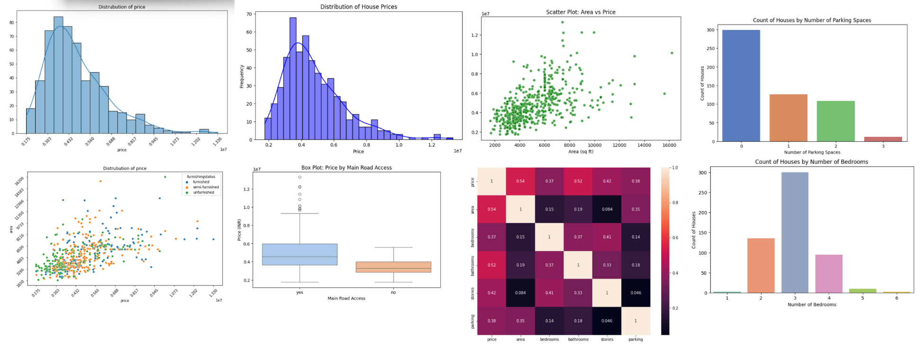
Internship Project - House price Analysis Project

Slide 12
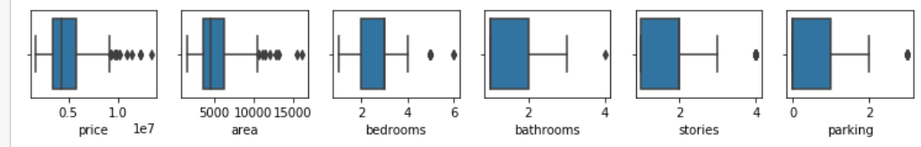

Internship Project - House price Analysis Project

Slide 13
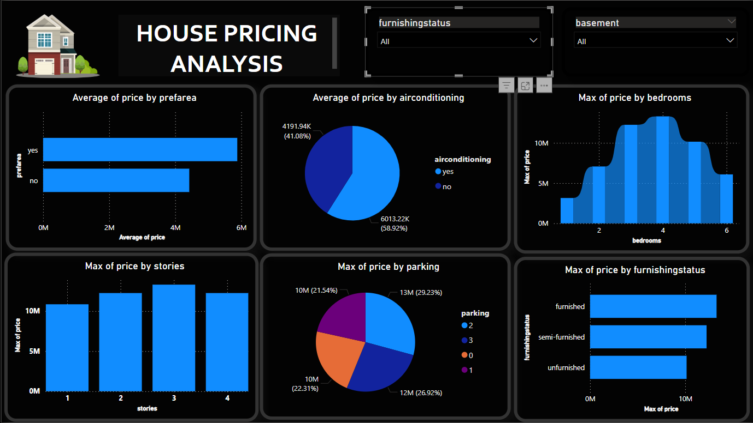

PowerBI DAshboard

Slide 14
Different Realtime domains analysis used
Where Housing Price Data Analysis Can Be Used
Real Estate Market Analysis
Helps track changes in property prices over time.
Helps investors find the best places to buy property.
Can be used to predict future house prices.
Urban Planning & Infrastructure Development
Helps city planners understand where property prices are high or low.
Can show areas that need better roads, schools, or hospitals.
Helps governments plan land use more effectively.
Banking & Mortgage Lending
Banks use property prices to decide home loan amounts.
Helps identify areas where property values might drop, reducing financial risks.
Government Policy & Taxation
Helps set fair property tax rates based on market trends.
Helps governments create policies to make housing more affordable.
Investment & Portfolio Management
Helps investors choose the best locations to buy property.
Helps understand rental income and long-term property value growth.

Slide 15

Thank you!
House price Analysis Project

